Slide 1
The Treasurer

Slide 2
Franek lived in a small house with parents, little brother and baby sister.

Slide 3
Franek’s father was a miner.
One day he was killed in an accident in the mine.

Slide 4
Franek went to the coal mine to get a job.

Slide 5
He had to dig as much coal in a week as other miners.

Slide 6
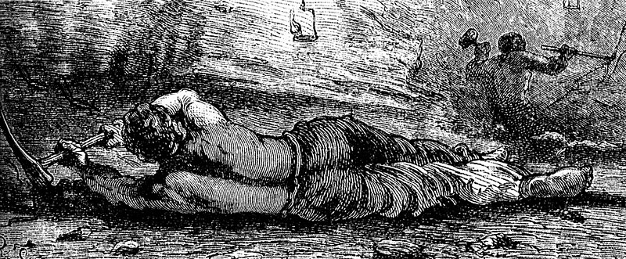
The work was very hard.

Slide 7
The coal was so hard …

Slide 8
And the pickaxe was so heavy!

Slide 9
At the end of the day he sat down and cried.

Slide 10
Suddenly, he saw a light in the dark corridor…

Slide 11
The old man offered to help Franek.

Slide 12
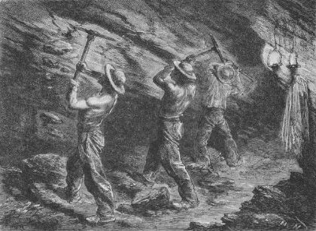
The old man helped Franek dig coal.
Other miners didn’t see him.

Slide 13
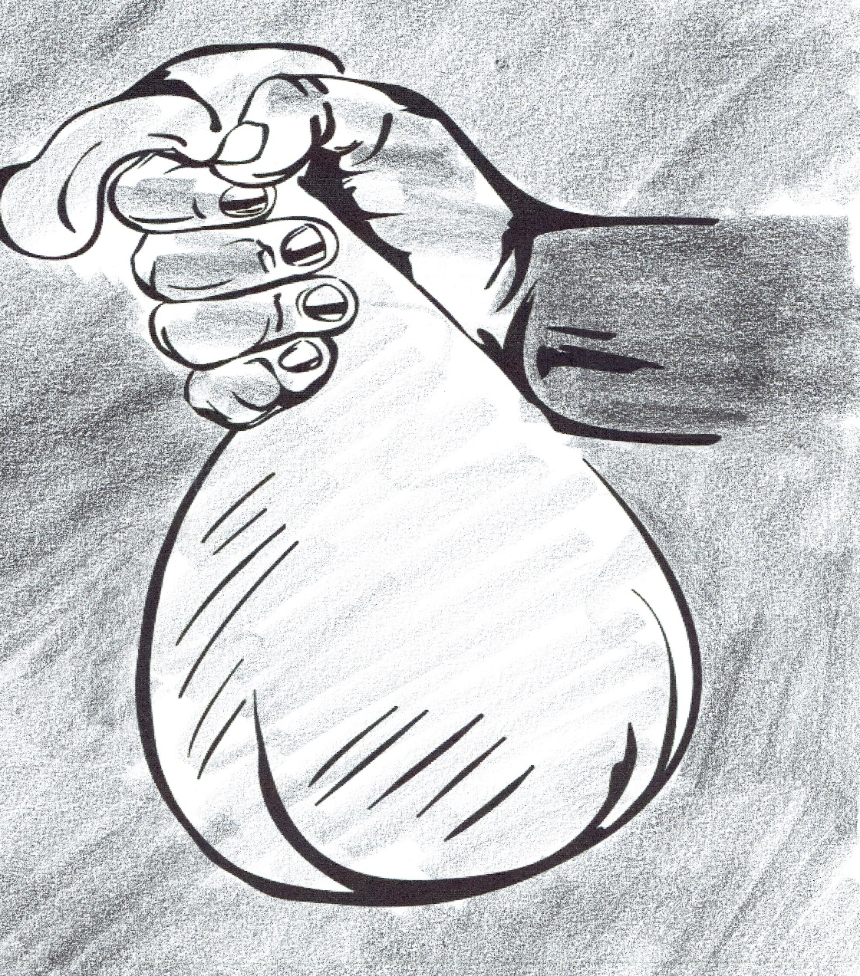
The foreman paid Franek and told him that he can be a miner.

Slide 14
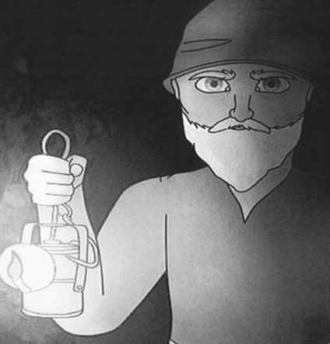
‘Have you got the money for me?’

Slide 15
Franek offered all the money to the old man.

Slide 16
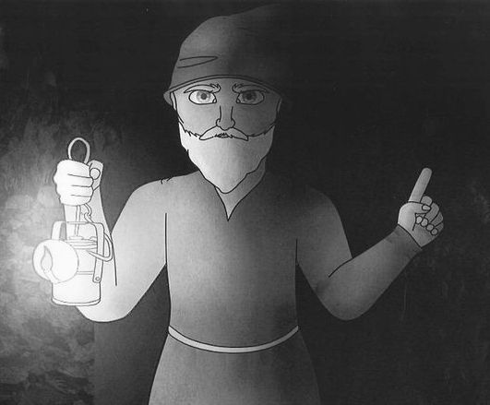
’Always be this honest!’, said the old man. Then he disappeared.

Slide 17
The End

