Slide 1
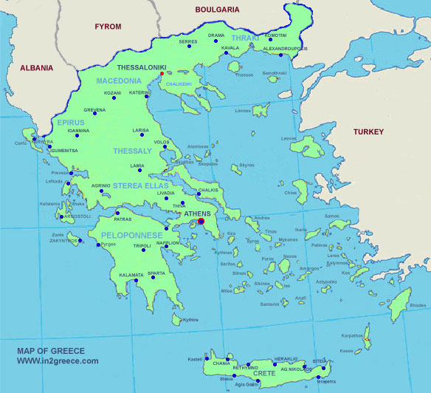
GREECE-HELLAS
LET’S TRAVEL AROUND GREECE

Slide 2
WHERE IS GREECE?
Greece (Hellas) is on the Balkan peninsula, south of Europe.

Slide 3
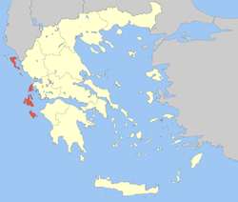
WEST: IONIAN SEA
THE 7 ISLANDS (EPTANISA)

Slide 4
THE ISLAND OF ZAKYNTHOS

Slide 5
WHY ZAKYNTHOS? ( Caretta- Caretta)
On the beaches of Zakynthos we can see the sea turtle Caretta- Caretta: It is 1 meter long and weighs about 100 kilos. https://www.youtube.com/watch?v=BGbMROUXK5Y

Slide 6
NORTH GREECE: MACEDONIA

Slide 7
MACEDONIA: VERGINA
THE TOMB (GRAVE) grobowiec / grób
OF MACEDONIAN KING
https://www.youtube.com/watch?v=c6j4TEfvoW4&spfreload=10

Slide 8
THE TOMB OF PHILLIP II-KING OF MACEDONIA (382-336)
In 1977 the tomb of Phillip the second (the father of Alexander the Great) was discovered by M. Andronikos.

Slide 9
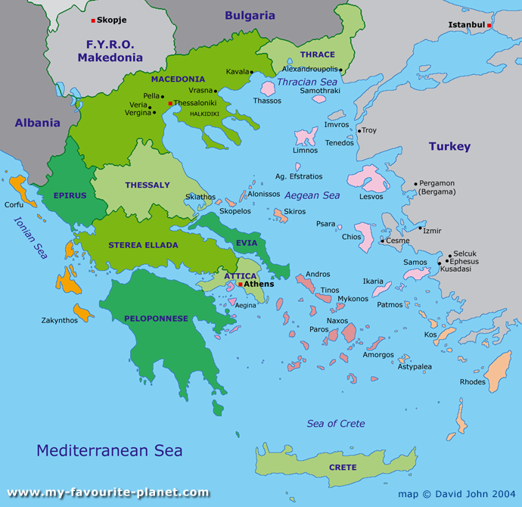
CENTRAL GREECE: THESSALIA

Slide 10
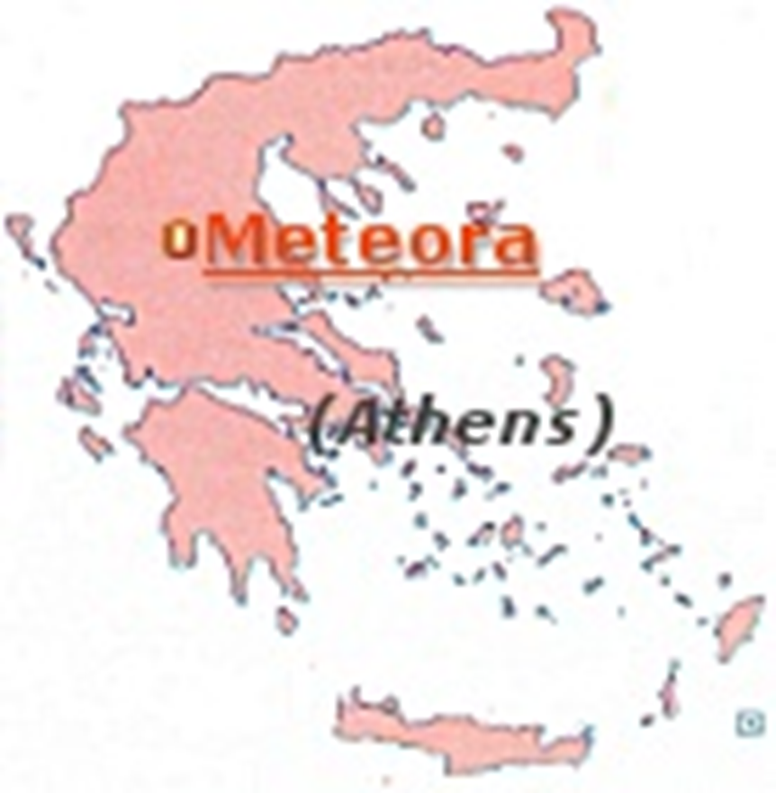
WHY THESSALIA? METEORA

Slide 11
METEORA (GROUP OF MONASTERIES on the cliffs-klifs)
IT IS ONE OF THE LARGEST AND MOST IMPORTANT GROUPS OF GREEK ORTHODOX MONASTERIES IN GREECE
https://www.youtube.com/watch?v=yzZUIfB79V0

Slide 12
METEORA MONASTERIES WERE BUILT IN LATE 11th –EARLY 12th CENTURIES.

Slide 13
Central Greece: Delphi

Slide 14
DELPHI THE ORACLE (wyrocznia )
Delphi is known as the “THE CENTRE OF the EARTH”. In ancient times the most famous and most important oracle in the Greek World was in Delphi.
https://www.youtube.com/watch?v=K_mTkNPT6fM&index=20&list=PLLGcw3eMOiw0n7_pYSJVn0kQw-LI7IYSC

Slide 15
DO YOU KNOW WHAT AN ORACLE IS?
A place where people go and ask questions about their future

Slide 16
6th-4th c BC Pythia telling her prophecy (przepowiednia )
Pythia, a high priestess of Apollo, (the god of music), told her prophecies in an enigmatic, puzzling way (niejasny sposób) lots of people came here to ask Pythia about their future.

Slide 17
EAST OF GREECE: AEGEAN SEA-CYCLADES ISLANDS

Slide 18
THE ISLAND OF SANTORINI/THERA

Slide 19
WHY? VOLCANIC ERUPTION (wybuch wulkanu )
The Volcanic eruption (3.600 years ago) was so strong that part of the island collapsed (część wyspy zapadła się) leaving a large caldera (creation of blank space of 80 km³).
https://www.youtube.com/watch?v=z0bdsAuTWB4

Slide 20
SOUTH GREECE: PELOPONNESE

Slide 21
ANCIENT OLYMPIA

Slide 22
ANCIENT OLYMPIA: WHY?
Olympia is the most important sanctuary of ancient Greece (ważne sanktuarium starożytnej Grecji ), dedicated to Zeus (the father of gods/goddesses), and the most important religious and athletic centre in Greece (ważne centrum religijne i sportowe). The Olympic games took place here every 4 years.
https://www.youtube.com/watch?v=3W63fdTrZuI

Slide 24
Let’s repeat WHERE-WHICH PLACE-WHAT?
1) WEST: IONIAN SEA Zakynthos (caretta- caretta)
2) NORTH: MACEDONIA Vergina (Tomb of King Philip II)
3) THESSALIA: Meteora (Orthodox monasteries on the cliffs)
4) CENTRAL GREECE: Delphi (The Centre of the Earth/Oracle)
5) EAST: AEGEAN SEA Santorini (Volcanic Eruption)
6) SOUTH: PELOPONNESE (Ancient Olympia)

Slide 25
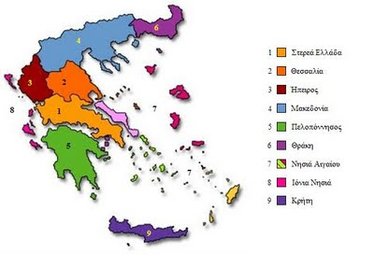
LET’S MATCH
IONIAN SEA=
AEGEAN SEA=
MACEDONIA=
THESSALIA=
CENTRAL GREECE=
PELOPONNESE=

Slide 26
THE END
WE HOPE WE BELONG TO THE SECOND CASE!!!!
THANKS FOR YOUR ATTENTION!!!

