Slide 1
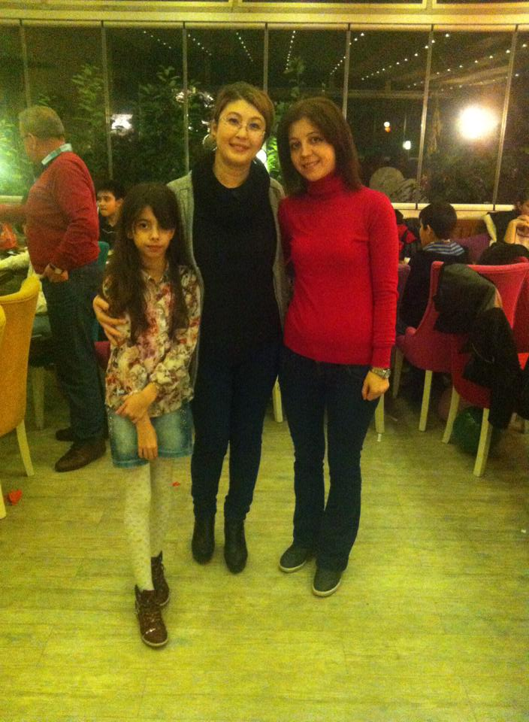
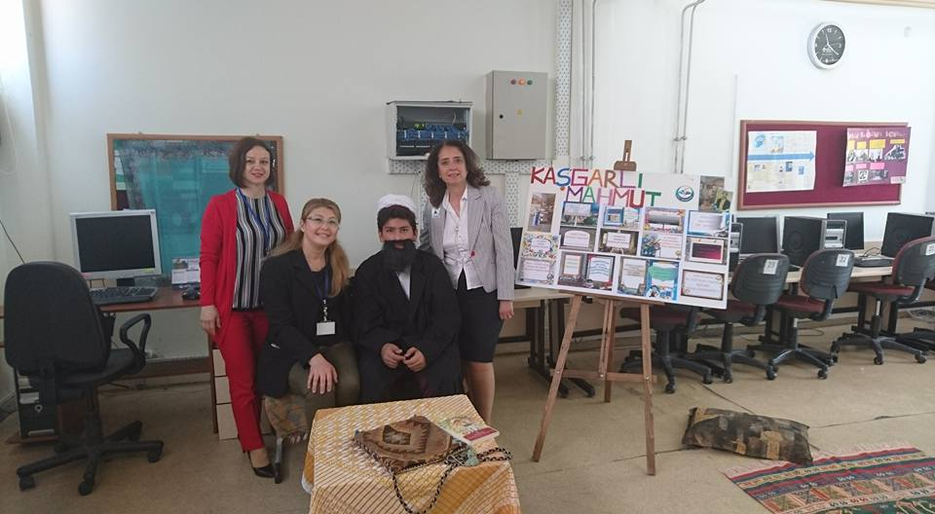
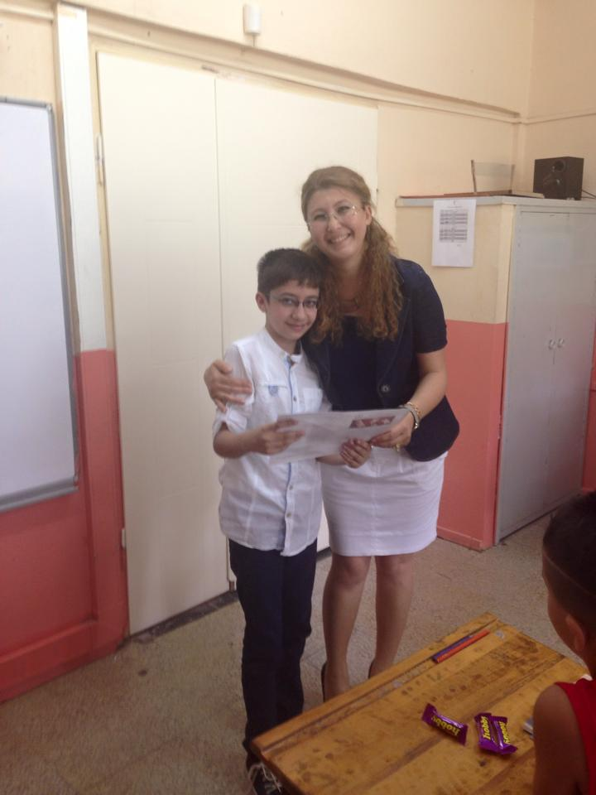
AYLİN KOÇ

Slide 2
My Name is Aylin KOÇ.I have been a teacher for 16 years.I have been working in Gazi Secondary School for five years. Mukaddes Sahin is my colleague and elder sister who leads how I can work on teaching English and Etwinning projects.I am so lucky that I can work with her at a good school.

Slide 3
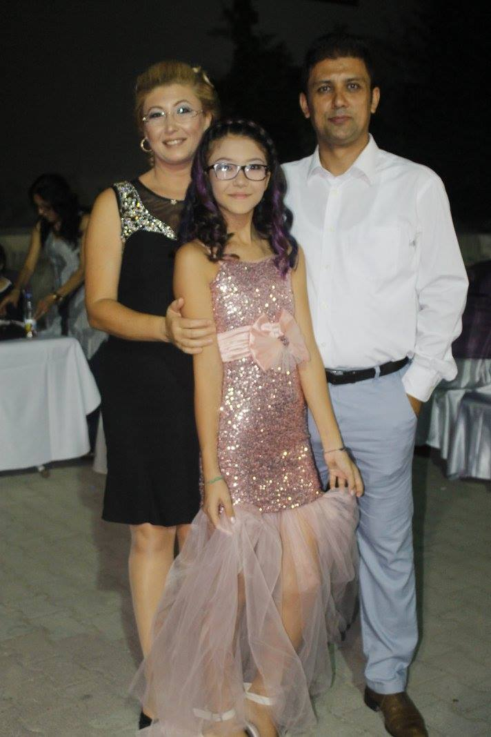
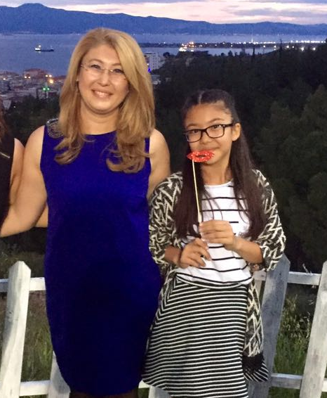
I am 38 years old .I am married and have a sweety daughter,Öykü.She is 13 years old and at athe same school with me.
I like baking cake with my daughter and listening to music.Also driving my car is my favourite hobby.

Slide 4
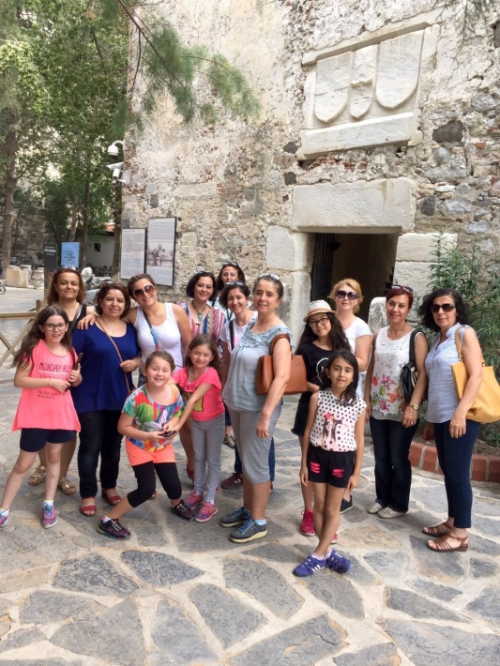
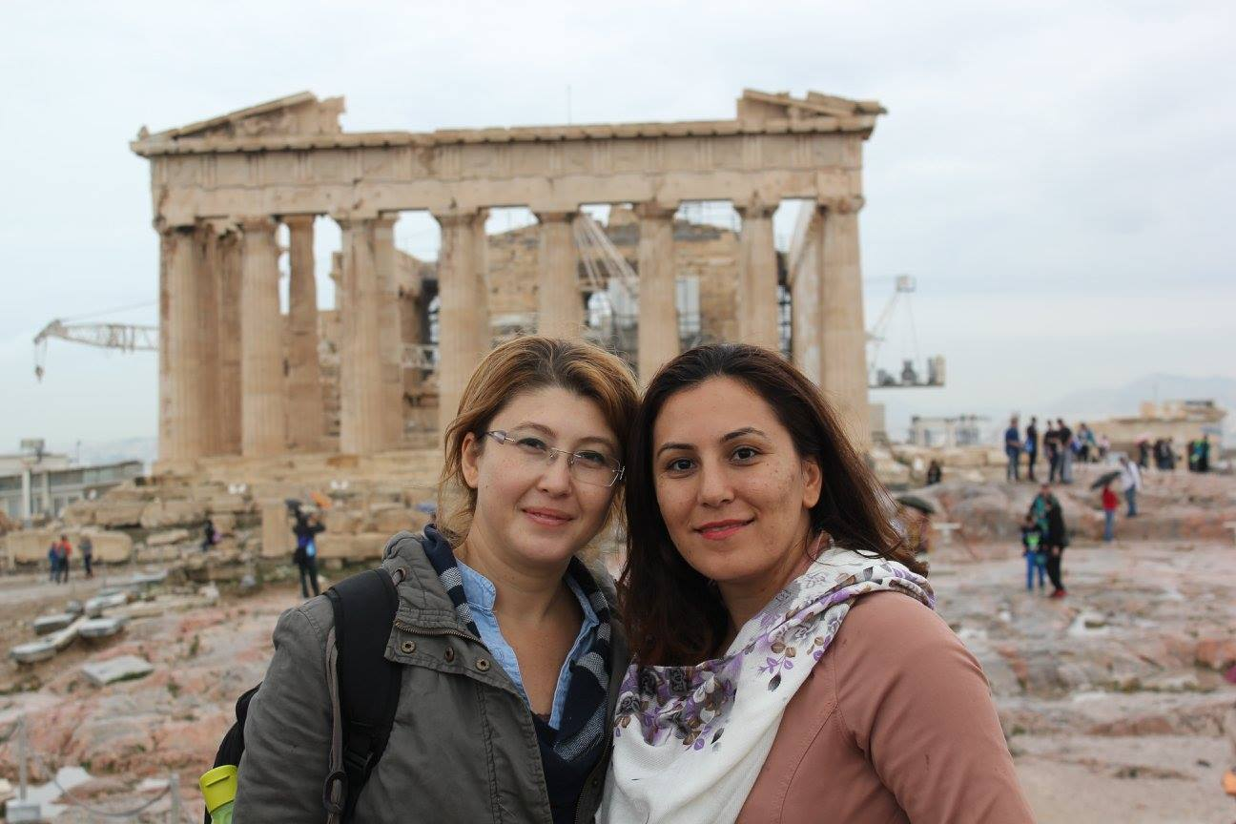
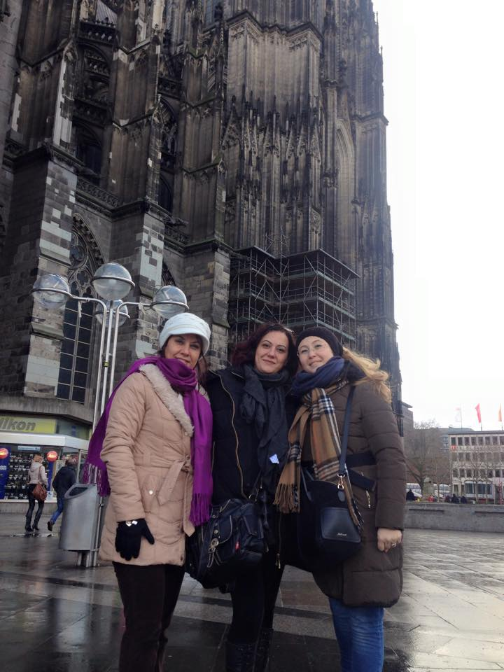
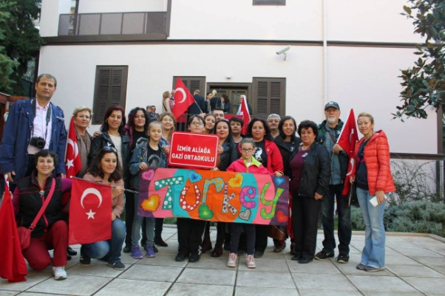
I also love travelling.So I and my colleagues at my school sometimes organize a tour to travel of our country or foreign countries.

Slide 5
I hate using mobile phone too much and wasting time on surfing the net.
I believe that time is the most sagnificant thing in our lives.

Slide 6
I am not so good at Etwinning projects.Because I didn’t do any projects for years. So I hope you can forgive me when I am alittle bit late .

Slide 7
I have a chance that I can work with you on this Etwinning project.
I hope ‘T4T ‘Etwinning project will have been resulted the best at the end of this educational year.

Slide 8
Thanks for watching BYE

