Slide 1
Wedding contracts in the Greek World
An assignment by Chrisanthi – Ioanna Dagka, student of the 2nd High School of Evosmos

Slide 2
Dowry
Dowry is an ordinance or institution in which the bride’s family gives her the property that proportionates to her when she is getting married. This ordinance dates back to the ancient years and it represents the bride’s contribution to the couple’s joint venture.
The reasons behind that were at first economical and then they became social. Besides the bride’s natural beauty, a cause of the marriage was the dowry. The dowry is a marriage contract and it was corroborated by a marriage protocol.

Slide 3
The parents of each girl were trying hard from her young age to the moment she would be asked to get married to collect the dowry. Usually the dowry was made up of clothes, but the wealthiest gave jewelry, land estates, animals, and dwellings. In essence, the dowry was a compensation to the man, as it ensured the family's relief in many areas and the husband by his burdens. Finally, the dowry is a symbol through which one can distinguish the financial state of each family.

Slide 4
Etymology of the word dowry
The property (mainly houses, land areas and money) that in the traditional societies were given from the bride's family to the groom to financially secure the new family.
The clothing and other movable items prepared by the bride and her family for the equipment of the new homemade.

Slide 5
Related words
To bid: I grant a dowry
Dowry hunter: the one who seeks to marry a bride with a great dowry
Pre-agreement: legally binding text (contract) signed by the groom and the bride's family and containing all the assets given as a dowry to him

Slide 6
Pre-agreement
From the first Byzantine years (5th century) documents were created for the establishment of the dowry. This custom lasted throughout the Byzantine period and continued during the Ottoman domination. Their syntax was always done in the presence of witnesses who were required to sign the pre-agreement. It was made before the wedding and was delivered to the groom before the ceremony.
It included clothing, furniture, household utensils, jewelery, animals, coins and real estate that were described in every detail.

Slide 7
The husband has the obligation to manage the dowry properly and to take care of its integrity. He did not have the right to grant any of the properties. The ownership belonged to the husband, and only the husband had the usufruct. If the husband died or the couple broke up the dowry would be left to the woman's property. If the wife died, then part of the dowry was inherited by the husband, and the most of it would be inherited by the children. If the couple had no children then the dowry would turn to the retailer if he lived or to his legitimate heirs

Slide 8
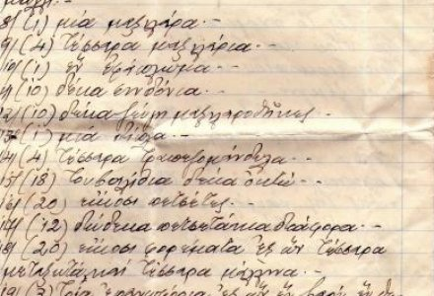
Example of a pro-covenant

Slide 9
Pre-agreement in Greece
A pre-agreement that dates back to the second half of the 17th century, in which the future bride Kithi is endowed, amongst other things with "two clean petticoats, one and a half pair of socks, so that the bride can knit the other sock and complete the remaining pair and two pairs of shoes that the one of them is patched. The groom is given a cap that he is allowed to wear only three times per week so that it does not pierce. In the Kithi's dowry are also included two pots that belonged to her grandmother, a ....urinal which is "neat and not used", two chickens, a rooster, a sieve of beans, homemade pasta and two kilos of olives.

Slide 10
In another prequel, written in 1919, the rich bride is endowed not only with clothes, mattresses, quilts, linen, towels, silk fabrics, but also with gold and land areas.
The interesting fact in the pre-agreement is that the groom also gives the bride a gold pen, two gold rings, a golden pin, a golden watch, and a diamond cross with a golden chain.

Slide 11
Sources
http://flashnews.gr/post/47064/prikosimfona-pou-eminan-stin-istoria
https://www.slideshare.net/1lykspartis/ss-61307864
https://el.wikipedia.org/wiki/%CE%A0%CF%81%CE%BF%CE%AF%CE%BA%CE%B1

