Slide 1
My town- Michałowo
Patrycja S. i Ewa B. kl IIb

Slide 2
Michałowo
Michałowo is a small town in east Poland in Podlasie.There is 40 kilometers to Białystok. 3107 people live in our city. .

Slide 3
Church in Michałowo of Providence
It’s roman catholic’s temple from 1909.

Slide 4
Orthodox church in Michałowo of St.Nicolas
It is old Orthodox temple from 1907.

Slide 5
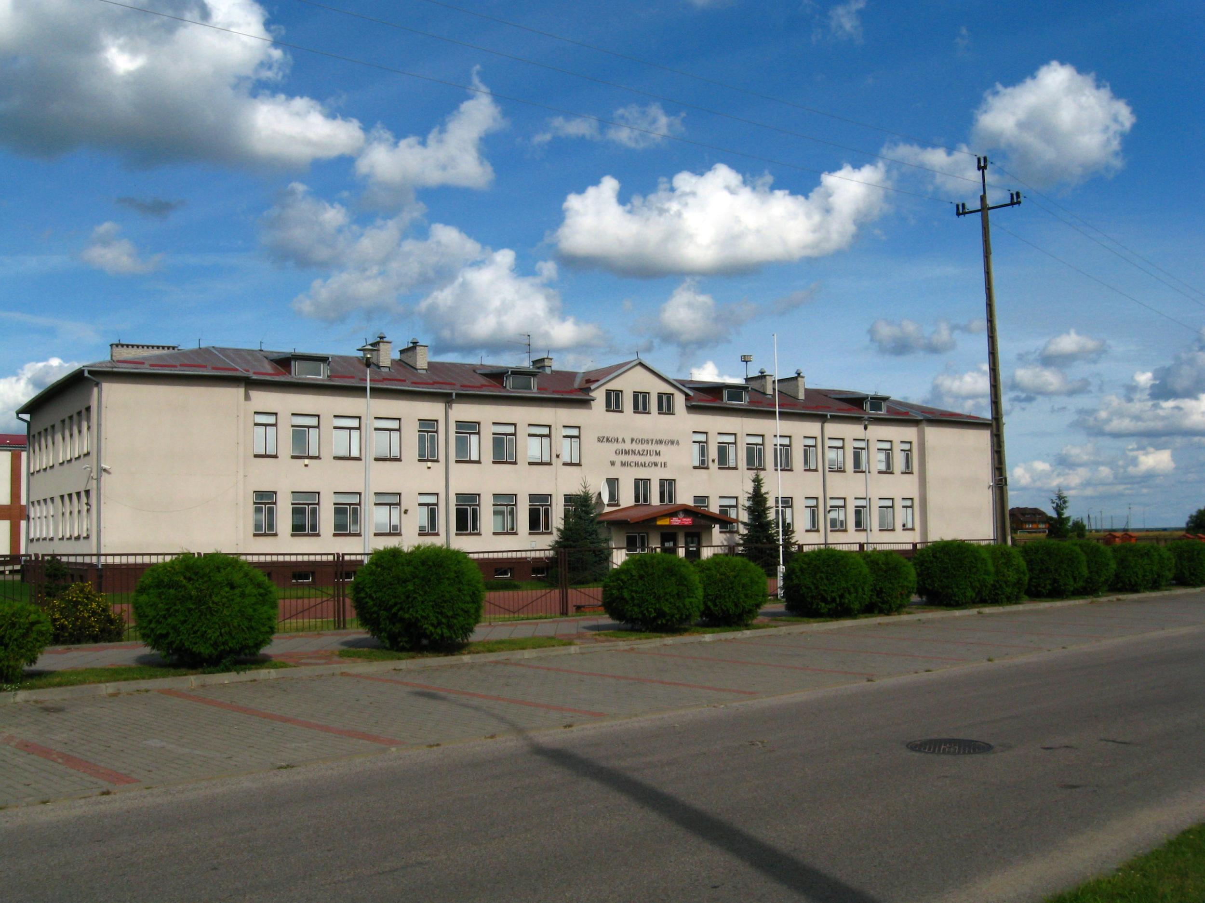
Primary school in Michałowo
It is a primary school.At that school there are 350 students and 45 teachers.

Slide 6
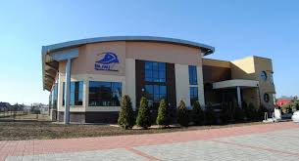
Swimming pool in Michałowo
The swimming pool is next to the primary school.

Slide 7
Thanks for watching!

