Slide 1
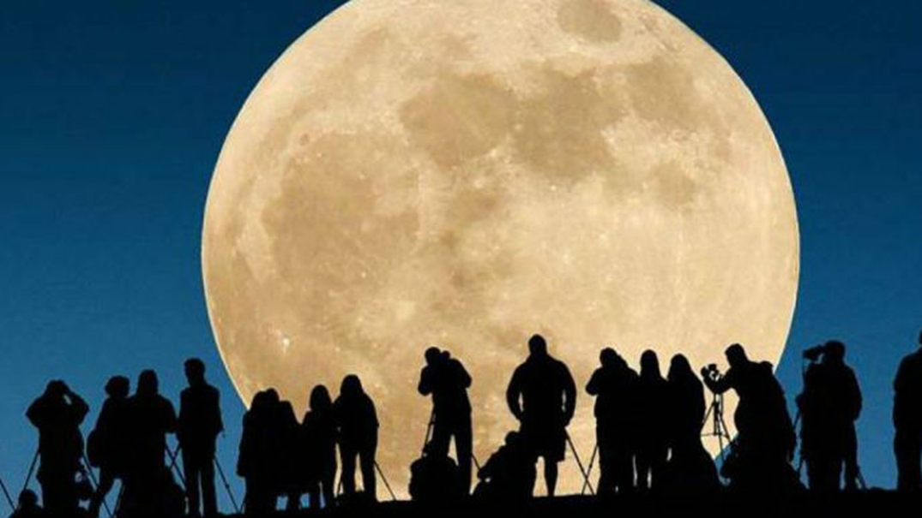
The most recent architectural designs for moon bases
Panayot Volov school, Varna, Bulgaria

Slide 2
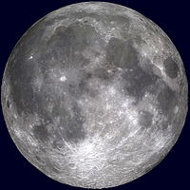
Moon bases and cities are not new. They have been on the pages of sci-fi novels for decades, and particularly relevant since the Americans stepped on the moon. Today, when many countries' aspirations for the return of the people in the earth to the earth moon are revived, the subject is becoming more and more relevant.

Slide 3
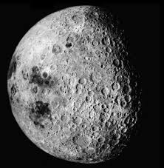
Moontopia international architectural competition
The goal was to create moon colony projects without limiting the imagination of designers and engineers (in terms of money or technology). The only condition is that they have factual justification and are self-supporting, to provide everything needed for long-term residence, work and space tourism on the Earth's surface.

Slide 4
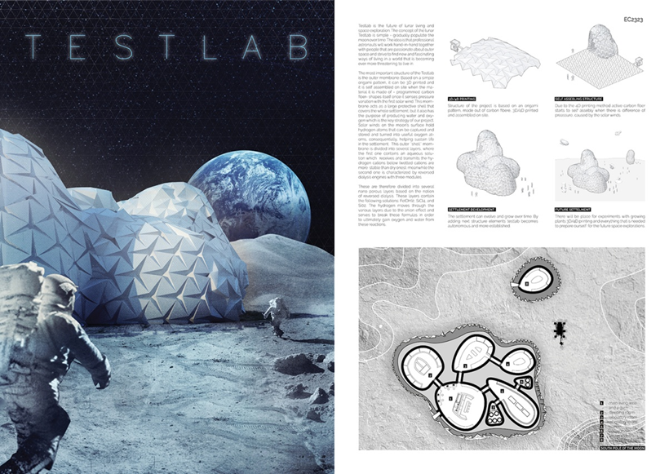
TESTLAB
The Testlab project is the most realistic but still fantastic-looking Moon life project.

Slide 5
The concept is simple - gradually popping over its surface over time. This will be a long-standing process that will begin with the construction of a simple, single segment, populated by only a few astronauts. Over time, however, it will expand rapidly, allowing more and more people to inhabit it and will eventually be able to accept even ordinary tourists and citizens contributing to the life of the lunar colony.
The colonizers will need to assemble a structure similar to origami that will be assembled in part and will probably be printed on 3D carbon fiber-based printers.

Slide 6
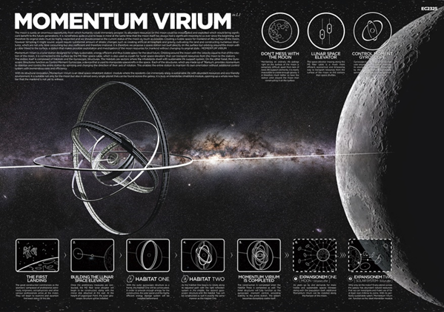
MOMENTUM VIRIUM IN L1
The suggestion is to build a station near the moon to investigate the earth satellite and to obtain useful resources without causing any harm.

Slide 7
The construction of rotating rings (probably to create artificial gravity) will be in close orbit to the Moon, and will be connected to it by a space elevator, a conceptual facility that has its variants in "Earth conditions".

Slide 8
MODULPIA
The creators offer the moon to construct multiple living houses of modular structures such as Lego. Of course, the first building to be built there will be ... the plant to produce the modules that will lead research laboratories and homes to scientists and visitors over time.

Slide 10
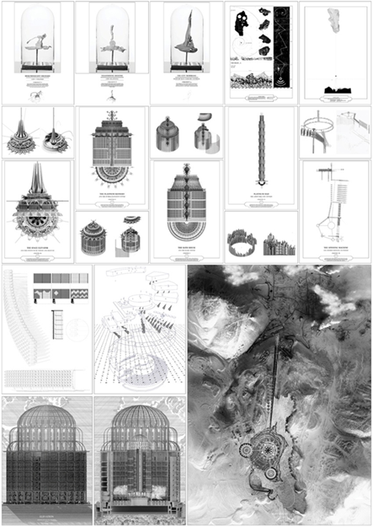
PLATINUM CITY
. The designer offers the Moon to create a city that accommodates at least 3,000 people. And quite logical - they will deal with mining and will develop space tourism.

Slide 11
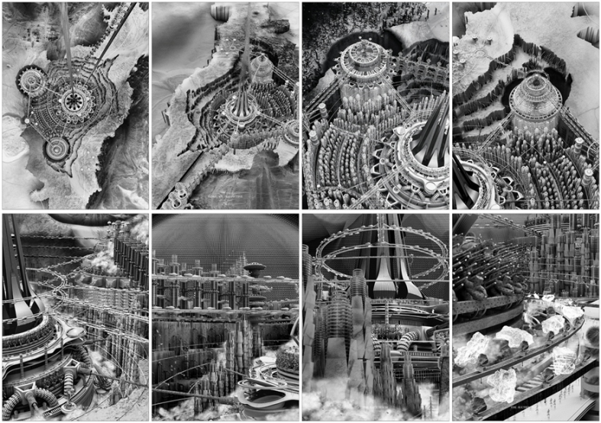

Slide 12
UPSIDE DOWN
The project is a rotating city ring, as we have seen in a number of sci-fi films. It is these projects that will enable people to harvest resources away from Earth and subsequently colonize Mars and other objects from the Solar System.

Slide 14
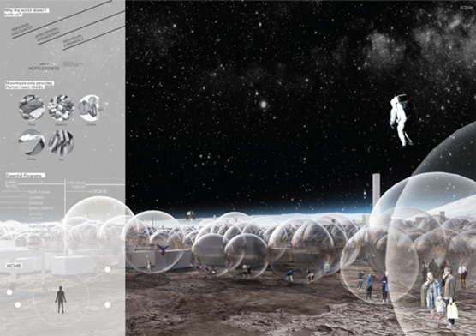
WOMB
The creators believe that the moon is an ideal place to relax and contemplate cosmic landscapes. That's why people there will live not in bunkers, but in transparent blisters.

Slide 15
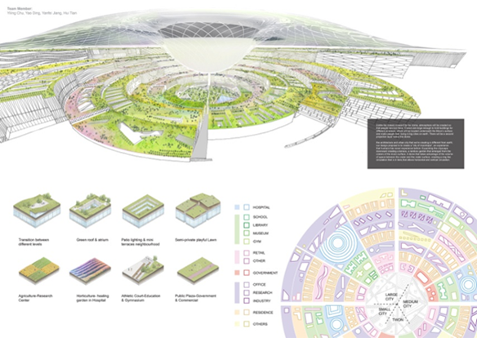
MOON EYE
Here architects offer to use the huge craters - already "dug" holes on the surface of the moon to be covered with protective glass and insulations so that people can live in it.

Slide 16
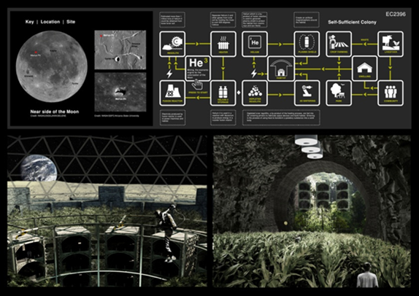
LUNAR OASIS
The main focus of the author is the development of green areas on the earth companion. But for them it will be necessary to pre-create large-scale structures and obtain different resources.
The realization will only be possible in 2110 - about 140 years after the first landing of a person on the Moon.

Slide 17
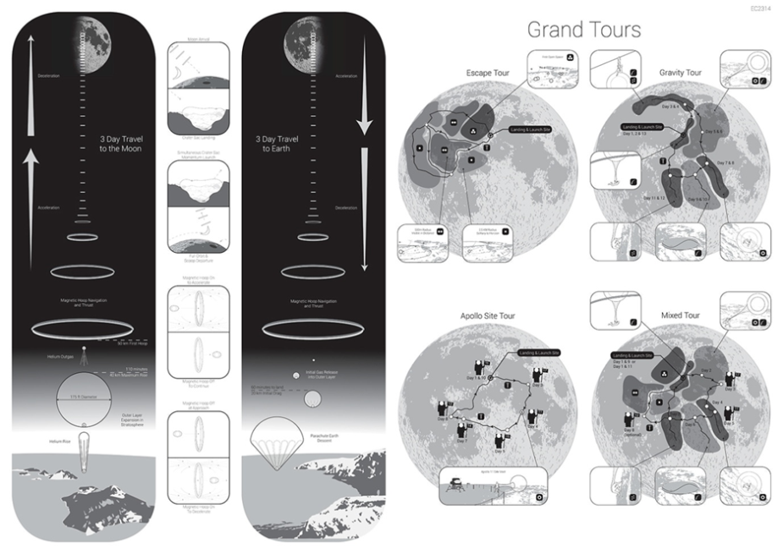
THE AEROSPHERE
The author believes that this way they can attract rich cosmopolitan tourists who will use the possibilities of non-traditional medicine in ... a non-traditional place. Namely - away from Earth.

Slide 18
The Studies and researches continue ...

