Slide 1
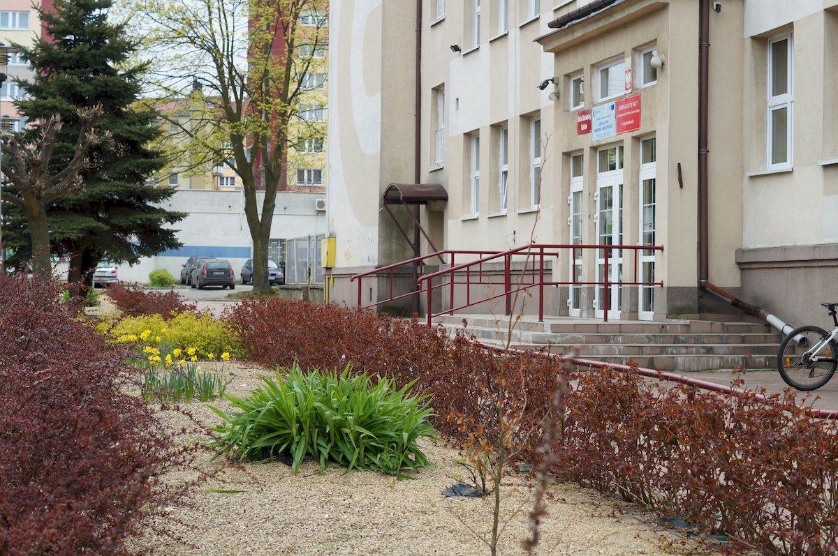
Szkoła Podstawowa nr 7 w Częstochowie
The school
The city
The surroundings

Slide 2
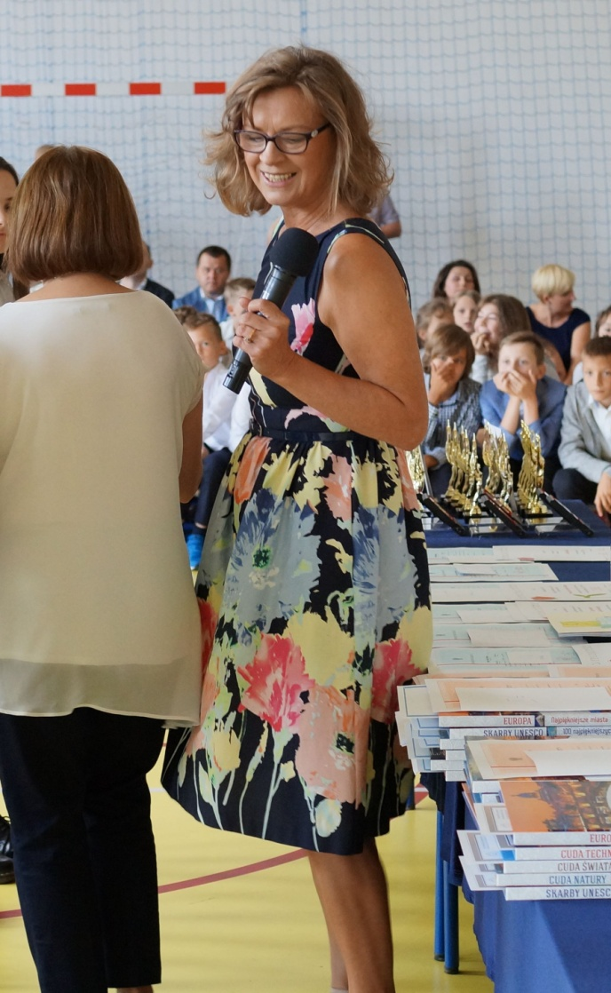
Our school A few pieces of information about our school
Primary School No. 7 in Częstochowa was created in September 2017 from Lower Secondary School as a result of the Polish education reform.
We have 383 pupils in our school. They are 6 – 15 years old and attend to 16 classes.
In addition to general, we also have sports classes with the specialization of football and athletics. Our school day starts at 8 o’clock and finishes between three and four. After compulsory, formal lessons our students can take part in additional classes, during which they have possibilities to develop their artistic, scientific or sport interests. The latter is the most popular.
The nice atmosphere connected with the commitment of the headmistress and the teaching staff influences the progress of our students and contributes to their successes in various fields.
Headmistress – Joanna Ziółkowska-Nowak

Slide 3
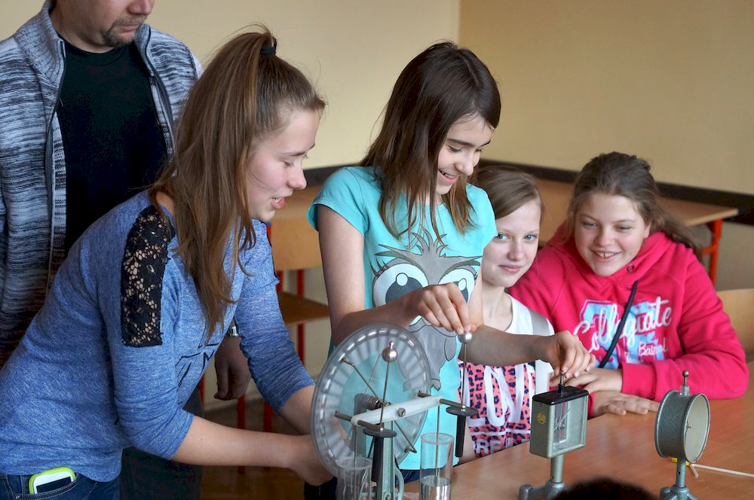
The students are keen on experiments.
Students during a lesson.

Slide 4
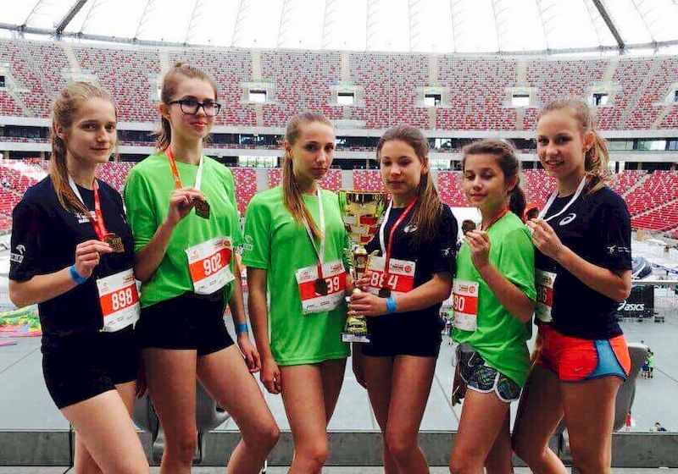
Sport plays an important role in our students activities. Every year we can be proud of our students’ achievements in between-school competitions in many sport disciplines.

Slide 5
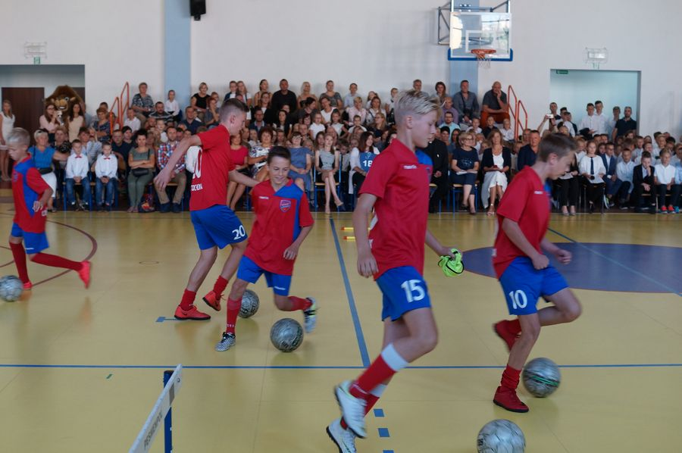
As elsewhere in Europe boys like playing football. We have six football classes for boys. In addition to the school, they train in a sports club.

Slide 6
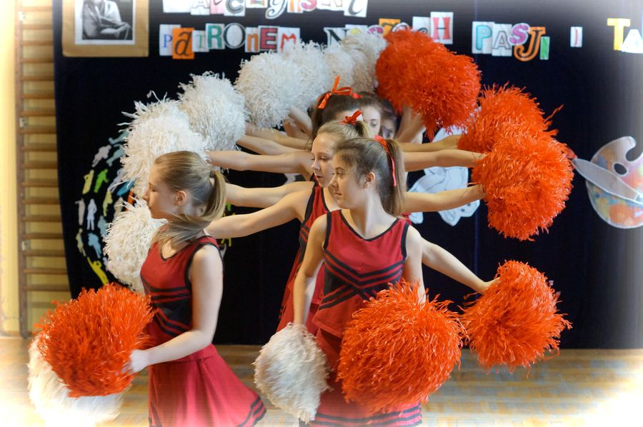
A lot of girls are keen on dancing. There is a very successful cheerleaders team in our school. They are really good.

Slide 7
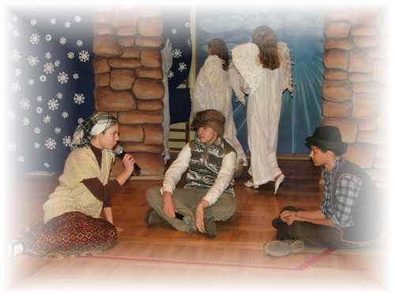
School ceremonies and events are opportunities to present acting skills of our theatrical club. Every performance is preceded by hard work and hours of rehearsals. Members of artistic classes are responsible for the stage design.
The presentation of the Christmas play - Jaselka

Slide 8
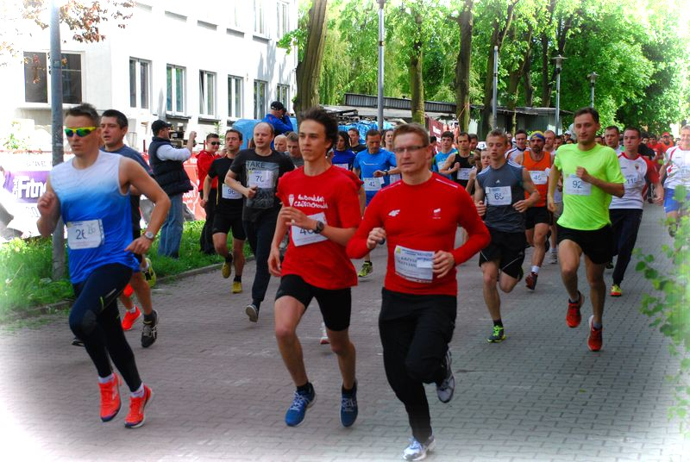
The school is a friendly and lively place which is very important for the local community. We organize many fetes, shows and performances for citizens of our district.
Street run, organized annually by our school.

Slide 9
Our city – Czestochowa
A brief history
First written references to Czestochowa date back to the 13th century. The small settlement situated on the Warta river, where major trade routes crossed, later grew into a town with numerous economic privileges, which promoted the development of trade and crafts. Thanks to the foundation of the Pauline Fathers' Monastery at Jasna Gora the fame of this place was spreading rapidly since the 15th century and great numbers of pilgrims from different regions of contemporary Poland and also from Bohemia, Moravia and Hungary started to flock to Czestochowa. Yet various disasters - numerous wars, fires, plunder - thwarted the development of the town for almost two centuries. It was not before the 19th and 20th centuries that the economic conditions in Czestochowa improved again which brought about the unparalleled so far development of industry and business relations. Today Czestochowa is the City of transforming economy, with the dynamically developing service, small manufacture and crafts sectors and also a thriving academic centre with numerous institutions of higher education.

Slide 10
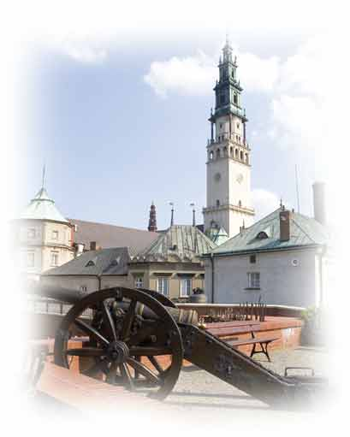
Czestochowa is regarded as the spiritual capital of Poland. Her history and present position is inseparably connected with Monastery of Jasna Gora.
Czestochowa with Jasna Gora Monastery is one of the major pilgrimage centres of the Christian world. It is also the second biggest - after Lourdes - centre of the Marian cult. Every year Czestochowa is visited by 3 - 4 million pilgrims and tourists. In 1996 five European towns, functioning as centres of Marian cult i.e. Loreto, Lourdes, Altötting, Fatima and Czestochowa signed a co-operation agreement. The main objective of this co-operation is to share experience in the field of organization of religion - motivated tourism and to create conditions for wide promotion of these towns.

Slide 11
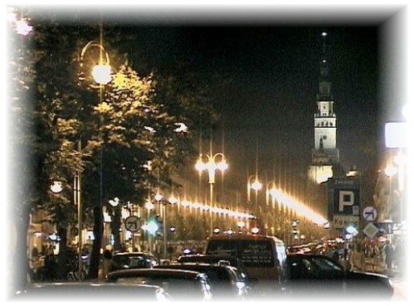
The population of Czestochowa is about 230 thousand people. The main street of the city - NMP Avenue is full of hustle and bustle. You can find many shops, restaurants, pubs and cultural institutions there.

Slide 12
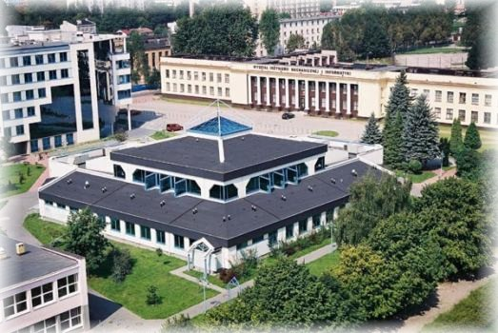
Czestochowa is also a very important academic city with many universities and places where students spend their free time.

Slide 13
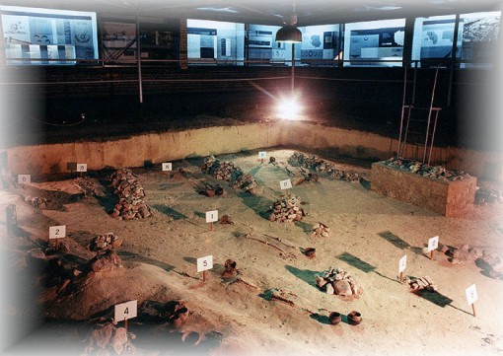
Archaeological reservation in the area of an excavation of the cemetery of luzycka culture. The unique in Europe museum is situated near our school and it contains 2,5 thousand years old exhibits.

Slide 14
Speedway is a very popular sport in our country. The club from Czestochowa is one of the best in Poland.

Slide 15
The second, and for some even more important is volleyball. Representatives of our city have always been in the forefront of Polish league.

Slide 16
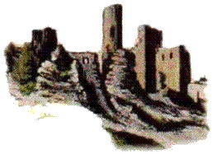
Our surroundings
Jura Krakowsko - Czestochowska
Jura Krakowsko – Czestochowska is a hilly Upland with Jurassic limestone rocks, stretching from Czestochowa to Krakow. This amazing area is situated in South – central part of Poland. It is famous for its cliffs and valleys. Several nature reserves are situated around Czestochowa. The biggest one is Sokole Góry (the Falcon Mountains) with limestone hills and picturesque white rock clusters hidden in the beech forest. Underground there is a mysterious world of 46 caves.
Jura Krakowsko – Czestochowska is very greenfull. Completely opposite plants coexist in the same time and place. That makes this area so special. Flora and fauna is very rich here. The whole upland is surrounded by huge forrest. Apart from green you may find here also different sorts of animals.
This upland is a unique cultural landscape. There are relicts of former inhabitants, monuments and art. Apart from flora and fauna there are lots of objects prepared for visitors like castles which represent different styles of epochs.
The area is a real paradise for those who like outdoor activities. It is perfect place for hiking, mountain biking or paragliding. The steep rocks give opportunity for improving climbing skills and for training under the supervision of professional instructors

Slide 17
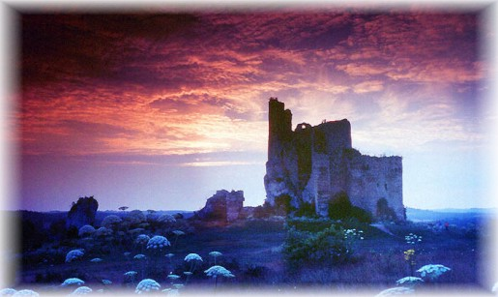
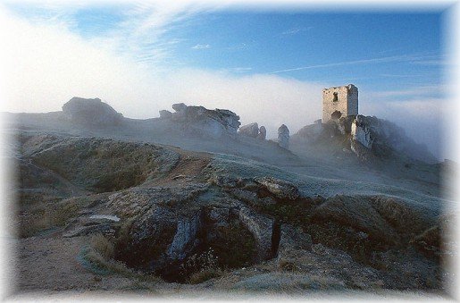
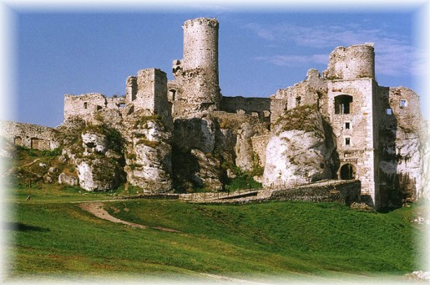
Jura is a hilly upland with limestone hills where you can find deep caves, mysterious ruins of old castles and historical buildings.

Slide 18
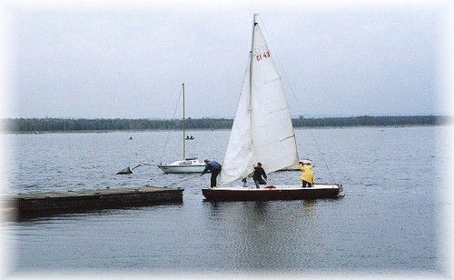
Situated about 15 kilometers from Czestochowa the artificial lake „Poraj” attracts fishermen, yachtsmen and everyone who likes water and sunbathing.

Slide 19
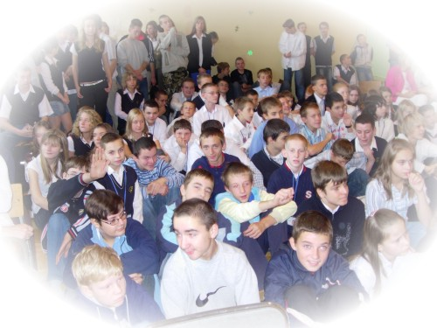
Thank you
We hope that this short presentation has given you a bit of knowledge about our school, city and region and will contribute to our better co-operation.

