Slide 1
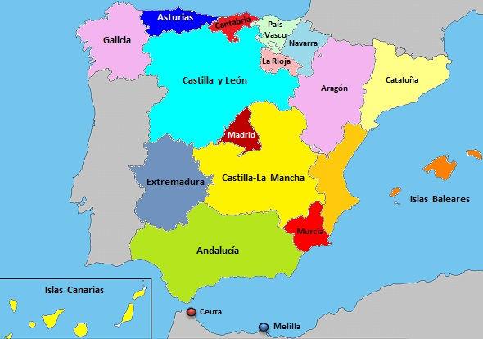
Marmolejo is situated in the South of Spain, in Andalusia, in the province of Jaén.

Slide 2
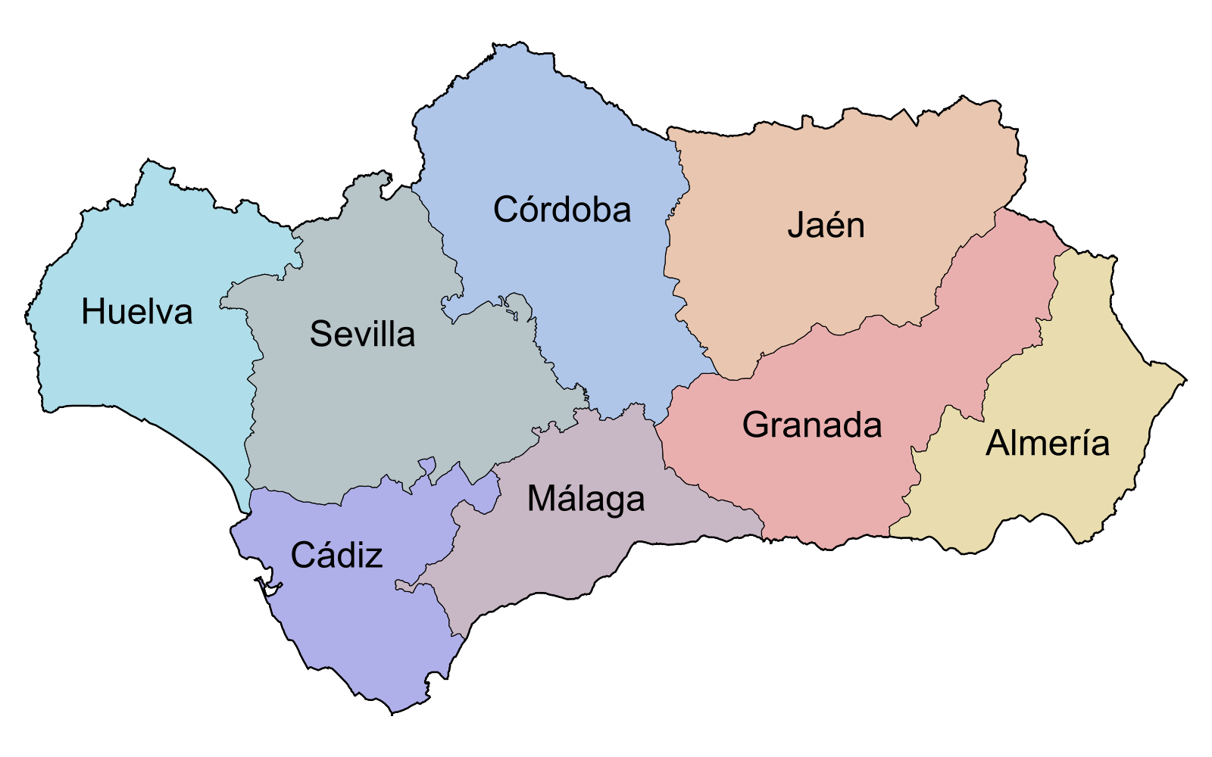
Jaén is between Córdoba and Granada.

Slide 3
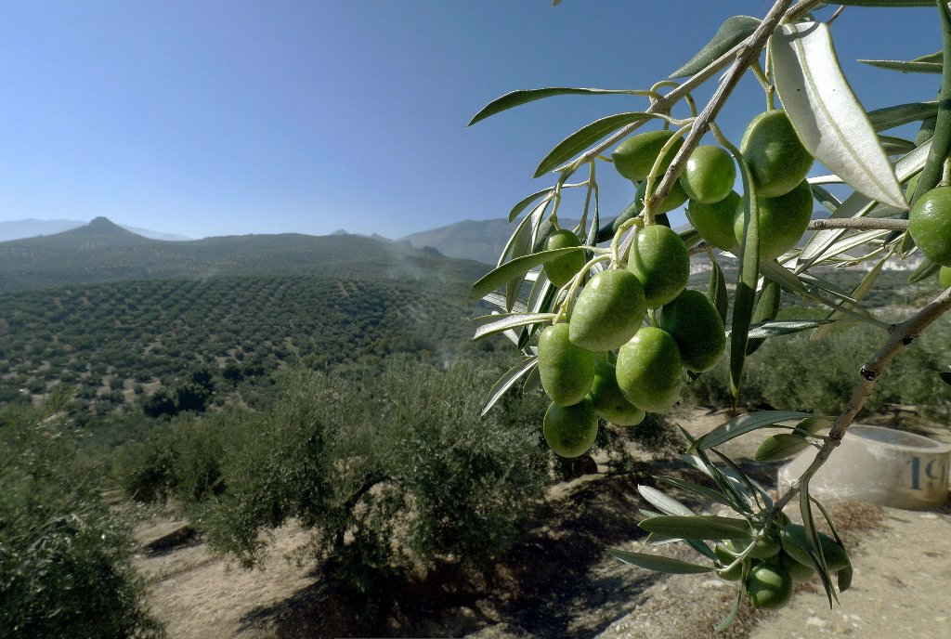
Jaén is known for the olive oil because it is the best of the world. The local economy is based on olive cultivation and olive oil production.

Slide 4
The population of Marmolejo is about 7.500 people.
It is not near the sea but in the mountain, “Sierra Morena mountain”, which is a natural park with plenty of green areas and a great variety of animals. It is also beside the Guadalquivir River, the longest in Andalusia.
Marmolejo has very hot summers, sometimes it is around 40 grades centigrade or even more and not very cold winters; the minimum temperature is about 3 or 4. It doesn’t rain very much

Slide 5
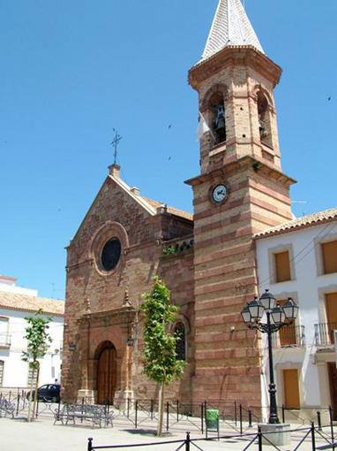
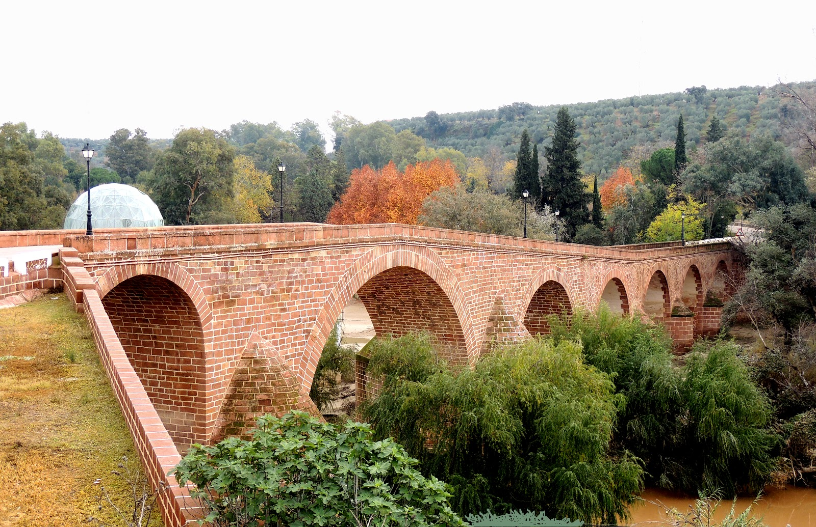
We are seeing now some pictures about our places of interest

Slide 6
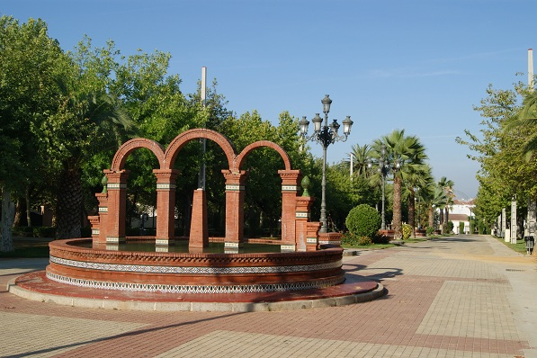
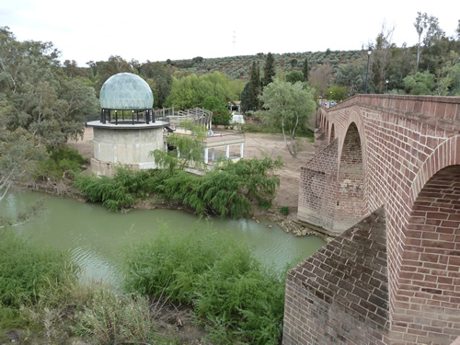

Slide 7
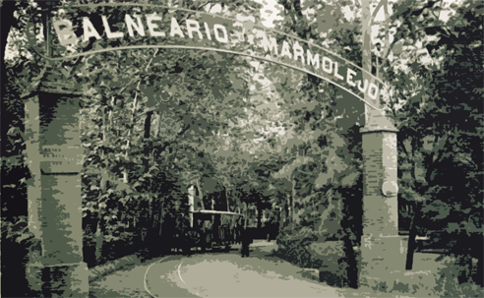
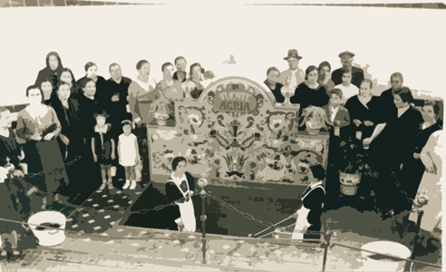
History
In this town there was a very famous spa where there were three springs. One spring was called “San Luis” and it is said that its water is good for the kidney. The second spring was called “Buena esperanza” and it is good for the liver, and the last one was called “Fuente Amarga” and it is good for the stomach. There was a tram from the center of the town to the spa, because people came to Marmolejo to drink this amazing and healthy water.
Marmolejo's spa was one of the most popular in Spain from the late 19th to the early 20th century. It was visited by well-known people, such as the Nobel Prize Ramón y Cajal, the Spanish philosopher Ortega y Gasset, Charles Chaplin, Rodolfo Valentino, the Spanish writer Palacio Valdés, the Sultan of Morocco...
It doesn't work now, because of the last floods.

Slide 8
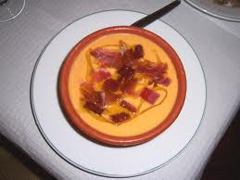
Tipical food
All our meals are prepared with olive oil, it is delicious and it is good for our health.
The most popular food in Marmolejo are:
The cascaflote, more known as “Salmorejo” (a type of cold soup)
It is made of tomato, garlics, cooked egg, tuna, bread, salt, olive oil and vinegar.

Slide 9
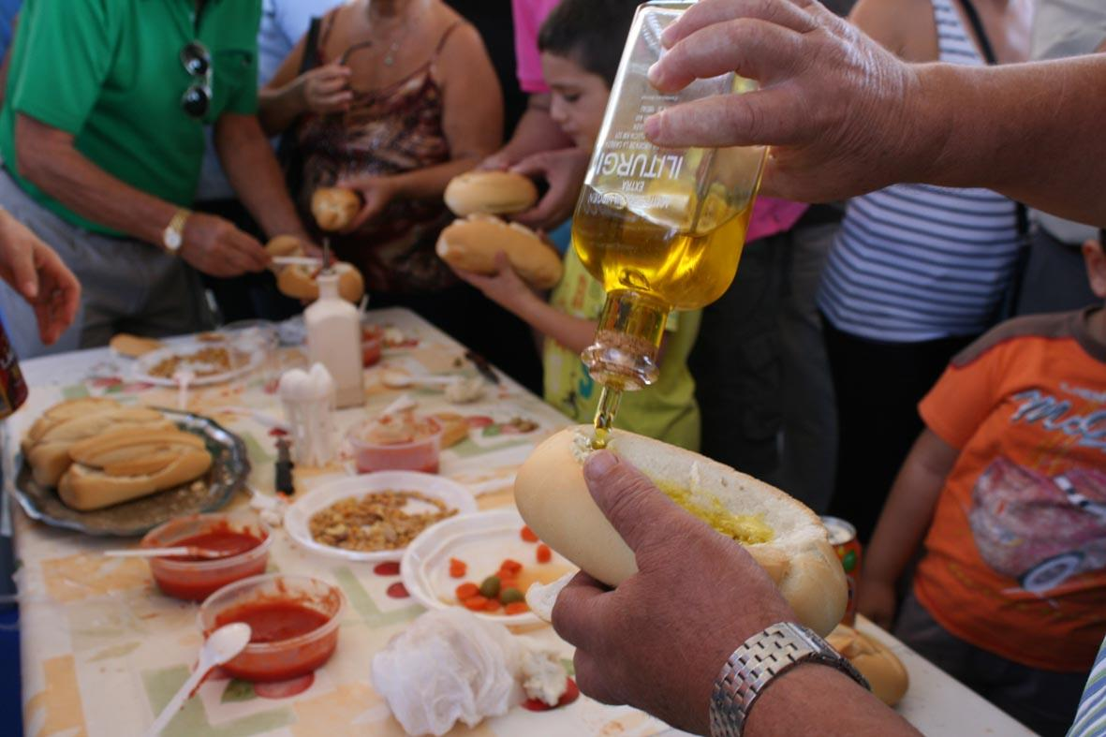
The canto:
This is very easy to prepare. It is bread with a hole where you must put olive oil and tomato.

Slide 10
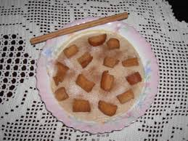
The gachas:
It is made of stale bread, milk, flour, olive oil, sugar, salt, ground cinnamon and a spice called “Matalaúva”.

Slide 11
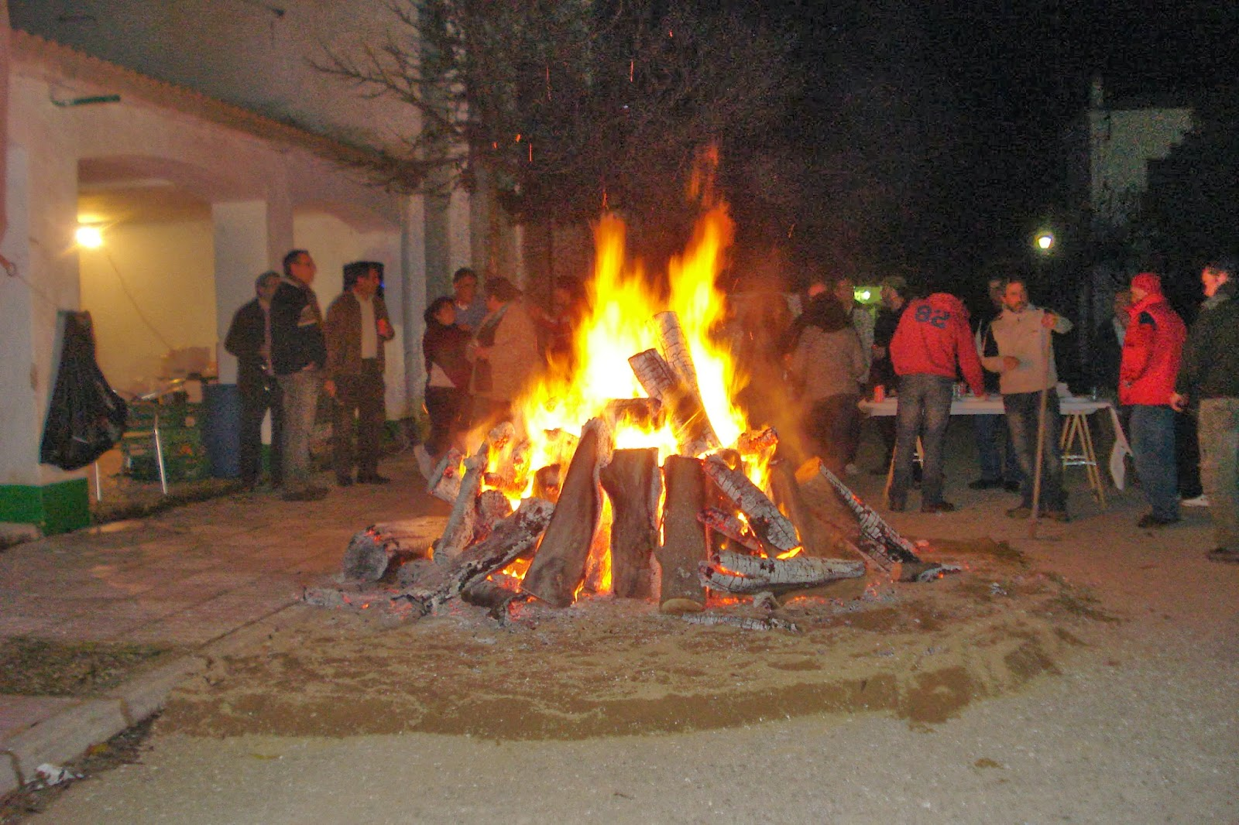
The most important celebrations
The Candelaria
This party consists of burning olive branches in the street. Meanwhile people drink, eat, dance and have fun. This celebration is in February.

Slide 12
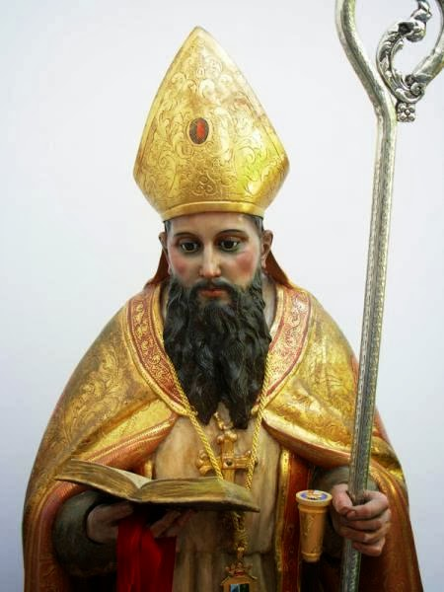
Fair of San Julián
This celebration is in the honor of “San Julián”, the Saint Patron of Marmolejo and there are attractions, traditional games, and many activities to have fun. It is in August.

Slide 13
Pilgrimage of the Virgen de la Cabeza
It is the most popular party in Marmolejo. It is in the honor of the Virgen de la Cabeza who appeared to a shepherd in the mountain many years ago. Every year, the last weekend in April, we celebrate a pilgrimage to this mountain. The party starts in town on Thursday when people wearing traditional dresses, offer flowers to the Virgen. Everybody is in the street dancing, singing, drinking and having fun.

Slide 14
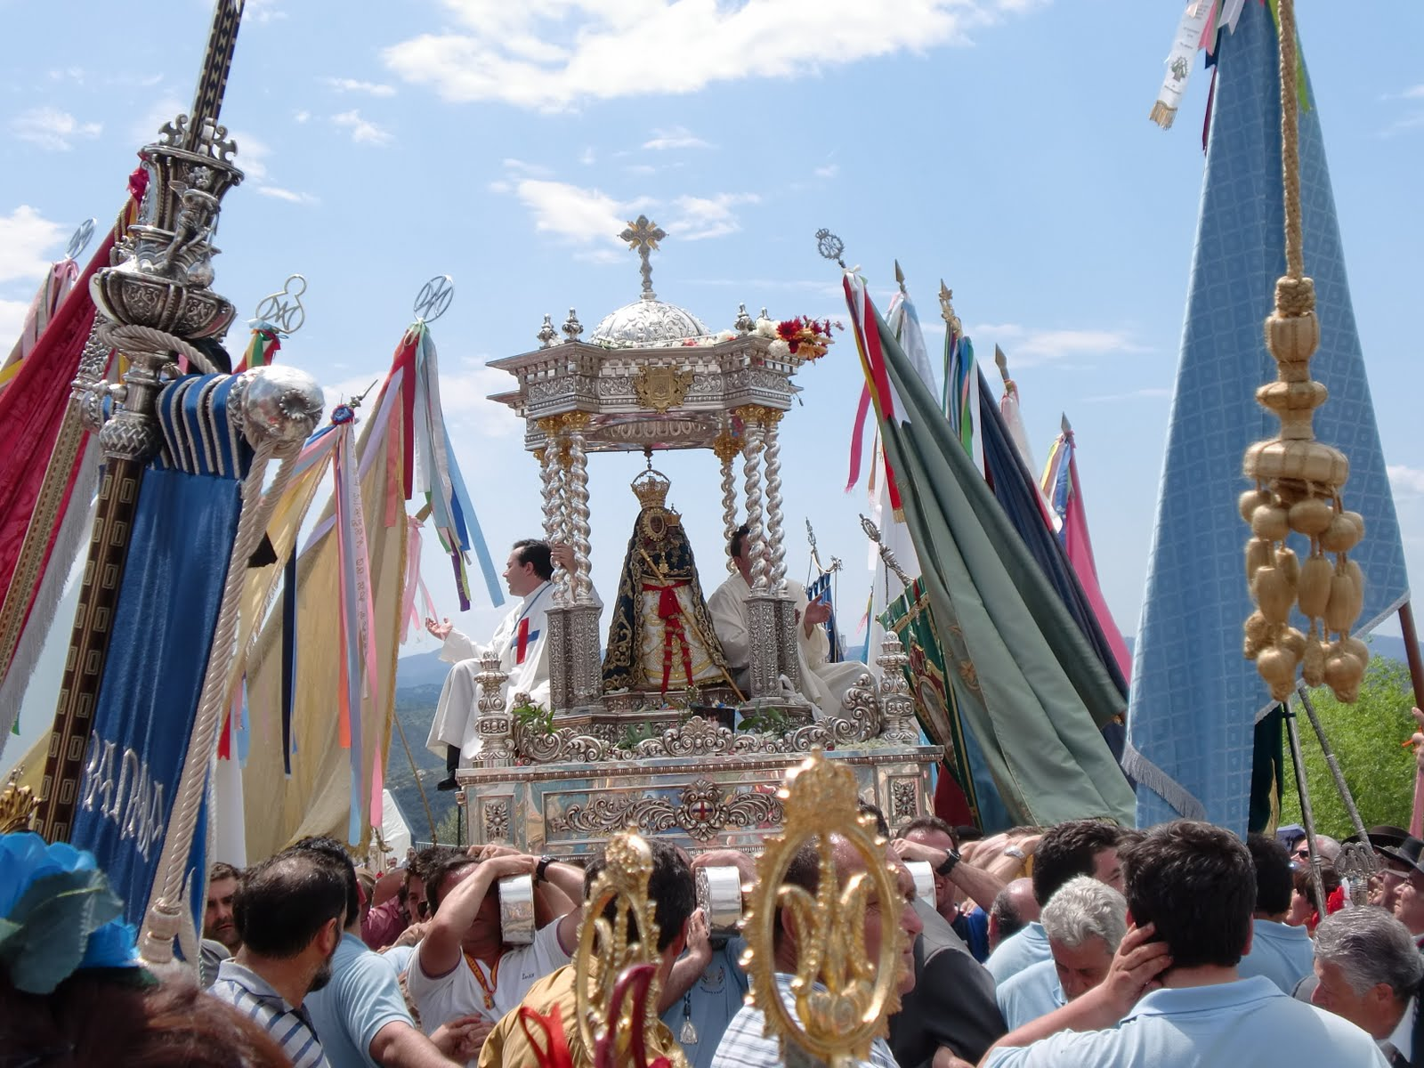
On Friday and Saturday people go to the mountain and they camp there. There are parades with people from different towns. Half a million people can meet there. It is fantastic. People go by car, cart, bus, riding horses or on foot. On Sunday everybody go back home.

Slide 15
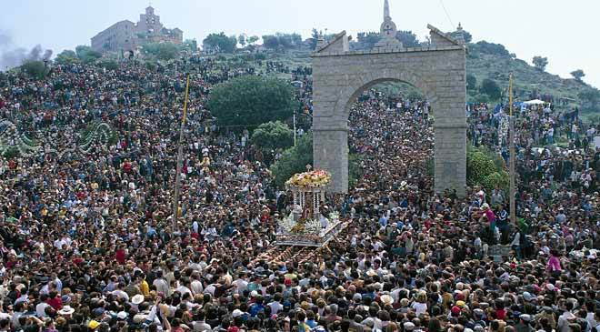

Slide 16
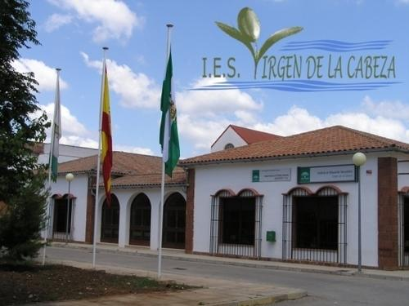
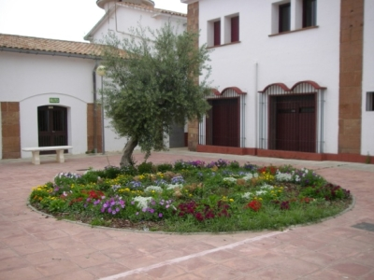
My school
My school is a big and great place and I like it
very much because I meet my friends there every day.
We are more than six hundred students.

Slide 17
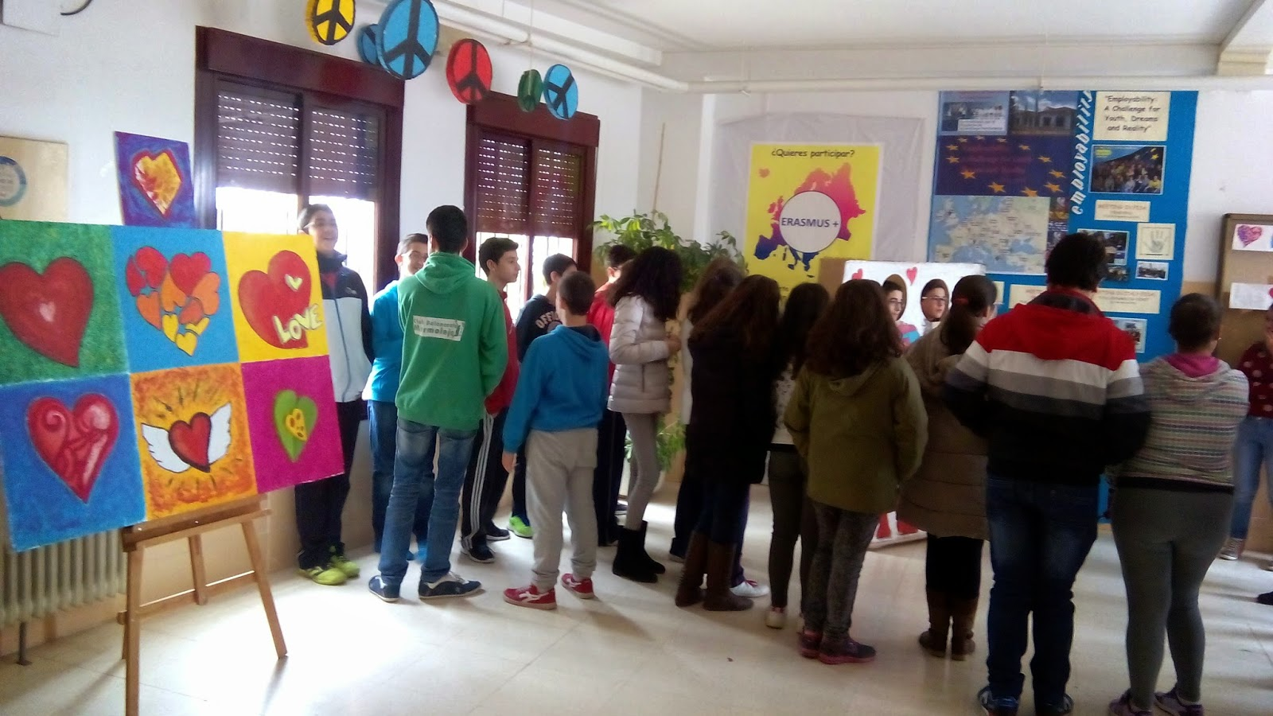
There are many buildings, a gymnasium,
a football pitch; there is also a big meeting room
where we go to attend speeches or watching films.
Moreover, there are three computer rooms,
although we can take computers to all
the classes as well. We have two laboratories
and a big library.

Slide 18
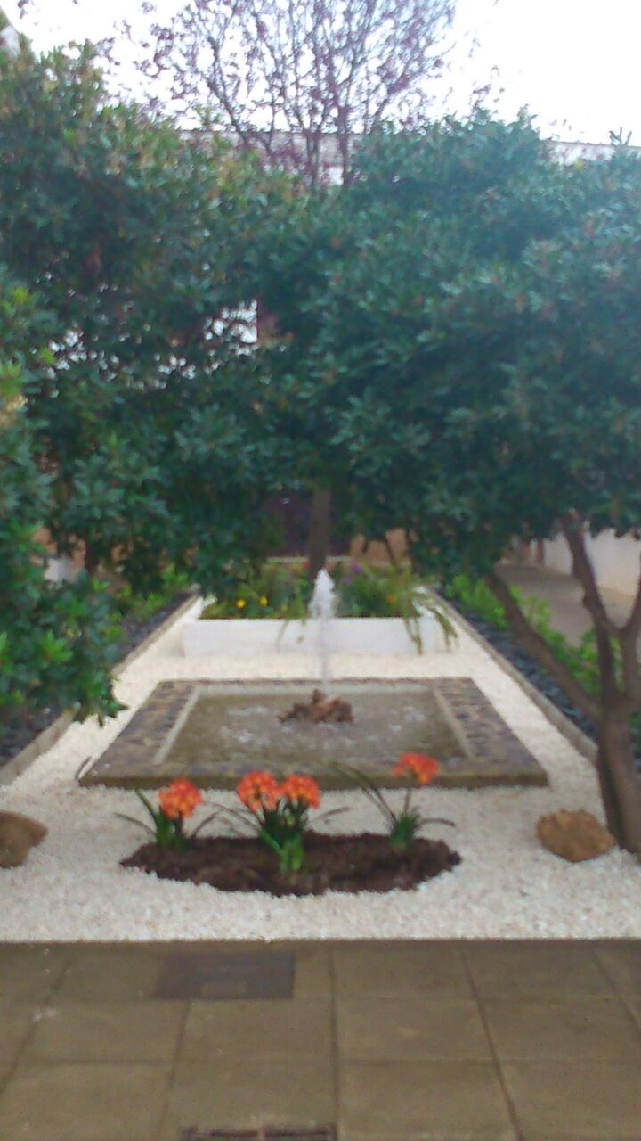
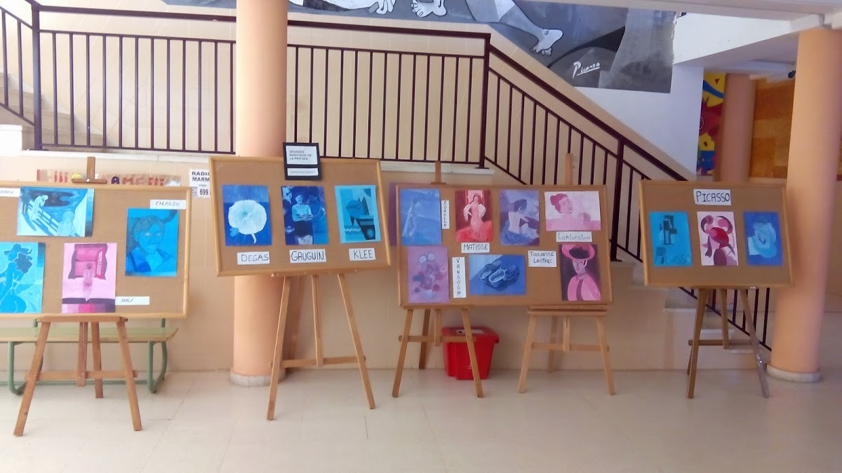
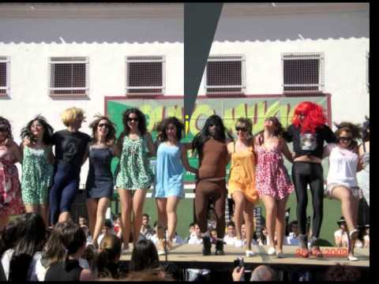
Our school is specialized in compulsory secondary education (ESO), post-compulsory secondary education and vocational education and training (specifically agriculture, forestry and gardening).

