Slide 1
The Slovaks – migration

Slide 2
The history of Slovakia would not be complete without talking about migration of people and exile.
Nowadays, there are about 2,8 mil of foreign Slovaks living in the world.

Slide 3
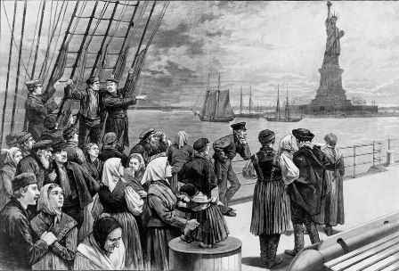
Reasons why people left their homes
In general there are 2 main reasons:
Economical crisis, bad social conditions for life.
Political reasons.

Slide 4
19th century – almost one third of the nation left their homes due to economic crisis and famine.
For most of them, The USA was their aim.
The wave of emigration reached its top by the beginning of the World War I – 600 thousand Slovaks had left by then.

Slide 5
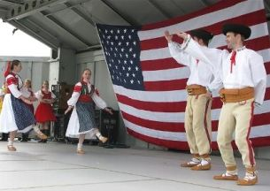
People settled in industrial parts of the States – New York, New Jersey, Ohio, Pennsylvania.
Most of them were farmers and workmen who did not have job at home.

Slide 6
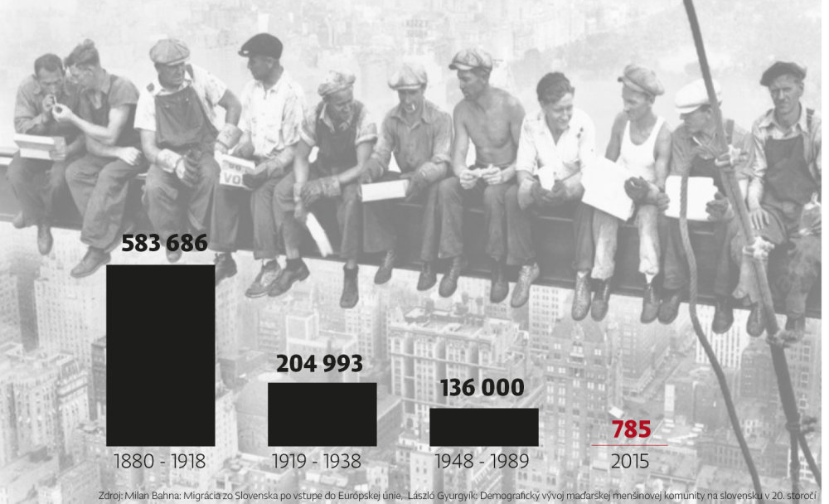
Emigration in numbers

Slide 7
After the WW I another emigration wave came due to bad – afterwar – social conditions in the country.
After the WW II – changes in political system forced people to leave
- Significant years – 1948, 1968 – socialist regime, the influence of The Soviet Union

Slide 8
The Slovaks in the world
The USA – cca 1,2 mil,
Canada – cca 100 000,
South America (Argentina, Brazil) – cca 50 000,
Autralia, New Zealand – 12 000,
Germany – 25 000,
Austria – 25 000,
France – 13 000,
Great Britain – 90 000,
Hungary, Romania, Czech Republic

Slide 10
Foreign words in Slovak language
German
Slovak
Ziel
Zwiebel
Zucker
Farbe
Küche
Maus
Papier
cieľ
cibuľa
cukor
farba
kuchyňa
myš
papier

Slide 11
Foreign words in Slovak language
Hungarian
Slovak
kocsi
paprikás
szilva
cseresznye
medve
koč
paprikáš
slivka
čerešňa
medveď

Slide 12
Foreign words in Slovak language
English
Slovak
club
weekend
team
hockey
klub
víkend
tím
hokej

Slide 13
Foreign words in Slovak language
French
Slovak
mode
poudre
ballet
reportage
móda
púder
balet
reportáž

Slide 14
Thank you for your attention

