Slide 1
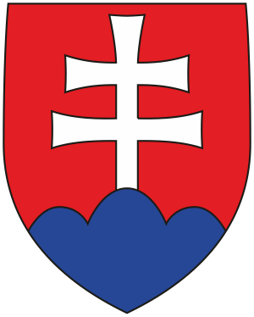
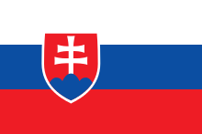
The Slovak Republic

Slide 2
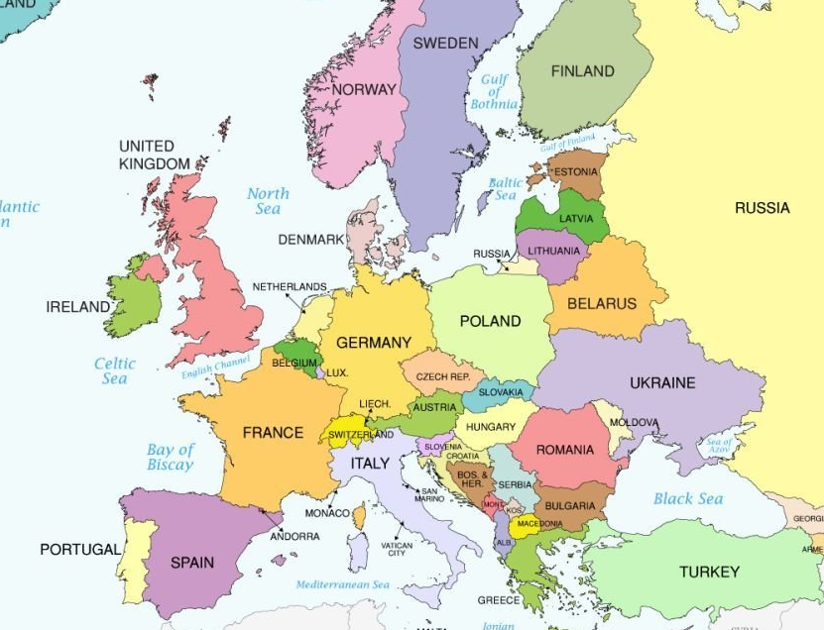
Central europe
Neighbouring countries

Slide 3
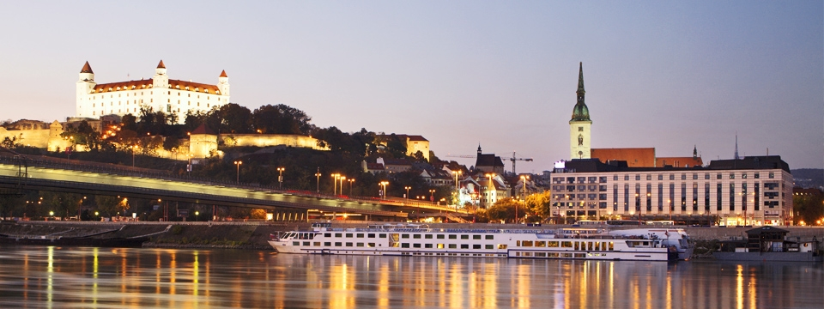
Basic facts about Slovakia
Capital city: Bratislava, the city on the river Danube

Slide 4
Basic facts about Slovakia
Population: 5 415 949 (2014)
Official language: Slovak
Political system: parliamentary republic
Member of EU: since 2004

Slide 5
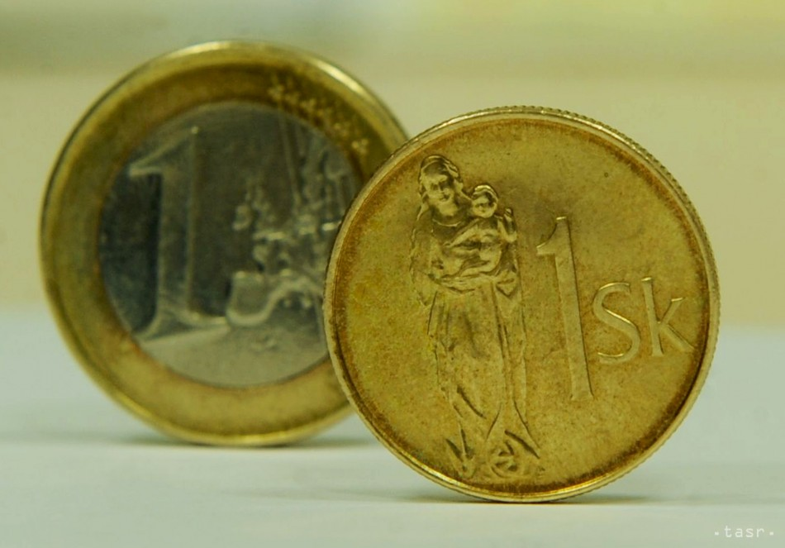
Basic facts about Slovakia
Currency: Euro since January 2009
Before Euro: slovak crown
1 Euro = 30,162 SK

Slide 6
Briefly from the history of Slovakia
Slovakia in its history was not always an independent country
1918: Slovakia and the regions of Bohemia, Moravia and Silesia formed a common state called Czechoslovakia
1939 – 1945: The Slovak State

Slide 7
After World War II Czechoslovakia came under the influence of the Soviet Union,
the country was occupied by the Warsaw pact forces in 1968,
it was the end of liberalization period,
1969 Czechoslovakia became a federation of the Czech Socialist Republic and the Slovak Socialist Republic.

Slide 8
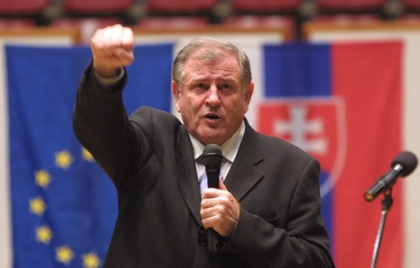
Establishment of the Slovak Republic
1989: the end of Communist rule in Czechoslovakia during the peaceful Velvet Revolution, was followed once again by the country's dissolution,
1992: Slovakia, led by Prime Minister Vladimír Mečiar, declared itself a sovereign state, meaning that its laws took precedence over those of the federal government.
1 January 1993: The Slovak Republic and the Czech Republic went their separate ways after.

Slide 9
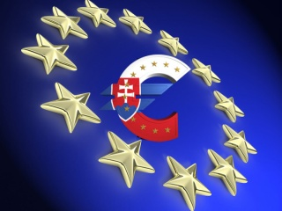
Nowadays
Slovakia became a member of NATO on 29 March 2004 and of the European Union on 1 May 2004
On 1 January 2009, Slovakia adopted the Euro as its national currency

Slide 10
Thank you for your attention Marcela Sabovčíková, A. Andrejovová, N. Markovičová 3.D

