Slide 1
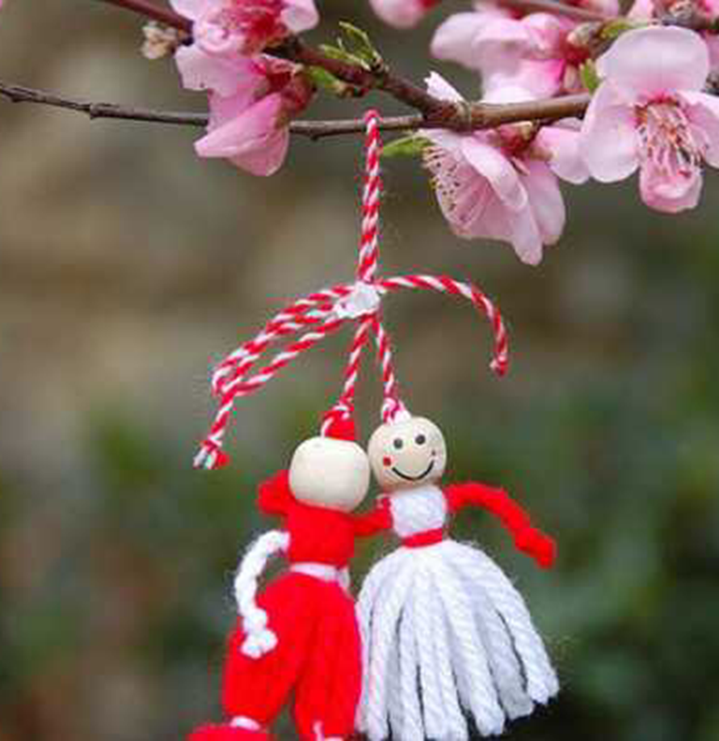
1st of March MĂRȚIȘOR
Presentation made by:
Mircea Roxana
Denisiuc Bianca

Slide 2
Mărțișor is a Romanian celebration marking the beginning of spring, on March the 1st.
The word Mărțișor is the diminutive of Marț, the old folk name for March (martie, in modern Romanian), and thus, it literally means "little March".

Slide 3
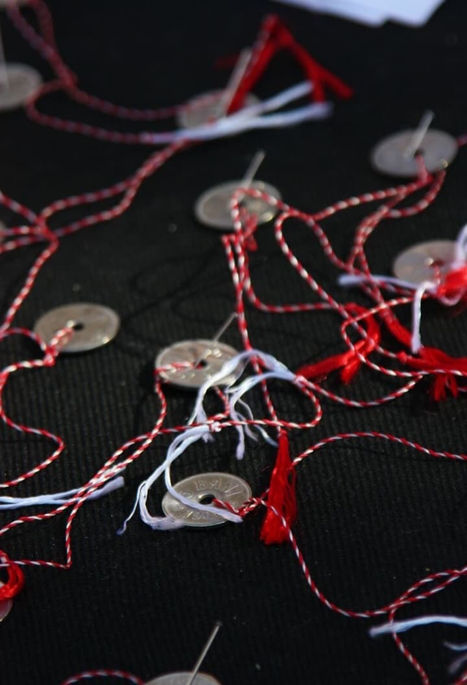
Mărțișor, marț and mărțiguș are all names for the red and white string with hanging tassel customarily given on the 1st day of March. Giving this talisman to the people is an old Romanian custom. It is believed that the wearer will be strong and healthy for the year to come. Women wear it pinned to their clothes, close to their hearts, until the last day of March, when they put it in a fruit-tree.
In some regions, a gold or silver coin hangs on the string and is worn around the neck. After wearing it for a certain length of time, they buy red wine and sweet cheese with the coin, according to a belief that their faces would remain beautiful and as white as cheese and rubicund as the wine, all year.

Slide 4
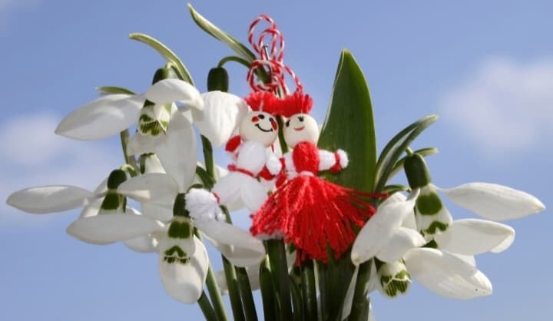
In modern times, and especially in urban areas, the Mărțișor lost most of its talisman properties and became more a symbol of friendship, love, appreciation and respect. The black threads were replaced by red, but the delicate wool string is still a ‘cottage industry’ among people in the countryside, who comb out the wool, dye the floss, and twist it into thousands of tassels. In some areas, the amulets are still made with black and white string, to ward off evil. Related to Martisor and also a symbol of spring in Romania is the snowdrop flower.

Slide 5
Superstitions
Before March 1st, women choose one of the first nine days of March; the weather on that day would predict how the year will be for them.
The first nine days of March are called Baba Dochia’s days – Baba Dochia is an image of the Great Earth Godess.

Slide 6
Initially, the "Mărțișor" string was called the Year's Rope (funia anului, in Romanian), made by black and white wool threads, representing the 365 days of the year. The Year's Rope was the link between summer and winter, black and white representing the opposition and the unity of opposites: light and dark, warm and cold, life and death. The Mărțișor is the thread of the days in the year, spun by Baba Dochia.

Slide 7
According to an ancient Roman tradition, the Ides of March was the perfect time to embark on military campaigns. In this context, it is believed that the red string of Mărțișor symbolises vitality, while white symbolises victory. Red is the colour of fire, blood, and a symbol of life, associated with the passion of women. Meanwhile, white is the colour of snow, clouds, and the wisdom of men. In this interpretation, the thread of a Mărțișor represents the union of the feminine and the masculine principles, the vital forces which give birth to the eternal cycle of the nature. Red and white are also complementary colours present in many key traditions of the Romanian folklore.

Slide 8
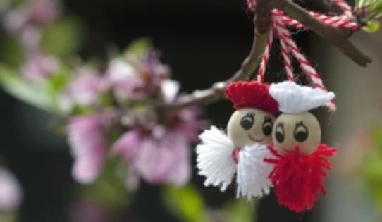
In the Romanian folklore, seasons are attributed symbolic colours: spring is red, summer is green or yellow, autumn is black and winter is white. That is why one can say that the Martisor thread, knitted in white and red, is a symbol of passing, from the cold white winter to the lively spring, associated with fire and life.

Slide 9
