Slide 1
THE MEDITERRANEAN FESTIVAL
eTwinng project
CFA Jacint Carrió i Vilaseca (Manresa)
GES2 afternoon group

Slide 2
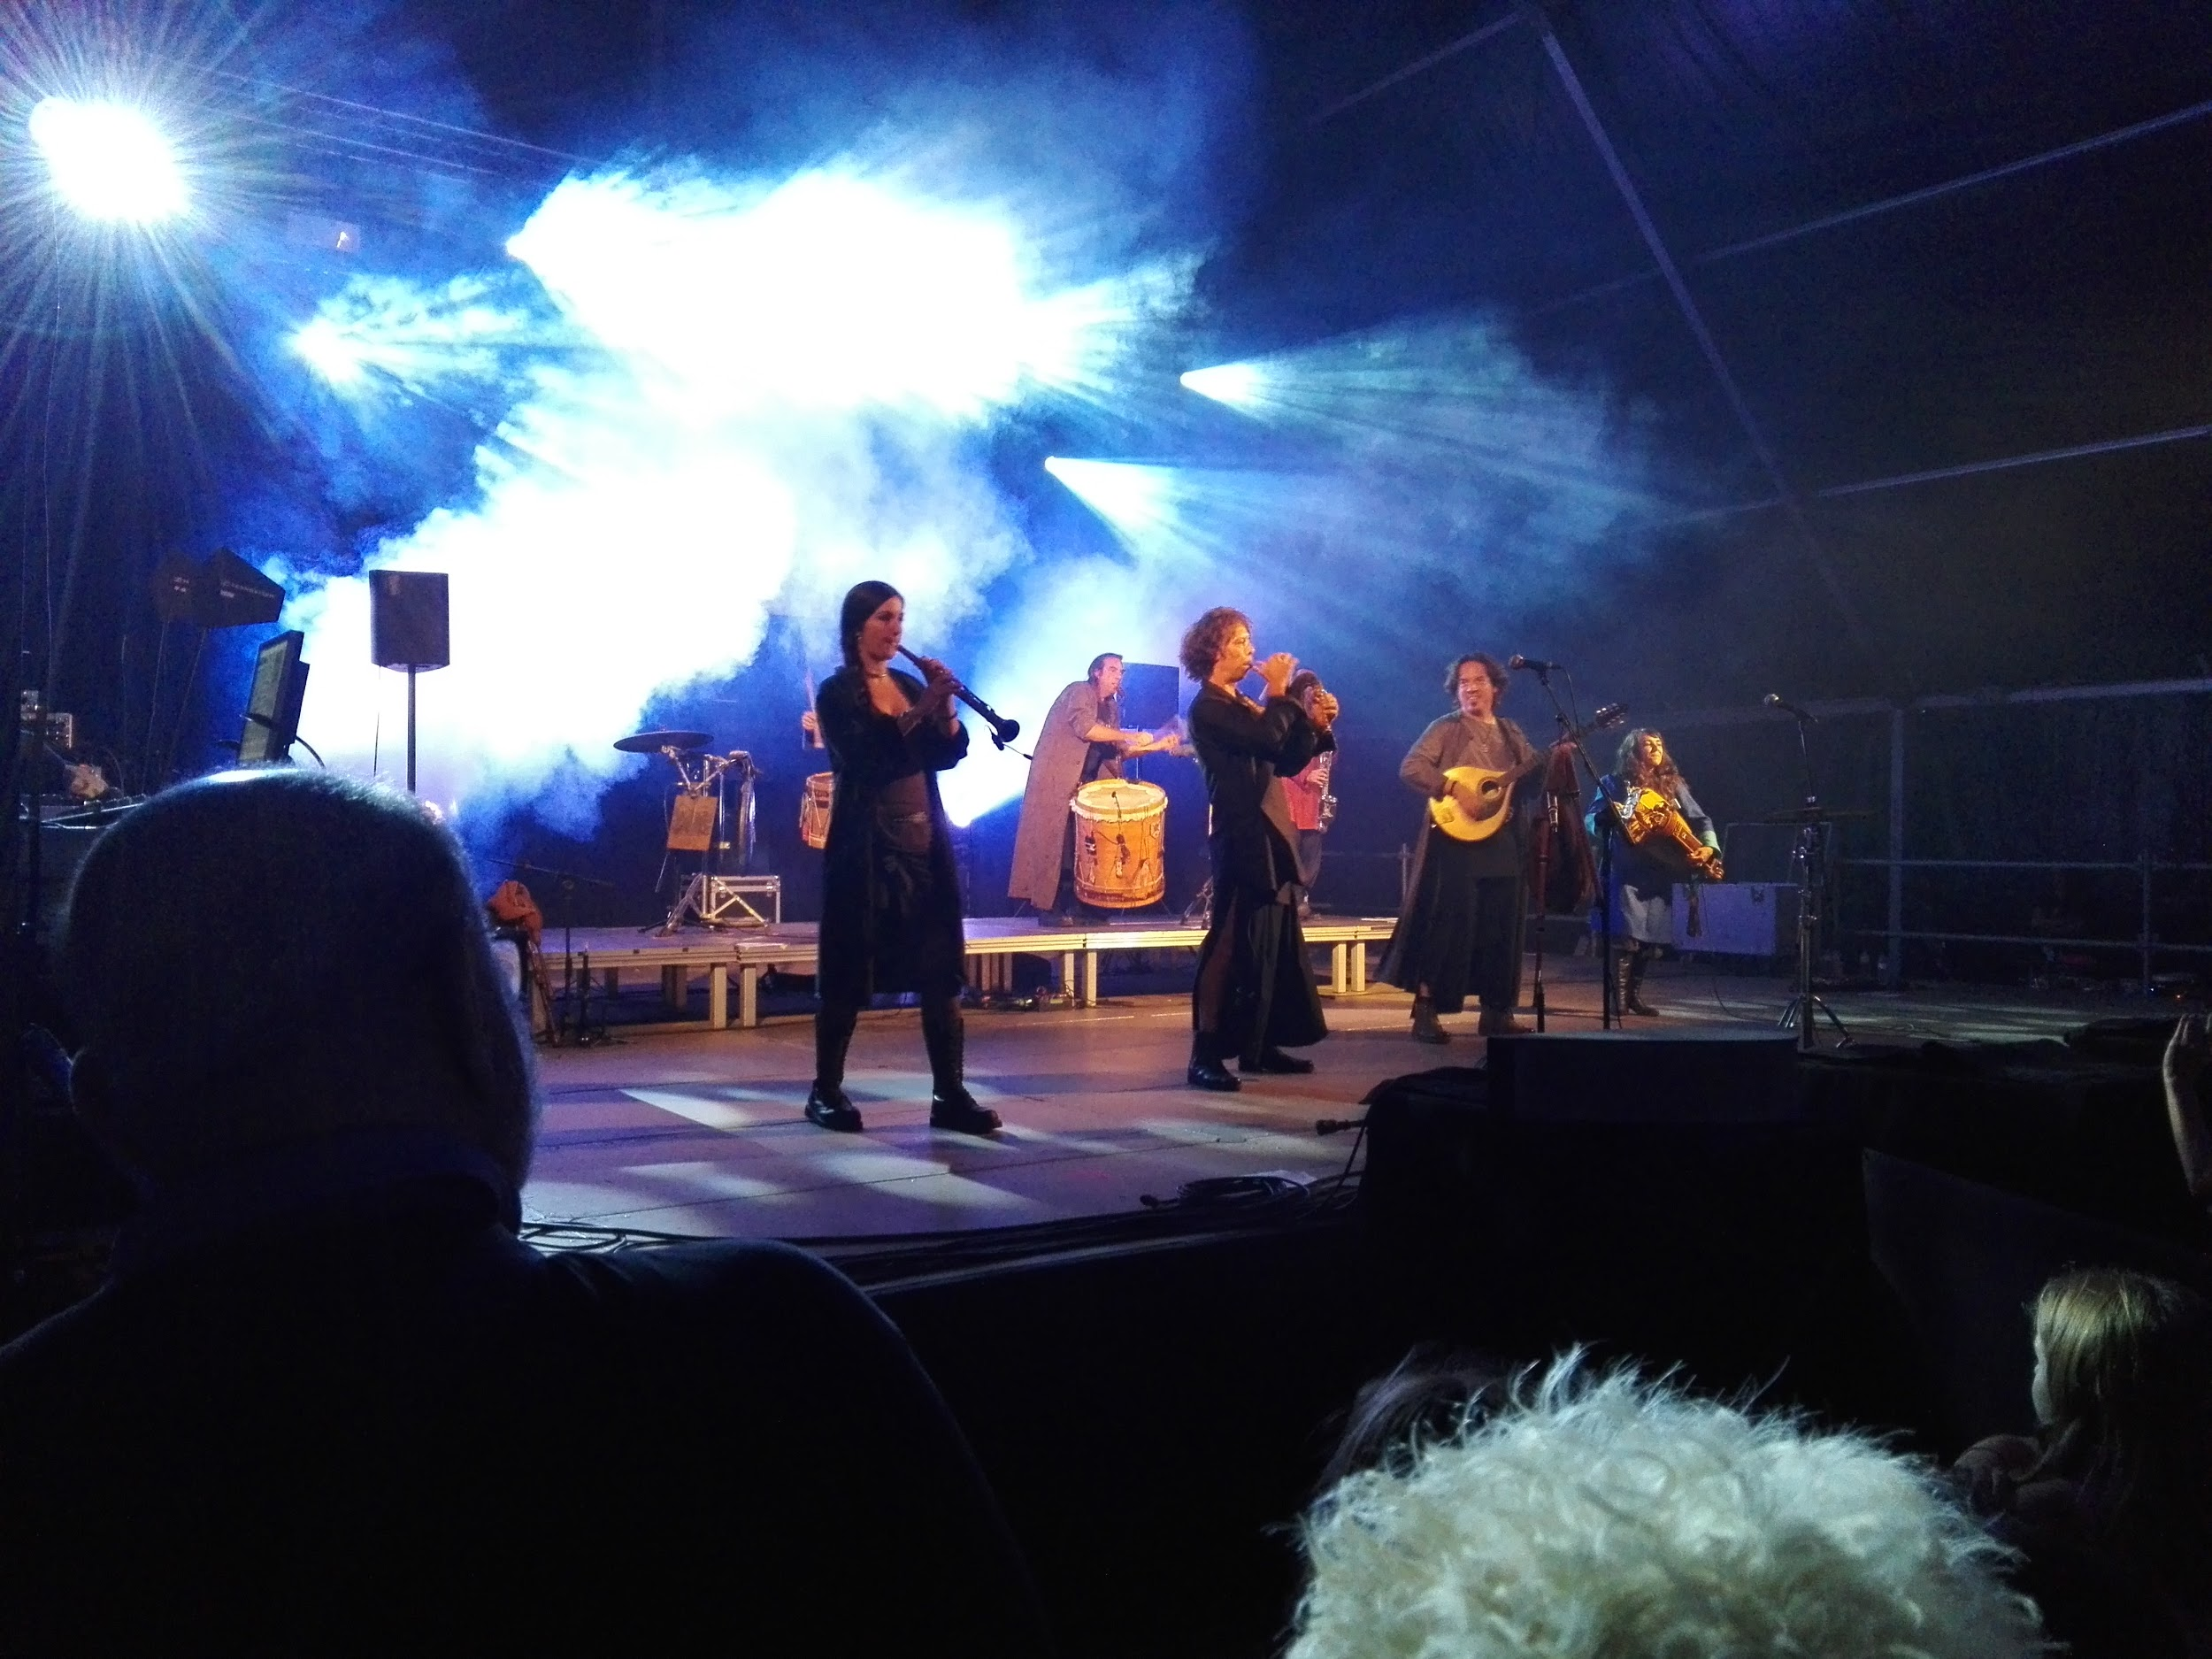
The Berro’s group from Catalonia.

Slide 3
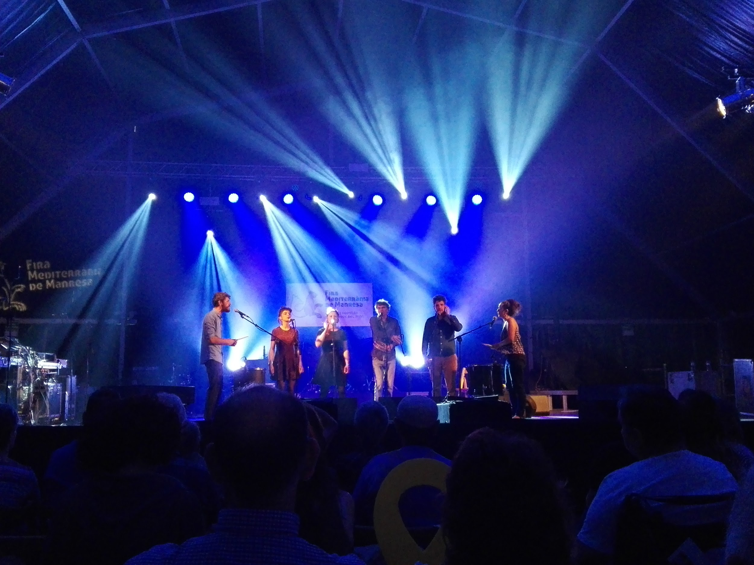
A French group singing folk songs in the Casino theatre

Slide 4
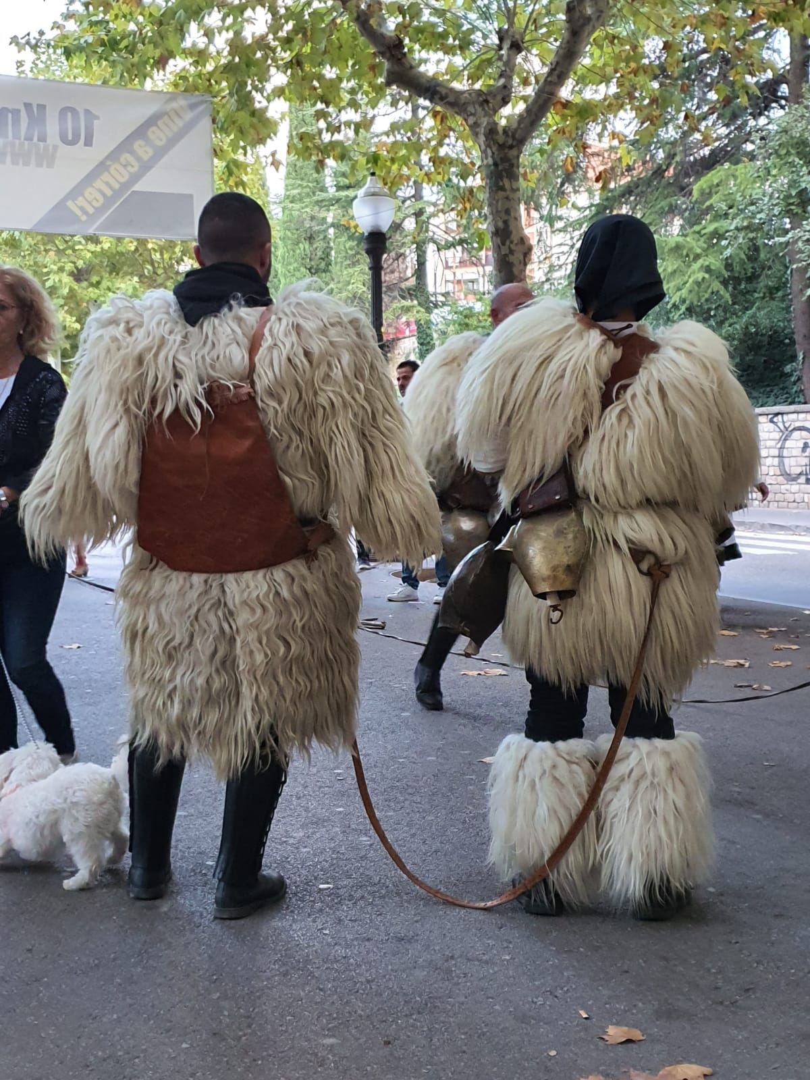
Carnevale Di Ottana ( a small village of Sardinia).

Slide 5
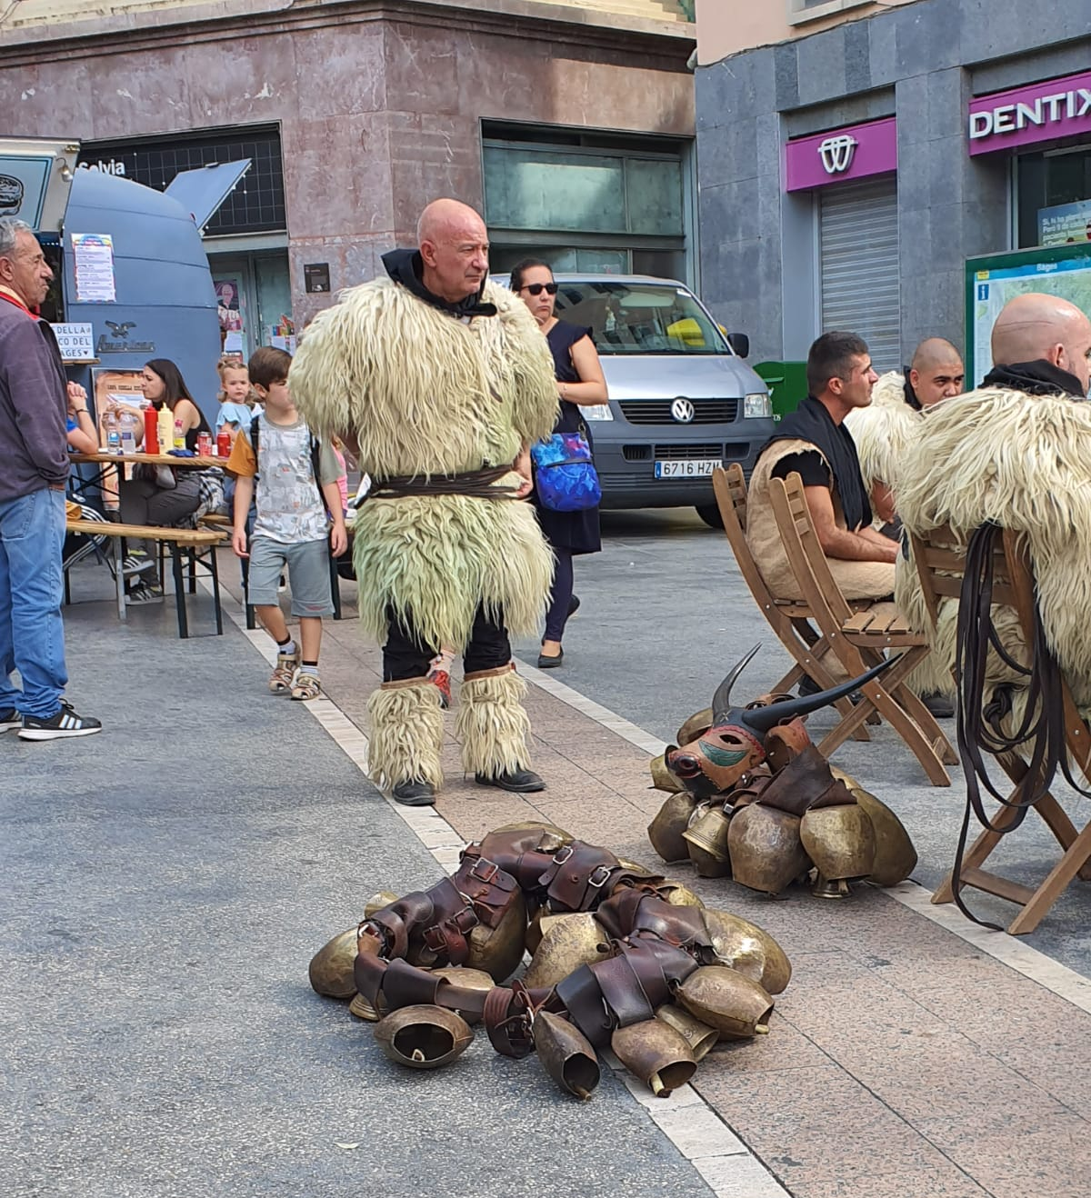
The bells of the group Carnevale Di Ottana.

Slide 6
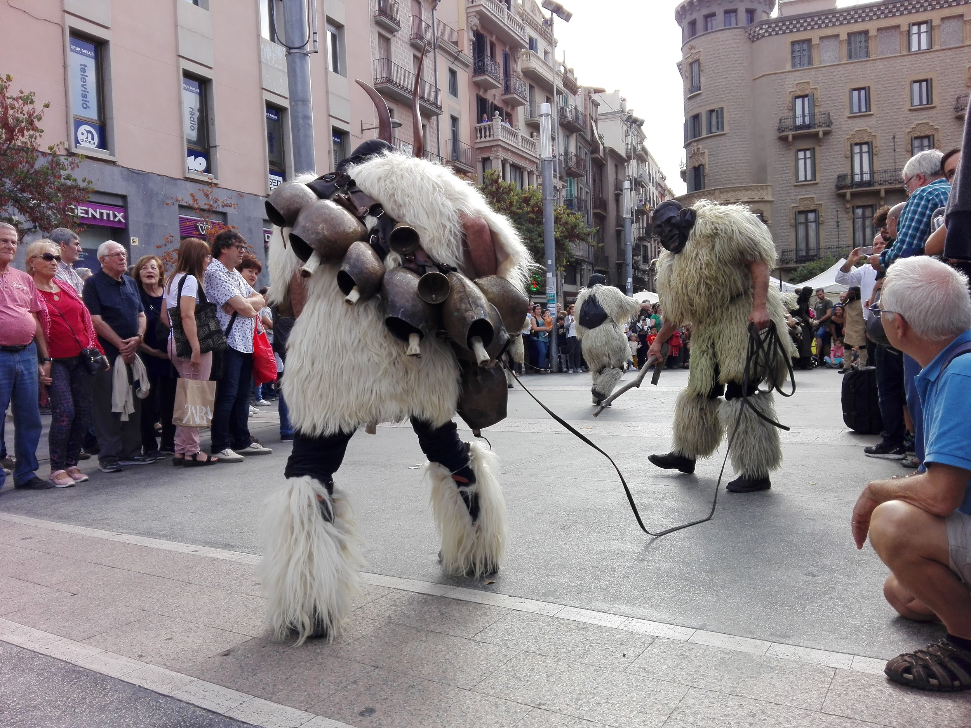
Two actors playing in Saint Domenec square

Slide 7
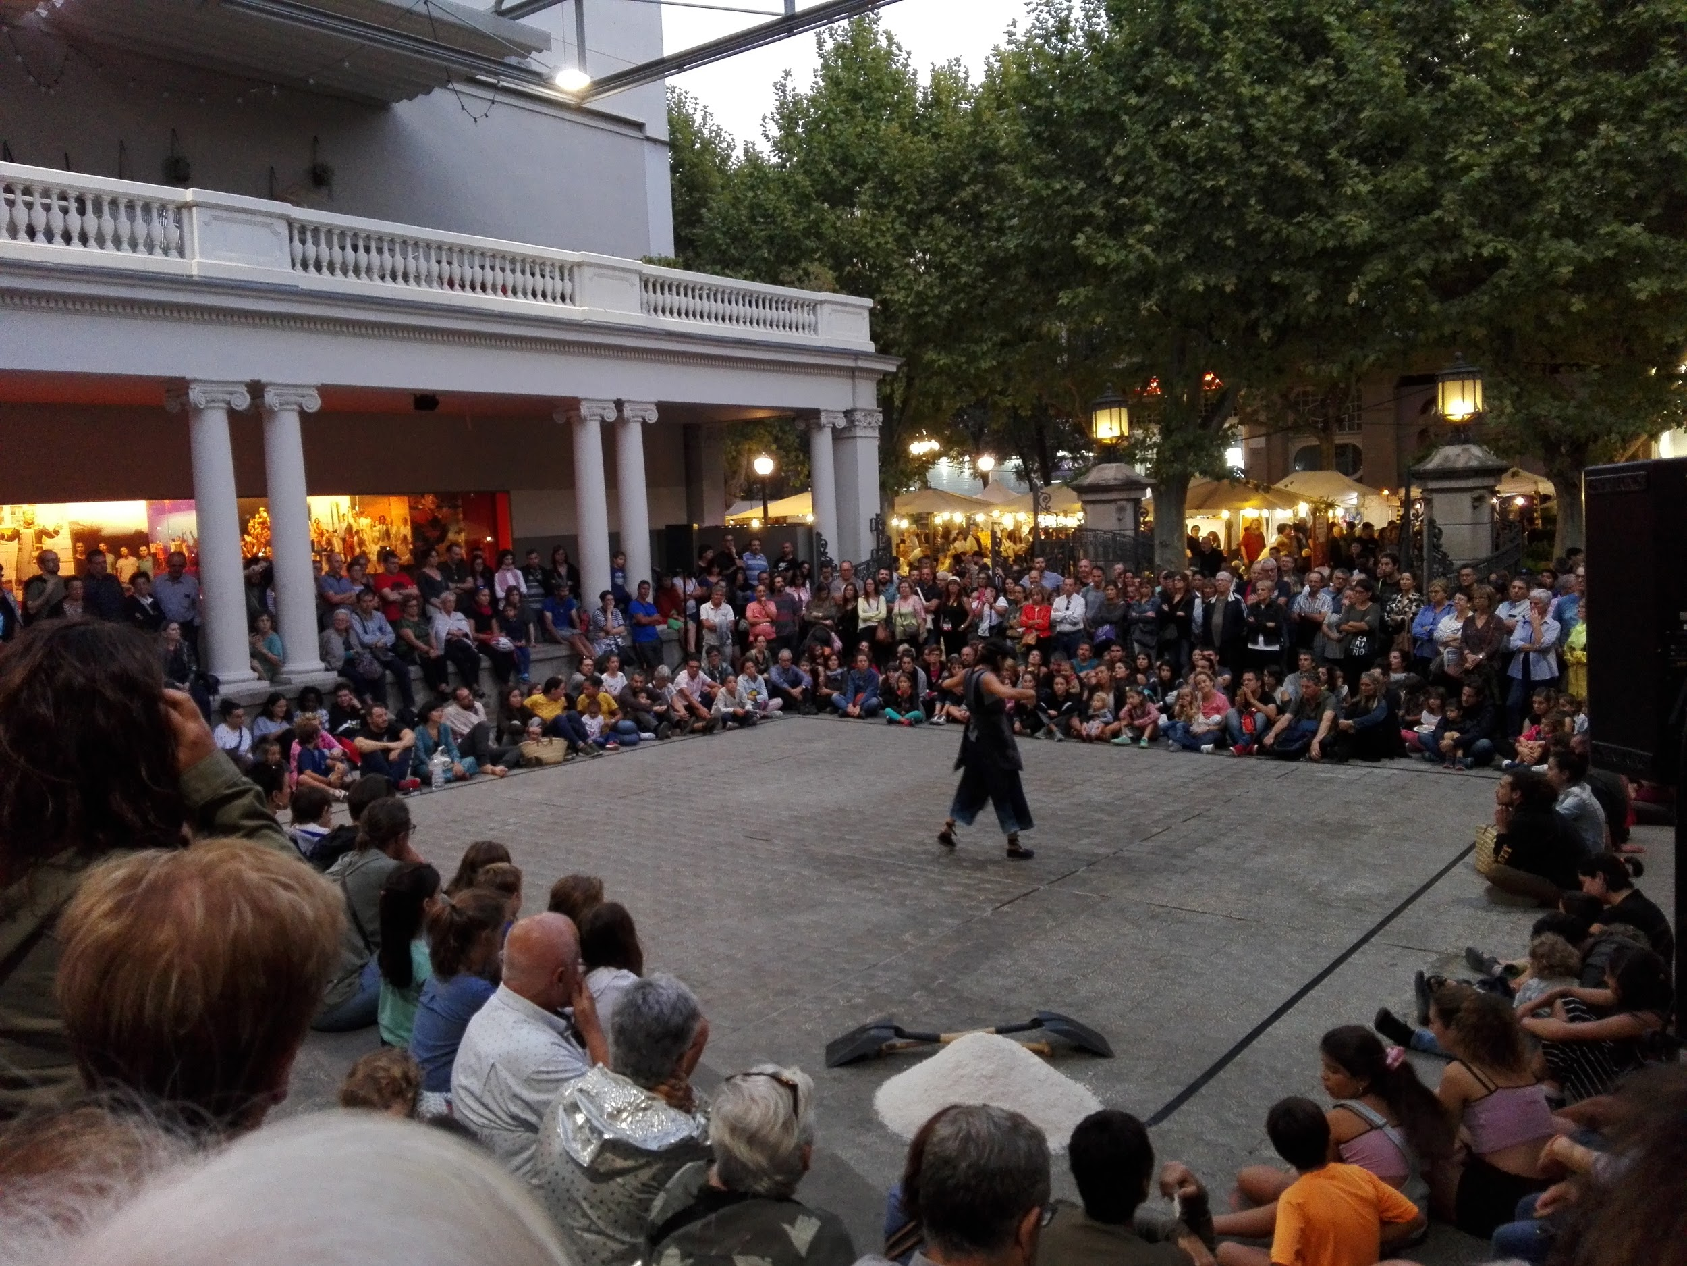
A modern dance in front of Kursaal theatre

Slide 8
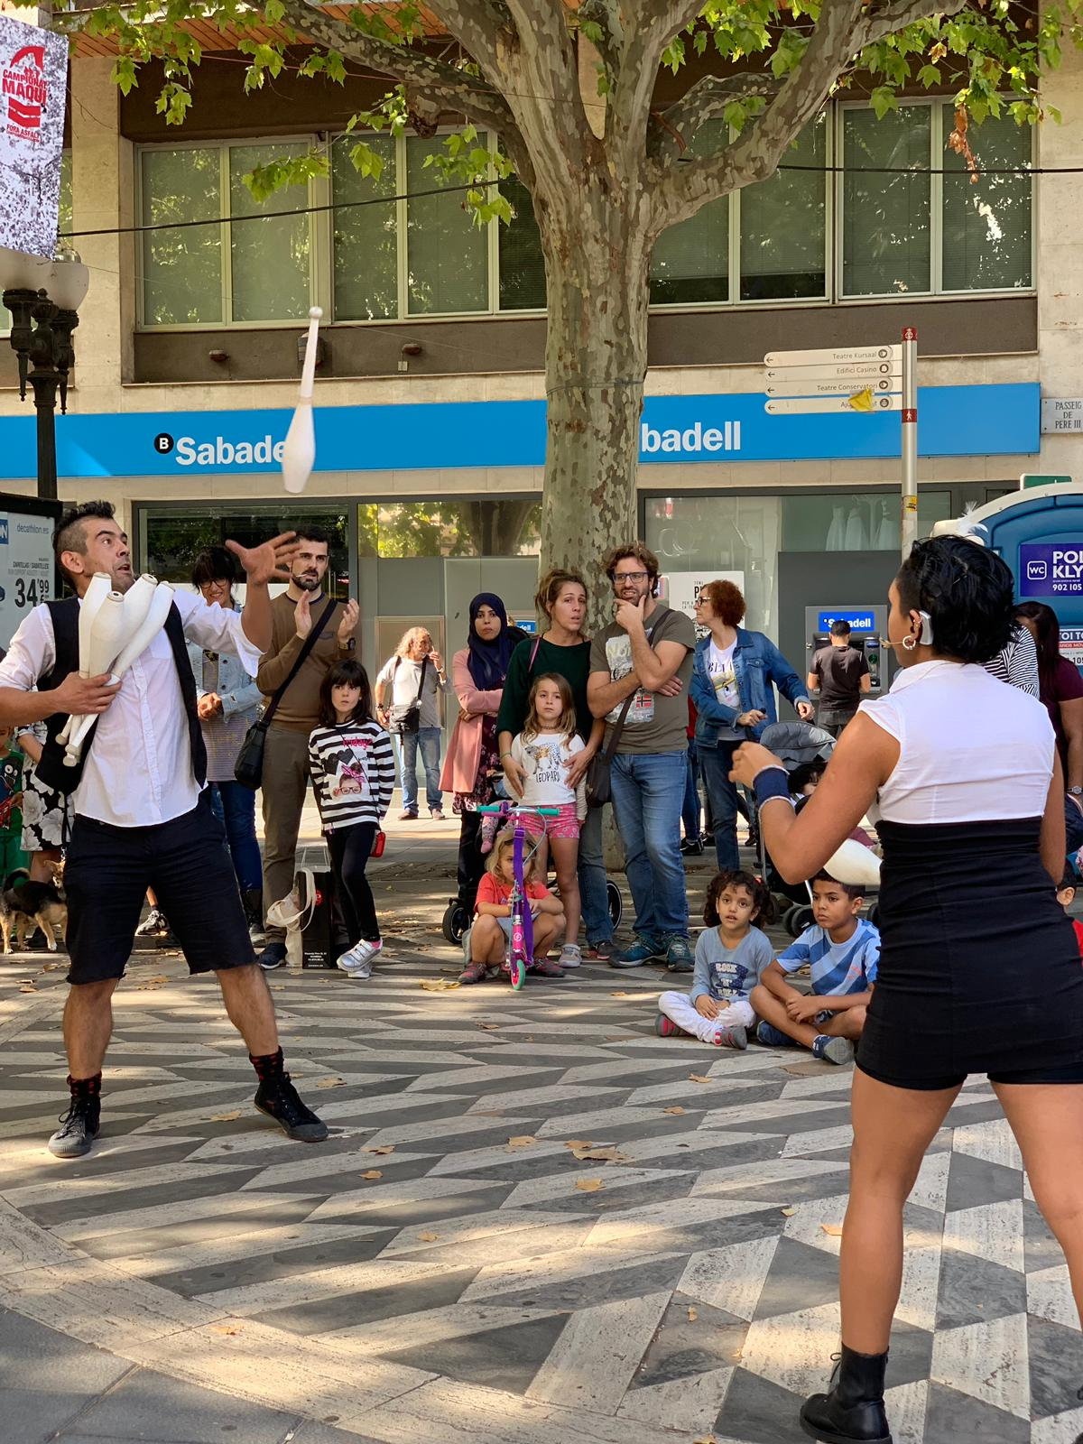
Man and woman playing street malabars.

Slide 9
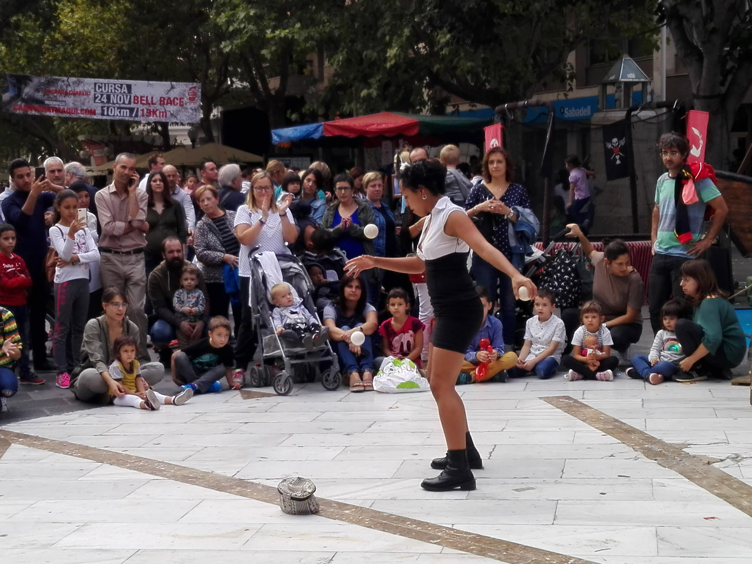
People watch street malabars in Crist Rei square.

Slide 10
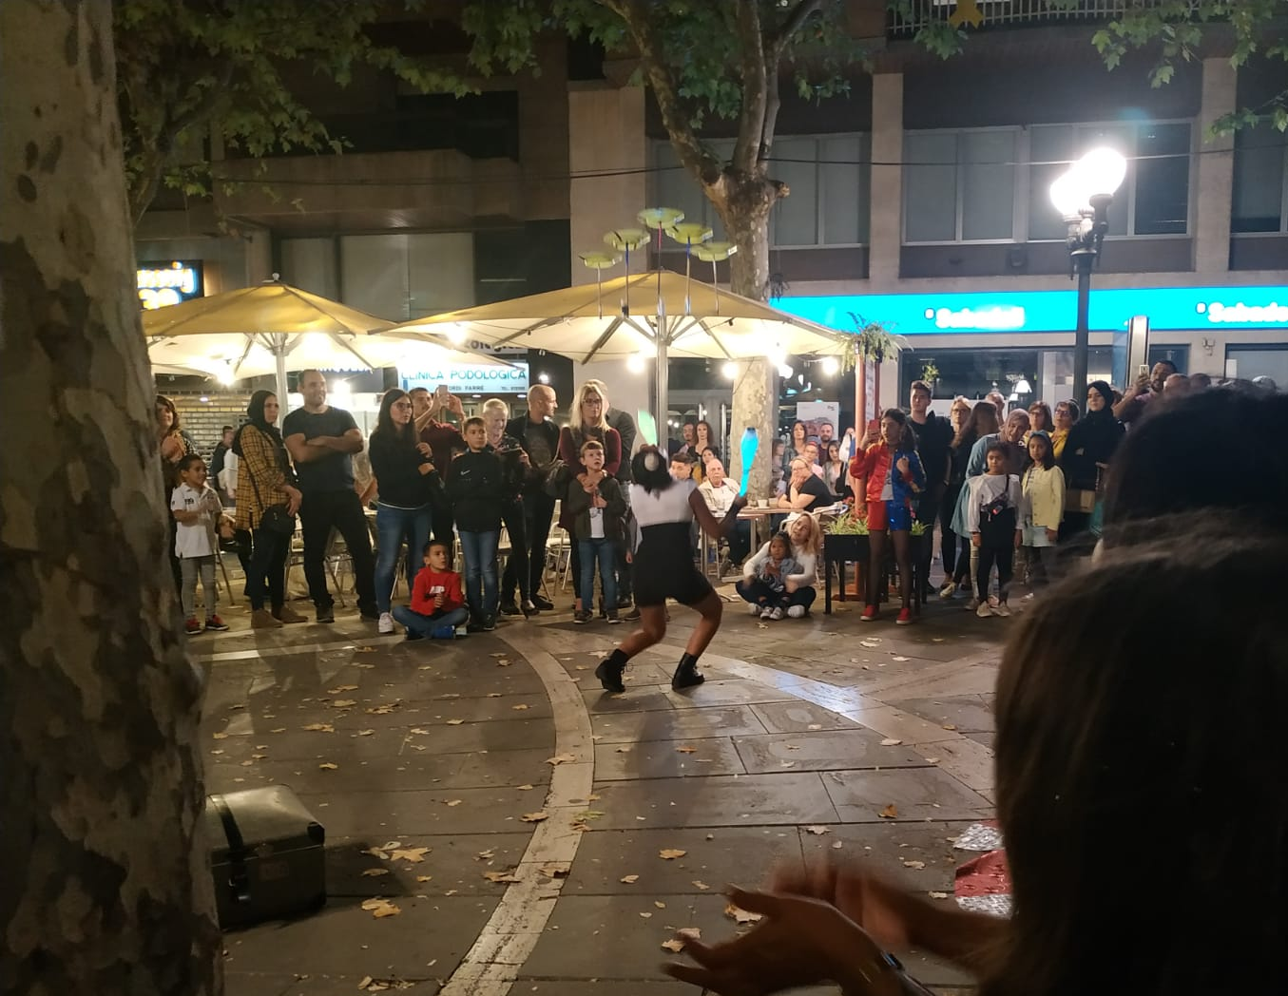
People have fun watching the play.

Slide 11
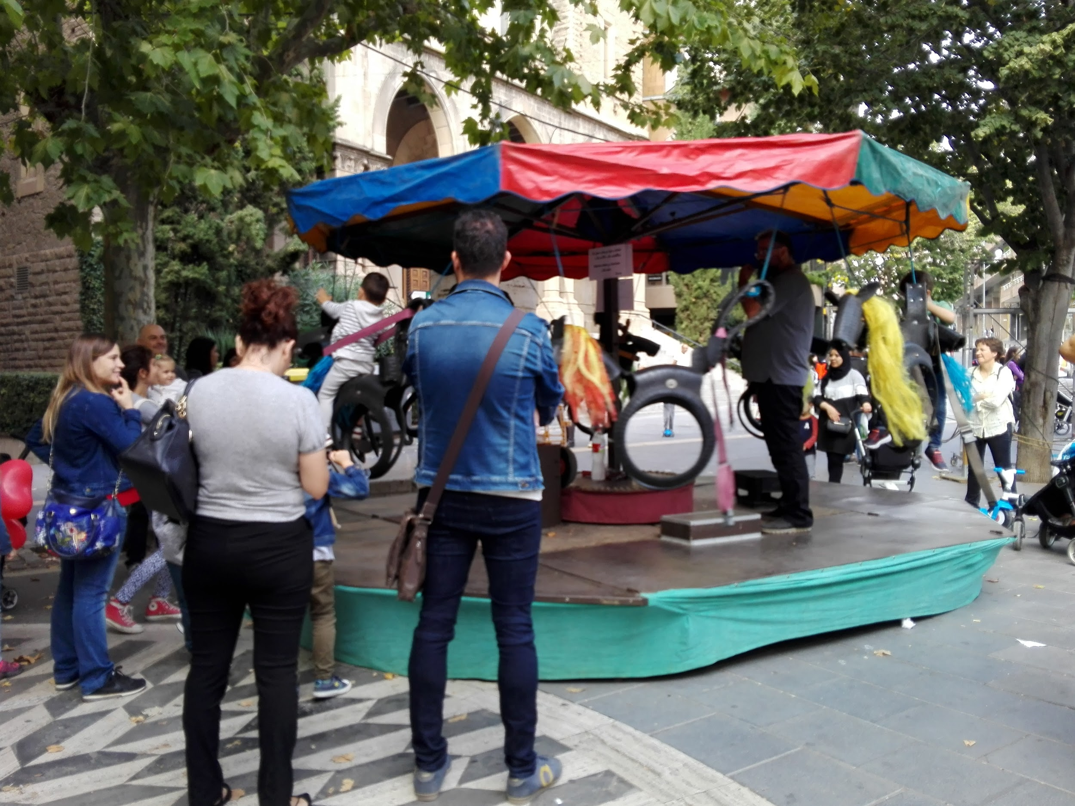
Children go on an old ride.

Slide 12
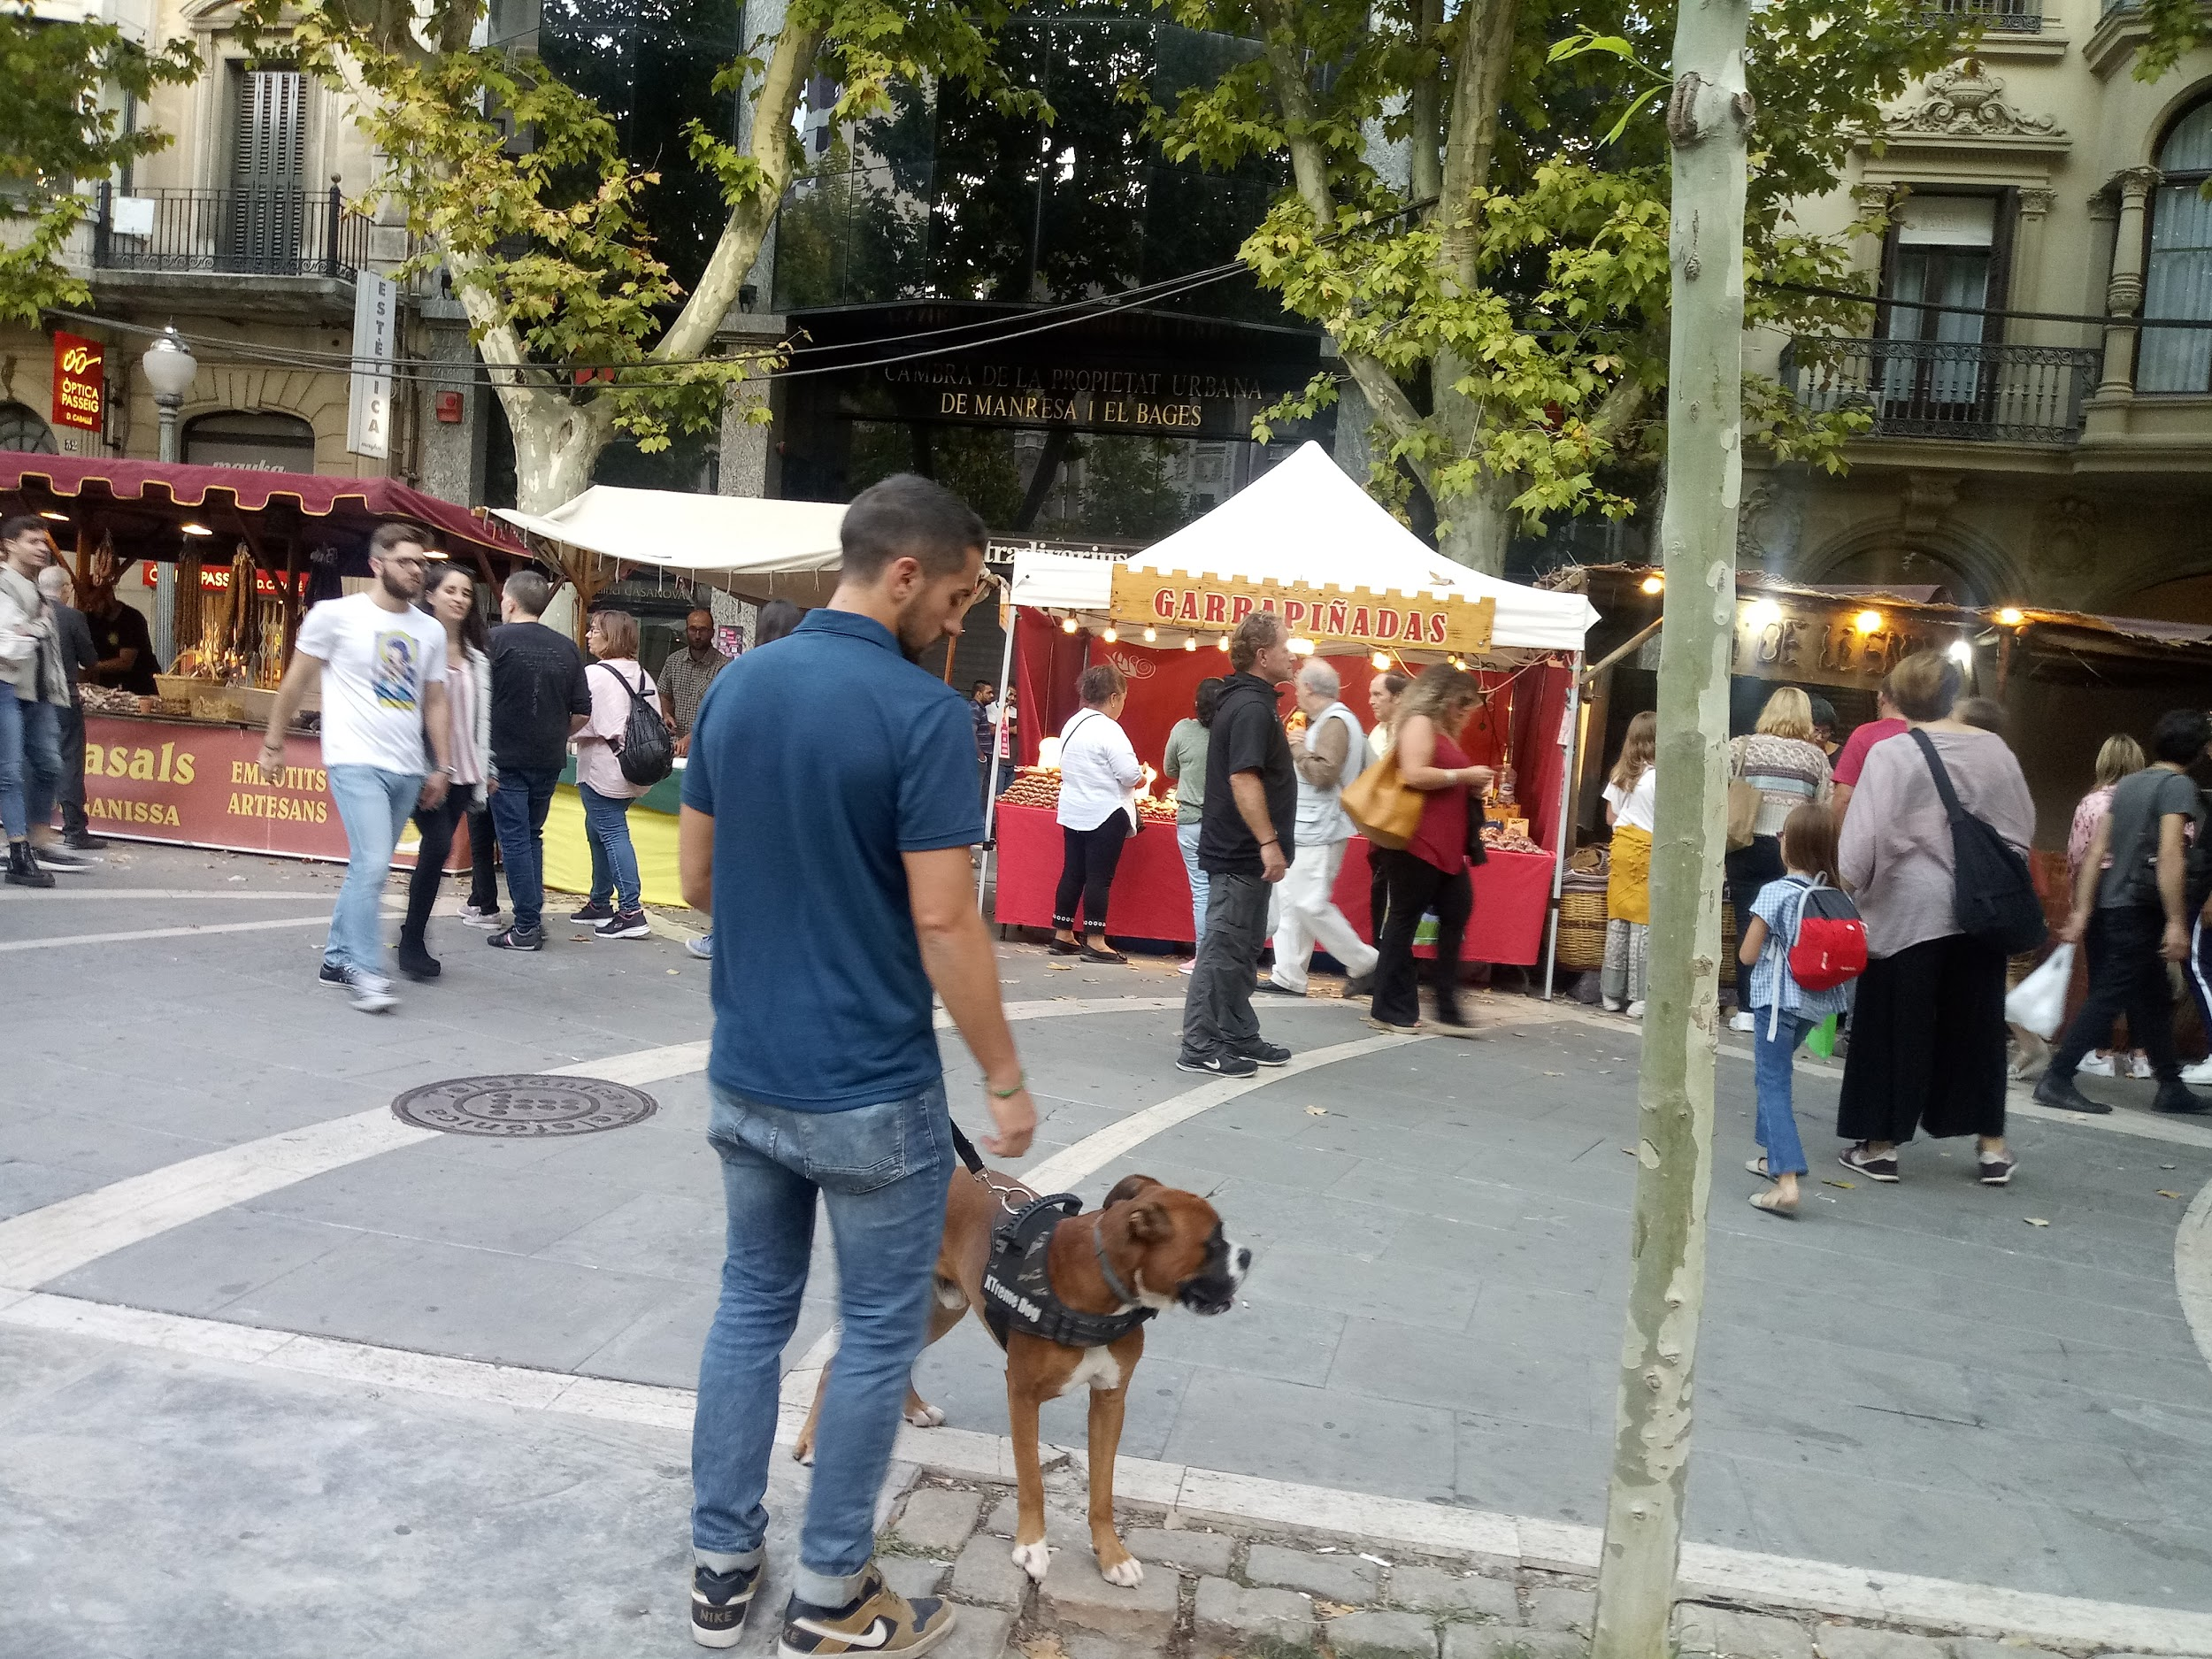
Pere III Boulevard

Slide 13
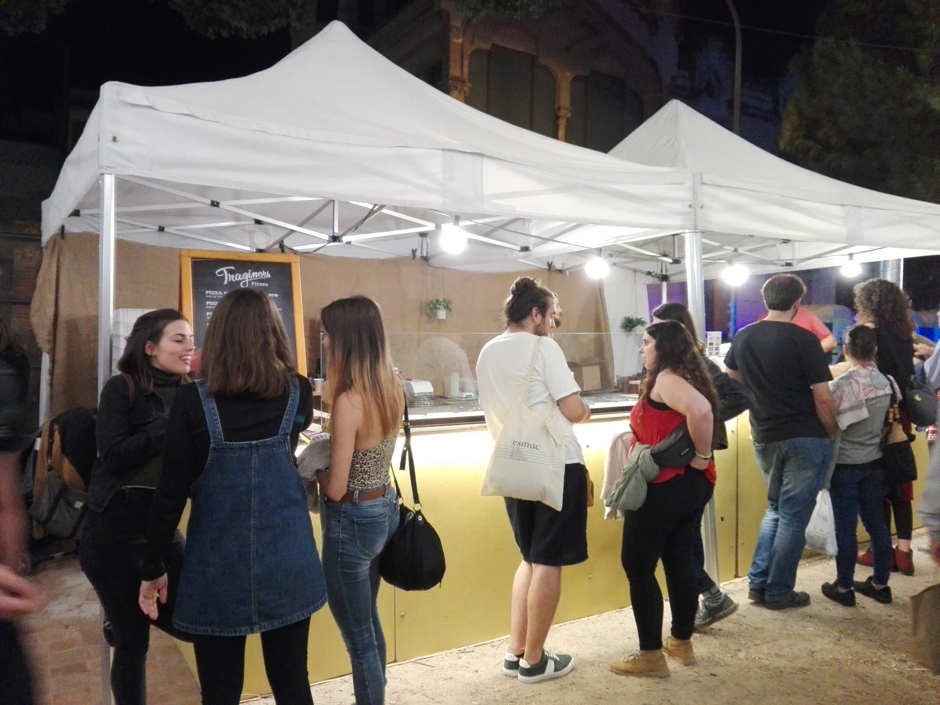
Food stalls

Slide 14
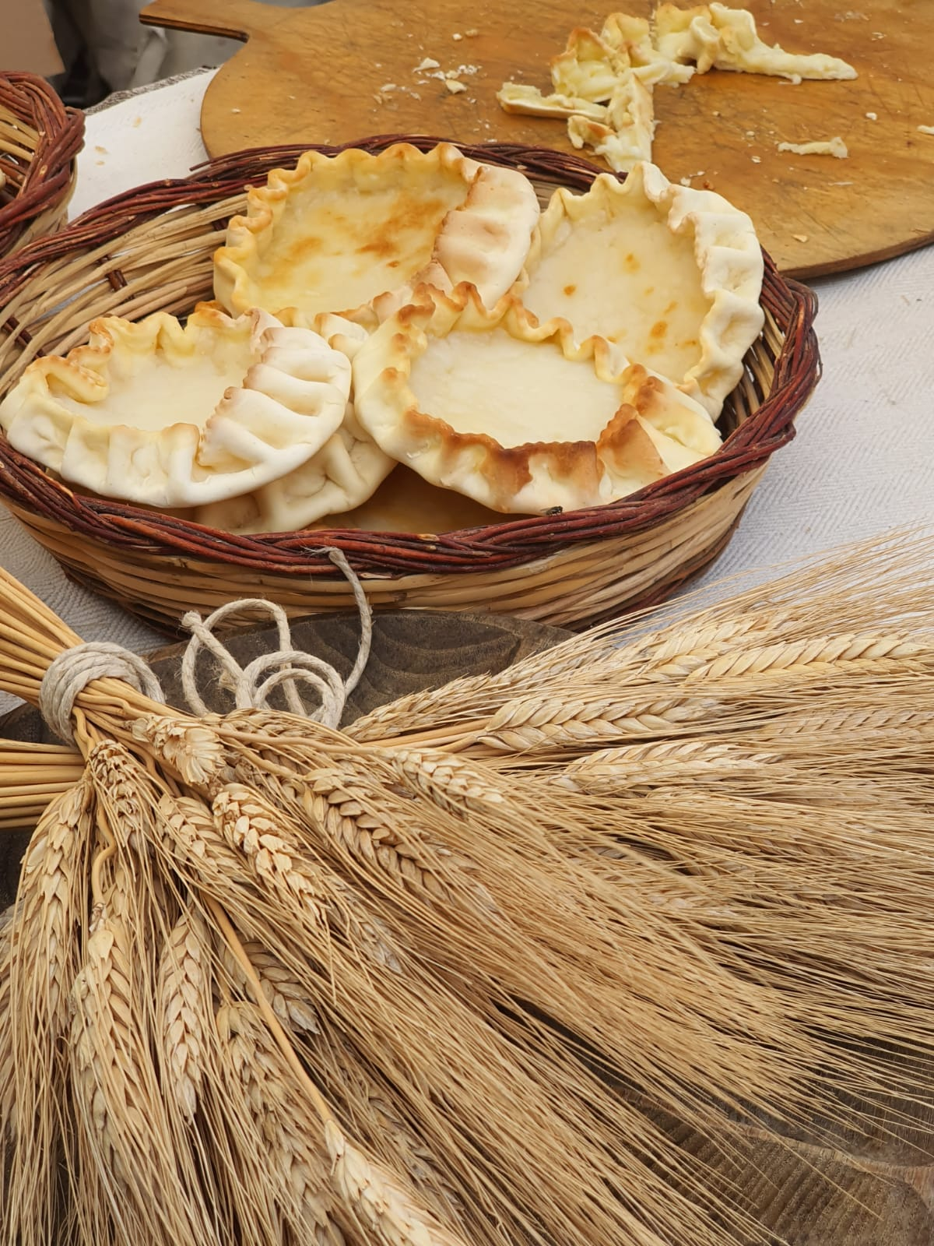
This is an Italian dessert.

Slide 15
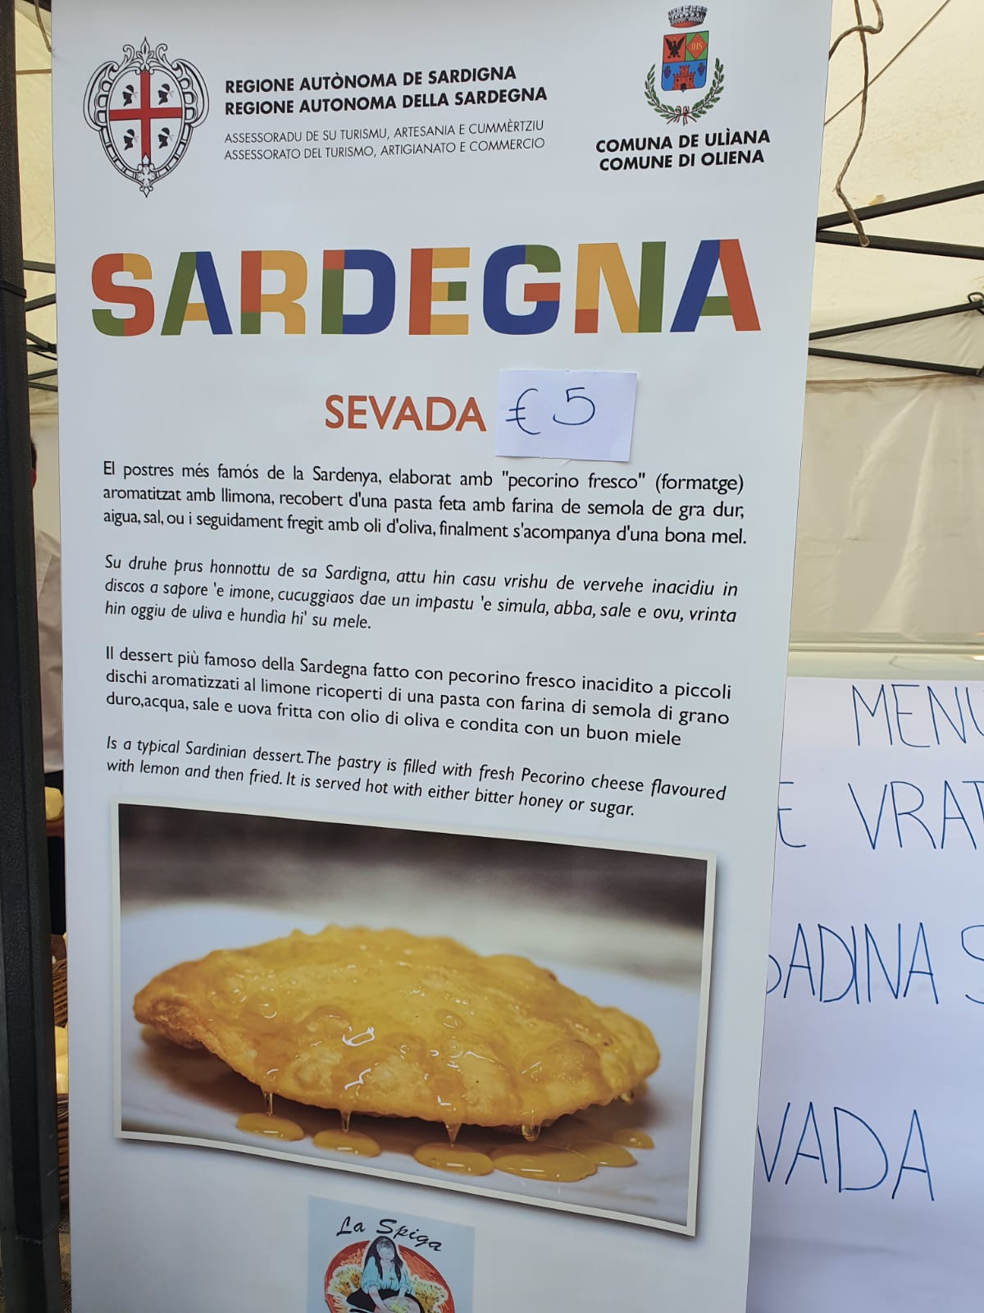
It’s a traditional food of Sardinia (Italy).

Slide 16
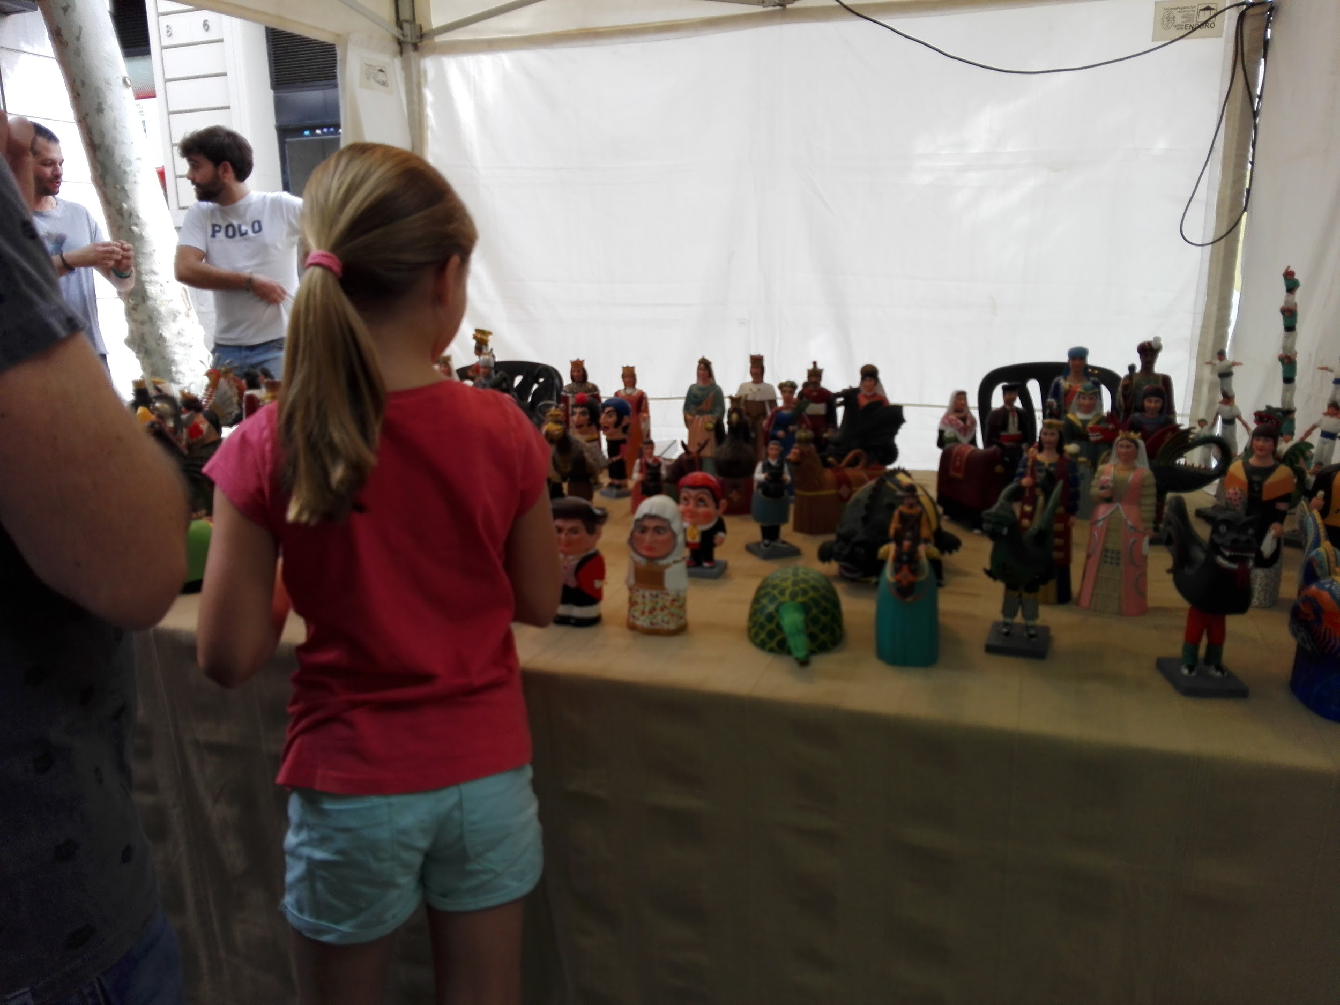
A girl watches handicrafts.

Slide 17
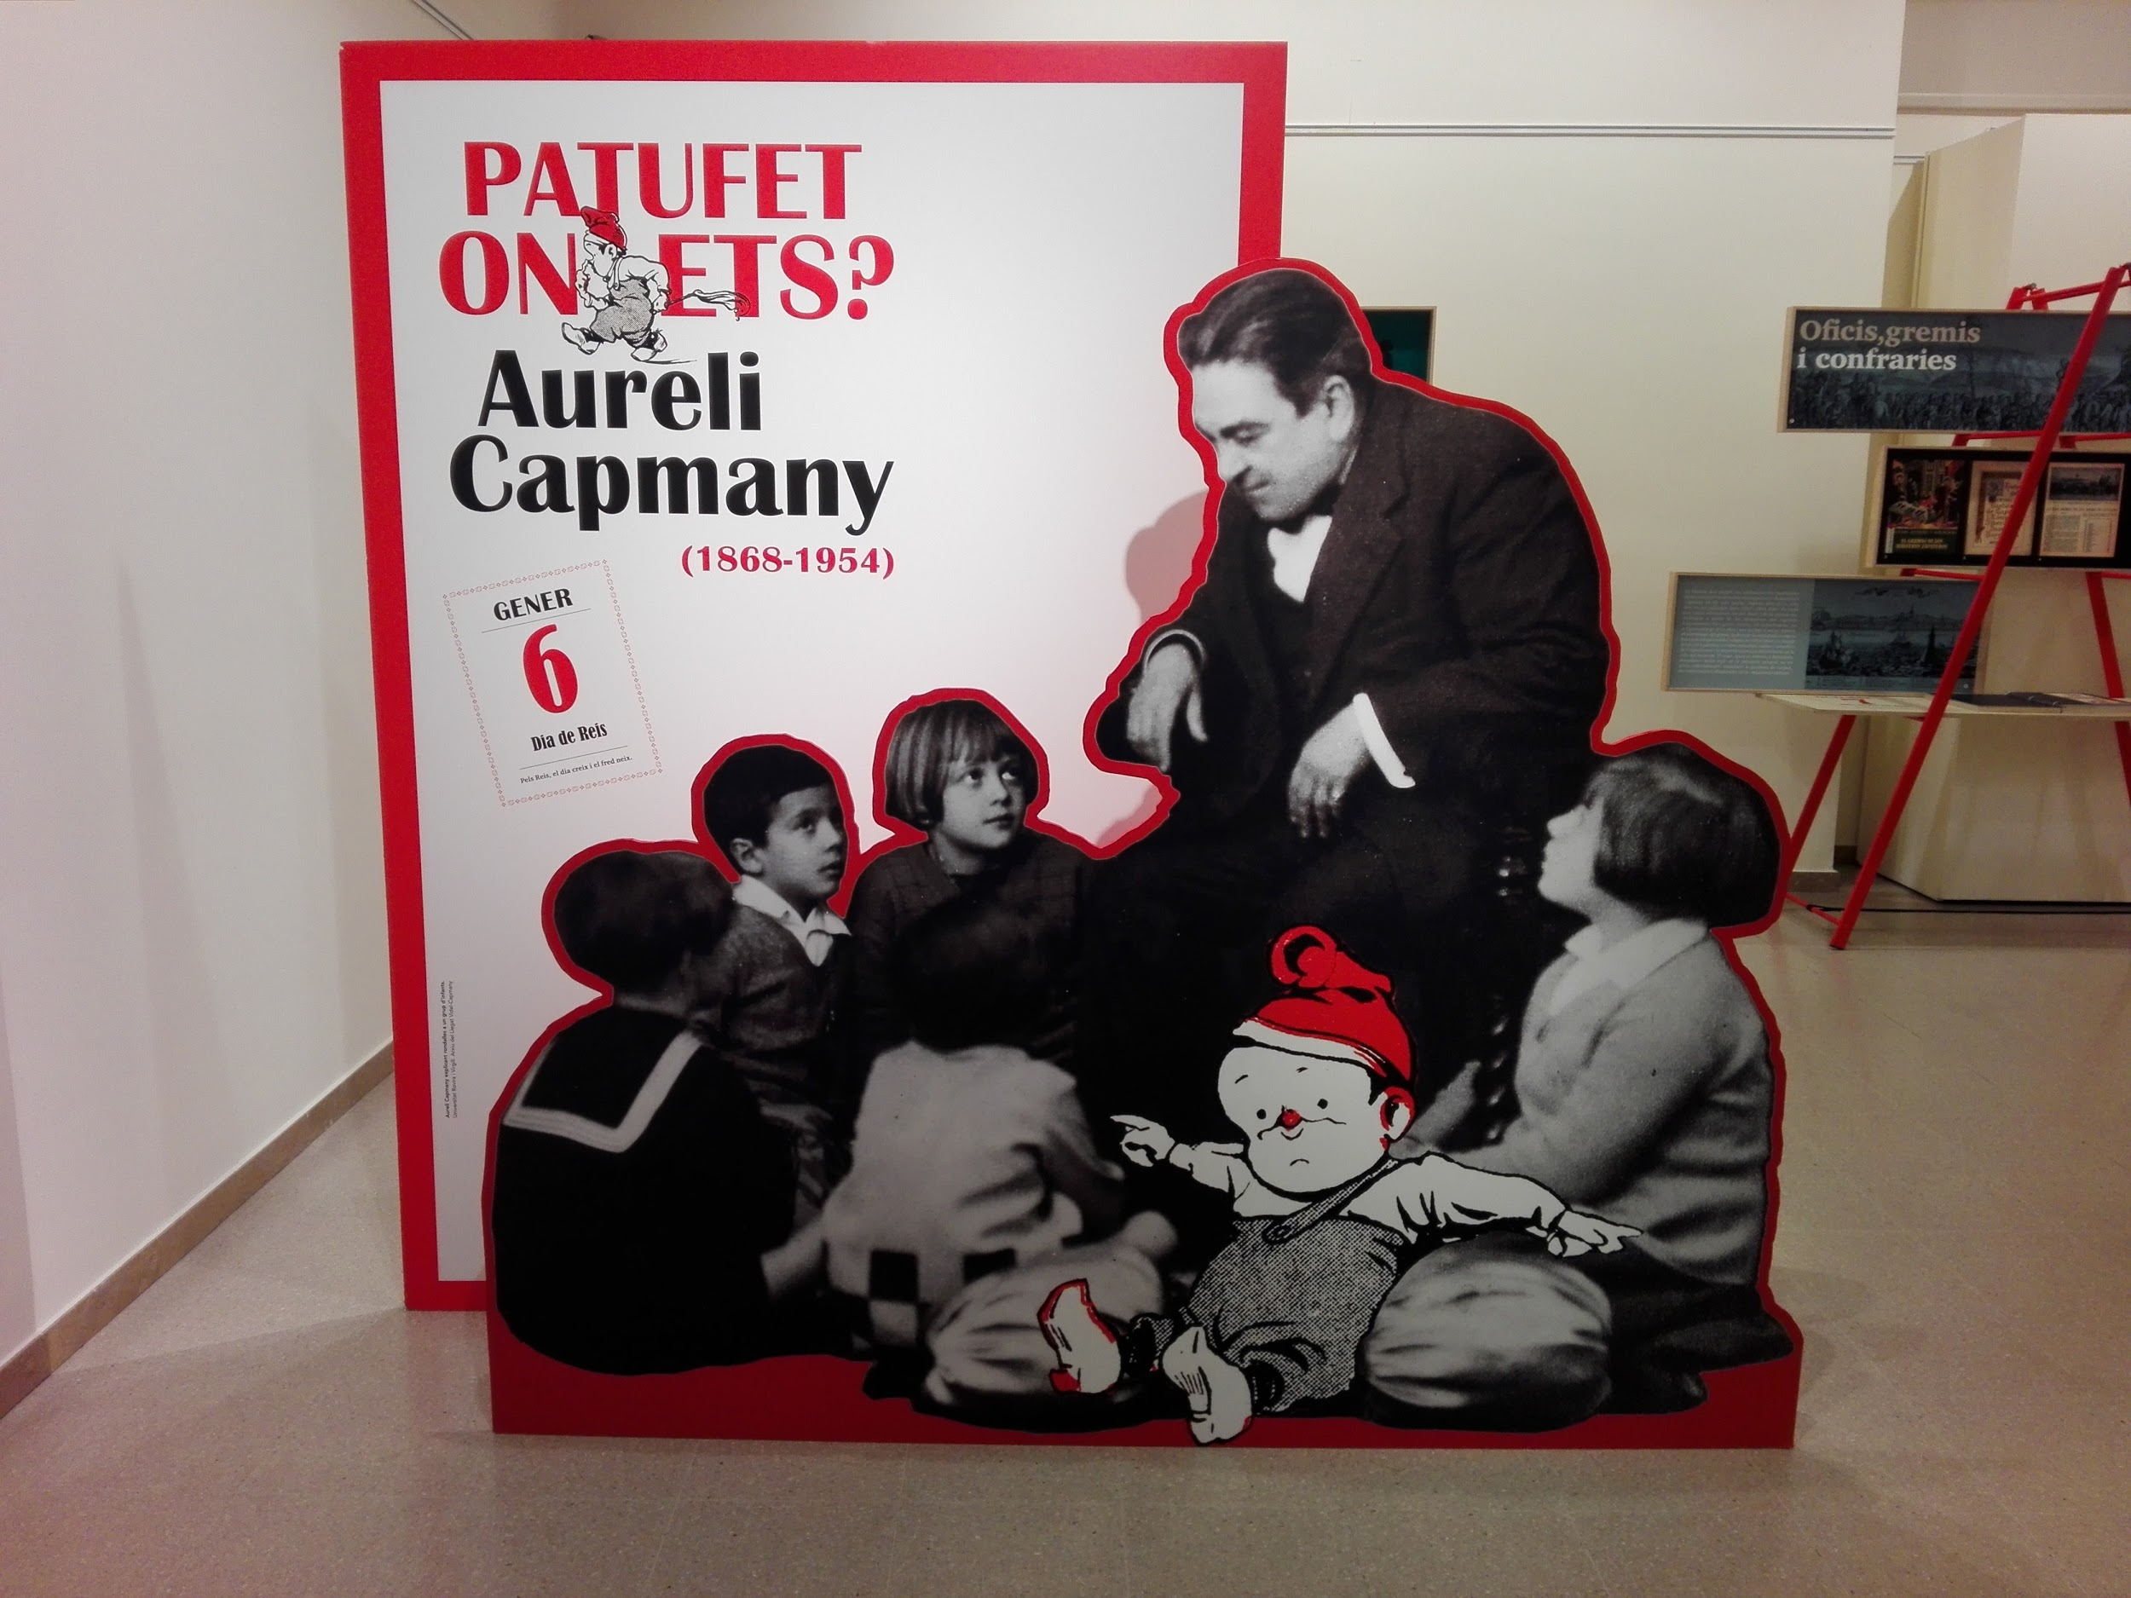
An exhibition at the Casino centre

Slide 18
The Mediterranean Festival
Text written and photos taken by students from GES-2 (afternoon group)
CFA Jacint Carrió i Vilaseca
Manresa, October 2019

