Slide 1
DRAGOBETE The Romanian equivalent of Valentine’s Day
Presentation made by:
Mircea Roxana
Denisiuc Bianca

Slide 2
What is Dragobete?
Dragobete is a traditional Romanian holiday celebrated on February 24th. Dragobete was the son of Baba Dochia, who stands for the main character in the myth related to the arrival of spring and the end of the harsh winter. Due to his endless kindness, he was chosen – according to some sources by Virgin Mary – to be the Guardian of Love.

Slide 3
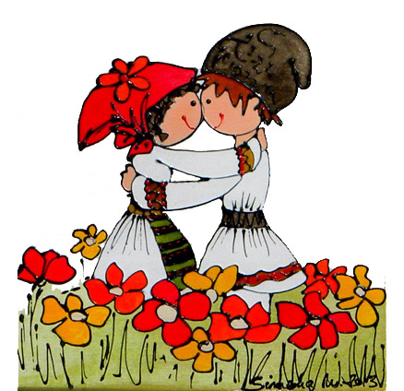
The day is particularly known as "the day when the birds are betrothed". It is around this time that the birds begin to build their nests and mate. On this day, considered locally the first day of spring, boys and girls gather vernal flowers and sing together. Maidens used to collect the snow that lay on the ground in many villages and then melt it, using the water in magic potions throughout the rest of the year.

Slide 4
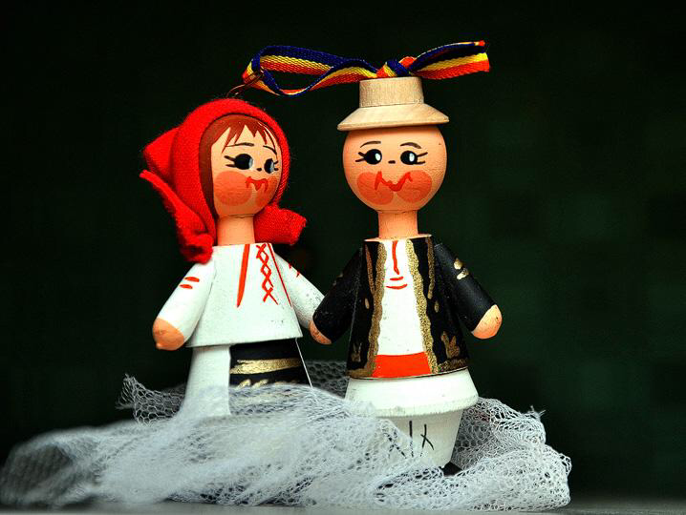
Those who take part in Dragobete customs are supposed to be protected from illness, especially fevers, for the rest of the year. If the weather allows, girls and boys pick snowdrops or other early spring plants for the person they are courting. Dragobete is known as the lovers’ Day, similar to Valentine’s Day.

Slide 5
Some ethnographers also link Dragobete to the arrival of spring. In certain areas, Dragobete was believed to be the saint patron of birds, the holiday being linked to fertility and the rebirth of nature. Dragobete is celebrated less than 1 month before the Spring Equinox, and it is said that on this day birds began to build their nests, the trees start blooming, and all of nature comes back to life after the long and heavy winter.

Slide 6
It is a common belief in some parts of Romania that, during this celebration, stepping over a partner's foot leads to the dominant role in the relationship. Dragobete customs vary from region to region.
In the countryside there is an old tradition with girls and boys going into the woods to pick flowers. When they return home, the traditions go that boys run after girls to kiss them. If the girl likes the boy, she lets him kiss her. Hence the saying “Dragobete kisses the girls”.

Slide 7
In some villages, the traditions were even more personal. On the day of Dragobete, young boys and girls would make a small cut in the shape of a cross on their forearms, and they would overlap their markings in order to become blood brothers or sisters. This ceremony was also performed by swearing oaths of loyalty, or by brotherly hugs and kisses. Those who became blood brothers would then organize a feast for all their friends, in order to celebrate.

Slide 8
Celebrating Dragobete
Despite the great worldwide success of Valentine's Day, Romania is still quite attached to its age-old traditions. Thus, Dragobete and Saint Valentine were forced to learn to co-exist. Some people celebrate only Valentine's Day, other celebrate Dragobete and those that are madly in love, both. But unlike Valentine's Day, Dragobete is not only about roses, heart-shaped chocolate, jewelry, and love letters. Be tender to your significant other, show them your appreciation and your love not through material objects but through your attention and your presence. Some of the old traditions advise us on how to behave on this day, in order to celebrate it properly.
First of all, both young girls and boys are not supposed to cry or complain. According to the tradition, those who do so will bring nothing but sorrow and trouble to themselves in the following months. Secondly, at least on this day, men should not annoy women, otherwise, their love life might fall apart. Housekeeping or working is also not recommended, but you can, however, clean the house. But if there is one thing that you should definitely avoid, that is sacrificing animals. It is believed that doing so will damage their mating ritual, and might have a long-term negative impact on the household.

Slide 9
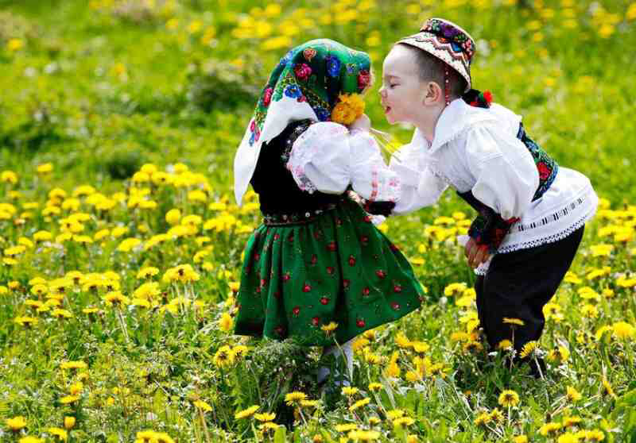
Dragobete is a holiday that also includes those who are single. So if you don't have a significant other, do not despair. Tradition says that if you meet and hug at least one person that you are attracted to, your love life will make a turn for the best. So asking your crush on a date for Dragobete might not be such a bad idea.

Slide 10
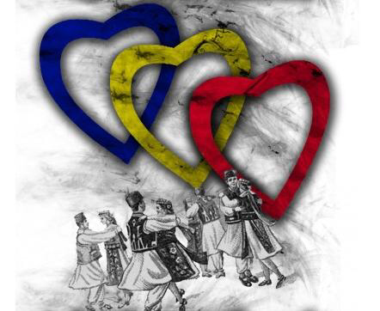
These being said, it’s obvious that in Romania February is really the month of love. After many years of censorship during the communist period, Dragobete is rapidly recovering its rightful place, reminding people to never stop loving each other , be it in the old-fashioned Romanian way or the global way.

