Slide 1
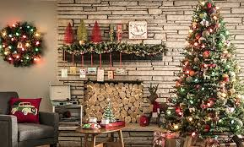
Christmas in Romania
Coman Erika
Denisiuc Bianca
Mircea Roxana
Nicolița Ana Maria

Slide 2
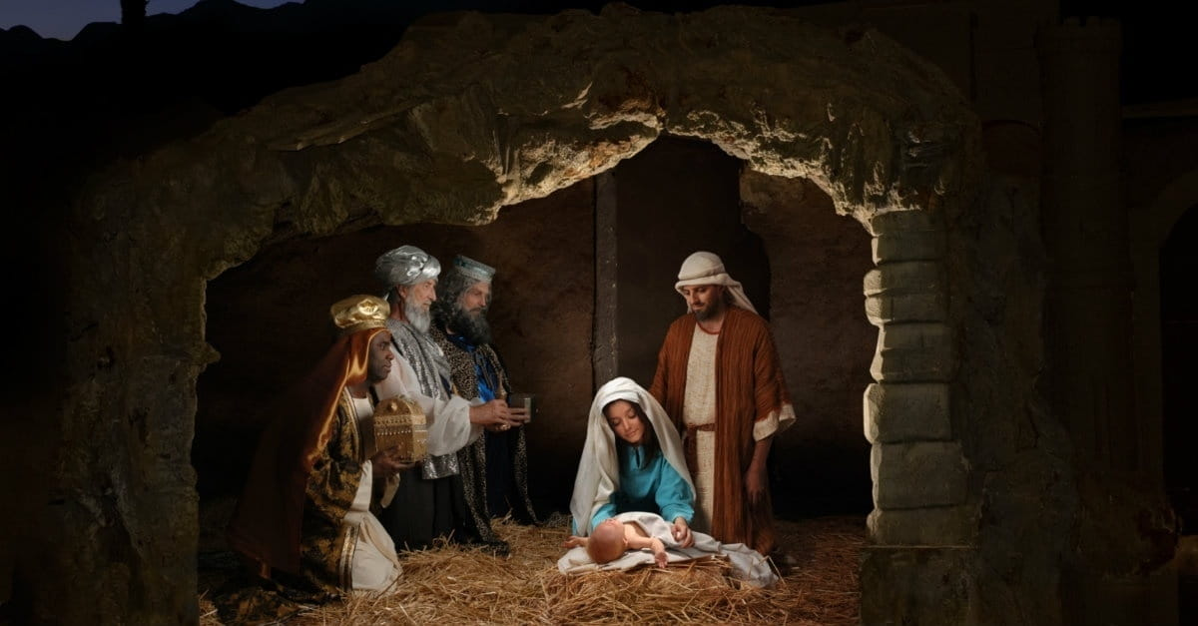
Christmas or the Birth of the Lord is a Christian holiday celebrated on December 25th every year. In some countries, where Christians are the majority, Christmas is also a legal holiday, and the holiday is extended the following day, December 26th: the second day of Christmas. Since the beginning of the twentieth century, Christmas has also become a secular holiday, celebrated by both Christians and non-Christians, the center of gravity of the celebration moving from attending church to rite to the family aspect of gift exchange. or, for children, the "gifts from Santa Claus”.
Christmas began to be celebrated by Christians on December 25th , after at least three centuries since the beginning of the mission of evangelization of the apostles, namely from the 4th century in the West and beginning with the 5th century in the East.

Slide 3
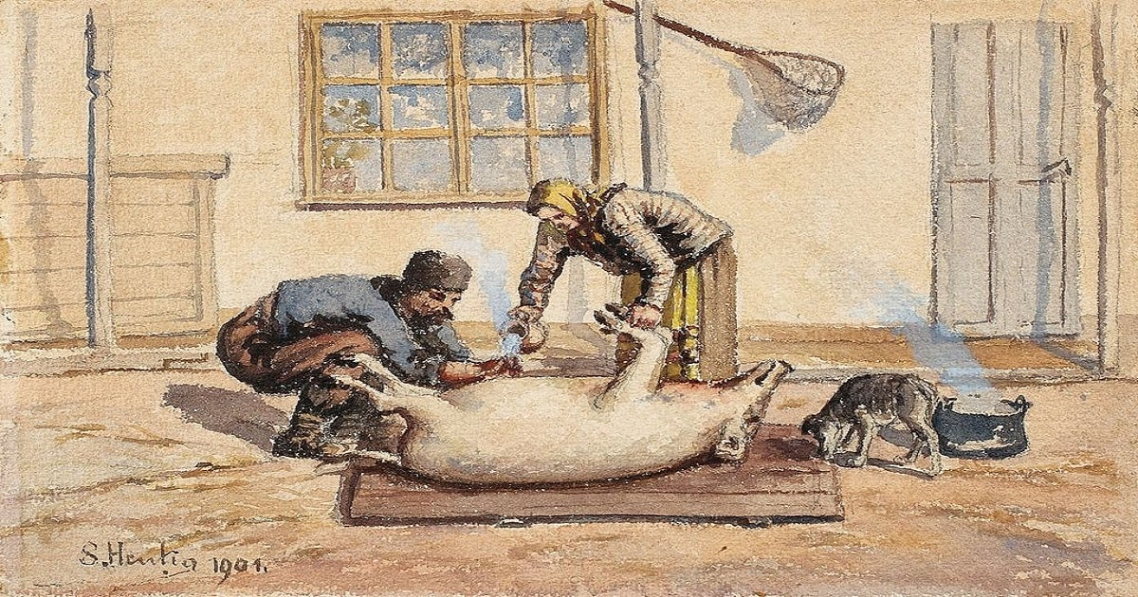
Christmas in romania -traditions and customs-
In Romania, Christmas and mid-winter celebrations last from 20th December to 7th January. The 20th is called 'Ziua de Ignat' or simply 'Ignat Day'. It is traditional that if the family keep pigs, one is killed on this day by the head of the household. The meat from the pig is used in the Christmas meals. After the pig is killed, the family members share a dish called 'Pomana Porcului' (Pork's Charity) which is traditionally cooked in a cauldron and consists of a variety of pork bits (pork belly, shoulder, liver, kidneys, etc.) in a garlic sauce and served with polenta. The name 'Ignat Day' comes from the 20th is also the saint day of 'Saint Ignatius of Antioch' and also 'Saint Ignatius, Archimandrite of the Kiev Caves' in some churches.

Slide 4
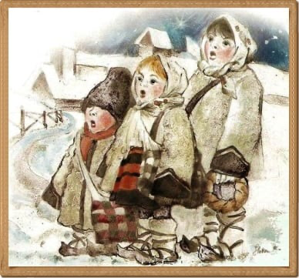
The Christmas celebrations really begin on Christmas Eve, on the 24th, when it's time to decorate the Christmas Tree. This is done in the evening of Christmas Eve. In Romanian, Christmas Eve is called “Ajunul Craciunului”.
Carol singing (known as 'Colindatul') is also a very popular part of Christmas in Romania. On Christmas Eve, children go out carol singing from house to house performing to the adults in the houses. They normally dance as well. The children get sweets, fruit, traditional cakes called 'cozonaci' and sometimes money for singing well. Adults go carol singing on Christmas Day evening and at night.

Slide 5
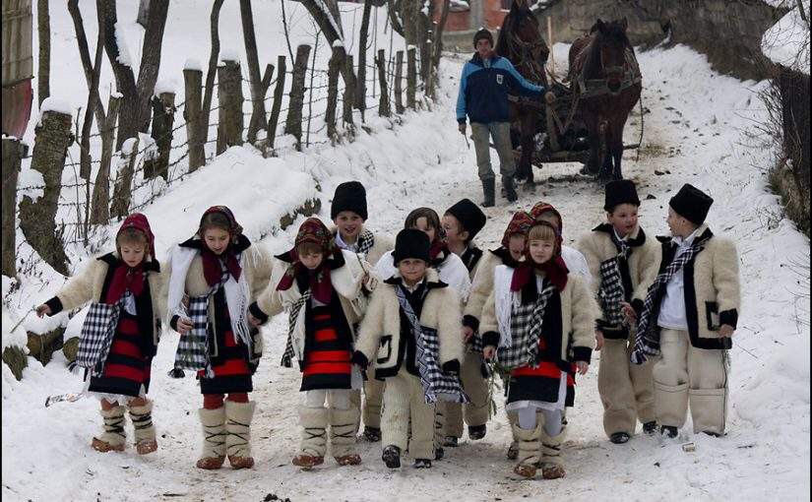
A traditional Romanian Carol is the 'Star Carol'. The star, made of coloured paper and often decorated with tinsel, silver foil and sometimes bells, is put on a pole. In the middle of the star there is a picture of baby Jesus or a nativity scene. Carol singers take the star with them when they go carol singing. The lyrics of the Star Carol are as follows:
"The star has appeared up high,
Like a big secret in the sky,
The star is bright,
May all your wishes turn out right!"

Slide 6
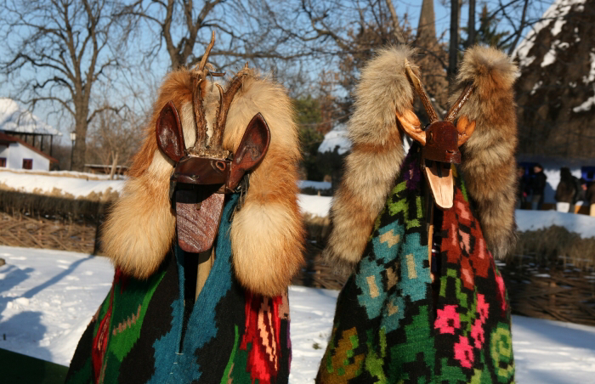
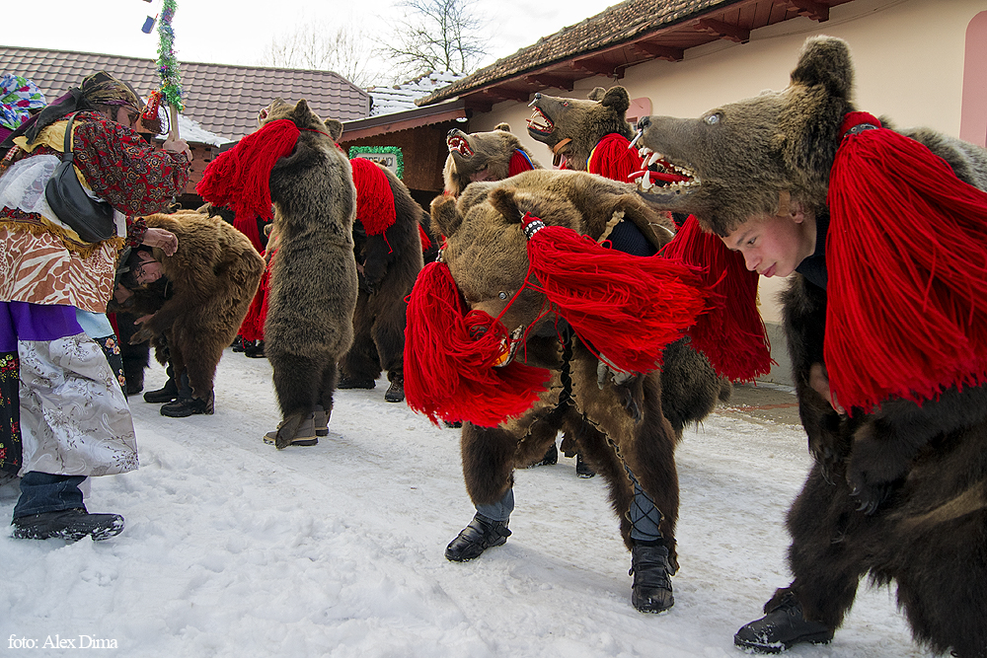
Other popular carols sung at Christmas include 'Oh, What Wondrous Tidings' ('O, ce veste minunata') and 'Three Wise Men coming from the East' ('Trei Crai de la Rasarit').
In many parts of Romania, it's also traditional to dress up as a goat, with a multicolored mask, and to accompany the carol singers. The goat is known as the 'Capra' and it jumps and dances around.

Slide 7
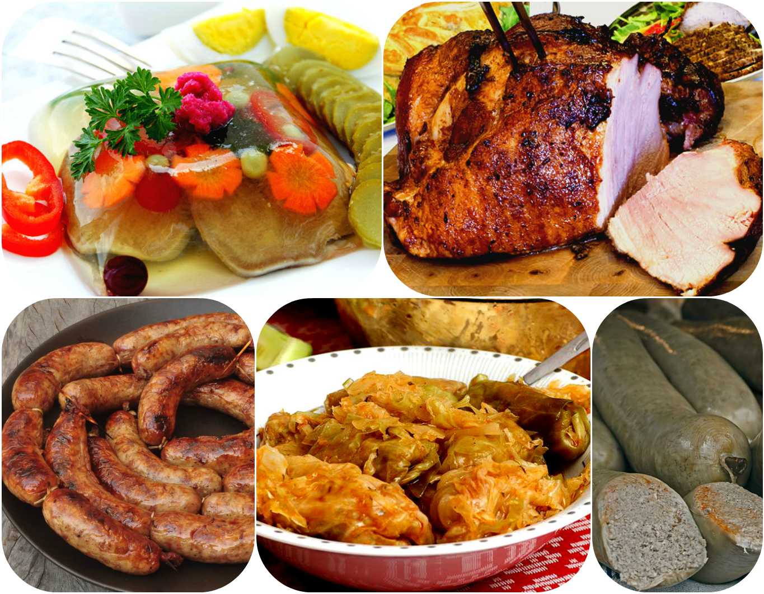
Traditional Romanian Christmas foods include Roast Gammon and Pork Chops; 'Ciorba de perisoare' which is a slightly sour vegetable soup made with fermented bran and pork meatballs; 'Sarmale' cabbage leaves stuffed with minced pork and served with polenta; 'Cozonac' a rich fruit bread; Romanian doughnuts are called 'gogosi' and cheesecakes.

Slide 8
In Romania the Christmas tree was first decorated in the palace of King Carol I of Hohenzollern in 1866, and since then the Romanians have taken over this tradition.
At first, the Christmas tree was adorned with fruit, paper flowers or biscuits. In time, it went on to be decorated with so many wonders, among which: glass baubles, candles, chocolate candies, light installations, tinsel etc.
There is also the custom of placing a star on the top of the Christmas tree, a symbol of the star that guided the magi to Bethlehem. About this star it is said that it brings good luck and fulfills desires.
In addition to the Christmas tree, Christians also decorate their houses with Christmas wreaths, hung on the entrance doors, symbolizing health and luck, while their round shape represents the eternity of love that never perishes.
Another plant used to decorate the houses around Christmas and New Year is the mistletoe. The mistletoe is said to be a healing plant, symbolizing harmony and peace. Also, kissing under the mistletoe is said to make the love of a couple stronger and stronger.

Slide 9
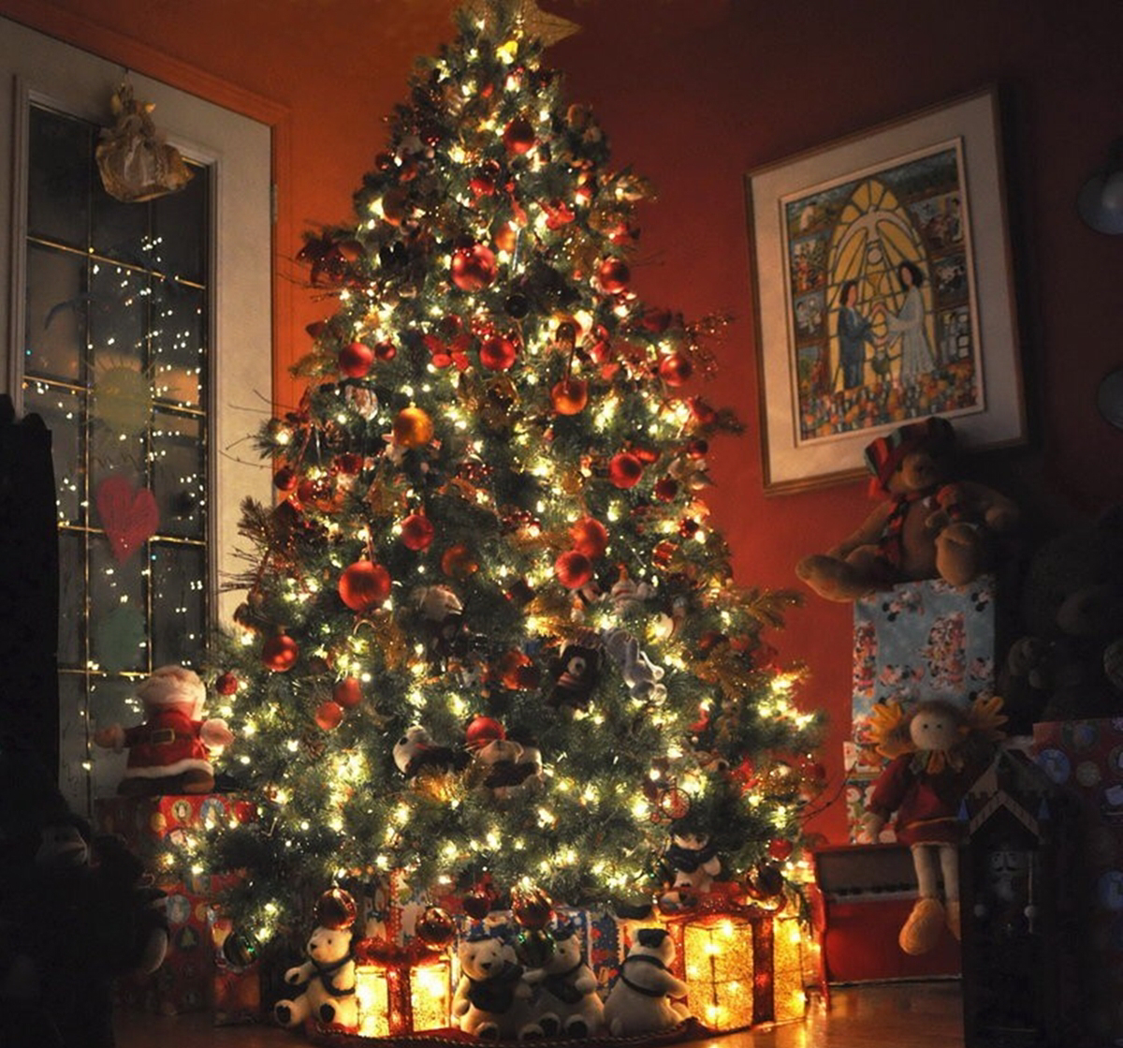
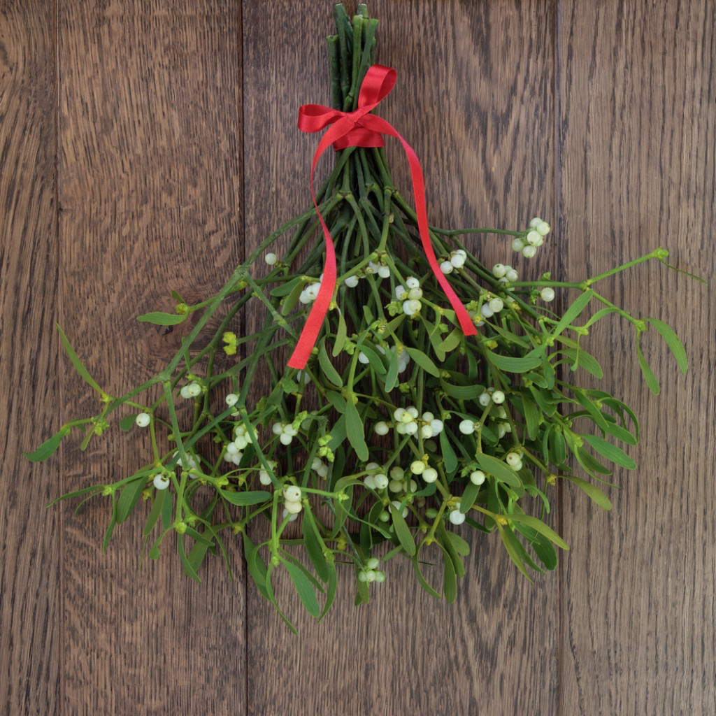

Slide 10
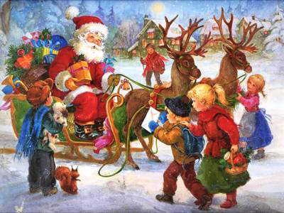
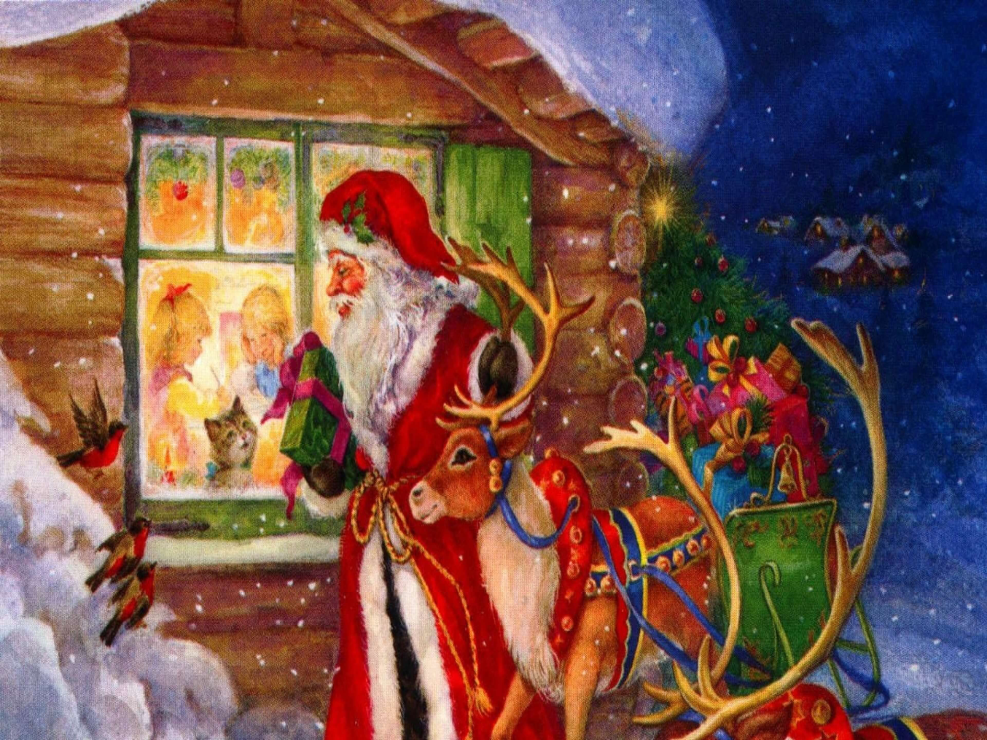
In Romanian, 'Crăciun Fericit’ is the translation for ‘Merry Christmas’.
In Romania, Santa Claus is known as 'Moş Crăciun' (Old Man Christmas). During the time when the country was under communist ruling, the gift bringer was 'Moş Gerilă' (Old Man Frost), but Moş Crăciun is the main gift bringer now!

