Slide 1
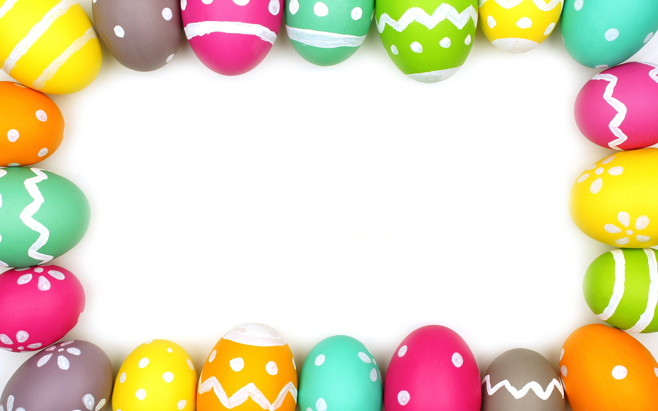
Easter in Romania

Slide 2
Easter is the most important holiday
of the year. It brings the hope of eternal life through the sacrifice of Jesus Christ. This year, Easter is celebrated on April, 19th.

Slide 3
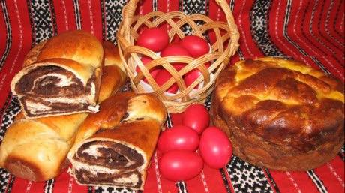
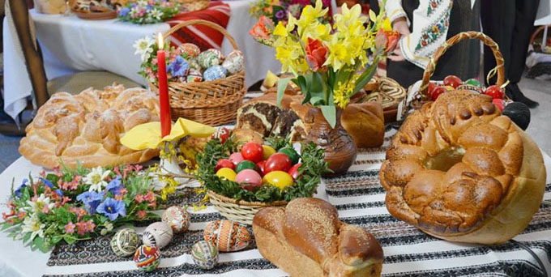
The beginning of the holiday is marked by the 7-week lent. One of the most significant days of the Holy Week is The Great Thursday. From that day, people are concentrated on the cleaning of their houses and the cooking of the traditional foods.

Slide 4
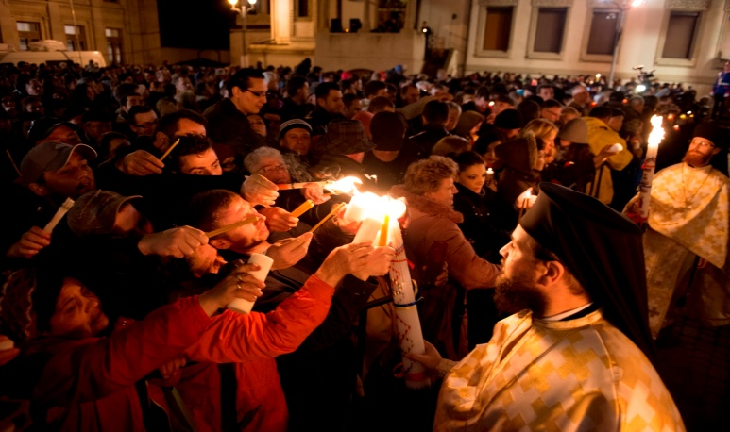
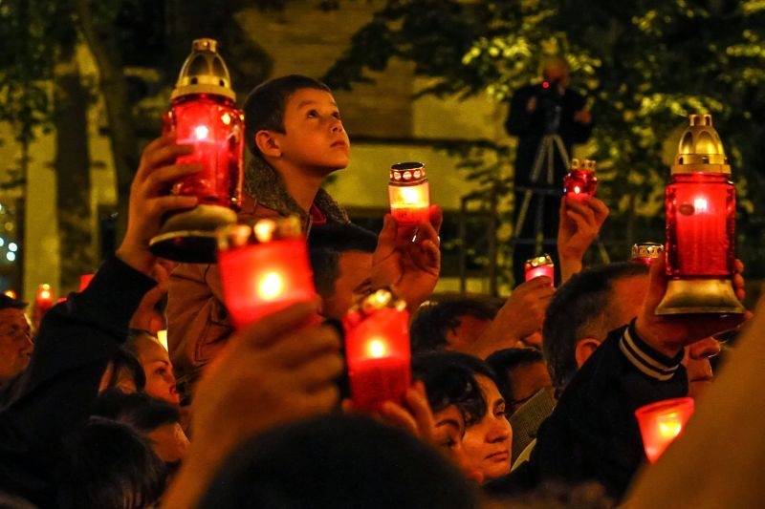
At midnight, between Saturday and Sunday, people go to church where the pastor, holding The Holy Gospel in his hand, is welcoming them. Together with the faithful ones, the pastor is surrounding the church 3 times in a row. When the father says "Christ raised from the dead!" the crowd replies with "He truly raised from the dead!". People are greeting each other using those words when they meet for 40 days.

Slide 5
Some of the most popular traditional Romanian foods are "cozonac" (which is a kind of sweet bread with cocoa, Turkish delight, nuts and raisins) and "drob" (which is similar to the Scottish haggis).

Slide 6
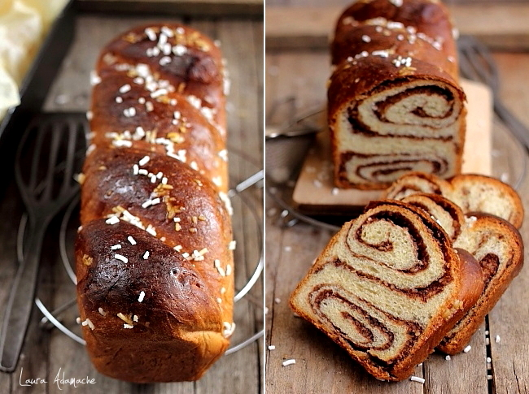
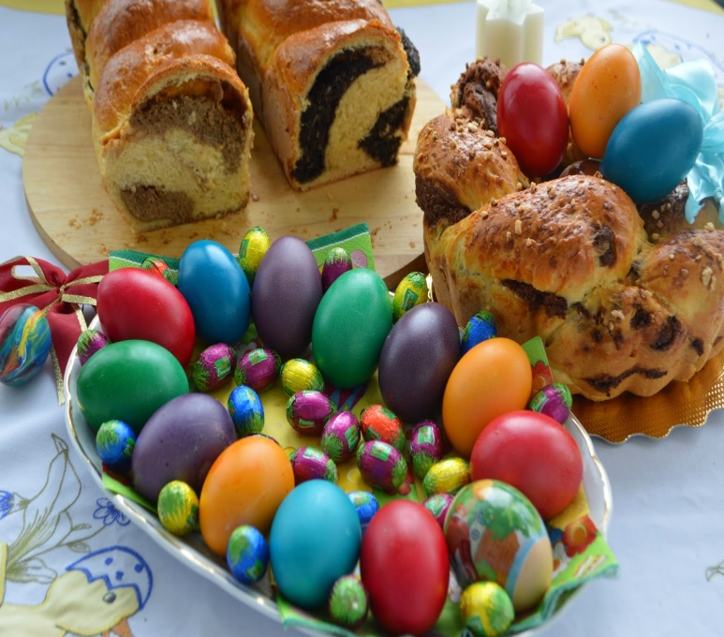
The Recipe of Cozonac:
For the dough you will need:
• 1 kg of flour
• 8 egg yolks
• 300 g of sugar
• 250 g of butter
• 50 g of fresh yeast
• 1 teaspoonful of salt
• vanilla sugar and rhum essence
For the filling you will need:
• 500 g of nuts
• 100 g of sugar
• 3 egg whites
• 300 g of cocoa.

Slide 7
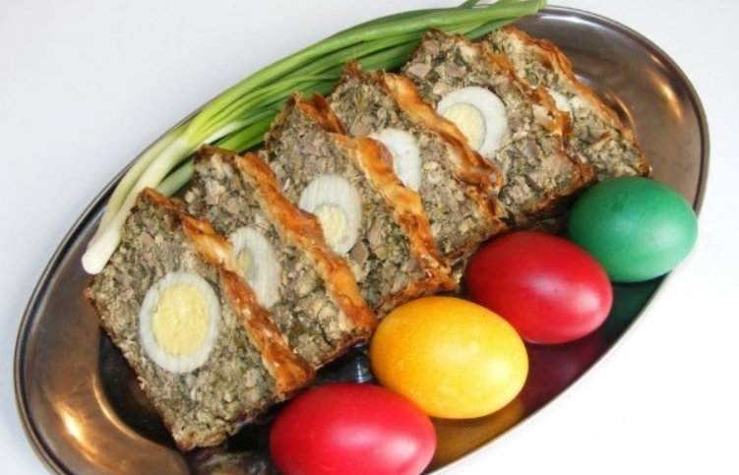
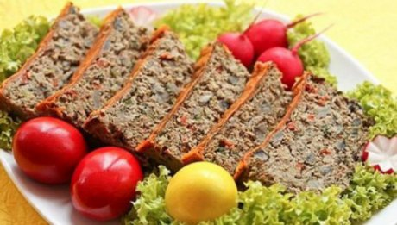
The Recipe of Drob: • 600 g of mutton • green onion • green garlic • 50 kml of oil • salt and pepper • parsley and dill • 2 eggs • 4 boiled eggs

Slide 8
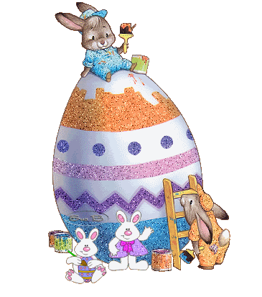
= PAŞTE FERICIT!

