Slide 1
Manresa streets at Christmas Time
eTwinning project “Keeping traditions all year round”
CFA Jacint Carrió i Vilaseca (Manresa)
GES-2 groups, december 2019

Slide 2
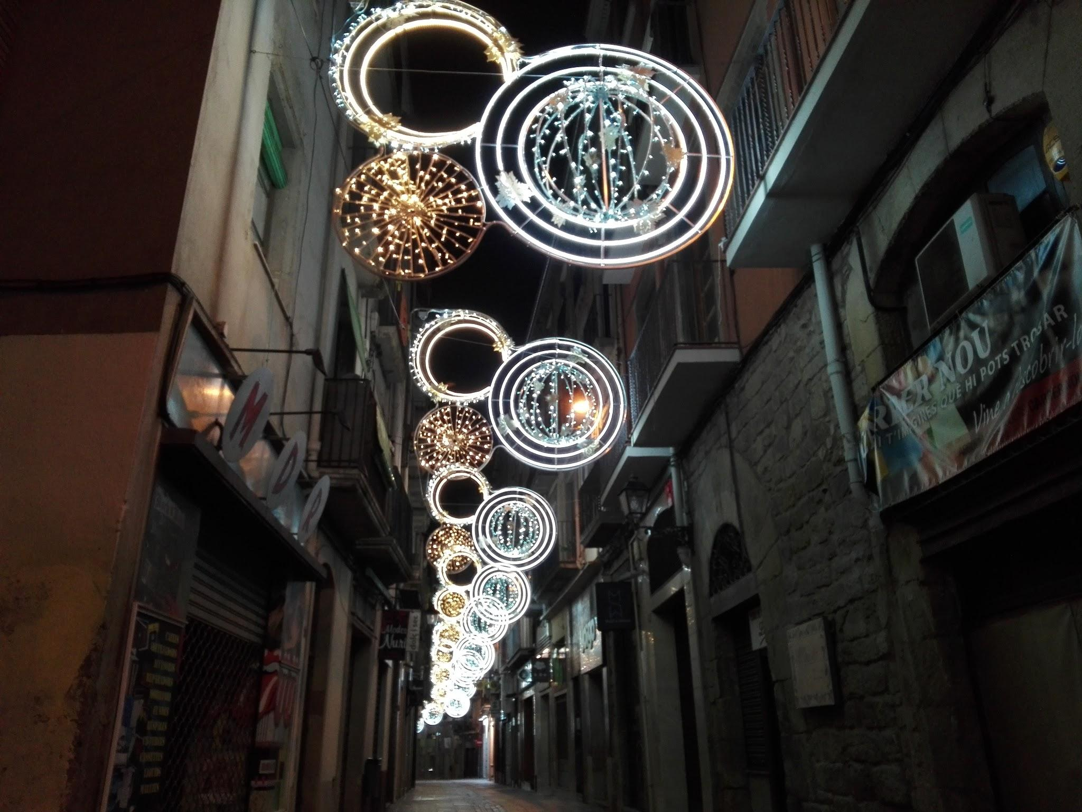
In New Street there are some white circles and gold circles, too.

Slide 3
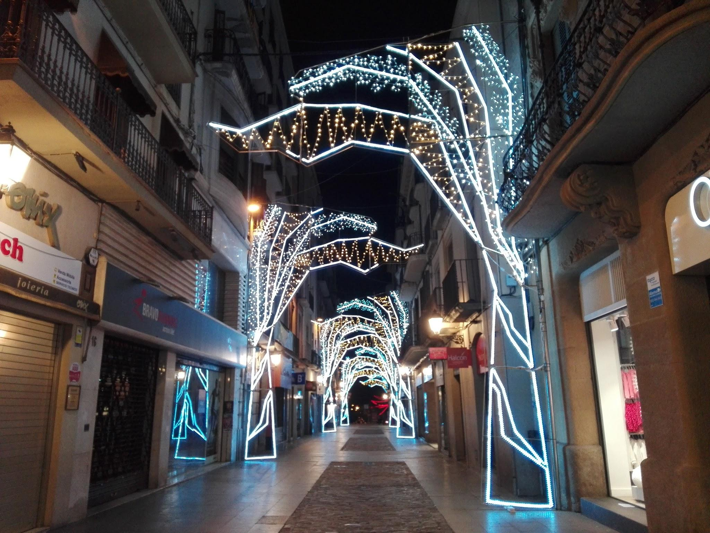
This is Born Street, in the city centre. There are so many shops in this area.

Slide 4
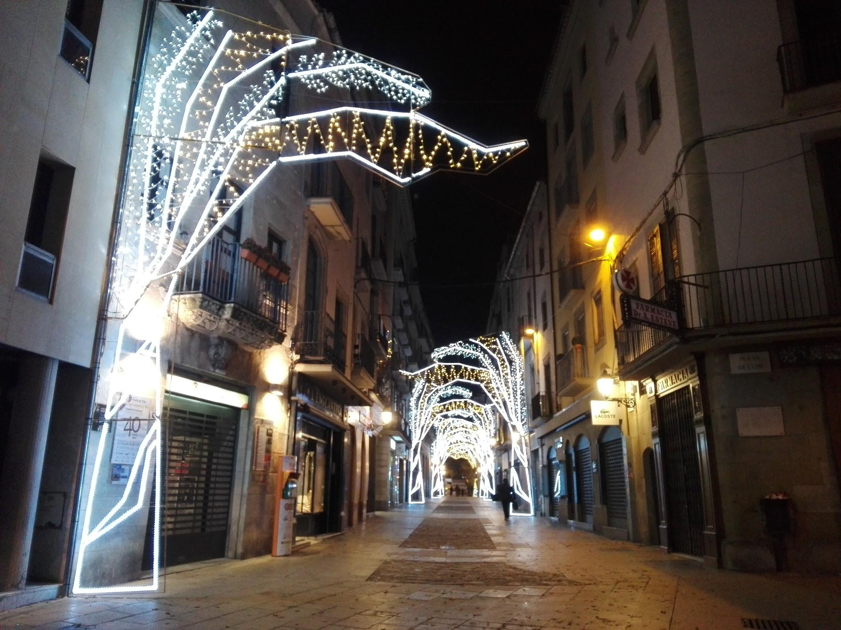
The lights represent big trees with the branches above the street.

Slide 5
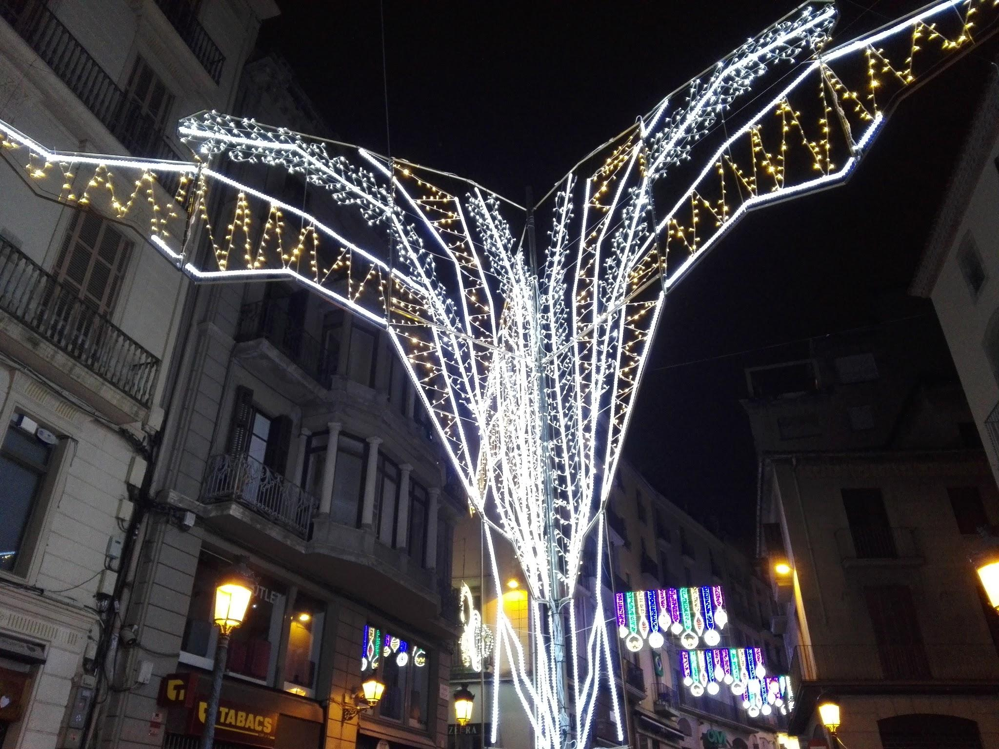
In Plana de l’Om there is a big tree in the center of the square.

Slide 6
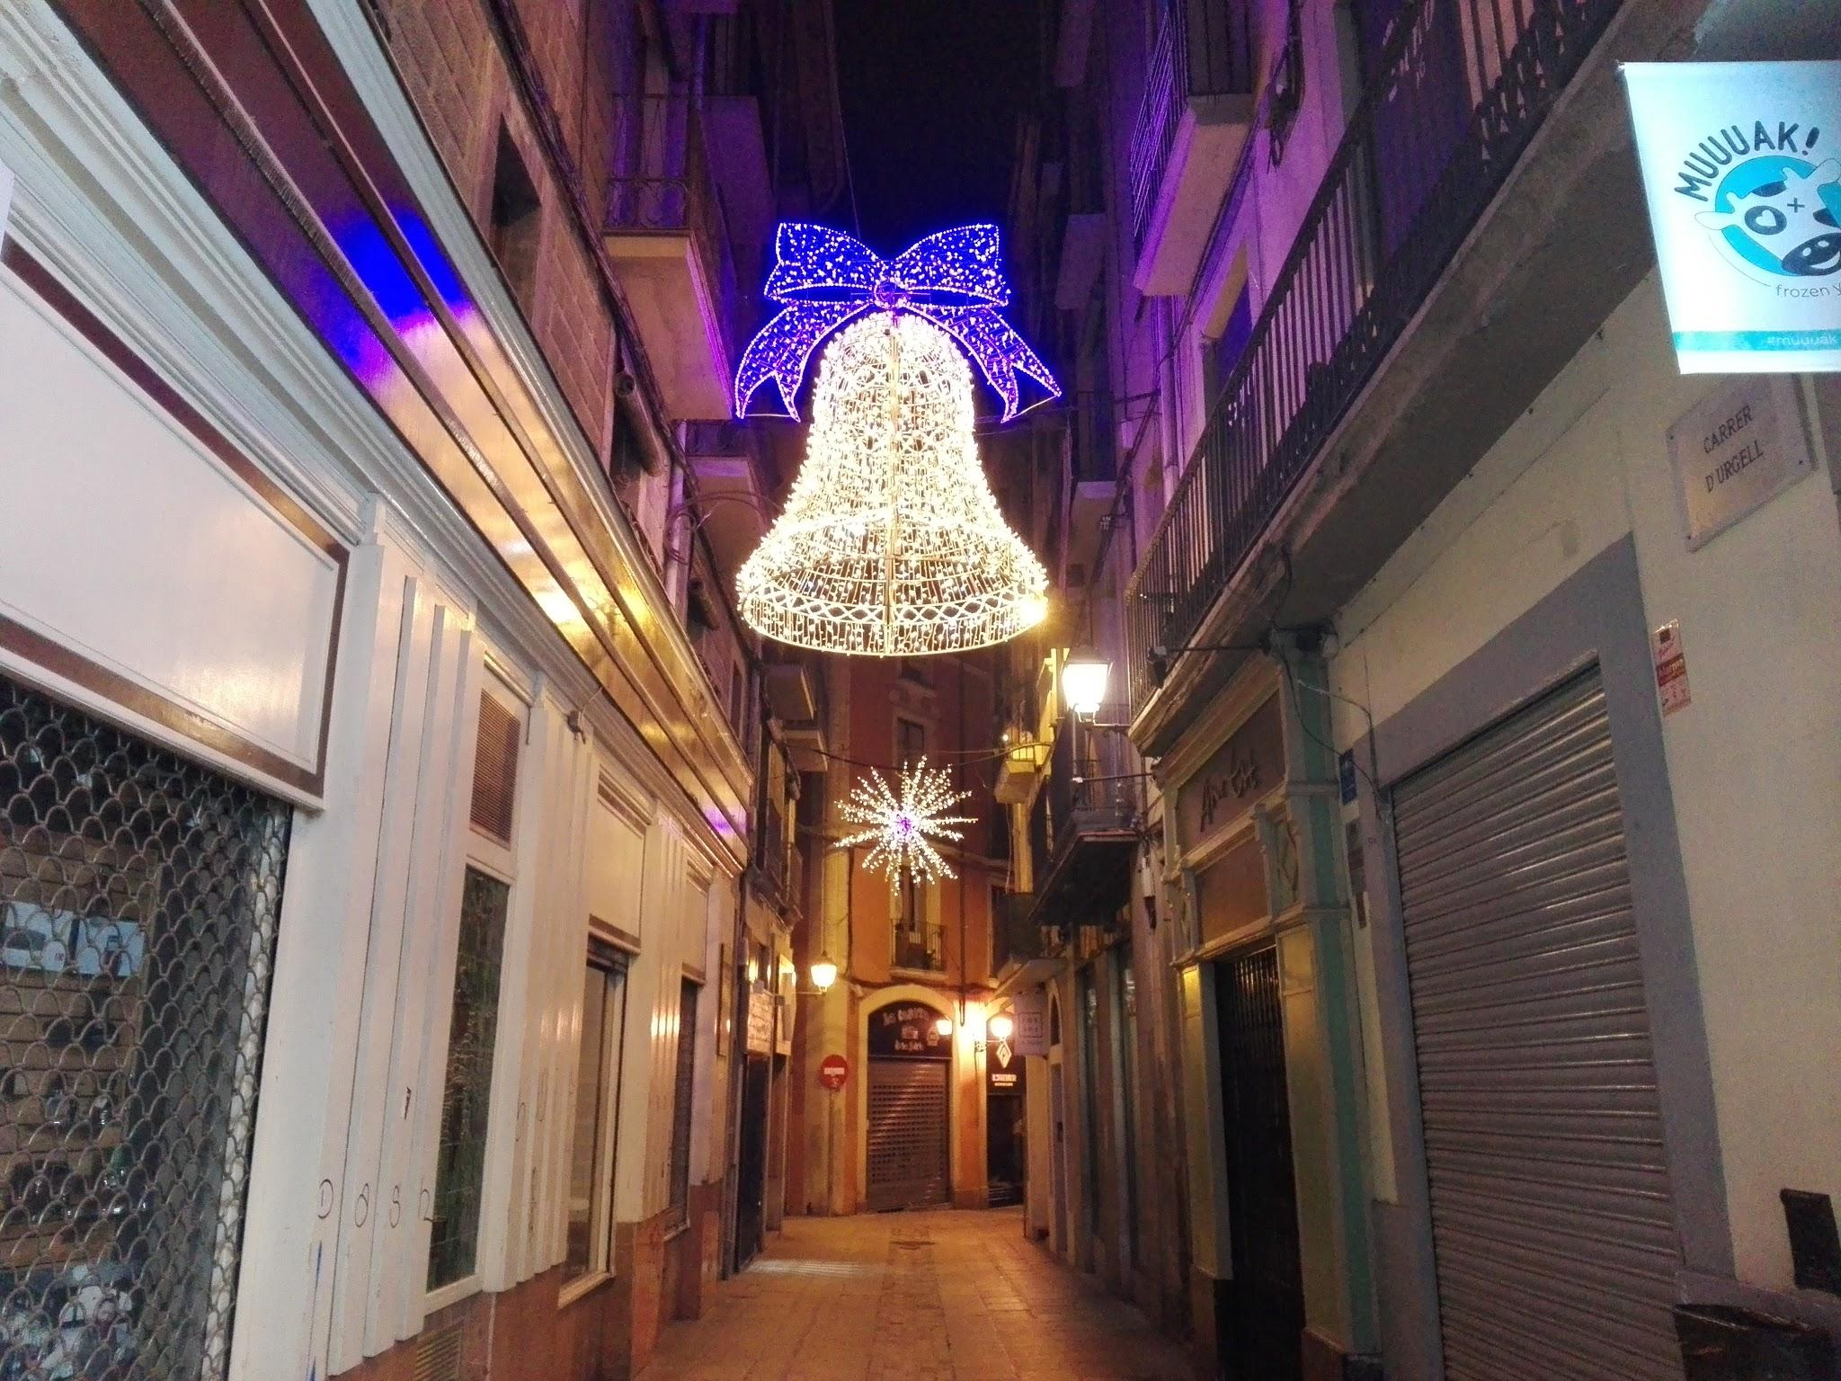
In Urgell Street there’s a big bell with a purple ribbon on it.

Slide 7
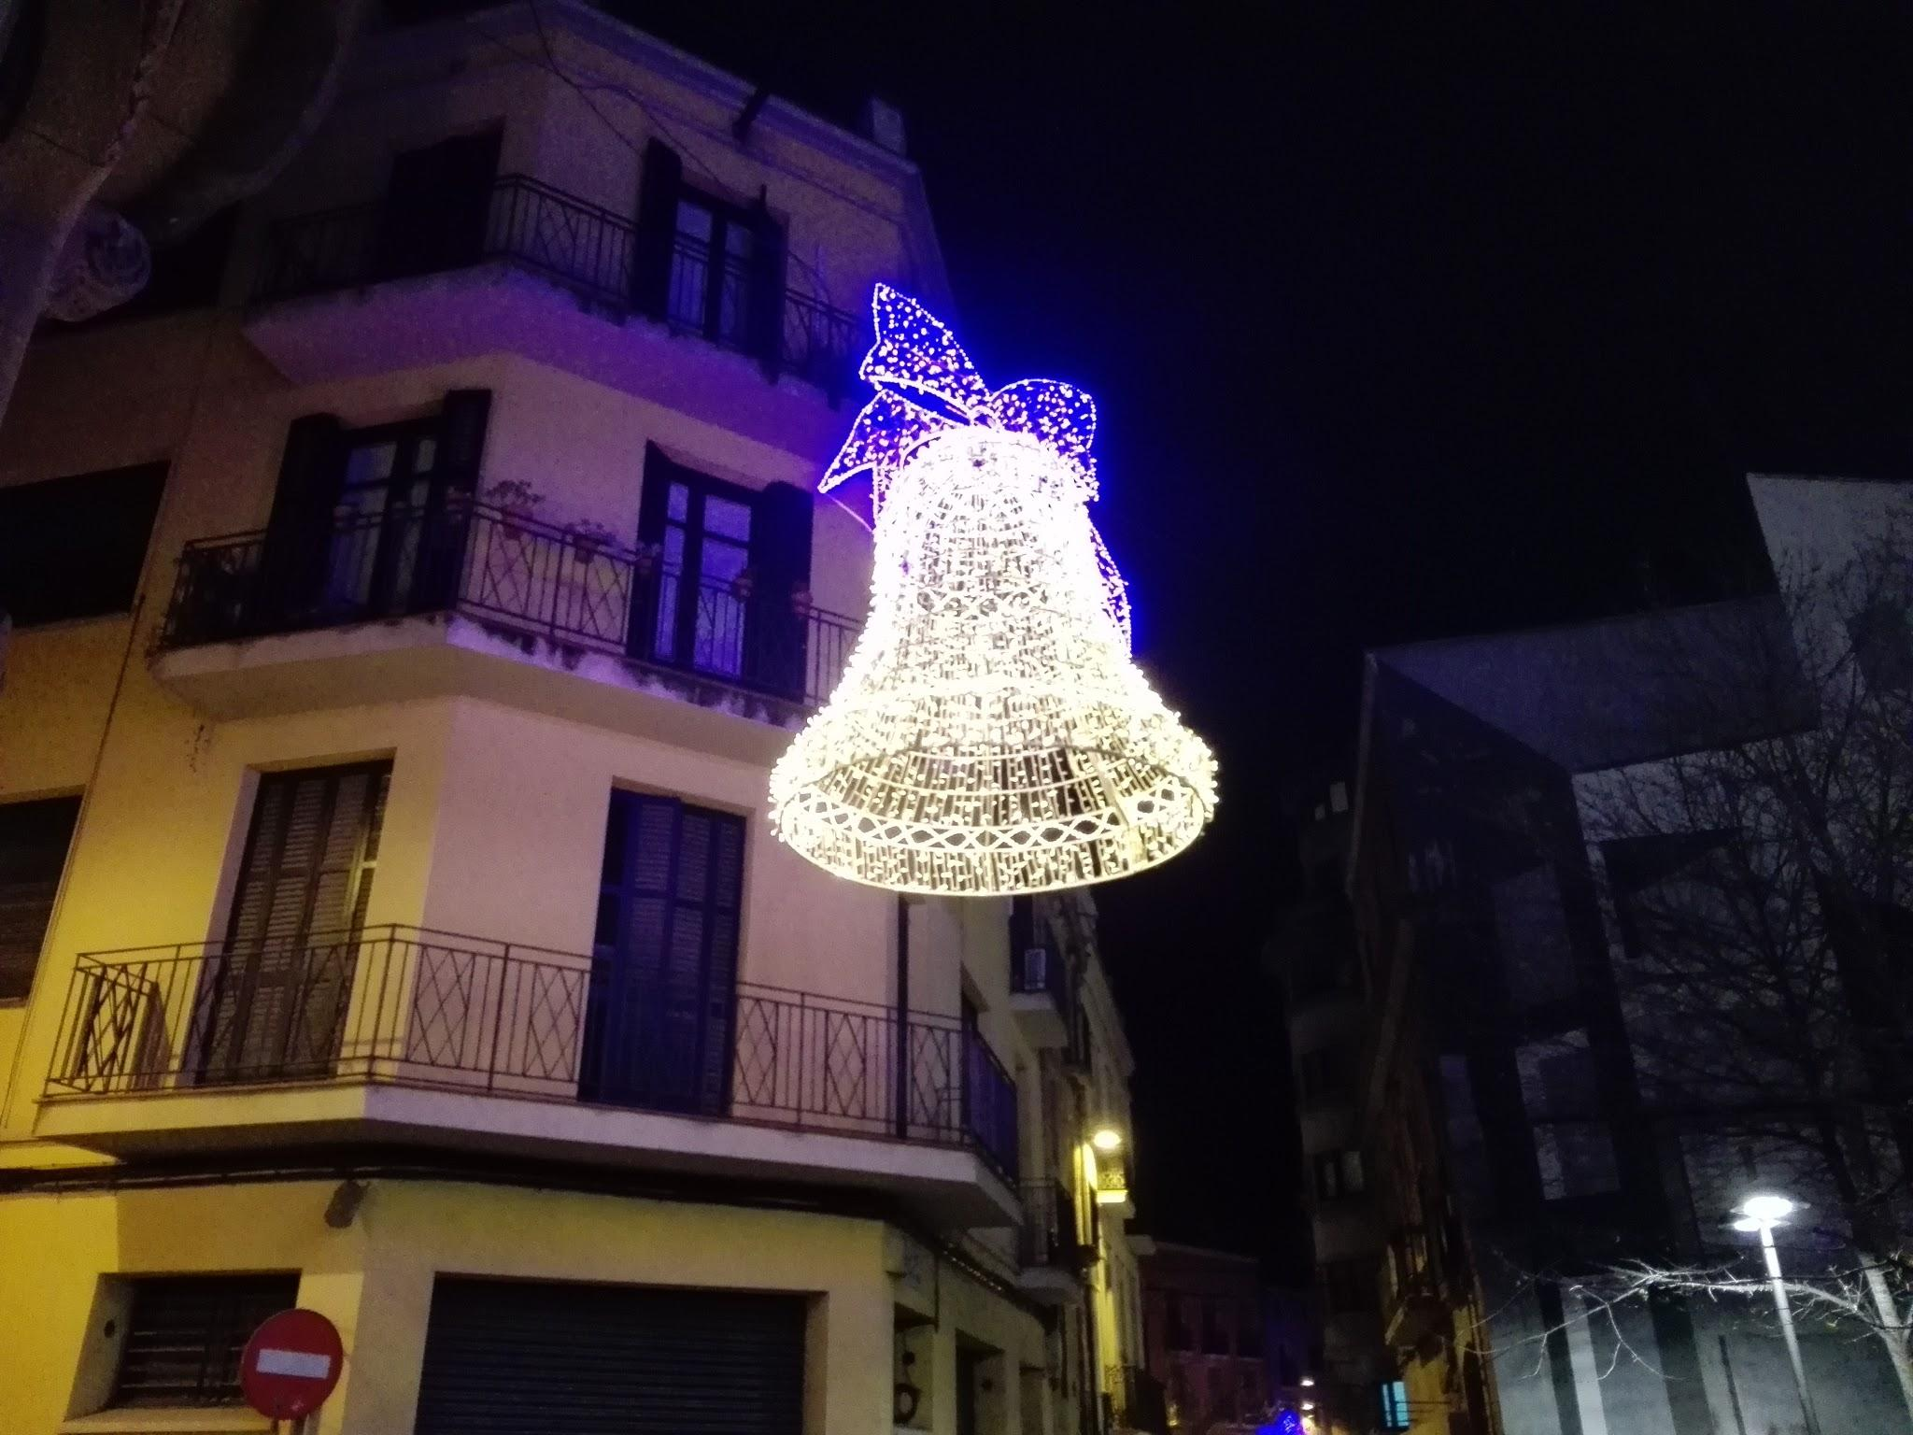
This bell is very spectacular...

Slide 8
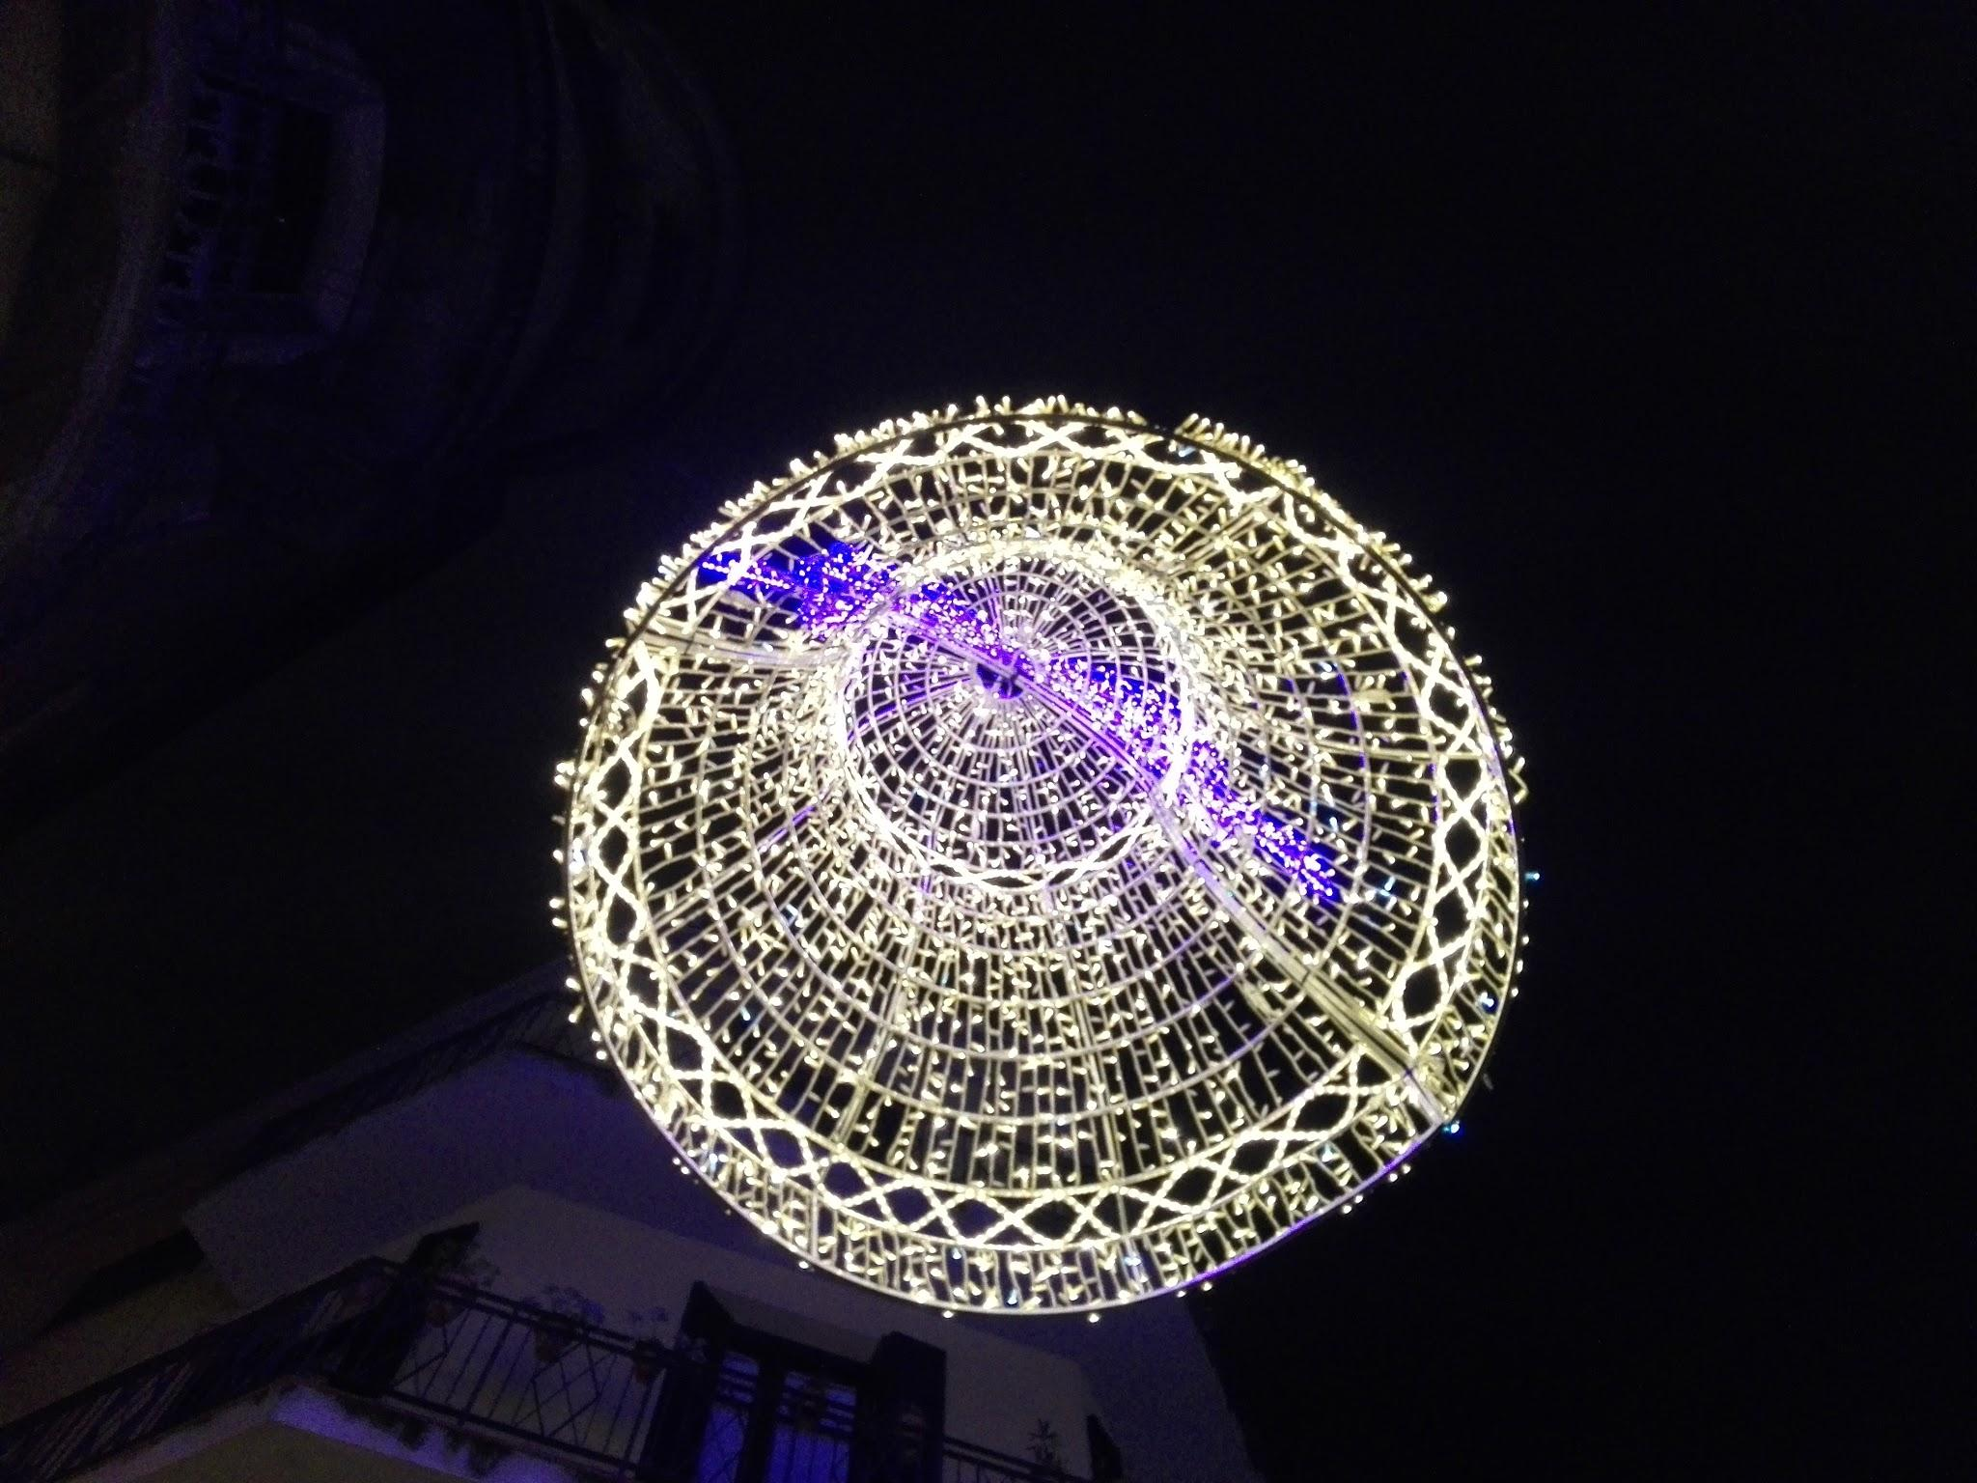
… and people take photos of it.

Slide 9
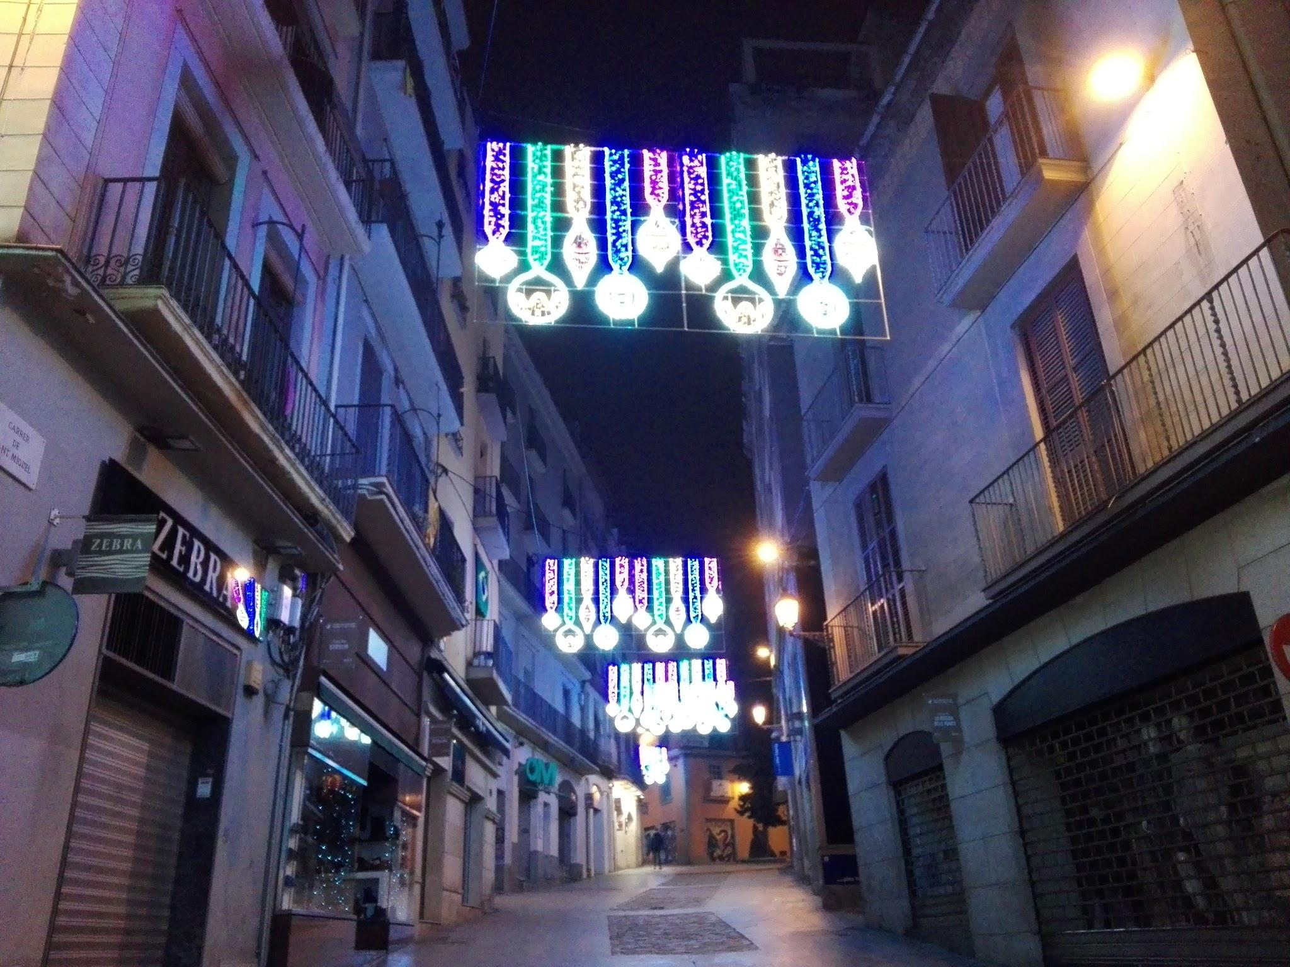
Another street with Christmas decoration.

Slide 11
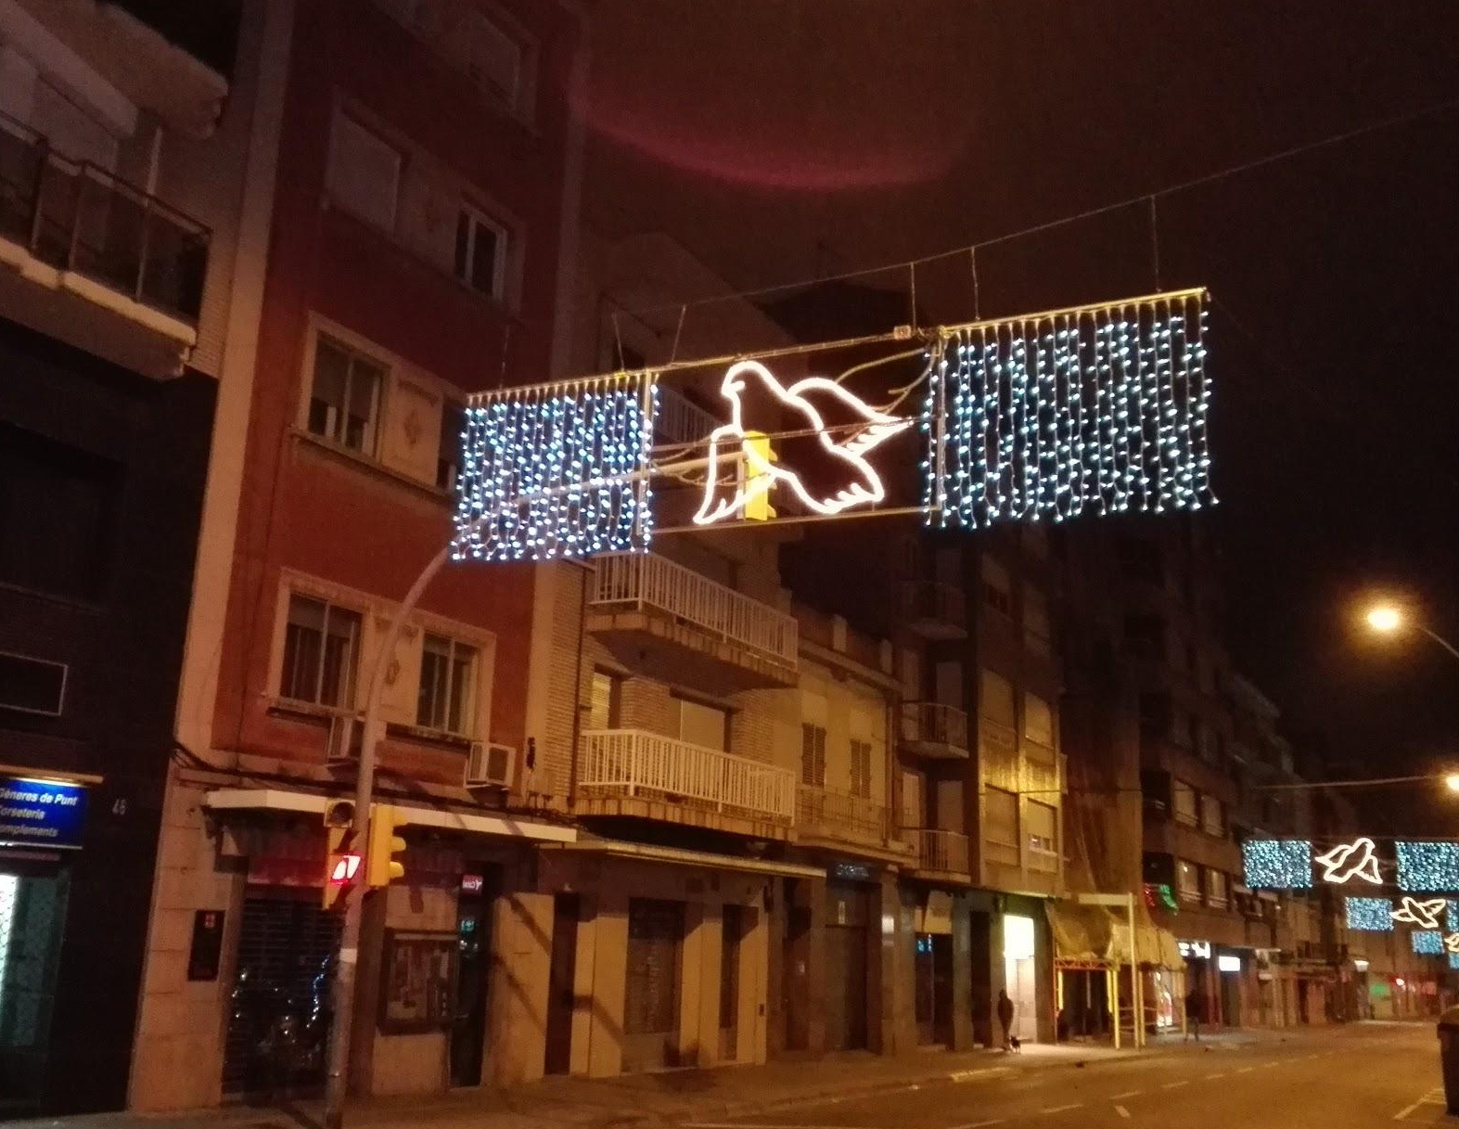
In Barcelona Street lights represent pigeons. These birds are a peace symbol.

Slide 12
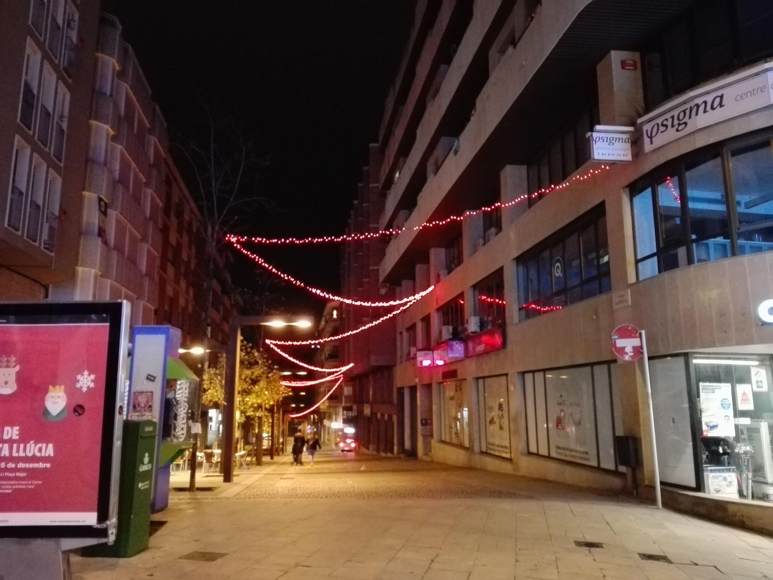
This is Alfons XII Street. There are some light strips in red from one side to another side .

Slide 13
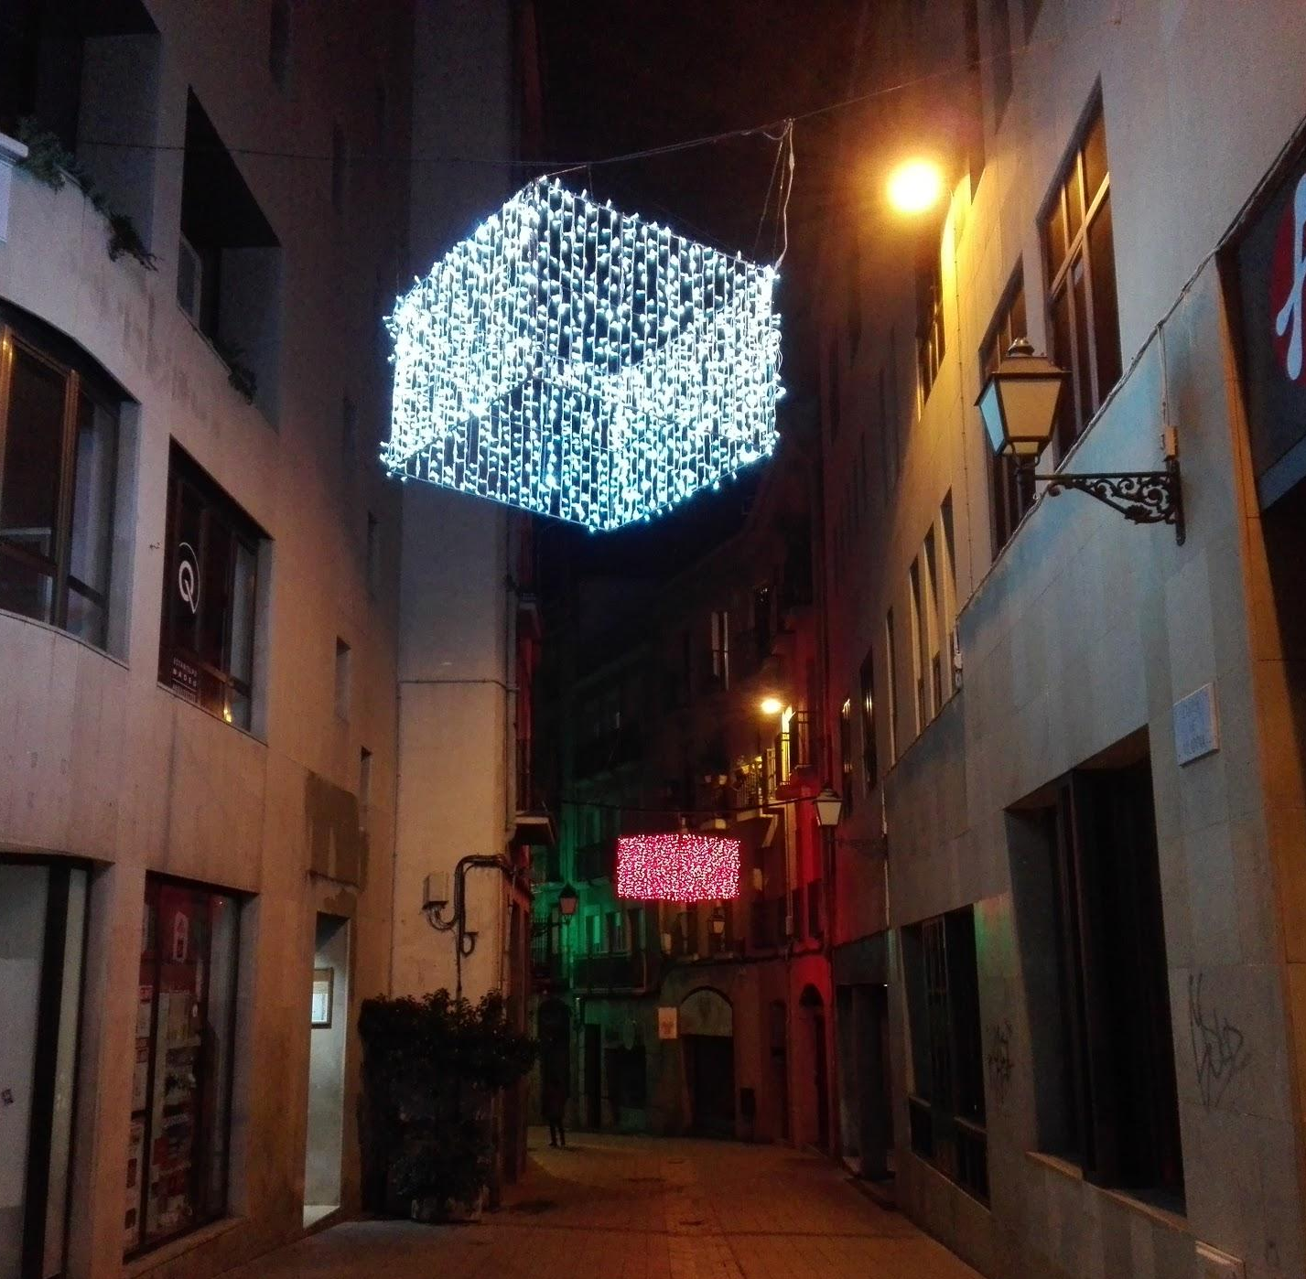
In Vilanova Street there is one white bright cube and a red bright cube all over the street.

Slide 14
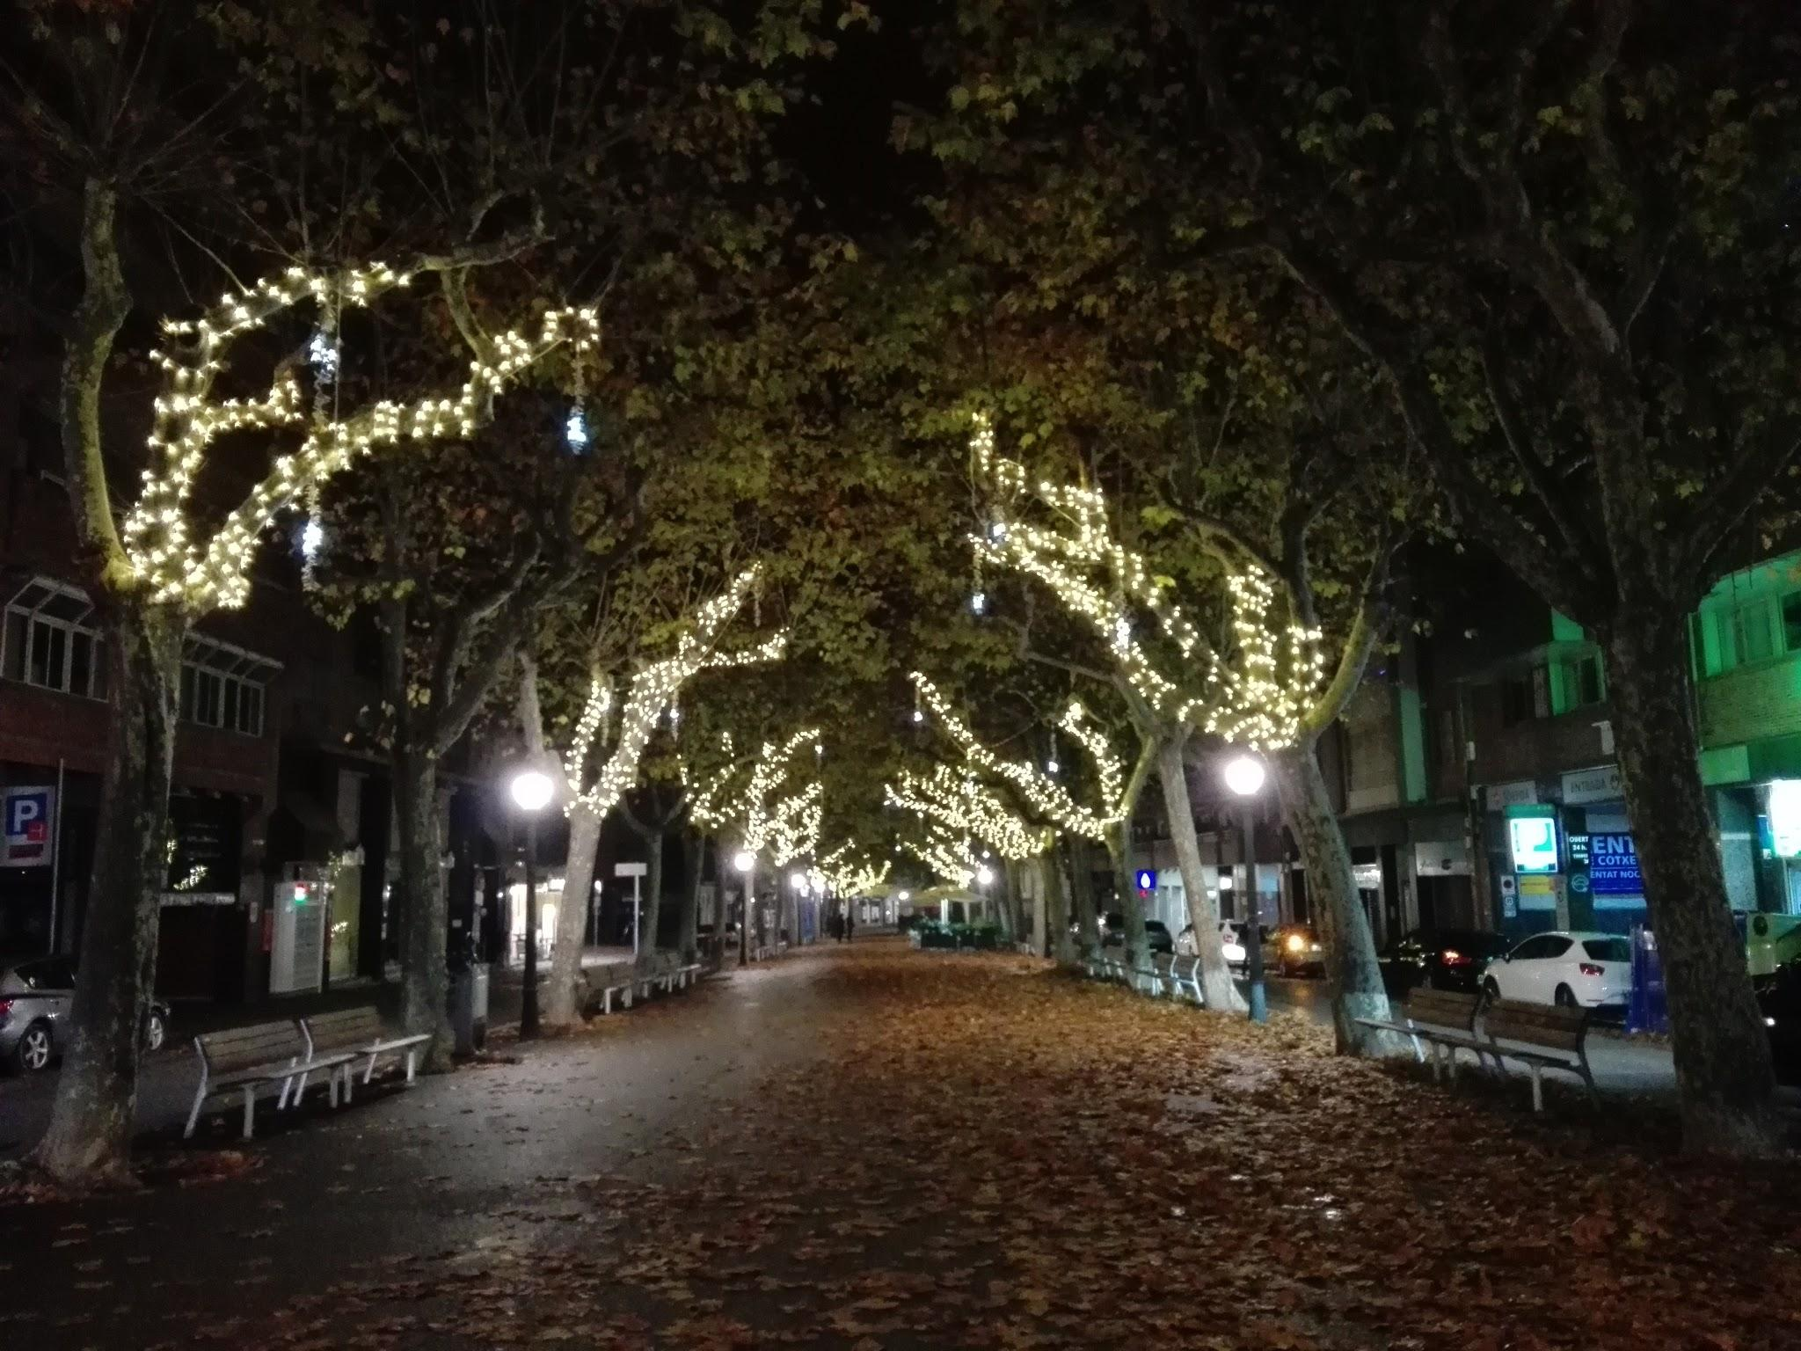
The boulevard is illuminated with white lights in the trees.

Slide 15
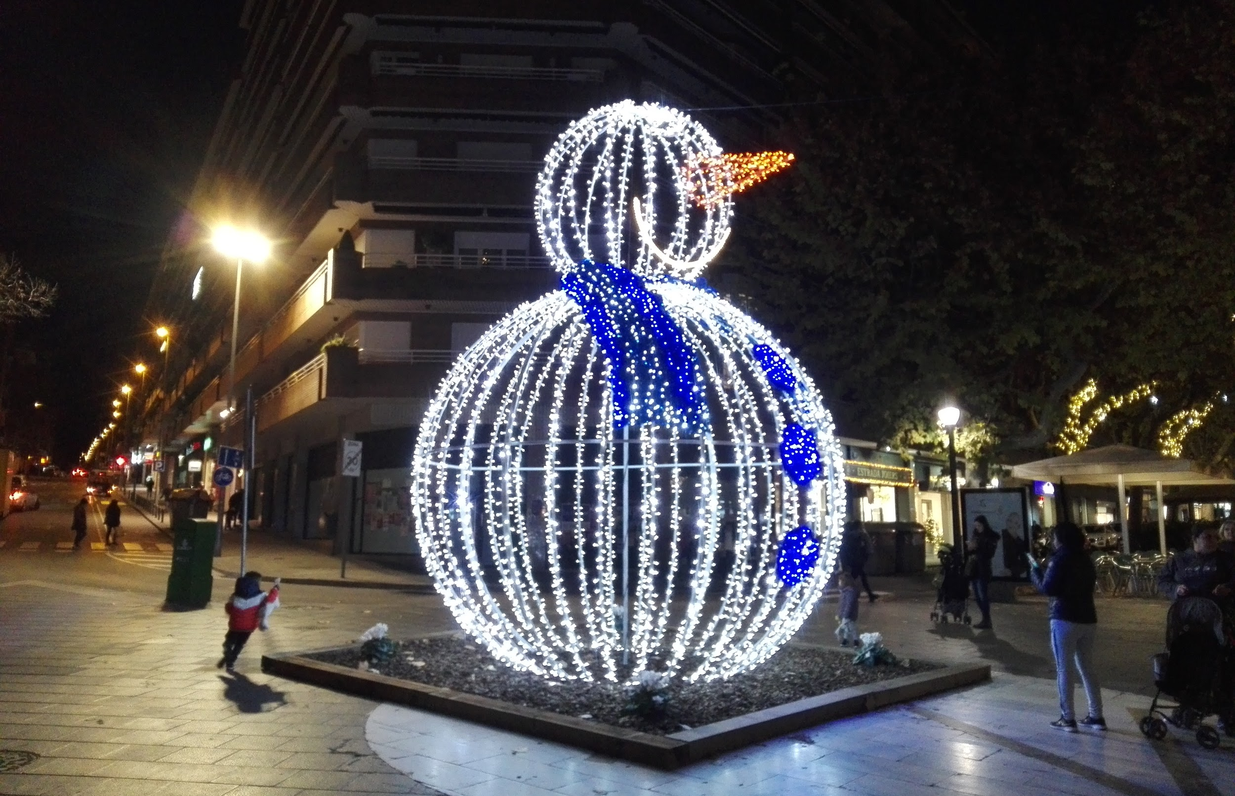
A snowman in the city center

Slide 16
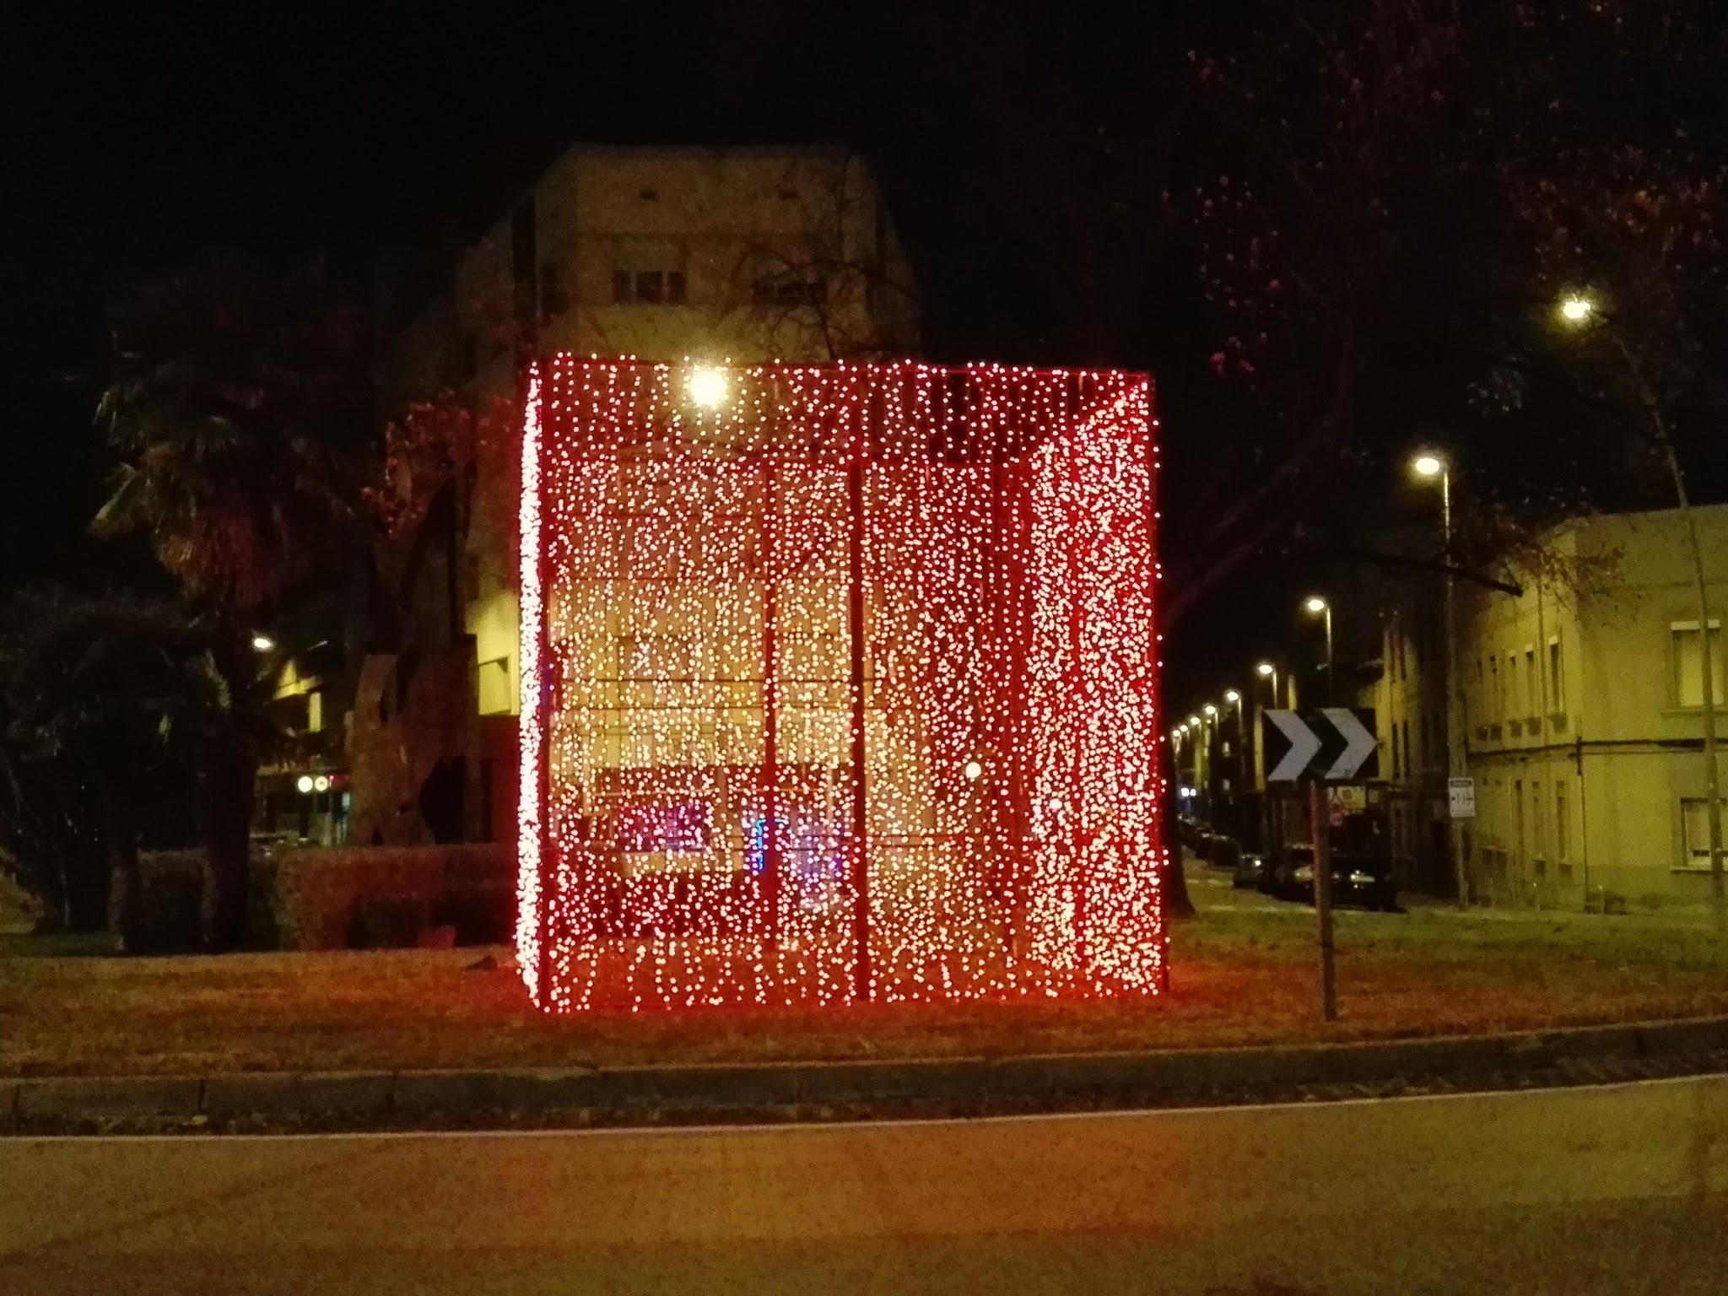
This is La Creu Roundabout. The Christmas decoration is a big red box, illuminated at night.

Slide 17
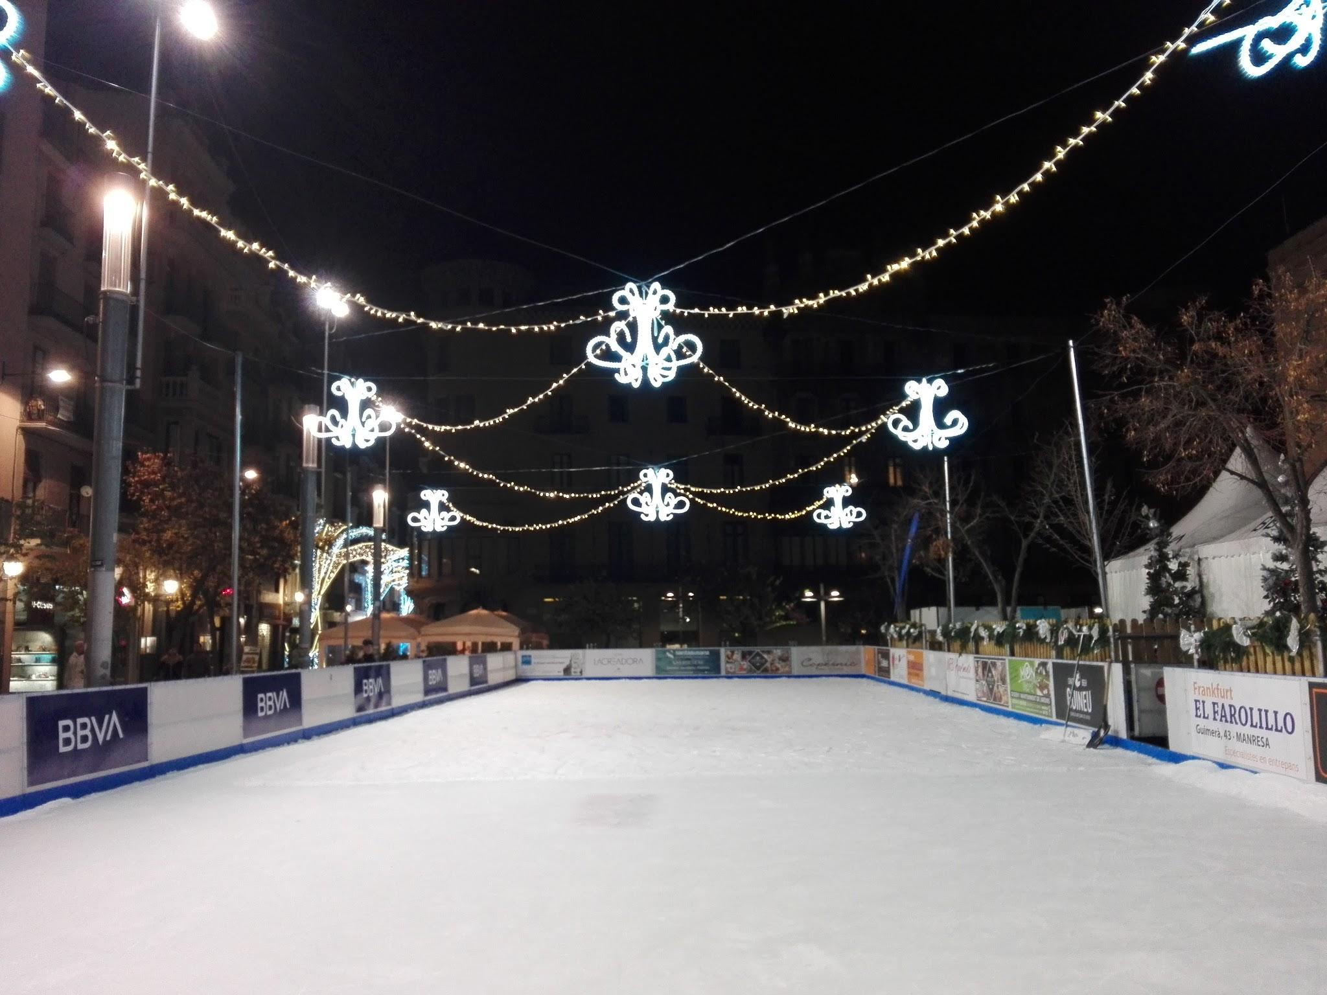
This is the ice rink at Saint Domenec Square.

Slide 18
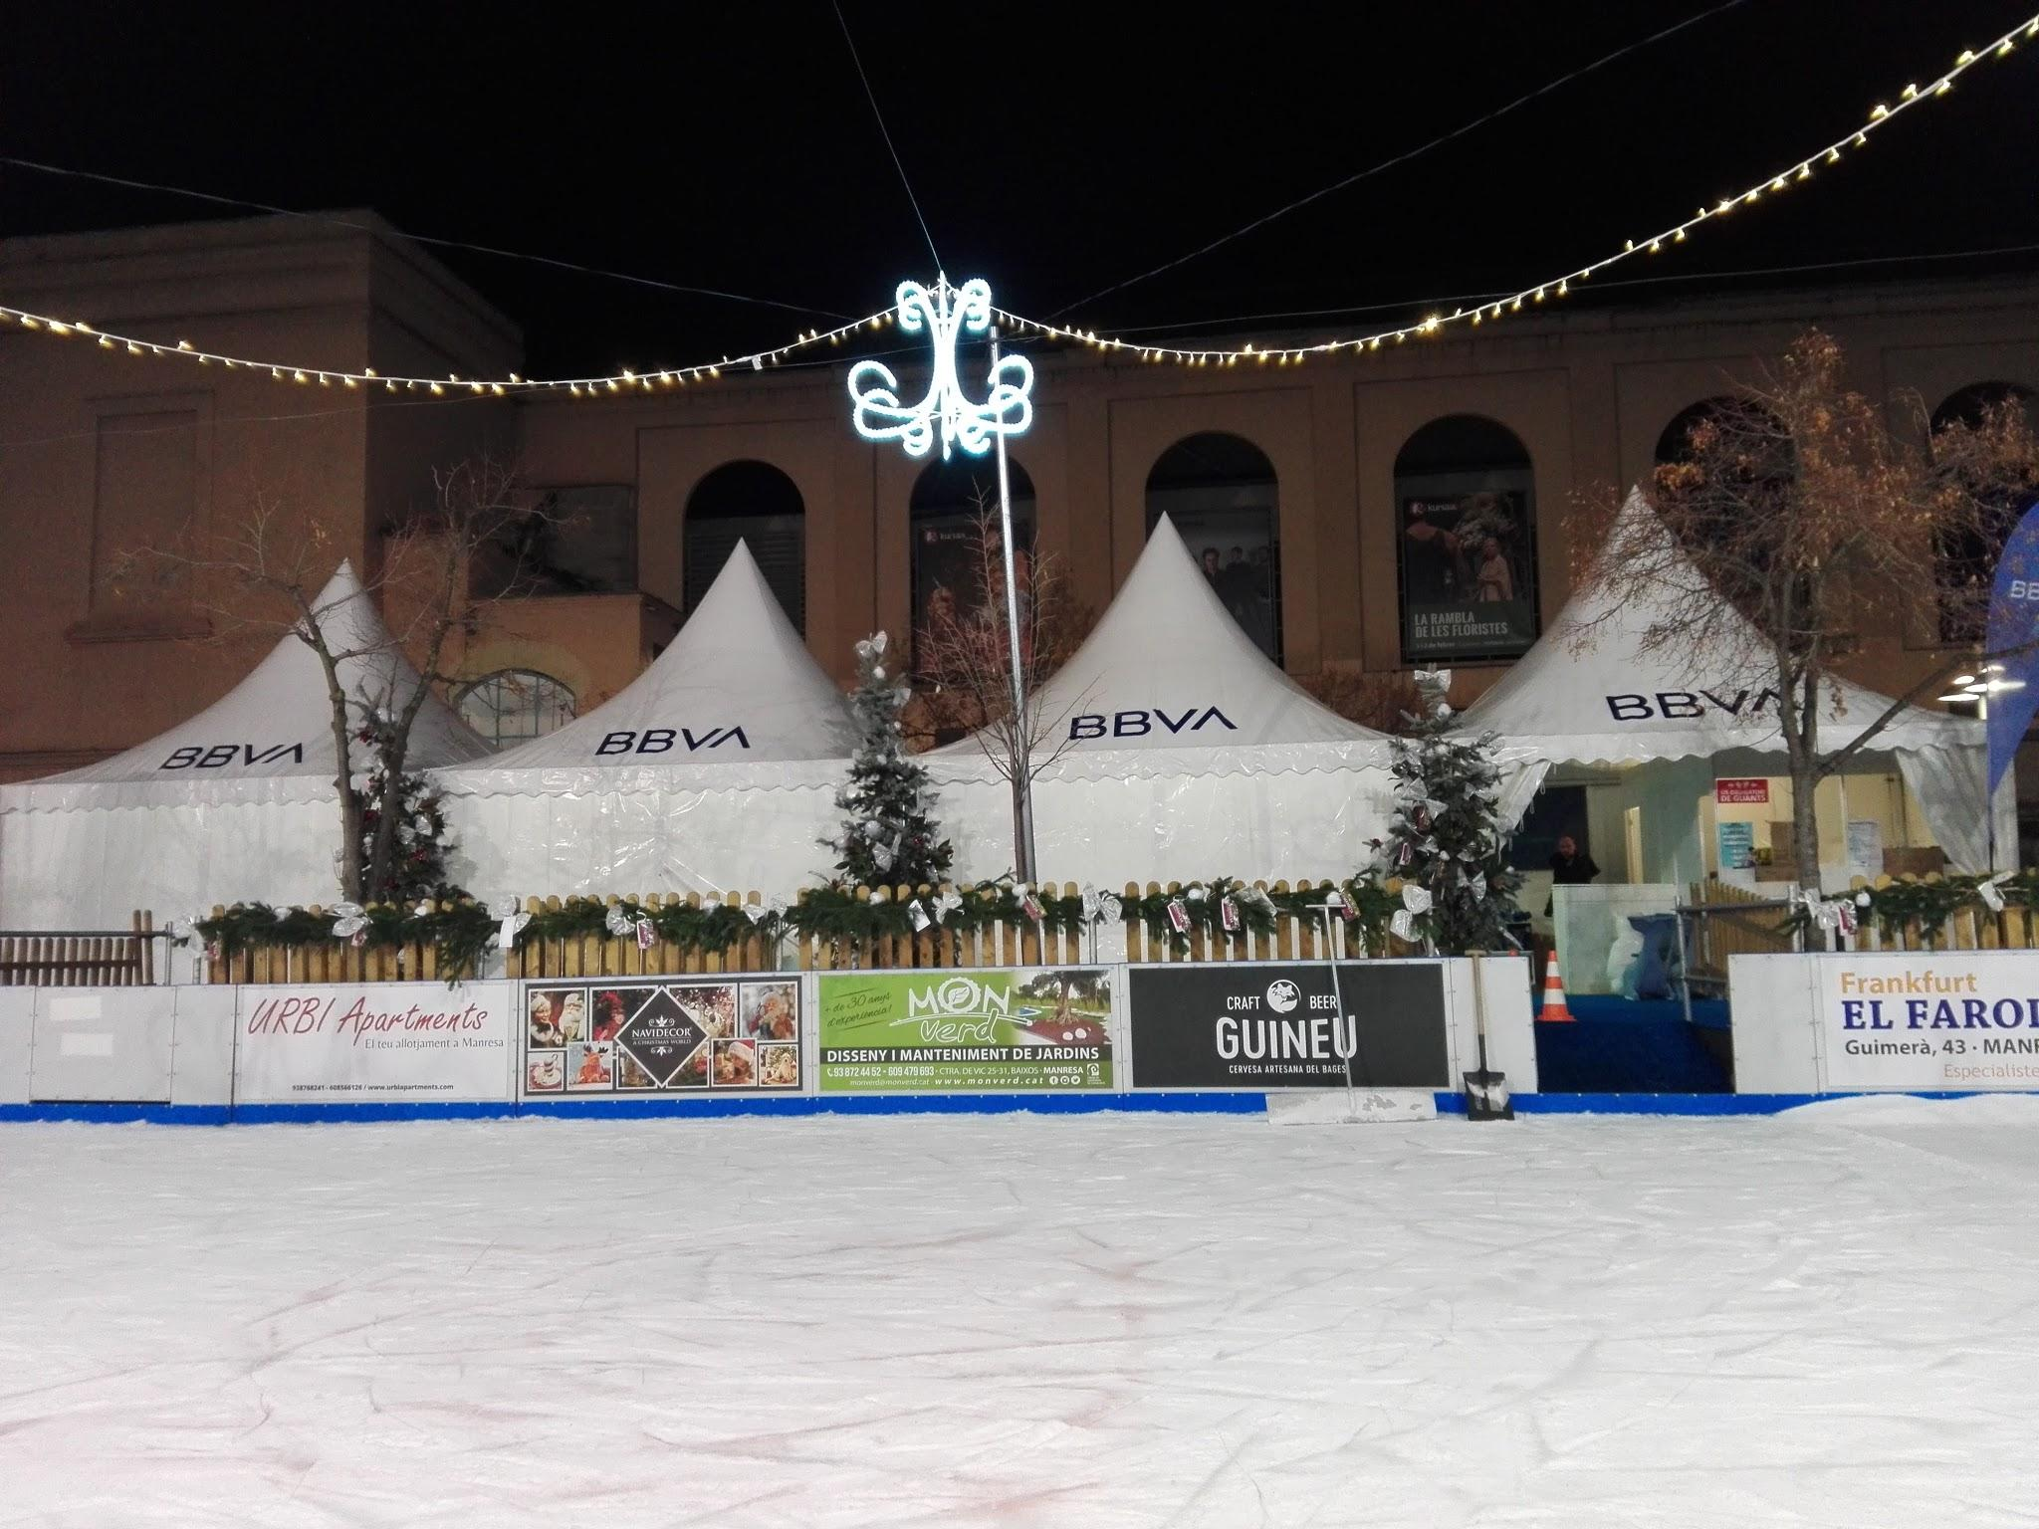
People from different ages, parents and children, groups of friends, etc., skate at the weekend.

Slide 19
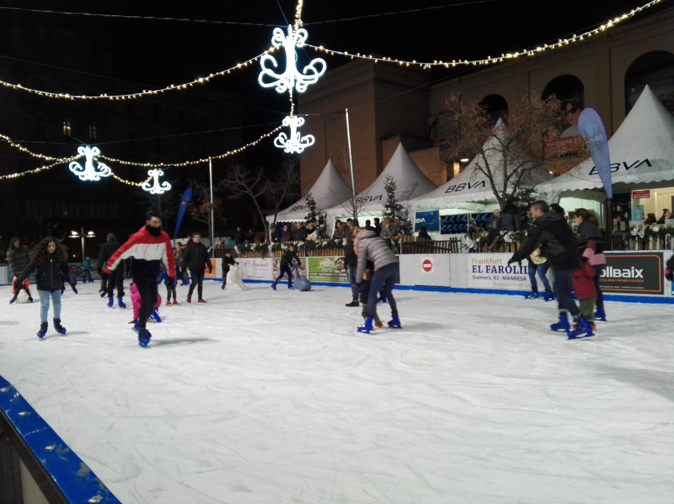
It’s so much fun!

Slide 20
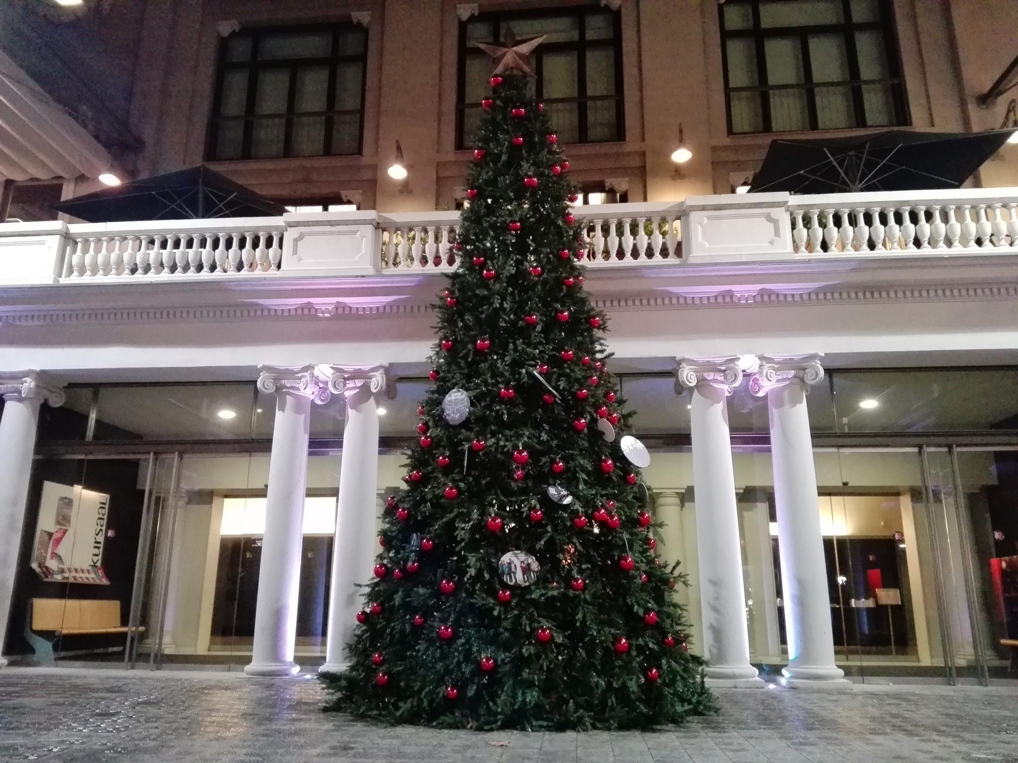
This is the Christmas tree, in the Kursaal theater, it is great and beautiful.

Slide 21
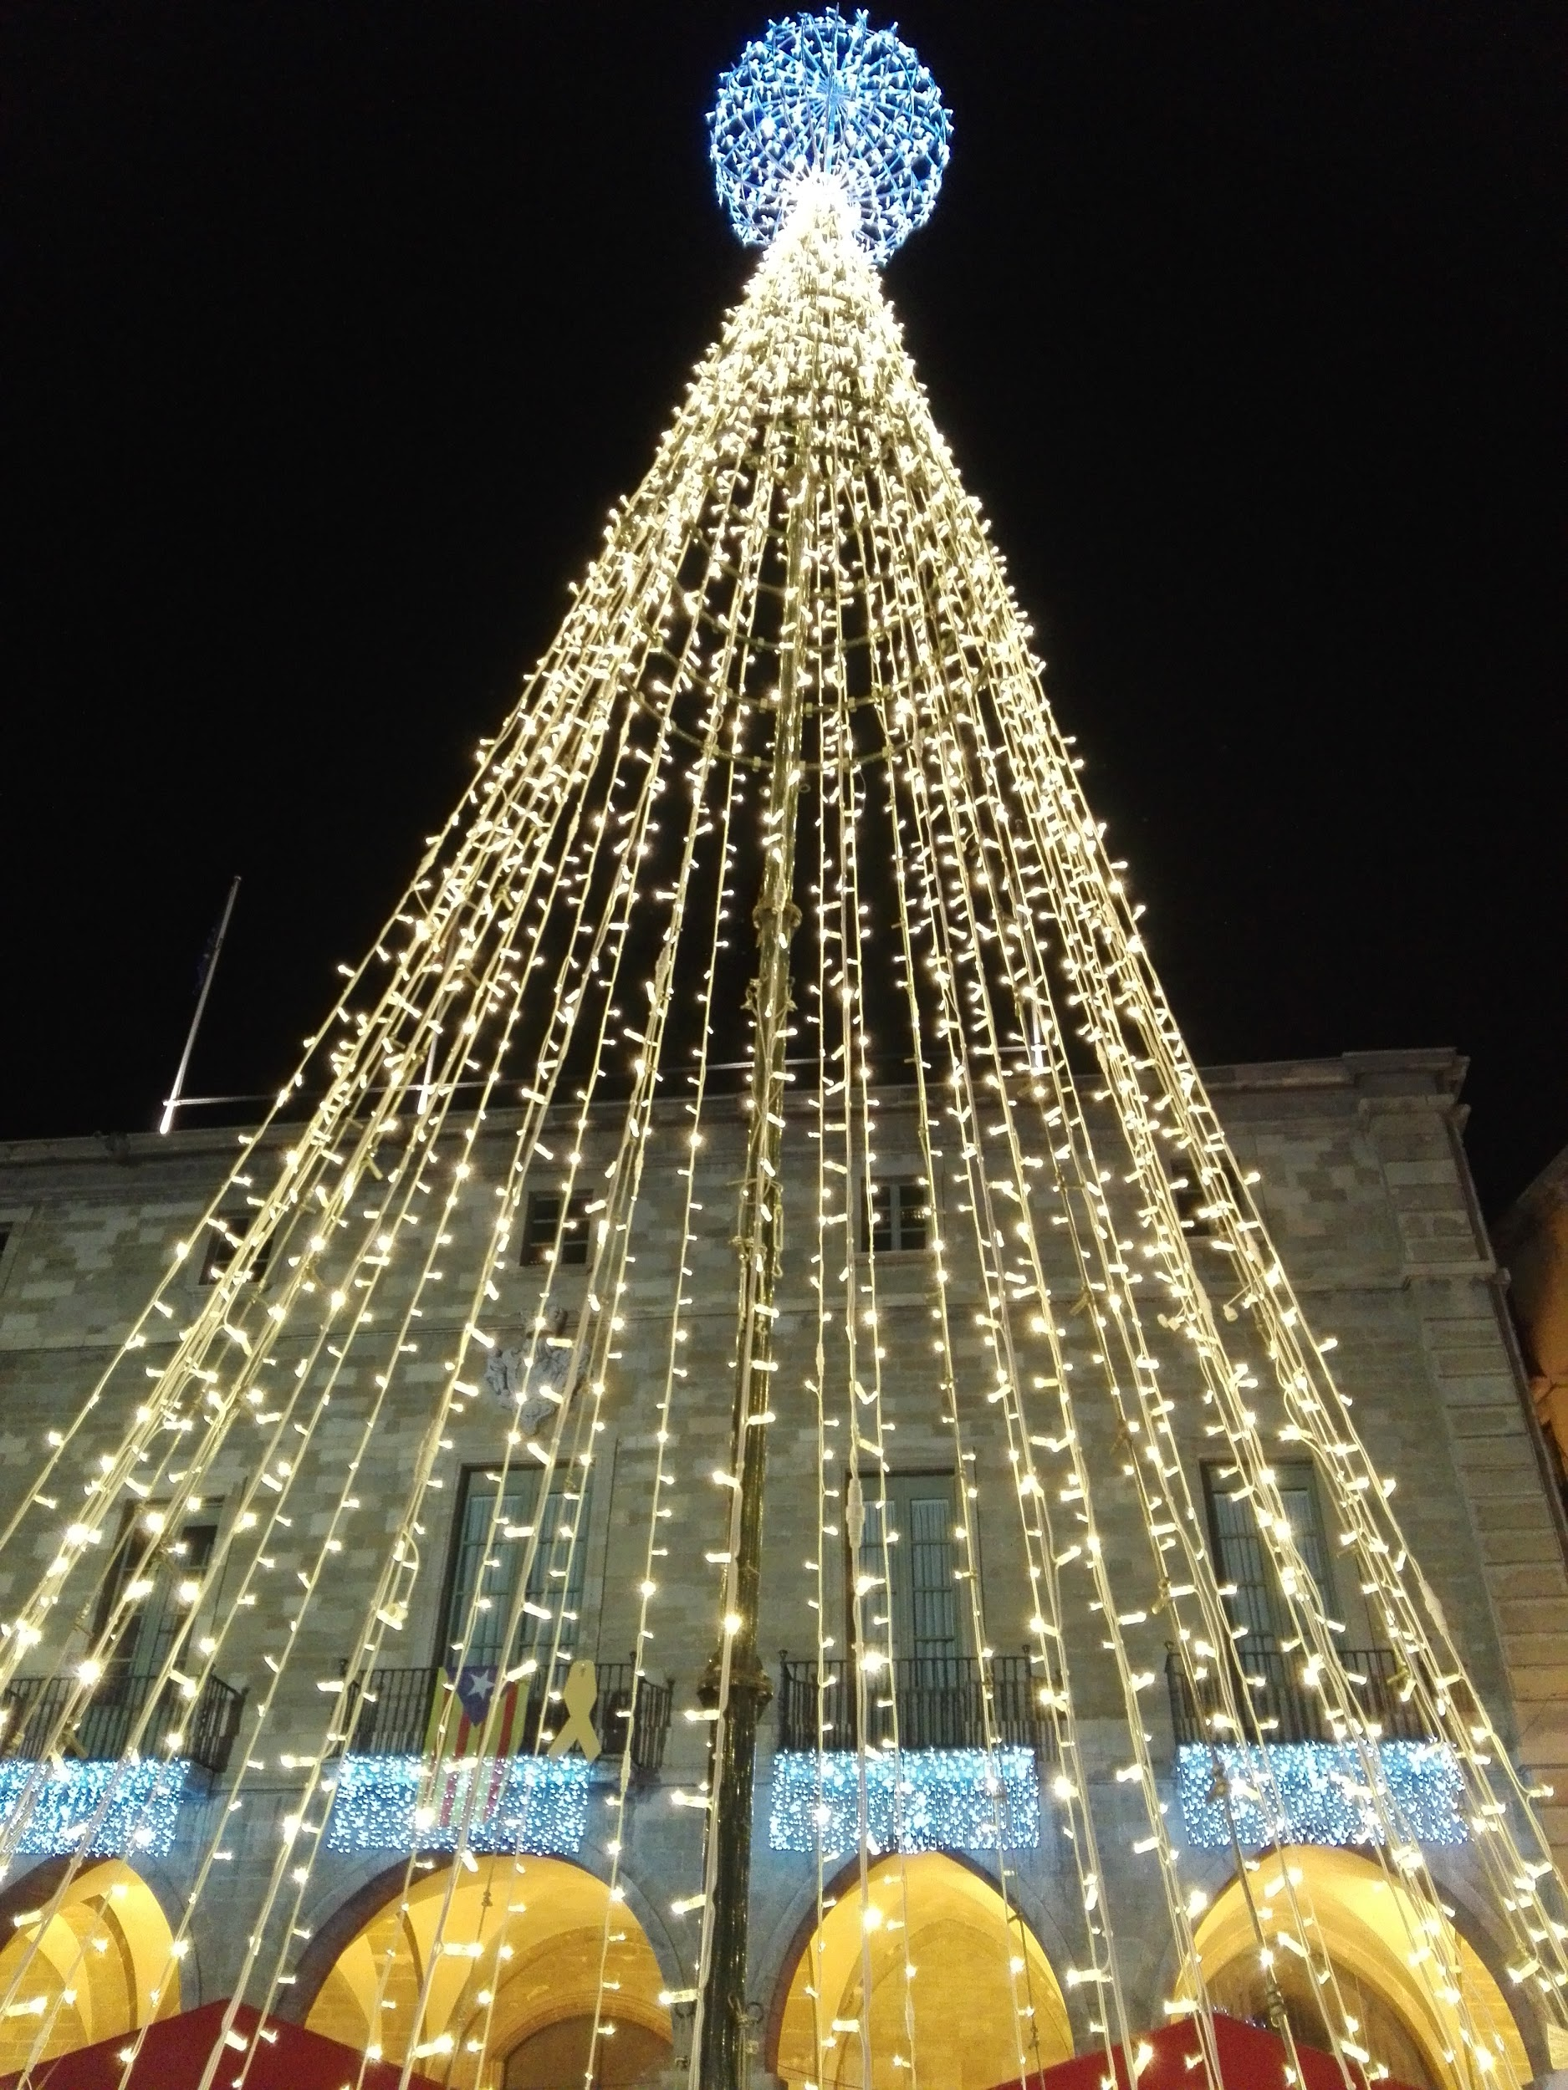
Another Christmas tree in front of the town hall.

Slide 22
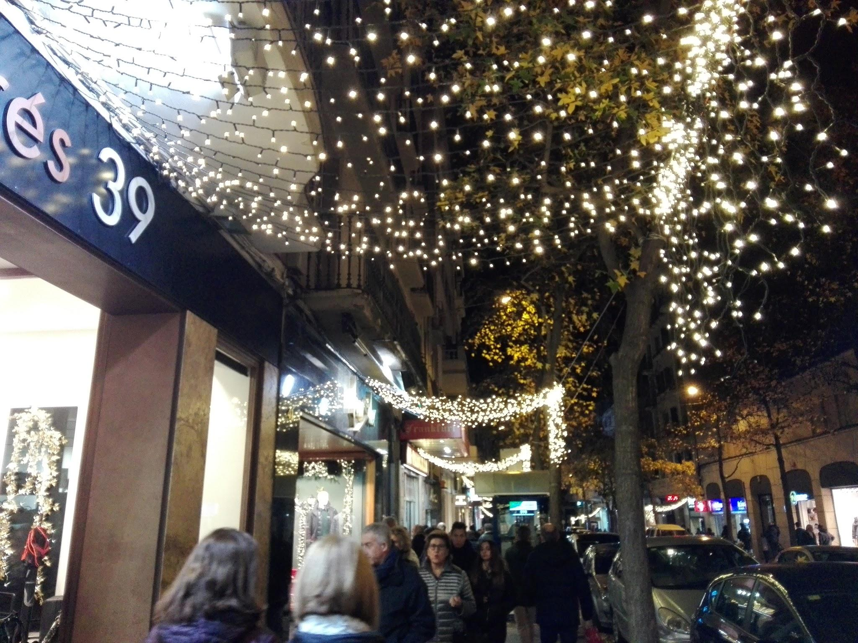
Commercial area

Slide 23
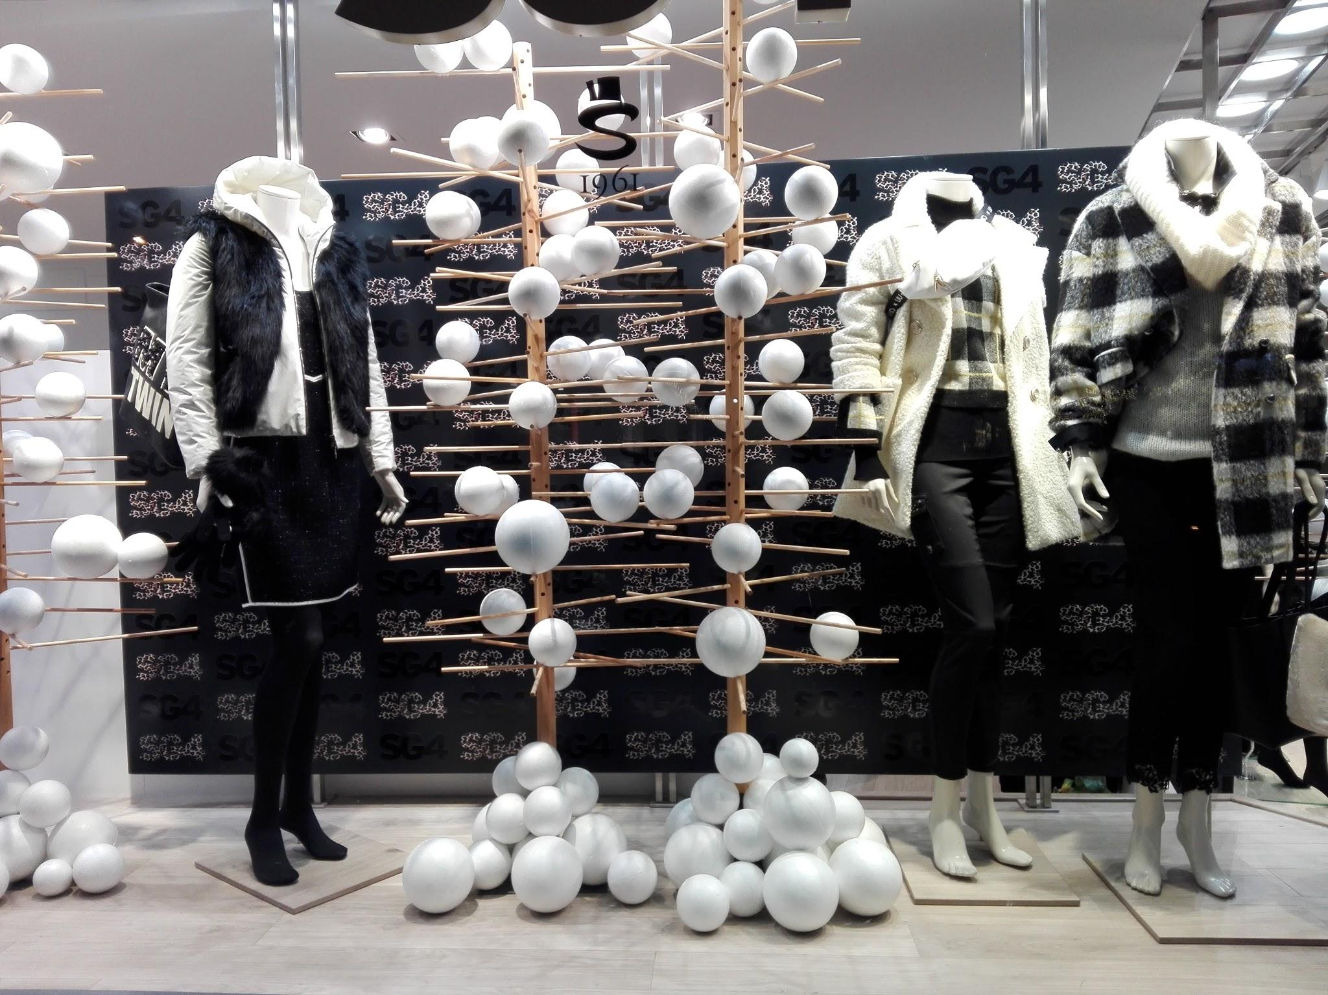
This is a clothing shop. For this year Christmas decoration, they’ve got small round white balls fixed on sticks and it’s really pretty with the clothes.

Slide 24
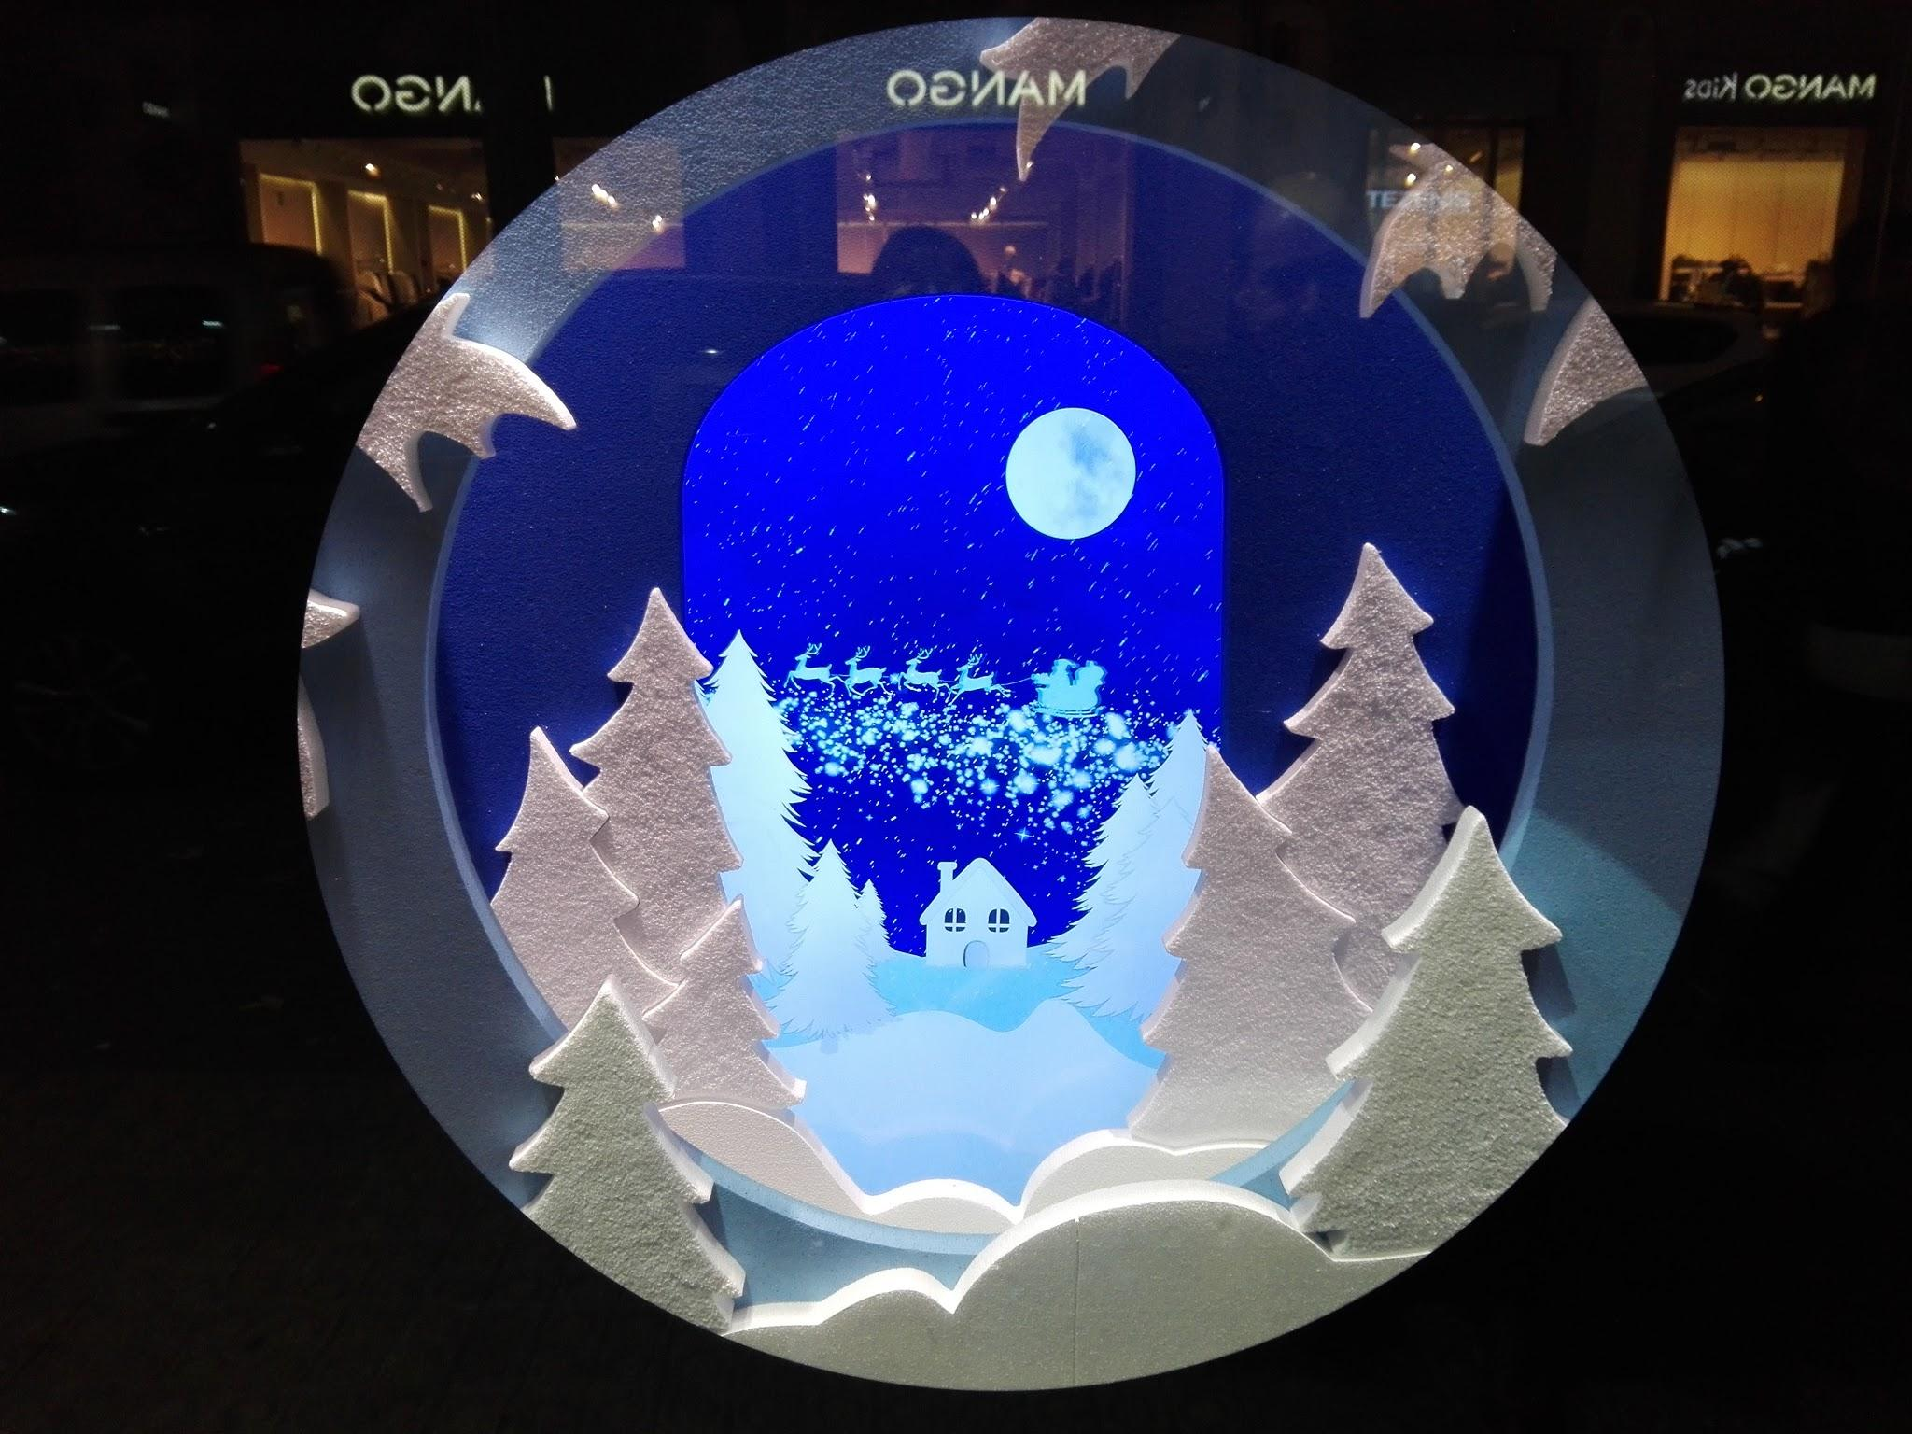
This shaped-like crystal snowball is set in front of a shoe shop as part of this years christmas decoration.

Slide 25
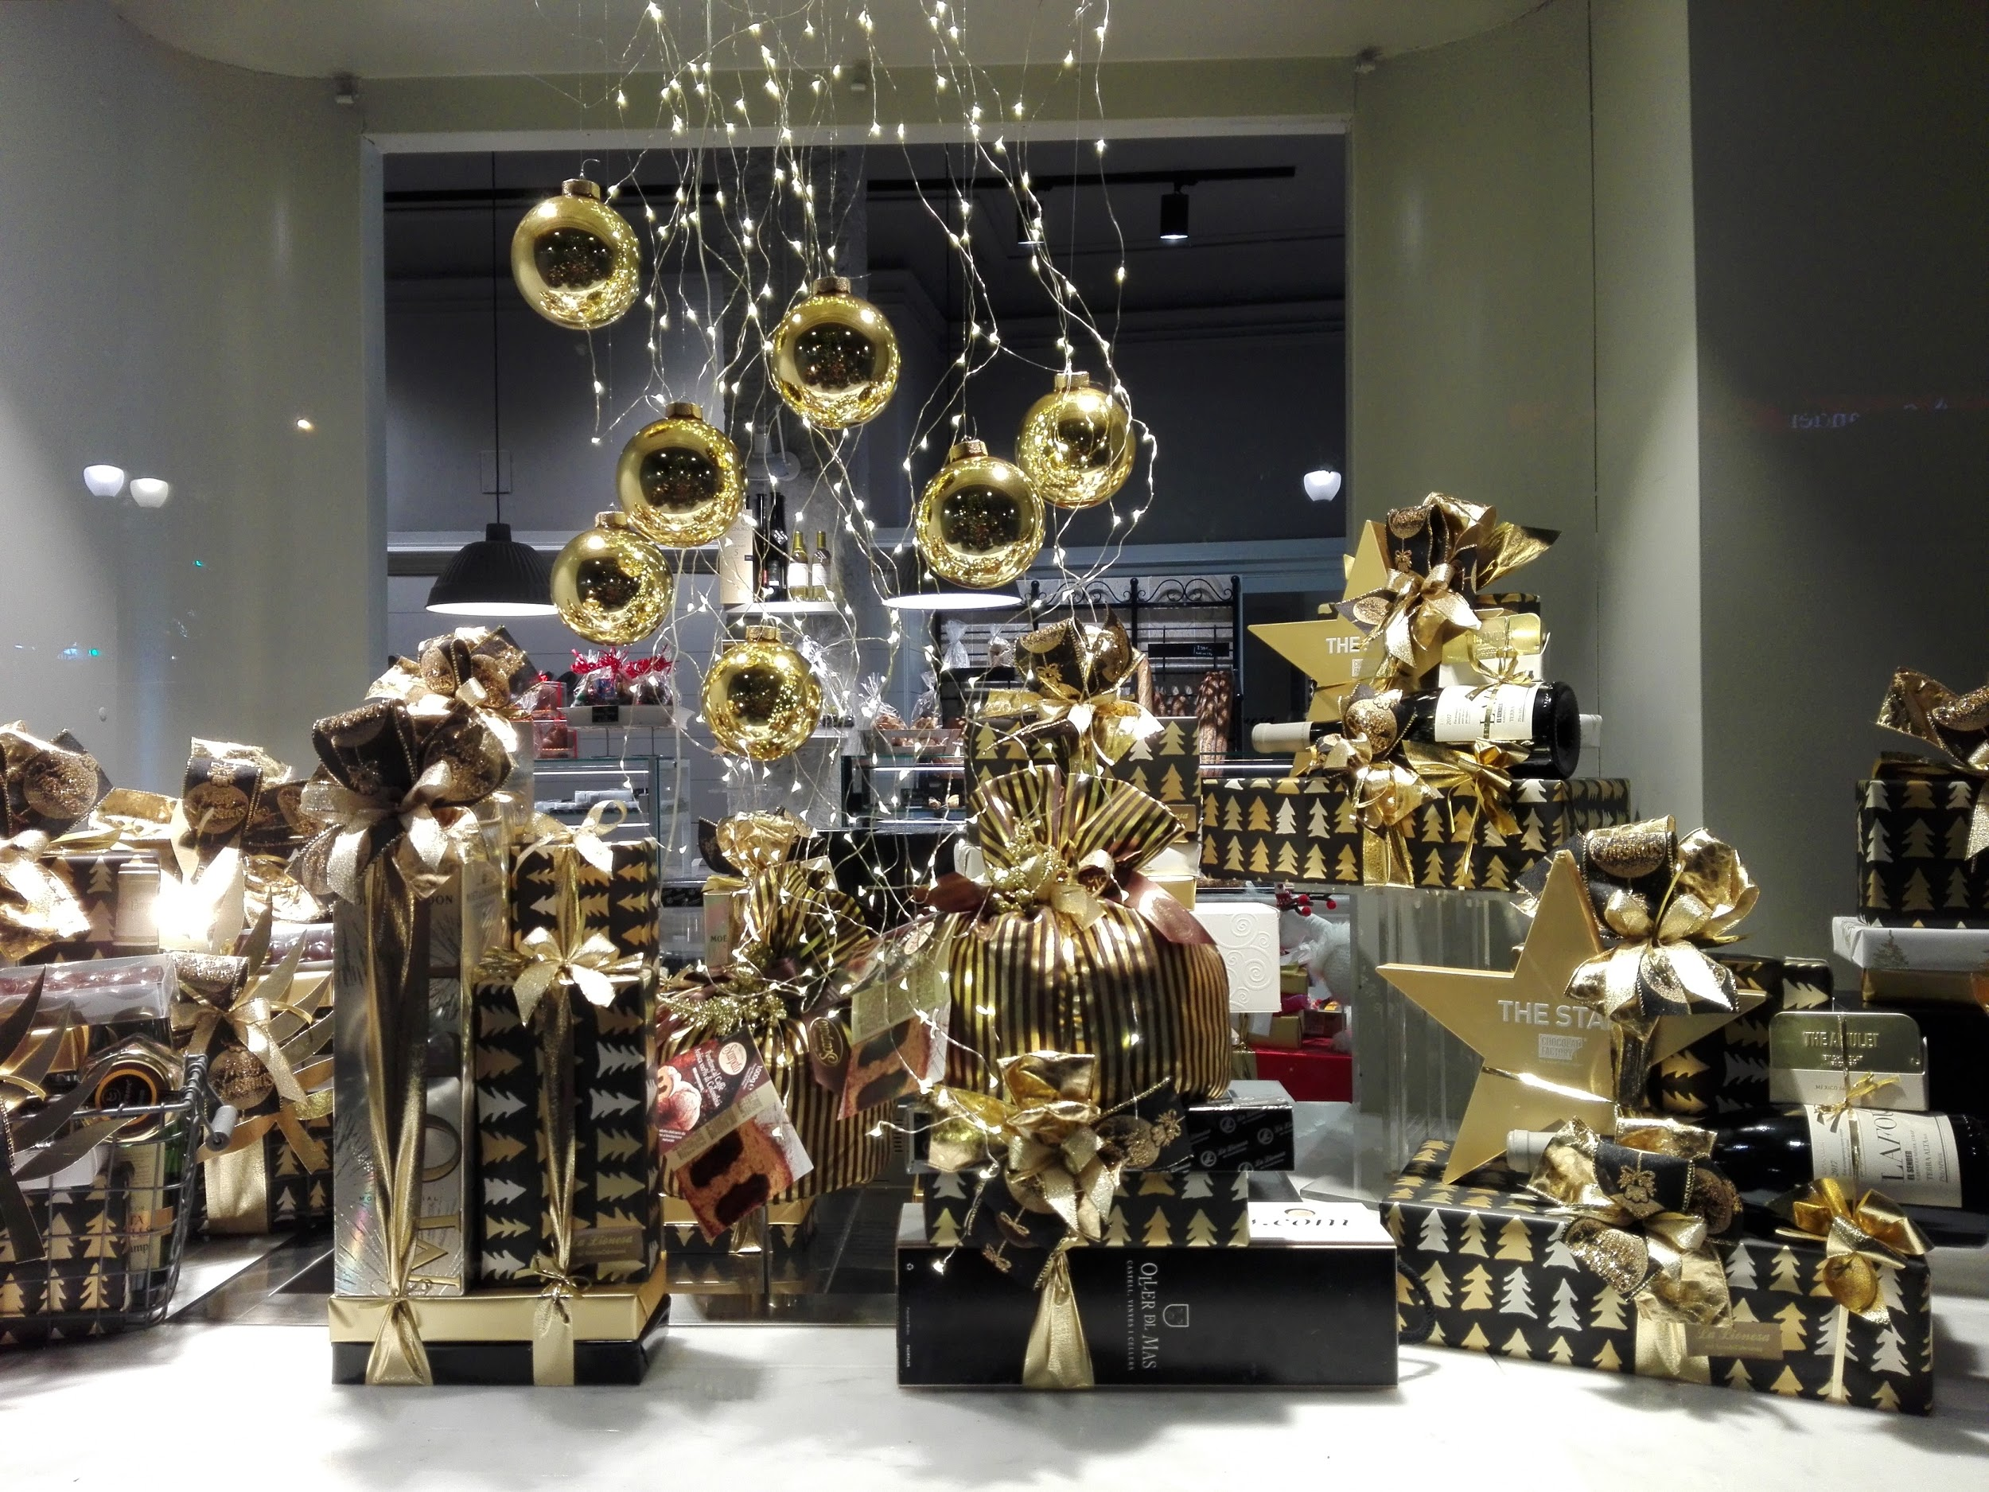
More shop windows

Slide 26
Presentation made by GES-2 students
Photos taken by students and teacher
Manresa, december 2019

