Slide 1
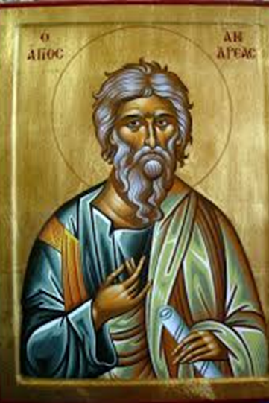
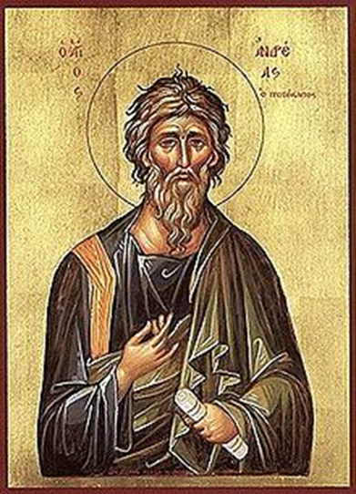
On On the 30th of November, the
the Romanians celebrate
St. Andrew the Apostle

Slide 2
It is a day off in Romania
St. Andrew is considered Romania's upholder because he is the one who brought Christianity in our country. The night of 29th to 30th November is considered in the Romanian tradition, the night when wolves and vampires come on Earth. The superstitions say that, if you want to protect your household from vampires and wolves, it's really important not to brush you hair, not to clean any room from the house and not to take the rubbish out on that day. It's also important to use garlic if you want to keep vampires far away from your home.

Slide 3
Other superstitions about this day:
It is said that, if a girl is cooking bread with flour, salt and water in equal quantities and she eats it, she will dream her future husband giving her a cup of water.
Basil thread: Traditions say that if you're an unmarried girl and you put basil under your pillow you will dream your future husband's face.

Slide 4
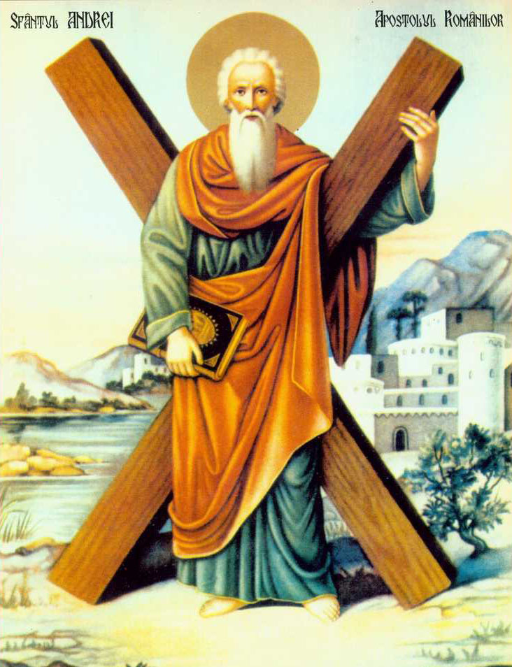
St. Andrei (born 6 BC, Judeea Province, Roman Empire - d.November 30 60 en, Patras, Achaia, Roman Empire) was an apostle of Jesus of Nazareth, brother to Simon Peter.

Slide 5
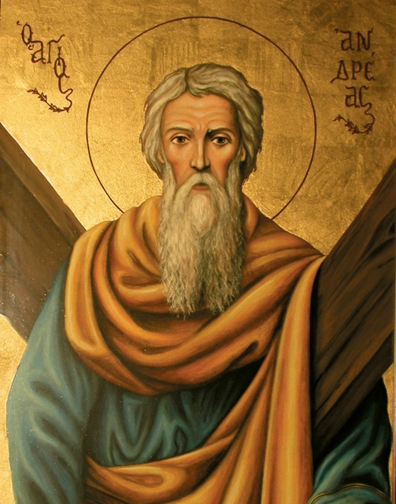
The Gospel of John mentions that Andrew was first a disciple of John the Baptist, who would have recommended him to follow Jesus. According to the same gospel, Andrew would have brought his brother Simon Peter to Jesus, telling him that he had found the Messiah (John 1:35-42).

Slide 6
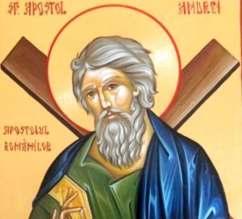
Andrew was a disciple of John the Baptist, when, at a time after Jesus' baptism, he heard John the Baptist say of Jesus, "Behold the Lamb of God!" (John 1:36) he followed Jesus, becoming the first apostle. After the resurrection of Jesus and the Descent of the Holy Spirit (at Pentecost), the apostles remained in Jerusalem for a few years, beginning with the formation of the Church. At the Apostolic Synod that took place around 49-50 AD. in Jerusalem, the apostles met and drew lots to decide where each one would go.

Slide 7
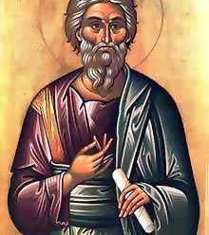
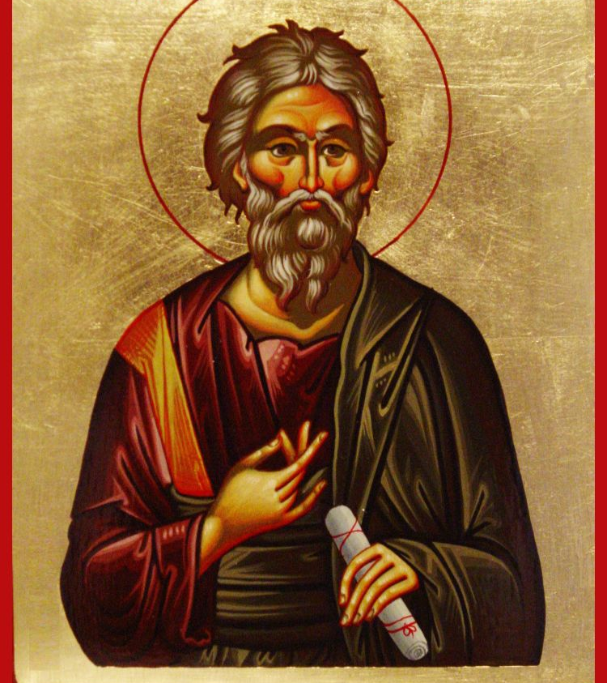
In the Tradition of the Church of the Apostle Andrew, Scytia (Dobrogea) returned. First, Andrei accompanied his brother (the Apostle Peter) through Asia Minor, then crossed the Balkan peninsula through the territory of today's Turkey, reaching Scytia, where it stopped for a while. Then continued the mission of preaching the gospel, reaching as far south as Russia today.

Slide 8
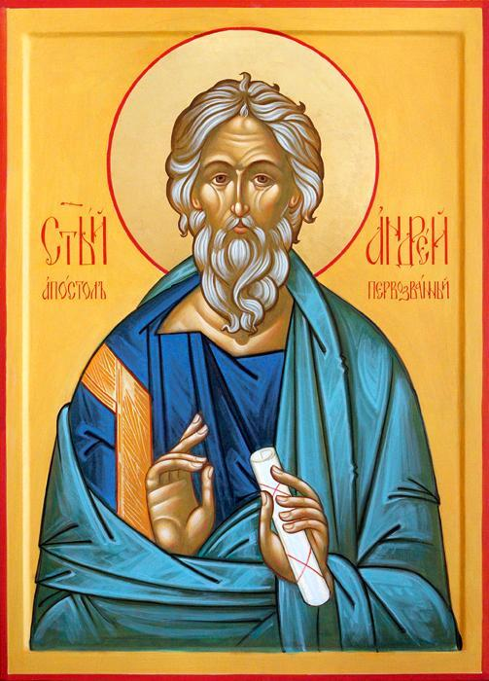
Veneration as a saint
Around the year 350 the emperor Constantius II (the son of Constantine the Great) takes the relics of Saint Andrew to Constantinople and places them in the Church of the Apostles.

Slide 9
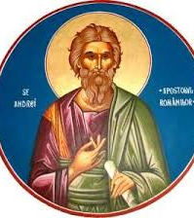
These were preserved until around 850, when the Byzantine emperor Vasile I of Macedonia surrendered to the prayers of the inhabitants of Patras and returned the head of Saint Andrew. In 1208 , during the Fourth Crusade, the relics reached Amalfi, near Naples, being kept in the dome of San Andrea. In 1462 they were taken to Rome because of the Turkish danger. In the 15th century Pope Pius II moved relics of Saint Andrew to the Cathedral of Saint Peter in Rome. In 1964, the head of Saint Andrew was returned to the church in Patras.

Slide 10
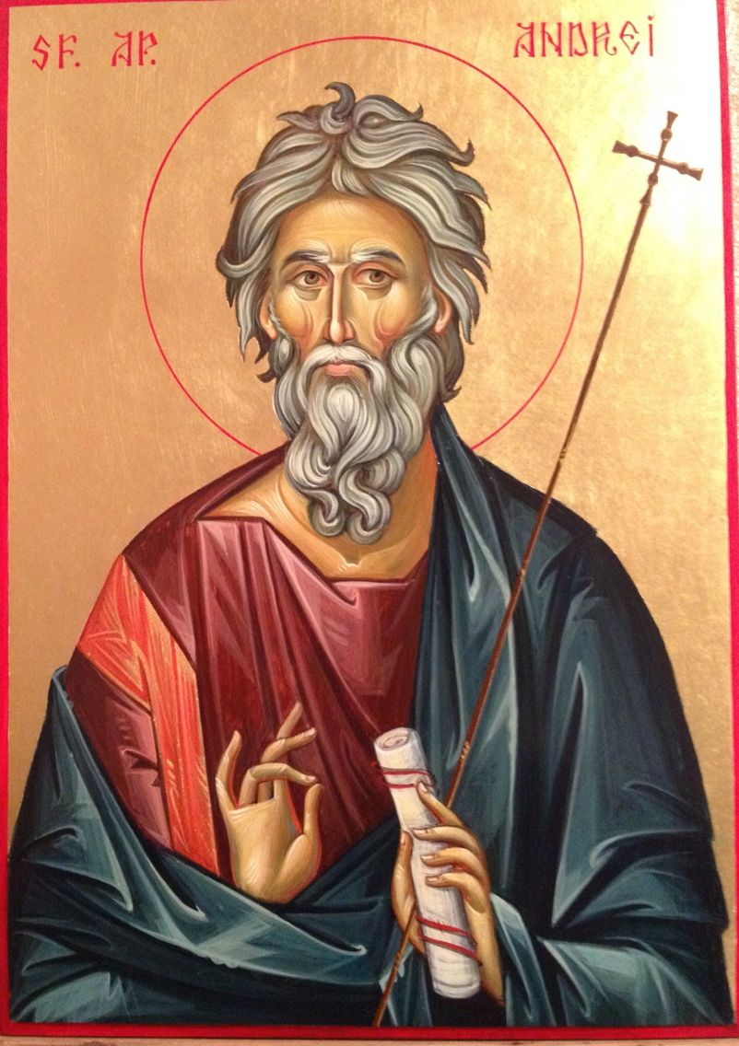
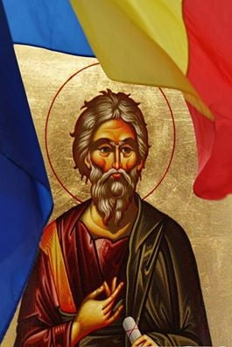
Because he was a fisherman, Saint Andrew is considered by Greek sailors and fishermen as their protector. St. Andrew's Cave, St. Andrew's Paradise are some testimonies that prove the Apostle's passing on these lands. According to the tradition of the Church, the fate of Saint Andrew the Apostle fell to the parts of the Black Sea and known at that time as Scythia.

Slide 11
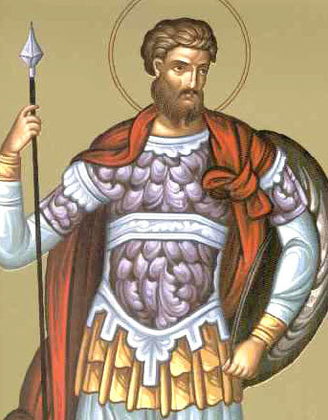
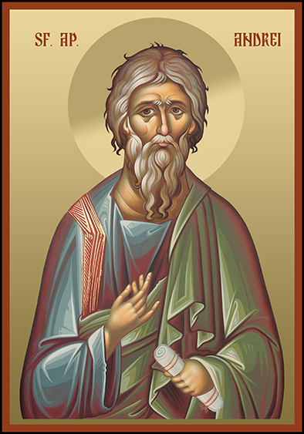
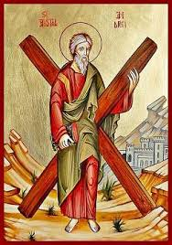
Celebrated:
- In the Orthodox calendar: November 30
- In the Roman Catholic calendar: November 30 and May 9 (the latter is celebrated only in Scotland, as a reminder of the date of receiving relics of Saint Andrew)
- In the Lutheran calendar: November 30th
- In the Anglican calendar: November 30th

Slide 12
Presentation made by:
Popoiu Andrei
Panait Florin
Dogaru Veronica
Arbunea Crina

