Slide 1
NOWRUZ FESTIVAL

Slide 2
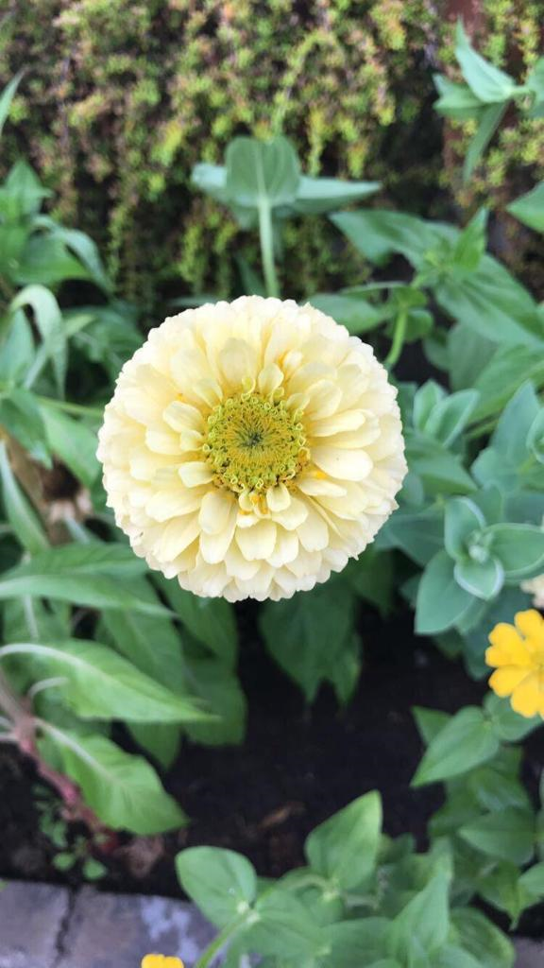
What is Nowruz?
In essence, it is a festival in which spring is celebrated with enthusiasm.
Nowruz means “new day”. It is formed by the combination of two words; now (new) and ruz (day).
It is celebrated as a new year by many people and communities especially Turkey.

Slide 3
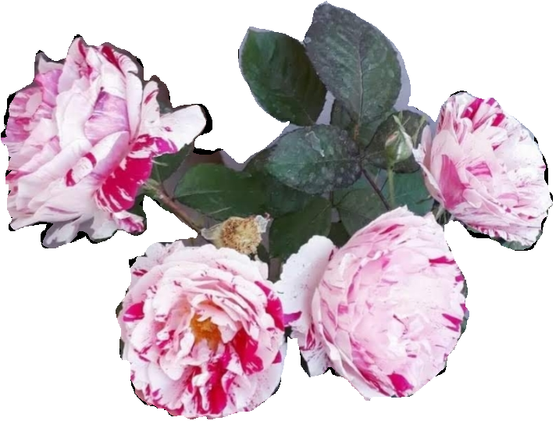
Nowruz is celebrated in different countries of the world. Nowruz festival varies according to the cultures of the countries where it is celebrated. Every
country celebrates
Nowruz in different
ways and different
times because of the
shape of the earth and
its rotation around the
sun.

Slide 4
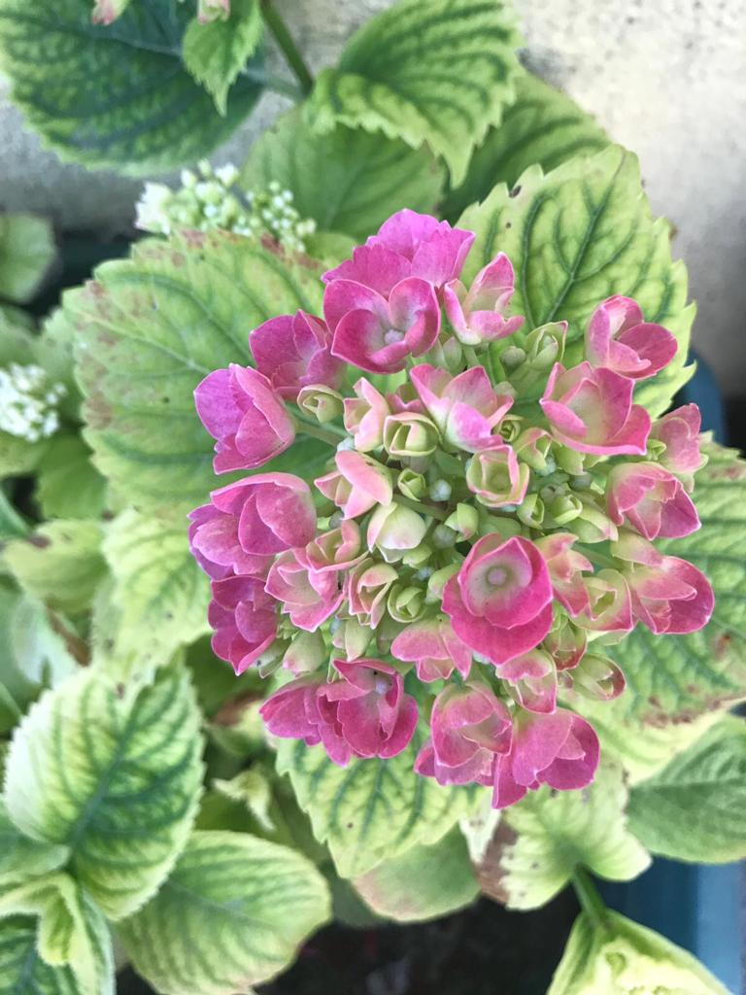
On March 21, when day and night are equal, the sun turns to the northern hemisphere. The weather gets warmer, the snow melts, the trees bloom, the soil turns green, the migratory birds begin to return to their nests.
For this reason, March 21 is accepted as the day of awakening, resurrection and creation for all beings and it is celebrated as Nowruz Festival.
The United Nations accepted March 21 as ‘International Nowruz Day' in 2010.

Slide 5
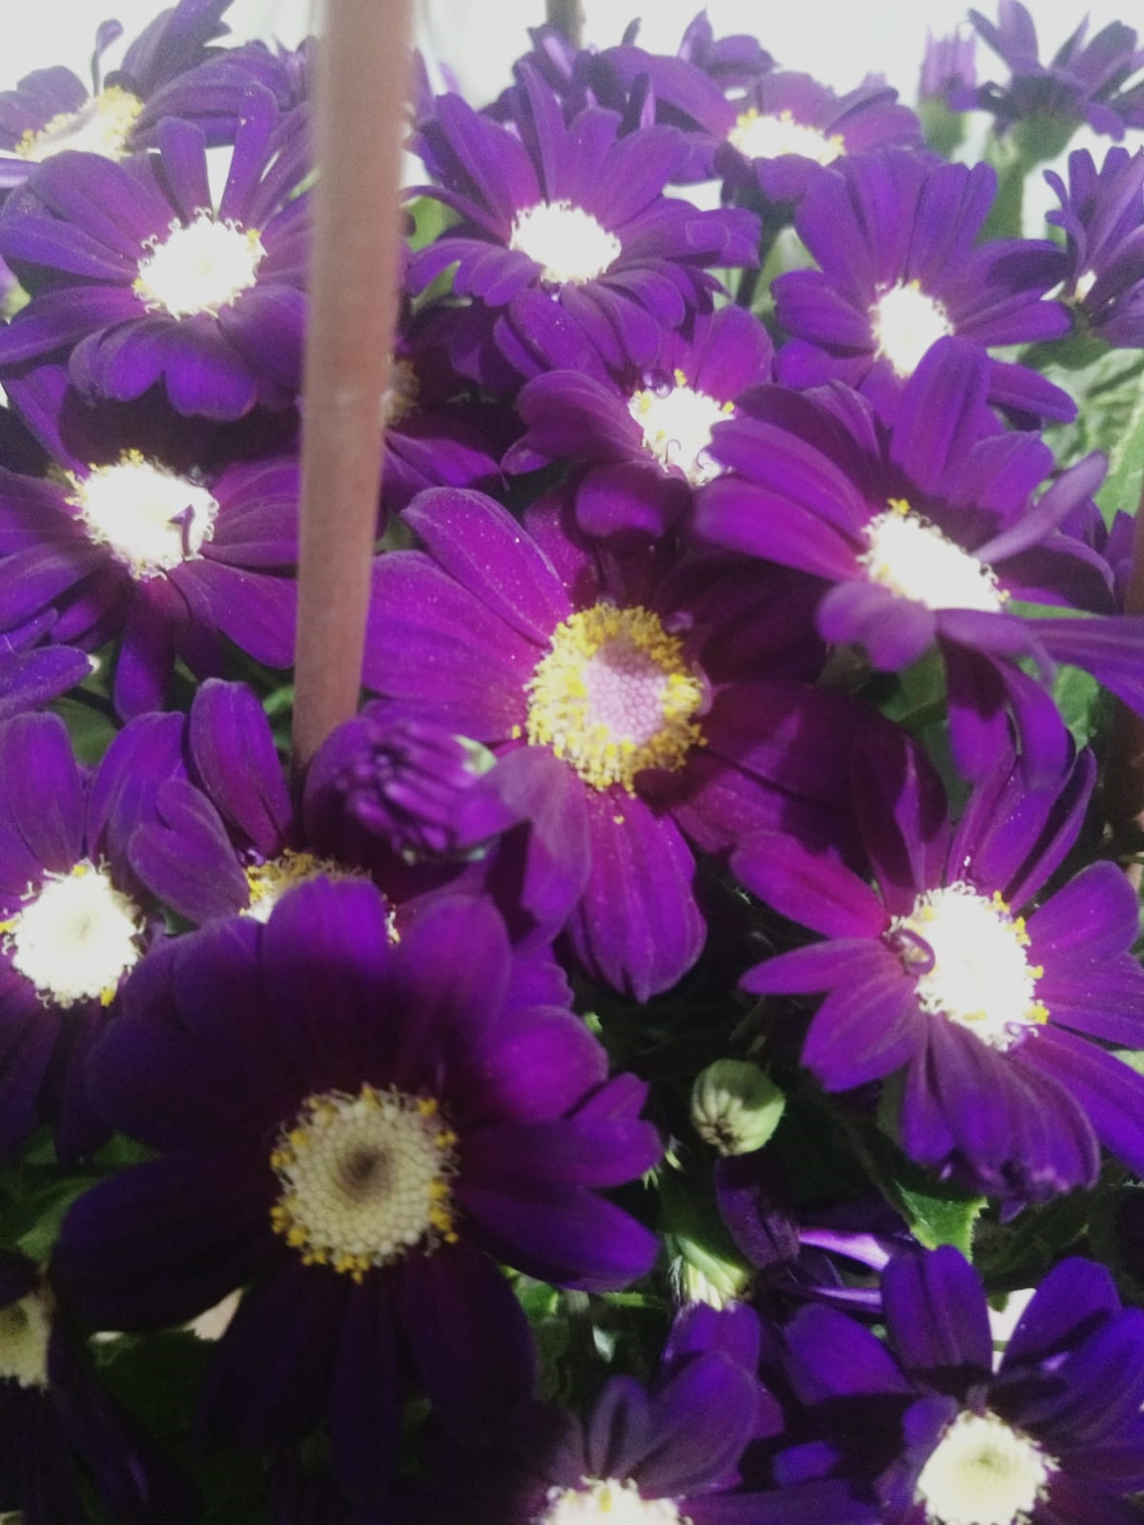
What to do on Nowruz ?
On Nowruz, children and young people gather on the streets and play egg tapping game. The eggs are painted by boiling in hot water with the outer skins of onions.

Slide 6
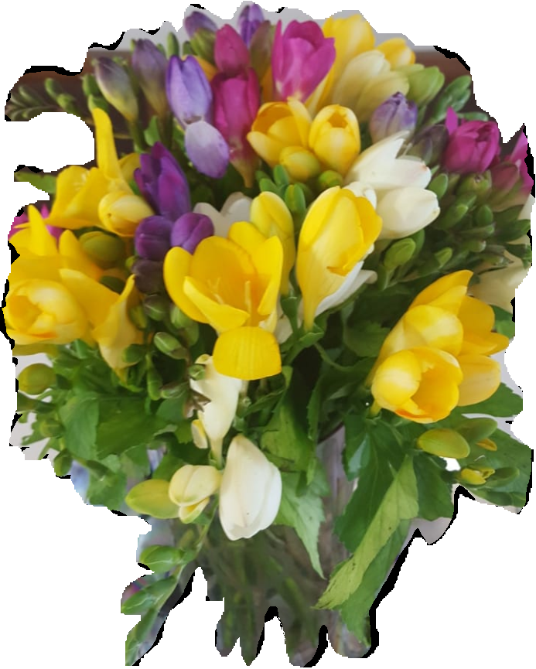
The most important principle of Nowruz is to light a fire. Lighting a fire is a way to get rid of the troubles and sorrows of last year. On Nowruz, the so called 'Tongel' fires are burned and everybody jumps over the fire making a wish. It is believed that the wishes of anyone passing over this fire will be accepted and this person will be healthy during the year.

Slide 7
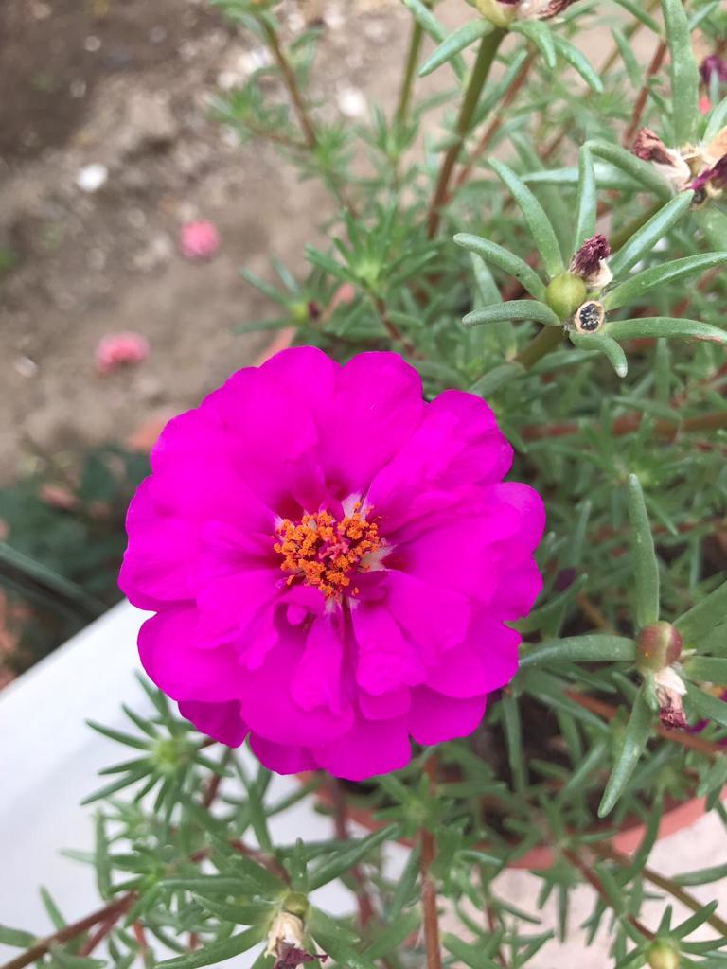
On Nowruz, houses are cleaned, old items are thrown away, relatives and neighbours are visited, cemeteries are visited and the tombstones are cleaned and flowers are planted. Everything is for a new, hopeful beginning.

Slide 8
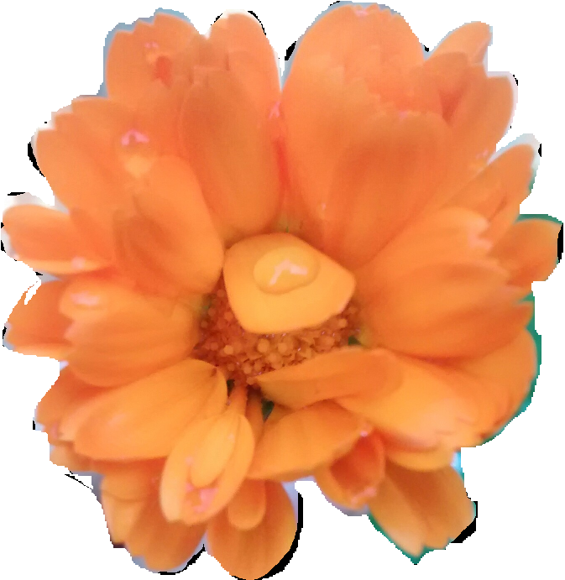
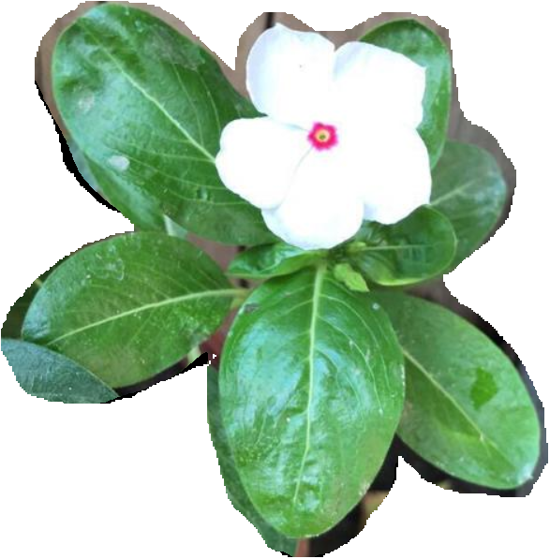
Another principle is putting some wheat in a container. You put some wheat in a container and then you add a little water in it. Next, you cover it with a very thin cloth. After some time, you can see the green fresh sprouts. These sprouts are seen as the symbol of hope.

