Slide 1
THE MEDITERRANEAN FESTIVAL
Manresa, 10, 11, 12 and 13 October 2019
GES-2 Morning group

Slide 2
CFA Jacint Carrió i Vilaseca (Manresa)
eTwinning Project
“Keeping traditions all year round”

Slide 3
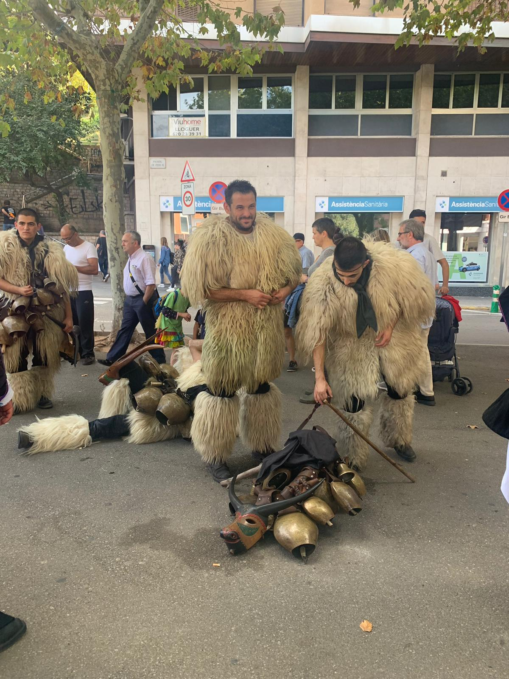
People wear costumes and carry some bells.

Slide 4
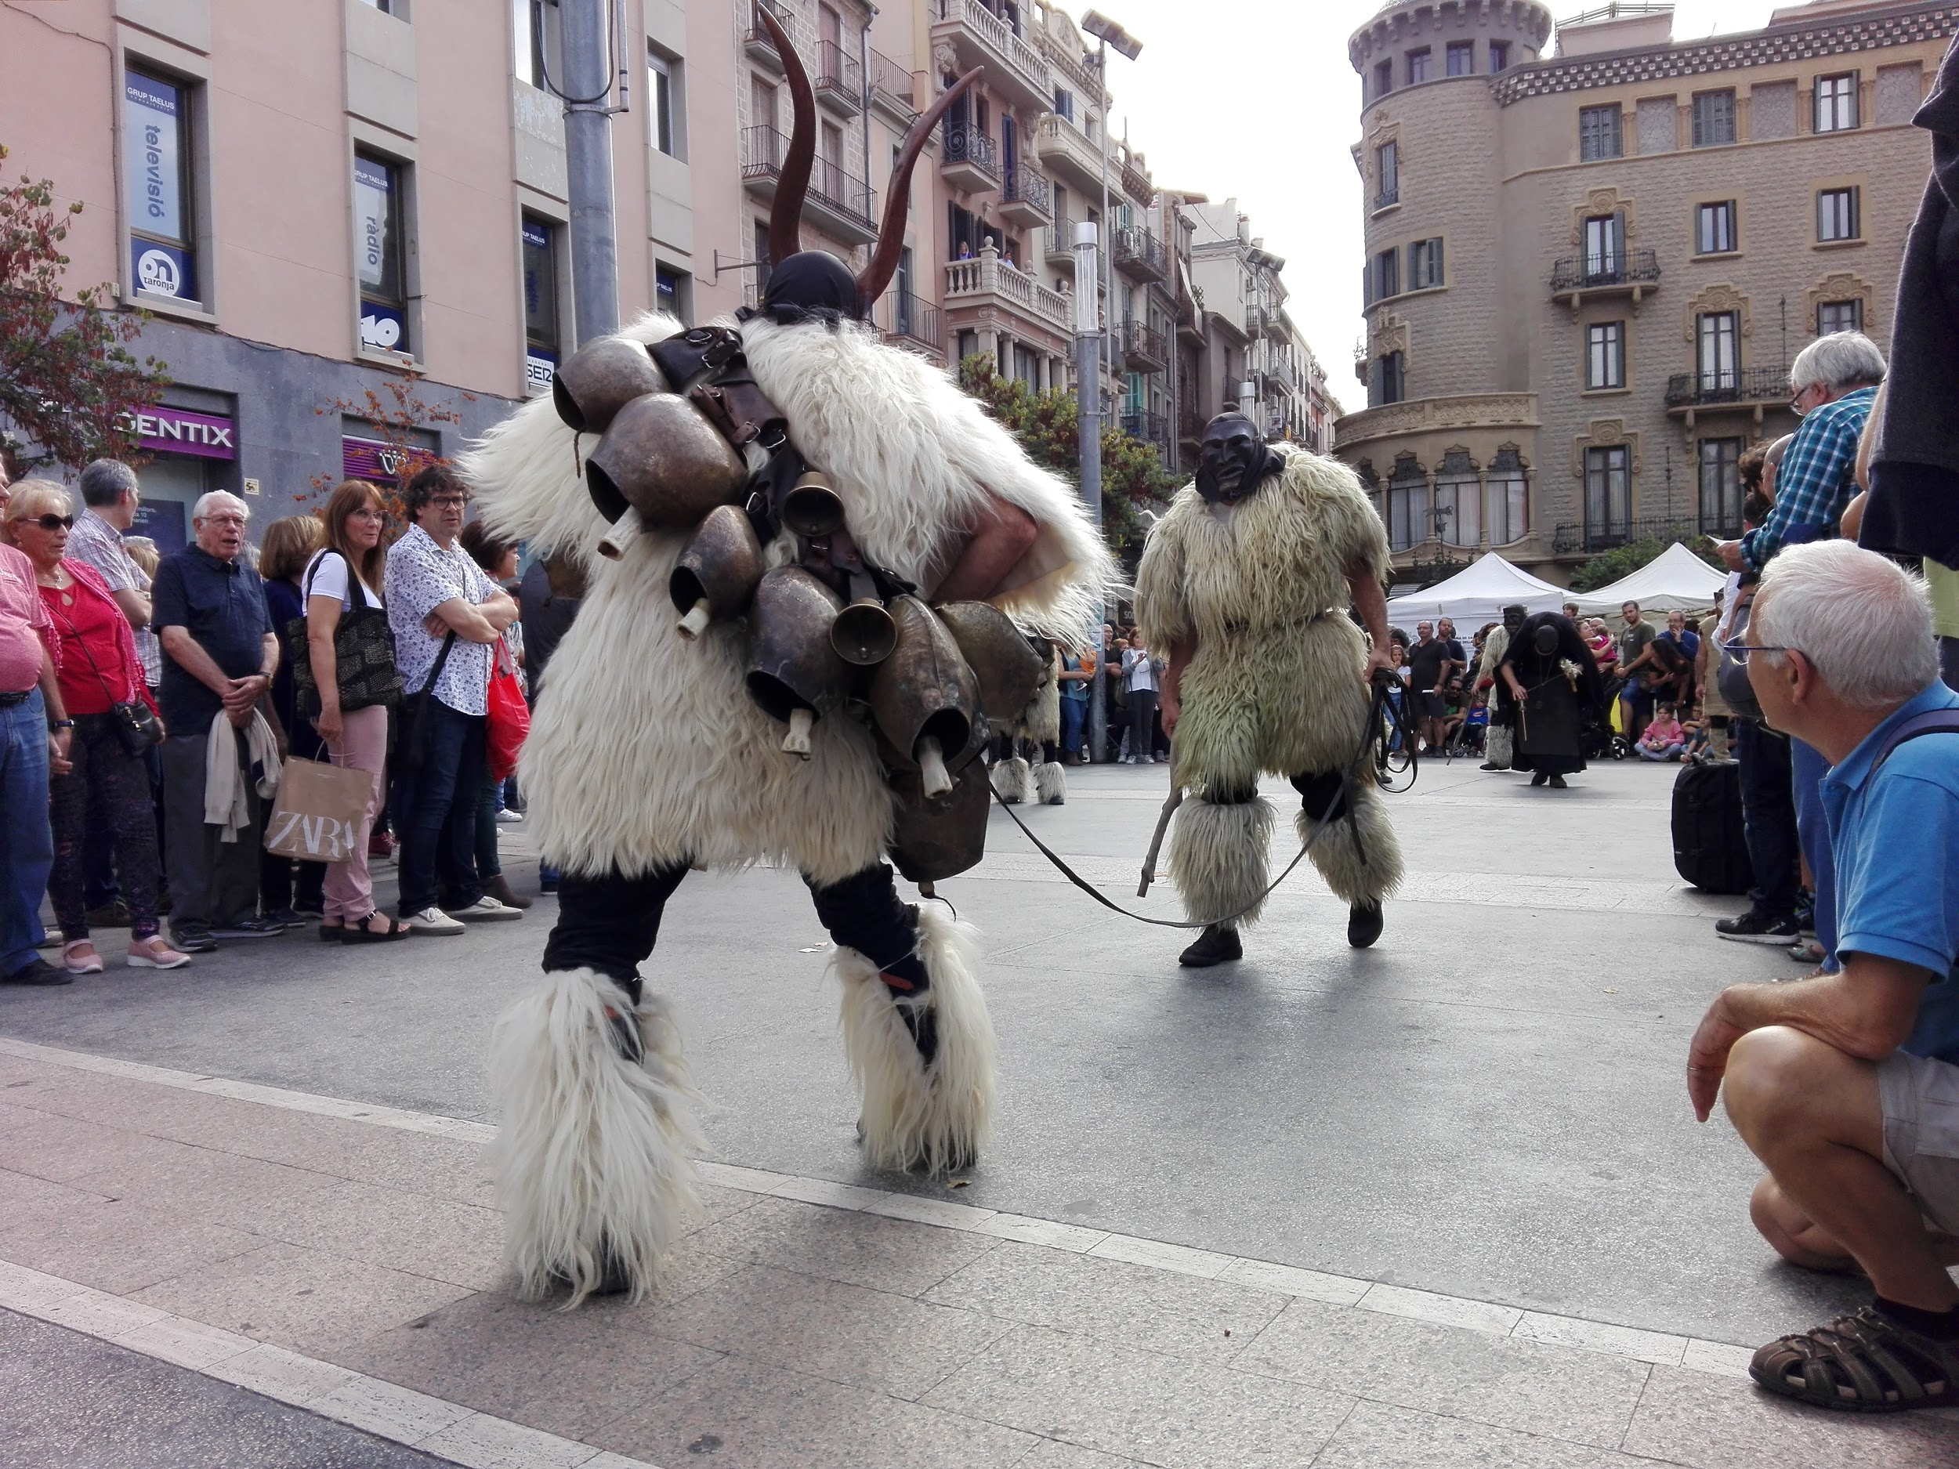
There are two men wearing costumes.
This group is from Italy.

Slide 5
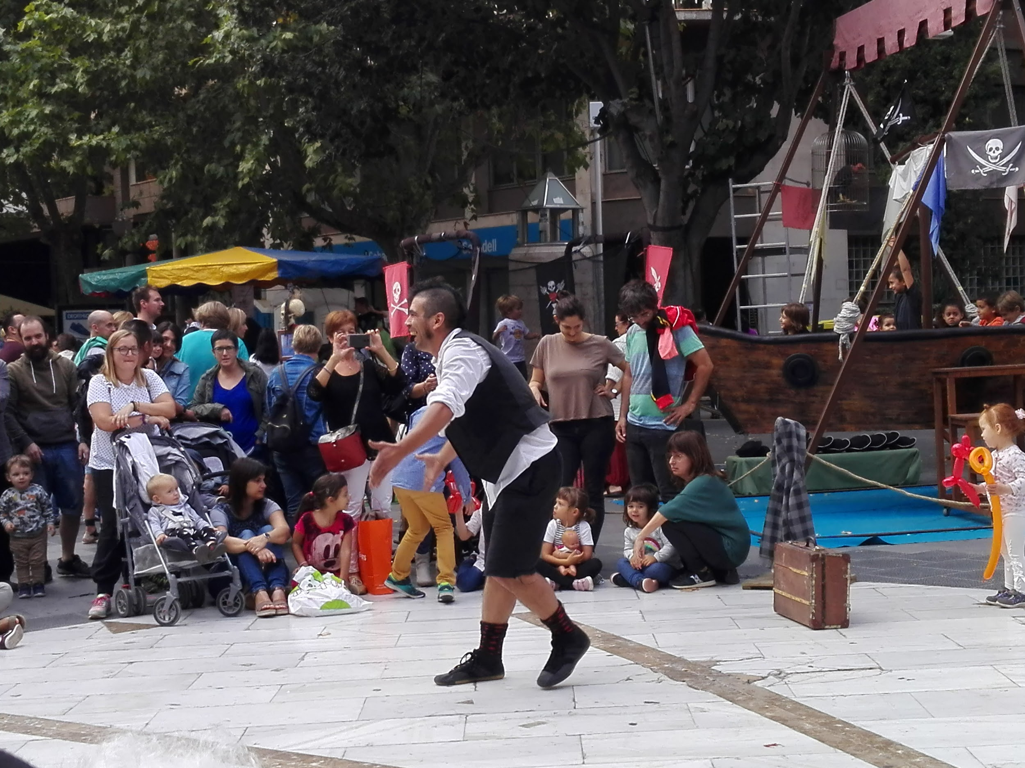
He’s a juggler.

Slide 6
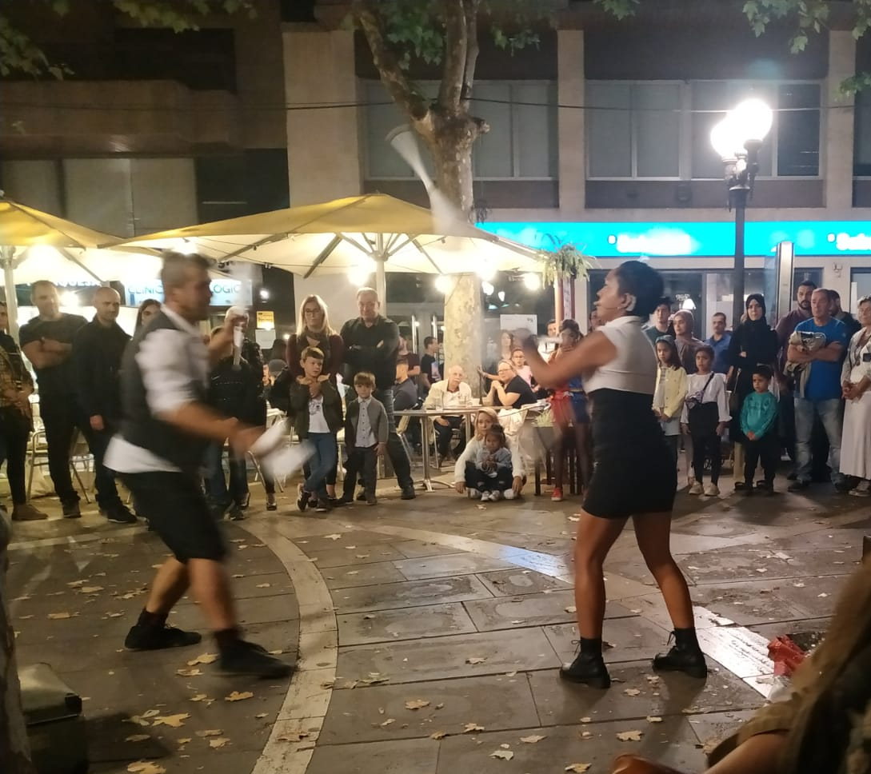
They’re jugglers.

Slide 7
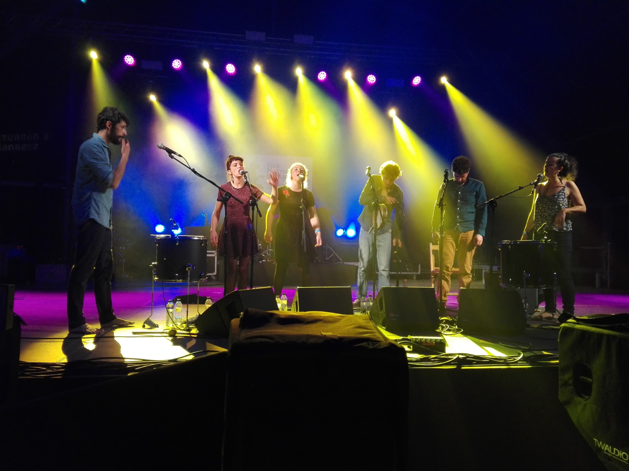
There are some people singing in a theatre.

Slide 8
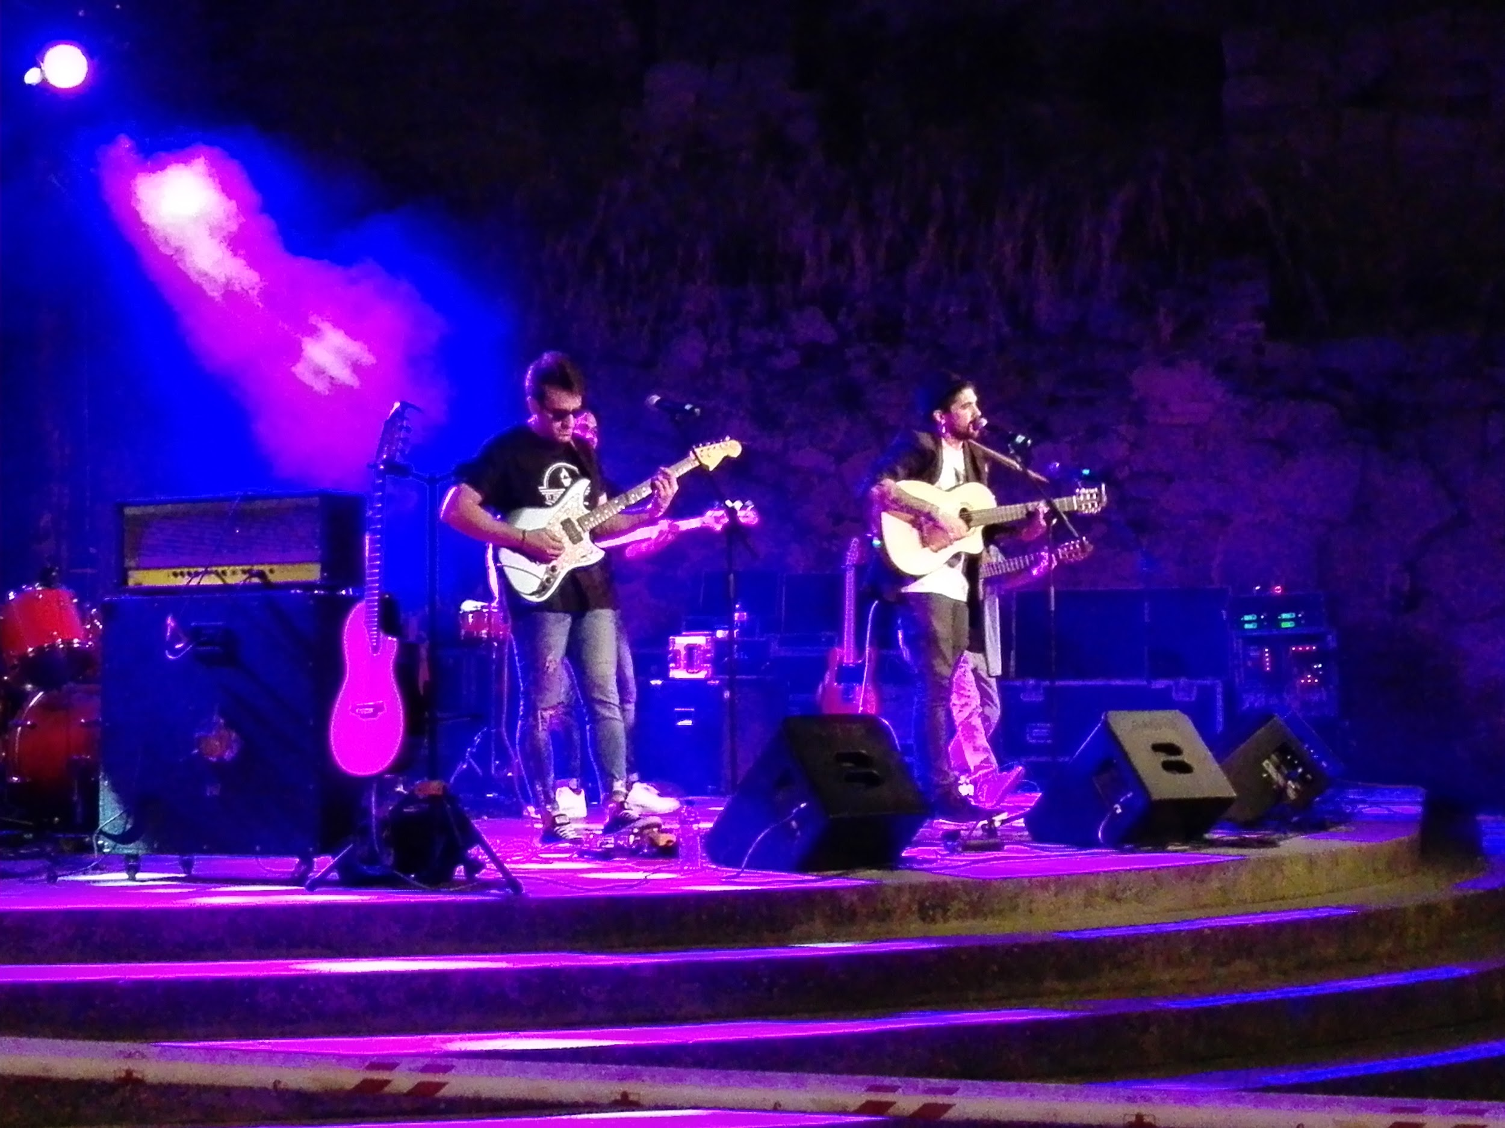
They’re singers from Manresa and they’re at the Mediterranean fair.

Slide 9
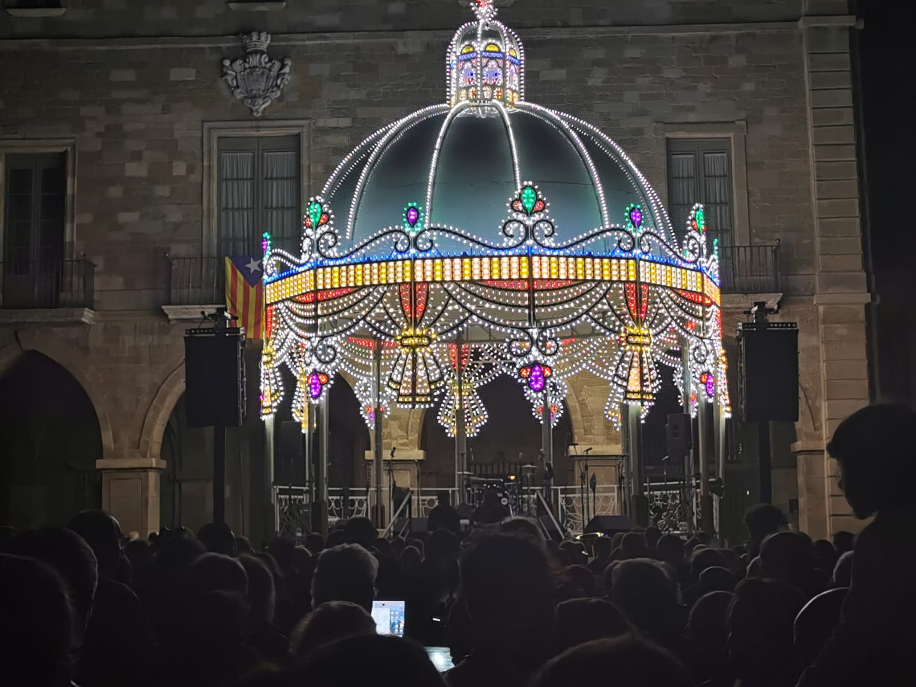
There is a cultural party and live music in plaça major square.

Slide 10
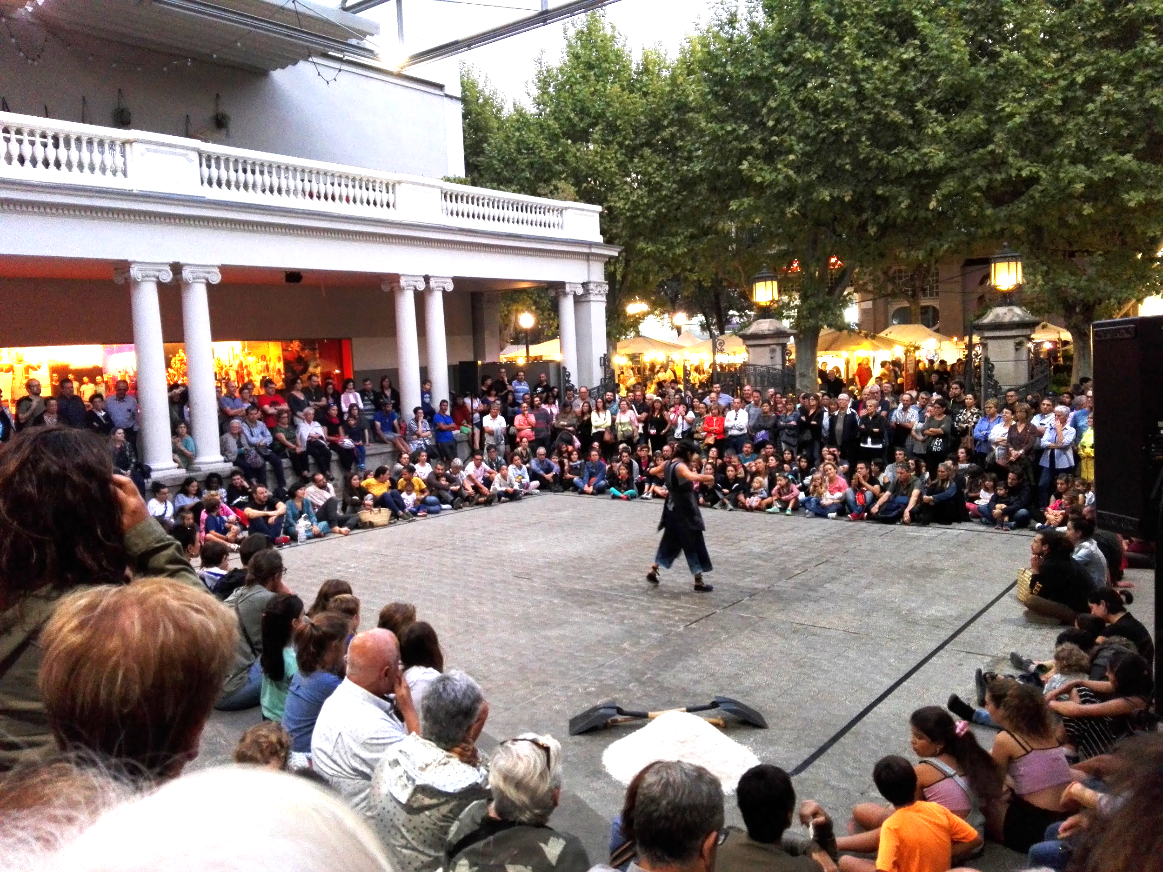

Slide 11
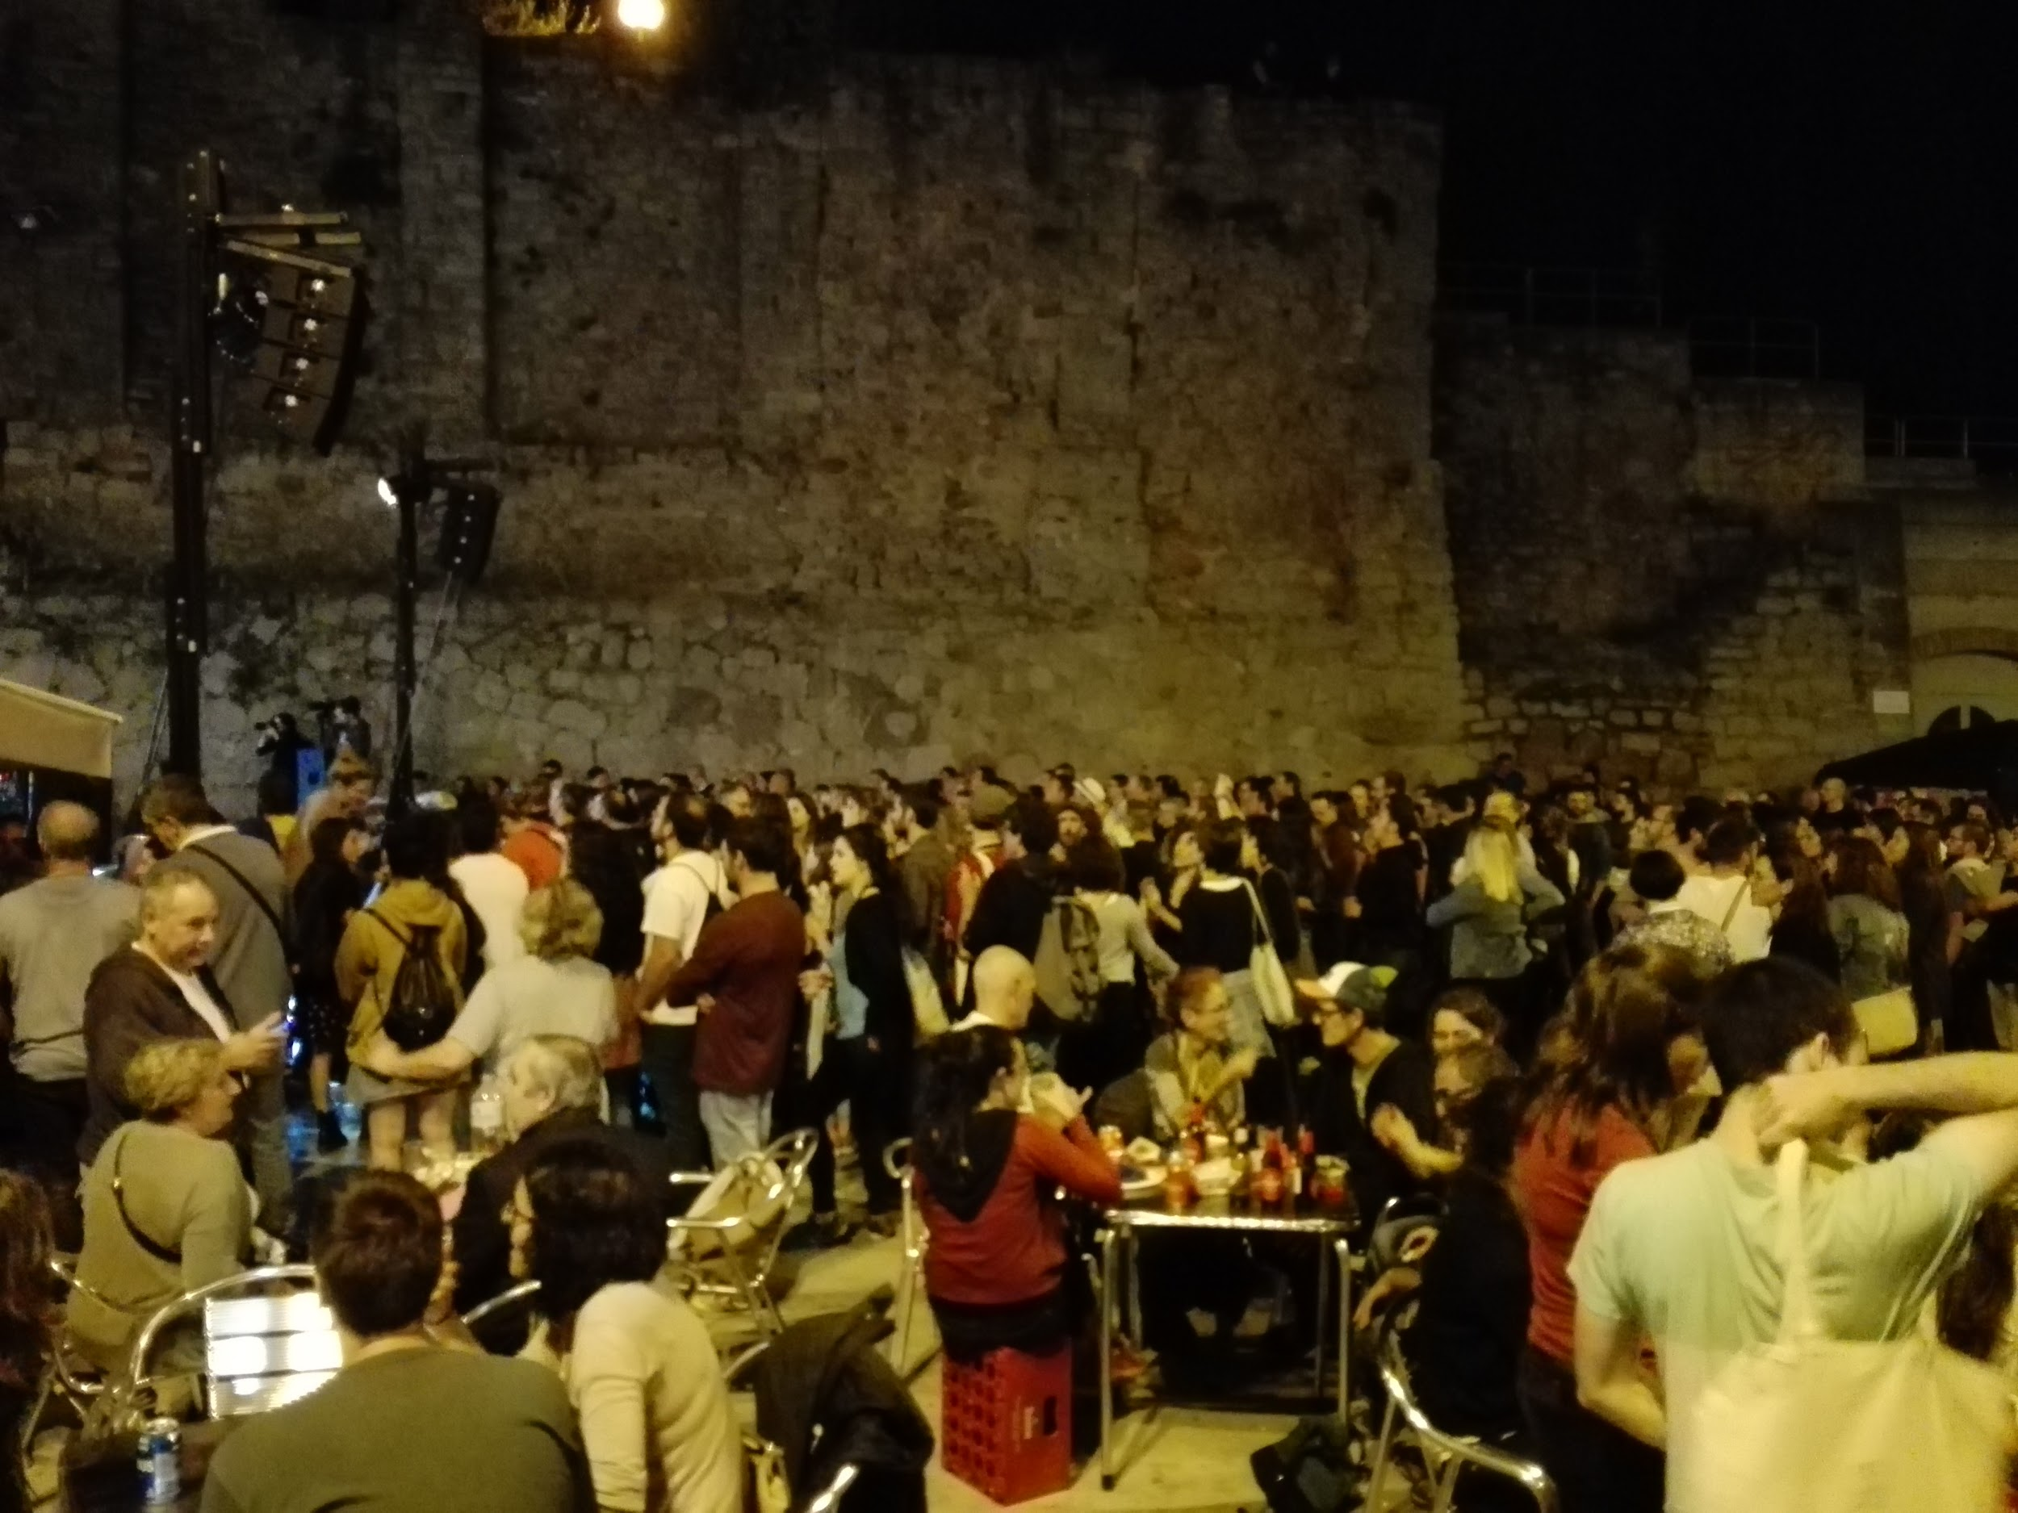

Slide 12
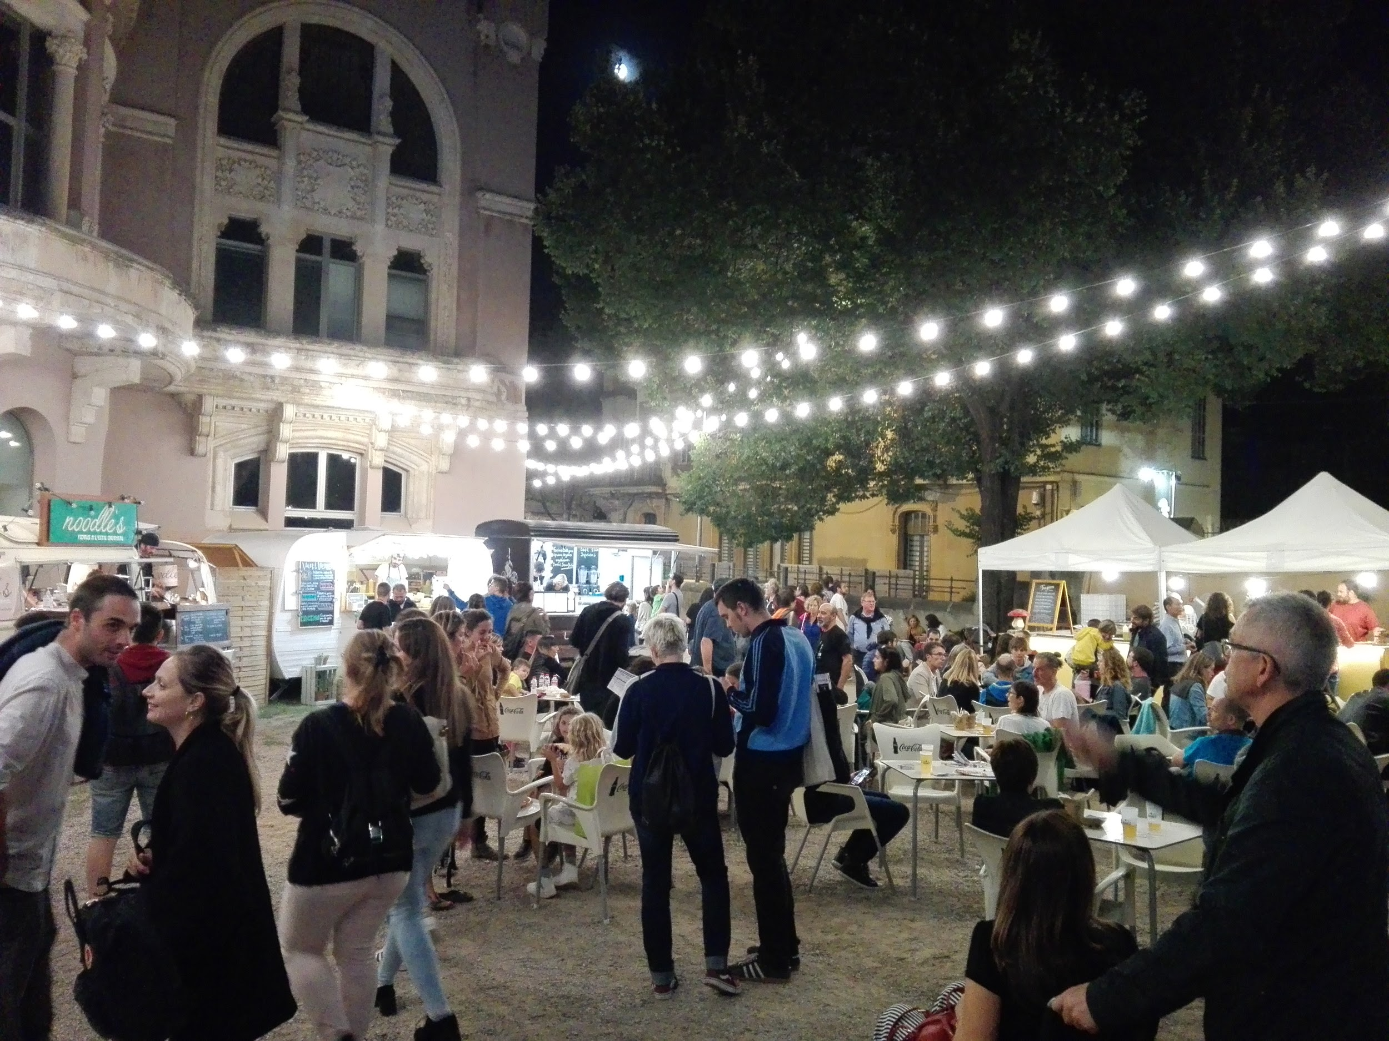
Food trucks in the city centre.

Slide 13
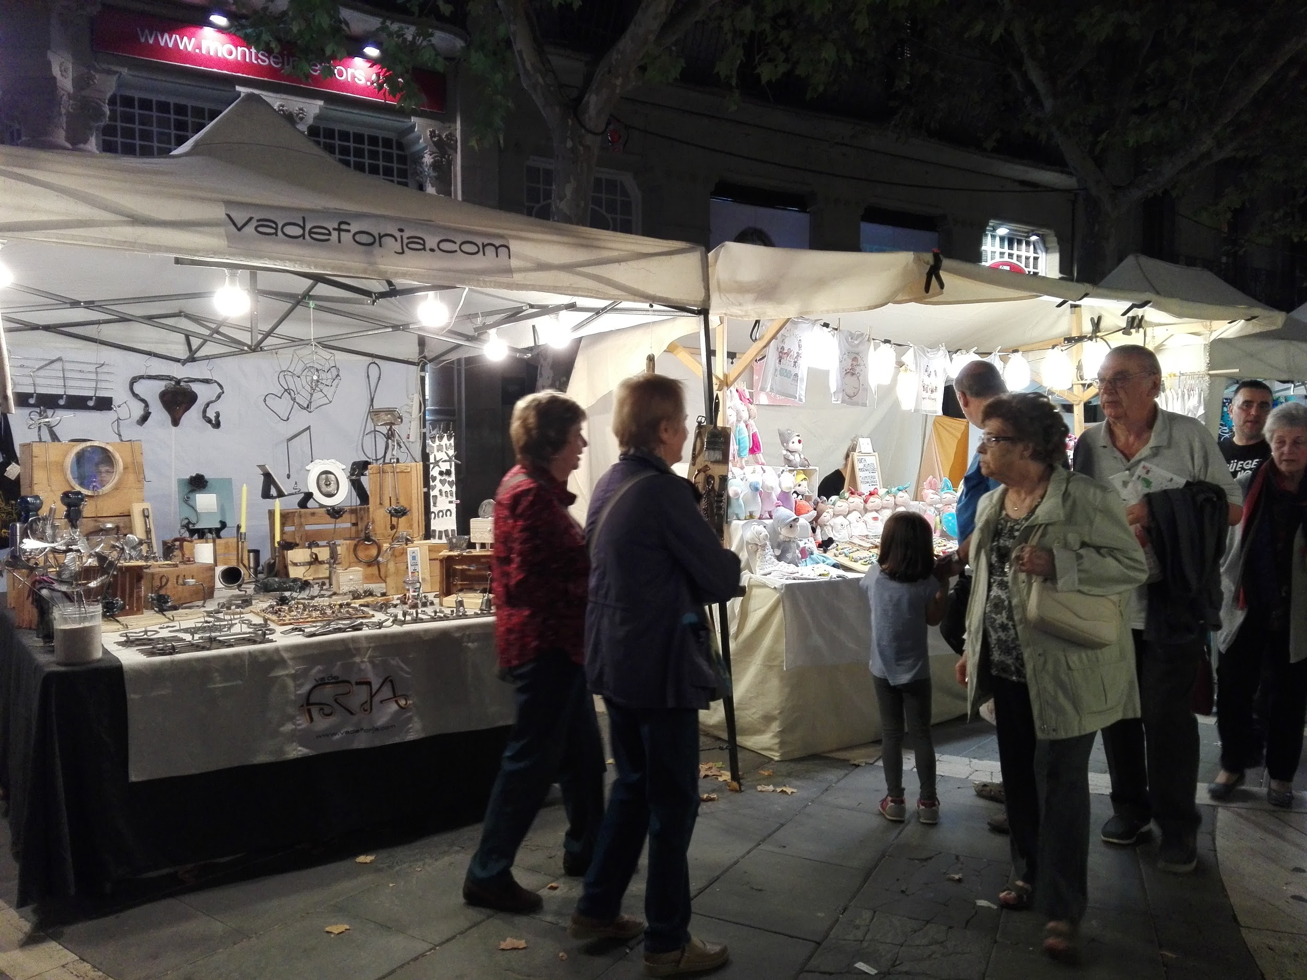
There are some stalls. They sell handicrafts.

Slide 14
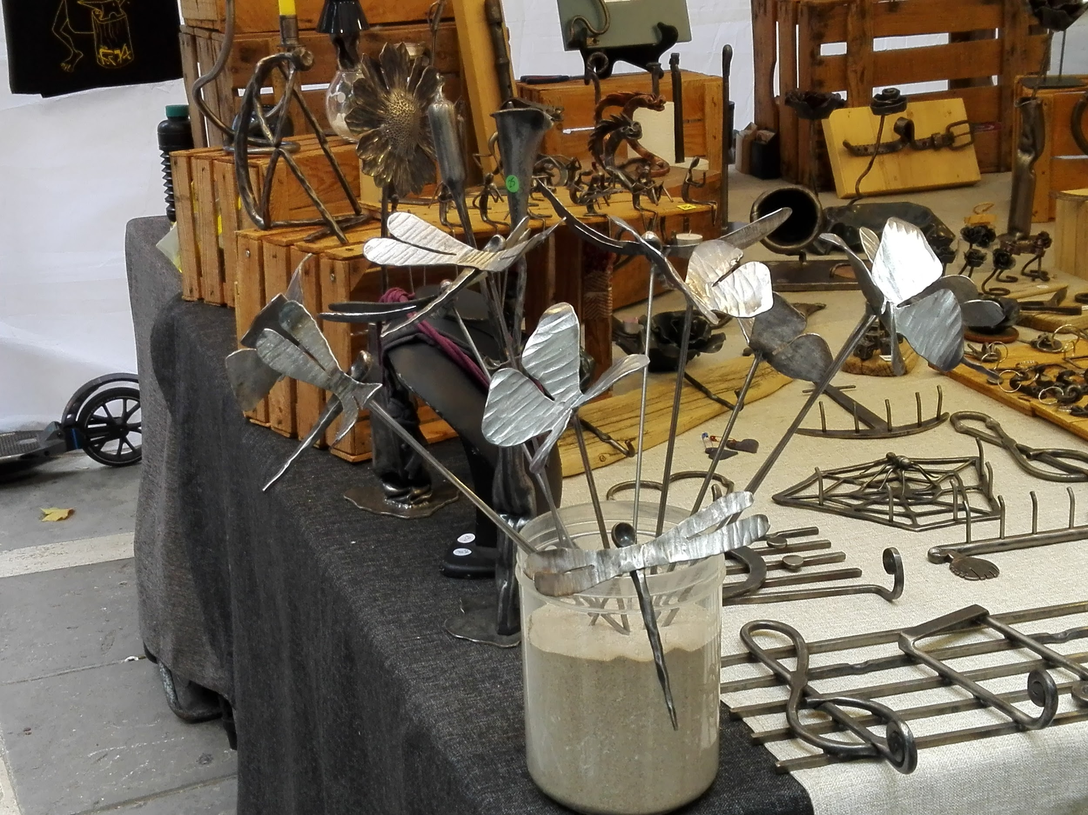
There are handmade metal figures

Slide 15
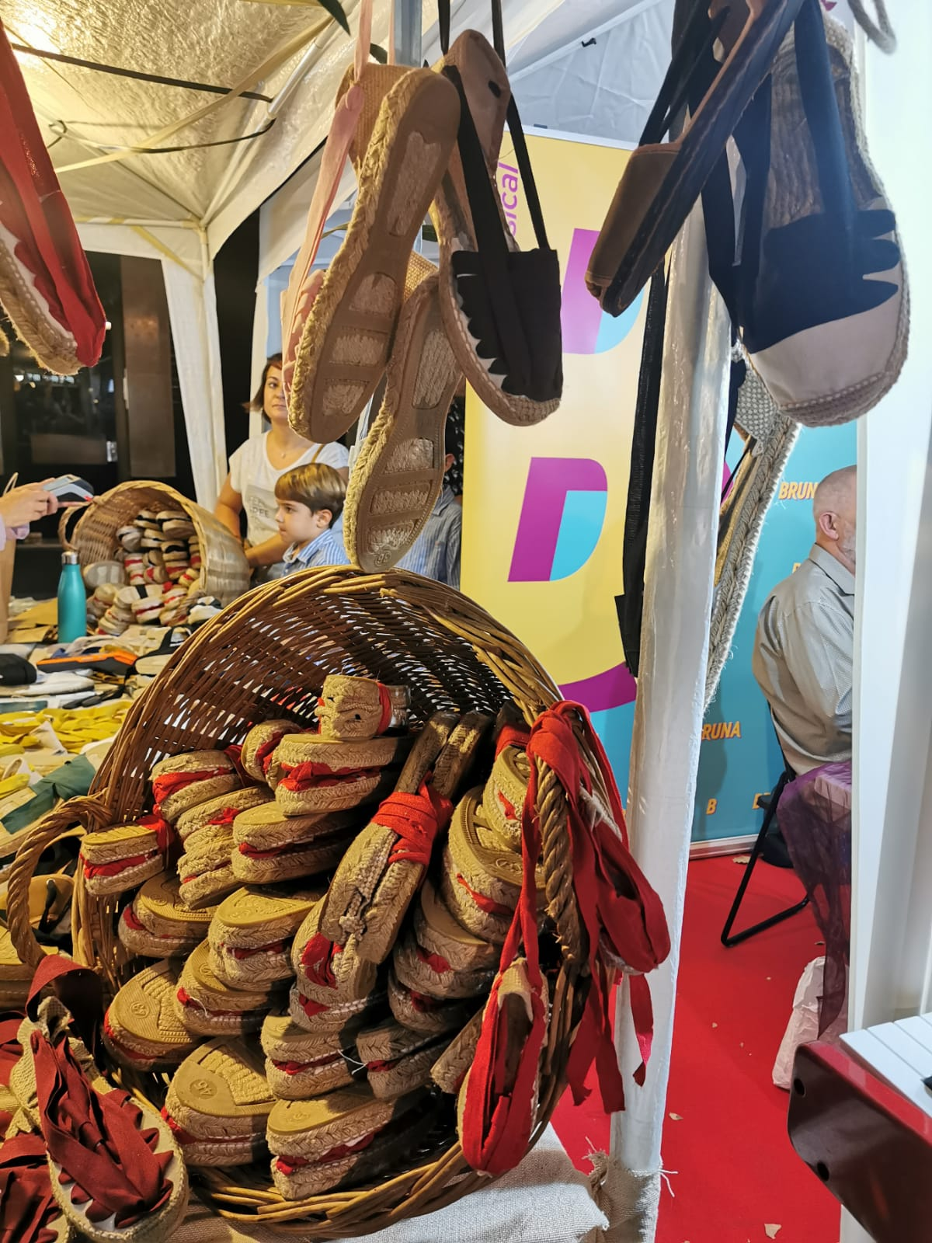
Traditional Catalan espadrilles.

Slide 16
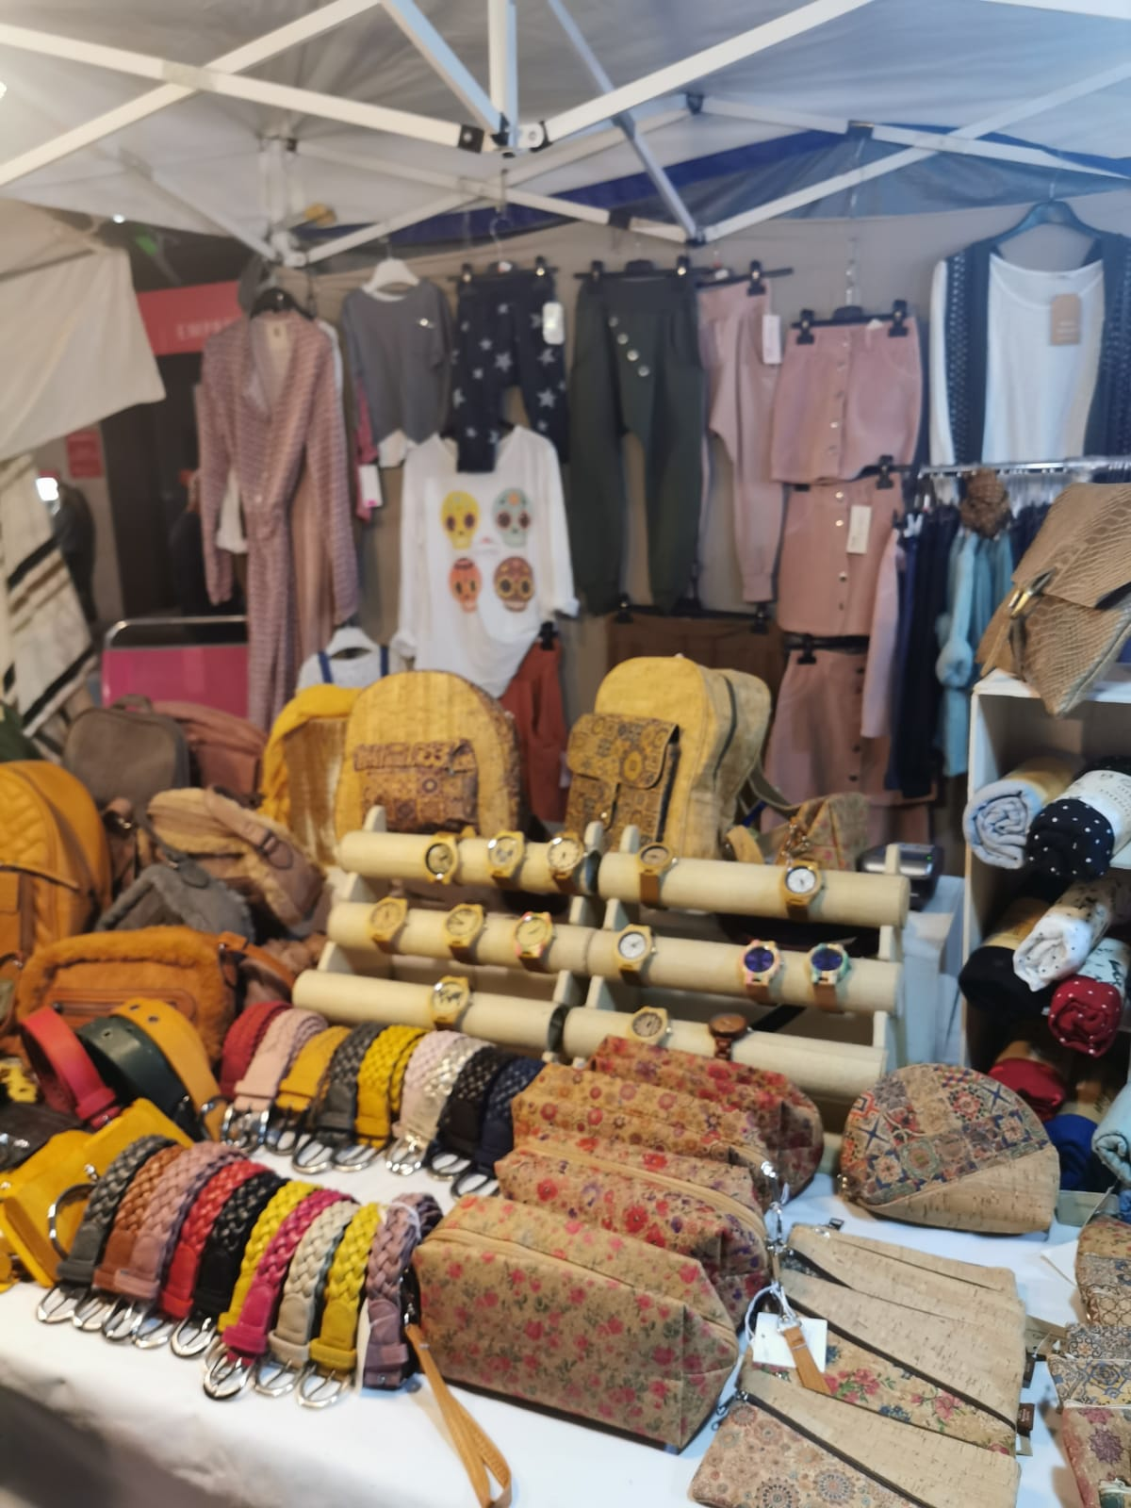

Slide 17
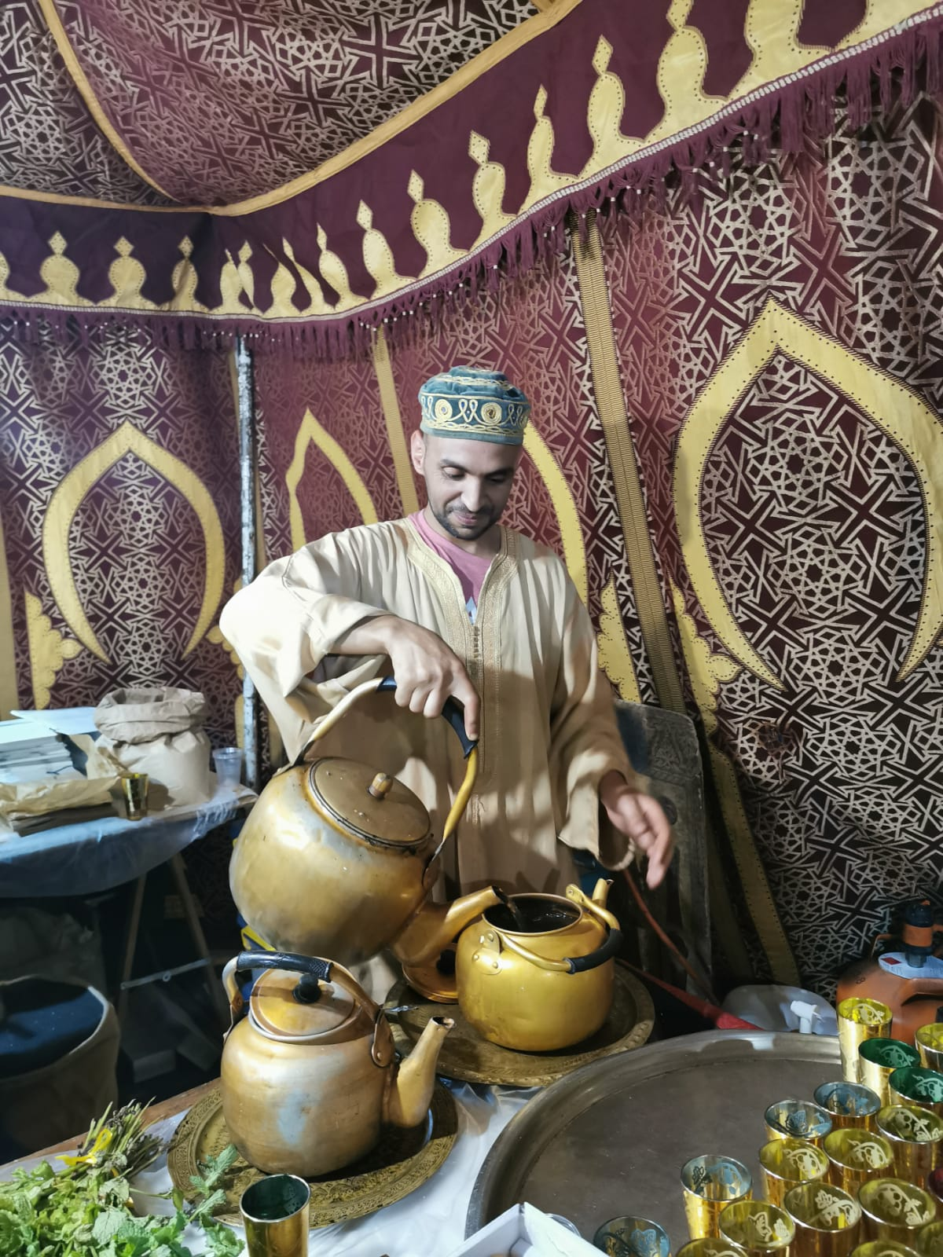
Moroccan beverages

Slide 18
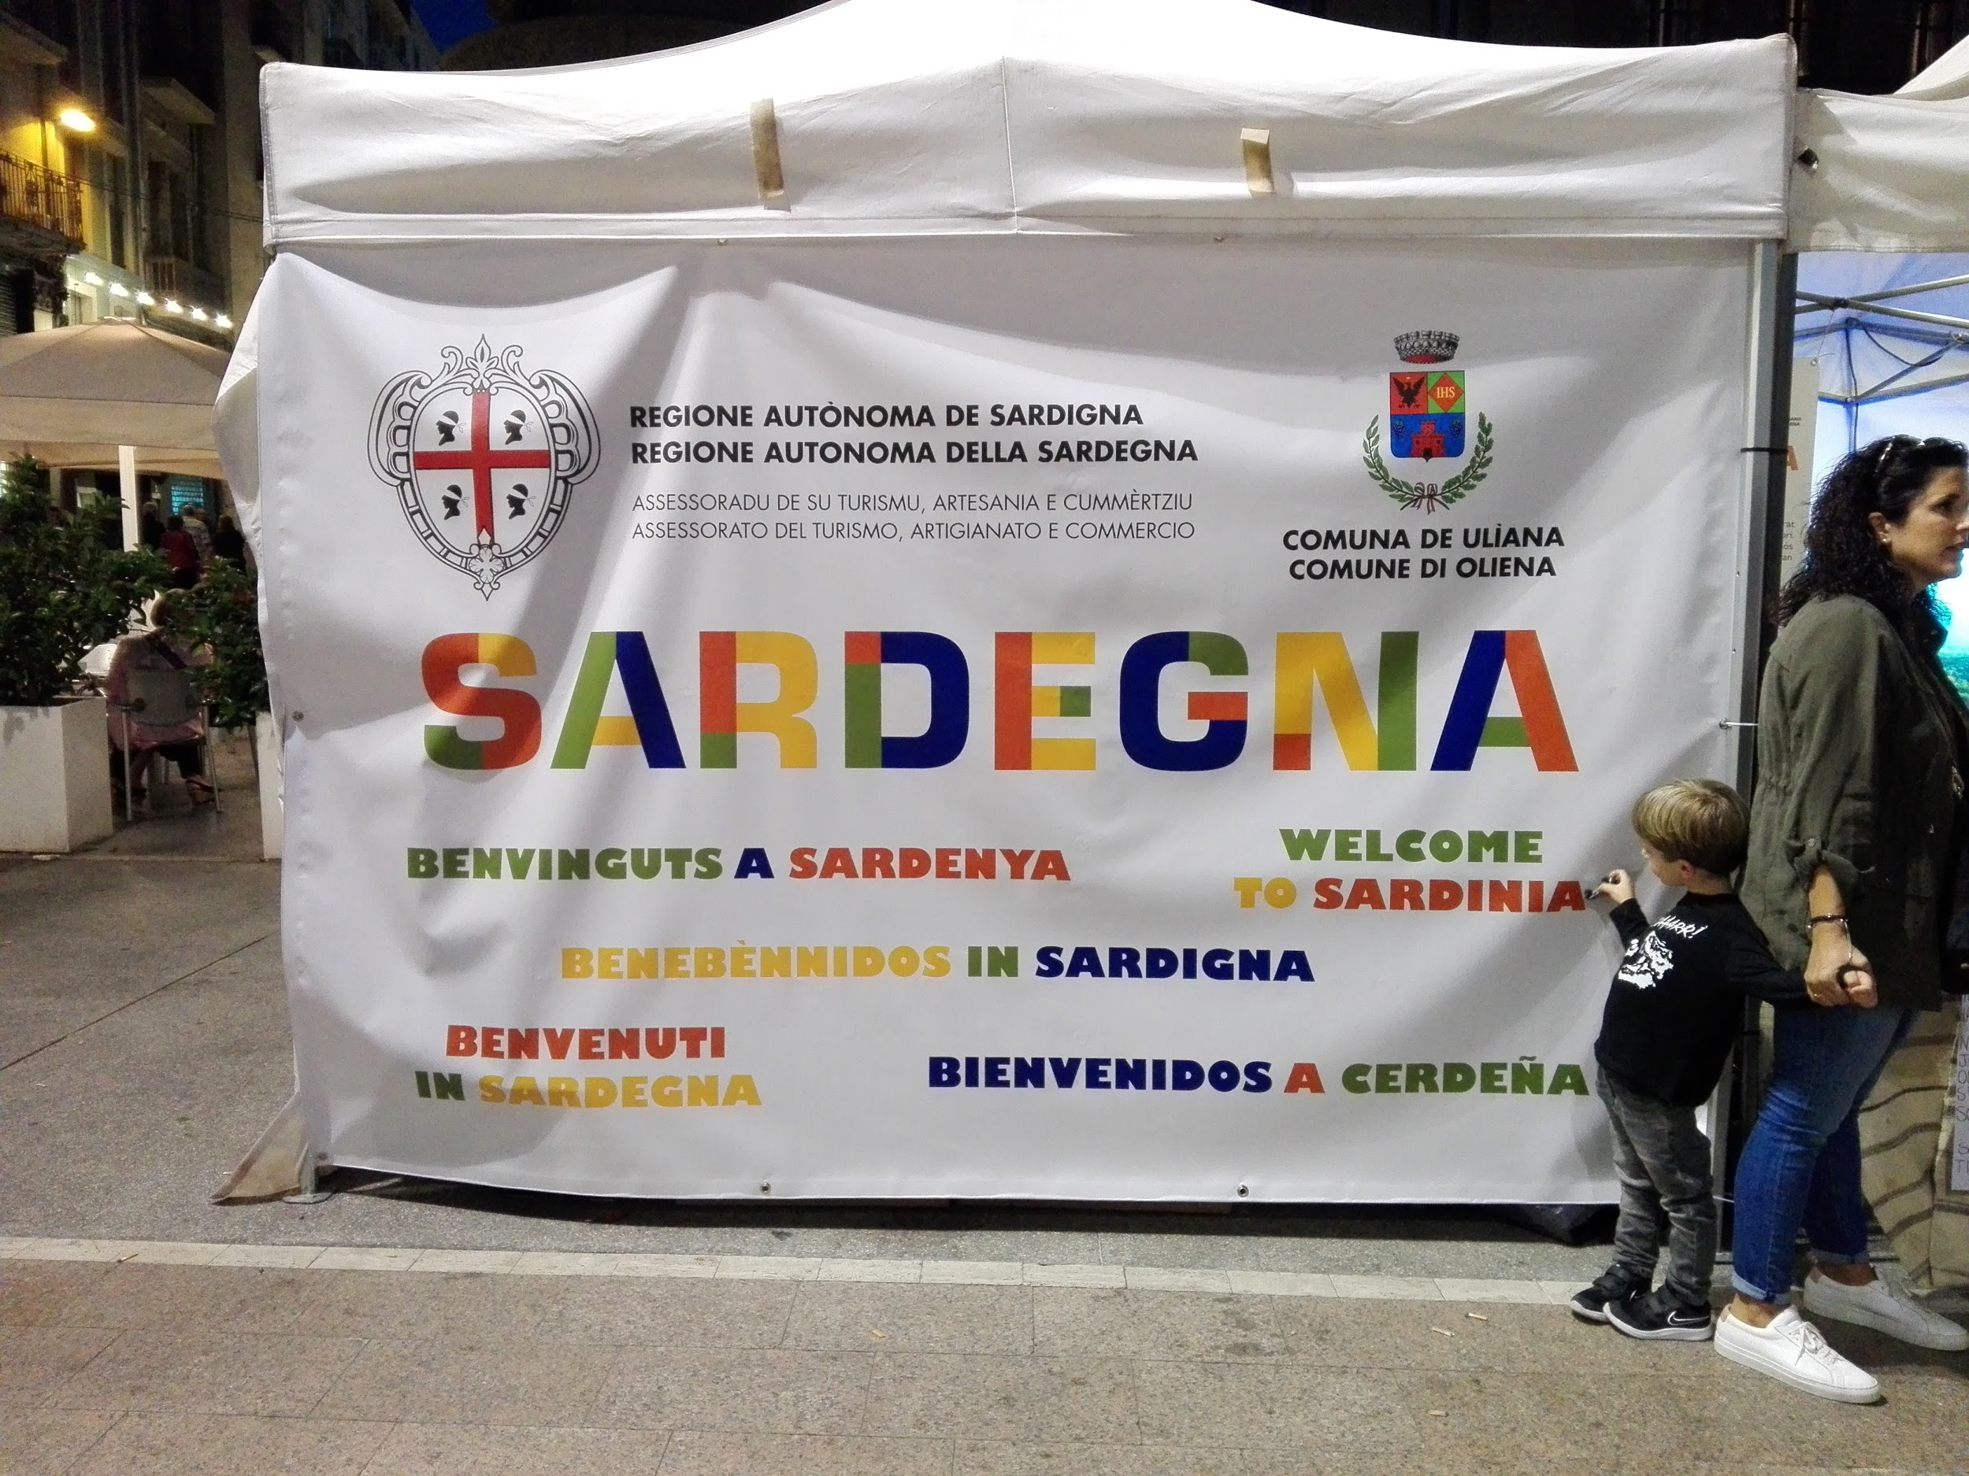
It is a stand of the region of Sardinia (Italy) in Manresa.

Slide 19
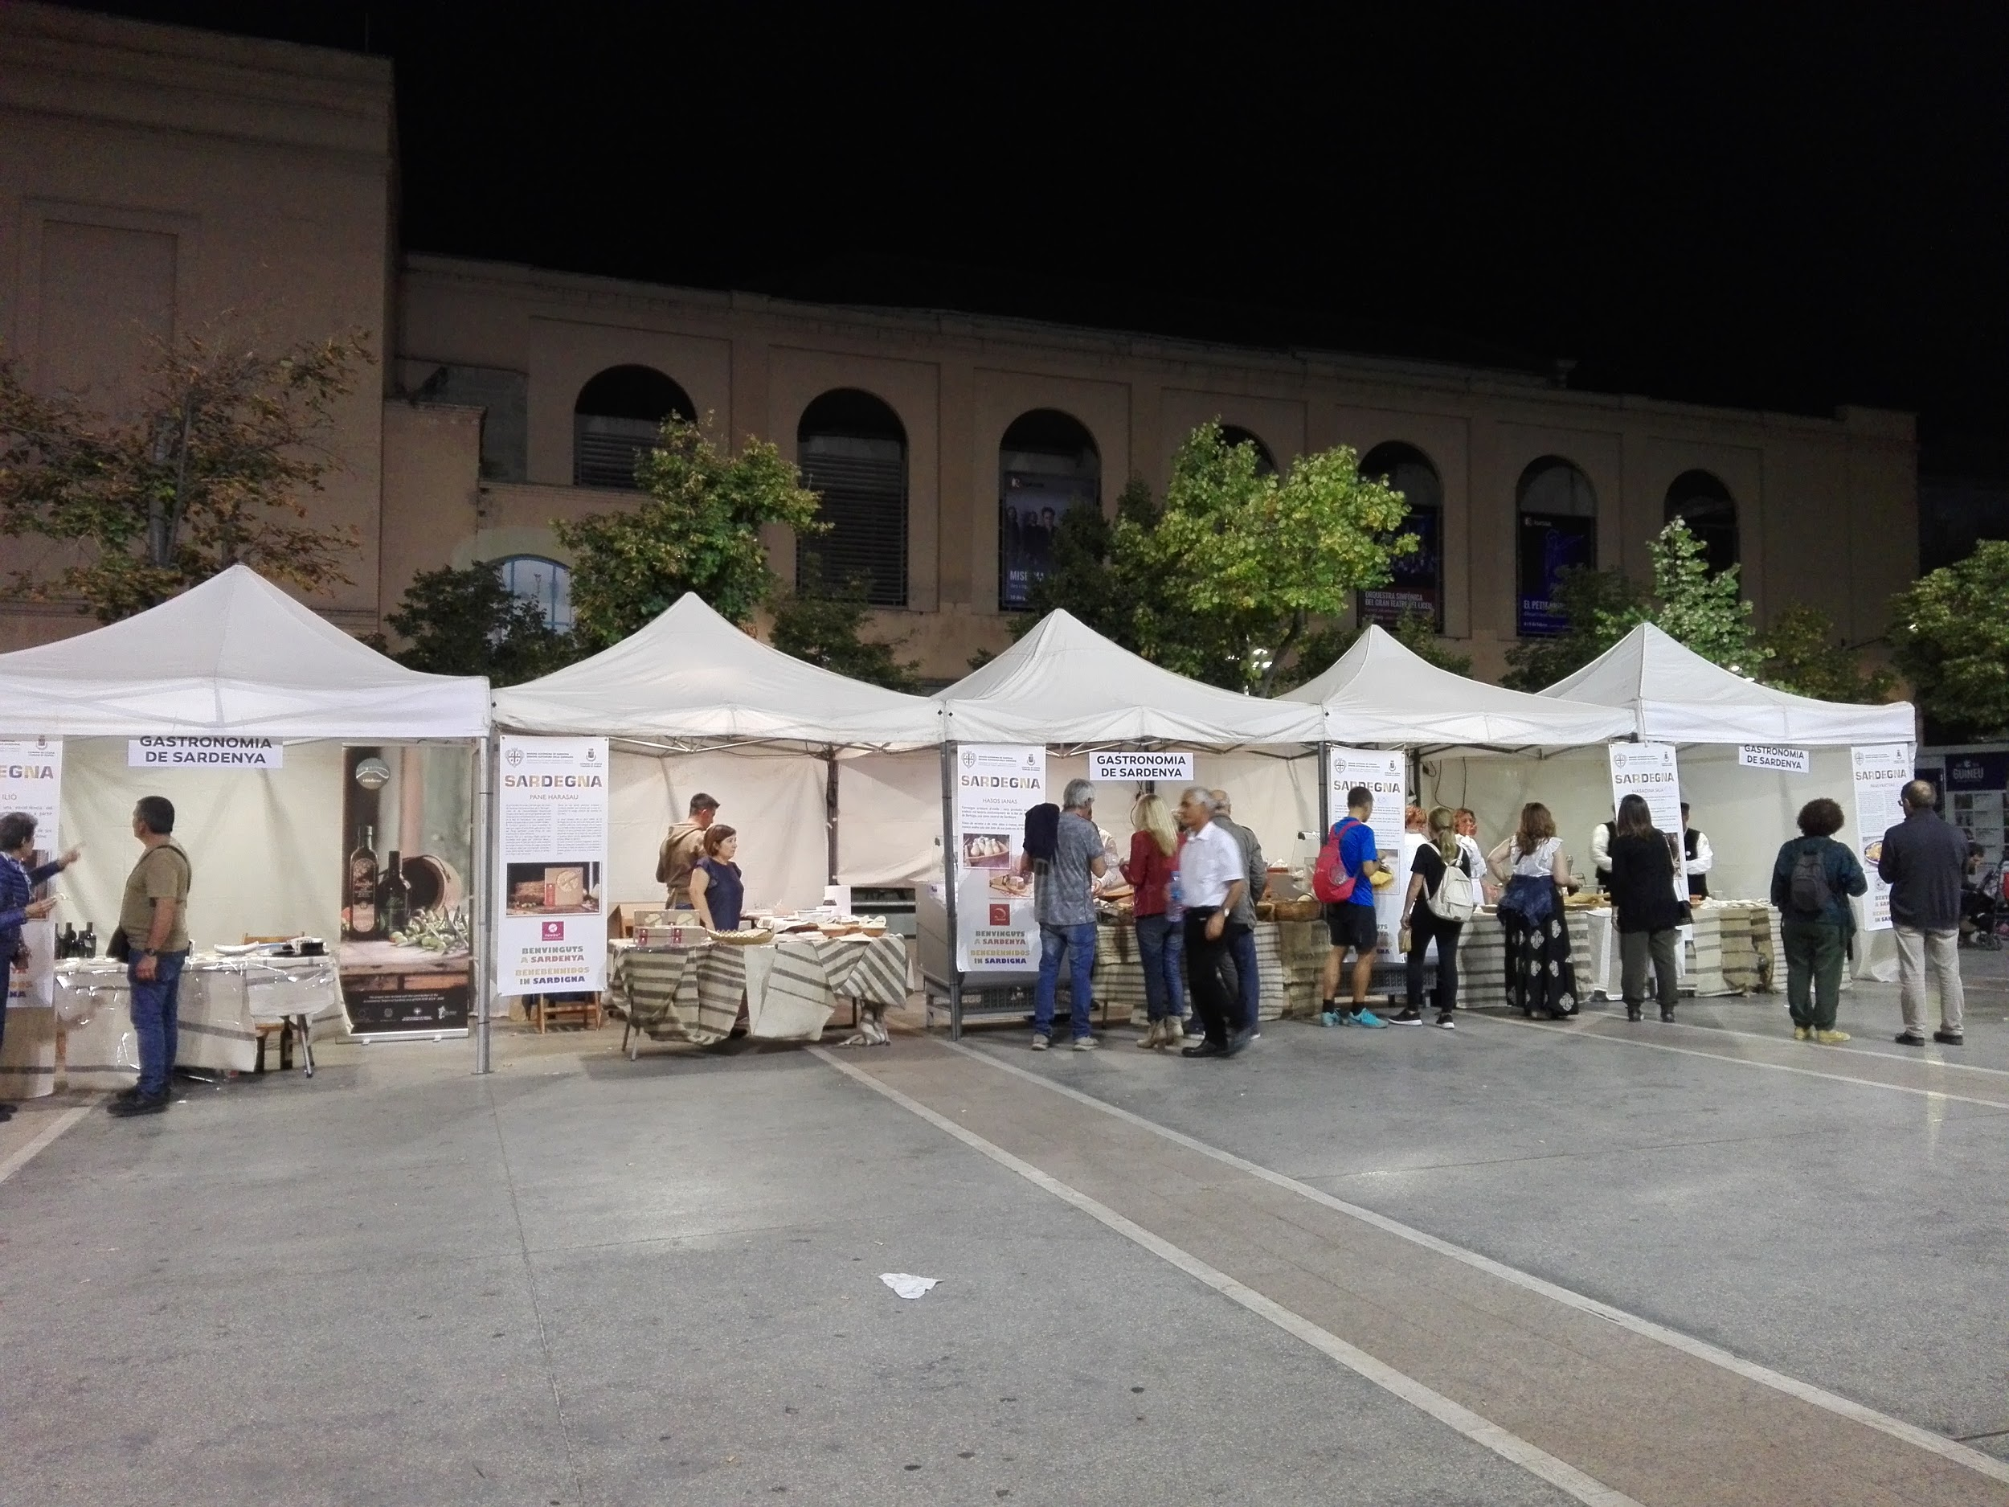
Food stalls from Sardinia (Italy)

Slide 20
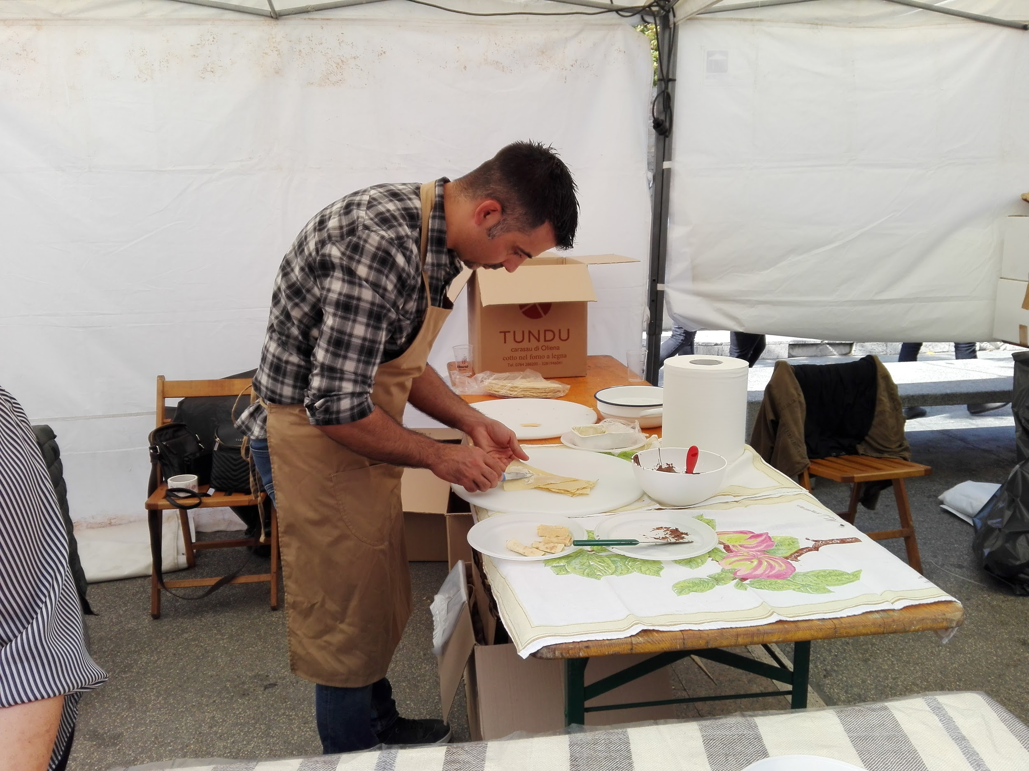

Slide 21
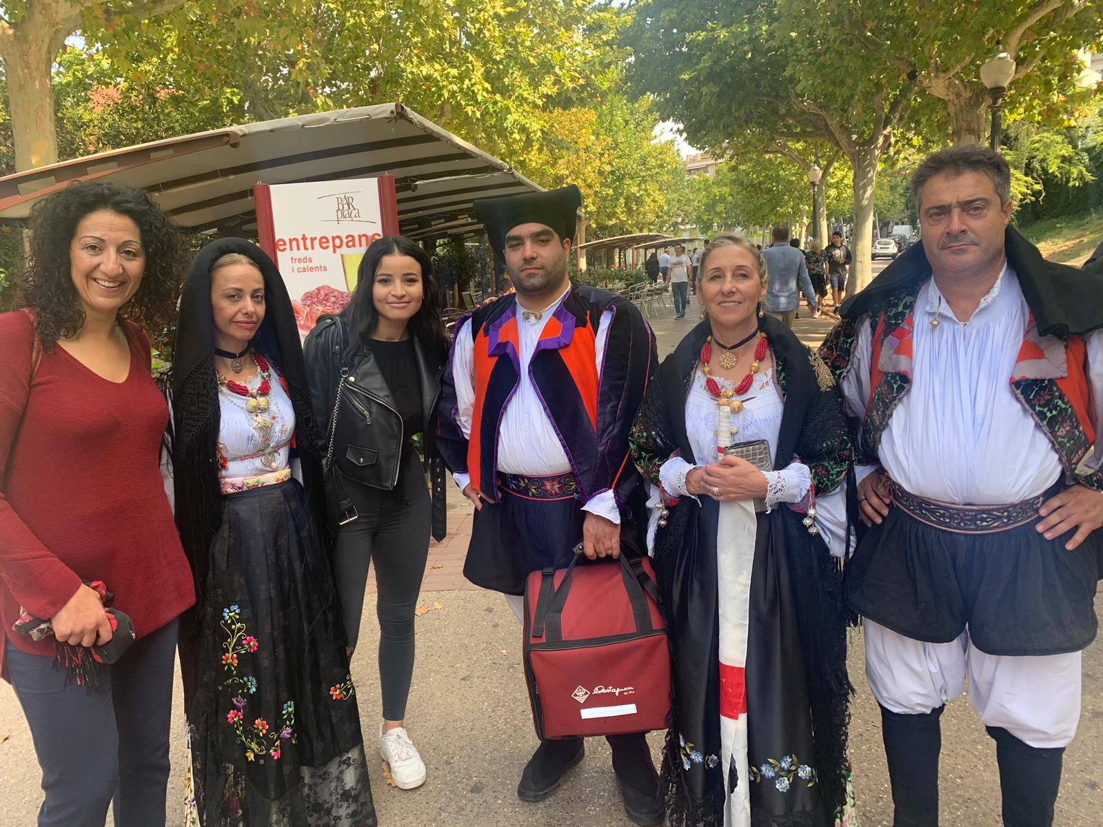
People wear a traditional costume.

Slide 22
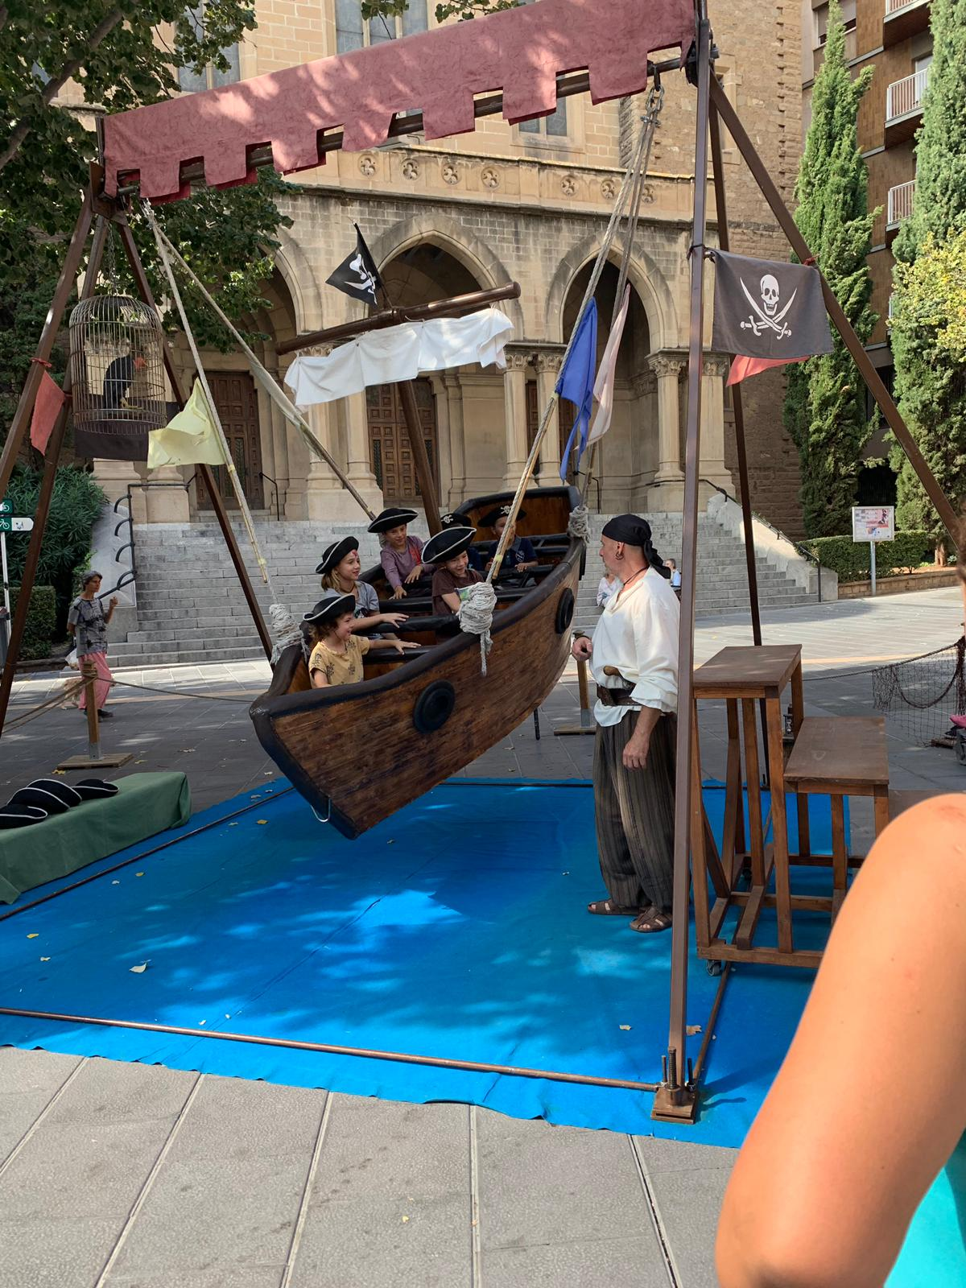
This is an ecological carrusel.

Slide 23
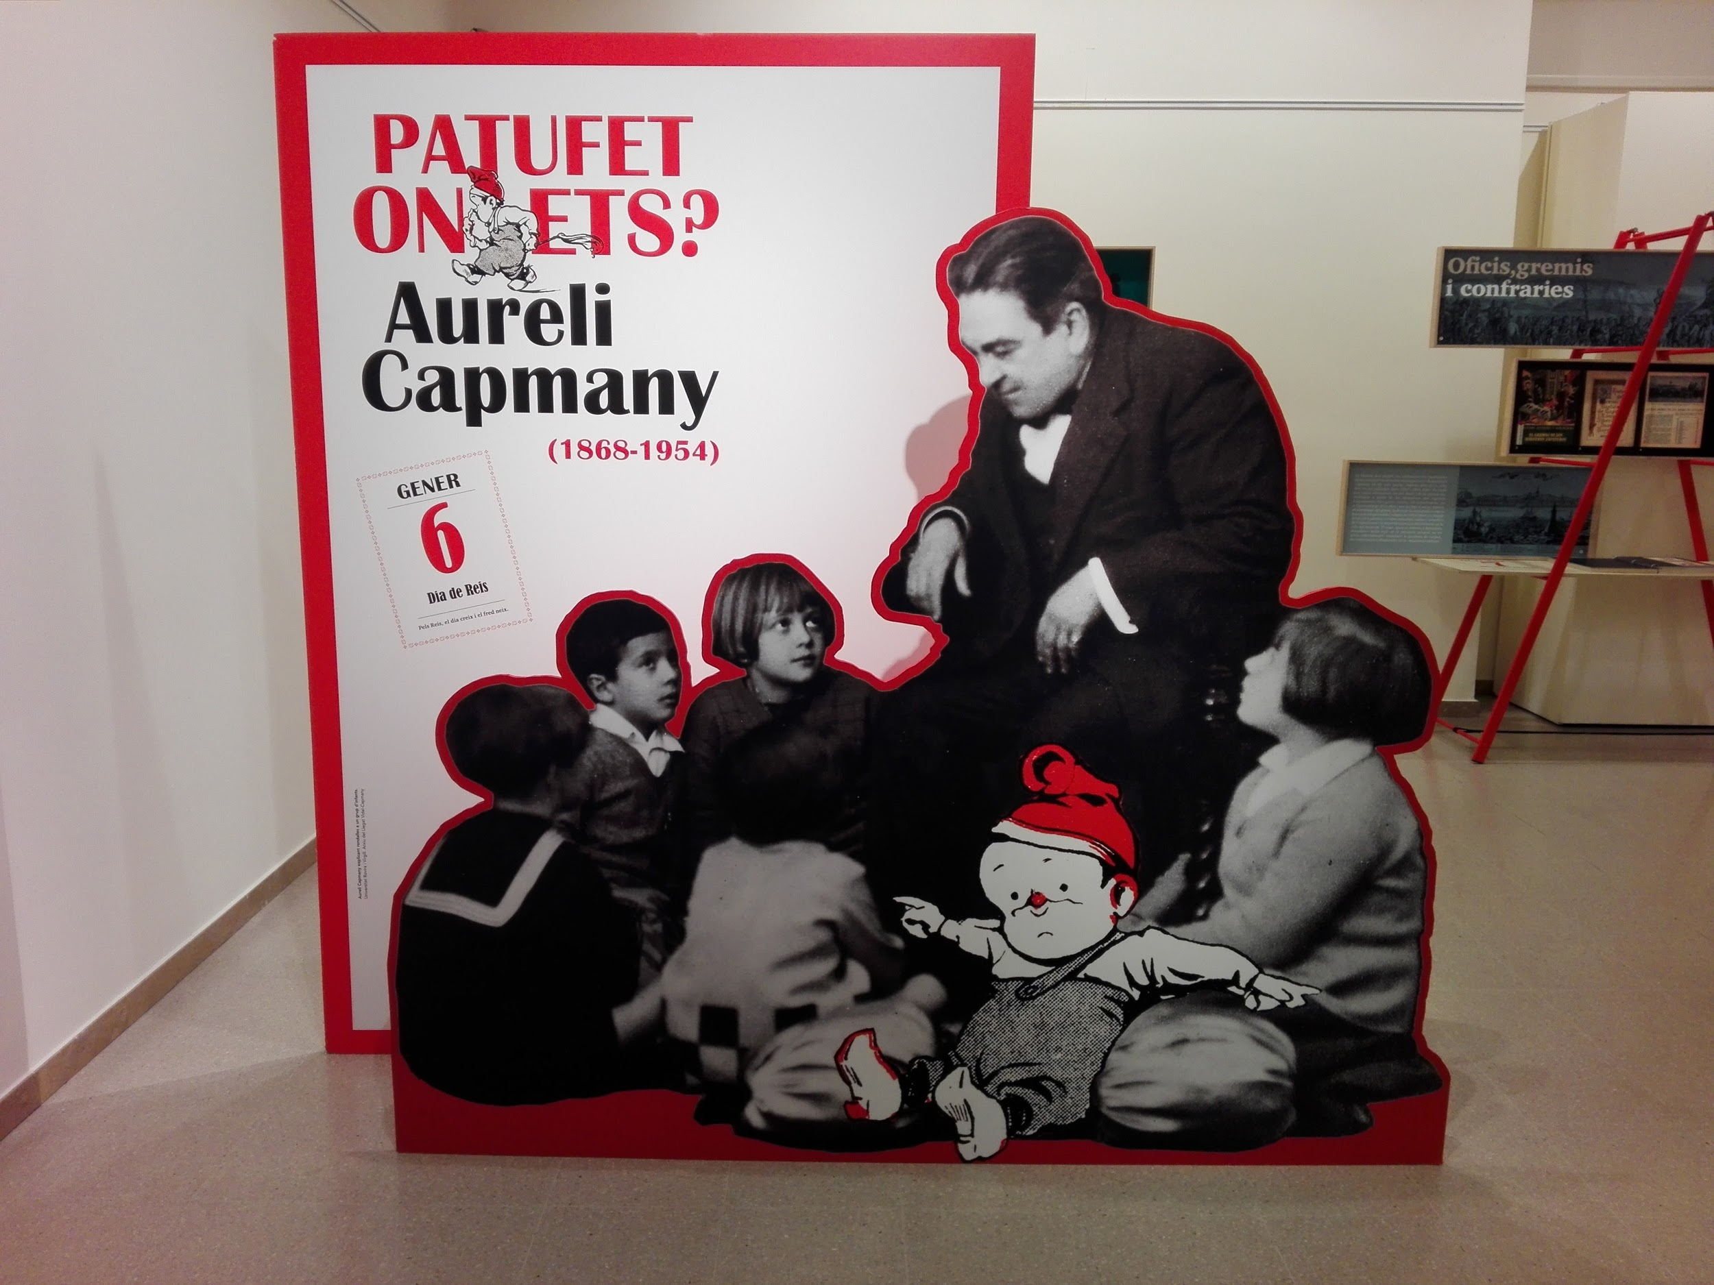
It’s the most popular comic book in Catalonia (1868-1954).

Slide 24
The Mediterranean Festival
Photos taken by students from GES-2 group
October 2019

