Slide 1
TURKISH TRADITIONAL KIRKPINAR OIL WRESTLING
Source: http://www.kamuajans.com/spor/kirkpinar-guresleri-hangi-kanalda-yayinlaniyor-yagli-guresler-hangi-kanalda-h526739.html

Slide 2
Kırkpınar Oil Wrestling
Kırkpınar Oil Wrestling is a traditional Turkish wrestling tournament. Thousands of wrestlers with different age groups and weights participate in the tournaments, and tons of olive oil is used during the festival since 1361.
Source : https://www.aa.com.tr/tr/spor/658-tarihi-kirkpinar-yagli-gureslerinde-1-tur-musabakalari-yapildi/1524819

Slide 3
Source : https://www.hurriyet.com.tr/sporarena/kirkpinar-yagli-guresleri-programi-canli-yayin-ile-saat-kacta-hangi-kanalda-41266394
This event is a combination of Muslim culture and Turkish tradition and a summertime activity for the local people. It is held in Edirne every year, from the end of June to the beginning of July. Wrestlers fight for three days in the square. In the finals made on the last day, each neck (category) first, second and third are determined. The most important of these is the head wrestler.
During the wrestling, Kırkpınar Festival is organized and various events are held. The municipality organizes contests and invites famous singers to give concerts. People go on a picnic and walk around the gypsy markets in the area where the festival is held.

Slide 4
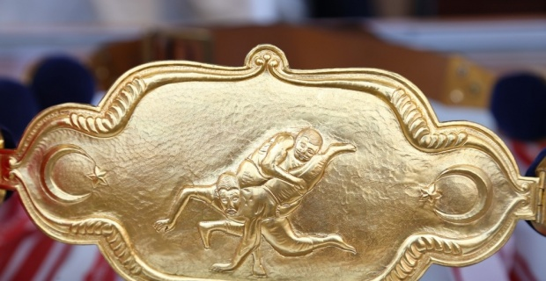
The wrestlers wear traditional leather shorts ( kispet) and pour buckets of oil on themselves and fight for the Golden Belt and try to get the title of Head Wrestler (başpehlivan). It is very prestigious to be a Head Wrestler because you become a national hero. The olive oil is used to prevent the sunburn and relax the tired muscles.
Each festival starts with prayers and the patron, the Kırkpınar Aga, launches the ceremony. The patron or Aga is a special figure because he organizes and promotes the events in Kırkpınar. The golden belt is carried through the city in a procession, followed by prayers recited in the Selimiye Mosque. Then, the tournaments start in the field.
Source https://www.esgazete.com/spor/kirkpinarda-para-odulleri-belirlendi-h113166.html

Slide 5
Source: https://edirne.ktb.gov.tr/TR-76392/kirkpinar-yagli-guresleri.html
You can also enjoy the local food during the festival. You can eat gözleme, a kind of Turkish pastry, Turkish meatball, and all kinds of grilled meat. After a delicious meal, you can enjoy the taste of Turkish coffee. If you like, the gypsy fortune-tellers can tell about your future from the remains of coffee in your cup. It is really fun to hear funny and always optimistic predictions .

