Slide 1
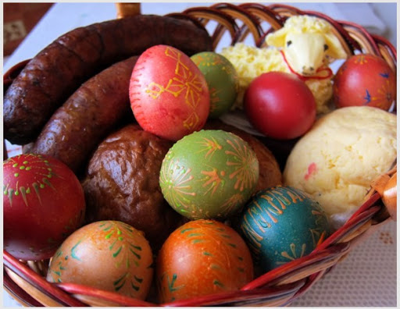
TRADITIONAL EASTER DISHES IN SLOVAKIA

Slide 2
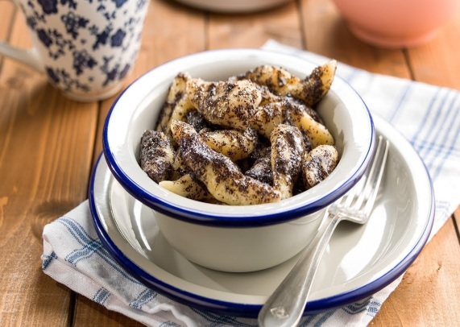
PALM SUNDAY
Meals on Palm Sunday were supposed to have magic-protective power.
Pasta with poppy seeds or legumes was prepared for lunch.
People ate the vegetables they wanted to bloom quickly.
Source of picture: https://www.komoraslovenskychgazdin.sk/prave-slovenske-makove-sulance/

Slide 3
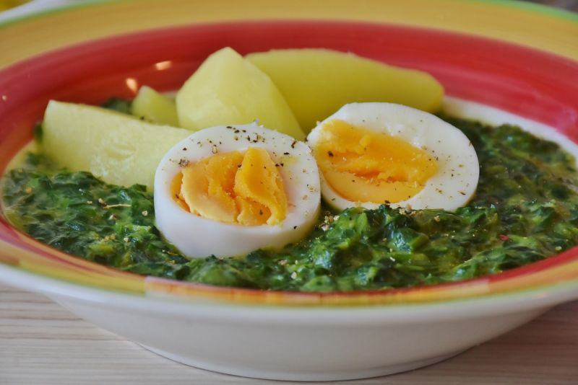
Green Thursday
Traditional dishes for Green Thursday are dishes made of vegetables, with a predominant green color (spinach). Green was supposed to heal the body.
Pasta, toasts, dumplings and noodles were cooked. Poppy, bean, pumpkin, peas and cucumbers were planted. This day fasting ends. The first fleshy meals were eaten on White Saturday.
source of picture: https://www.aktuality.sk/clanok/685895/cakali-40-dni-na-to-aby-mohli-hodovat-co-jedli-na-velku-noc-nasi-predkovia/

Slide 4
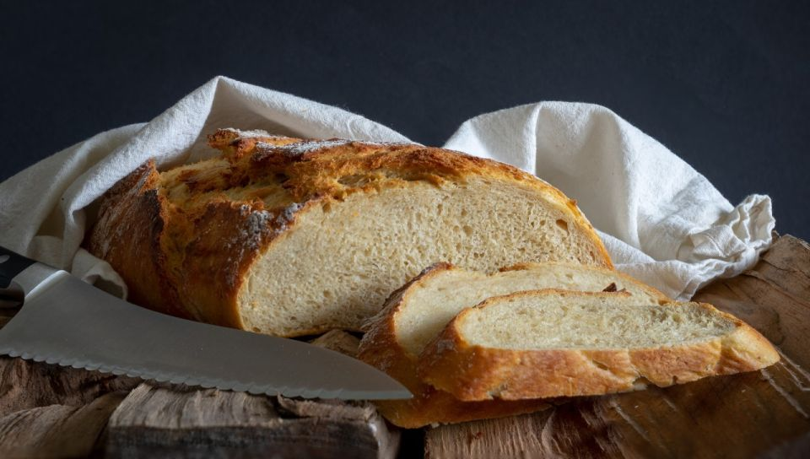
Good Friday
On Good Friday Christians adhere to strict fasting - they can eat only three times a day and only once in deep. They should avoid meat.
There is no work on this day, nor the earth should not move - nothing has been sown.
source of picture: https://www.aktuality.sk/clanok/685895/cakali-40-dni-na-to-aby-mohli-hodovat-co-jedli-na-velku-noc-nasi-predkovia/

Slide 5
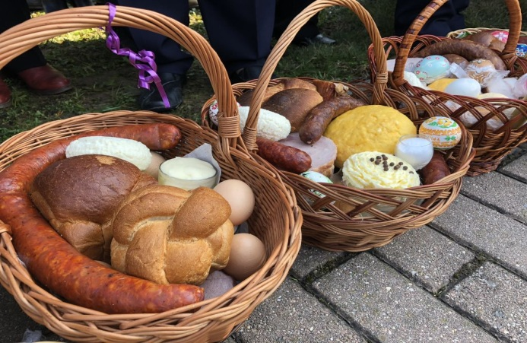
White Saturday
During the White Saturday, cakes were baked for guests. For lunch, it was typical the sour soup from the smoked meat with egg. Dinner was eaten with the same soup or cabbage soup with mushrooms, sausage, garlic and spices. The bryndza or poppy toasts were eaten, too.
Housewives prepared baskets filled with ham, sausages, painted eggs, white cakes, bread, salt, apples, horseradish on this day. In some parts of Slovakia, a lump (prepared from eggs and milk) is also added to the basket. The basket is covered with crocheted, woven or embroidered blankets that are blessed by a priest. These blessed foods are eaten for Easter and end fasting.
source of picture: https://www.aktuality.sk/clanok/685895/cakali-40-dni-na-to-aby-mohli-hodovat-co-jedli-na-velku-noc-nasi-predkovia/

Slide 6
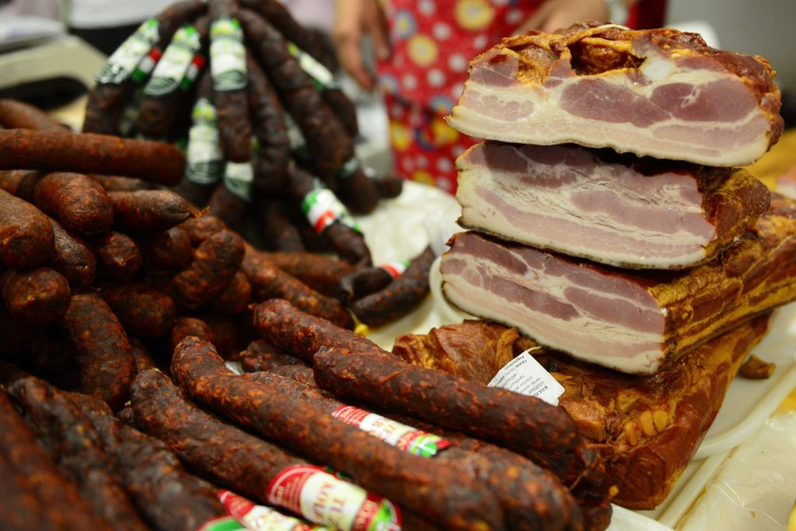
White Saturday
The most commonly prepared meat dishes were pork, boiled ham, smoked meat, sandwich and sausages.
In the villages food was mostly ham and sausages from pig-sticking. Meat dishes could be replaced by dairy products - cottage cheese, chips or cheese
source of picture: https://www.aktuality.sk/clanok/685895/cakali-40-dni-na-to-aby-mohli-hodovat-co-jedli-na-velku-noc-nasi-predkovia/

Slide 7
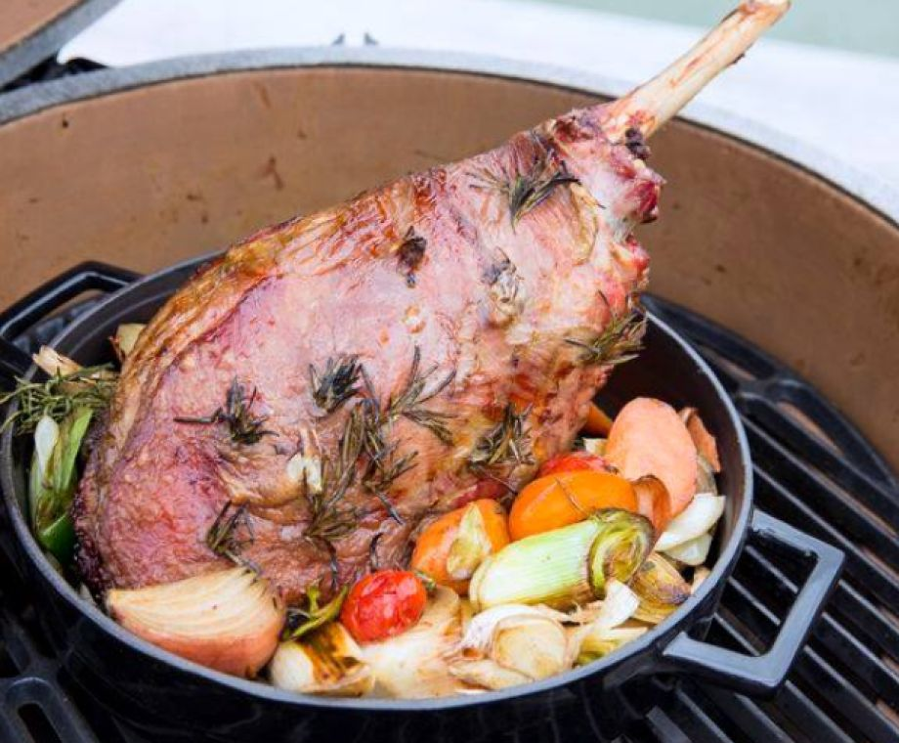
White Saturday
People used to prepare lamb in various ways.
In the south of Slovakia, lambs are prepared from eggs, buns and sausages, as not everyone could afford lamb.
source of picture: https://www.aktuality.sk/clanok/685895/cakali-40-dni-na-to-aby-mohli-hodovat-co-jedli-na-velku-noc-nasi-predkovia/

Slide 8
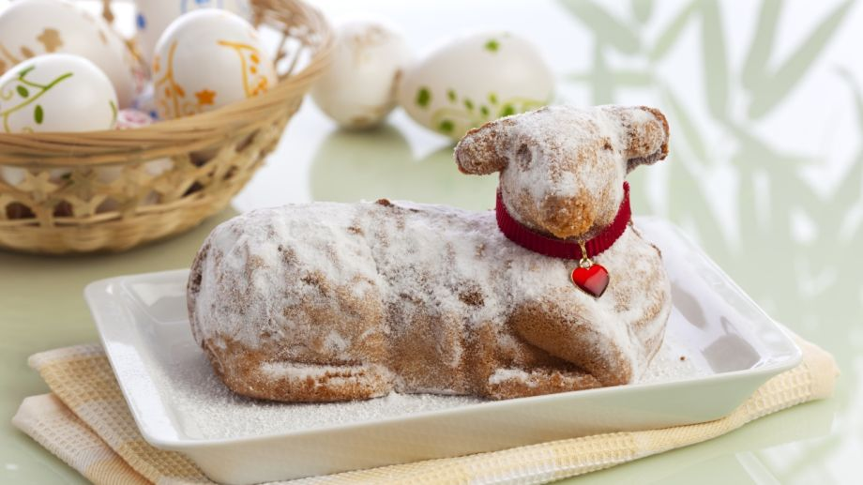
How to bake The Lamb
Mix the flour with the Golden Ear and baking powder. Mix yolks with sugar and vanilla sugar into the foam. Then gradually add the yolk mixture to the flour, add other ingredients and make a dough similar to sponge cake. Grease the lamb mold and sprinkle with flour.
Bake at 160 degrees for about 40 minutes. After baking, let it cool in the mold for 1 hour.
source of picture: https://recepty.aktuality.sk/recept/6635/velkonocny-barancek/

Slide 9
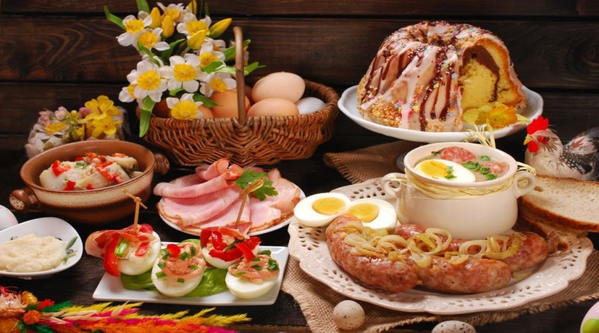
Easter Sunday
People consumed blessed meals, the whole family together.
Together they sat down at the table for lunch. The main dish was roast lamb or goat.
In addition to meat, chicken soup or beef broth with vegetables and roast dumplings or garlic soup with pearl barley was served. At the end, everyone enjoyed the prepared cakes.
A lot of eggs or meals with eggs were eaten. They were a symbol of new life, joy and spring.
source of picture: https://kosicednes.sk/zaujimavosti/nezabudnime-velkonocne-zvyky-tradicie/

Slide 10
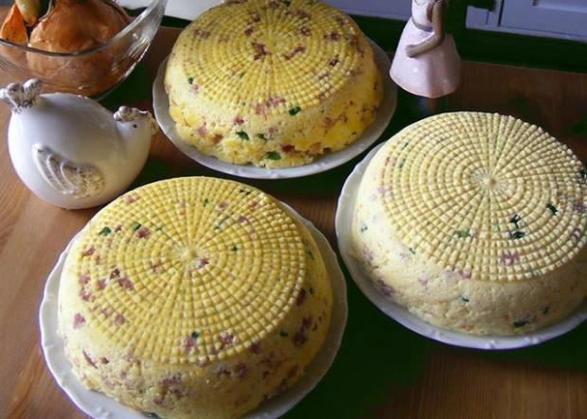
Easter Monday
This day was the day for visitors. Wider family and friends came. People sat down for lunch. The menu was not specified. Either what was left of Sunday was eaten, or the duck or chicken was baked. In addition, sausages were also eaten. In the east, special egg dishes were made.
The evening was fun. The girls brought bacon, eggs, sausages, the boys paid musicians. People could finally have fun after a long time.
source of picture: https://nanicmama.sme.sk/ine-recepty/velkonocna-hrudka-so-sunkou

Slide 11
THANK YOU FOR YOUR ATTENTION
Simona Krličková – 3.A Class

