Slide 1
the Shebi Arus, or ‘’Reunion Night’’

Slide 2
WHO IS MEVLANA?
Mevlana Celaleddin – i Rumi was an Anatolian holy man who gave hope and inspiration to humanity. He was born in 1207 in the city of Balkh, Horasan and died in 17th December 1273 in Konya.
He studied Sufism and wrote poems about Sufism. He advocated love through tolerance and positive thinking.
Today his poems and words of wisdom are very famous all over the world. The United Nations declared 2007 as the year of Rumi.

Slide 3
CELEBRATIONS
Mevlana died on 17th December 1273 in Konya, Turkey. He has a mauseloum there. Every year on the day he died we celebrate Seb-i Arus, his Wedding or Reunion Day. Rumi thought that his death was not something to mourn but to celebrate because he reunited with his God.
This year we celebrated the 746th Reunion Day.
People from all over Turkey and other countries attend the celebrations each year.
At the celebrations you can listen to Sufi music concerts and watch the Sema Ceremony (Whirling Dervishes).

Slide 4
Whırlıng dervıshes
The ‘dance’ of the Whirling Dervishes is called Sema and is a part of the inspiration of Mevlana and has become part of Turkish custom, history, beliefs and culture.
Sema represents a man’s spiritual journey through mind and love to ‘Perfect’.
While they are dancing, they raise their right palm up to get God’s blessings and they point their left hand to the ground to communicate these gifts to earth.

Slide 5
Meanıng of theır clothes
During the Sema Ceremony , the whirling dervishes wear a long white dress, which symbolizes the death of egos.
They also wear a long black cloak, which is a symbol of the grave. Before the Semazens start whirling, they remove their cloak. By taking off their cloak before the whirling begins they mean that they have turned their back to the world and are seeking nearness to God.
They also wear hats that symbolize the tombstones of their egos.

Slide 6
Why do these dervıshes whırl?
Because everything turns in the universe. The world turns, the sun turns, our blood turns, and also the Dervish turns.

Slide 7
WORDS OF WISDOM by RUMI
Yesterday, I was clever, so I wanted to change the world.
Today I am so wise, so I am changing myself.
In the mountain of your body there’s a jewel. Search for it!
Love is to see beyond what the eye sees.
Raise your words, not your voice.
It is rain that grows flowers not thunder.

Slide 8
WORDS OF WISDOM by RUMI
You’re not a drop in the ocean.
You’re the entire ocean in a drop.
My heart, so precious, I won’t trade for a hundred thousand souls yet your one smile takes it for free.

Slide 9
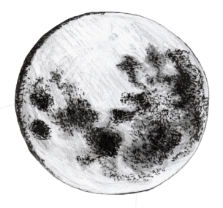
A Poem by rumI
If you want the moon,
do not hide
from the night.
If you want a rose,
do not run
from the thorns
If you want love,
do not hide
from yourself.
RUMI

