Slide 1
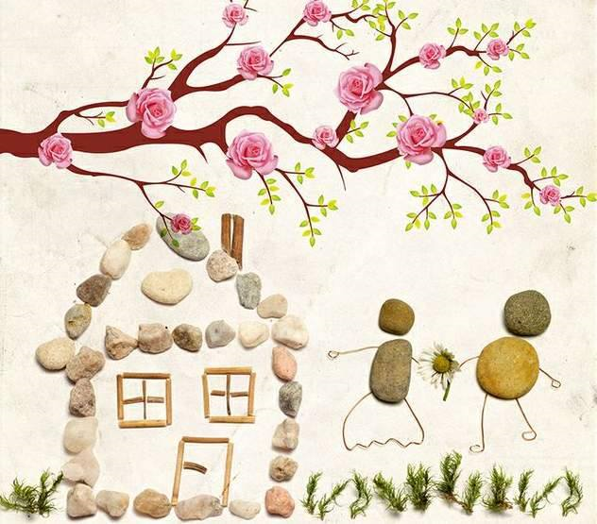
HIDIRELLEZ
.
Picture Source:
http://blog.kayakapi.com/wp-content/uploads/2016/05/hidirellez-nedir-ne-yapilir-ne-yapilmazjpg.jpg

Slide 2
WHAT IS THE DAY OF HIDIRELLEZ? Hıdırellez or Hıdrellez is one of the seasonal holidays celebrated in the Turkish world. It is called Ruz-ı Speed or Speed day. This day is celebrated by The Day when Helith and Elijah (two prophets) met on earth. The day of Hıdırellez is celebrated in Turkey on the night that connects May 5th to May 6th.
Picture Source:
https://i.internethaber.com/files/2016/2/8/1564114/1564114.jpg

Slide 3
WHAT TO DO ON HIDIRELLEZ DAY? On the morning of Hıdırellez, a house is made from mud on the edge of a stream and then wheat is placed in it. This is because of the belief that wheat will bring prosperity and abundance to home that year. On May 5, 41 kinds of grass and small clean stones are collected from the countryside. The collected herbs are put in a bowl of water and the face is washed with that water on the morning of Hıdırellez. This water is said to be good for the face. Eggs are boiled for breakfast on the morning of Hıdırellez. These eggs are fed to children. Hıdırellez egg is thought to give power. People make wishes. They draw pictures of them on pieces of paper or make a small model of them and then hang them on the branches of a rose tree.
Picture Source:
https://encryptedtbn0.gstatic.com/images?q=tbn%3AANd9GcThu_qy5NjZk9zYM84wGe1Z_yNVMppDD7-3e1GFtj3qE1UOpnaE&usqp=CAU

Slide 4
On Hıdırellez Day, the hungry in the surrounding are filled, meals are shared. Sharing is believed to bring abundance in later periods.
New locks are opened on the heads of the girls who want to get married but cannot. In this way, it is thought that their fortunes will also be opened.
On the night of May 5, Hıdırellez fire is lit and jumped over at least three times. It is believed that the wish that was made while jumping over the fire would come true that year and you will be healthy the whole year round. On the night of Hıdırellez (May 5, night) a willow branch is hung on the doors of the houses.
Picture Source :
https://www.diyarbakirsoz.com/Images/208160.webp

