Slide 1
SAINT
GEORGE’S DAY
23rd April
CFA Jacint Carrió i Vilaseca (Manresa)
Photo: Isabel Roca
Notes:
April 23 Saint George’s day of the book and the rose.

Slide 2
“Keeping traditions all year round”
e-Twinning project 2019-20
English, GES-2
Manresa, April 2020.

Slide 3
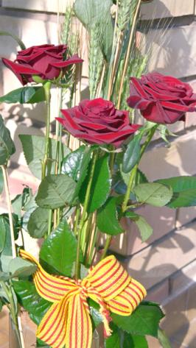
The Saint George’s tradition is based on a legend. The story is that Saint George fighted against the dragon to save the princess of it, and protect people of the village. Finally, he won the fight and the dragon died.
When he stabbed the sword on the heart of the dragon, from its blood were born roses.
After that, he offered one rose to the princess.
Photo: Isabel Roca
The typical roses of Sant Jordi.
Notes:
He gives the man to the woman by tradition

Slide 4
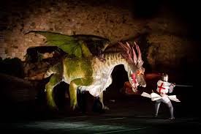
© setmanamedieval.cat. Montblanc
Photo: Isabel Roca
The knight fighting with the dragon is the typical legend of Catalonia.

Slide 5
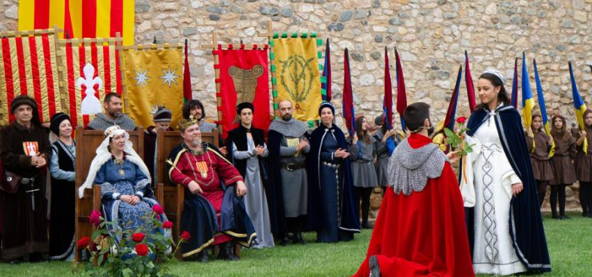
© setmanamedieval.cat. Montblanc
Photo: Isabel Roca
Scene of the prince and the princess. The prince offers a rose to her.

Slide 6
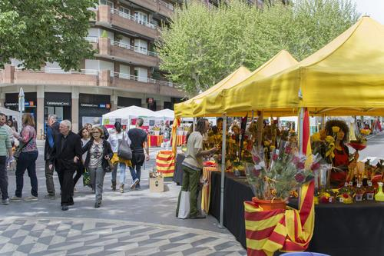
© Ajuntament de Manresa
Stalls selling roses and books and typical items of Sant Jordi.

Slide 7
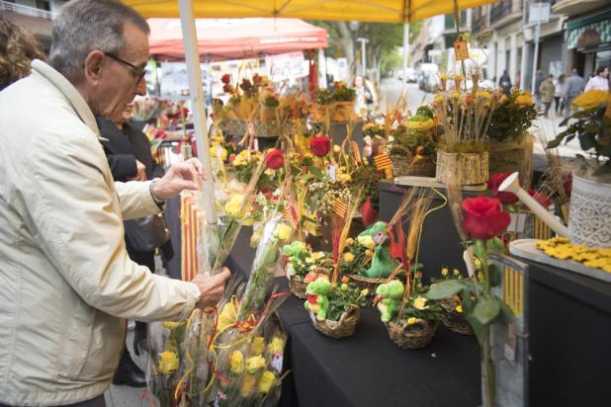
© Oscar Bayona. Regió-7
A man buying a rose to give to his wife.

Slide 8
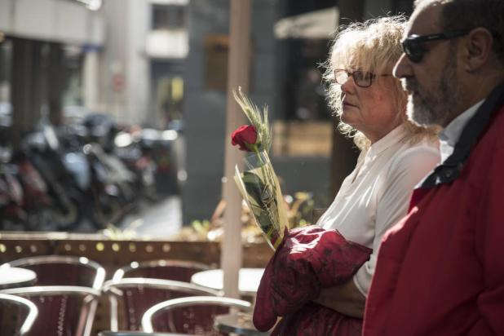
© Oscar Bayona. Regió-7
Couple sunbathe with rose.

Slide 9
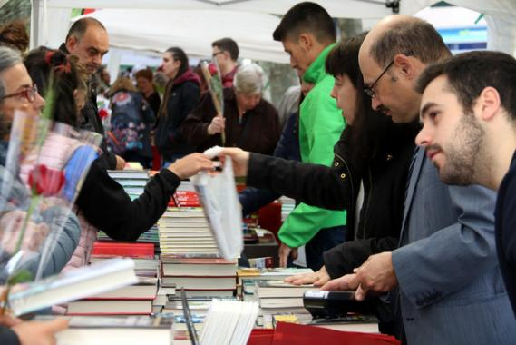
© ACN Manresa /CCMA
Men buying roses for their wifes and women buying books for their husbands.

Slide 10
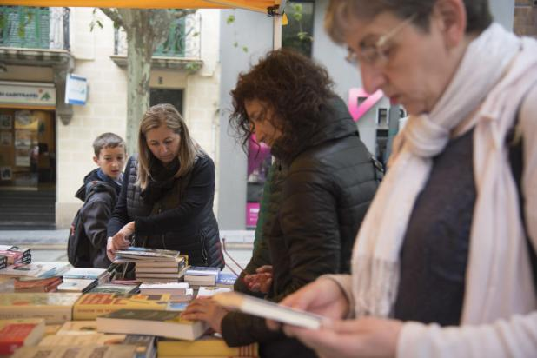
© Oscar Bayona. Regió-7
People buy books for their husbands or children.

Slide 11
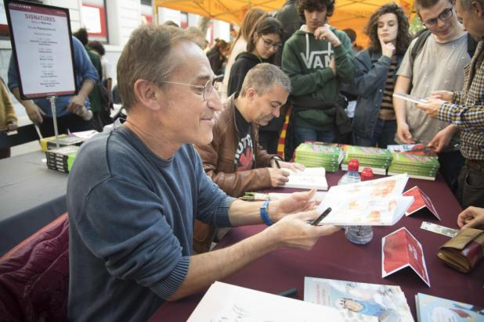
© Oscar Bayona. Regió-7
A writer signing books.

Slide 12
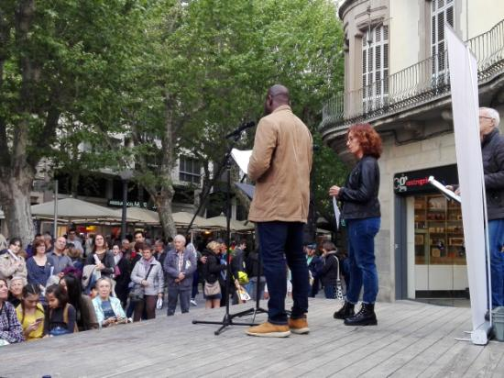
Photo: CFA Jacint Carrió i Vilaseca
People doing a recital about the legend of Sant Jordi.

Slide 13
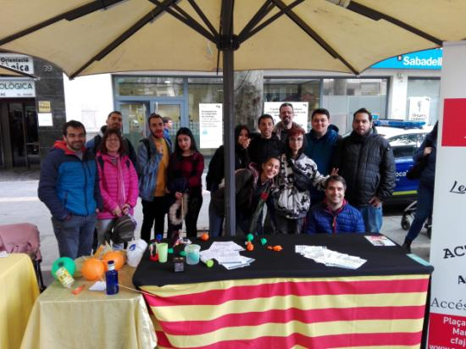
Photo: CFA Jacint Carrió i Vilaseca
Teachers and students of the CFA Jacint Carrio i Vilaseca school (23rd April 2019).

Slide 14
TEXT WRITTEN BY
Arrey A.
D. Marín
N. Valldeperas
I.Romero
P.Fernández
X.Vives
GES-2, 2019-20
(Morning and afternoon group)

Slide 15
Happy Saint George’s Day!

