Slide 1
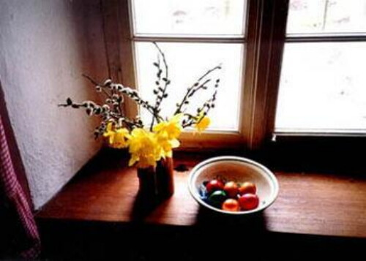
Typical Slovak Easter Eggs

Slide 2
PAINTED EASTER EGGS

Slide 3
DECORATING WITH WAX

Slide 4
PAININTG WITH WAX

Slide 5
DECORATING WITH WIRE

Slide 6
STRAW WRAPPING

Slide 7
STICKING COLOURED COTTON

Slide 8
SCRATCHING

Slide 9
DRILLING

Slide 10
DECOUPAGE

Slide 11
USING PLANTS

Slide 12
STICKING BRANCHES AND BARK

Slide 13
EMBROIDERY

Slide 14
STICKING BEADS

Slide 15
STICKING STRINGS

Slide 16
CROCHET EGGS

Slide 17
3D

Slide 18
THANK YOU FOR ATTENTION 3.A CLASS
https://artmama.sme.sk/slovnik-rucnych-prac/velkonocne-vajicka-kraslice
www.pohladnice.sk
www.sashe.sk

