Slide 1
New year IN IZMIR
By Asal Mardalipour from
Cem Bakioğlu Anadolu Lisesi

Slide 2
We have been waiting for the New Year for a long time. I know we all love winter and snow and building a snowman with our families and specially the wonderful New Year night with so many joy and gifts under our tree. Now I want to tell you about the New Year in Izmir,Turkey.

Slide 3
First I have to tell you that because the Turkish nation is a majority of Muslims, Christmas is not celebrated in Turkey. However, the spirit is still there, as Noel Baba, Turkish Santa is believed to bring children gifts on New Year's Eve.

Slide 4
But we have a wonderful time when the New Year approaches. First, we all go out with our friends to buy presents and gifts for our parents and siblings. Then, we write a card saying happy new year and we stick the card on the gifts. We can keep them in our diary later on.

Slide 5
On New Year’s Eve we should be all together with our grandparents. We play tombala (Bingo) and have a house party. We eat chicken or Turkish famous foods like meatballs, rice and sarma (stuffed grape leaves) or döner kebab.
It is also a tradition to wear something red that night.We believe that we will be wealthier if we do that.

Slide 6
In Izmir streets and shopping malls there are so many trees and santas singing or playing some music instruments to bring us happiness at New Year’s. There are so many options for boutiques and shops for us. And sometimes the salers wear green or red to match the mood.

Slide 7
Here are some pictures about New Year decorations and trees and how we spend this night with our family, hope you enjoy it. Wish you a wonderful year & merry Christmas to everyone..

Slide 8
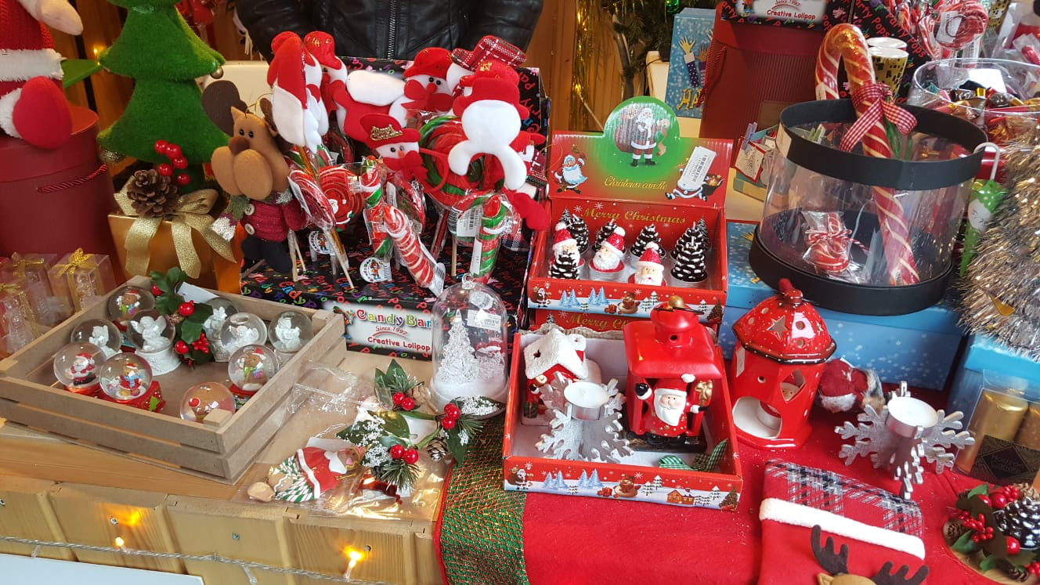

Slide 9
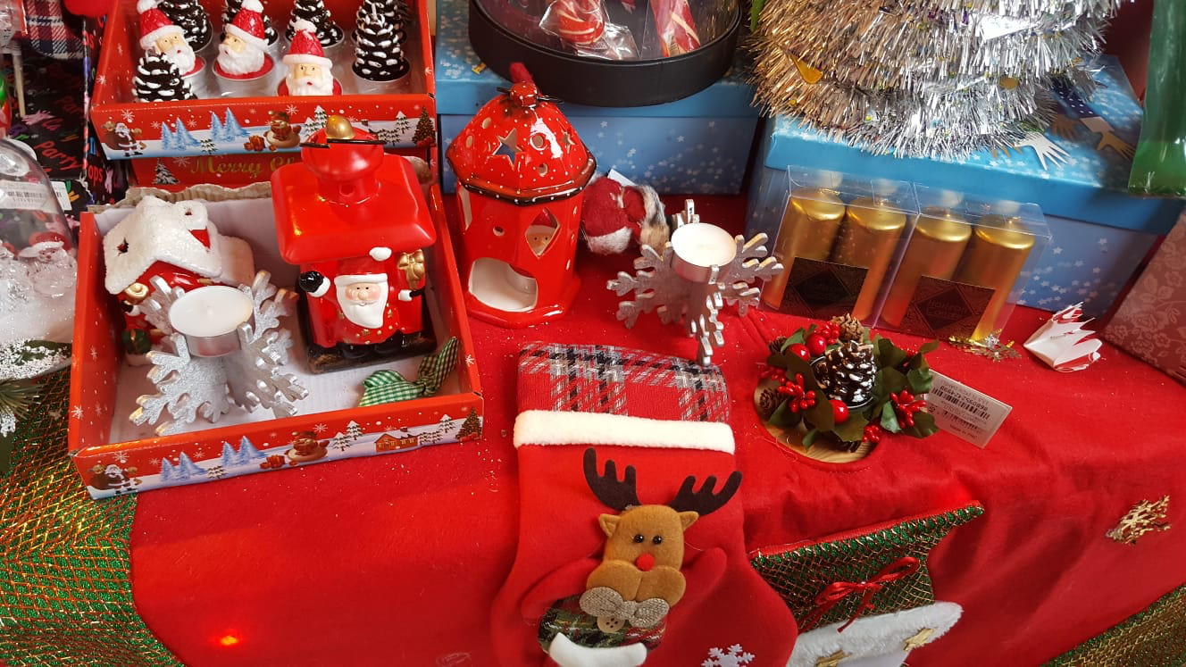

Slide 10
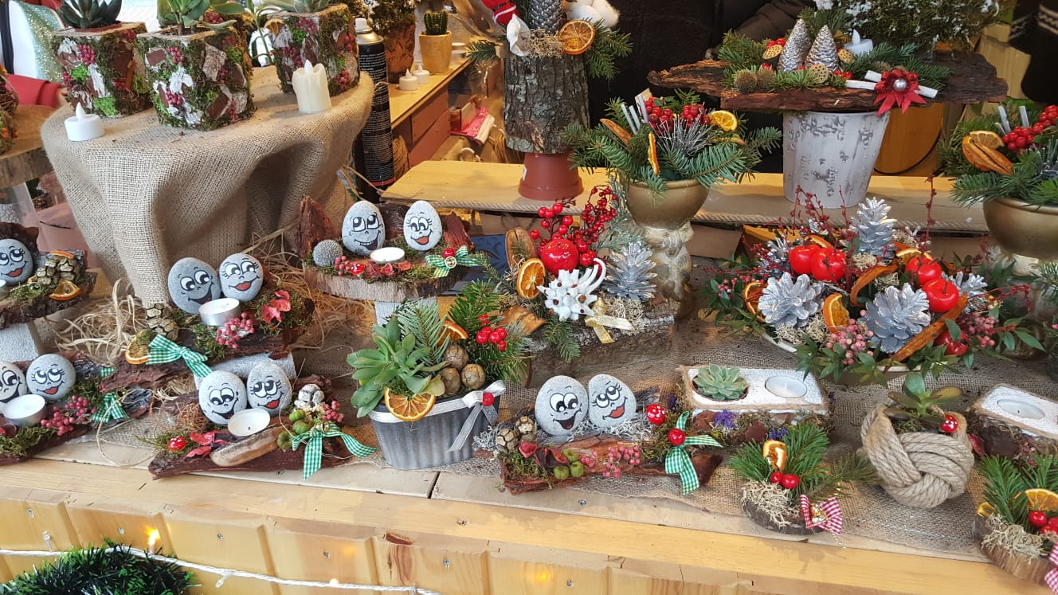

Slide 11
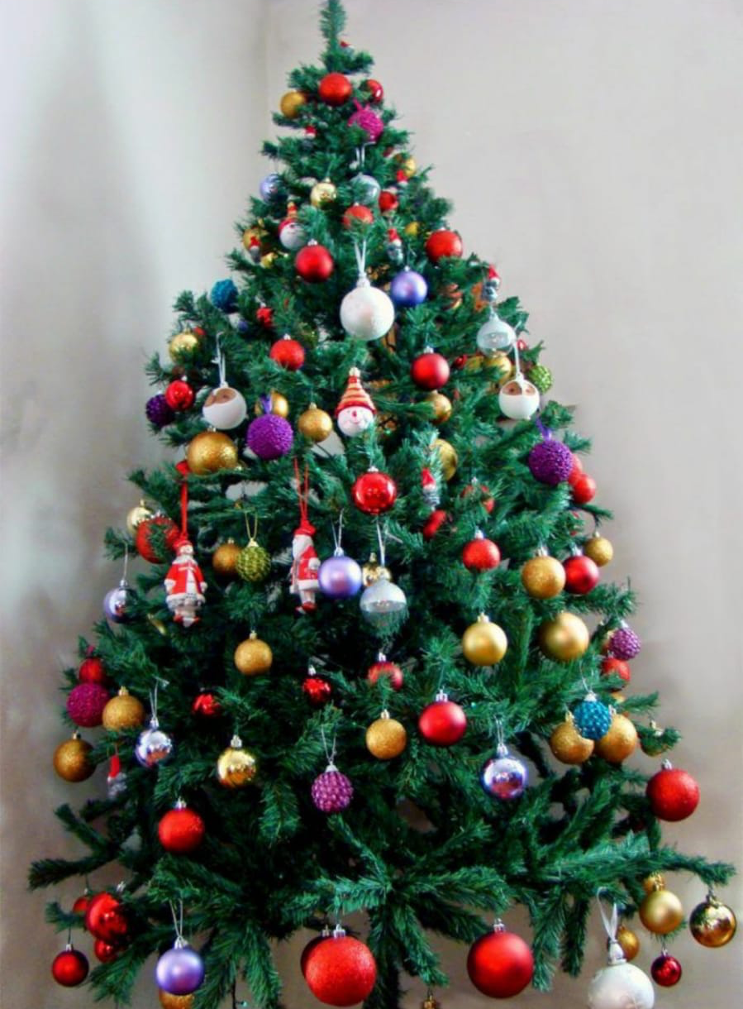

Slide 12
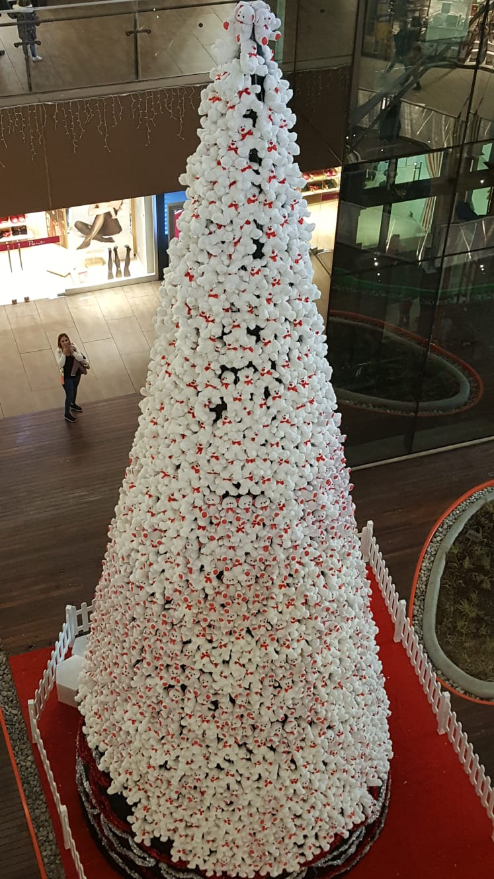

Slide 13
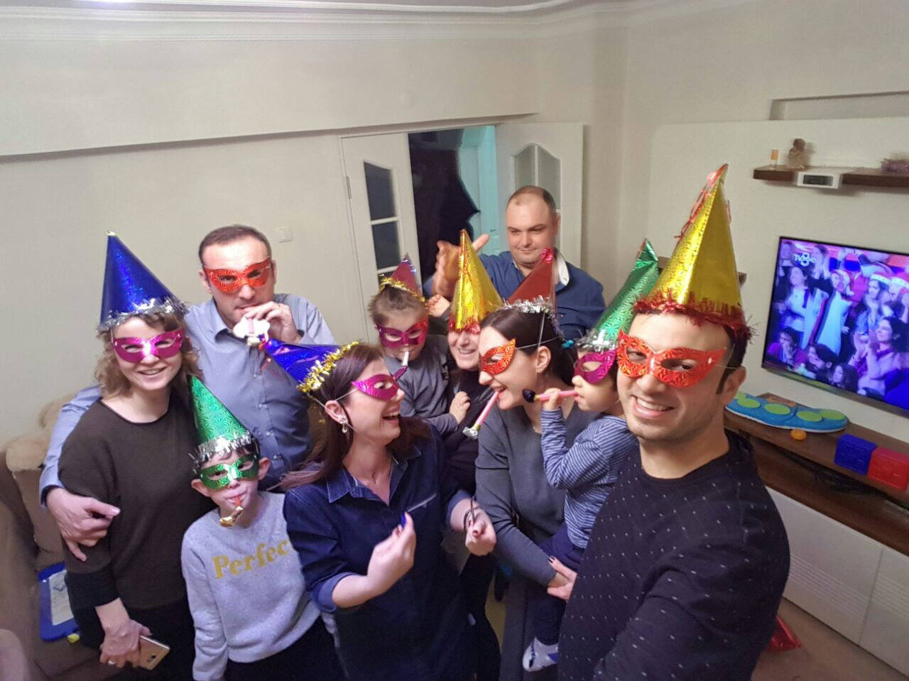

Slide 14
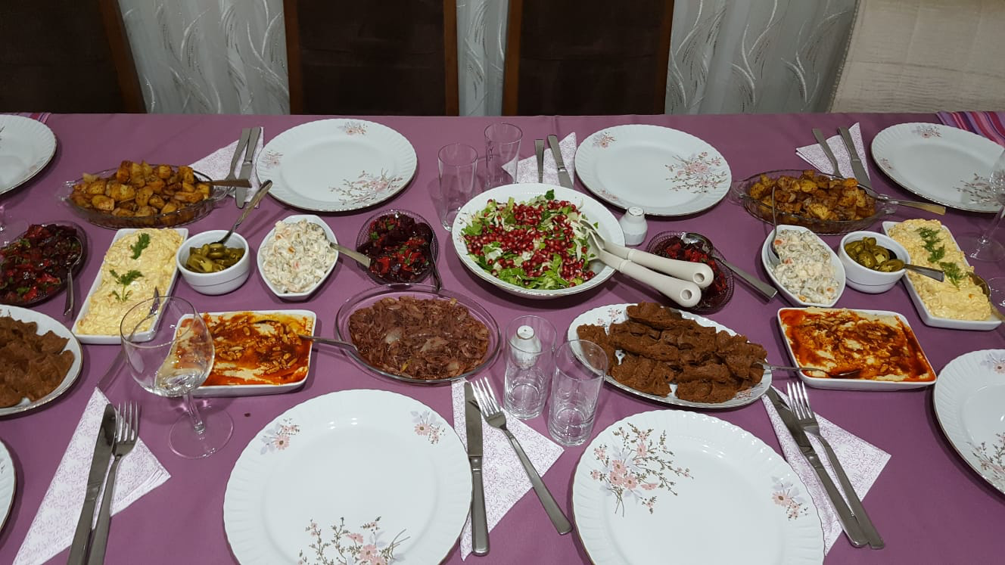

Slide 15
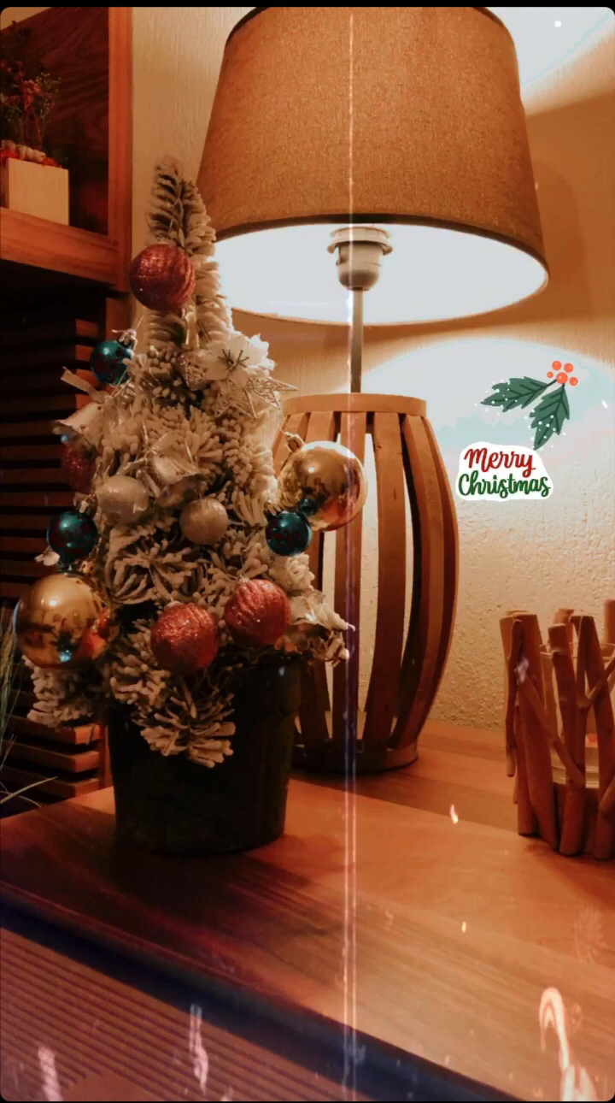

Slide 16
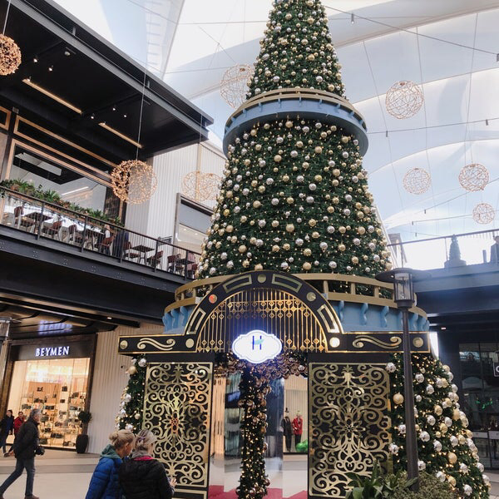

Slide 17
