Slide 1
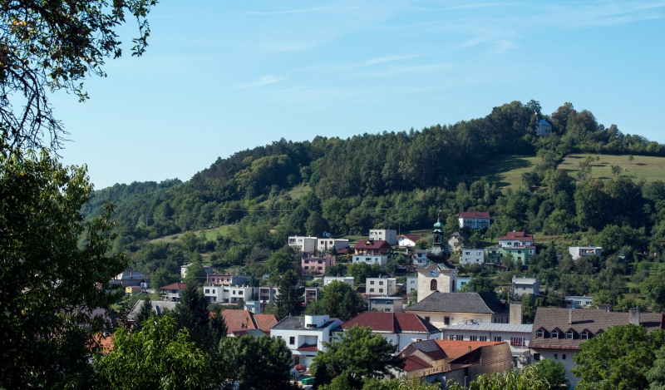
Mining procession in NovÁ Baňa

Slide 2
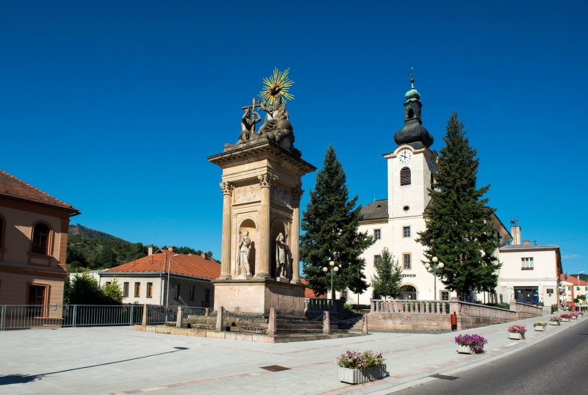
Royal mining town
Nová Baňa used to be a royal mining town in 14.th century .

Slide 3
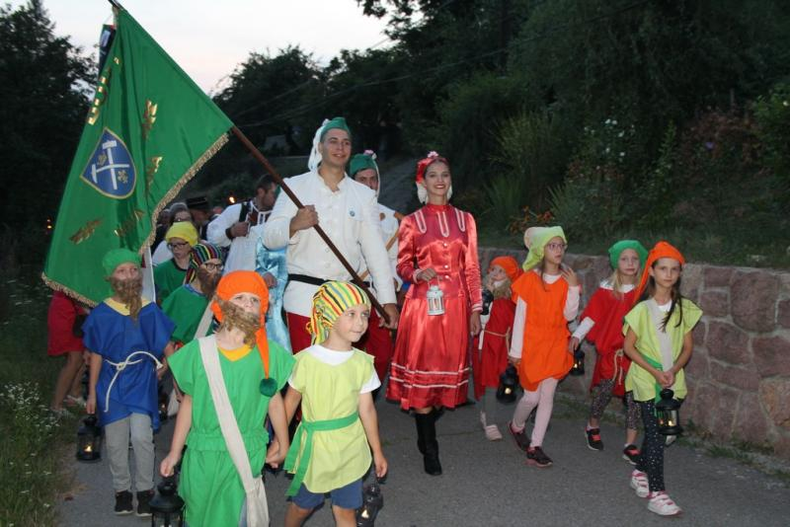
Mining procession
Mining procession is organized every summer in our town.

Slide 4
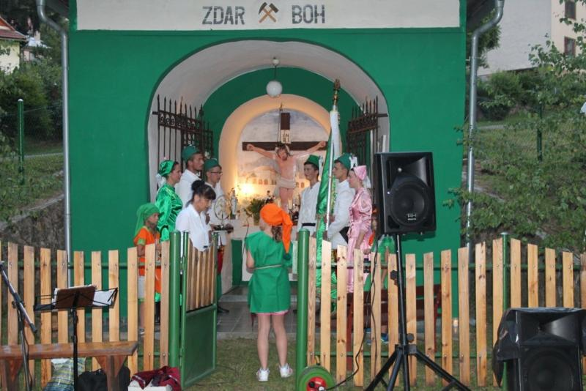
Mining chapel
Program starts at St. Ann mining chapel.

Slide 5
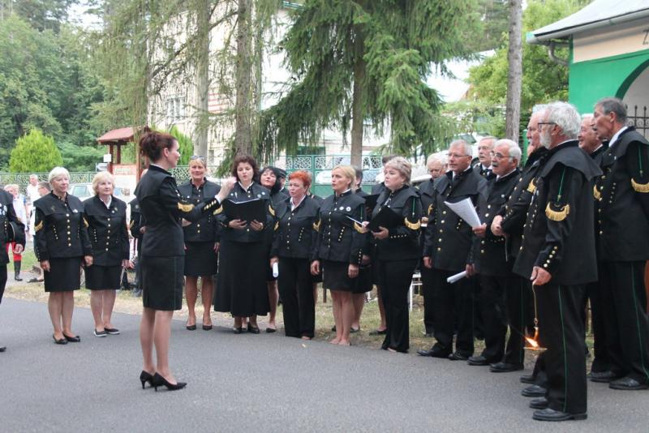
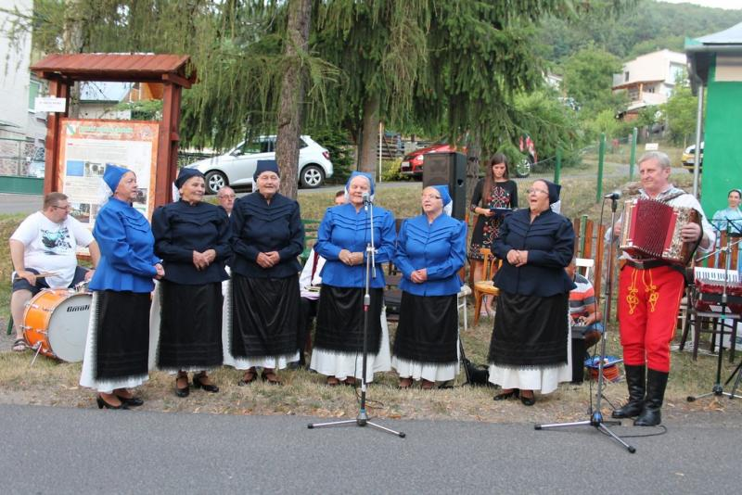
Musical performances
Monte Regis and folk group Vinička are very popular .

Slide 6
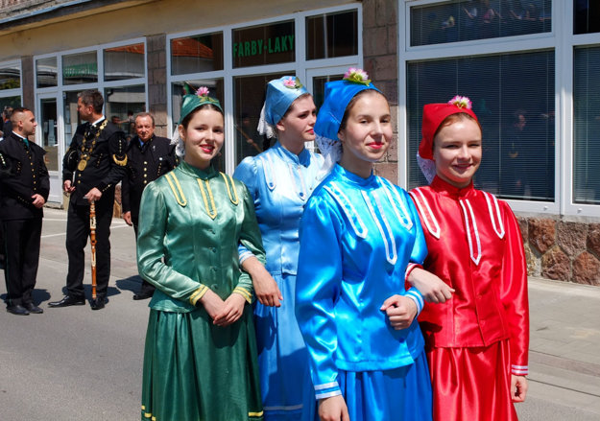
Typical mining folk costumes
Men are wearing black mining uniforms and girls are wearing colourful costumes.

Slide 7
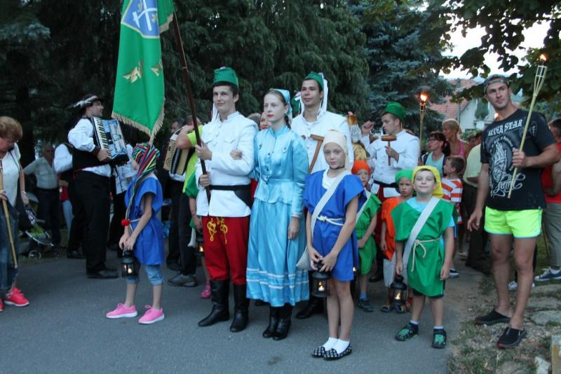
Torchlight procession
People have torches in their hands and go to Zvonička in the evening

Slide 8
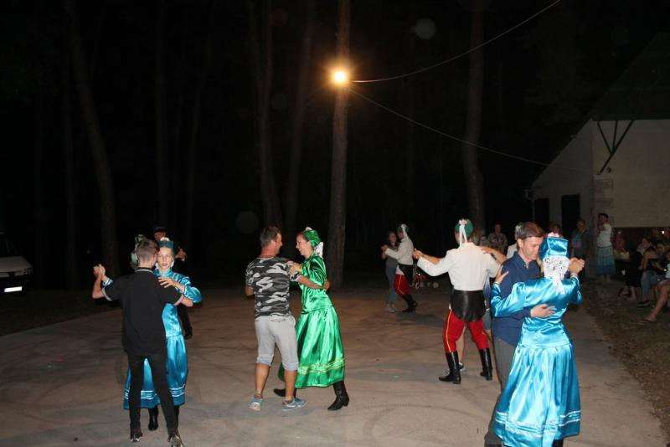
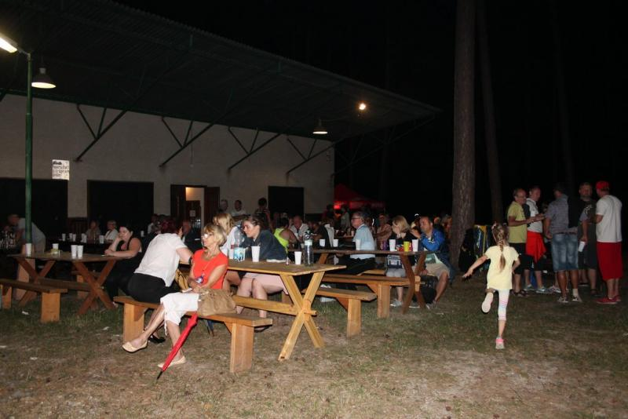
Evening dancing
People like dancing, singing and eating there

Slide 9
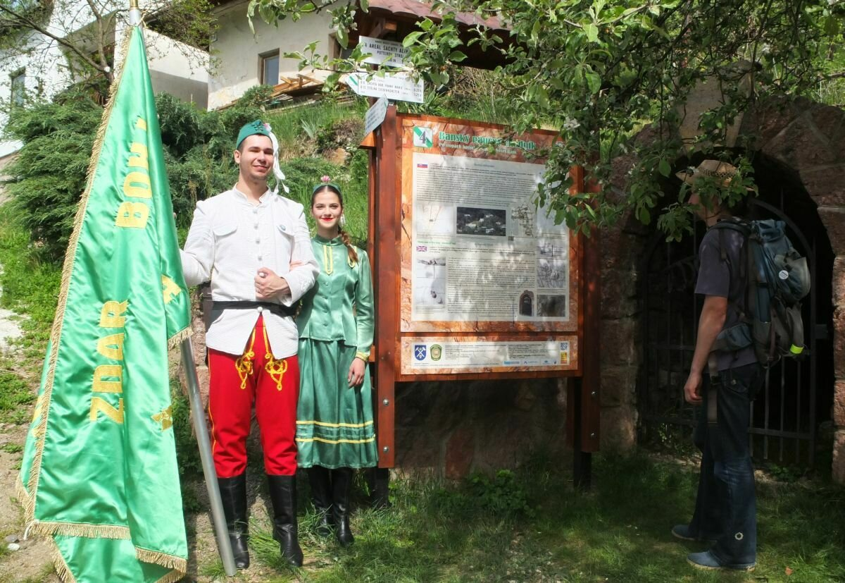
Educational Mining trail
Nová Baňa had a lot of mines, so visitors can walk along educational mining trail.

Slide 10
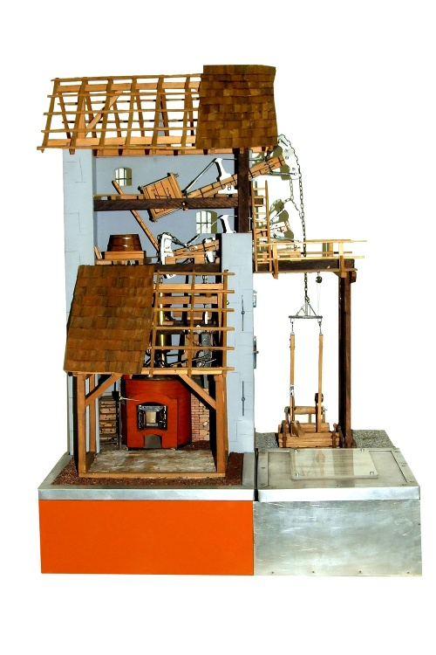
potter's machine
Potter's machine was used in Nová Baňa for the first time in the mining history. It pumped water from the mines.

Slide 11
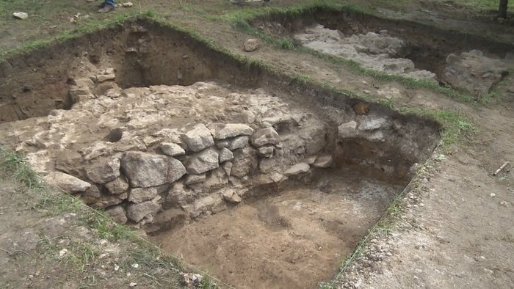
Discovery of the engine room
The engine room of the Potter's machine was found in Nová Baňa this year. It is the unique archeological excavation in Europe.

Slide 12
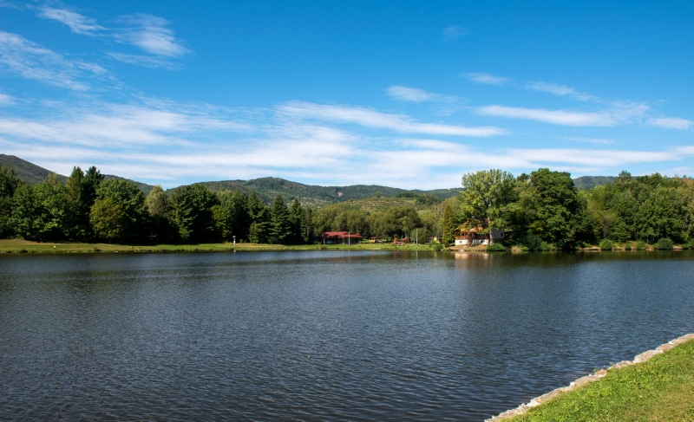
Water reservoir Tajch
Lake Tajch was used as a water reservoir for mines in the past. Nowadays people like swimming and fishing there.

Slide 13
You are welcome !
Thank you for your attention
3.A Class
Source of pictures:https://www.novabana.sk/

