Slide 1
Ahaus,Germany – 26.03 - 01.04 2017

Slide 2
Working in Europe – skills for success 4th meeting /Ahaus-Germany/

Slide 3
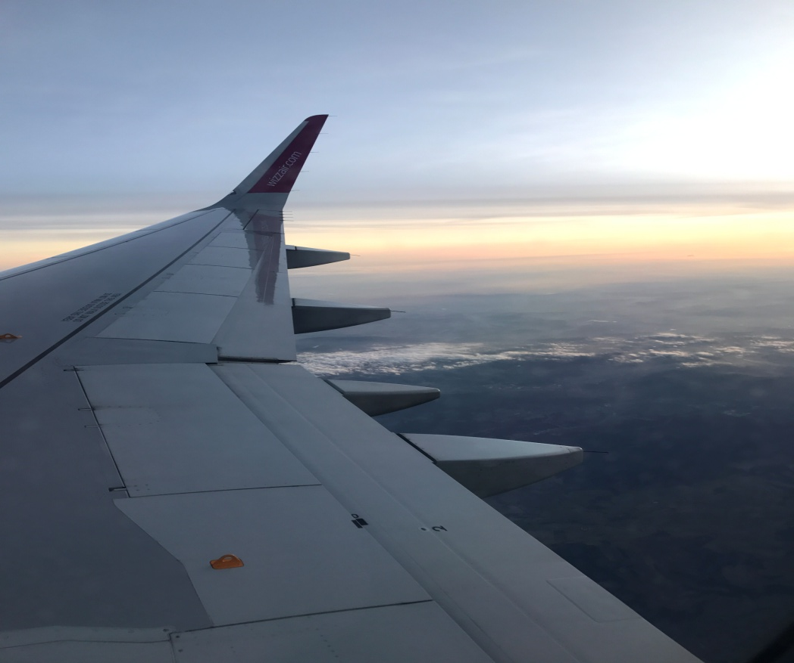
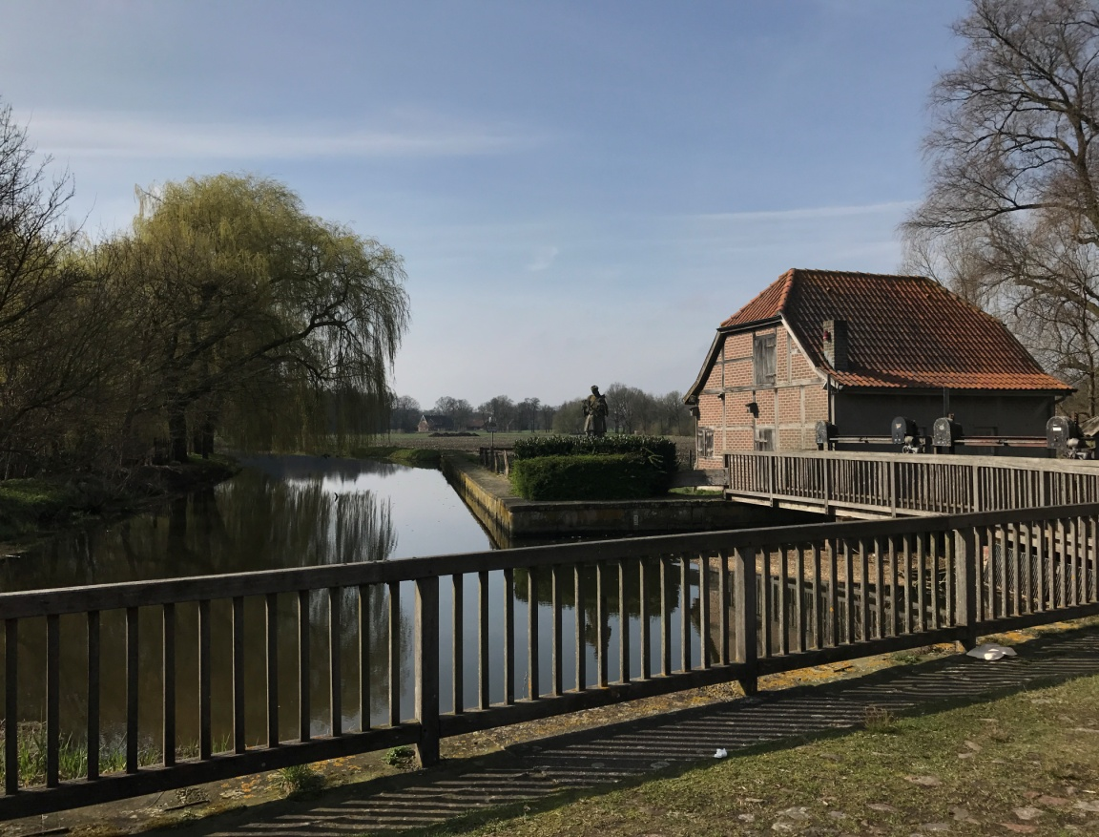
26th March (Sunday)
On this day we arrived in Nienborg,Germany and walked around the town.

Slide 4
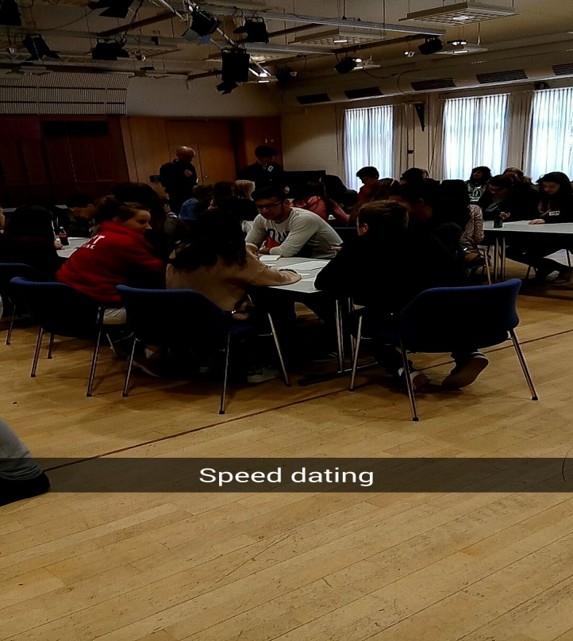
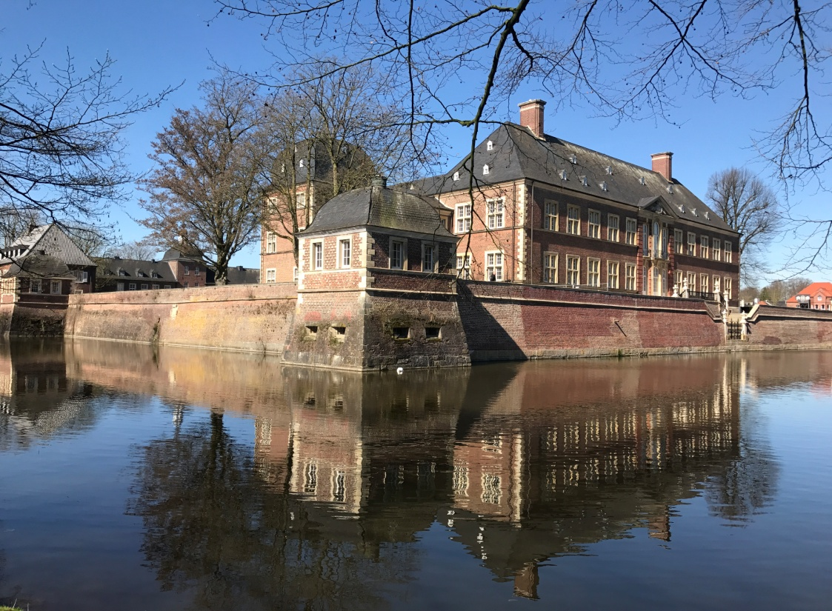
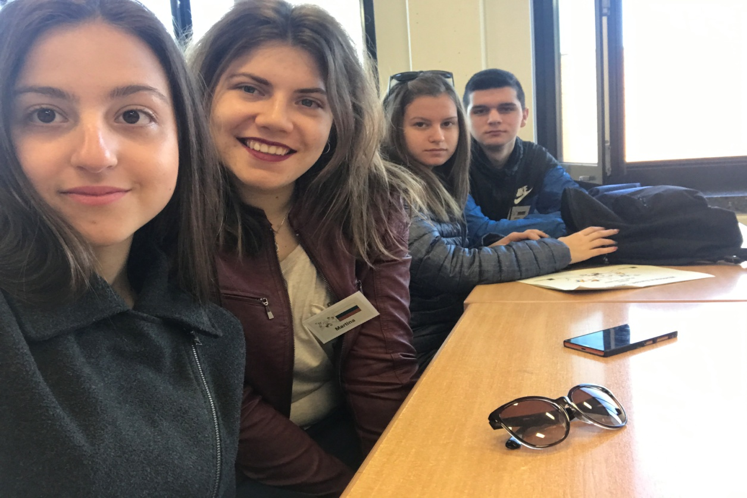
27th March (Monday)
In the morning we attended speed dating program. Then we walked around Ahaus and visit company Tobit.

Slide 5
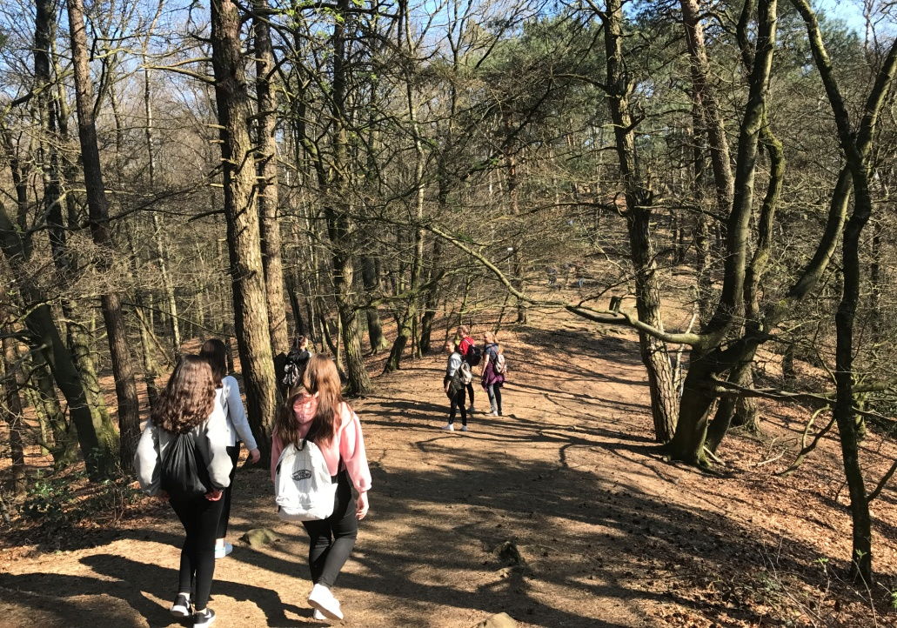
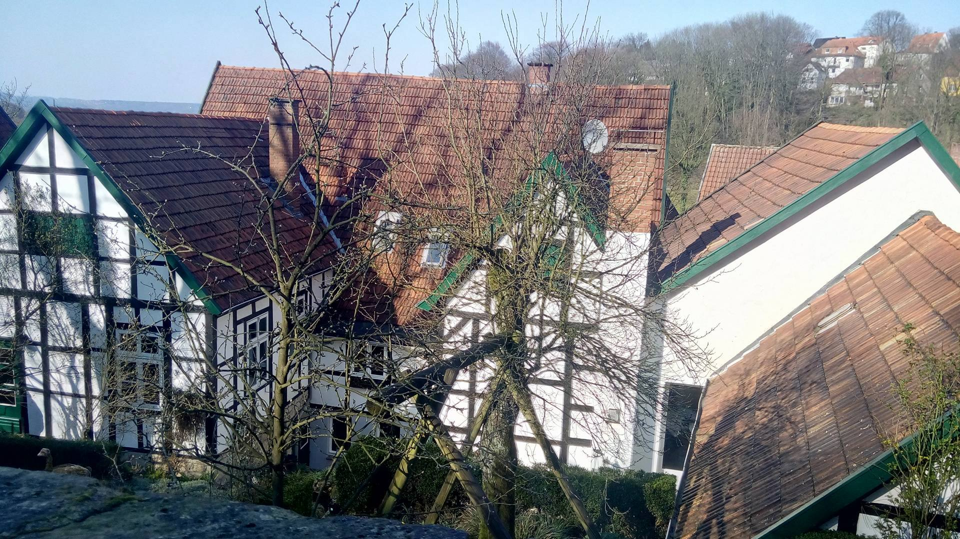
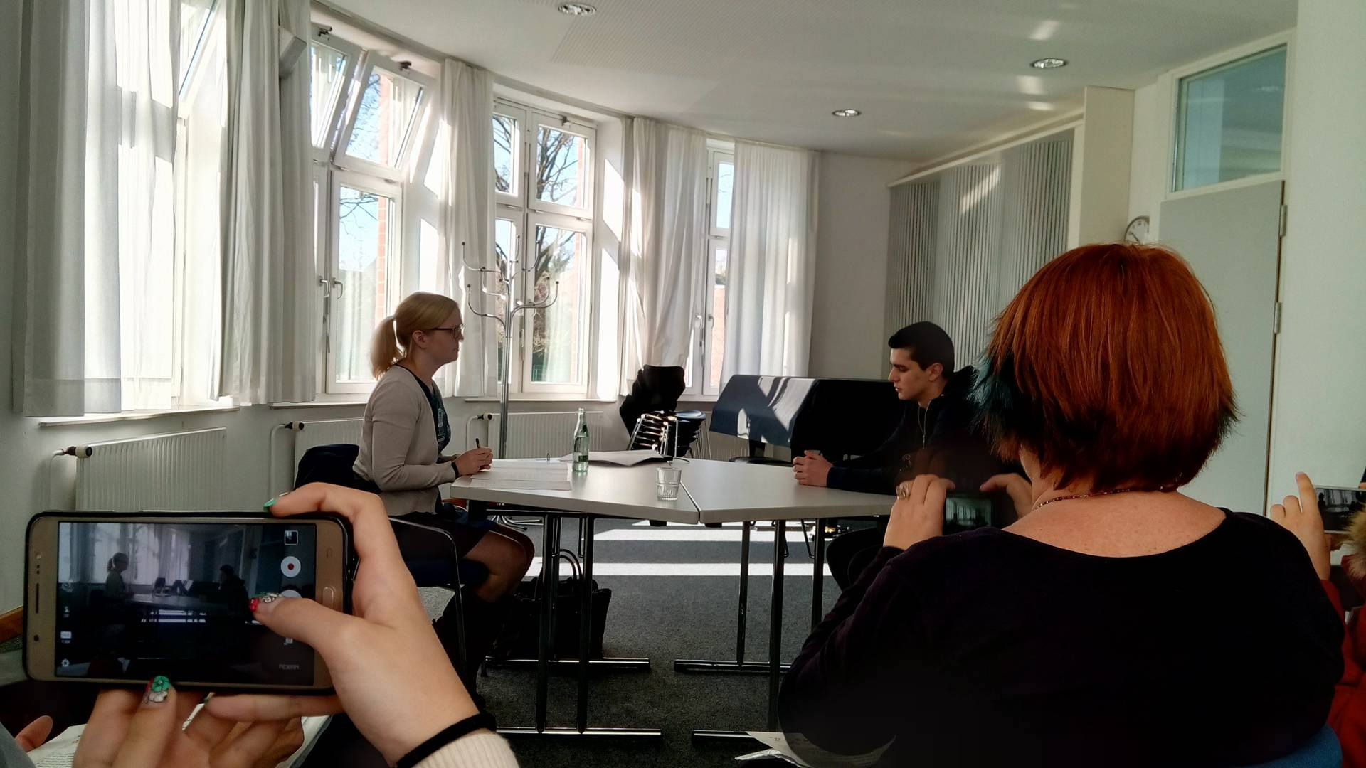
28th March (Tuesday)
On this day we had simulation of job interviews with entrepreneurs .Then we had trip to Dörenthe and Tecklenburg.

Slide 6
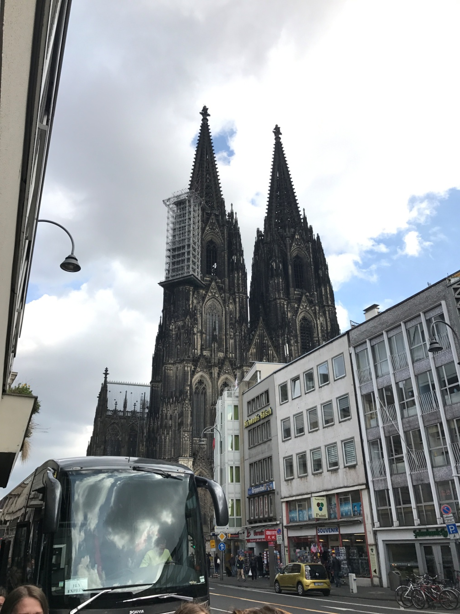
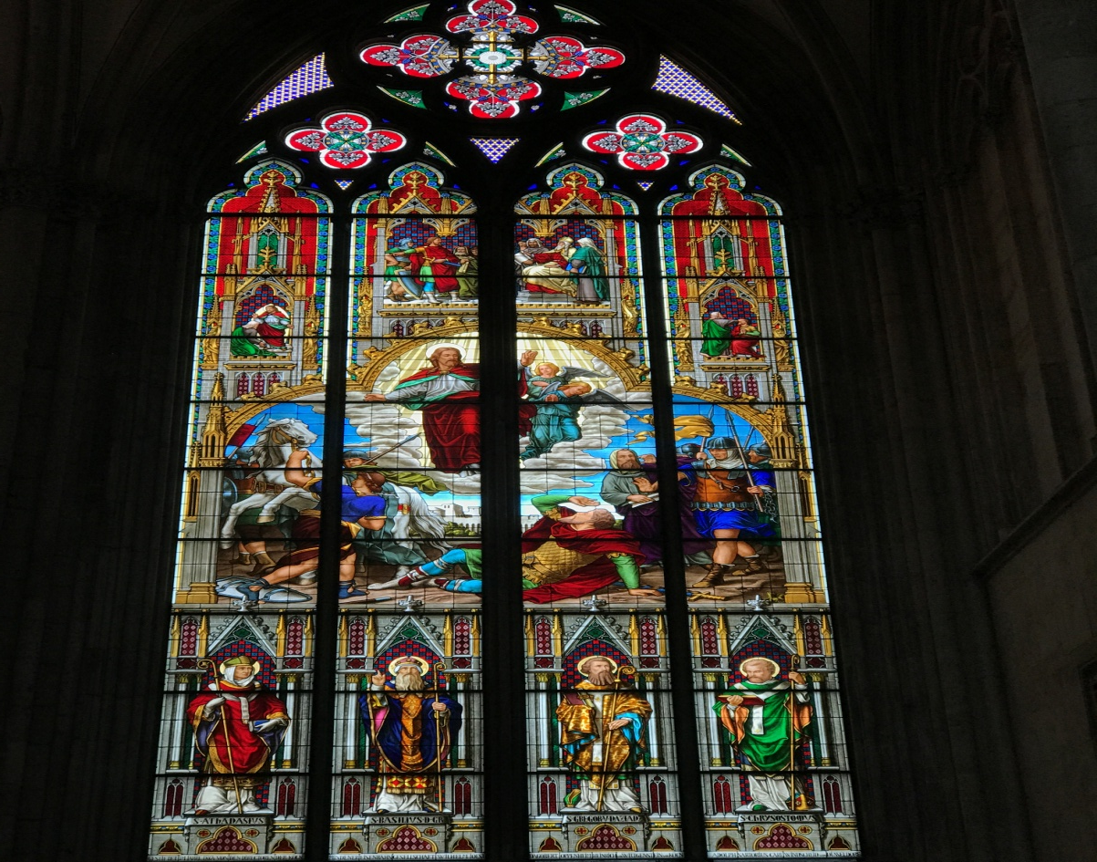
29th March (Wednesday )
In the morning we had seminar with Sonja Hüls on behaviour in private and business context and then we visited Köln .

Slide 7
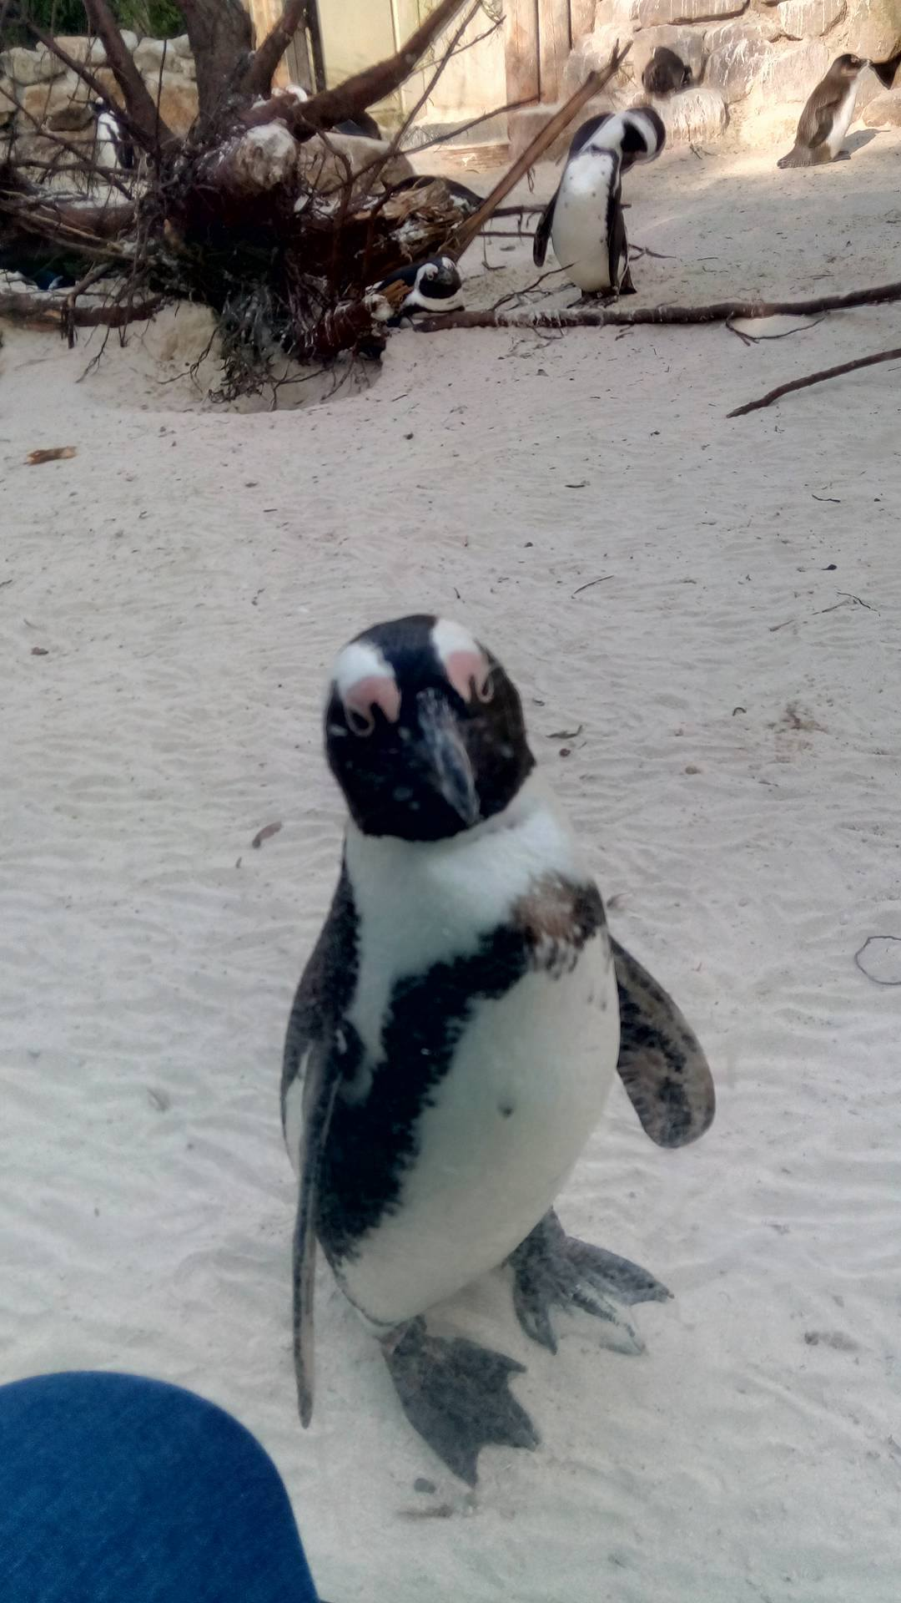
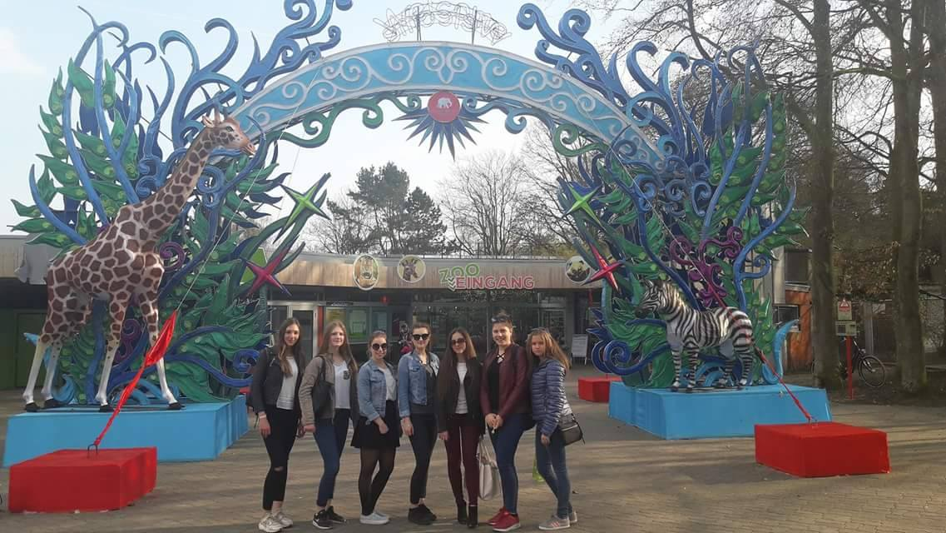
30th March (Thursday)
On this day we had to work on scenario for short film and then we had free time with the host families.

Slide 8
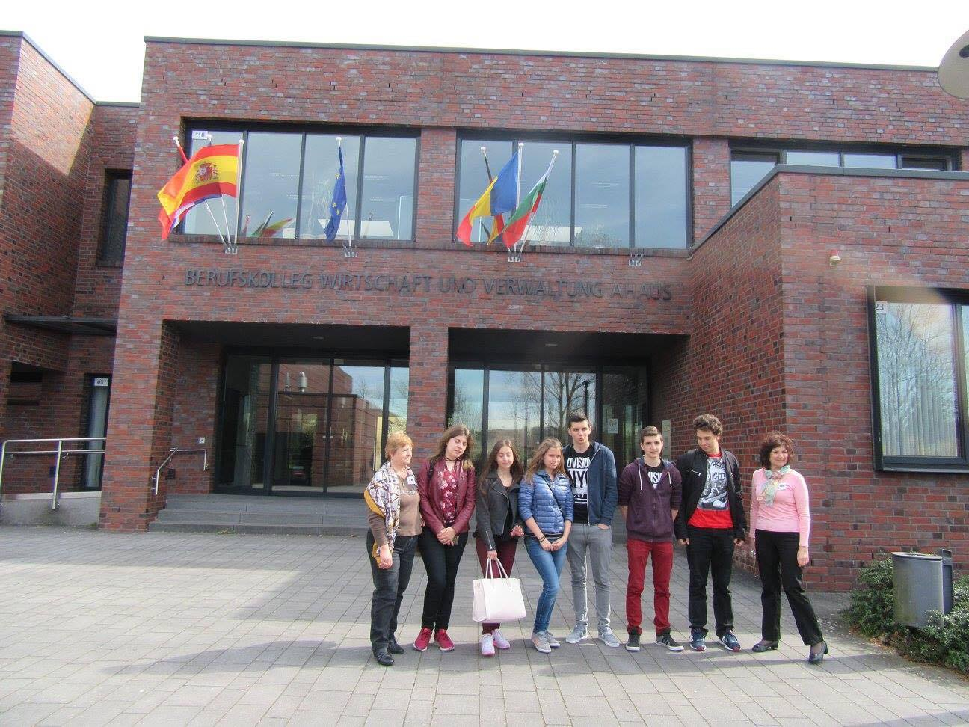
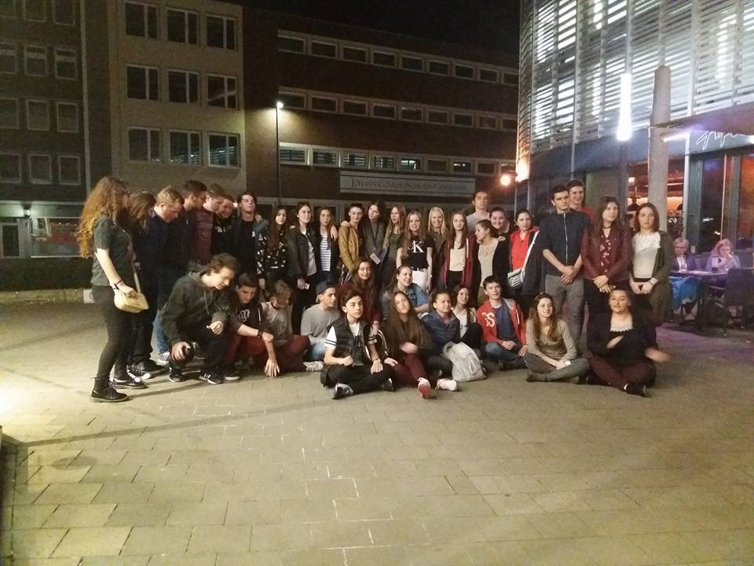
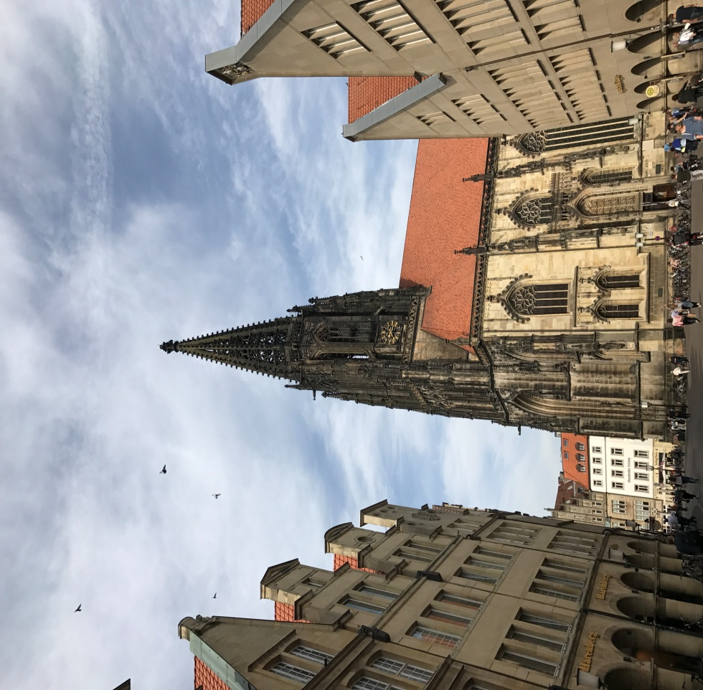
31th March (Friday)
This was our last day of the project and we went to Münster.

Slide 9
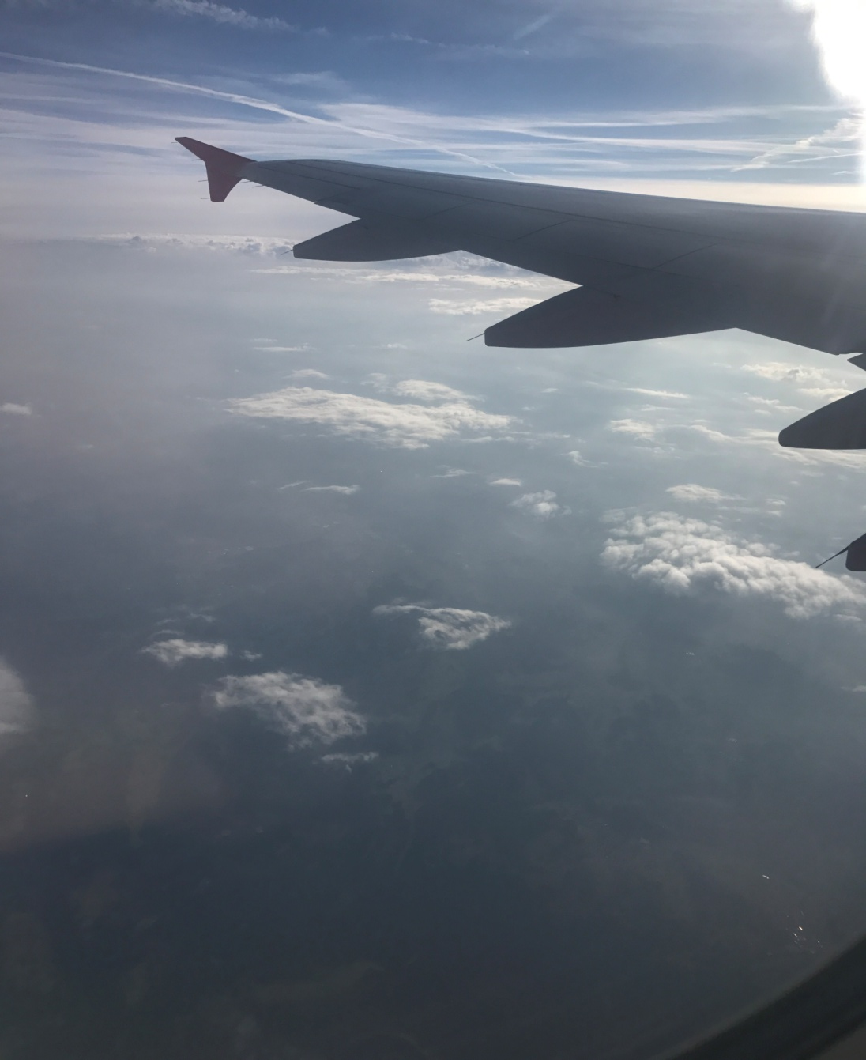
1st April (Saturday)
We left to Bulgaria in the early morning.

Slide 10
The End
From : the Bulgarian group

