Slide 1
Kenmare, Co. Kerry, Ireland.

Slide 2
About the town
Founded in 1670.
Irish name for Kenmare is ‘Neidín’ meaning ‘Little Nest’
Situated on in the South West of Ireland, on the internationally famous ‘Ring of Kerry’
Also situated on the ‘Wild Atlantic Way’ – A drive around Irelands beautiful coastline.
Kerry’s 1st Heritage Town.

Slide 3
Kenmare Activities and Places of Interest
Fair Day - 15th August
The Church
The Stone Circle
Reenagross
Kenmare Nightlife
The Suspension Bridge
Sport

Slide 4
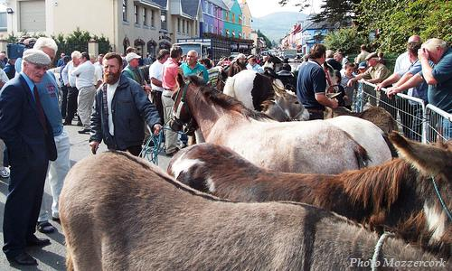
The 15th of August – Fair Day
The 15th of August is a huge market day which takes place In the street. You can buy almost any thing from clothes to tools. There are also a lot of travellers at the 15th they man the stalls sell many things.

Slide 5
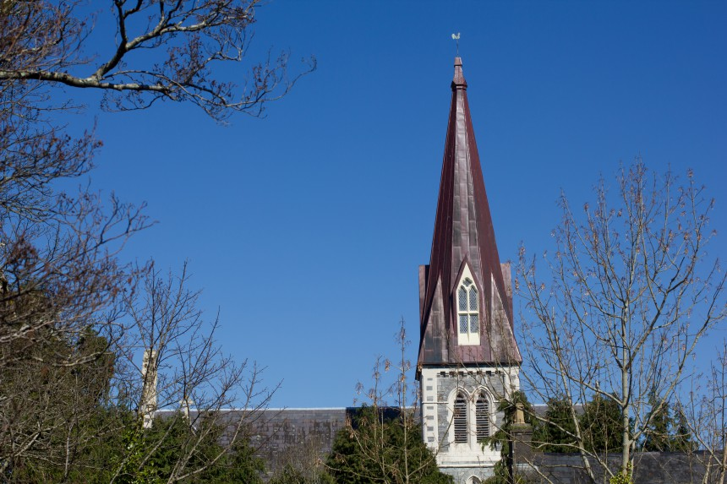
Holy Cross Kenmare
Holy Cross was consecrated in 1864.
It was built by Fr. John O’Sullivan who is buried in front of Our Lady’s altar. The Architect was Charles Hansom. It is locally believed that Fr. O’Sullivan topped the spire of the church with a cock to crow over the local landlord’s agent, whose office was in the Square and had refused him a site for the church.
The most notable internal features of the building are the ornate chancel, the organ and the carved roof (the wood for which came from the Black Forest in Germany.

Slide 6
Reenagross
This stunning park on the southern edge of town is one of Kenmare’s closest hidden gems.
A unique natural heritage area, the woodland park is filled with oak & holly, birds and butterflies, and of course, Rhododendrons.
Here is a video of a local photographer capturing a moment during the peak of the tunnel flowering:
view-source:http://kenmare.com/gem/reenagross/

Slide 7
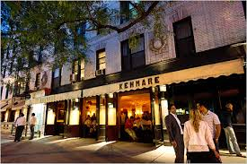
The Kenmare night life
In Kenmare there is a wide range of bars and restruat to dine in of have a drink in. They are all good choices with award winning food.
There are no night clubs in Kenmare but there is a wide range of pubs to choose from with that there are lots of places to go and dance the night away!

Slide 8
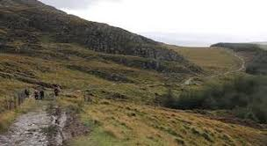
The old Kenmare road
The old Kenmare road is a 16km walk that starts in Kenmare and goes rough the beautiful Killarney national park were you walk to parking lot of torc waterfall.

Slide 9
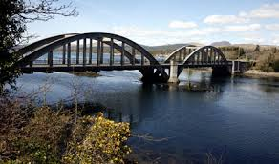
Kenmare Suspension Bridge
Work on the road began in 1834 and as the work progressed the question of a bridge across the Kenmare River was discussed.
The proposal was investigated by one William Bald, F.R.S.E., M.R.I.A. at the expense of the Marquis of Lansdowne who had offered to build at his own expense "a floating chain or fly bridge" over the Sound at a cost no exceeding £1,500.
Bald also designed the road from Kenmare to Glengariff, Co. Cork

Slide 10
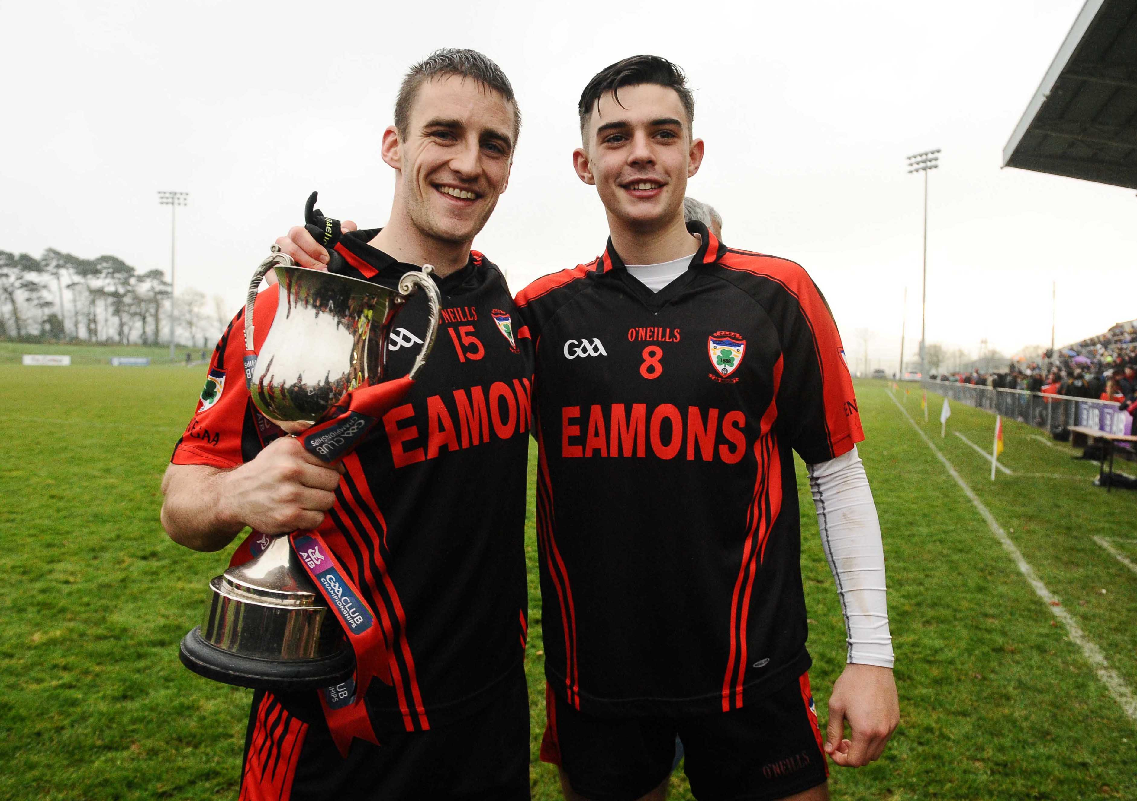
Sport – Gaelic football
Kenmareis famous for its GAA team.
The team competes as a joint divisional side with other clubs from the Kenmare area in the county championships.
Most matches are played at Father Breen Park, Kenmare. The Kenmare District is the smallest such district in Kerry

Slide 11
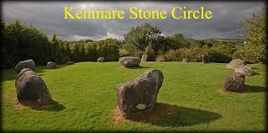
This attractive setting of fifteen small boulder stones is readily accessible, being situated close to the centre of Kenmare. Measuring 17.4 by 15.8 meters in diameter, it is of special interest in being the only example in Munster of an egg-shaped stone ring.
The ring surrounds a boulder-burial consisting of a massive seven ton capstone supported by several low stones. This style of burial appears to be restricted to this part of Ireland: there are over seventy examples in the south Munster area, with apparently just one elsewhere in Ireland.

