Slide 1
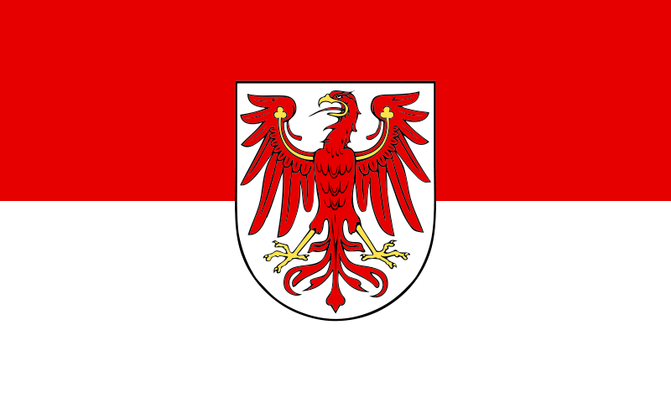
Brandenburg – State of Germany

Slide 2
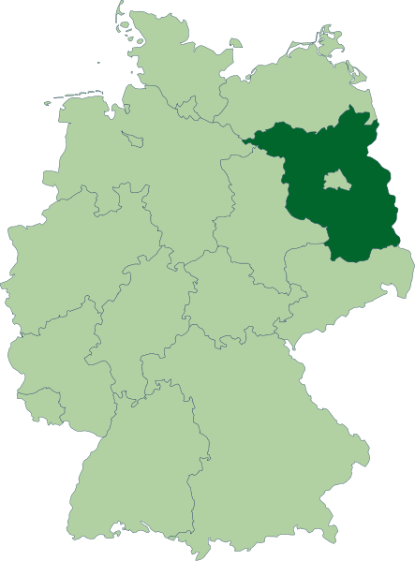
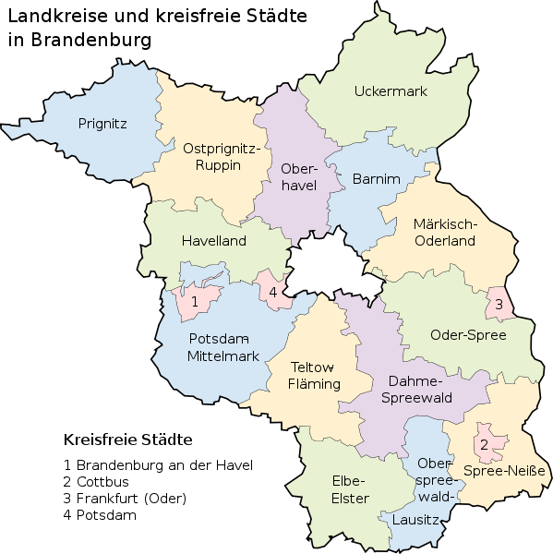

Slide 3
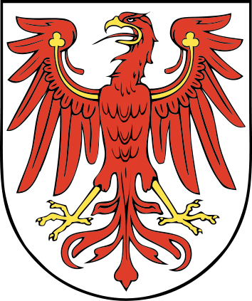
Coat of arms

Slide 4
Country | Germany
Capital | Potsdam
Government
• Minister-President | Dietmar Woidke
• Governing parties | SPD / The Left
• Votes in Bundesrat | 4 (of 69)
Area
• Total | 29,478.63 km² (11,381.8 sq mi)
Population (2010-12-31)^{[1]}
• Total | 2,503,273
• Density | 84.9/km² (219.9/sq mi)

Slide 5
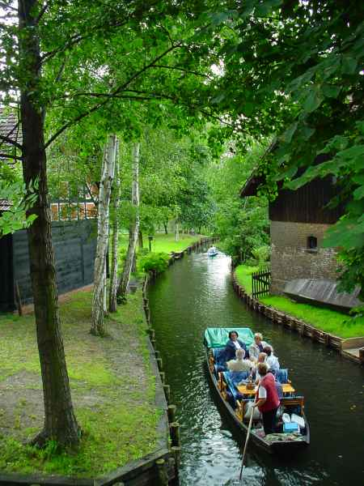
Spreewald
The Spreewald (German for "Spree Woods"; in Lower Sorbian: Błota) is situated about 100 km south-east of Berlin. It was designated a biosphere reserve by UNESCO in 1991. It is known for its traditional irrigation system which consists of more than 200 small channels (called "Fließe"; total length: 1,300 km ) within the 484-square-kilometre (187 sq mi) area. The landscape was shaped during the ice-age. Alder forests on wetlands and pine forests on sandy dry areas are characteristic for the region. Grasslands and fields can be found as well.

Slide 6
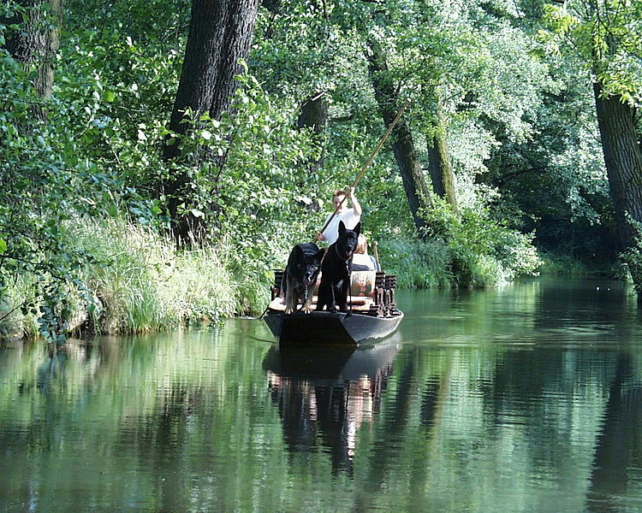

Slide 7
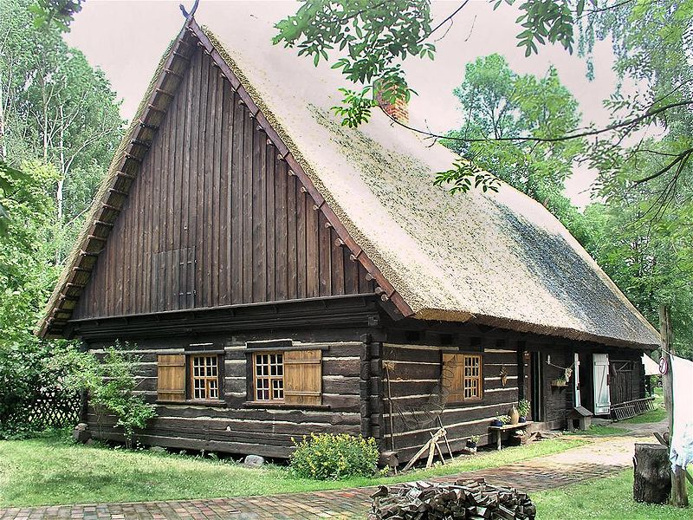
Historical house in Lehde

Slide 8
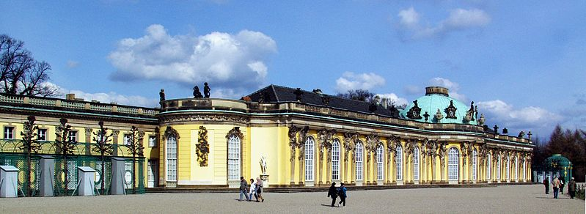
Castle Sanssouci in Potsdam

Slide 9
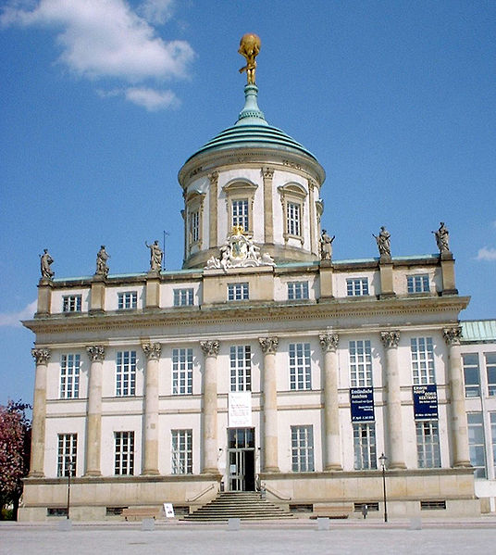
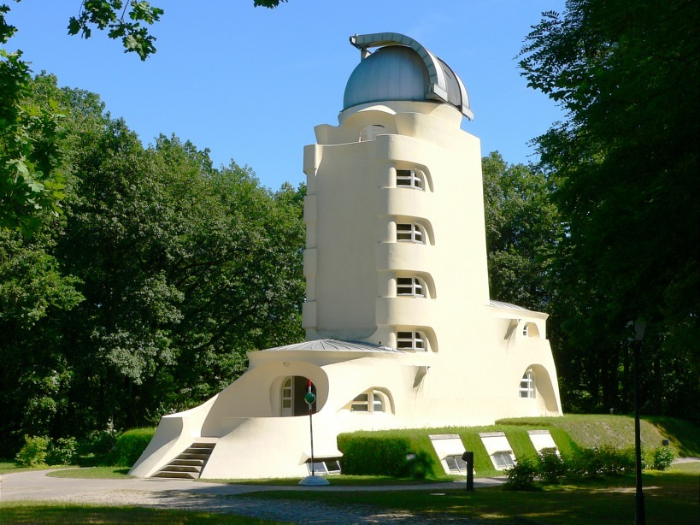
The old town hall and the Einstein Tower

Slide 10
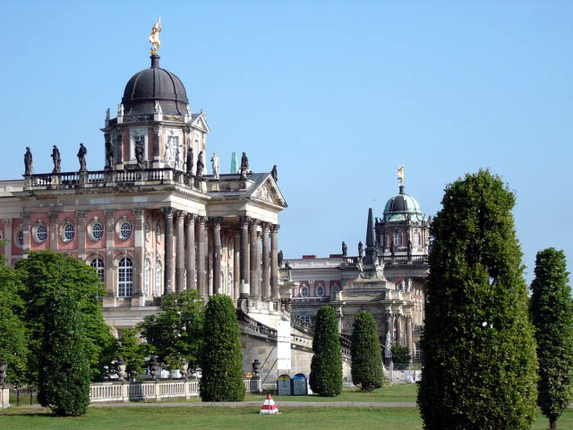
University of Potsdam

Slide 11
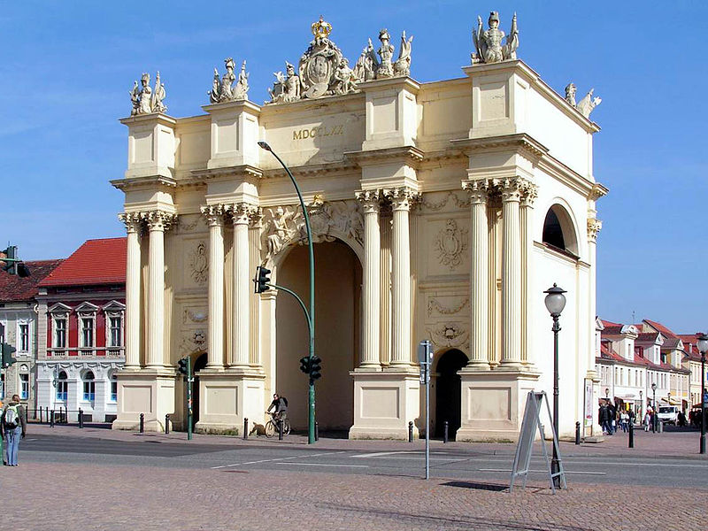
Potsdam`s Brandenburg Gate

Slide 12
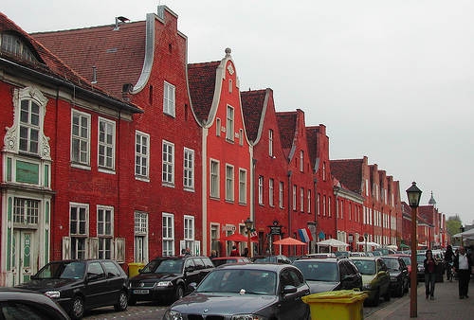
Dutch Quarter in Potsdam

Slide 13
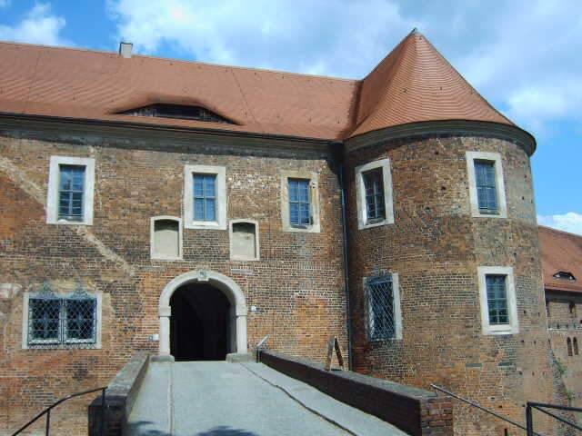
Belzig Castle

Slide 14
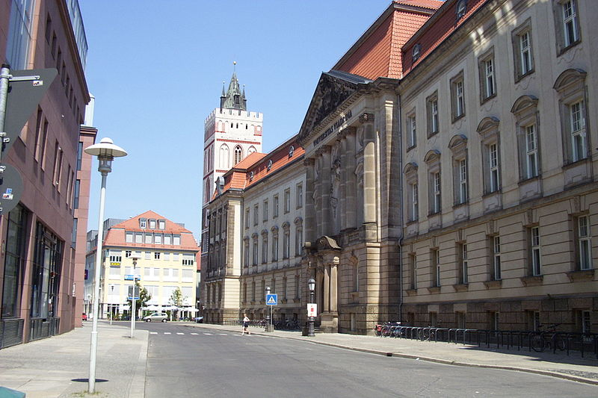
European University in Frankfurt ( Oder)

Slide 15
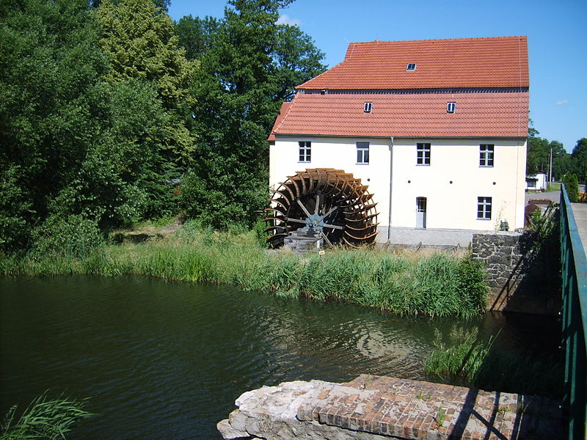
Watermill in Plessa ( Elbe-Elster district)

Slide 16
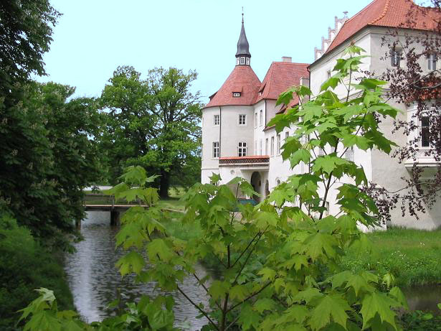
Lausitz – lots of old castles and rivers

Slide 17
F60 Overburden Conveyor Bridge in the past

Slide 18
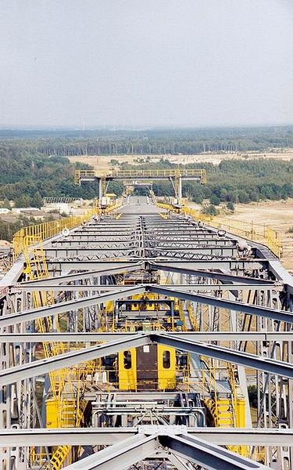
…and now … a museum

Slide 19
F60 is the series designation of five overburden conveyor bridges used in brown coal (lignite) opencast mining in the Lusatian coalfields in Germany. They were built by the former Volkseigener Betrieb TAKRAF in Lauchhammer and are the largest movable technical industrial machines in the world. As overburden conveyor bridges, they transport the overburden which lies over the coal seam. The cutting height is 60 meters, hence the name F60. With a length of 502 meters, it is described as the lying Eiffel tower. In total, the F60 is up to 80 m high and 240 m wide. In operating condition, it weighs 13,600 metric tons.

Slide 20
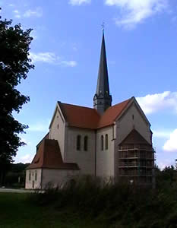
Doberlug-Kirchhain

Slide 21
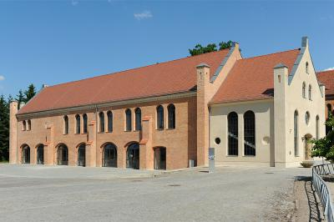

Slide 22
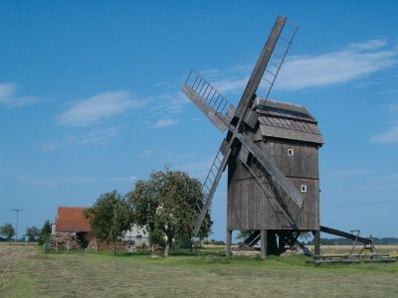

Slide 23
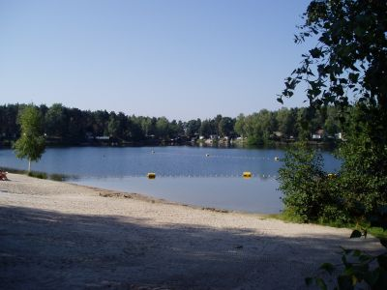

Slide 24
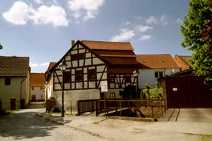

Slide 25
