Slide 1
EDUCATION IN REFUGEE CAMPS
Notes:
ΣΗΜΕΙΩΣΗ: Θέλετε διαφορετική εικόνα σε αυτή τη διαφάνεια; Επιλέξτε την εικόνα και διαγράψτε την. Στη συνέχεια, κάντε κλικ στο εικονίδιο "Εικόνες", στο σύμβολο κράτησης θέσης, για να εισαγάγετε τη δική σας εικόνα.

Slide 2
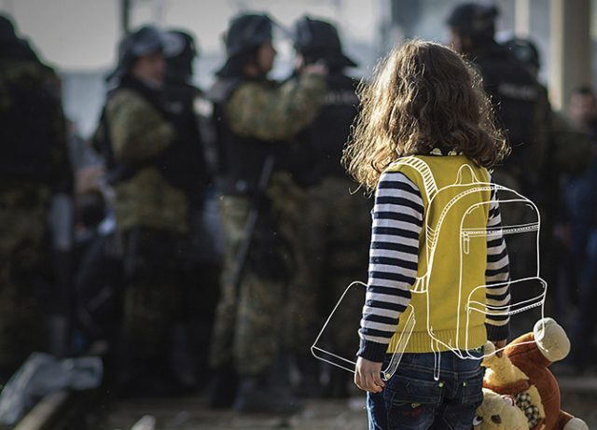
THE OBJECTIVE OF THE UNHCR
UNHCR advocates for access to quality education for refugees of all ages through their inclusion in national education systems.
They aim to ensure access to school, or school-readiness programmes , within the first three months of displacement.
UNHCR is committed to extending primary and secondary education opportunities to all children and youth. They have worked :
to improve access
retention of children in primary school through cash grants
strengthening partnerships with key education partners.

Slide 3
Primary and Youth Education
The literacy and numeracy skills learned at primary and secondary level form the basis of lifelong learning. These enable refugee children and youth to continually build their knowledge and competencies in order to survive and thrive in their personal lives.
to develop critical thinking
Quality education helps
problem solving
analytical skills in daily life

Slide 4
SECONDARY EDUCATION
Secondary education:
Secondary education offers a critical opportunity for young people to complete formal education. However, since the needs of forcibly displaced adolescents and youth vary in different contexts, it is just one of several education options that should be made available.
UNHCR supports a range of education programmes, designed in close consultation with refugee adolescents and youth. These include:
Accelerated Education programmes to promote access to certified education.
improved quality of education through digital technology.
relevant technical and vocational training.
basic literacy and life skills courses.

Slide 5
Tertiary Education
knowledge
skills
the acquisition of a new language
chance of becoming self-reliant
Higher education plays a central role in protecting young refugees.
It helps to nurture future generations of highly educated individuals who are able to work in the public and private sector.

Slide 6
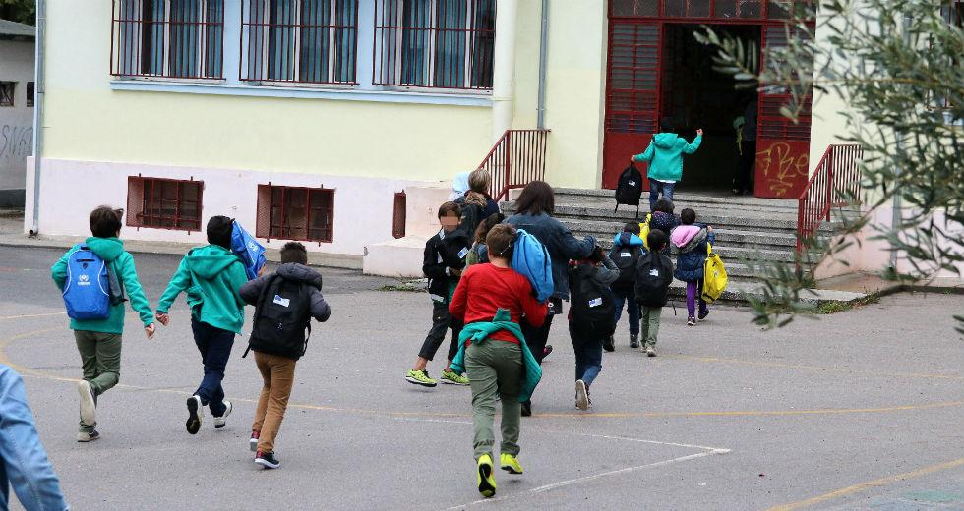
Situation in Greece
The reality proves that the problem is the implementation of the law. There are many parents who protest against to refugee children going to the same school with their children as it happens in Samos (Greek island).
In Samos, at many schools
the locals complained
and the schools closed
for 4 days as a refusal to
accept refugees.

Slide 7
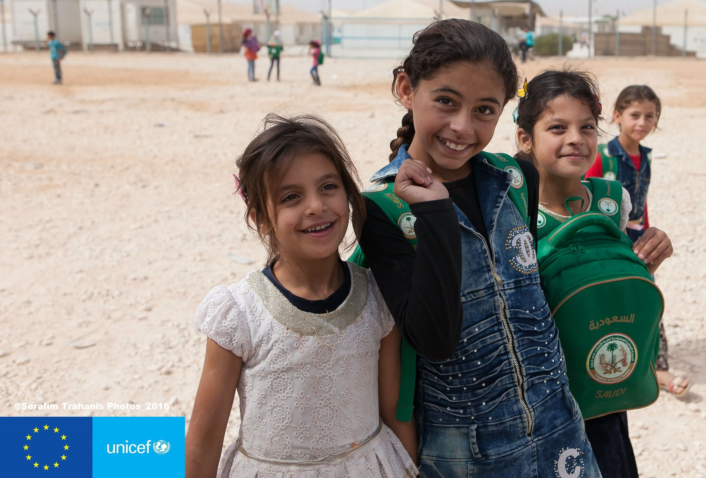
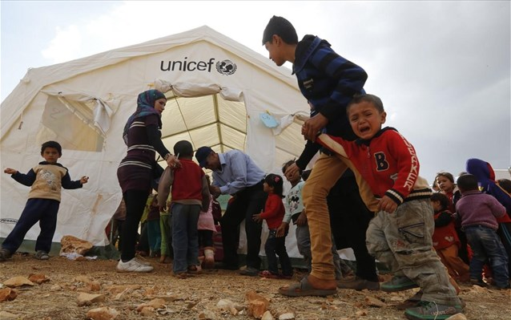
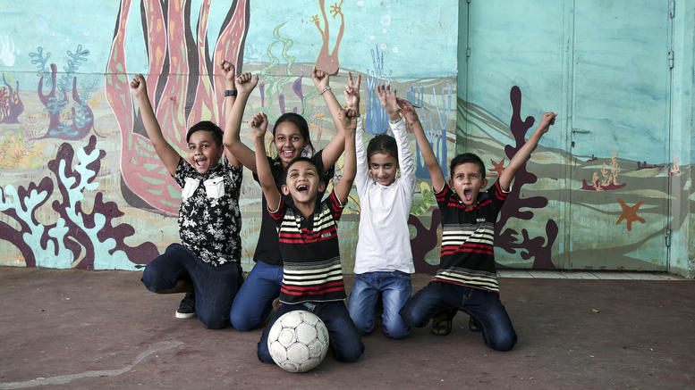
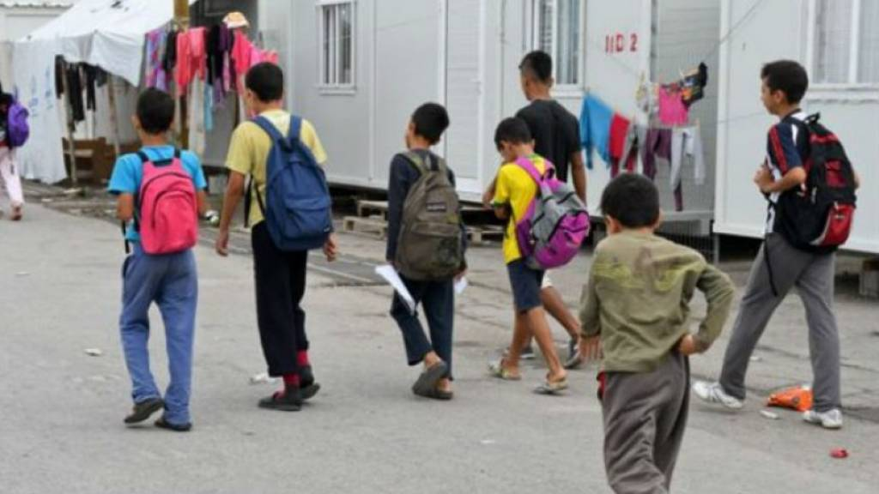
There are many organizations such as UNICEF that help refugees qualitatively and effectively. So children take courage and confidence to conquer their dreams.

Slide 8
https://bit.ly/2F5iN7P

Slide 9
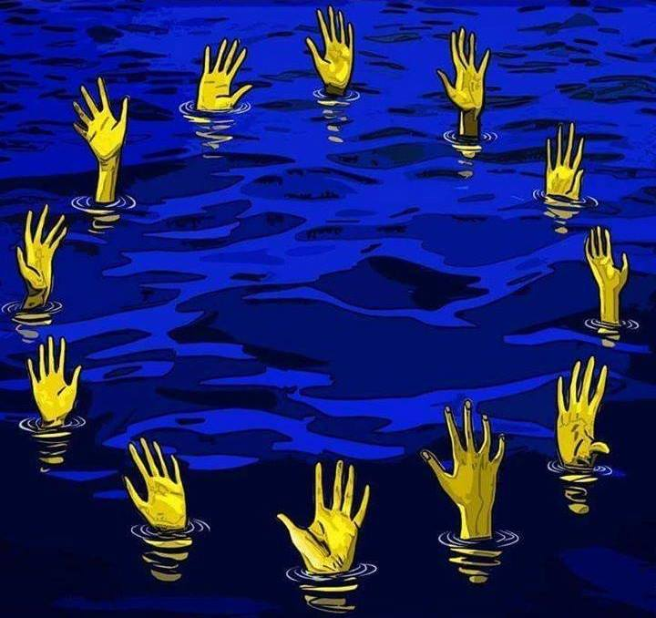
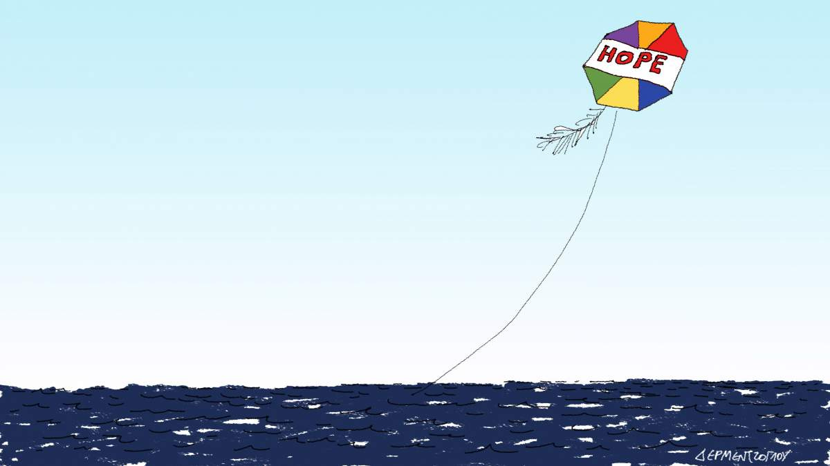
EXPECTATION REALITY

Slide 10
End of the presentation
Students: ATHANASIA NIKOLAIDOU
VIRGINIA ZAFEIRIOU
Supervisor Teacher: Triantafyllia Vrana
THANK YOU FOR
YOUR ATTENTION

