Slide 1
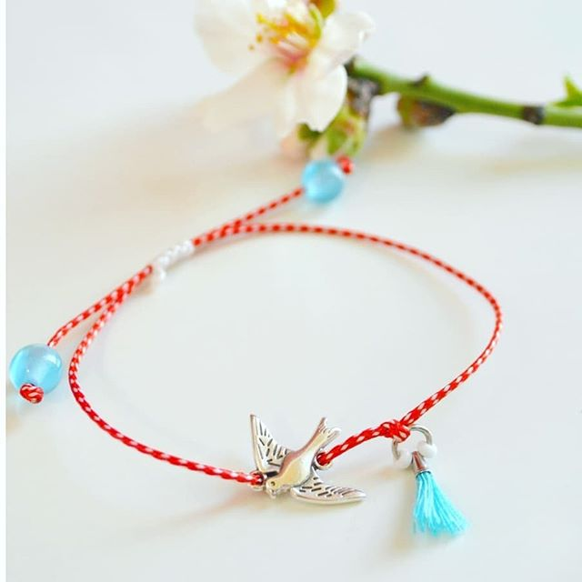
The custom of MARCH BRACELeTS AND IMMIGRATION Presentation: Melitini Lagou Supervisor teacher: Triantafyllia VRANA

Slide 2
The custom of march bracelets
March bracelets are a custom that originates from ancient Greece
Are made of white and red thread
Greeks wore them on 1st March until 31rd March
The aim of those bracelets was the persecution of evil spirits
After 31rd March Greeks hung the bracelets on a tree in order to help swallows build their nests

Slide 3
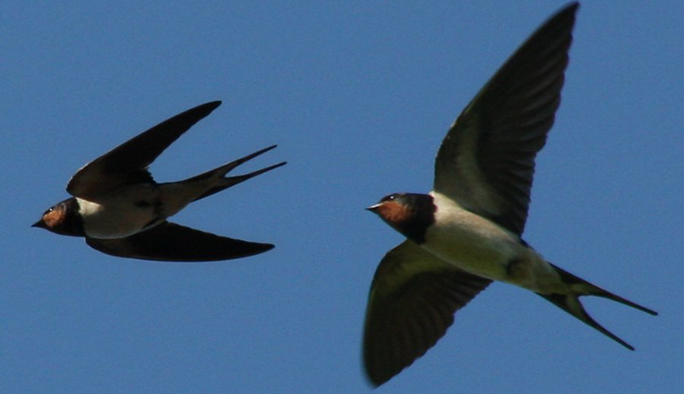
These are the swallows, the birds that we referred to previously.

Slide 4
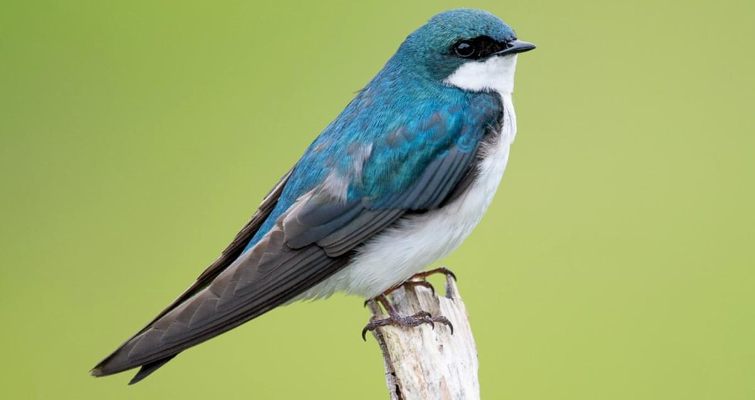
THe swallows
Swallows were very beloved birds and considered as domestic. Greeks hung the March bracelets on trees in order to help them build their nests. They thought that in this way they helped the swallows to end their long journey and the swallows with their turn protected them from evil. These birds travel in spring to Greece and when winter comes they are forced to go to warmer places.

Slide 5
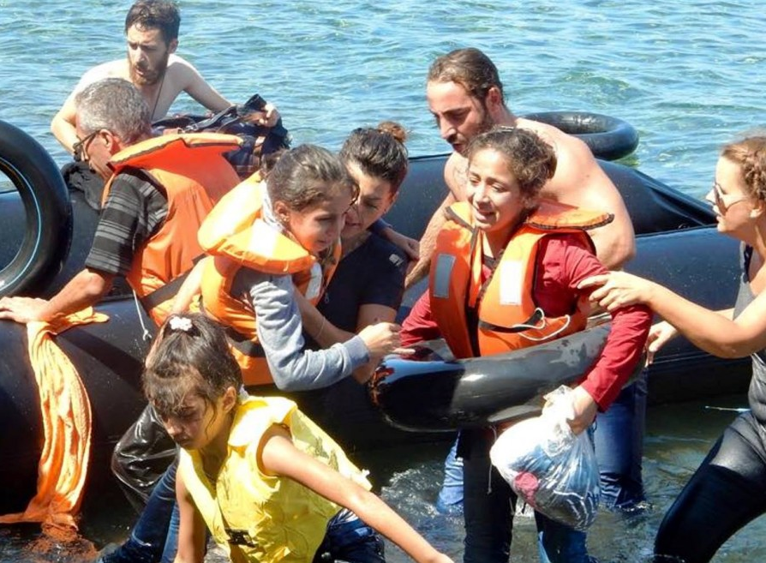
Migrants... the swallows of our community
We can conclude that migrants are like swallows. They travel in order to find a better place to live, with conditions that ensure their survival. They find many barriers in their way to the destination of their dreams, but they never stop hopping, they never stop trying, they never give up!

Slide 6
Our moral obligation related to migrants.
We should:
Stand by their side
Realise that migrants have the same dreams, desires and RIGHTS
Respect their diversity
Protect their health
Help them with all means
Our society has a moral obligation related to migrants. We should stand by their side in every way that we can. We should always think migrants have the same dreams, the same desires and the mainly the same rights. We s

Slide 7
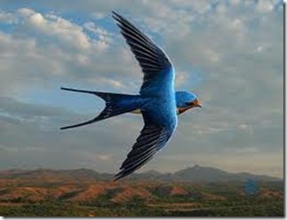
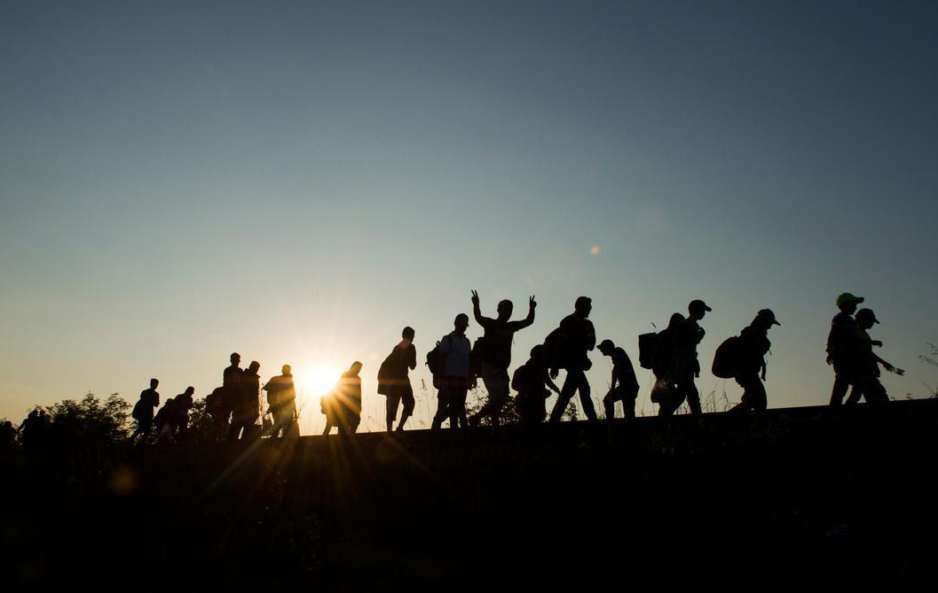
That means: Swallows and migrants come to us and we should try to lead them to a better future.

Slide 8
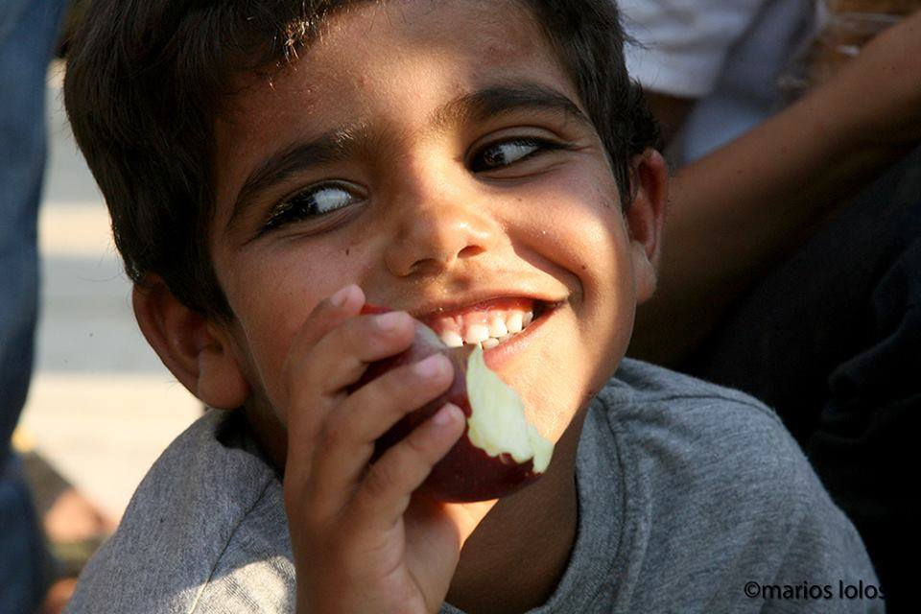
CONCLUSION
We all should help migrants to reach their dreamed future! We SHOULD create a better world! We CAN create a better world! It depends on us! Let's do it... TOGETHER... equal in dignity and rights!

