Slide 1
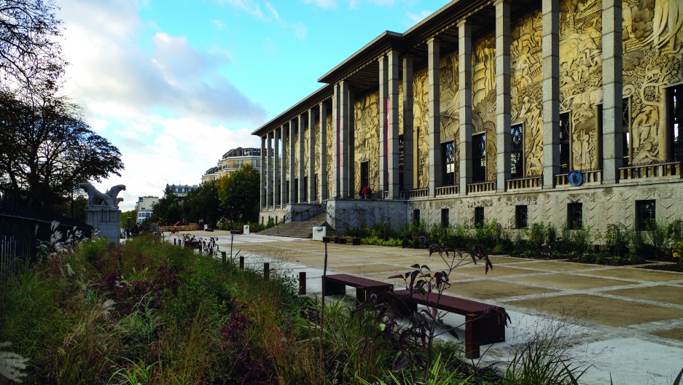
The national museum of immigration in Paris
Erasmus+ “Together: equal in dignity & Rights”
By MARINA ANDRIOTI
Supervisor teacher: Triantafyllia vrana

Slide 2
The National museum of immigration first opened up to the public in 2007 and is located in eastern Paris, in Bois de Vincennes park. It is dedicated to the various immigration communities in France and aims to bring a new perception to the history which connects the immigrants to France. The permanent exhibition combines documents, everyday items, video interviews to highlight the immigrants' contribution to the financial, social and cultural life in France. There are also regular exhibitions by modern artists (like Dens Dorzacq, whose photos show the role of street dance in downgraded suburbs in France), which challenge certain cliches and stereotypes. In this way the museum highlights the multiculturalism of modern France. What is noteworthy is that the museum was created where the museum of colonialism used to be since 1931. It was designed by Albert Laprade and the architecture is influenced by the districts of the colonial empire of France.

Slide 3
Offering and services
A free audio guide allows you to visit the permanent exhibition 'Repers' on your own. It takes you on a tour that links immigrants personal accounts, extracts from reports, ancient and contemporary works of art, etc.
Offerings and services:
Lecture tours (upon prior reservation)
Areas for rent
Auditorium
Multi-media library
Bookshop-gift shop

Slide 4
Events and activities
At the museum:
Workshops and activities for youngsters
Self-guided tour for youngsters with games booklet
Self-guided tours for groups on literacy courses and learning French as a foreign language
Meetings and conferences
Performing arts and films

Slide 5
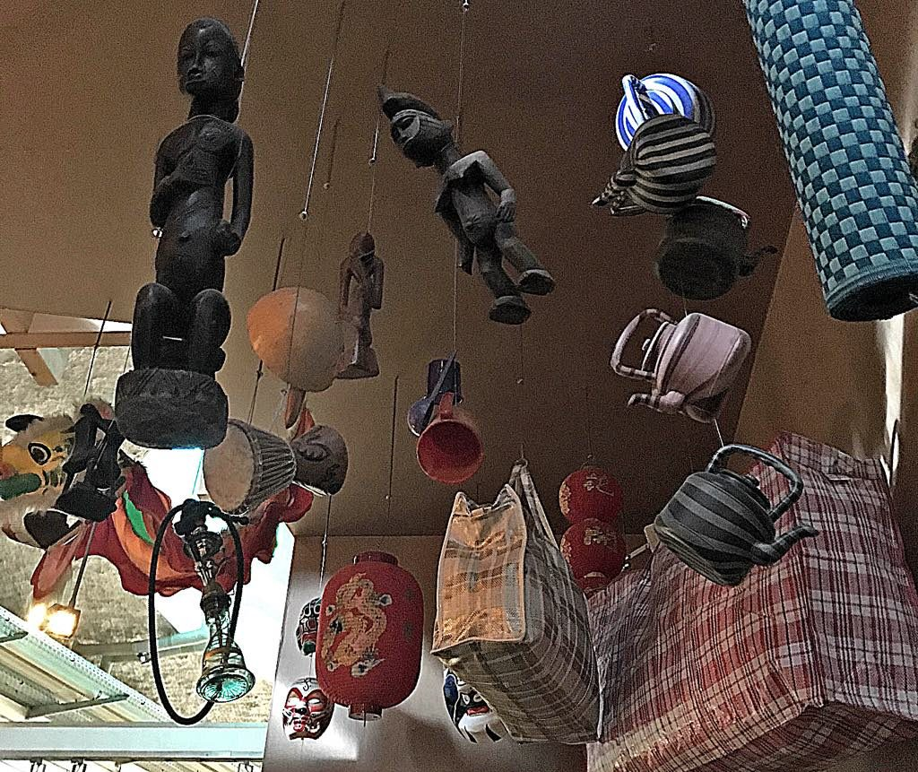
EVERYDAY ITEMS
Items found in the homes of immigrants, part of the permanent exhibition at the National Museum of the History of Immigration.

Slide 6
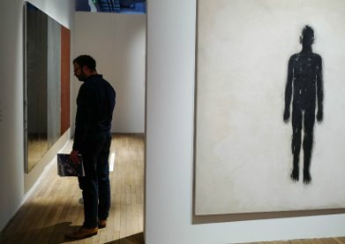
PERSONA GRATA': PARIS CONTEMPORARY ART EXRO SHINES A LIGHT ON IMMIGRANDS WELCOME
“Persona Grata,” a thought-provoking temporary exhibition that runs through January 20, 2019, showcases contemporary art and photography that deals, tangentially or directly, with the current crisis over the many immigrants from the Middle East and Africa. It is, to put it mildly, a wake-up call about the virtues of hospitality.

Slide 7
interview
Below I present you an interview between the culture trip and Helene Orain who is the executive director of the National museum of immigration in Paris where they talk about the importance and the activities of the building that has.
Culture Trip: What is the museum showcasing?
Helene Orain: The museum's permanent gallery shows a retrospective of the history of immigration in France from the 19th century through artwork, photos, archives, and testimonies. In addition, the museum produces two temporary exhibitions every year.
Culture trip: Can you choose one exhibit and tell me how it teaches us about immigration?
Orain: I would choose' fashion mix'. The whole world is fascinated by fashion and luxury goods. But what most people ignore, even in France, is that many of these creators are foreigners and therefore immigrants. What we want to say through this exhibition is that immigration has helped to build our economy, our industry, and our culture and that without it, France would not be what it is today.

Slide 8
The Message
The president of the museum said that the purpose of his museum " is to tell the history of immigration ". Also Mr. Toubon added, " We' re inside a building that is a memory place for colonization, but our message is the contrary: to show what all these people coming to France for two centuries have brought, which ends up being not just the history of immigration but the history of France.

Slide 9
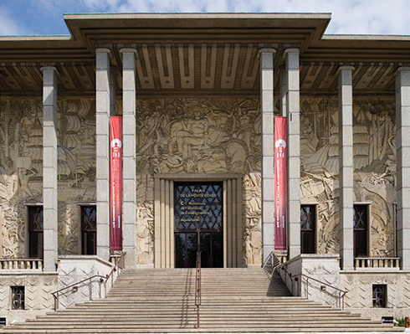
THE NATIONAL MUSEUM OF IMMIGRATION IN PARIS

