Slide 1
Human rights Together: equal in dignity and rights
Students:
Kostas Kyriakou
Kostas Triantafyllidis
Melitini Lagou
Supervisor teacher:
Triantafyllia Vrana

Slide 2
Prologue
Human rights
The right in education
Education and refugees
Provided education to refugees in Greece
In this project we dealt with:

Slide 3
What does right mean?
Right:
Something entitled to someone
Guaranteed liberty
Human rihts:
Fundamental rights entitled to everyone
Just because they are human beings

Slide 4
Universal Declaration of Human Rights
Was authorized by the United Nations General Assembly in 1948
The purpose: the avoidance of repetition of the awful incidents that happened in the Second World War
This resolution is not mandatory
It is applied as customary law
It refers to rights such as freedom, equality, education etc.

Slide 5
Eleanor Roosevelt was the representative of U.S.A at U.N.O and president of the committee of human rights in the organization.

Slide 6
Who is a refugee?
A refugee is every person who is outside the country of his nationality and due to a well-founded fear of being persecuted for reasons of race, religion, nationality, membership of a particular social group, or political opinion and additionally they are unable to avail themselves of the protection of that country.

Slide 8
What are the rights of refugees?
Refugees are entitled;
To claim asylum, that secures not only physical protection but also equal treatment as any other foreigner
That means thoroughly;
Freedom of thought
Access in health system
Access in education
Right in employment

Slide 9
What is valid in Greece?
Education is a fundamental human right
Greece respects, secures and forwards this right
European law: every child and especially refugee children have the right to education
Greek state in order to incorporate refugee children in society created reception structures in 2016
Also,a school programme was created especially for them

Slide 10
Detailed data
More than 60.000 refugees have been educated in our country and from them 40% are children.
About 4.000 live in specific structures
About 2.500 unaccompanied minors are under the responsibility of competent national structures
According to Unicef 2.000 refugees live out of registered national structures.

Slide 11
A message from Unicef
Without education a whole generation of refugees will grow up in Greece without having the appropriate abilities to contribute to our country and its economy, dealing with increased danger of being marginalized. Education is a fundamental right for every child and their only hope to create their own future.

Slide 12
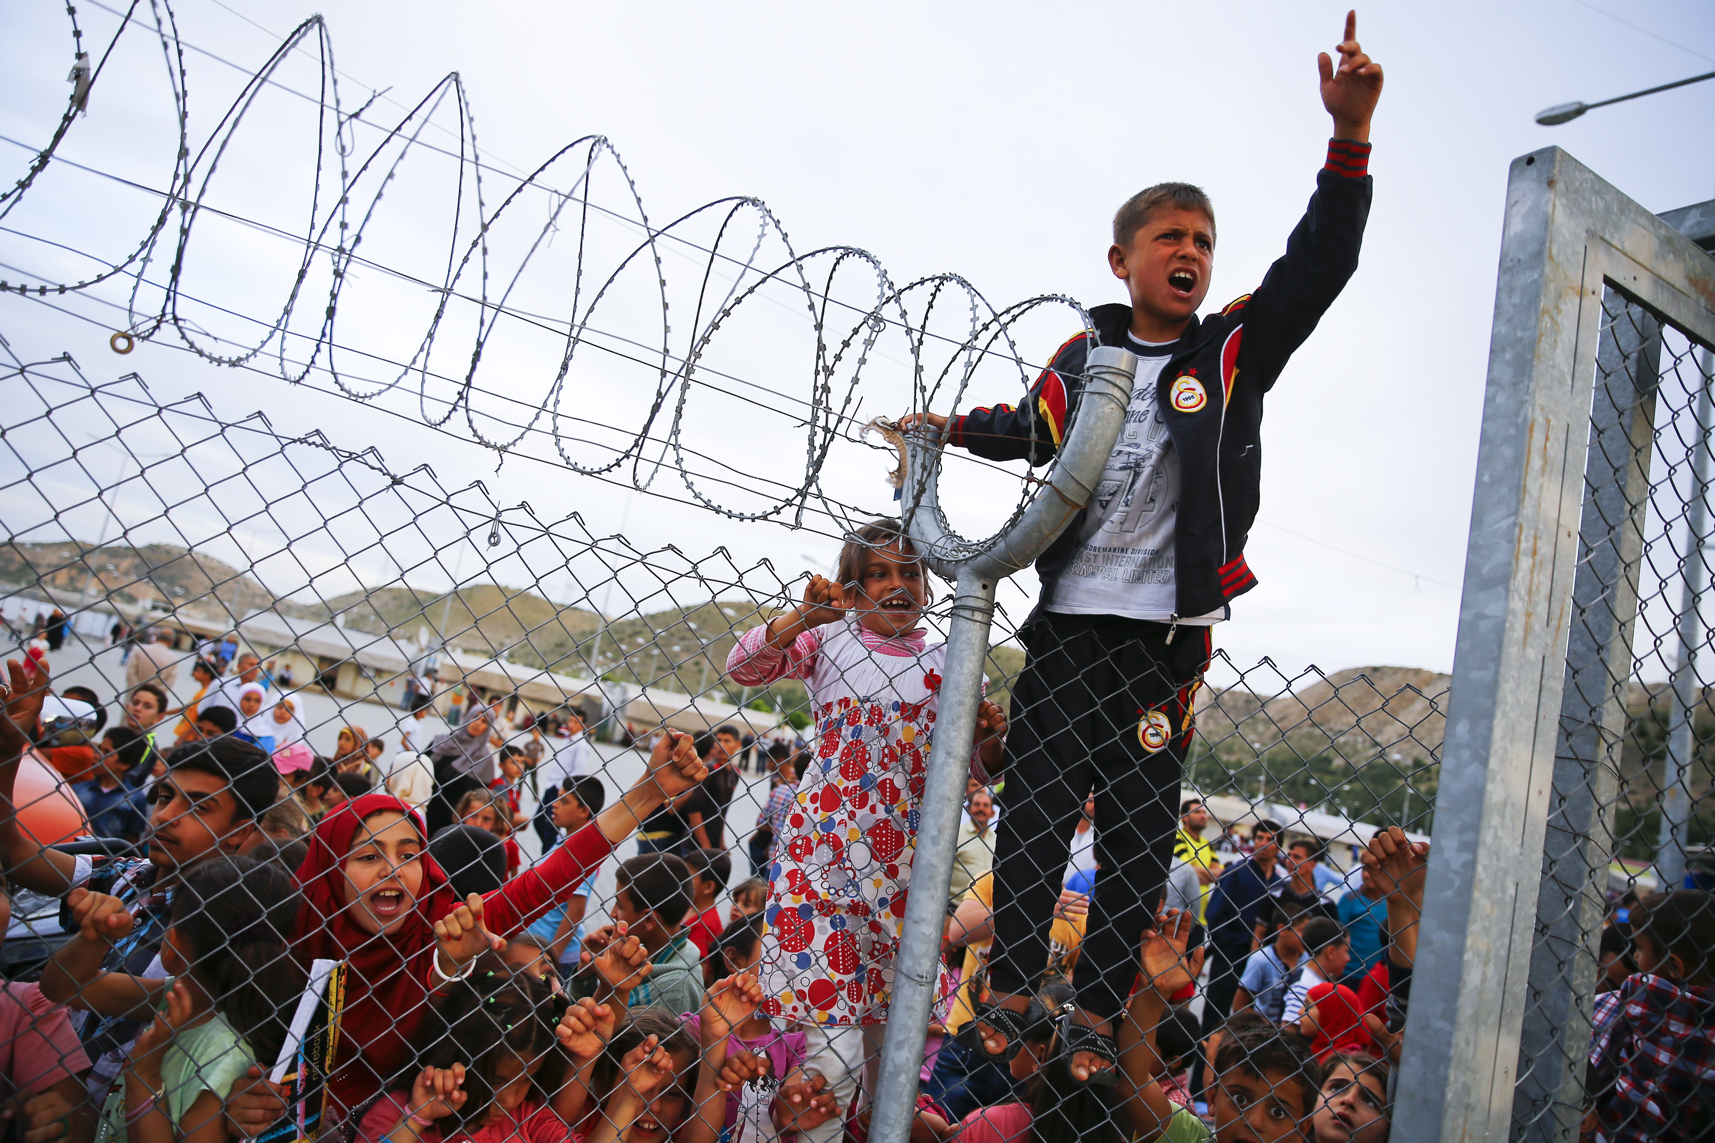
Epilogue
In conclusion, it is perceivable that all humans should have the same rights, without any differentiation. The refugee-children have the right to dream for a better life. So, all children should always be educated not only for their own good, but also for a better humanity.

