Slide 1
Hellenic theatre - drama education network
Student: Melitini Lagou
Supervisor teacher: Triantafyllia Vrana

Slide 2
This is the logo of the network

Slide 3
On part of The missions of this network:
Intergrate easier refugees in our societies
Relieve the pain of refugees
Learn to little refugee children how to express their feelings

Slide 4
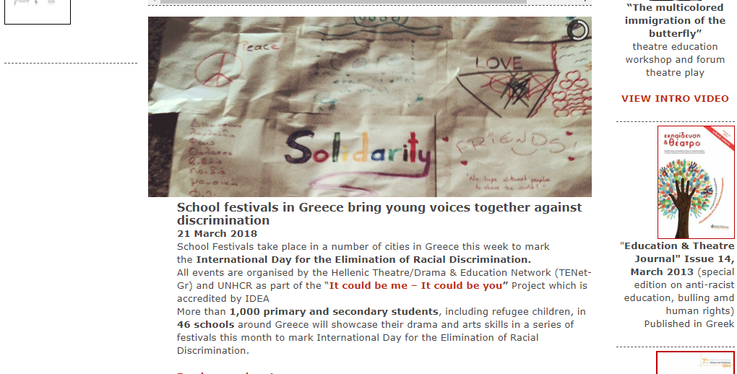

Slide 5
The network manage its goals through:
Theatre plays
Different programmes
Publication of a magazine
Informative conferences in schools
Other events
Seminars and workshops

Slide 6
Present actions
It could be you- it could be me:
An awareness raising project
Targets on educational community
It concerns refugee and human rights
Uses experiential learning, theatre and drama techniques

Slide 7
That is the logo of the previous actions

Slide 8
Monologues across the Aegean Sea
From this network's action emerged a book.
This book contains true stories of refugees throughout their journey from Syria to Greece.
Schools as ours can work on this book.

Slide 9
The logo of the action

Slide 11
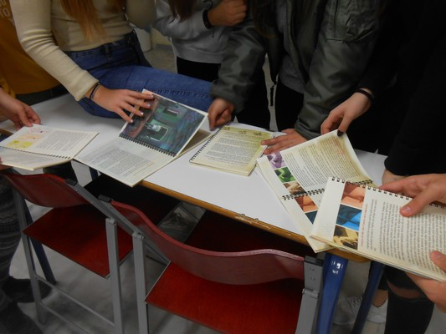
THE ACTION IN OUR SCHOOL

Slide 12
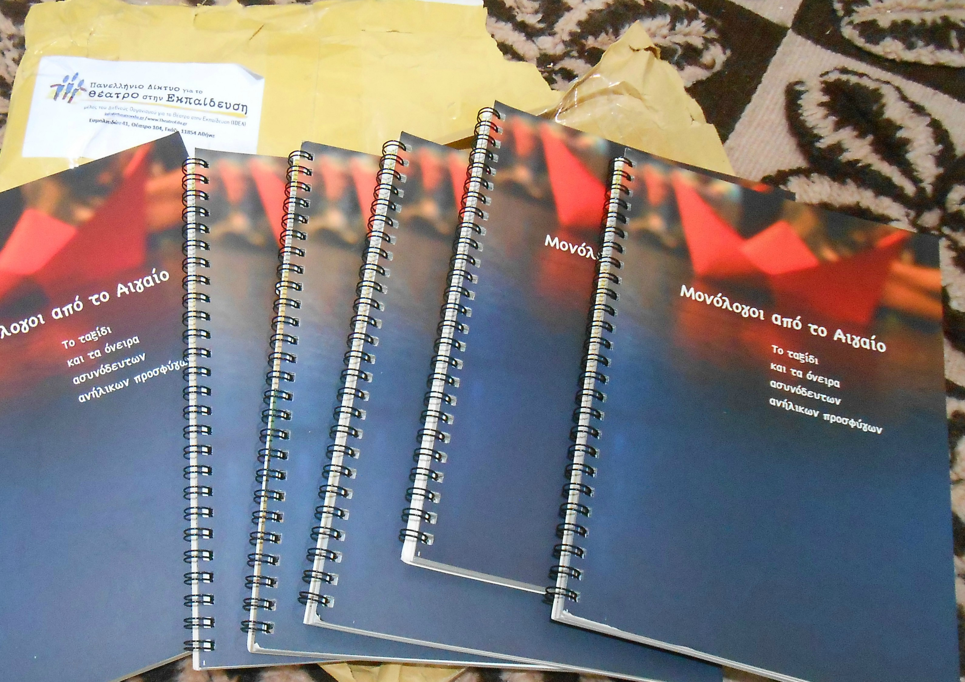

Slide 13
Conclusion
The work of this network is significant not only for refugees, because they relieve their pain and other negative feelings, but also for Greek community. In this way, Greeks come in contact with the cruel experiences of refugees and feel that they have many things in common, as Greeks have experienced migration in the past. Also, they have the chance to understand better the human rights and feel more human at all.

