Slide 1
Hosting structures for refugees in Greece Together: equal in dignity and rights Presentation: Eugenia Thoma Supervisor teacher: Triantafyllia Vrana

Slide 2
In Athens
Estia Prosfigon centrer, operated by Arsis and contains 48 beds.
Ostos center, operated by Ostos and contains 70 beds.
Praksis Apartments center, operated by Praksis and contains 120 beds.
Praksis women apartments centrer, operated be Praksis and contains 50 beds
INEDIVIM center, operated by INEDIVIM and contains 60 beds

Slide 3
In Thessaloniki
ΕΚΚΑ center, operated by EKKA and contains 20 beds.
Filoxenio center, operated by Arsis, Municipality of Thessaloniki, and GCR. It contains 28 beds.
Praksis apartments center, operated by Praksis and contains 120 beds.
Arsis Thessaloniki apartments center, operated by Arsis and contains 21 beds.

Slide 4
Chios, VIAL hotspot
Capacity of 1274 people.
It is characterized as ‘prison’, as the condition are inhumane.
It is overcrowded and the people often get sick because of the poor healthcare conditions.

Slide 5
Leros island
Capacity of 1000 People.
Many racist attacks on refugees have been reported according to the Racist Violence Recoding Network.
Leros used to be an exile island in the recent Greek history. Many people were sent there for political reasons.

Slide 6
Samos’ camp
Capacity of 700 people.
It is built on a steep muddy hill, which becomes even more muddy and dangerous when it rains and provides very little protection from the bad weather.
Voluntary organizations are working hard to respond to the conditions
https://youtu.be/HfuAzi-oI5c

Slide 7
Moria hotspot, Lesvos island
Capacity of 3100 people.
It’s the biggest refugee hotspot in Greece.
Moria is one of the most notorious hosting stuctures for refugees in Greece, as many people have died due to the hardships. Moria also faces high risk of desease transmission due to overcrowding.

Slide 8
Moria hotspot: the last destination for many refugees
Doctors without borders
They were shocked by the number of deaths in such a small period of time, as in just 3 days 7 people lost their lives! Also, they claimed that the Greek government and the European Union are obligated to take measures in order make the living conditions better.

Slide 9
Moria hotspot: people living in a landfill
The refugees in Moria camp complained about the massed rubbish in the toilets, shaking the fence shouting ‘Moria not good’.
Violent attacks have been reported –beating, rapes, but not officially recorded.
Today, more than 6500 refugees stay there.

Slide 10
On the other hand
Mrs Zervou is a member of the action ‘Co-existence’. They often organise activities for the refugees from the Moria hotspot, like excursions.
This action is beneficial for them, as staying in camps like this has a bad influence on the emotional state of the refugees.

Slide 11
The excursion in Agiasos
40 boys from the camp were lucky enough to join the excursion team.
A member of the organization says: The children of the war and the poverty. The children who desperately seek a better future. The victims of the global rivaltry, who pay for the benefits of the grandees. I wished them luck and they replied in Greek: Ευχαριστούμε (thank you).

Slide 12
Acceptance

Slide 13
Structures accepting refugees beyond capacity

Slide 14
Sea arrivals

Slide 15
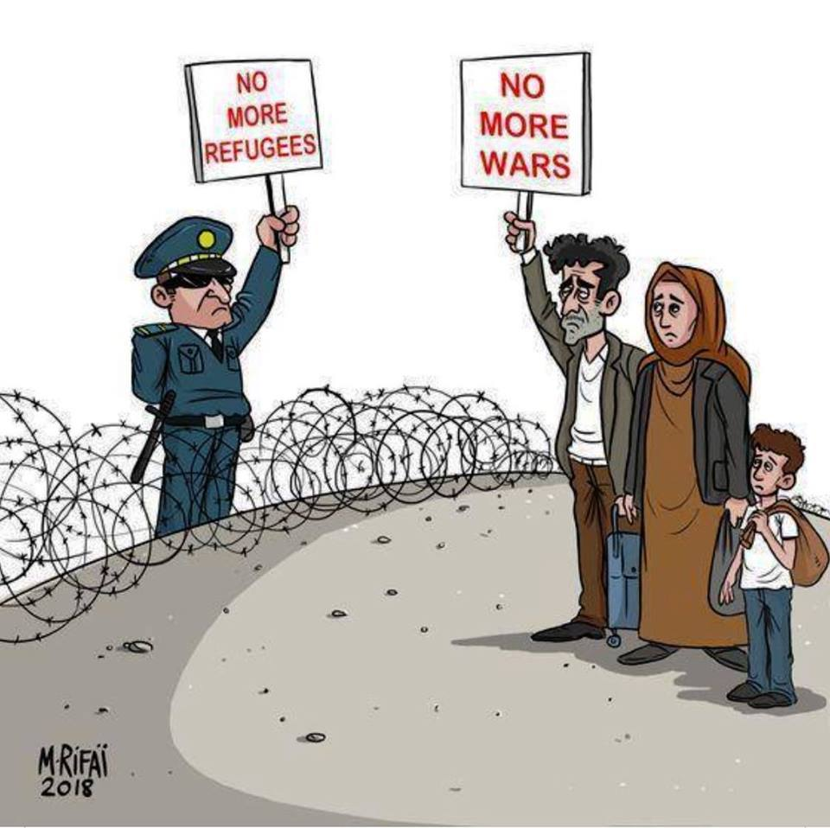

Slide 16
Bibliography
http://www.asylumineurope.org/reports/country/greece/reception-conditions/housing/types-accommodation
https://www.google.com/amp/s/amp.dw.com/en/overcrowded-refugee-camps-greek-islands/a-46771466
https://medium.com/are-you-syrious/ays-special-from-chios-truth-about-hotspot-vial-616a5e852a80
http://www.ekathimerini.com/228940/article/ekathimerini/news/police-conduct-survey-at-vial-hotspot-on-chios
https://www.google.com/amp/s/www.independent.co.uk/news/world/europe/moria-refugee-camp-closure-greece-lesbos-deadline-waste-dangerous-public-health-a8531746.html%3famp
https://theconversation.com/amp/samos-grim-winter-leads-to-protests-by-refugees-living-in-limbo-on-greek-island-110116

