Slide 1
Arsis –fighiting against marginalisation
Project; "ERASMUS + Together: equal in dignity and rights"
Curators: Triantafyllidis Konstantinos, Kalanidi Eleni
Supervised professor: Vrana Triantafyllia

Slide 2
Index:
Preface(3)
Arsis is.. (4)
Executives and volunteers(8)
Vision and Mission( (6)
Our experience (9)
Bibliography (12)
Epilogue (11)
Services(7)

Slide 3
Preface:
Due to our participation in "ERASMUS +" programme and our mission in France, we create this presentation in order to note down the acts of the Youth Support Center of Arsis.
Also, we are going to describe our experience during our visit in this Center.

Slide 4
Arsis is...
Association for the Social Support of Youth
It is a Non Governmental Organization, specializing in the social support of youth that are in difficulty or danger and in the advocacy of their rights.
The main target is the prevention of youth marginalisation, the elaboration of policies which defend youth rights and the active social support towards disadvantaged young people.

Slide 6
Mission and Vision:
ARSIS vision is a society of equal opportunities for all young individuals with respect of their rights.
ARSIS mission is to take actions for the prevention of youth exclusion. In this frame, Arsis develops new methods and tools for youth support, organizes and participates in networks for social solidarity, cooperates with public and private services and promotes improved methods for the social policy of youths.

Slide 7
Services:
It provides services such as;
psycho-social support: counselling, group work, etc.
preparation for employment: assessment, orientation, etc.
legal support: information and counseling about law issues.
educational support: fighting illiteracy, educational assistance to immigrants, refugees
temporary housing and food services for young people without home or in major difficulty
social and recreational mobilisation: participation in group and leisure activities, art and creative workshops, etc.

Slide 8
executives and volunteers:
Arsis is framed by trained executives and volunteers, works based on the collective values of social solidarity, of acceptance and mutual respect.
There is a team of executives who share the resposibilities of planning, developing and monitoring of the project. The volunteers join in teams and are supervised by responsible executives.

Slide 9
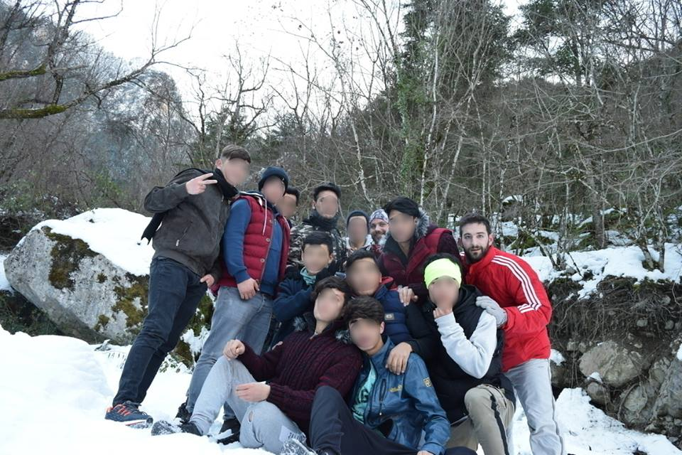
ARSIS HPEIROU & THE REFUGEES: OUTDOOR ACTIVITIES

Slide 10
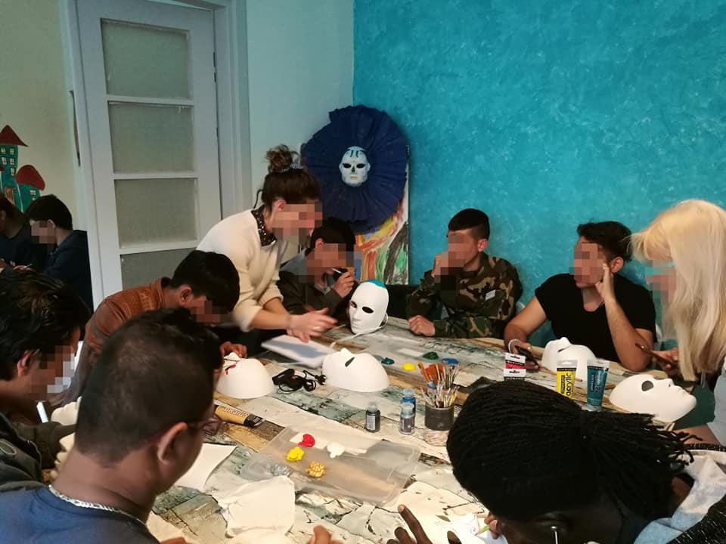
Arsis HPEIROY: CELEBRATING THE CARNIVAL

Slide 11
participatING in the 22nd Bizanio Road (2700m) – LEADING A NORMAL LIFE

Slide 12
LEARNING GREEK CUSTOMS –HAVING FUN

Slide 13
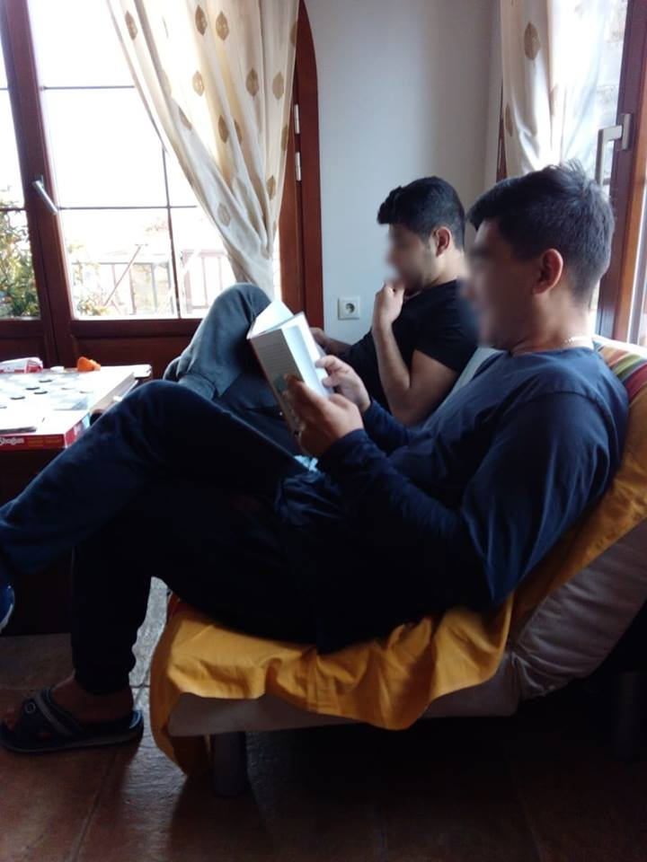
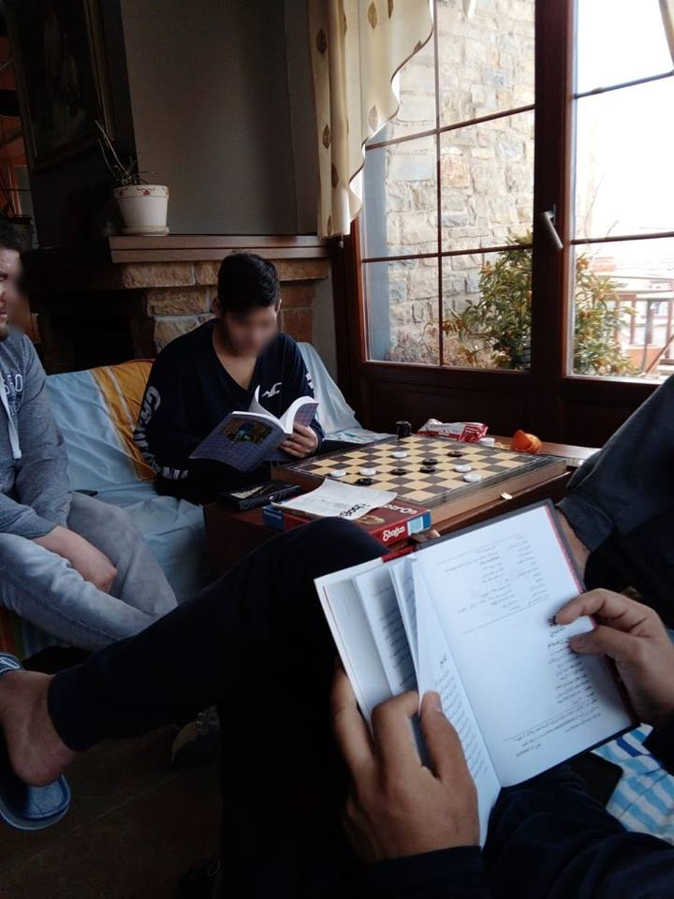
Reading: DONATIONS OF BOOKS TO THE CHILDREN

Slide 14
Our experience: VISITING ARSIS IN THESSALONIKI
Based on our school programme, two years ago, we organised a school trip to Thessaloniki. There we visited the Youth Support Center of Arsis. We were informed by a pschychologist who described to us the difficulties which the refugees face, until they arrived in our country and the current difficulties.
Also, she told us their habits and their hobbies, how they spend their free time and how their life in Greece is. After the information, we were looking forward to meeting the refugees. When we met them, we developed good relationships, we ended up playing football in the yard and we had a chat. The guys were from 10 to 18 years old.

Slide 15
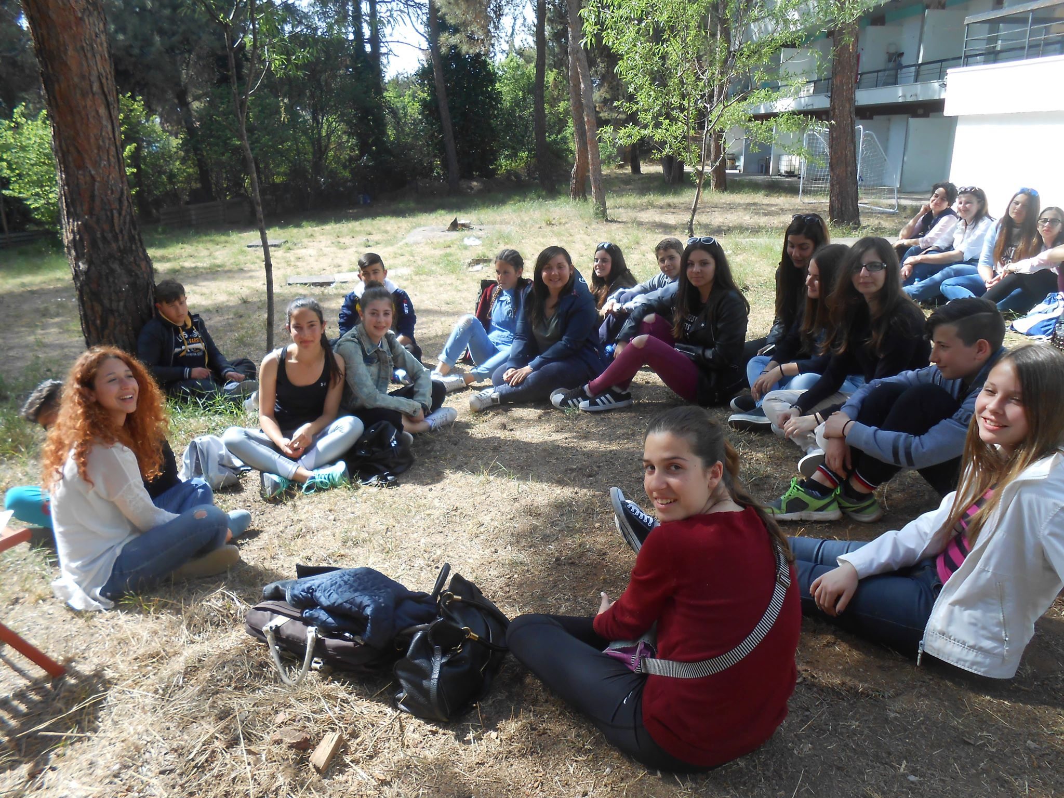

Slide 16
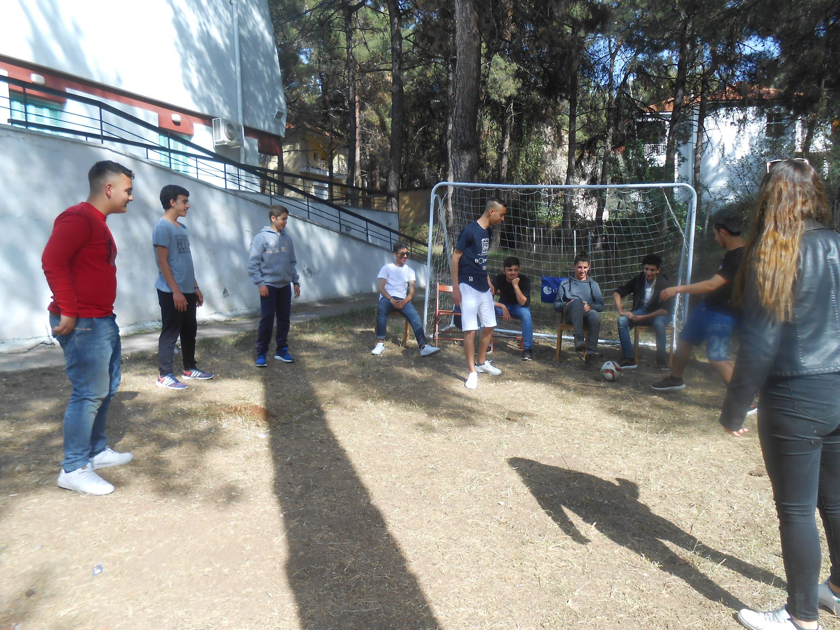

Slide 17
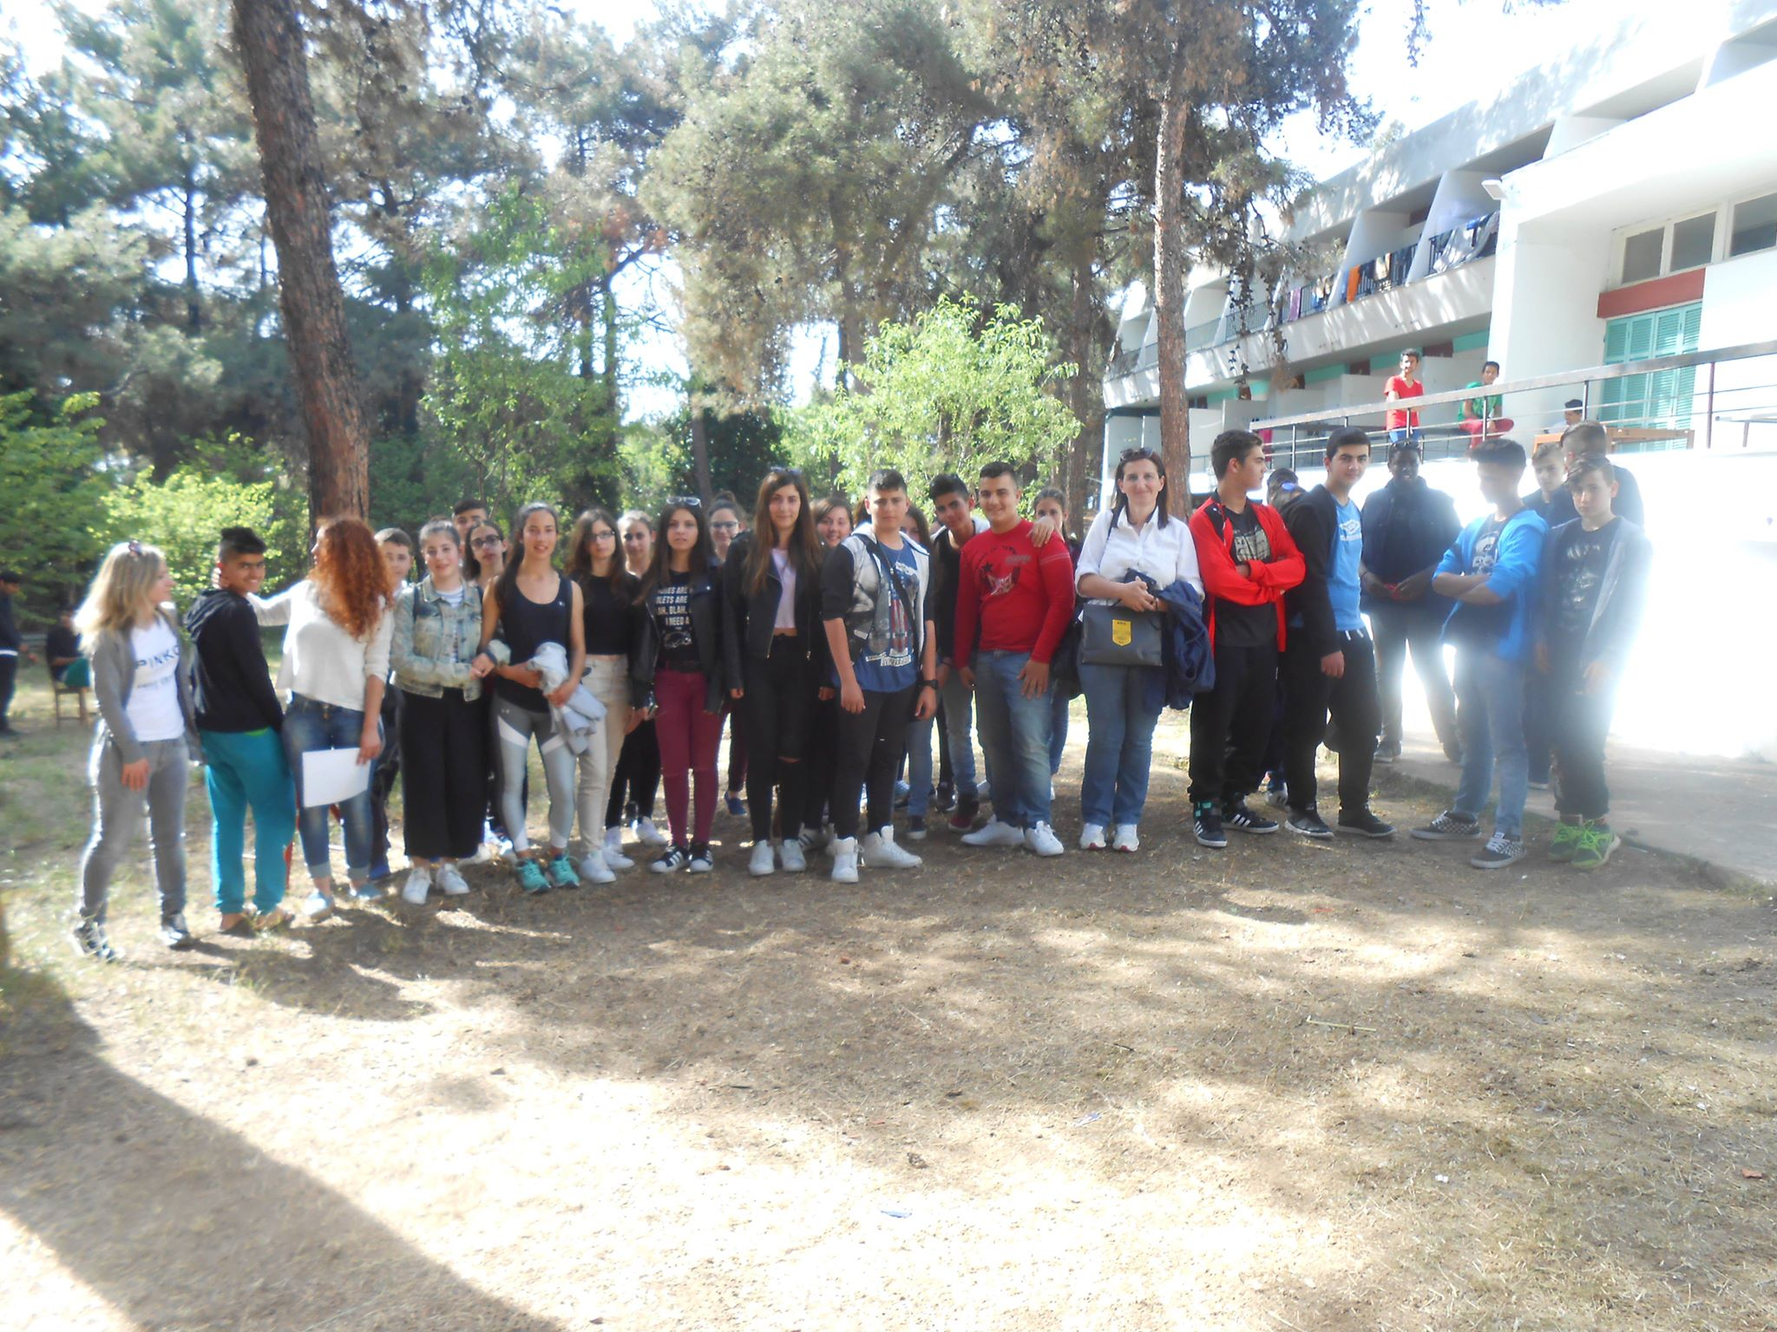

Slide 18
Epilogue:
ARSIS meets the citizens to share their conquests, concerns and proposals with the aim of participating in the effort to improve the position and role of young people in society
" ARSIS believes that young people defeat the conditions that lead them to isolation. It is enough to be with them."

Slide 19
Bibliography:
https://l.facebook.com/l.php?u=http%3A%2F%2Fwww.arsis.gr%2Fpii-imaste%2Fi-arsis%2F%3Ffbclid%3DIwAR0tpdzqtX6mY9VRonMleg3Ot49_10F8HixKjBO24t0M7NQURLNtjPqwZLQ&h=AT3GmgvBq6rPk0Y8SRkpQVGCSUCsD3mp5FLxOJVpU27cIQ6Ohrppxd8E6LPlTkG_8jZfAe1oAFIl0eMAKn76MCCpCQxM-yl0IlUBRD6JfvXKbl1b2-yr7xktoROgxi1NBQ0jbWUxhdMBBsoUPkVXLA
https://l.facebook.com/l.php?u=https%3A%2F%2Farsisthess.blogspot.com%2F%3Ffbclid%3DIwAR2YwOONRdwPBVeQ90SRfZTKZJvixhJE8Fho3Vx0xqyq_DrhzMAO3tJNBb8&h=AT3GmgvBq6rPk0Y8SRkpQVGCSUCsD3mp5FLxOJVpU27cIQ6Ohrppxd8E6LPlTkG_8jZfAe1oAFIl0eMAKn76MCCpCQxM-yl0IlUBRD6JfvXKbl1b2-yr7xktoROgxi1NBQ0jbWUxhdMBBsoUPkVXLA

