Slide 1
REFUGEE CRISIS IN GREECE
Together: equal in dignity and rights

Slide 2
What is a refugee crisis?
Movements of:
Large groups of displaced people
Internally displaced people
Forced displaced people
Refugees
Other migrants

Slide 3
When was the first refugee crisis in Greece?
The 1923 population exchange between Greece and Turkey
1.230.000 Greeks Orthodox from Asia Minor returned back to Greece
610.000 Muslims from Greece returned back to Turkey

Slide 4
Where was this population exchange based on?
Language
Ethnicity
Religious identity
Did they respect the right of diversity?

Slide 5
Greece 2015: What caused the refugee crisis?
Syrian civil war
Avoidance of entering
in neighbouring countries of the Middle East
So, Europe is an increasingly attractive option for them since they have no secure legal status in the countries where they now live.

Slide 6
How many people arrived in Greece since 2015?
2015
857.000
2016
173.000
2017
29.000
2018
32.000

Slide 7
Table of sea and land arrivals in Greece

Slide 8
From where did they approach Greece?
Islands of the Aegean:
Samos
Leros
Lesvos
Rhodes
Chios
Symi
Land borders of Greece and Turkey:
Evros

Slide 9
From where did they approach greece?

Slide 10
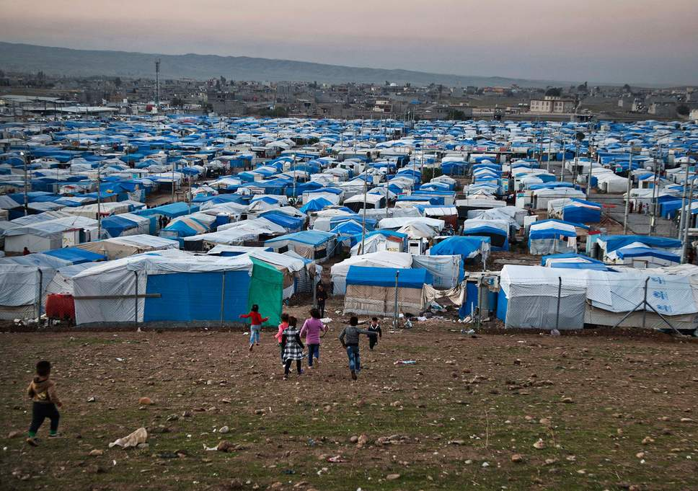
How about the living conditions?

Slide 11
What conditions prevailed in welcoming refugees?
Since mid-2015, and as Greece was facing large-scale arrivals of refugees, those shortcomings have become increasingly apparent. However, the number of reception places has increased mainly through temporary camps and the UNHCR accommodation scheme. Despite this increase, destitution and homelessness are still a risk of a significant number of applicants, including those who do not fall within the scope of these schemes. The situation on the islands also remains dire due to the overcrowding of reception facilities.

Slide 12
What do national authorities have to do?
The law provides a legal basis for the establishment of:
Different accommodation facilities
Reception centres
Identification centres
Ministry of Economy
Ministry of Migration Policy
Establish open Temporary Reception Facilities for Asylum Seekers and open Temporary Accommodation Facilities

Slide 13
Actions
UNHCR started implementing an accommodation scheme dedicated to relocation candidates (“Accommodation for Relocation”). The project was continued and UNHCR committed to gradually establishing 20,000 places in open accommodation, funded by the European Commission and primarily dedicated to applicants for international protection eligible for relocation.
The scheme remained in place throughout 2017 and it was implemented by 15 partners, including seven NGOs and eight municipalities.

Slide 14
UNHCR accommodation scheme

Slide 15
How about the conditions on the Eastern Aegean islands?
The situation on the islands is extremely alarming and it has become obvious that the reception conditions prevailing in particular in the hotspot facilities may reach the level of inhuman or degrading treatment in certain cases. As it emerges from official data, severe overcrowding persists in the RIC on the islands.

Slide 16
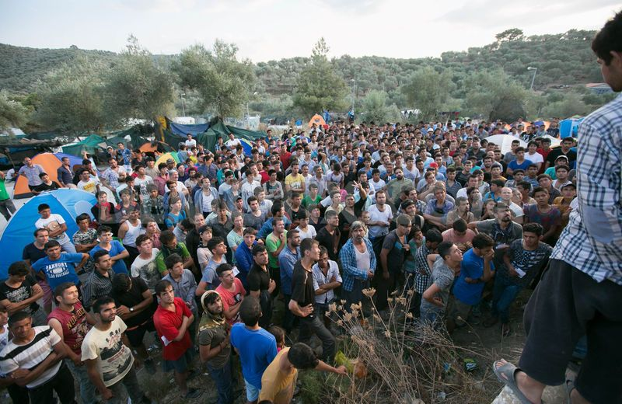
How about the conditions on the Eastern Aegean islands?
Lesvos
Nominal capacity:
3.000 people
Remained people:
4.950
31 January 2018
Samos
Nominal capacity:
700 places
Remained people:
2.380
Chios
Nominal capacity:
895 places
Remained people:
1.380

Slide 17
Due to overcrowding, many people are sleeping in tents exposed to extreme weather conditions, while food and water supply is reportedly insufficient, sanitation is poor and security highly problematic. This photo published by international press demonstrates the unacceptable conditions prevailing at the Moria RIC, Lesvos.

Slide 18
Refugees' living conditions in Idomeni

Slide 19
Refugees standing on borders (Idomeni)

Slide 20
Souda's refugee camp in Chios island

Slide 21
However, solidarity doesn't end at the borders...

Slide 22
A woman volunteer promotes the value of cooperation to the children

Slide 23
A doctor from Doctors Without Borders organisation offers his services to refugees

Slide 24
Volunteers help the refugees arriving on land

Slide 25
Playing is necessary for children to overcome what they have experienced in the past

Slide 26
This Erasmus project gives us the opportunity to perceive the value of man as a man, not as a number! Let's take the chance and be together, equal in dignity and rights.

Slide 27
Works cited
https://www.asylumineurope.org/reports/country/greece/reception-conditions/housing/types-accommodation
https://ec.europa.eu/echo/where/europe/greece_en
https://www.rescue.org/country/greece
People of Nowhere
https://www.youtube.com/watch?v=VXHYtIfaEQ8
Presentation: Dimitra Toulaky
&
Stamatia Afentouli
Supervisor teacher: Triantafyllia Vrana

