Slide 1
Pärnu Mai school
Form 4.c

Slide 2
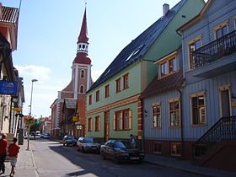
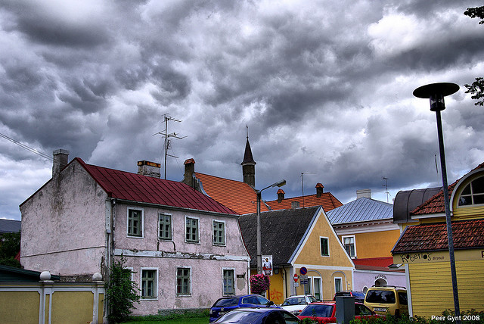
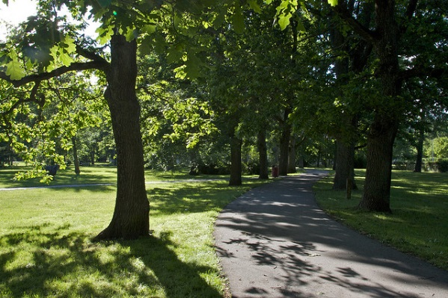
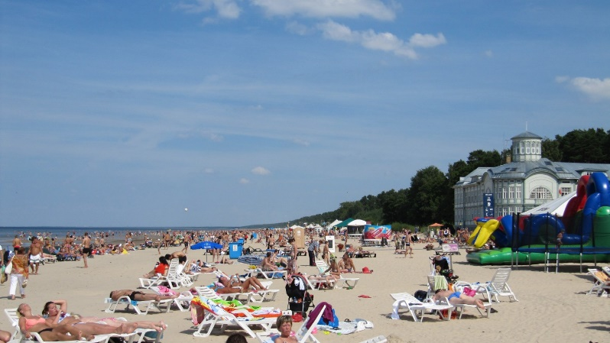
Our hometown

Slide 3
Our school

Slide 4
Our class
In our class there are 20 students: 16 boys and 4 girls.
We like sport, music and computers.

Slide 5
Thank you!

