Slide 1
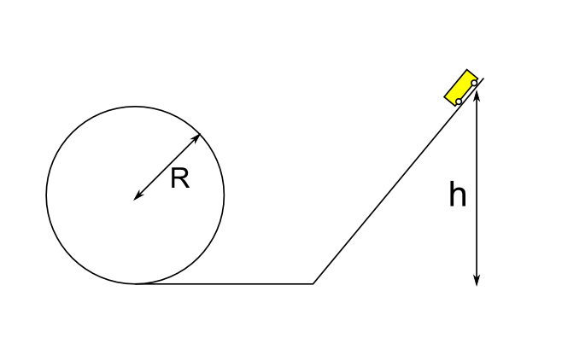
Surviving the Death Loop
(Etwinning Project)

Slide 2
Lab report
Aim: we are going to verify from which height it is enough to start to do a complete loop.
Materials: - track
- car
- meter

Slide 3
Introduction The most important point of the experiment is point “C”, where the car must have a precise amount of strenght not to fall. This strenght is called centripetal force and it has to be bigger than the weight force.
Let’s find out the height !
A
C
EtotA = Epot A
EtotC = Ekin+Epot = ½ * m *V² + m * g * 2R
(as we have already said, the centripetal force must be bigger than the weight force)
m * v² / R > m* g (we obtain that m*V² > m*g*r)
There’s an energy conservation so we can equalize the 2 formulas.
m*g*h = ½ *m*v² + m*g*2R (we replace)
m*g*h> ½ *m*g*R + 2*m*g*R
m*g*h> ½ *m*g*R+ 4/2*m*g*R
m*g*h> 5/2*m*g*R
h> 5/2*R

Slide 4
Conclusion: so do a complete loop, the height must be larger than 5/2*R (THIS IS VALID ONLY WITHOUT FRICTION )
To see a real DEATH LOOP, come to visit us and go to MIRABILANDIA!
Click here to see!
Group 2
Francesca Miola, Camilla Bendandi, Nicola Balbi, Simone Ricuperati and Giulia Tusone

