Slide 1
DISCRIMINATION
Democracy in our school
Made by: Klaudijus Jaroščenka, Ieva Paplauskaitė, Jokūbas Černiauskas, Roberta Mickevičiūtė, Ernesta Onusaitytė, Deimantė Kovalkovaitė, Lukas Kaminskas
2B

Slide 2
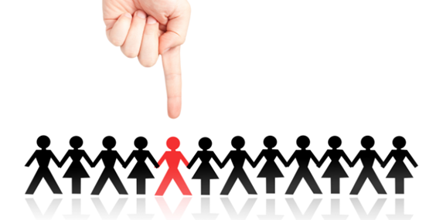
Discrimination – Our rights restriction or deprivation for a person or a person's category because of race, nationality, language, religion or politics, property or social situation, birth place and etc. Also measure of a state or a couple of states restricts other states, its representitive or citizens, legal and physical persons rights. (Vikipedia)

Slide 3
Our team decided to make a short survey. During breaks we interviewed our school students and there is the result.

Slide 4
Questions:
1.What is discrimination?
2.Why is discrimination happening?
3.Between what is it happening?
4.Consequences of the discrimination.
5.How to stop it?

Slide 5
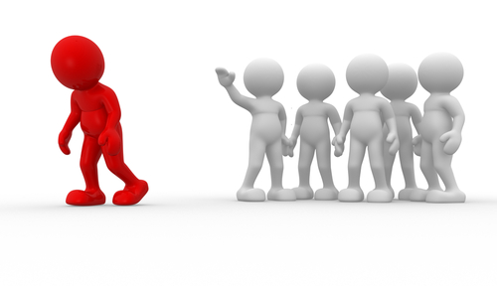
What is discrimination?
Discrimination - a person's rights restriction and deprivation;
Discrimination is when people are mocking or avoid contact with other people that are different;
Discrimination is other person's cancellation and his features exposure.

Slide 6
Why is discrimination happening?
1. Discrimination happens because there are different people who do not get along because of their different features and others laugh at him because of it.
2. It happens because people who make fun of another person, that they would show how great and brave they are by mocking them;
3. Happens because of people's desire to mock someone and wanting to humiliate others.

Slide 7
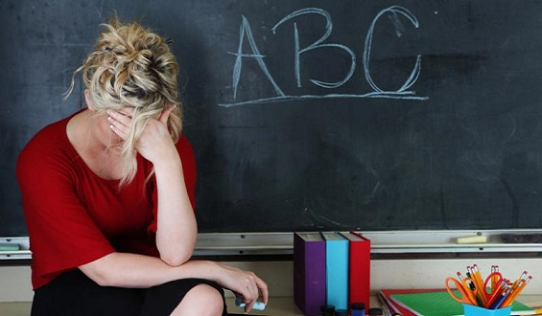
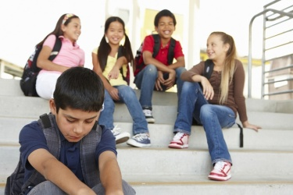
Who are involved in discrimination?
1. It mostly happens between students;
2. Students and teachers;
3. Different race or religion people;
4. Between teachers.

Slide 8
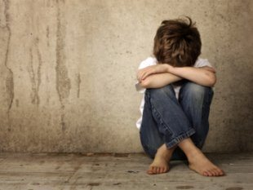
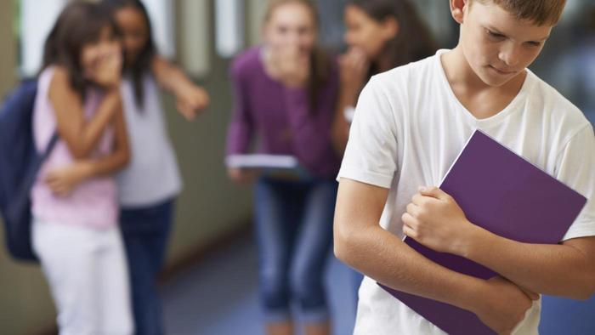
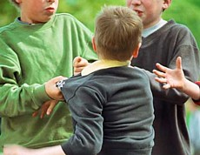
Consequences of the discrimination:
1. Consequences are very negative : a student who has no friends becomes closed and may commite suicide;
2. Discrimination can bring up fights;
3. Wanting to revenge they start doing the same;it spreads.
4. It effects the person, he looks at himself differently, starts hate himself, loses his confidence;
5. It effects his results, if he's a student, it lowers his grades and motivation.

Slide 9
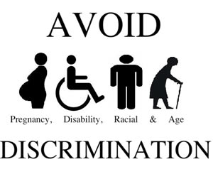
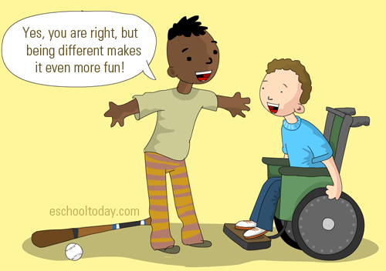
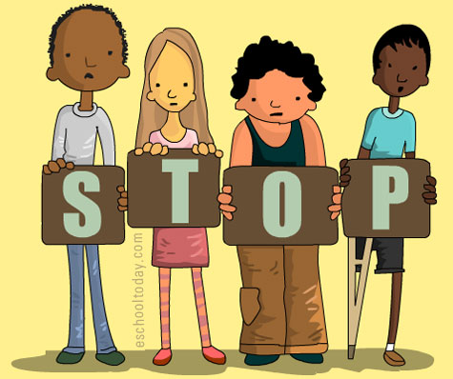
How to stop it?
I think it could be stopped by conducting lectures to kids about discrimination and its consequences. Do events in which all the students participated and could meet each other.

