Slide 1
Our research of a city called
Jonava
Presentation made by: Lukas, Jokūbas, Martynas, Klaudijus
Jonava Senamiestis gymnasium

Slide 2
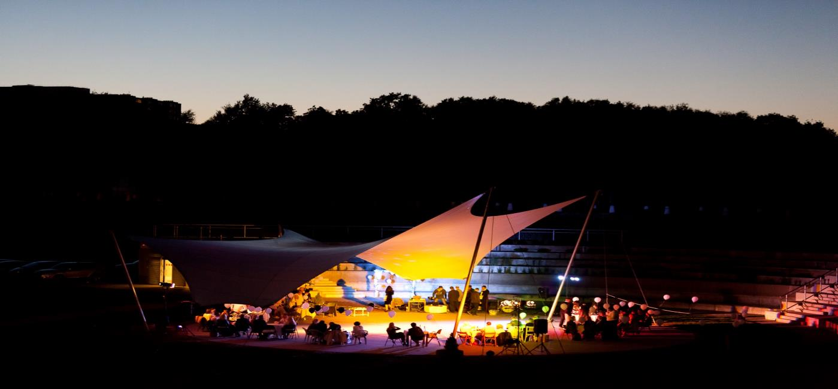
Most visited places in Jonava
Joninės valley

Slide 3
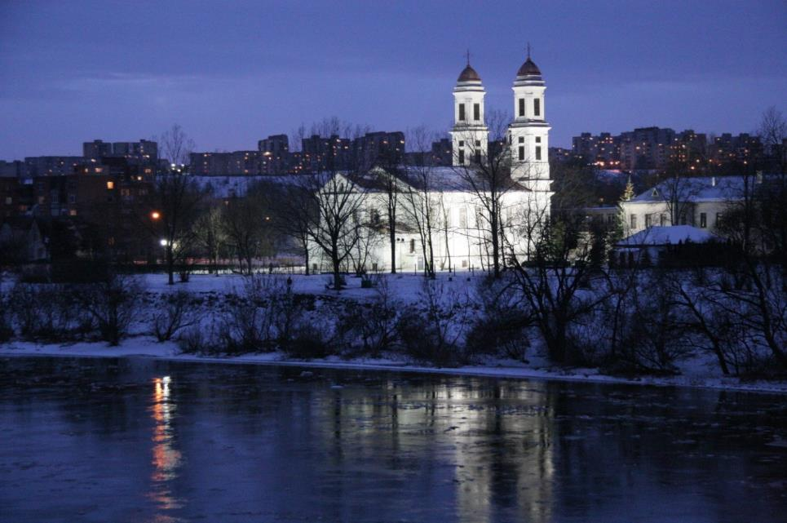
Church of saint Jokūbas
Church of saint Jokūbas, it stands on the left side of river called Neris (You can see it in the picture as well near the church)

Slide 4
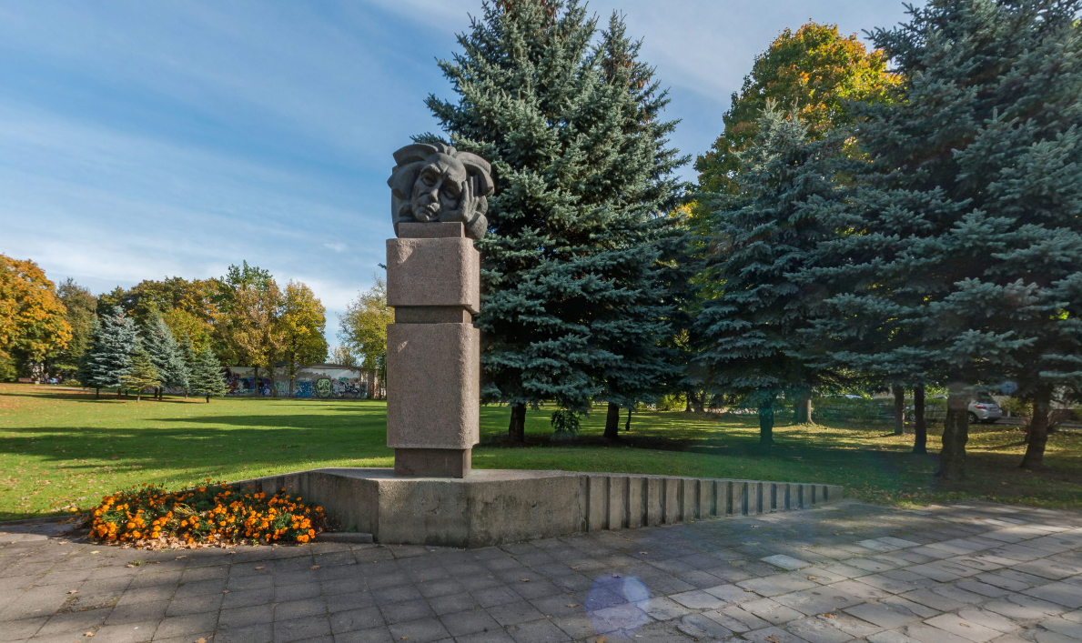
Main monuments in Jonava
Monument for Petras Vaičiūnas

Slide 5
Some facts about Jonava
Jonava is the ninth most popular city in Lithuania.
City birthday is celebrated on 8 August., Often associated with St. John's.
There are currently about 30 thousand people in Jonava
Jonava was founded in 1750, august 8th

Slide 6
