Slide 1
GROUP PRESENTATION Jonava Senamiestis gymnasium
Made by: Karolina Rodaityte, Ugne Grabaziute, Roberta Mickeviciute, Ieva Paplauskaite

Slide 2
Personal presentation

Slide 3
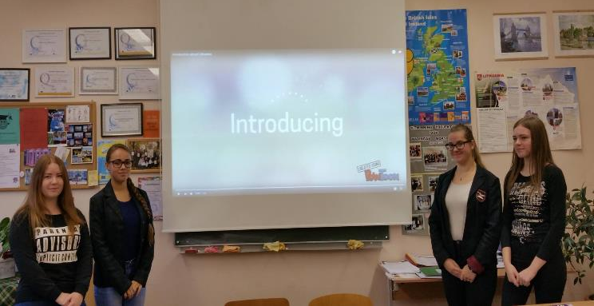
Our group
Ieva Paplauskaite
Ugne Grabaziute
Roberta Mickeviciute
Karolina Rodaityte

Slide 4
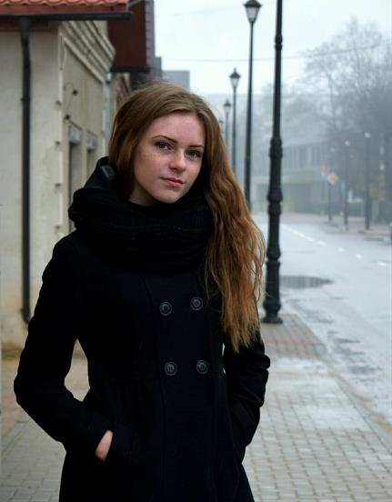
Ieva Paplauskaite
My name is Ieva. I'm studying in Jonava Senamiestis gymnasium. I'm 15 years old. I like playing football and volleyball. I hate playing basketball, because I get tired very fast. Most of my free time I spend with my friends or I just stay and relax at home. If I could I would just sleep all the time.

Slide 5
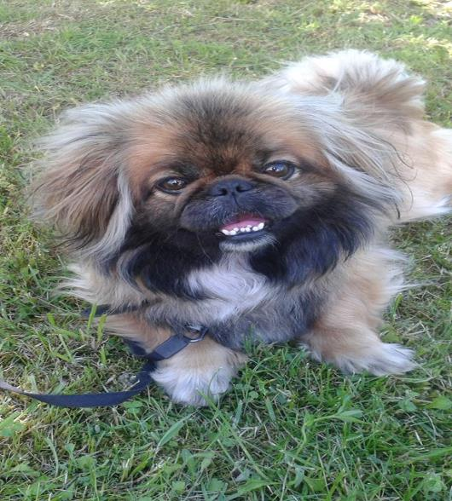
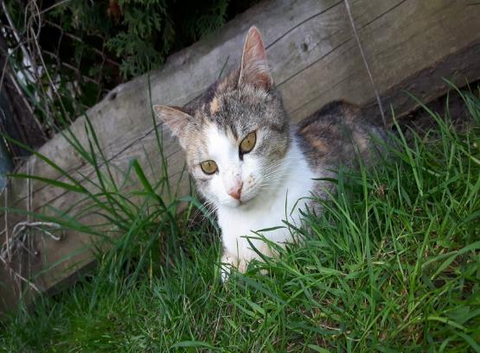
I'm in love with animals. I have a dog, her name is Milka and a cat, her name is Murze. My future dream is to have a job I would love such as painting, art or home design.

Slide 6
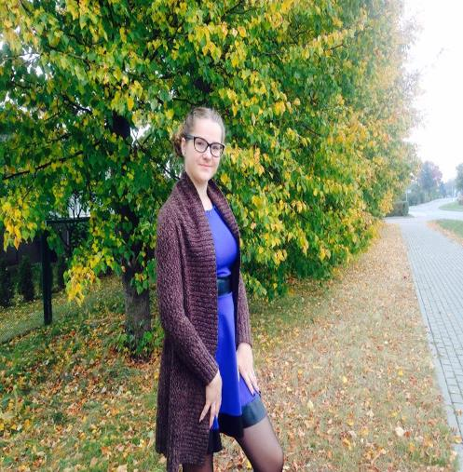
Roberta Mickeviciute
My name is Roberta, I'm studying in Jonava Senamiestis gymnasium. My favorite subject is economy and art. In free time I sometimes draw and listen to music, but most of the time I spend with my friends.

Slide 7
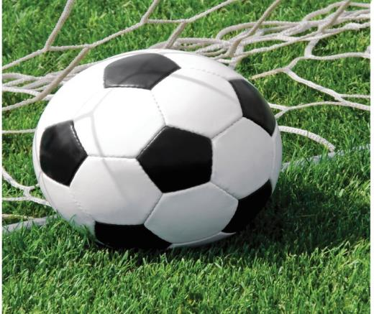
I have one dog his name is Gufis, he live with me in my room, I love him so much! My favorite sport is football, but I don't like to play it, I just love to watch it.

Slide 8
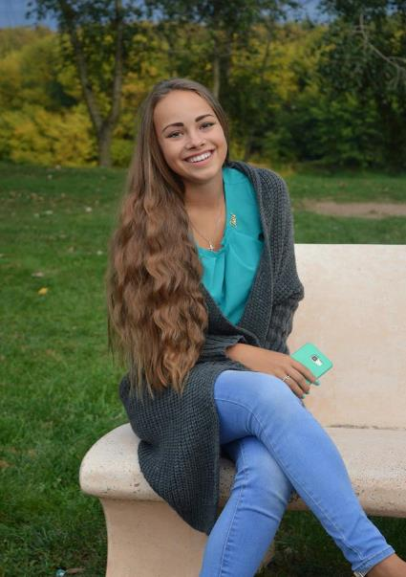
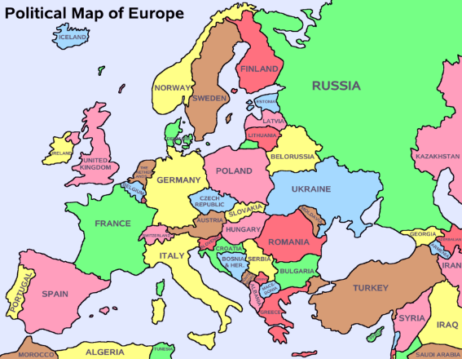
Karolina Rodaityte
My name is Karolina, I’m studying in Jonava Senamiestis gymnasium. I’m 16 years old. I love to travel, I was in ten differnt countrys.
Norway
Sweden
Estonia
Latvia
Poland
Slovakia
Czech Rebublic
Austria
Italy
Ukraine

Slide 9
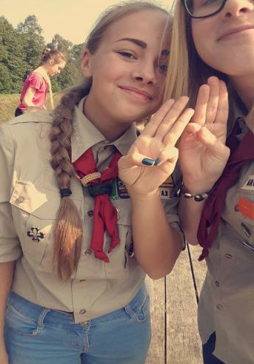
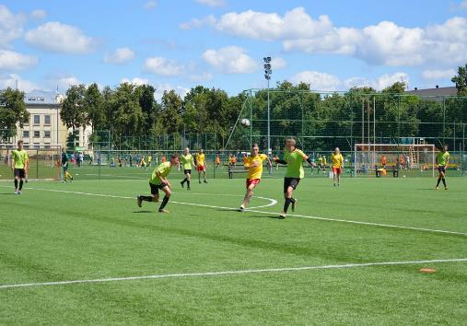
I singing in ’’Intermezzo,, group. I’m scout over six years. On my free time I love to be in some football games. I’m new volunteer in ’’JonAS’’ organization.

Slide 10
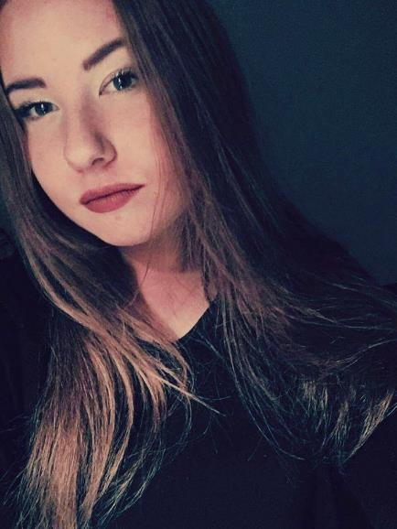
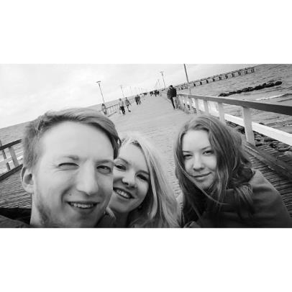
Ugne Grabaziute
My name is Ugne, I’m studying in Jonava Senamiestis gymnasium. I‘m 16 years old. I love making new friends, on my free time I meet my best friends for a movie night or a sleep over. I love to sing and dance when nobody sees.

Slide 11
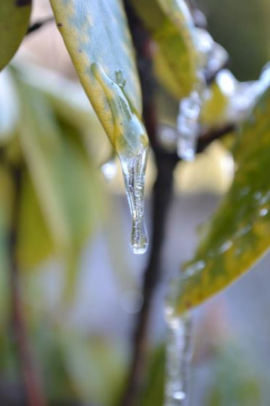
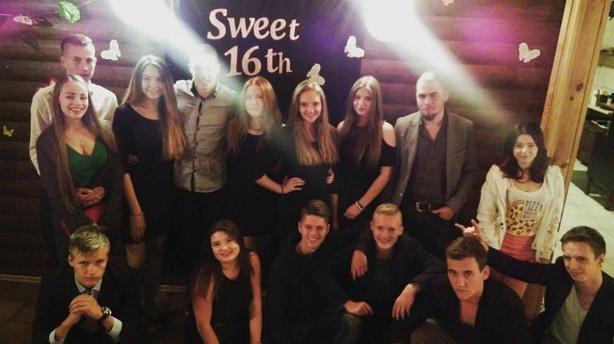
I have a lot of good friends that i love very much and I‘m going to a photography lessons

