Slide 1
Introducing our team
Team members: Lukas, Klaudijus, Jokūbas, Martynas

Slide 2
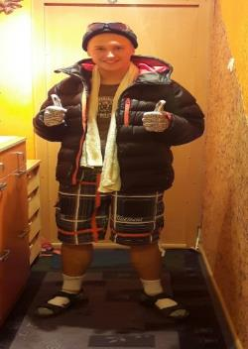
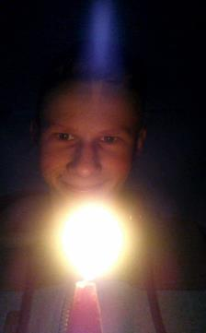
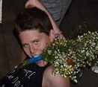
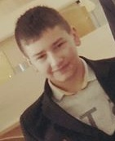
Talking about our team
So our team consists of 4 people:
Lukas Martynas
Klaudijus Jokūbas

Slide 3
Our hobbies
Lukas likes playing basketball, football or any other kind of sport, playing computer games is a thing too. Last year he was playing for this schools basketball team.
Martynas likes playing football or other games with friends. He’s riding his bike from time to time. Martynas likes eating everything. He was a footballer 2 years ago.

Slide 4
Klaudijus is an active guy, he never stops doing his thing, likes sports mostly basketball, he also likes riding either a bike or with a car, and also with his skateboard.
Jokūbas likes eating, sleeping, at leisure he’s at his PC or going outside. He was taking classes for arts with paint.

Slide 5
Where do we study and where will we study after finishing this school ?
Our school is in Lithuania, Kaunas District, Jonava, Senamiestis Gymnasium.
Everybody is in the same class, so we meet every work day, from monday ‘till friday.
Everyone is probably going to separate after we are finished with this school, some might go after jobs, while others are going to study even more, reaching greater hights in education.

Slide 6
THANKS FOR WATCHING

