Slide 1
Our school
Natalie prouzová, vladimír vavera ,tereza sojková and alžběta müllerová

Slide 2
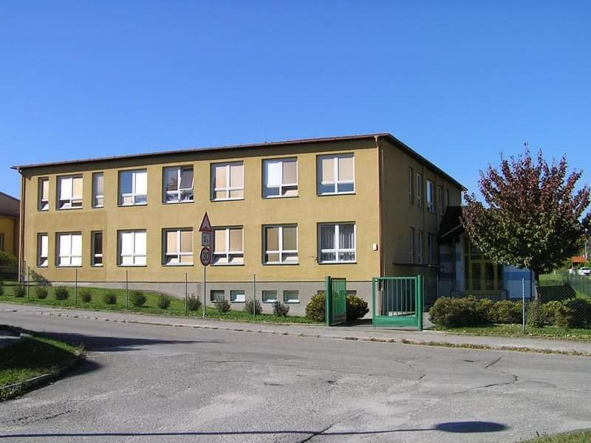
This is our Grammar school. You can Visit it in a small town Trhové Sviny in The czech republic.

Slide 3
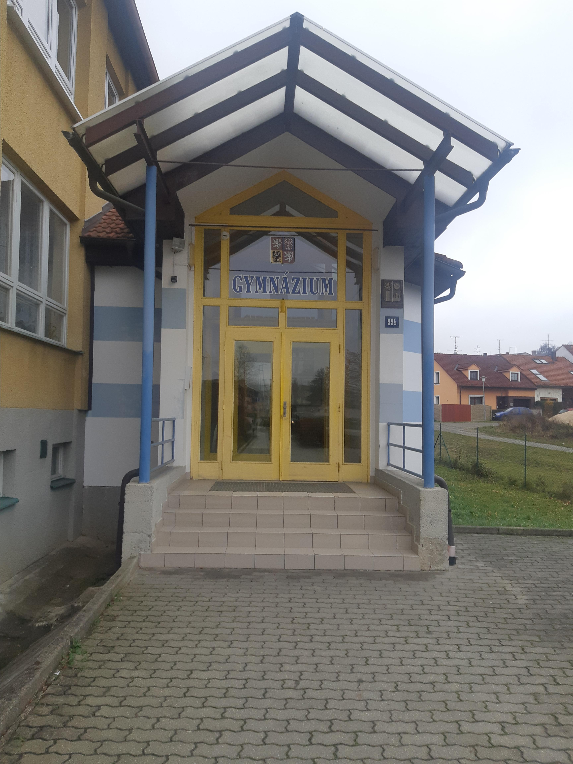
This is the main door of the school. It has got two buildings - “A” and “B”. building “a” is from the second half of The 20th century and building “B” was built in 2001.

Slide 4
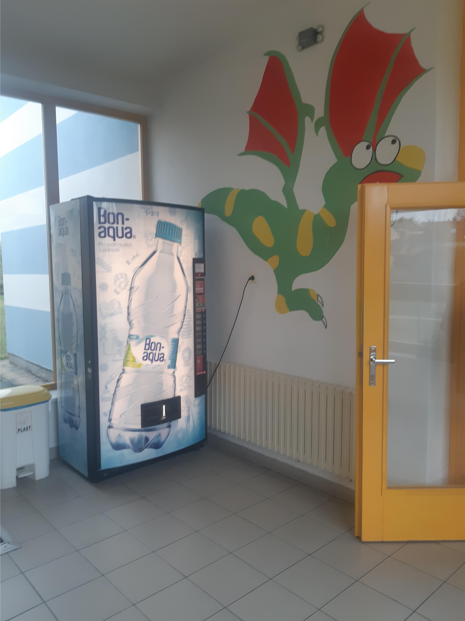
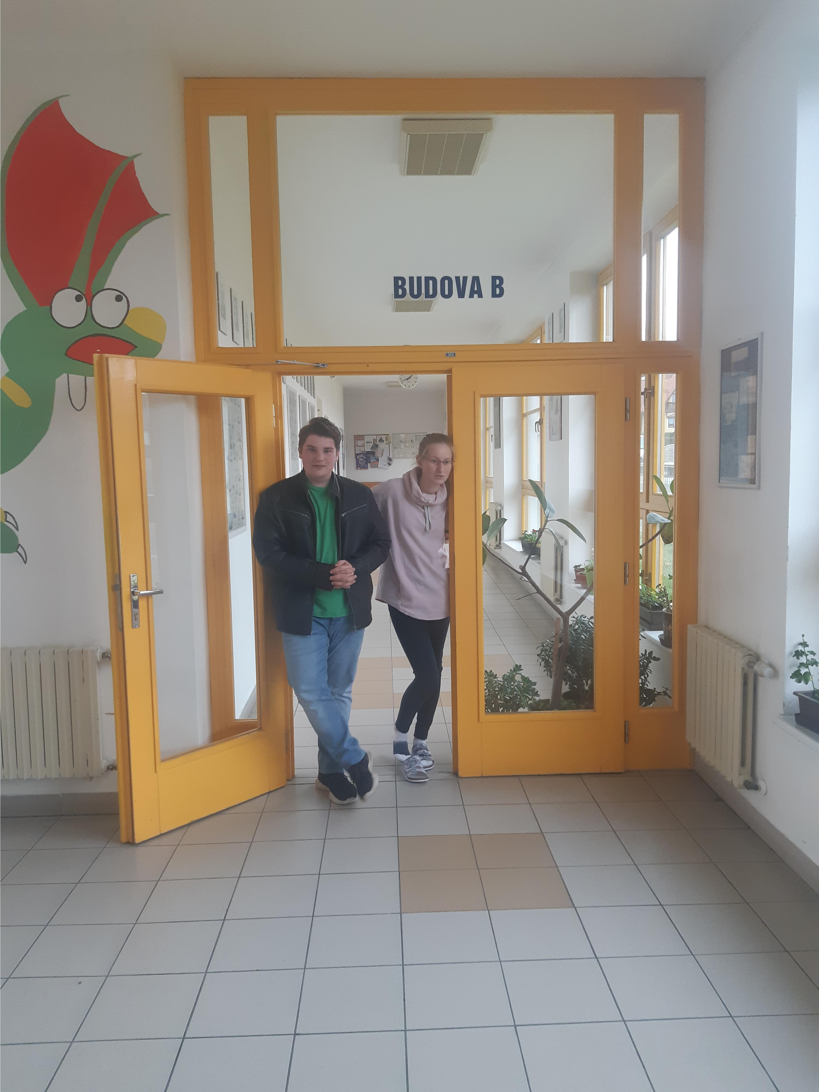
When you enter the main door, you are in the main hall. There is an automat in the hall where you can buy some water or juice .

Slide 5
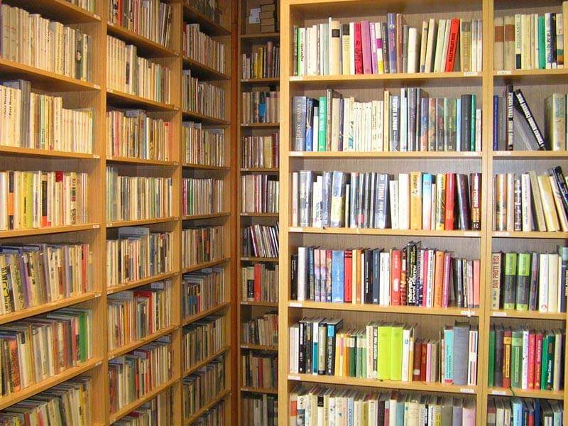
This is our school library. It is in the building “B”. you can find there all the books you need for your studies.

Slide 6
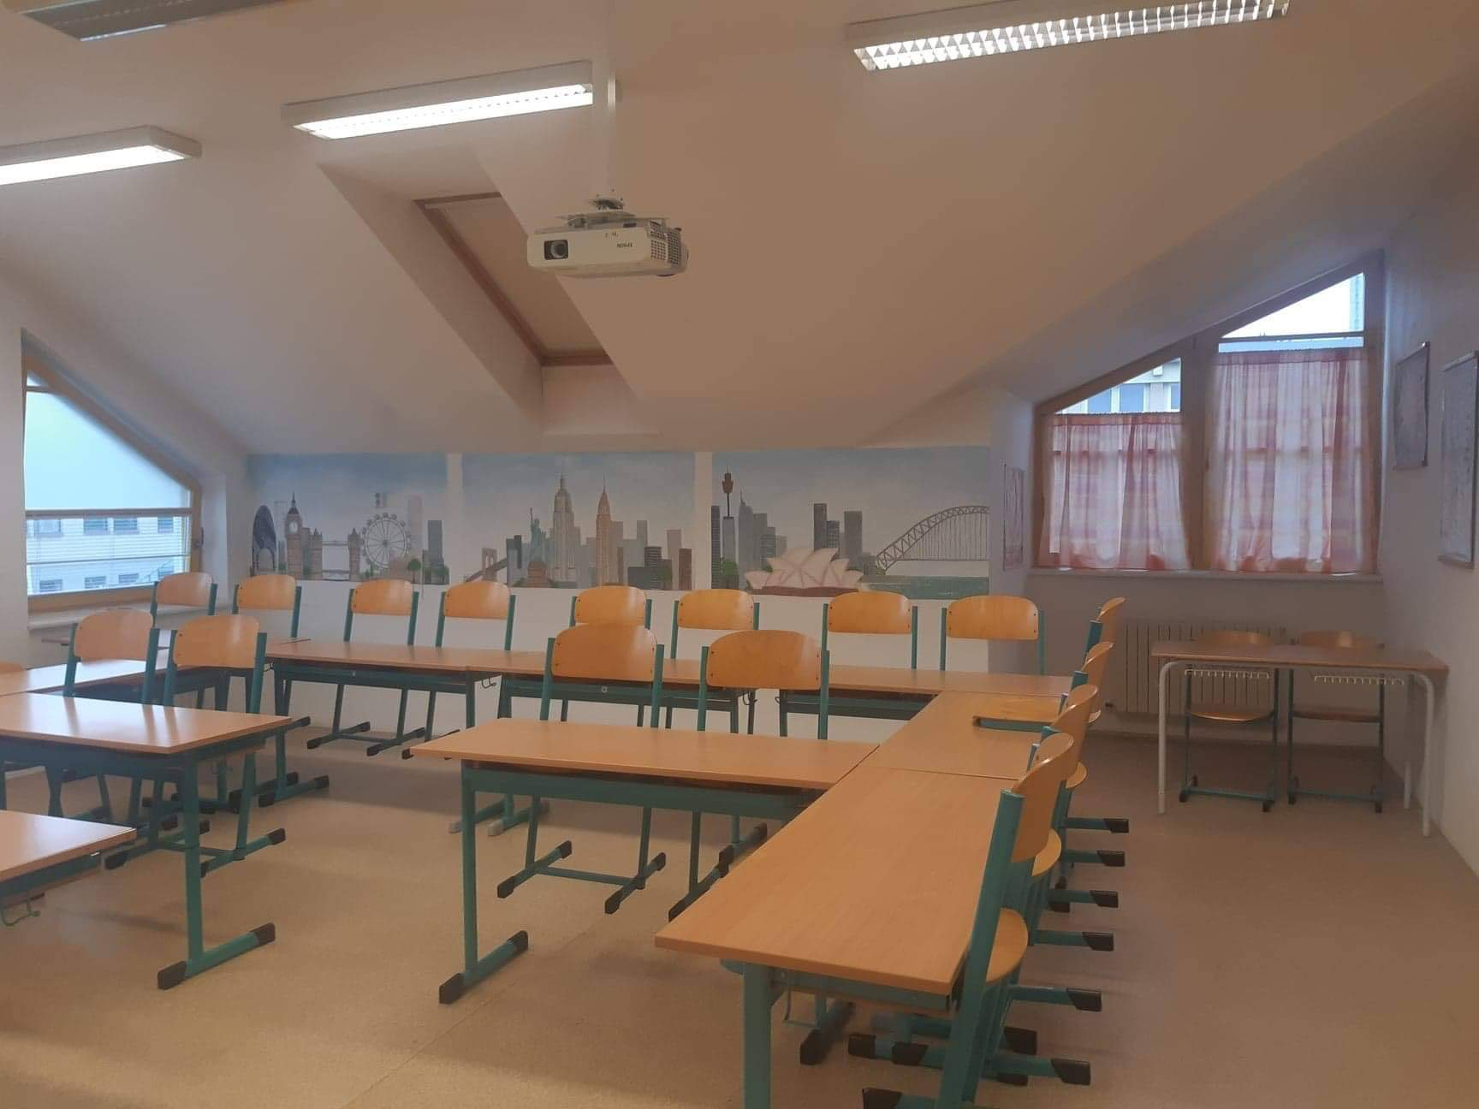
This is our english class. It is the most beautiful class in our school.

Slide 7
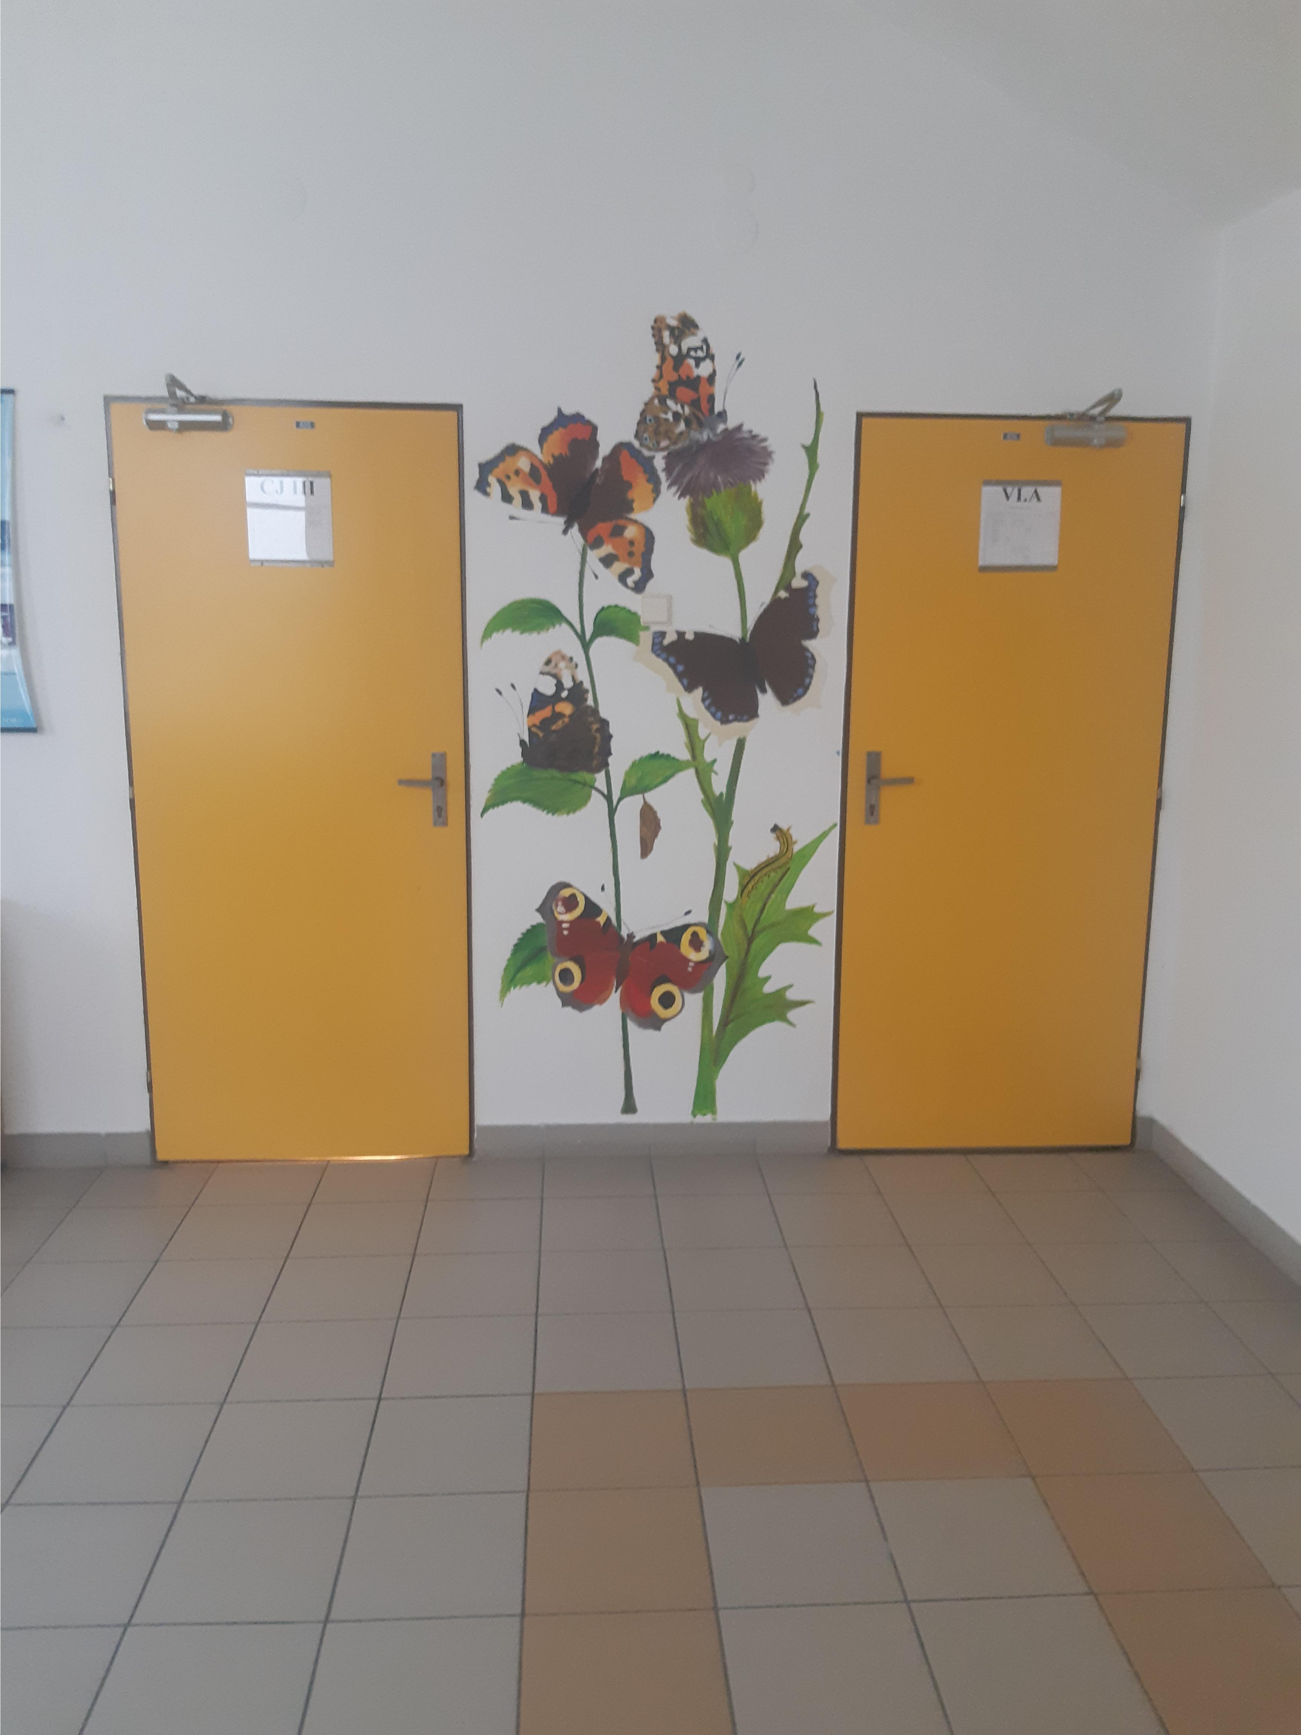
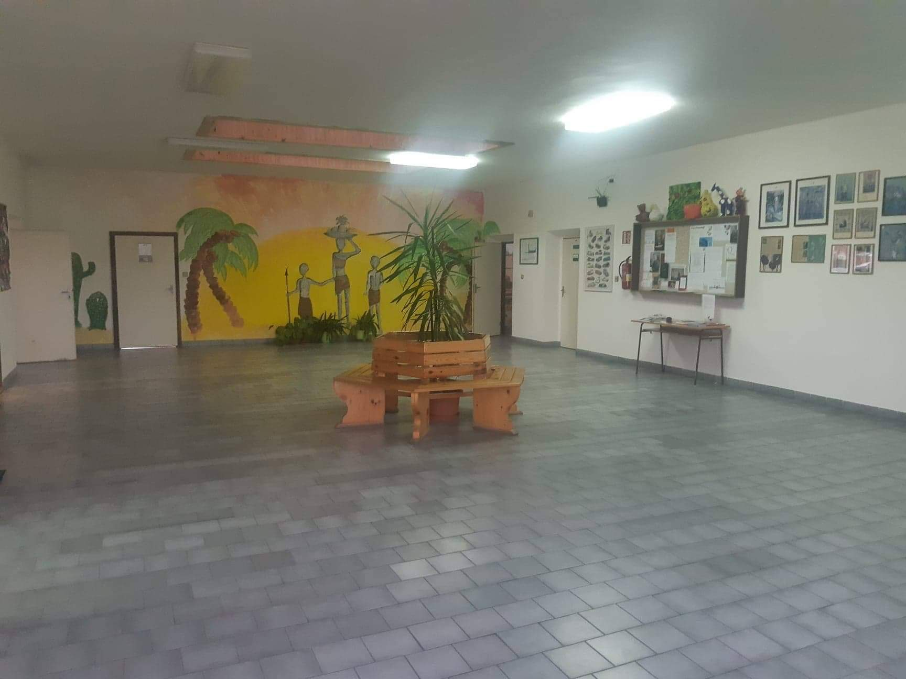
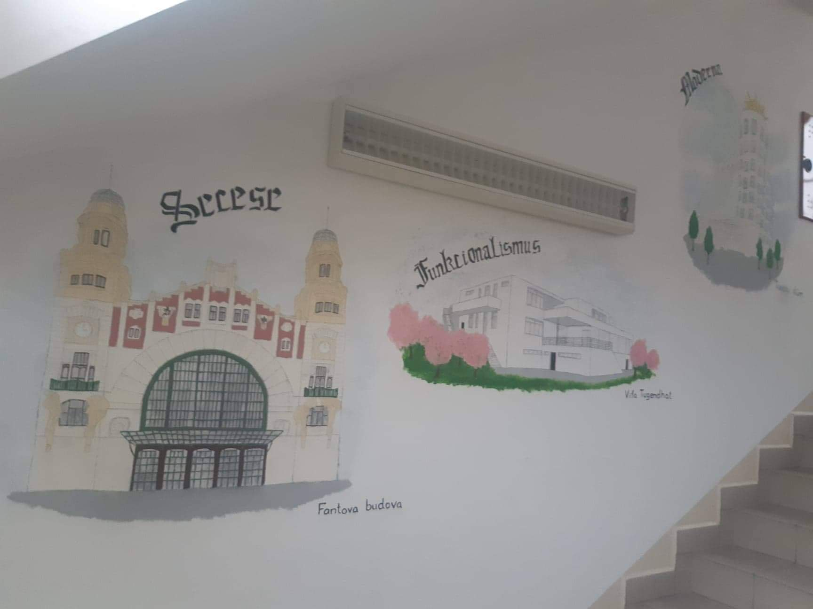
We have a lot of wall paintings in the school. It is drawn by groups of students .

Slide 8
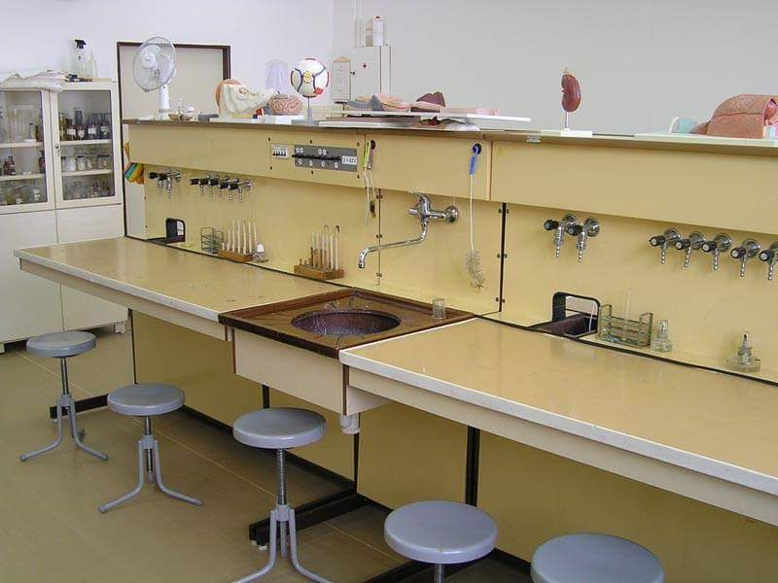
Our Chemistry class is quite old and small, but i think that we don‘t need a better class now.

Slide 9
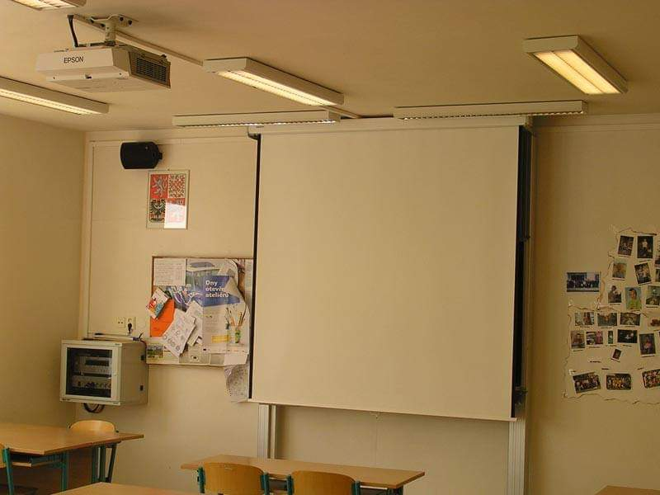
This is our main class. We have most of the lessons there.

Slide 10
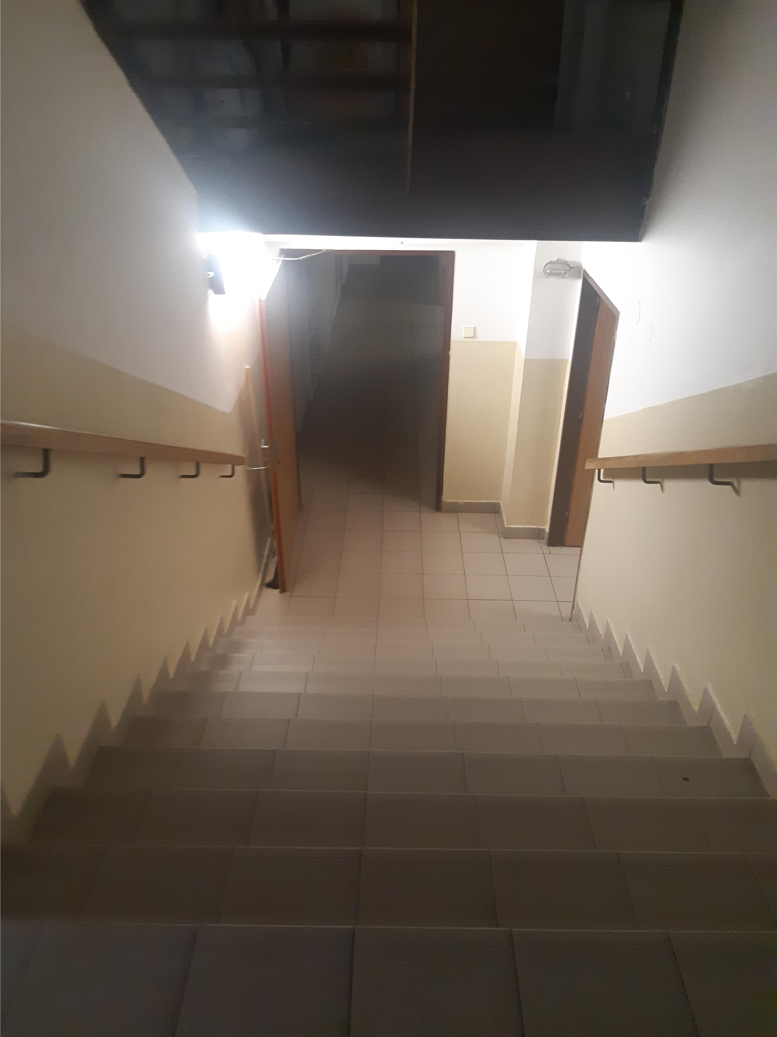
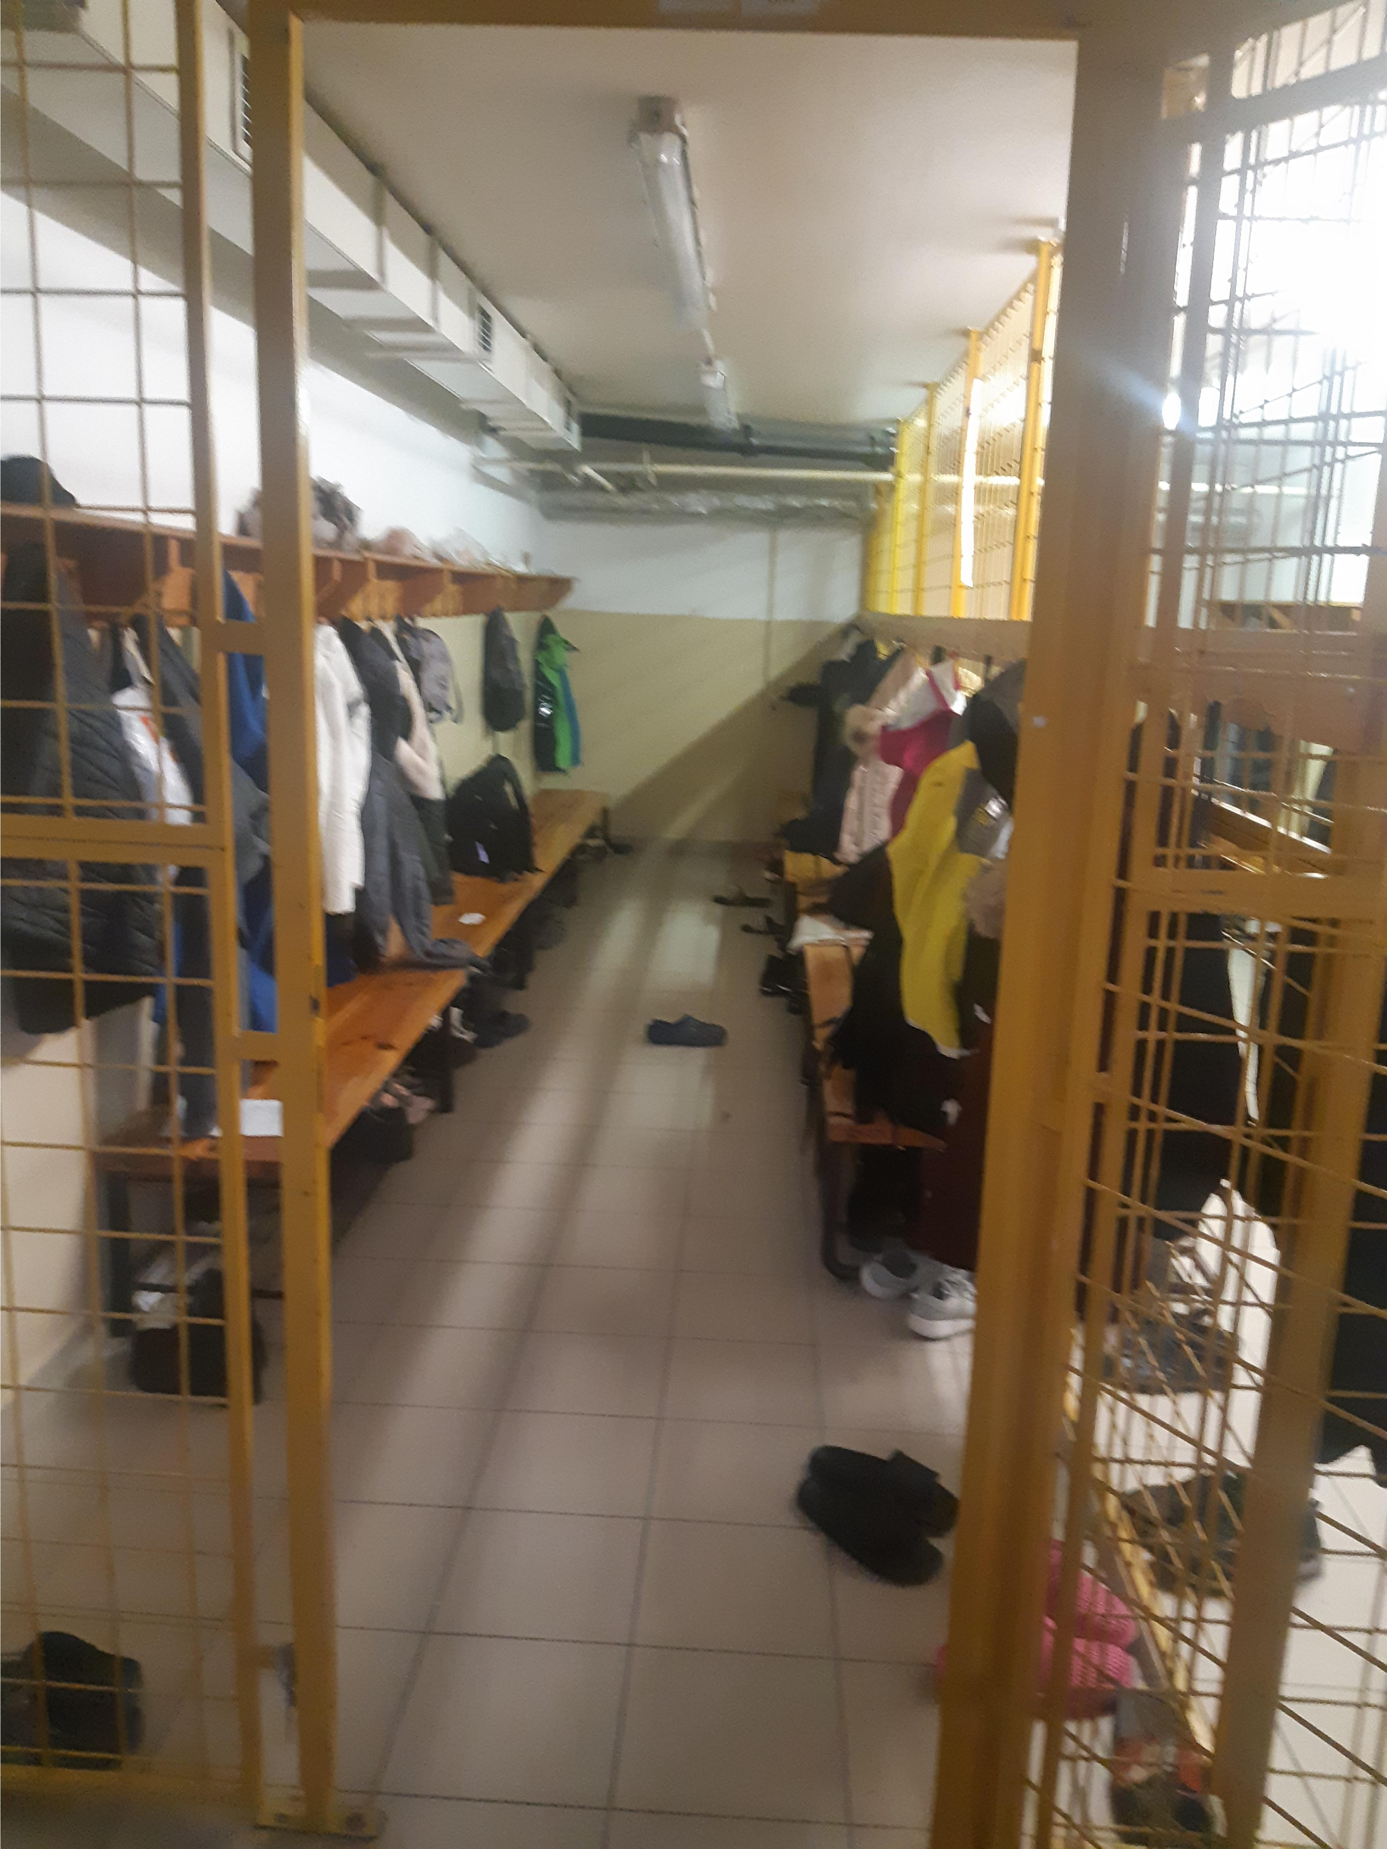
And this is our changing room. The changing rooms are in the school cellar.

