Slide 1
MARINHEIRA SCHOOL
MADEIRA
PORTUGAL
EB1/PE da Marinheira

Slide 2
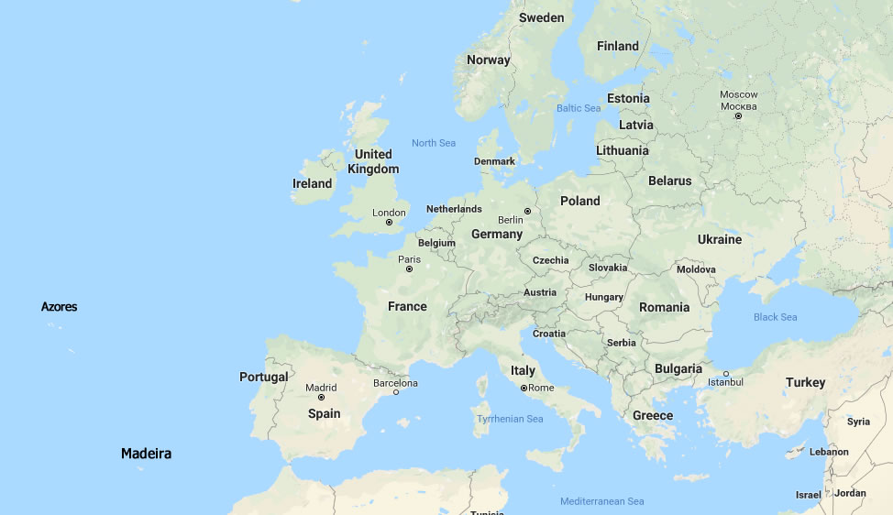
PORTUGAL
We are one of the oldest countries in Europe.
Our country has about
10 million inhabitants.
Our capital is Lisbon and we speak Portuguese, a language spoken by around 250 million people worldwide.
Currently, Portugal consists of the continental territory
and two archipelagos: Azores and Madeira.

Slide 3
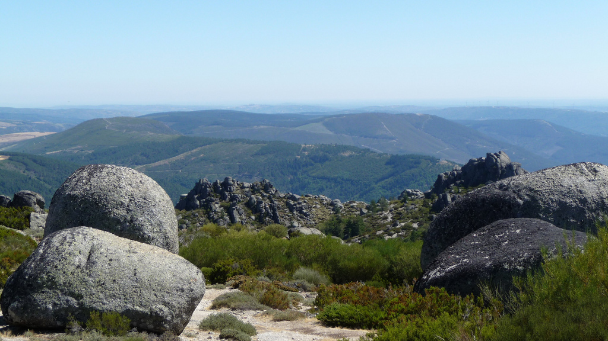
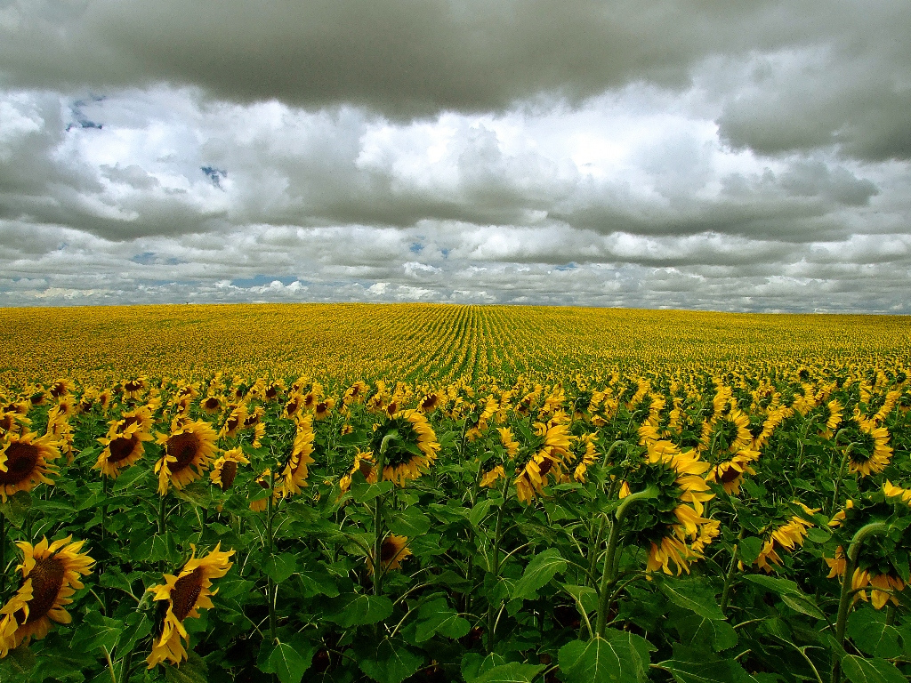
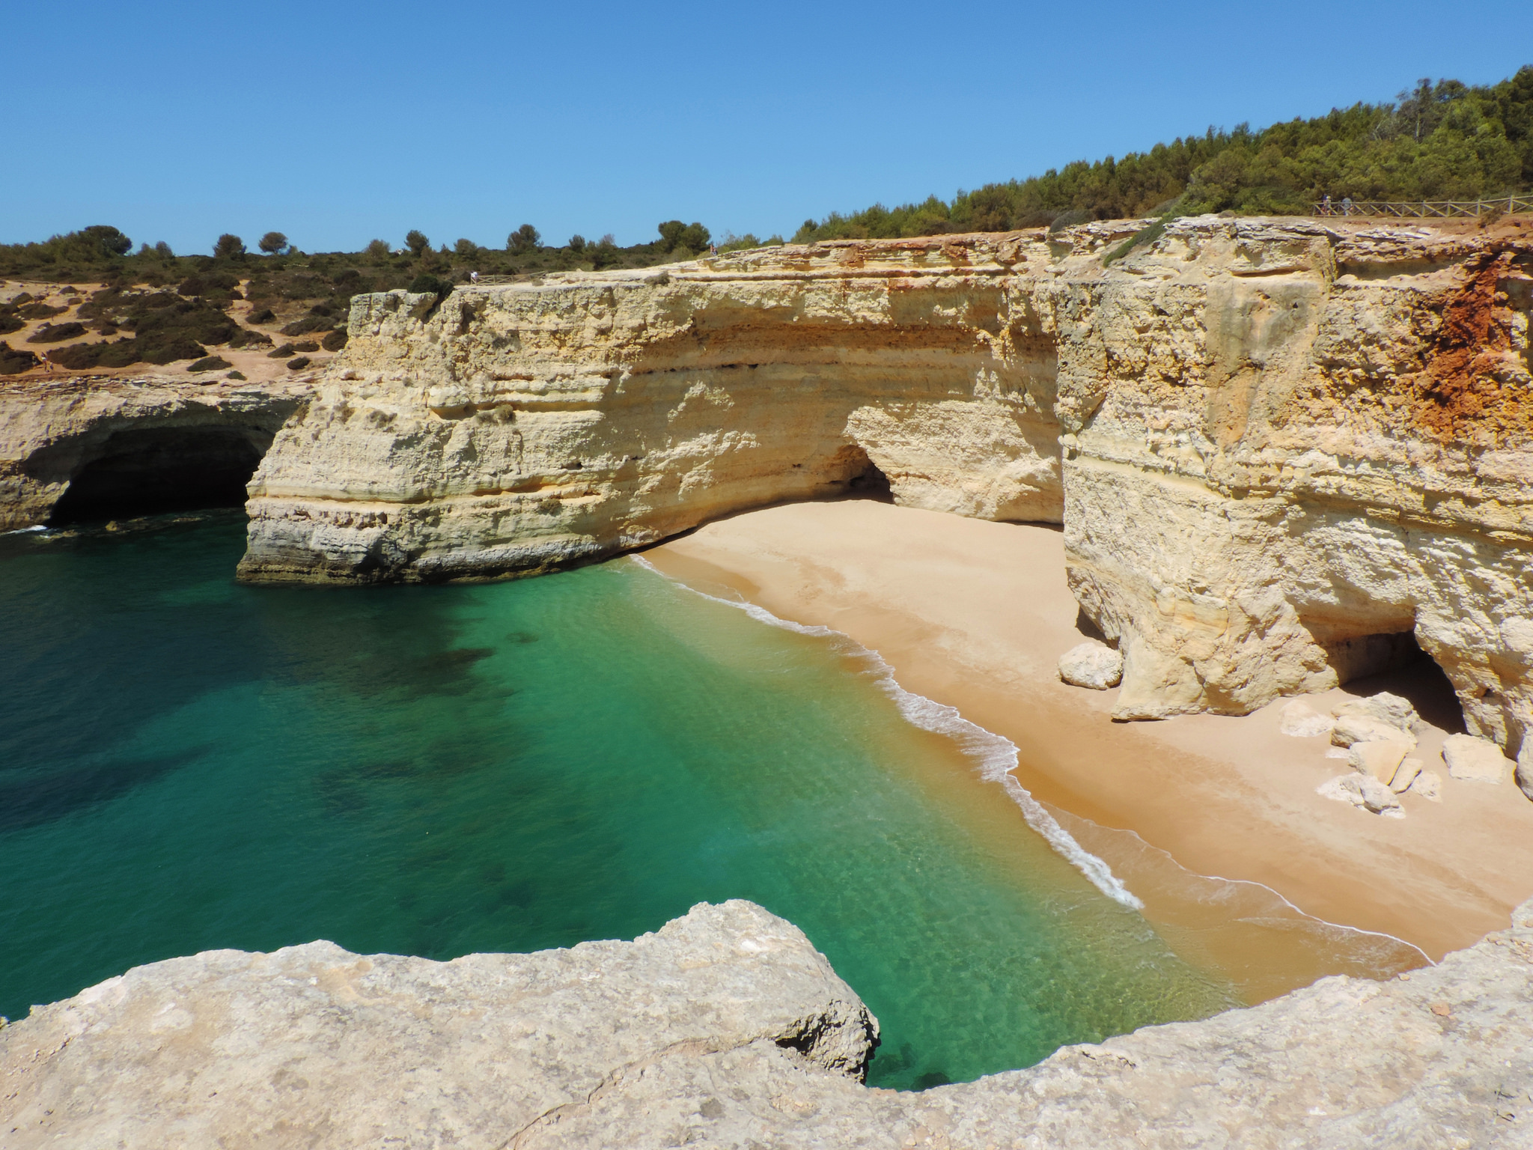
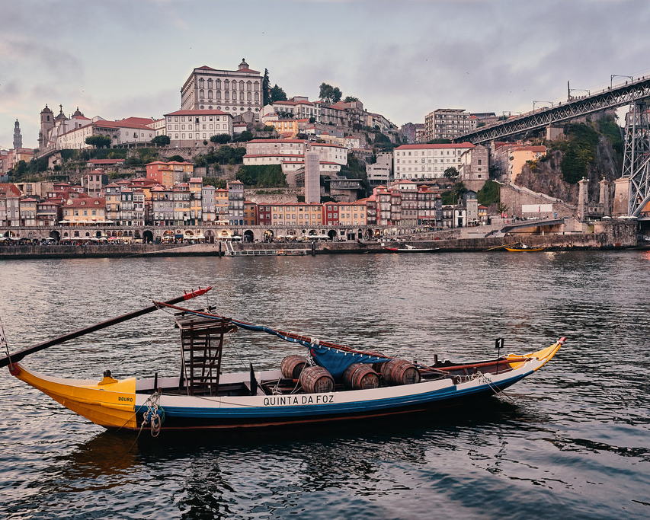
PORTUGAL
Portugal is a country of mountains, plains, beaches, beautiful cities, friendly people and lots of history!

Slide 4
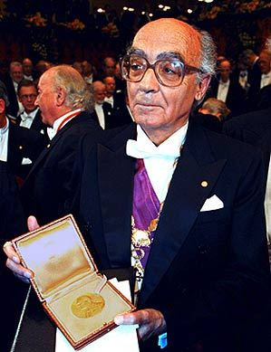
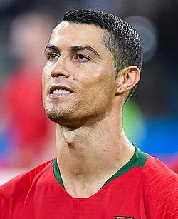
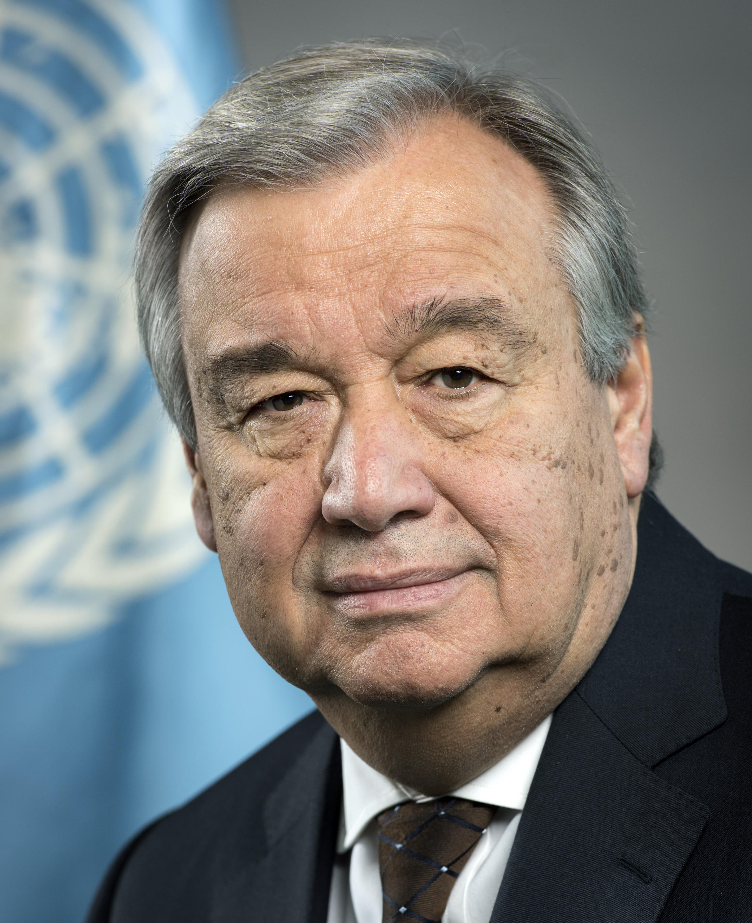
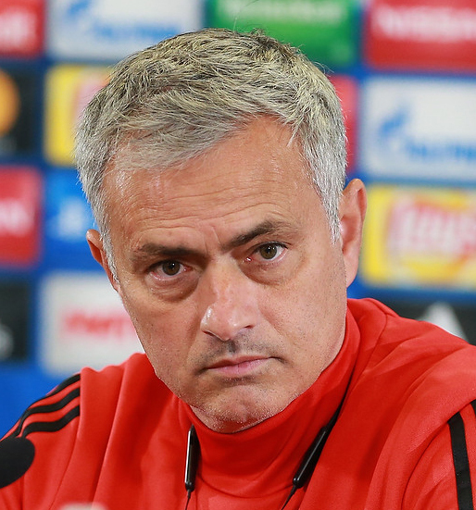
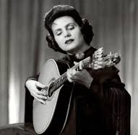
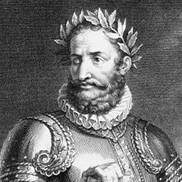
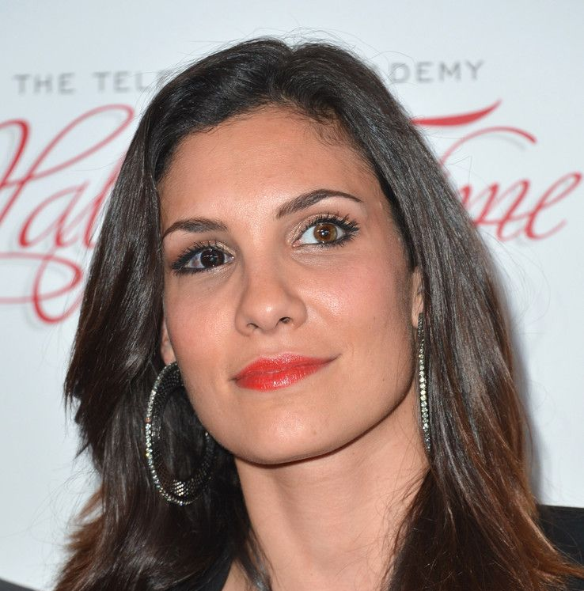
PORTUGAL
Some famous Portuguese people may know:
José Saramago
Nobel Prize in Literature
1998
Cristiano Ronaldo
Famous footballer
Sara Sampaio
Famous topmodel
António Guterres
Secretary-General of the United Nations
José Mourinho
Football coach
Amália Rodrigues
Singer
Luís de Camões
National poet
Daniela Ruah
Actress

Slide 5
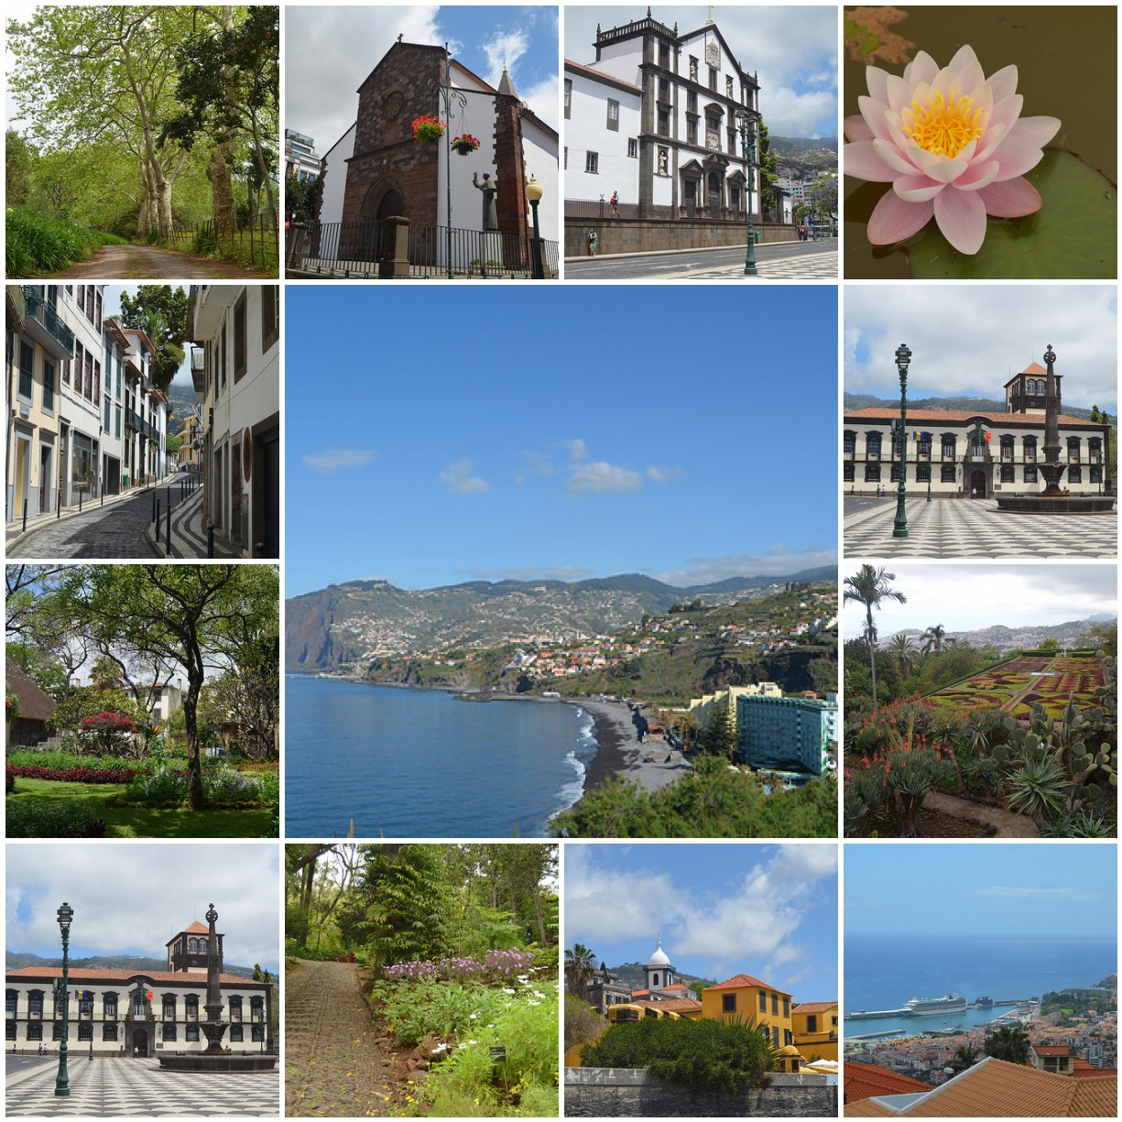
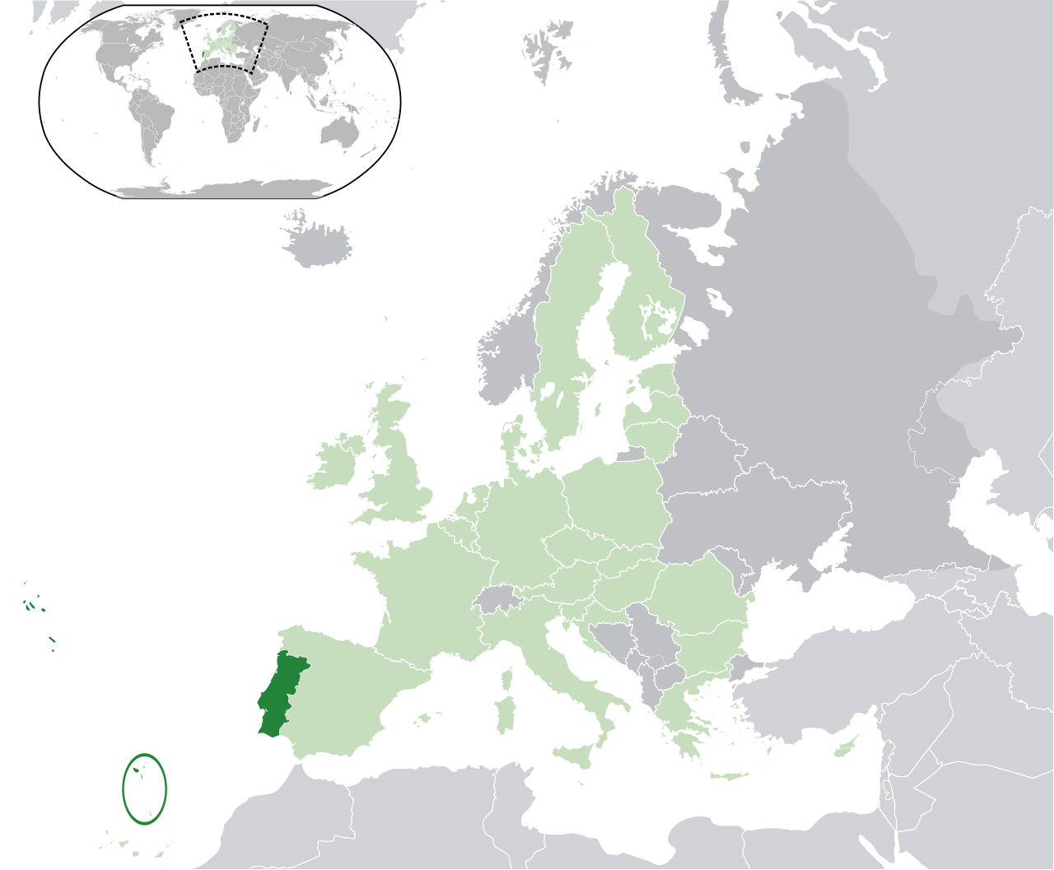
PORTUGAL
MADEIRA
The Pearl of the Atlantic
Autonomous Region of Madeira
Population: around 267.000
Capital: Funchal

Slide 6
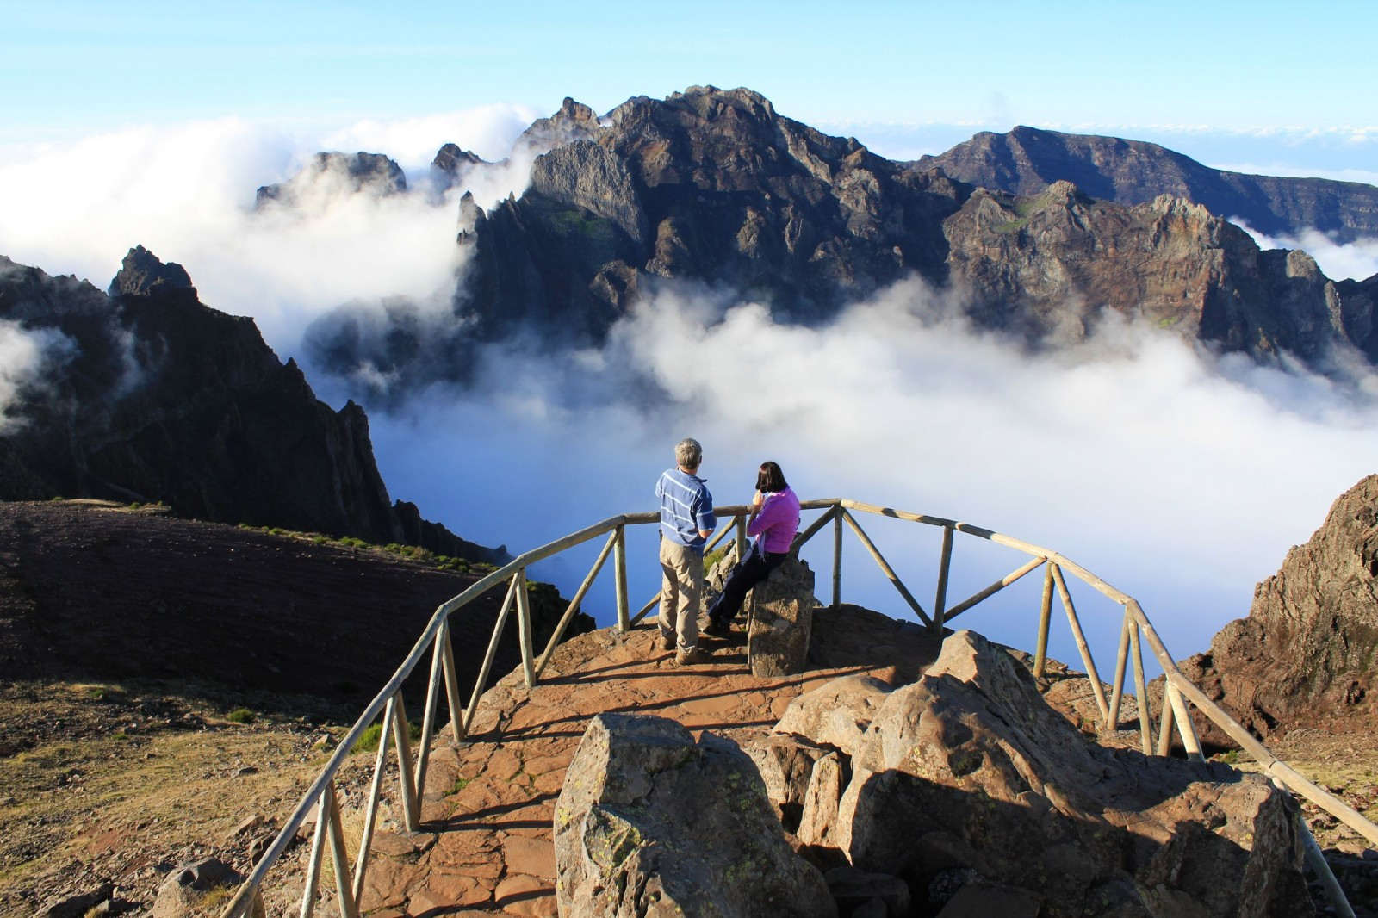
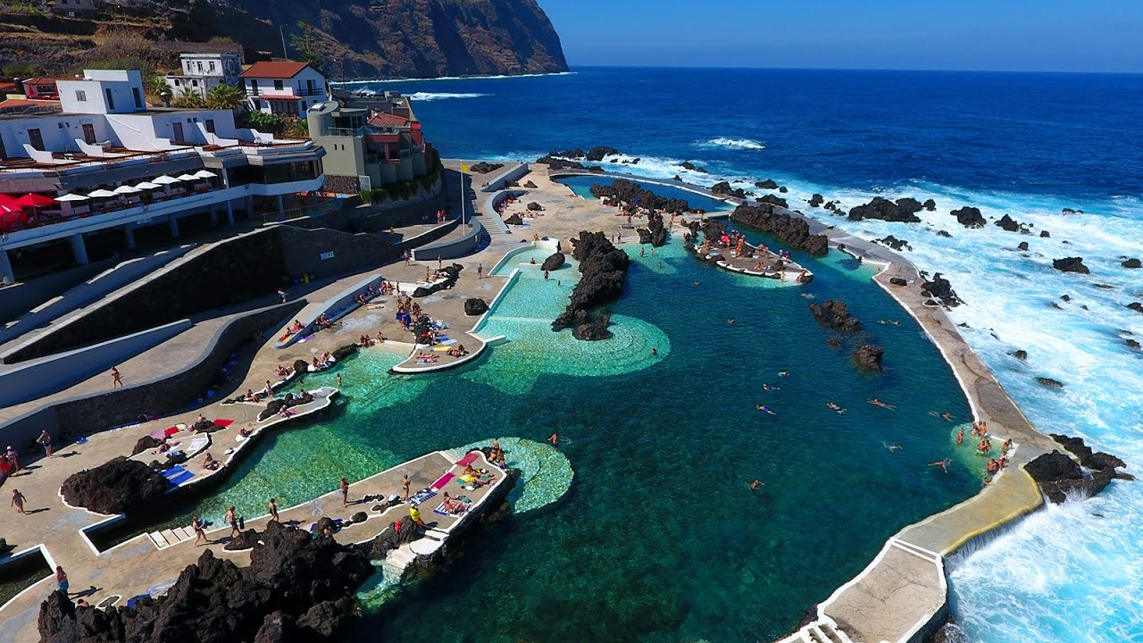
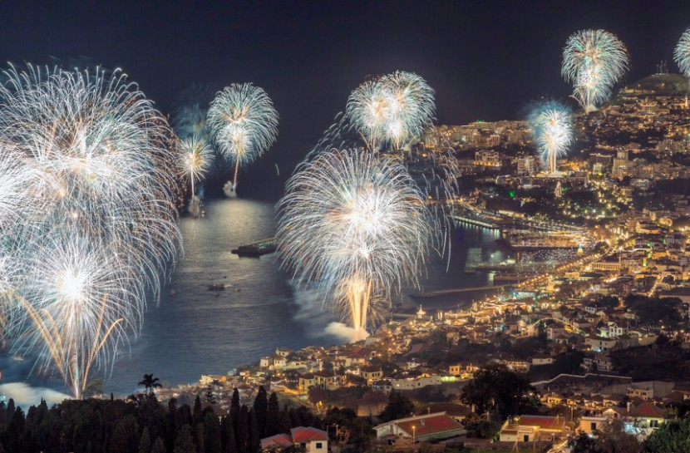
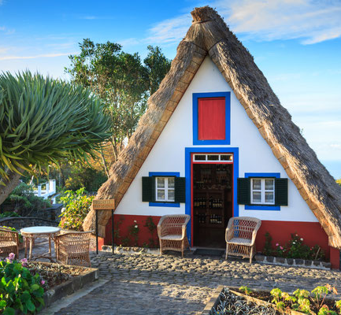
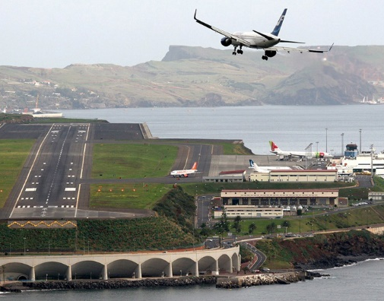
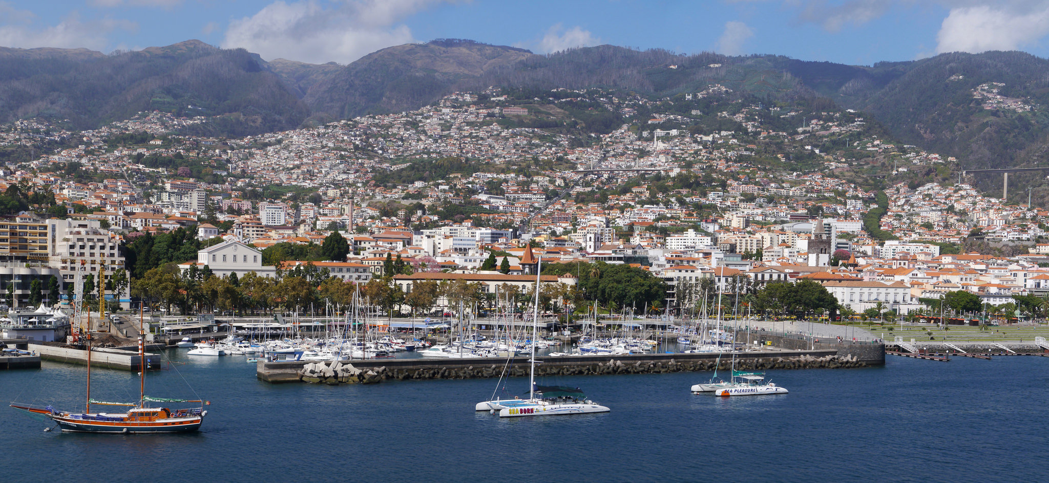
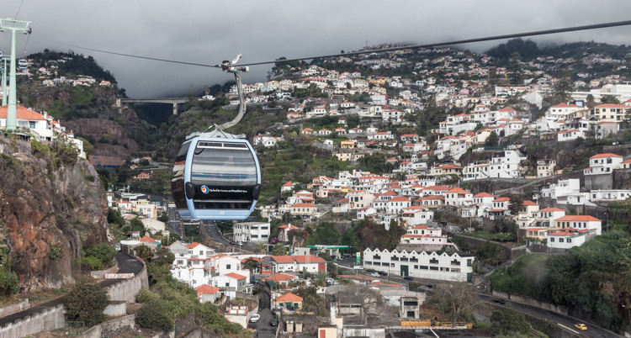
PORTUGAL
MADEIRA
Madeira is an island of high mountains, deep valleys and beautiful cities.

Slide 7
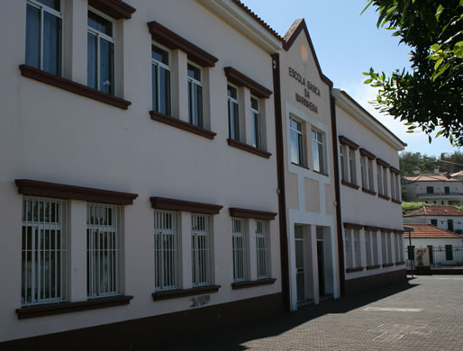
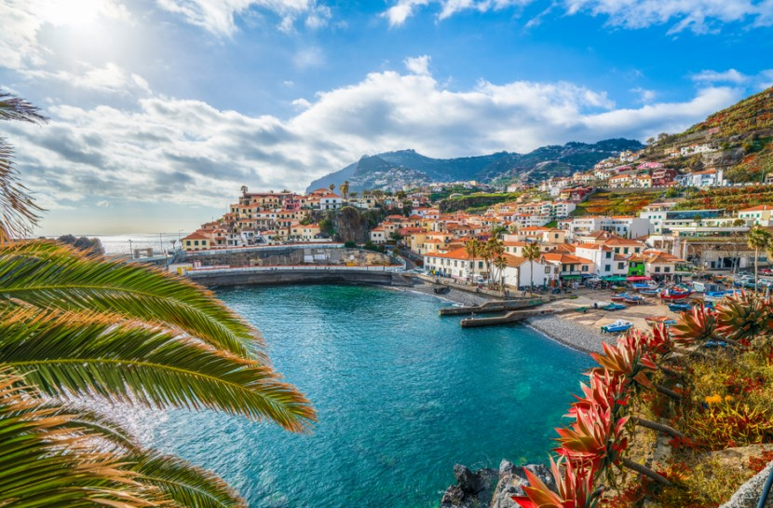
PORTUGAL
MADEIRA
MARINHEIRA SCHOOL
The school of Marinheira (EB1/PE da Marinheira) is located in the municipality of Câmara de Lobos, about 15 kms from the city of Funchal, the island capital.

Slide 8
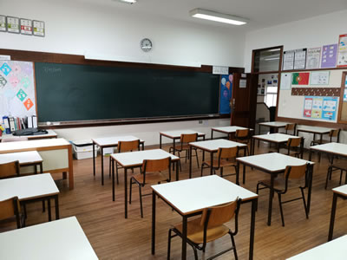
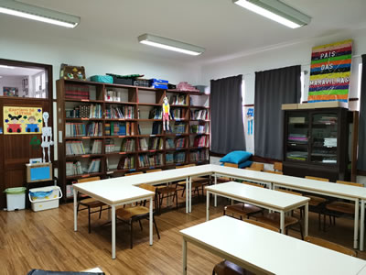
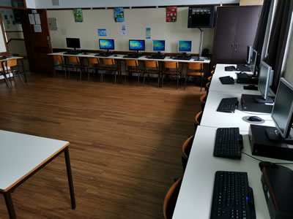
PORTUGAL
MADEIRA
MARINHEIRA SCHOOL
We are a small Primary School with Preschool.
2019/2020
6 classes
1 Preschool: 22 children (3-5/6 years old)
4 Primary: 61 students (6-9/10 years old)
1 Adult teaching: 11 adults
19 teachers
10 employees

Slide 9
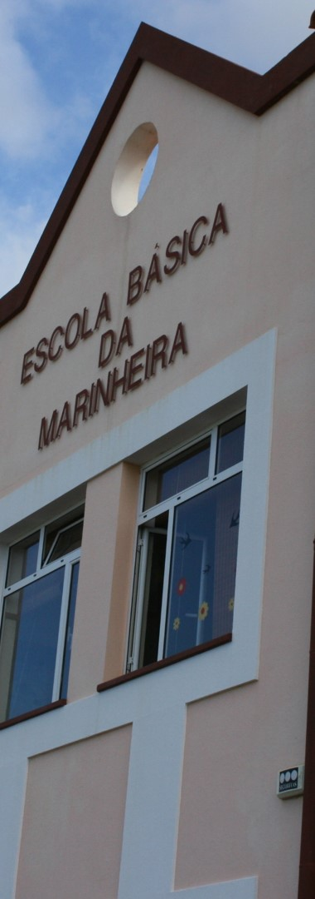
PORTUGAL
MADEIRA
MARINHEIRA SCHOOL
We are a full time school (08h30-18h30)
GENERAL CURRICULUM (mandatory)
PORTUGUESE
SOCIAL STUDIES
PHYSICAL EDUCATION
MATHEMATICS
ENGLISH
MUSIC & DRAMA
EXTRACURRICULAR ACTIVITIES (optional)
ICT
ENGLISH
PHYSICAL EDUCATION
STUDY SUPPORT
MUSIC
THEMATIC CLUBS
LIBRARY
VISUAL ARTS

Slide 10
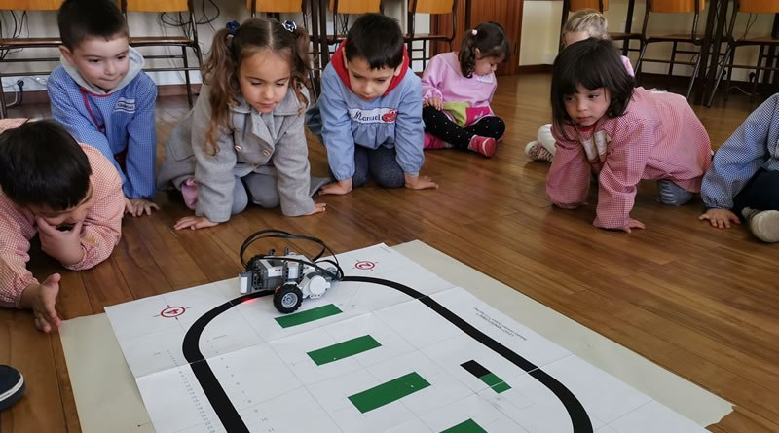
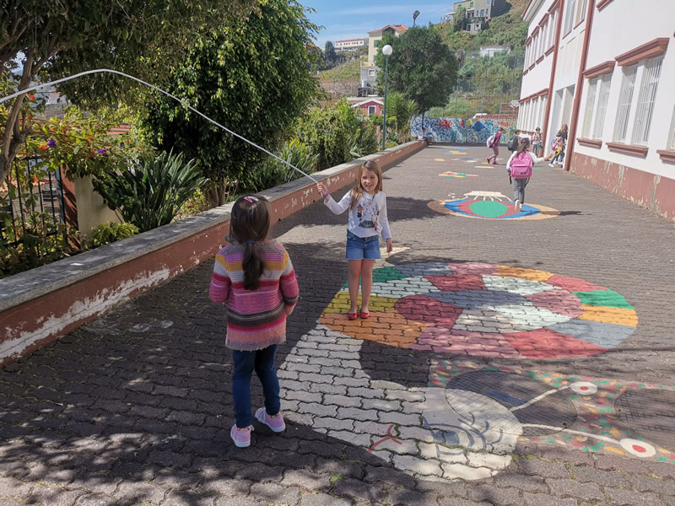
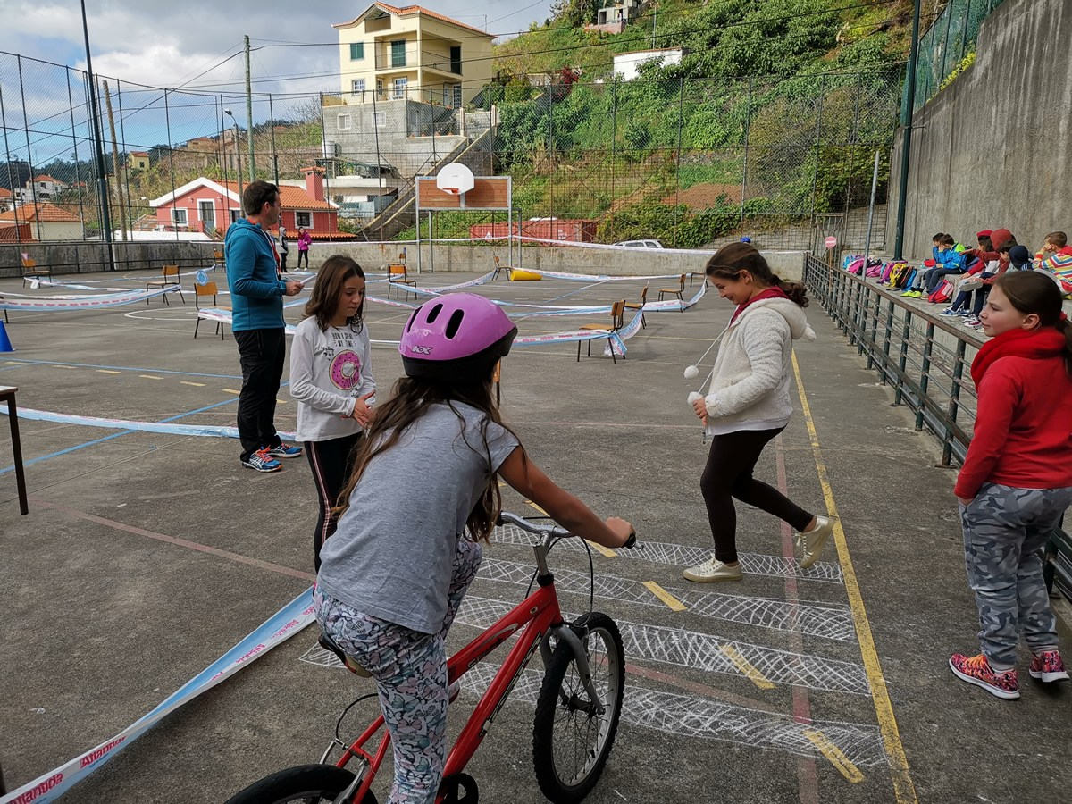
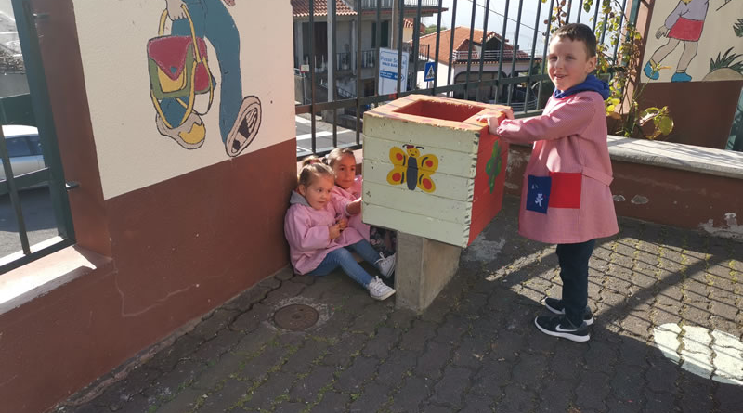
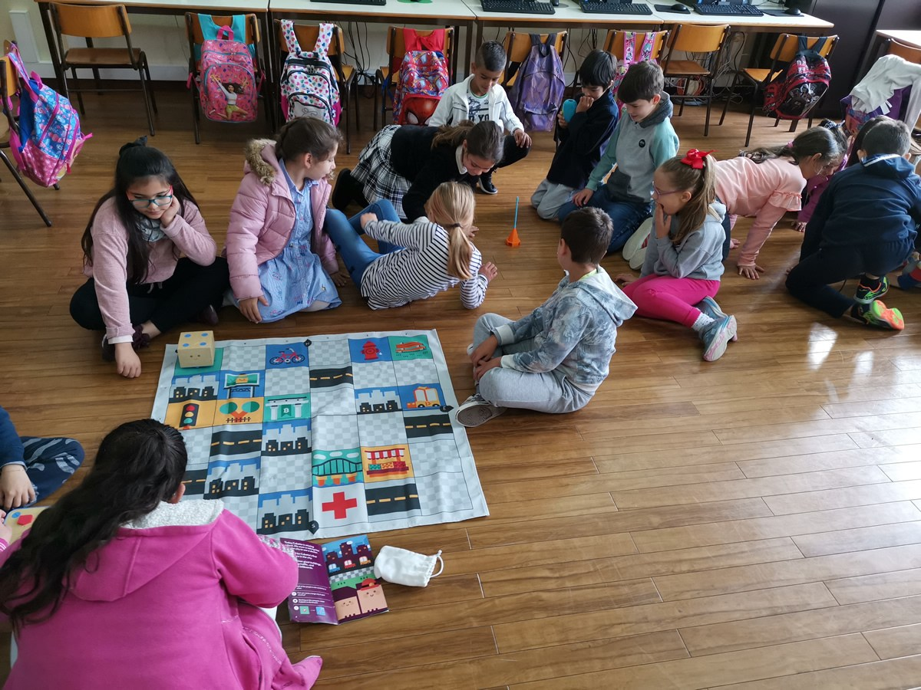
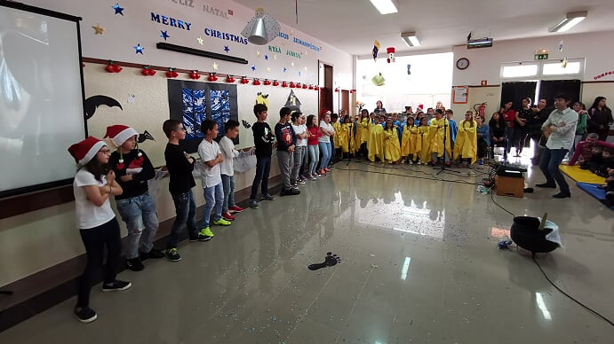
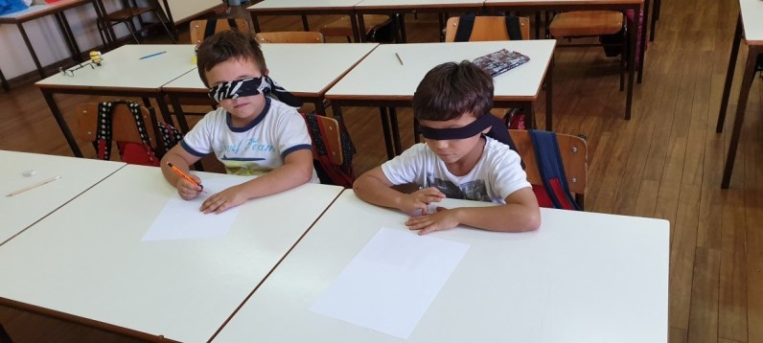
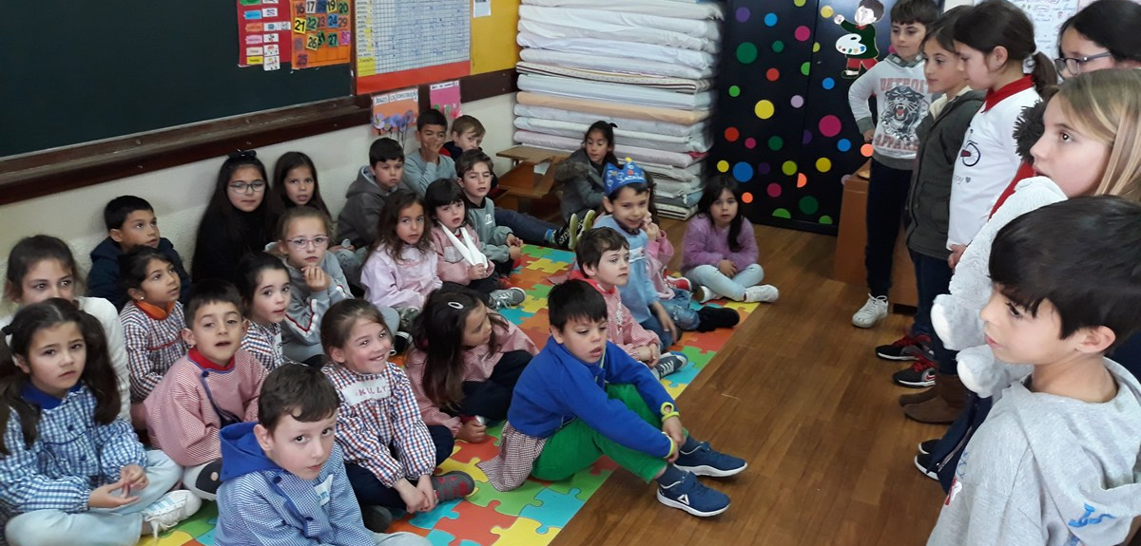
PORTUGAL
MADEIRA
MARINHEIRA SCHOOL

Slide 11
PORTUGAL
MADEIRA
MARINHEIRA SCHOOL
OFFICIAL WEBSITE
http://escolas.madeira-edu.pt/eb1pemarinheira
FACEBOOK
@escolamarinheira
SCHOOL BLOG
blog.marinheira.info
YOUTUBE
@EB1Marinheira
ECO SCHOOL
eco.marinheira.info
INSTAGRAM
@escolamarinheira
LIBRARY
biblioteca.marinheira.info
THANK YOU
OBRIGADO

