Slide 1
Choose 2 photographs from your own gallery
and explain it to the other ones in your group.

Slide 2
Order the photographs in front of you chronologically.
Can you guess which one is the oldest?

Slide 3
Visit the online museum “Science and Media Museum History of Photography”
and find the correct order.

Slide 4
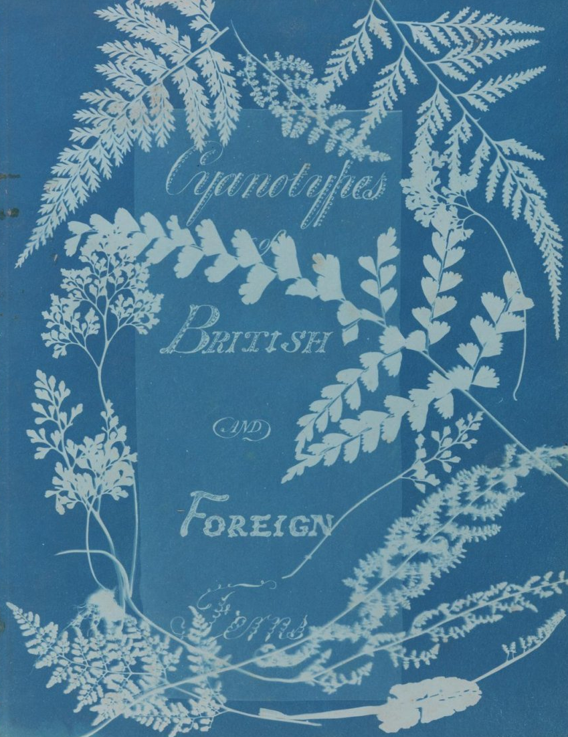
Cyanotype, from Cyanotypes of British and Foreign Ferns, Anna Atkins, 1851
Anna Atkins (1799 – 1871) was an English botanist and photographer. She is often considered the first person to publish a book illustrated with photographic images. Some sources say that she was the first woman to create a photograph.

Slide 5
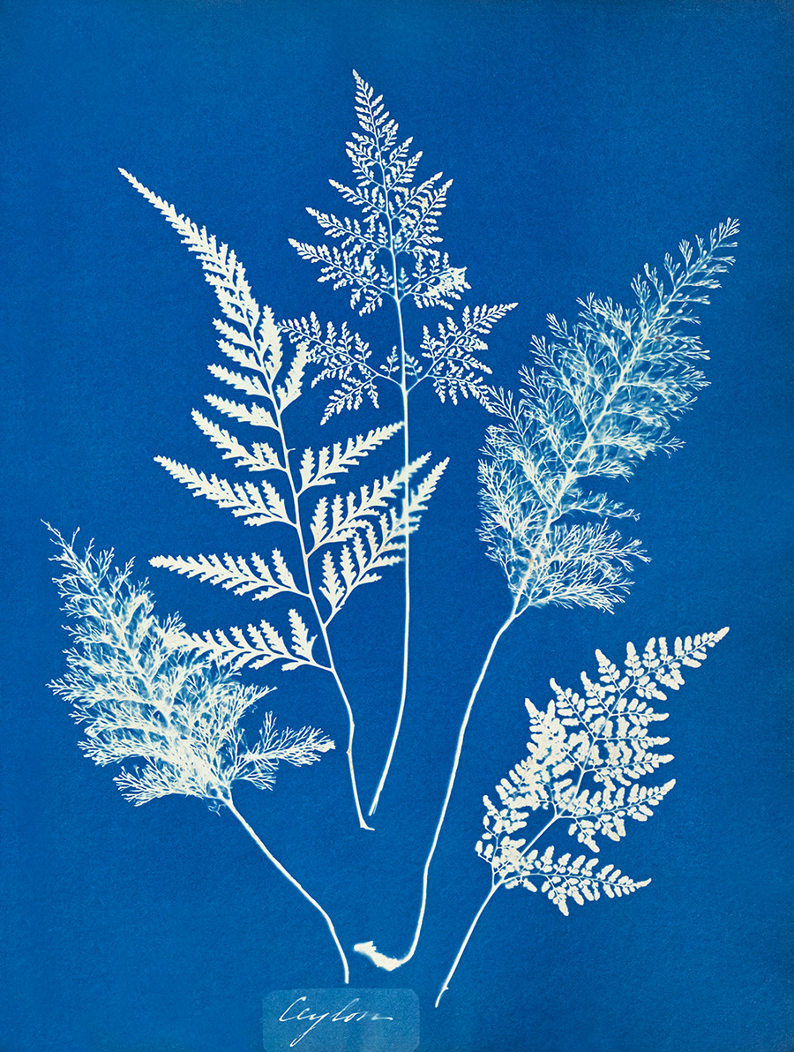
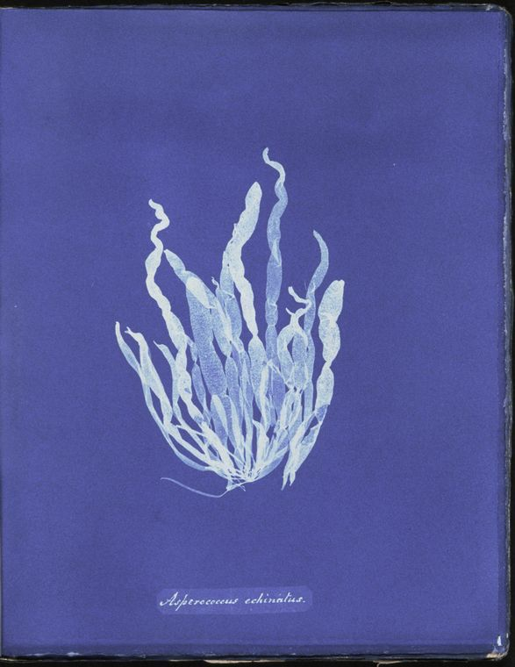
the "photogenic drawing" technique
an object is placed on light-sensitized paper(AgCl) and exposed to the sun to produce an image

Slide 6
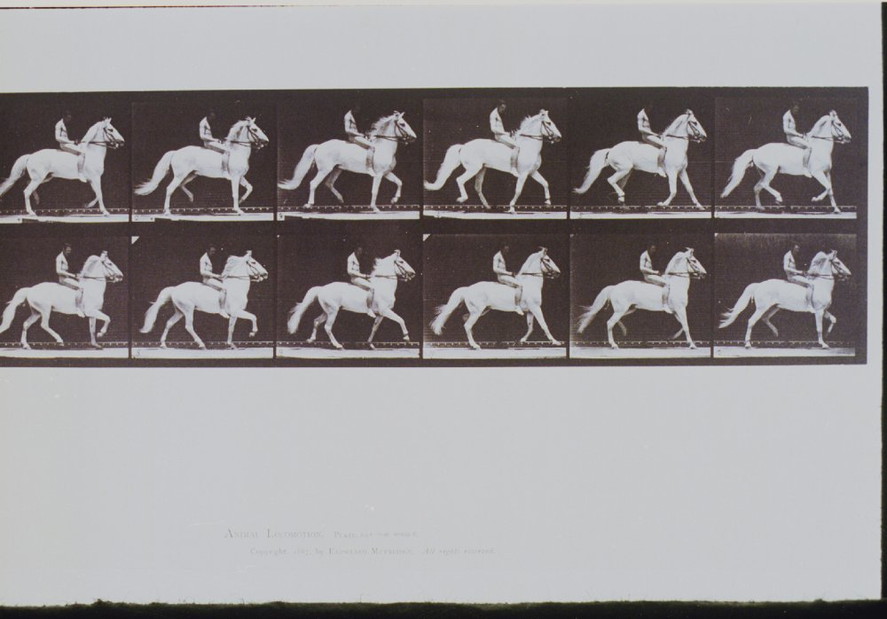
The Horse in Motion, Eadweard Muybridge, 1878.
Eadweard Muybridge (1830 – 1904) was an English photographer important for his work in photographic studies of motion, and in motion-picture projection.

Slide 7
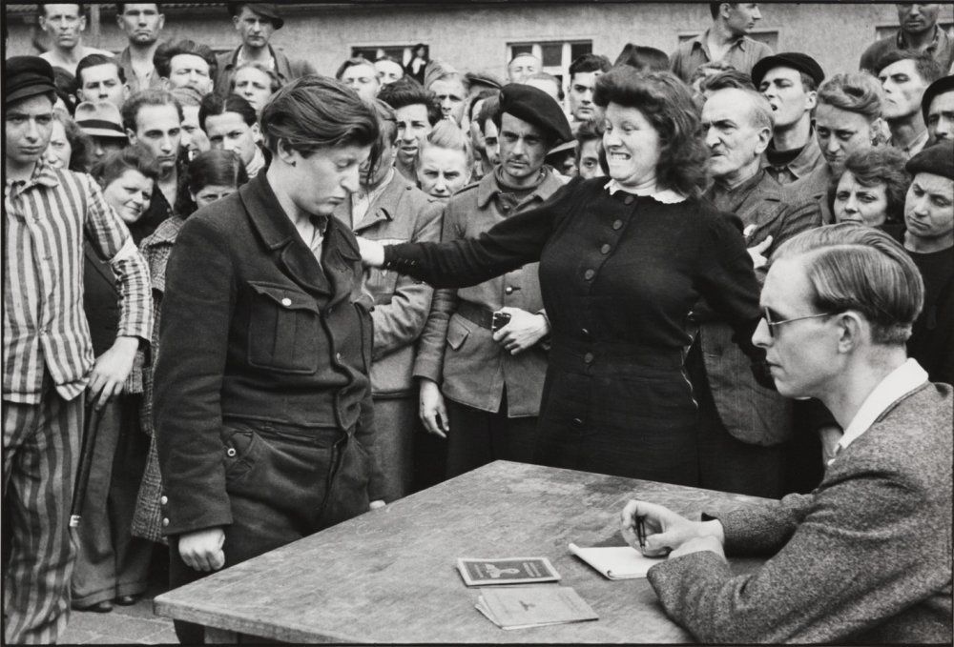
Dessau, Germany, Henri Cartier-Bresson, 1945
Henri Cartier-Bresson (1908–2004) is a French photographer and a well-known figure in the street style photography. He was also a co-founder of the Magnum Photos agency. Cartier-Bresson took this photograph in 1945 at a transit camp in Dessau, Germany.

Slide 8
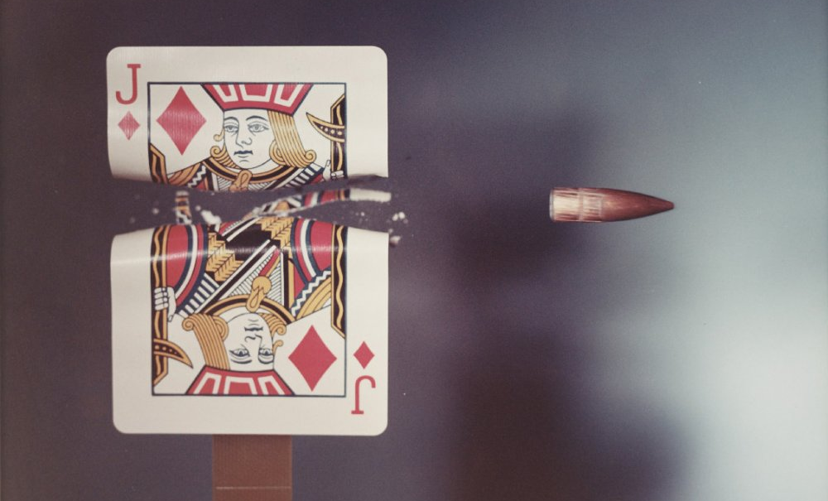
Jack of Diamonds playing card hit by a .30 calibre bullet, Harold Edgerton, 1970
“The man who froze time”
Dr Harold Edgerton (1903–1990) is famous for his split-second photographs, which reveal actions that are too fast for the human eye to see.

Slide 9
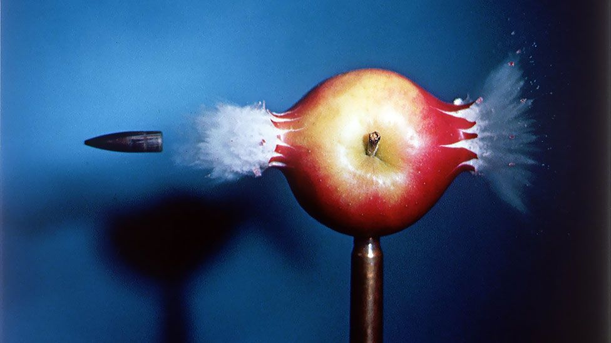

Slide 10
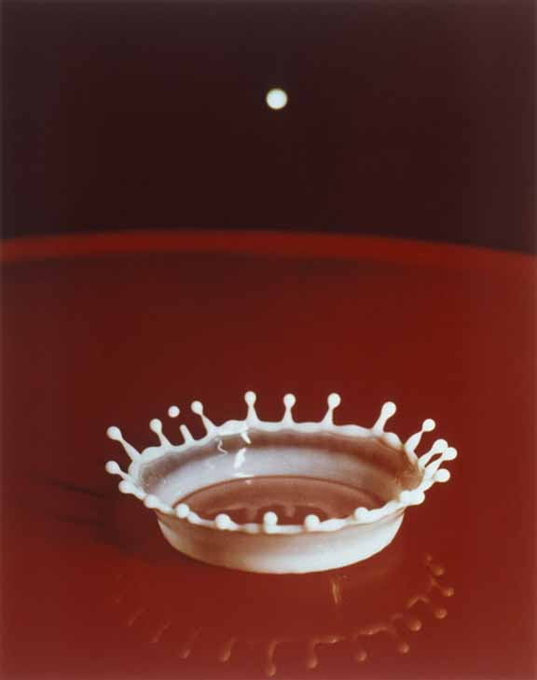
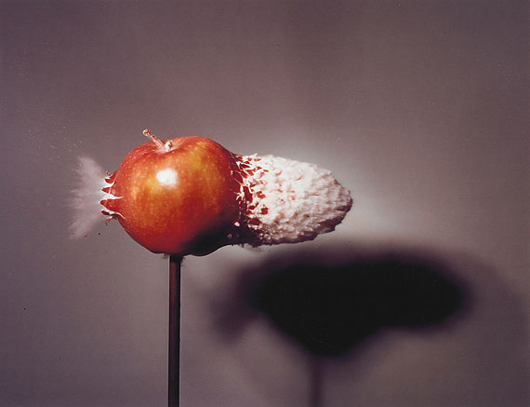

Slide 11
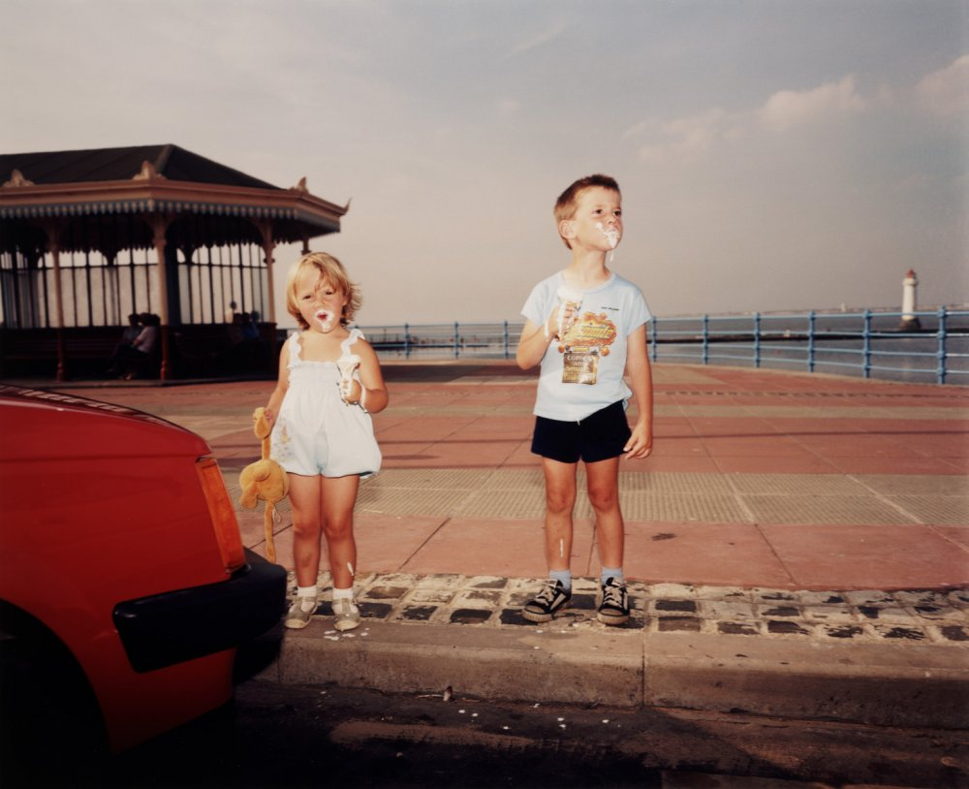
From ‘The Last Resort’, Martin Parr, 1985
“The fundamental thing I'm exploring constantly is the difference between the mythology of the place and the reality of it ... Remember I make serious photographs disguised as entertainment. That's part of my mantra.” -Martin Parr

Slide 12
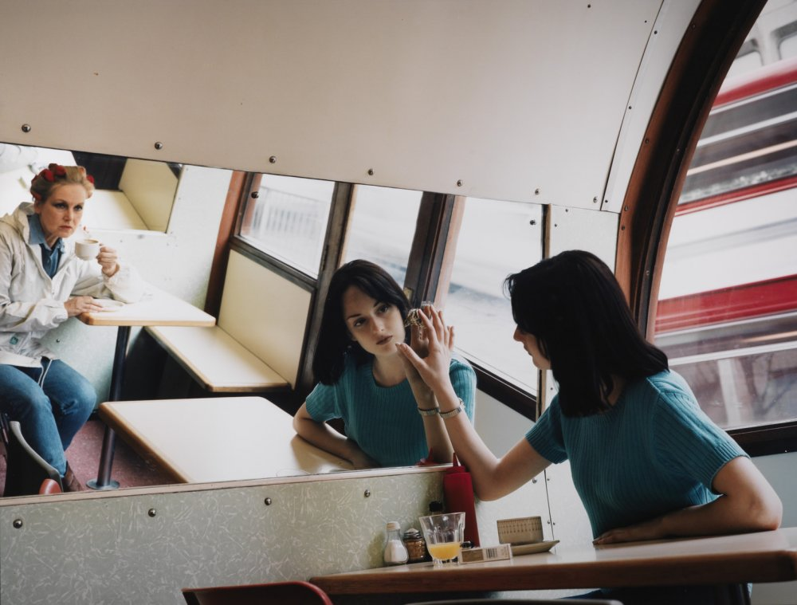
Untitled, Hannah Starkey, 1997
Hannah Starkey (1971-) is a British photographer who specializes in staged settings of women in city environments.

Slide 13
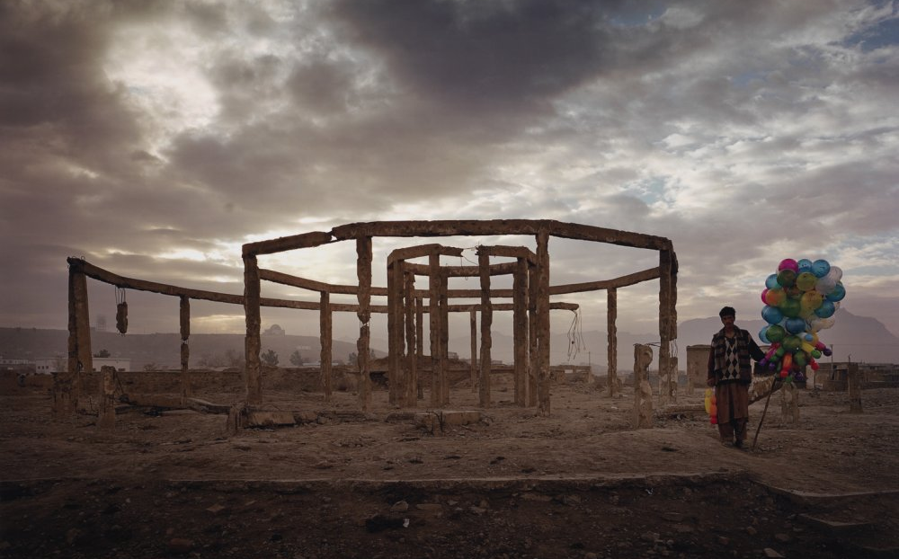
Simon Norfolk is known for his large-scale colour photographs of the aftermath of wars. Ruined landscapes, buildings and local communities are his typical themes.
From ‘Afghanistan: Chronotopia’, Simon Norfolk, 2001

Slide 14
READY TO GET TECHNICAL?

Slide 15
EXPOSURE
Exposure is the amount of light per unit area reaching a frame of photographic film or the surface of an electronic image sensor.

Slide 16
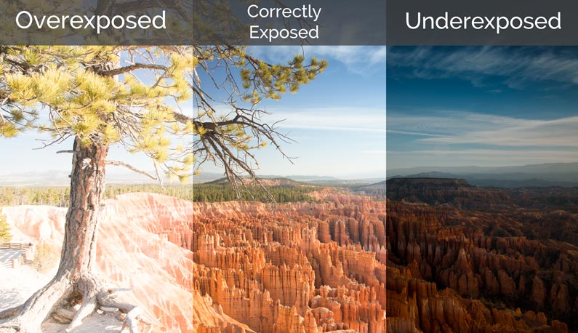

Slide 17
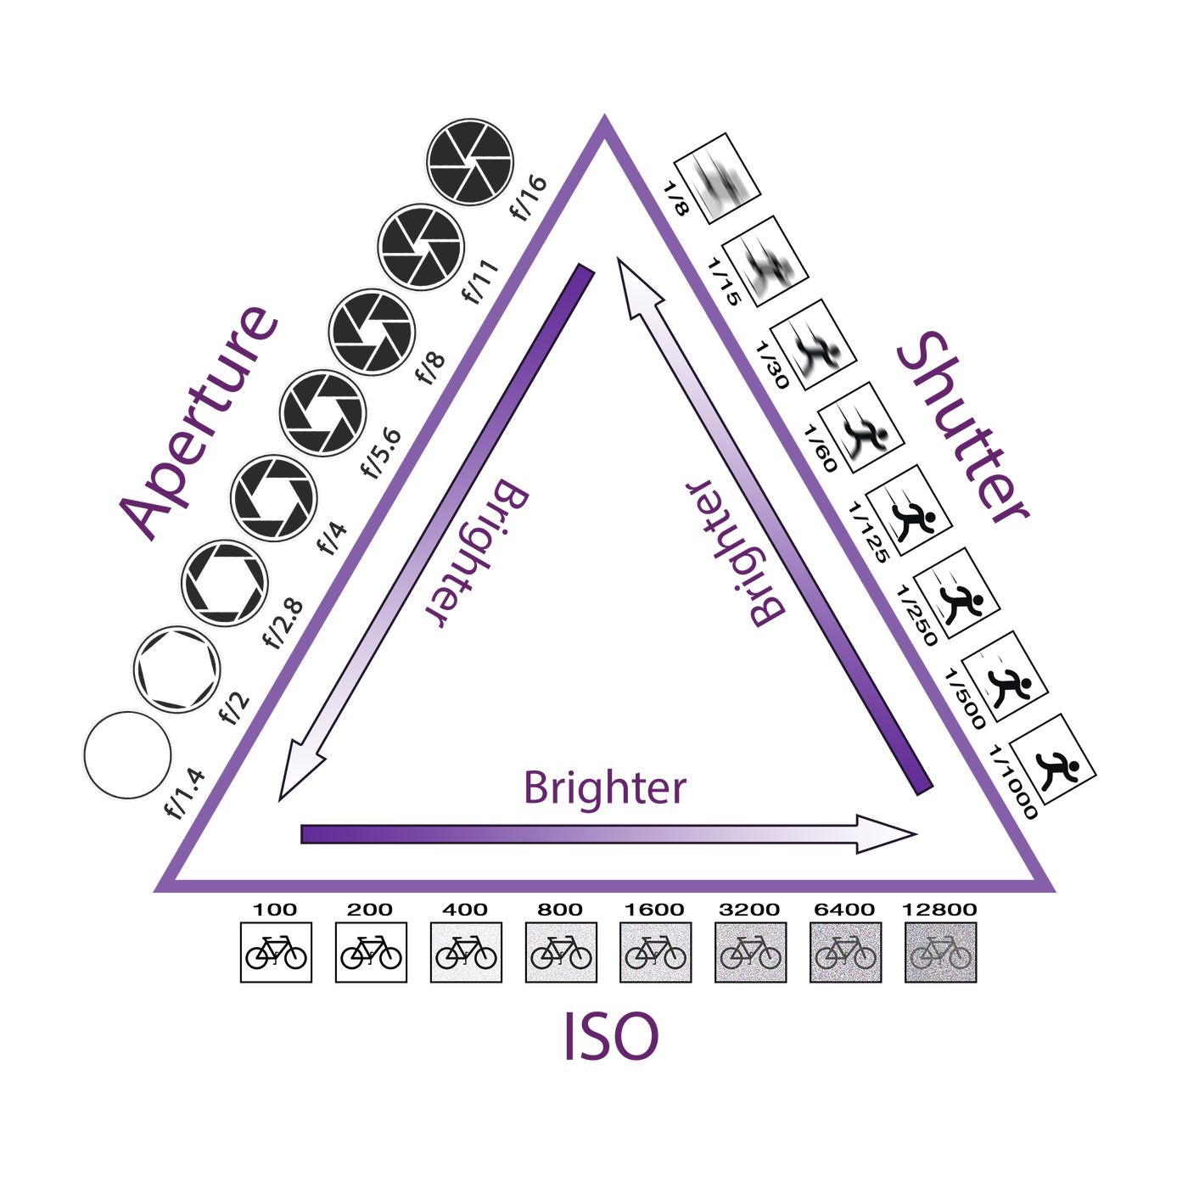

Slide 18
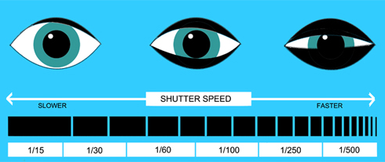
SHUTTER SPEED

Slide 19
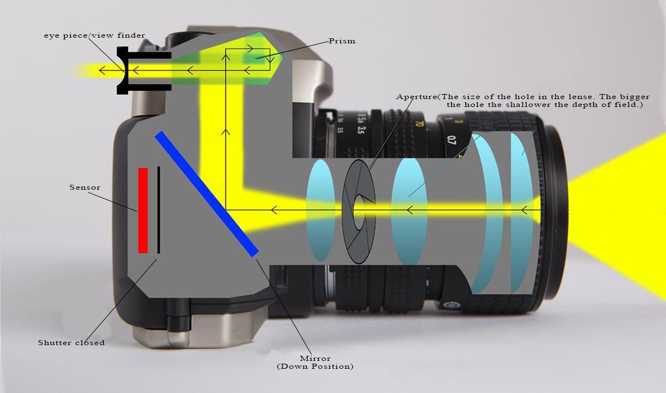

Slide 20
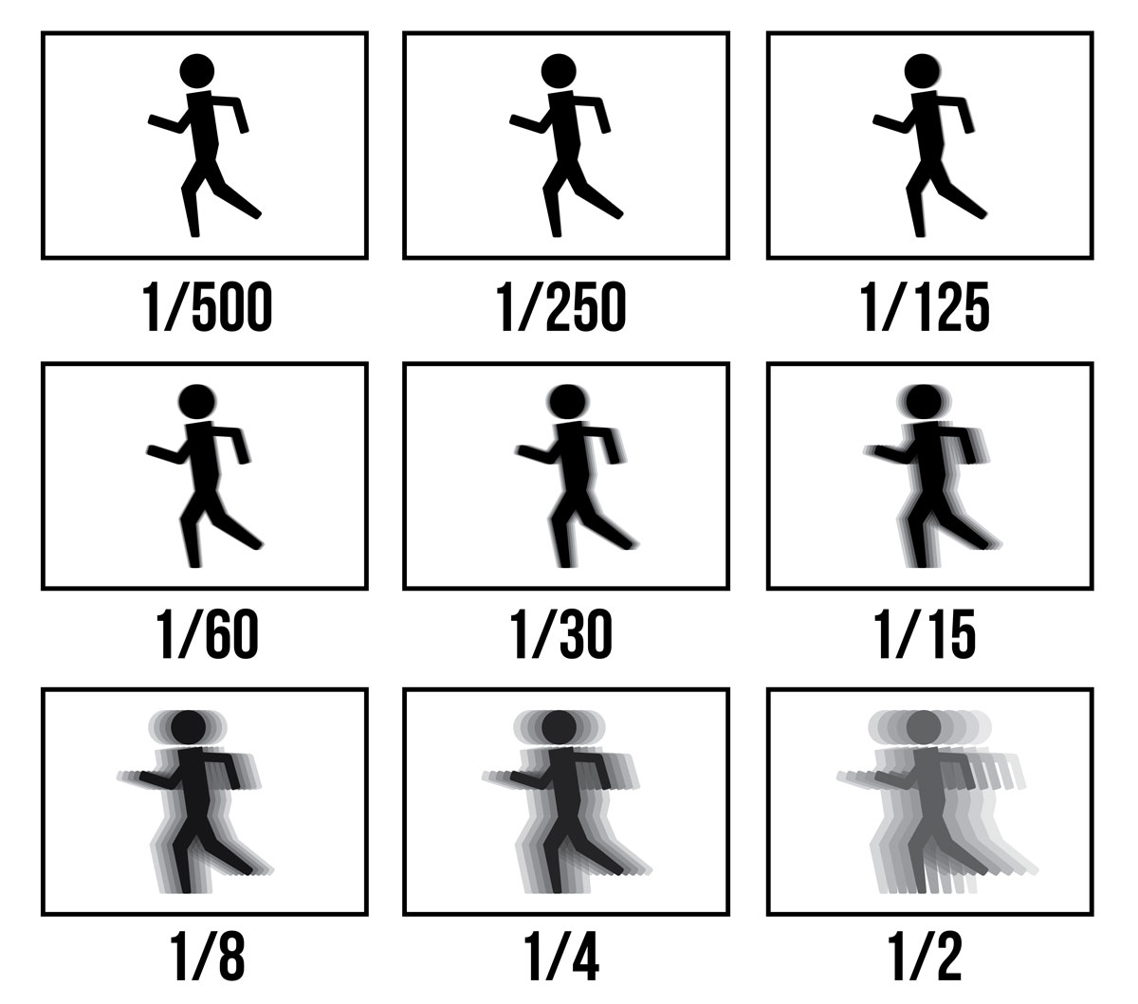
Shutter speed:
affects the amount of light
controls how long the camera shutter remains open
30”, 1”, 1/2, 1/30

Slide 21
APERTURE

Slide 22
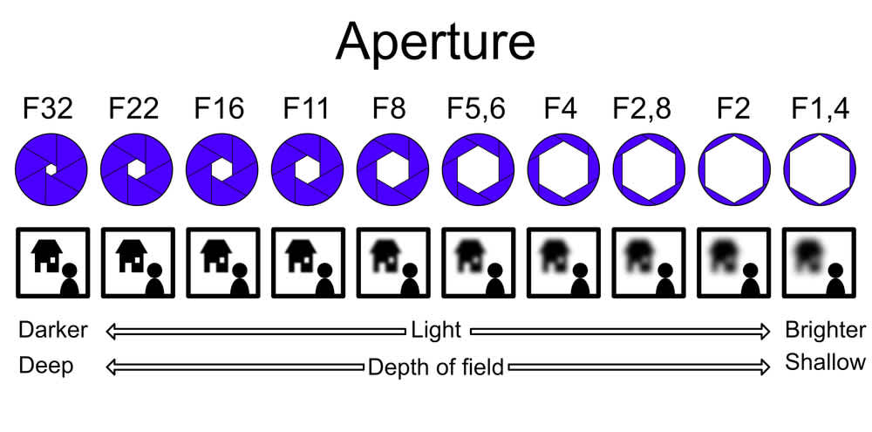

Slide 23
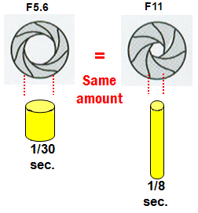

Slide 24
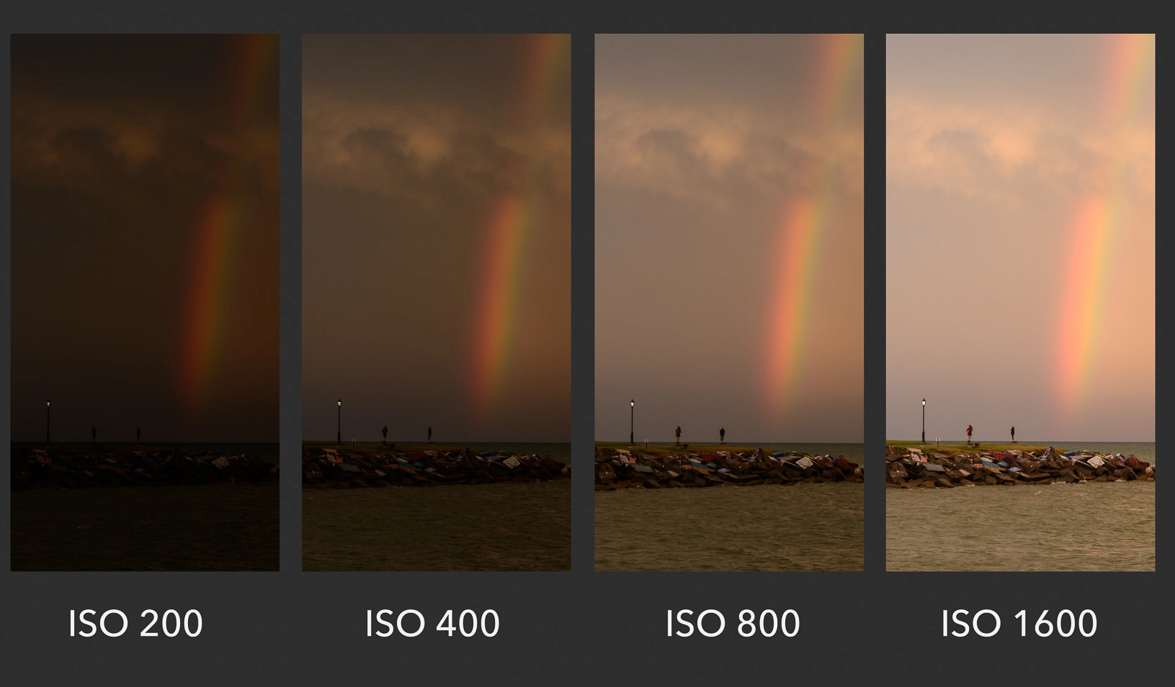
ISO
A higher ISO number increases the sensitivity; this means that less light is needed to produce a correct exposure.

Slide 25
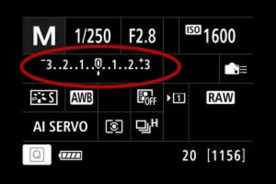

Slide 26
TRY “EXPOSURE TRIANGLE SIMULATOR”

Slide 27
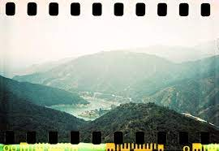
PHOTOGRAPH - DRAWING WITH LIGHT
The word photograph was coined in 1839 by Sir John Herschel and is based on the Greek words phos meaning light, and graphê, meaning drawing, writing.

Slide 28
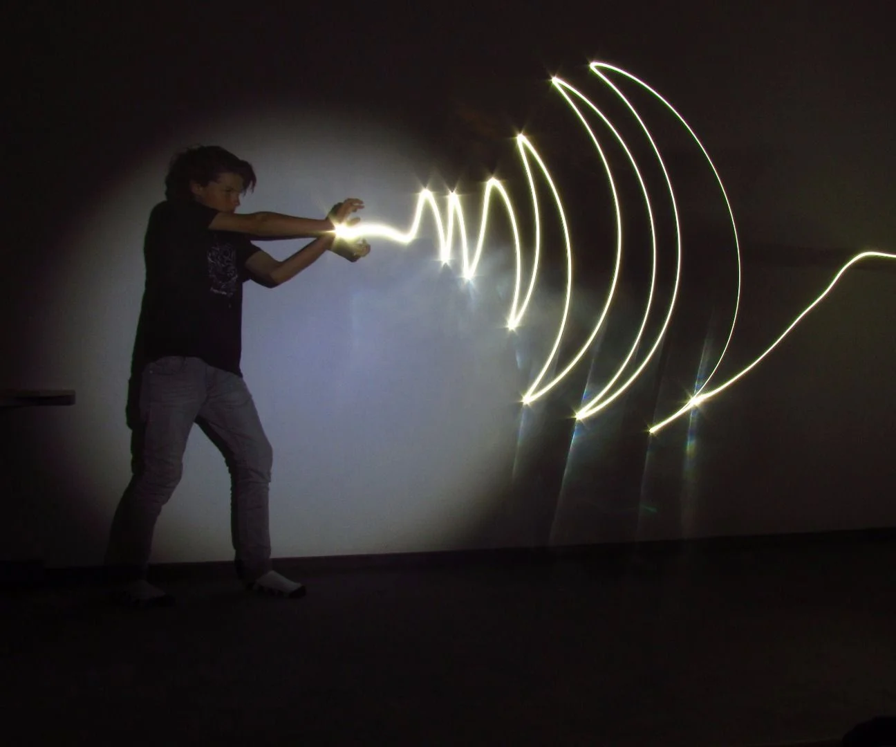
You can literally draw with light!

Slide 29
f/10 1/2 ISO100
f/22 5” ISO 100

Slide 30
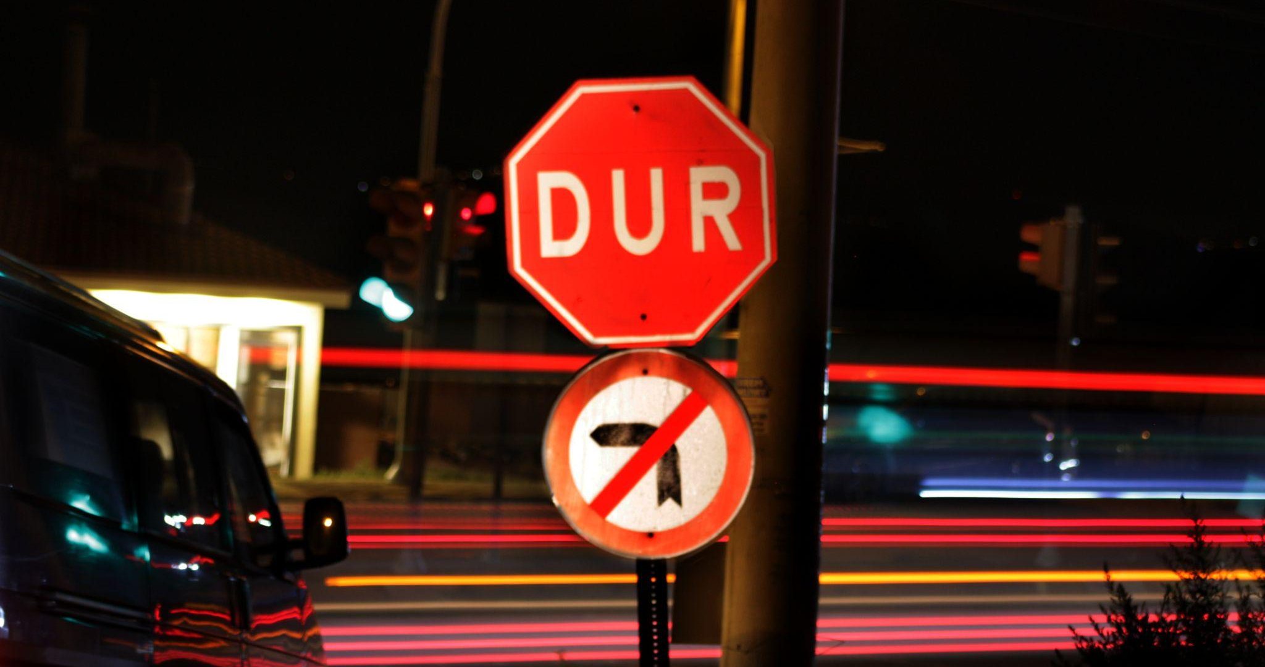
LONG EXPOSURE

Slide 31
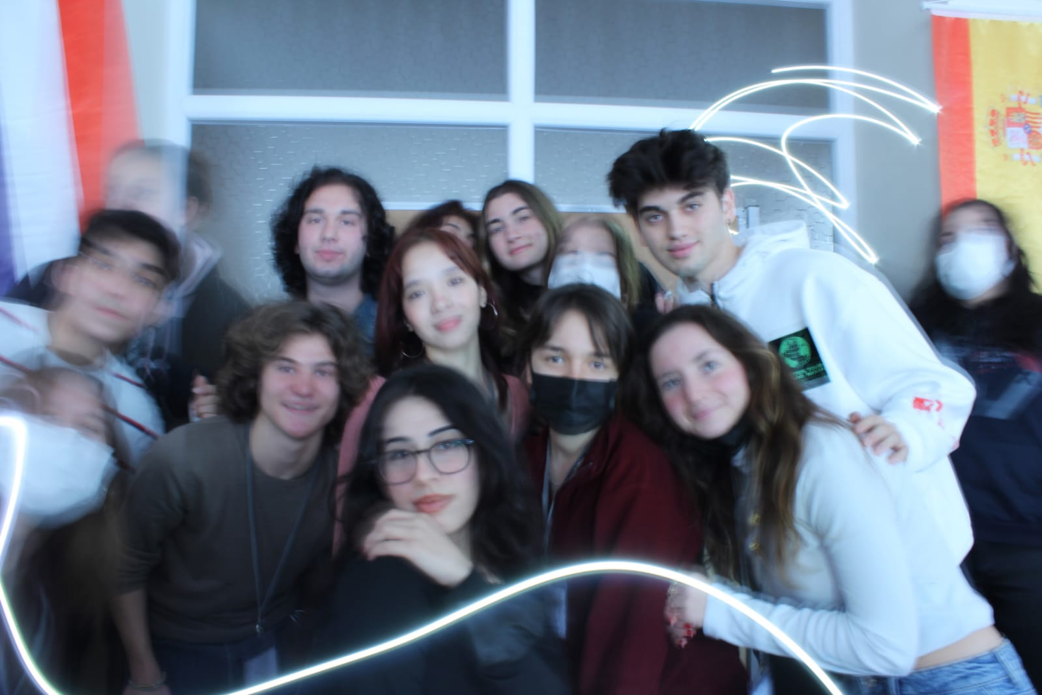

Slide 32
