Slide 1
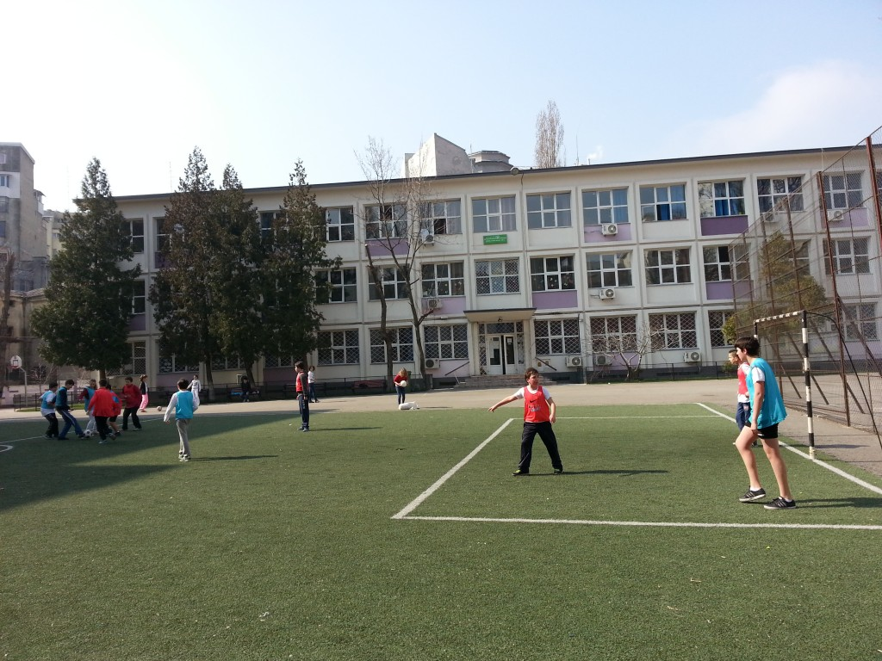
My School
School No5 Bucharest

Slide 2
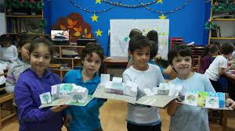
Who we are
Situated in the center of Bucharest, School no 5 was established in 1960. About 600 students are studying in our school. The school is also known as School Corneliu M. Popescu, as a tribute to the one who is still considered to be the greatest translator of Eminescu’s poems.
WE are:
a friendly school
a communicative school
a school for everyone
a participative school

Slide 3
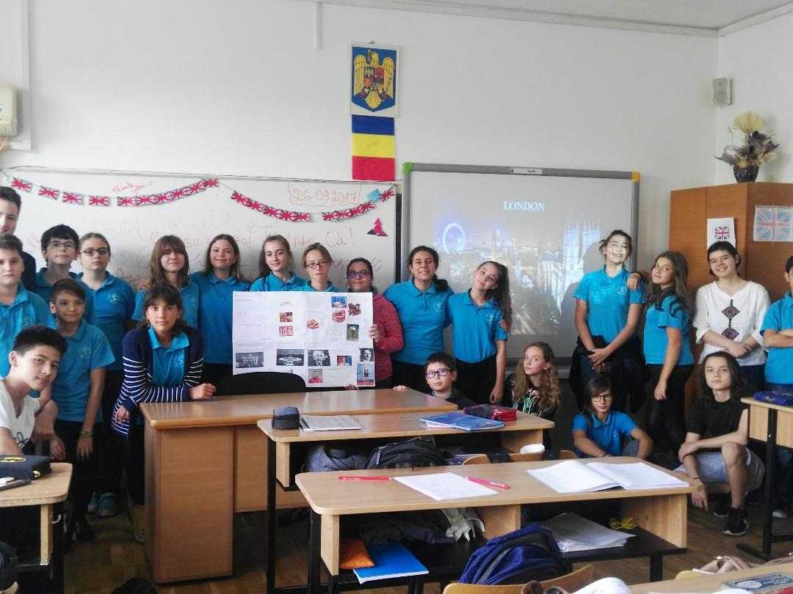
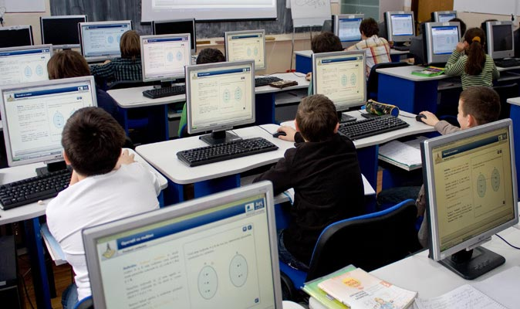
Facilities
WE are very proud of our school material base that offers us the opportunity to improve our knowledge in a modern way, where the traditional methods embrace technology.
All our school classrooms benefit from a host of hi tech teaching aids including smart boards, computers and projectors.

Slide 4
The educational offer
WE are involved in numerous school activities which attract many of our students. After classes the students can take extra curricular English lessons, they can participate in drama courses, robotics, basketball, chess club or art.
The students of the school are also actively involved in math and science competitions and constantly achieve high results.

Slide 5
Students’ creations
Together with our dedicated teachers, we participated in many creative activities and we have published a number of books with the guidance and coordination of our principle, Mrs Cornelia Ghita, our physical education teacher, Miss Irina Petcu, and our wonderful Romanian teacher, Mrs Doina Dobre.
All the books are written entirely by the students and they are then translated into English by the students.

Slide 6
Students’ creations
Our printed publications include:
Literature vs reality – writers and places of Romania
Dobrogea – an ancient Romanian land
Flowers, lakes, fairy tales – fantasy realms of Romania
The history of the Romanians on the Danube

Slide 7
Our school will be participating in eight separate Erasmus + projects between 2018-2020.

Slide 8
WE are involved in several European projects through the Erasmus + programmes, including:
The European Heritage Project
Rembrandts Movie Camera
Innovating by Doing Experiments about Leonardo
Power of Friendship: antibullying programme for schools
ACE (Acceptance, Citizenship and Equality)
Intercultural Dialogue between European Citizens

Slide 9
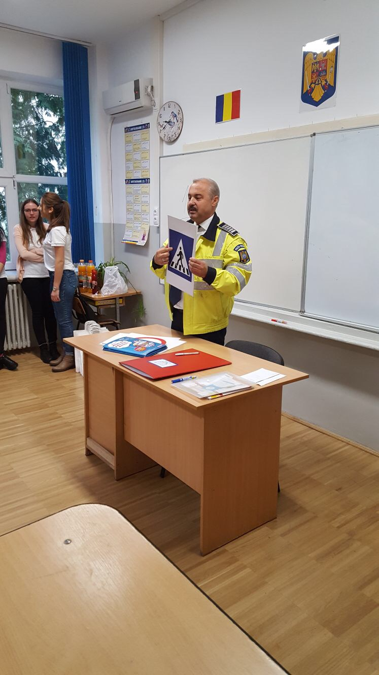
Activities
Our school’s students always have great ideas of spending time together and getting everyone from the school involved in a variety of activities.
Sometimes we learn the traffic rules with the
help of a police officer.

Slide 10
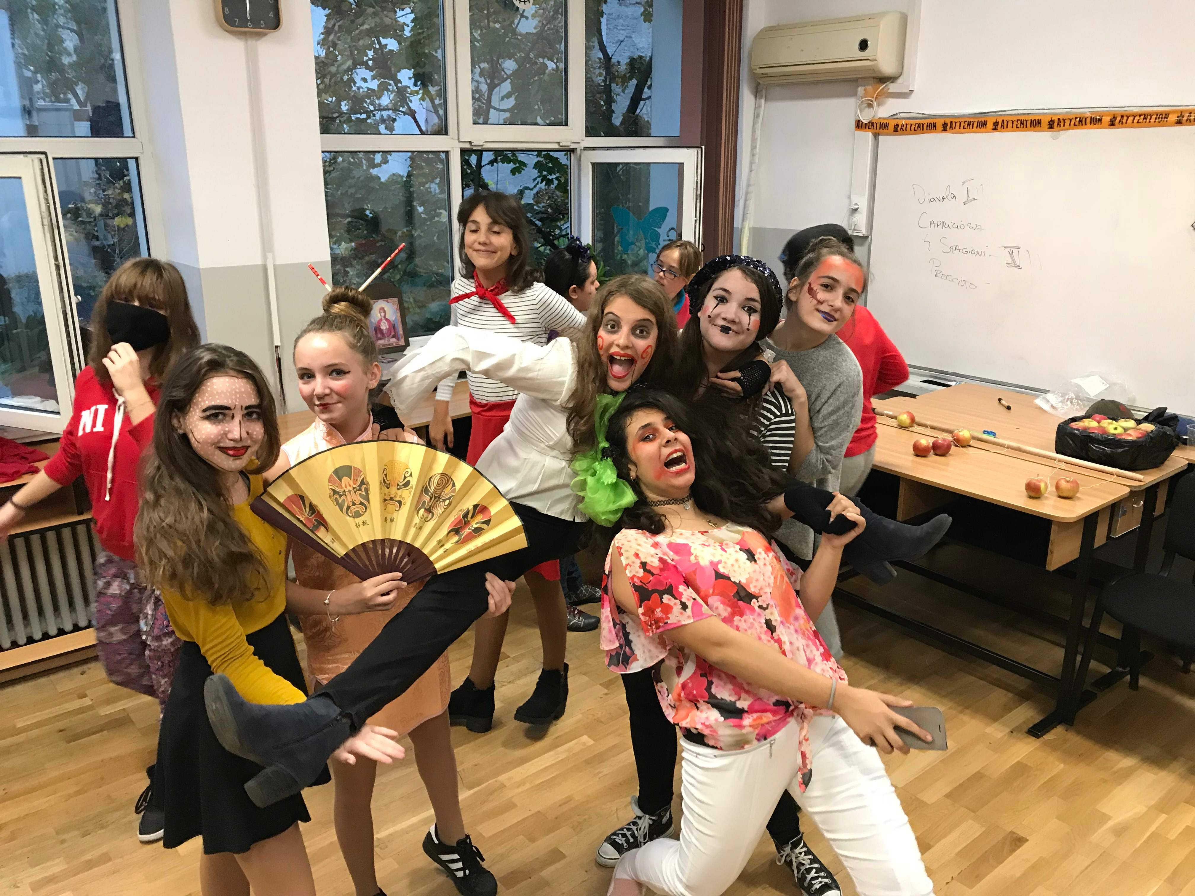
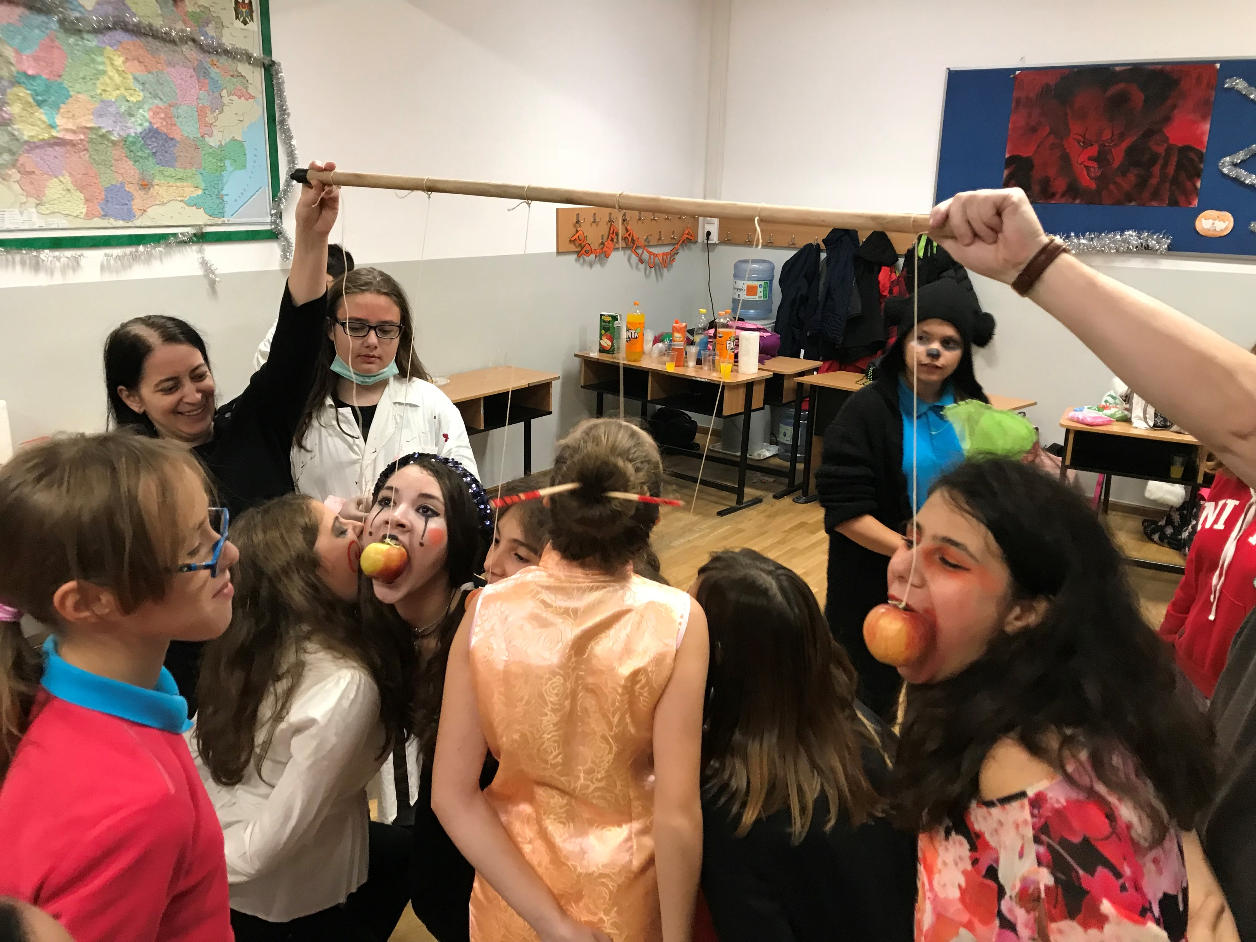
Activities
We organize “scary” and fun Halloween parties for everyone to enjoy

Slide 11
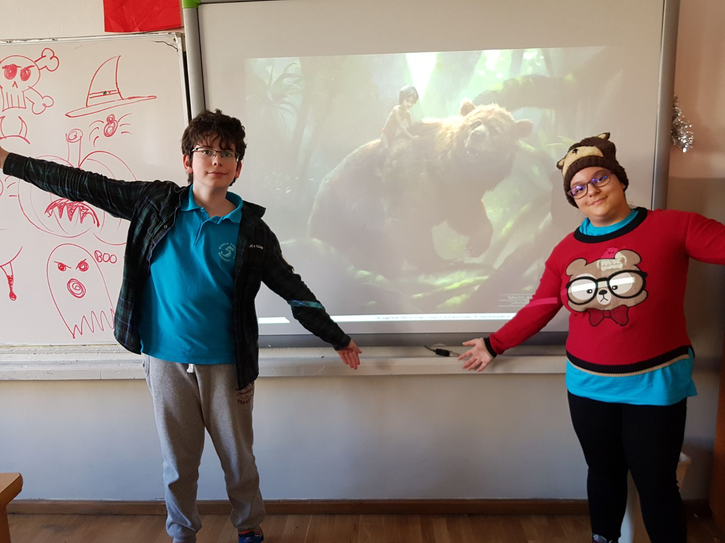
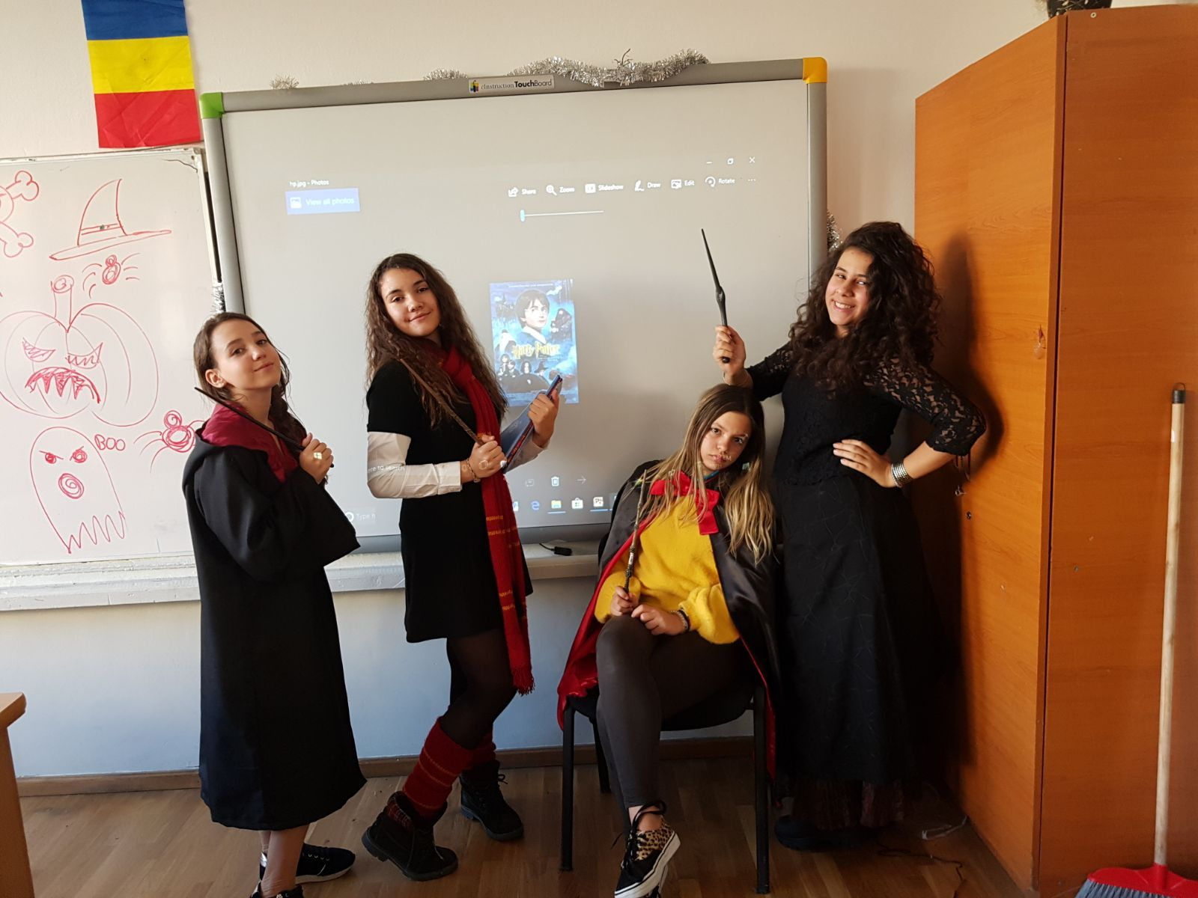
Activities
We present different interesting projects, like the ones about The Jungle Book or Harry Potter

Slide 12
Activities
We celebrate all European languages

Slide 13
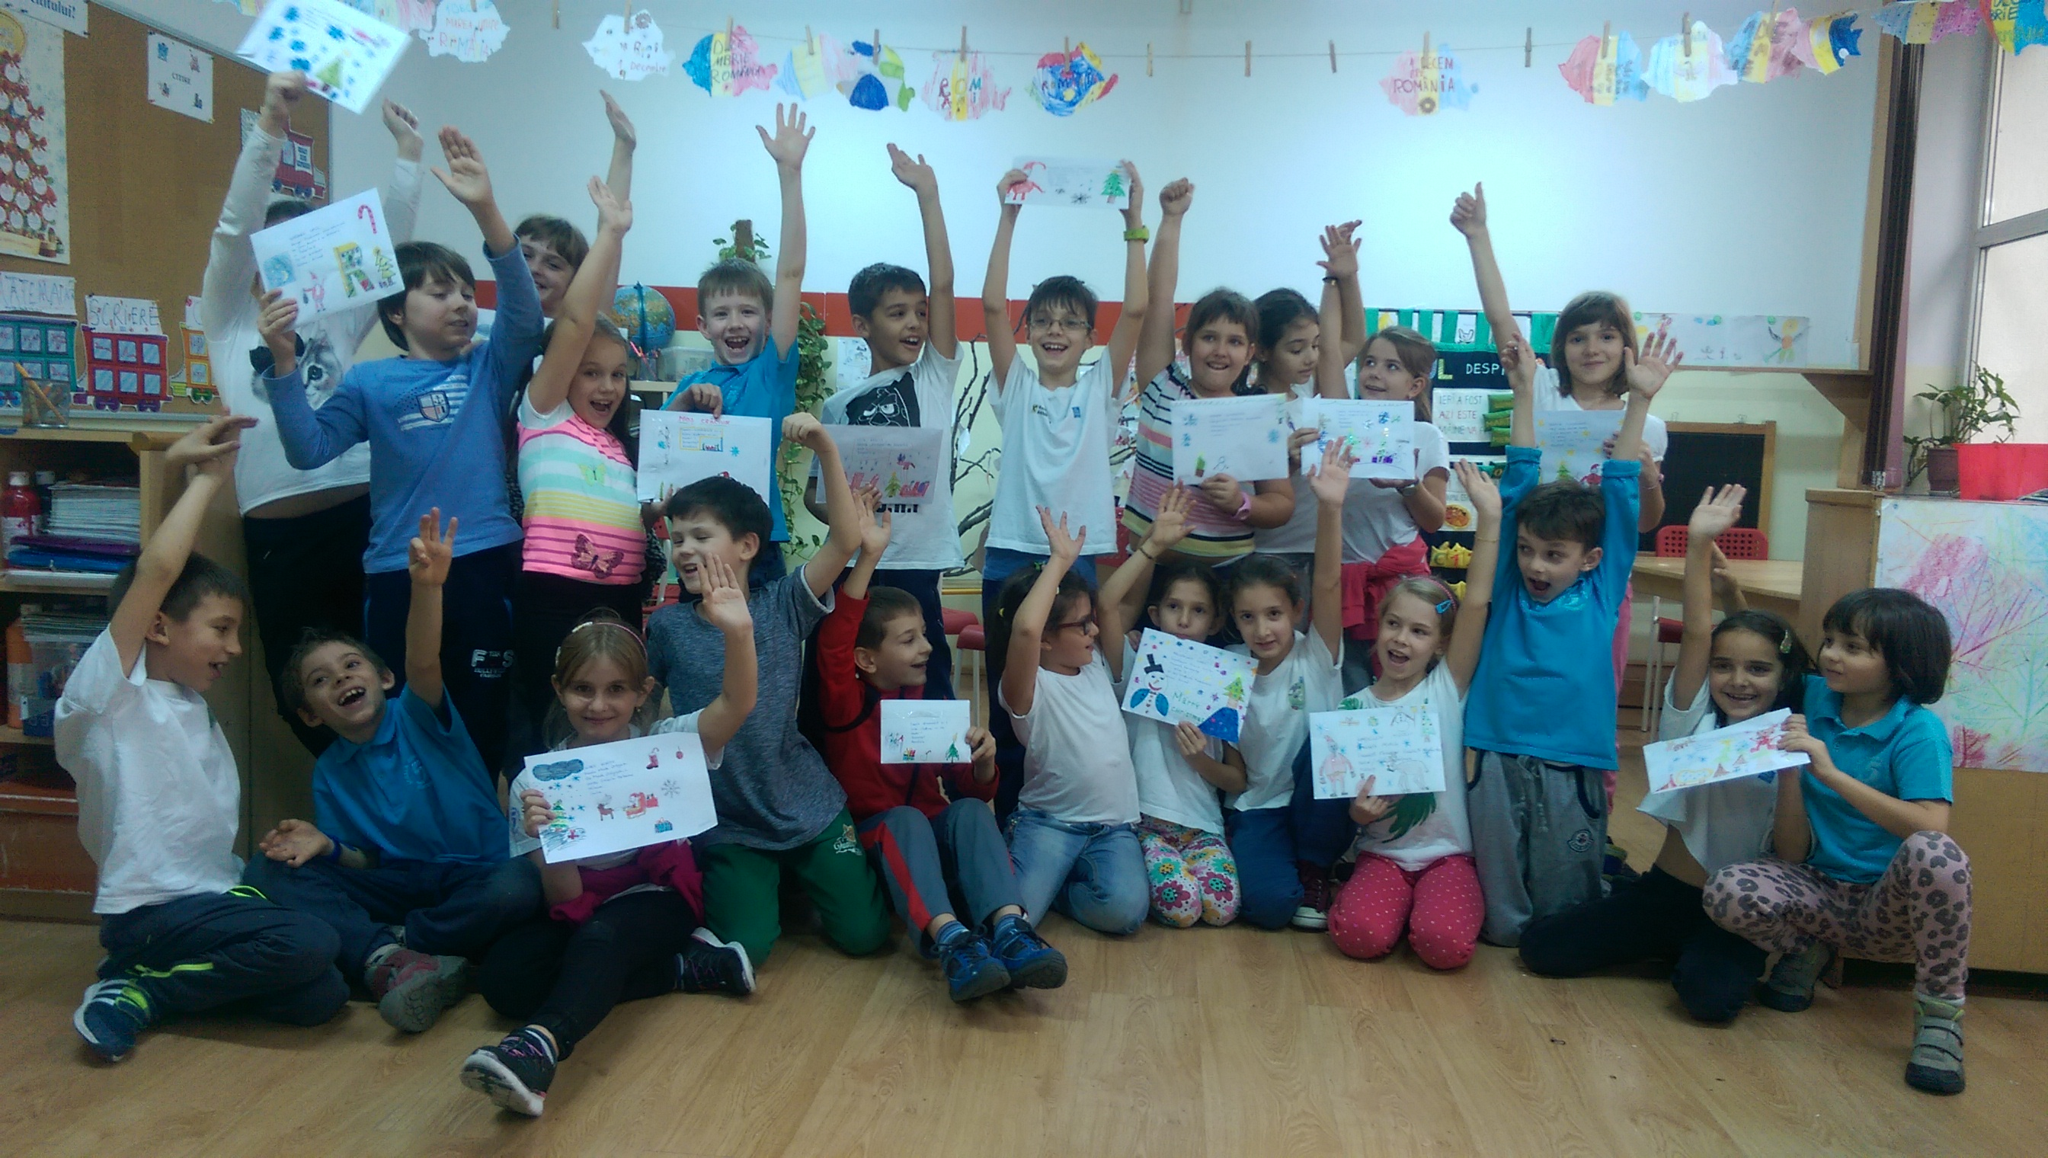
Activities
We draw and send Christmas cards to our European partners

Slide 14
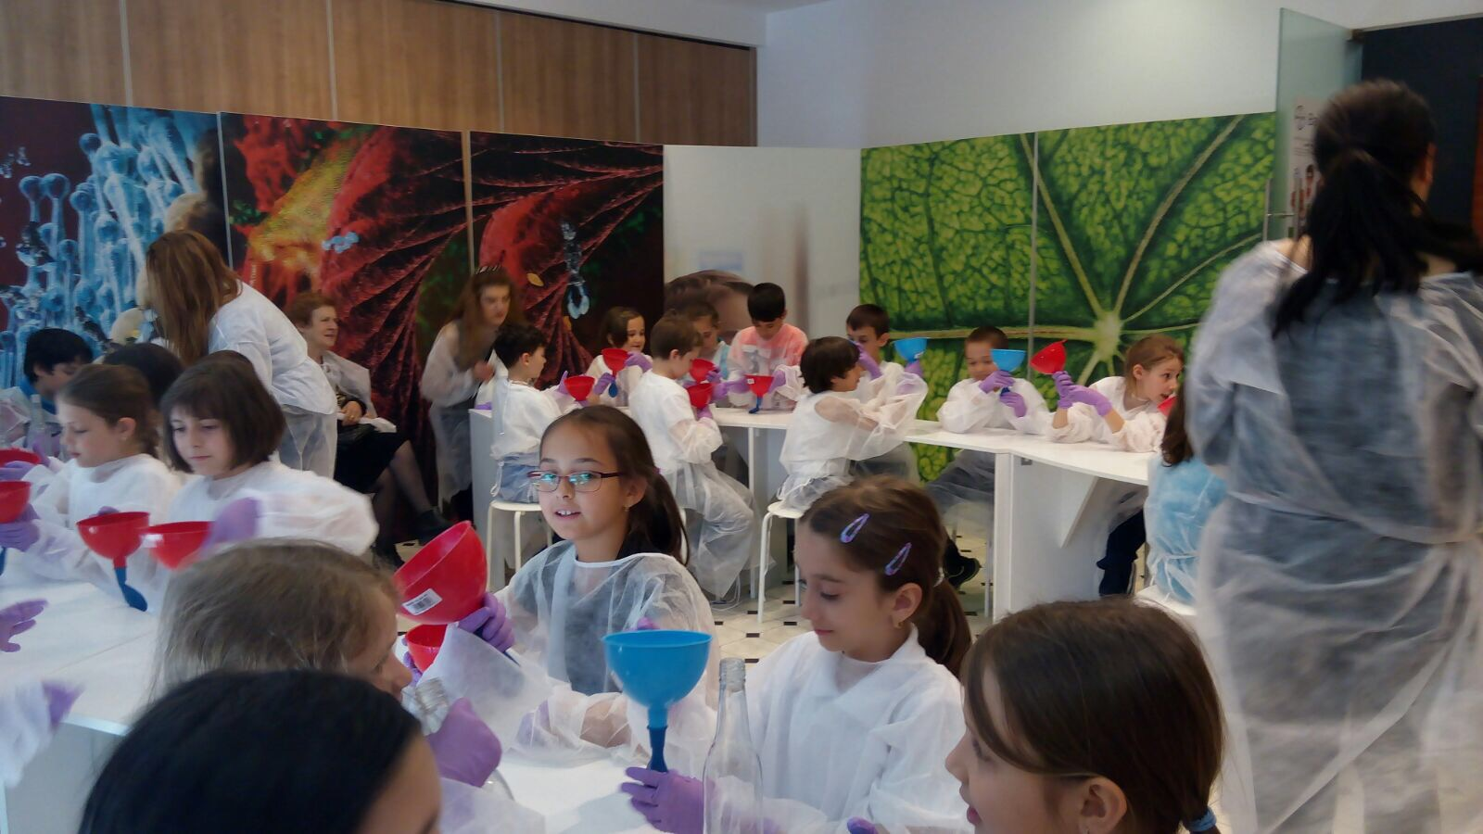
Activities
We learn by visiting and experimenting

Slide 15
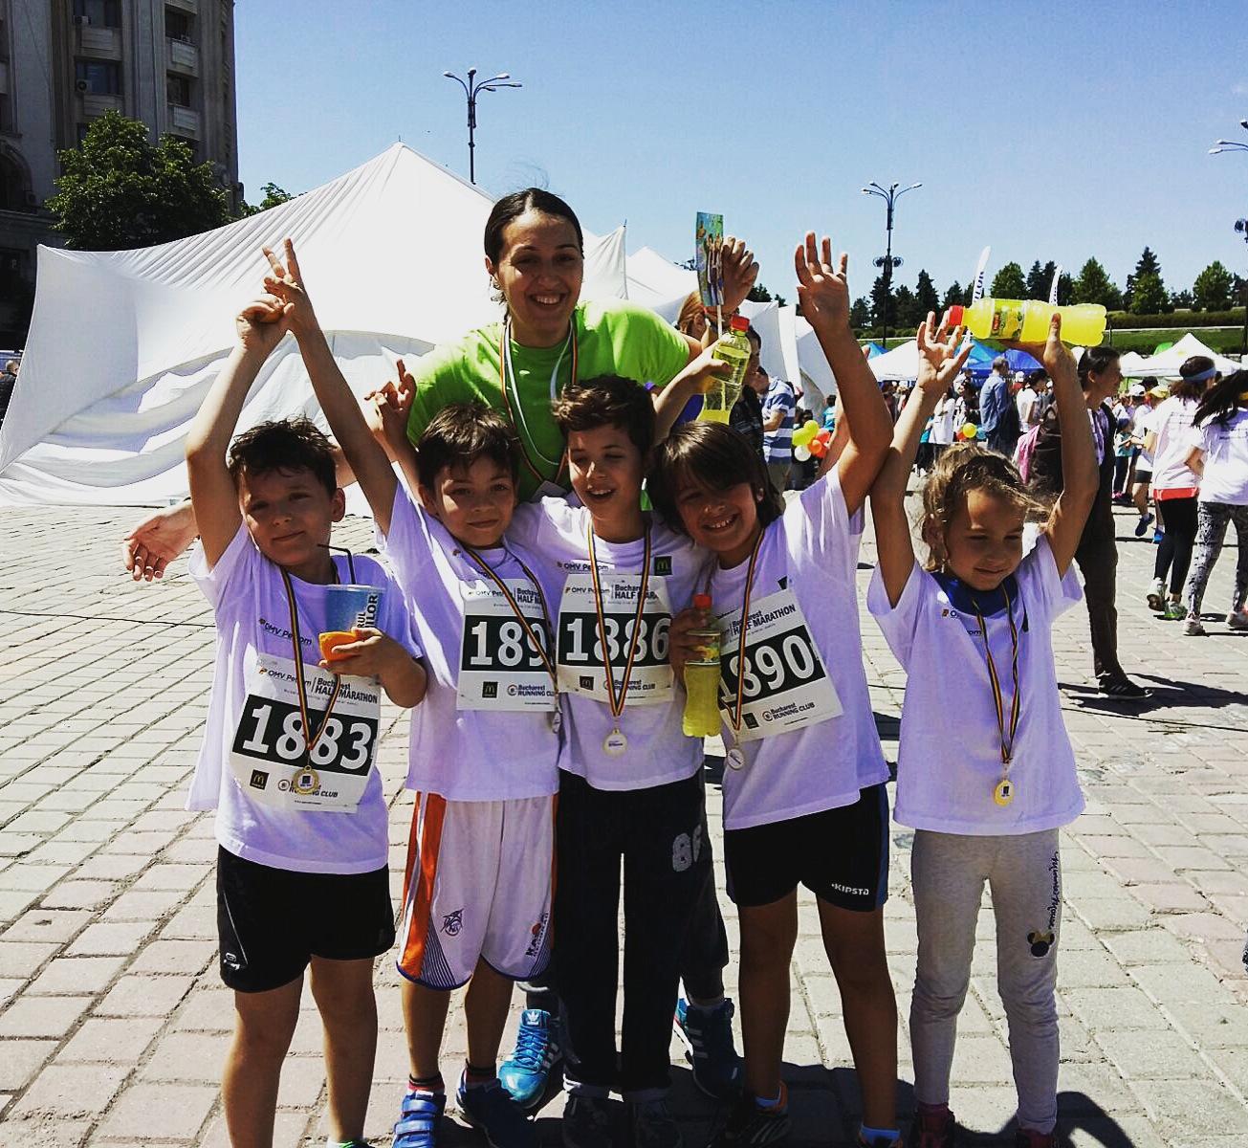
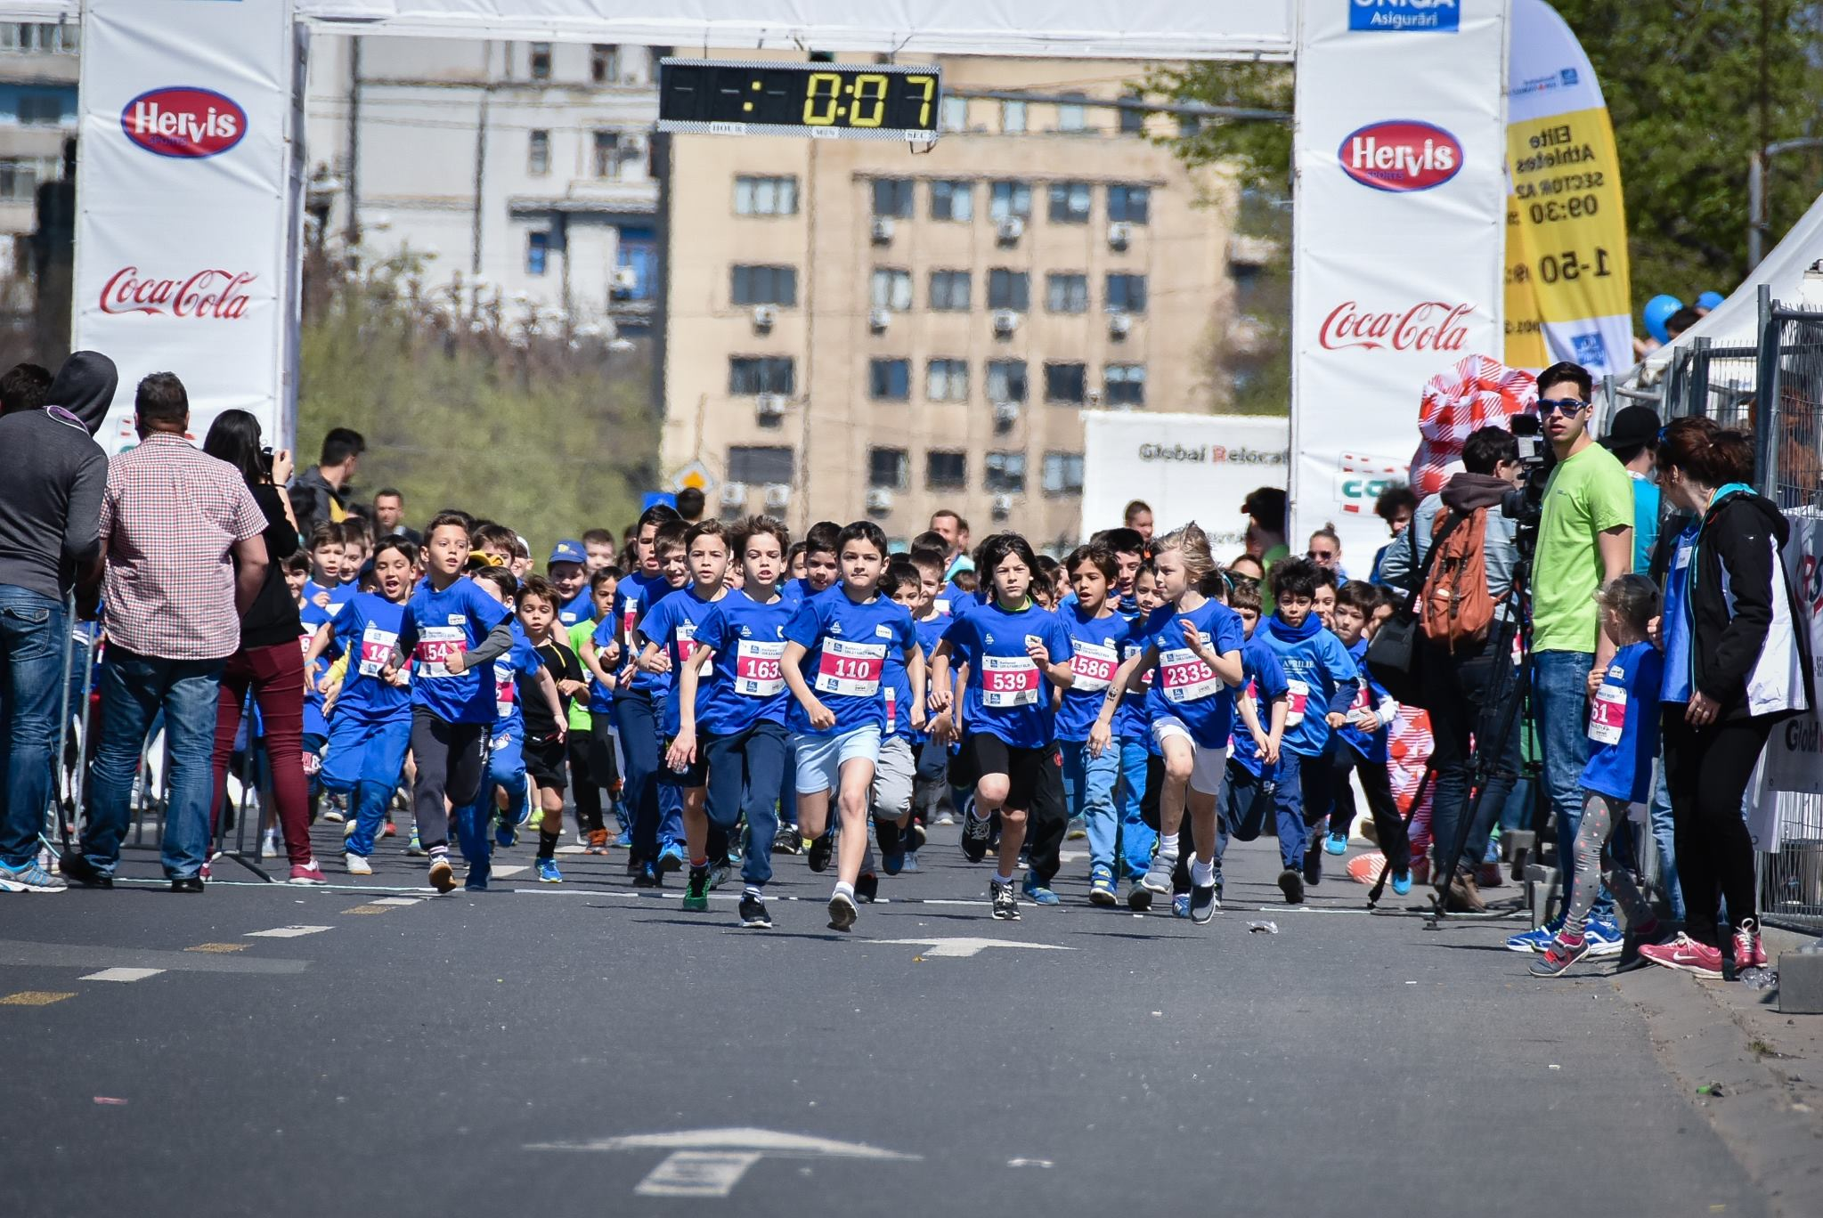
Activities
We take part in sport competitions

Slide 16
WE ARE SCHOOL NO 5

