Slide 1
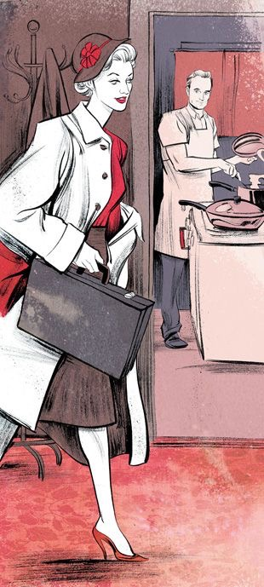
Gender Roles in Media and Literature
The media may just be a simple made up fantasy, but does this unbalanced representation of gender roles actually affect people? In adolescents, “dominant gender images on television may tend to reinforce traditional expectations” . In other words, television reinforces the concept of the male as head of the house, and the female as housewife. This could be a result of the minor roles that women play in the media, and the lack of important, commanding female figures. When asked about gender roles on television, a large portion of both males and females outside of the media were found to “agree with [the] view of what men and women aught to be” . While not necessarily correct, many people believe that gender role stereotypes in the media are accurate.

Slide 2
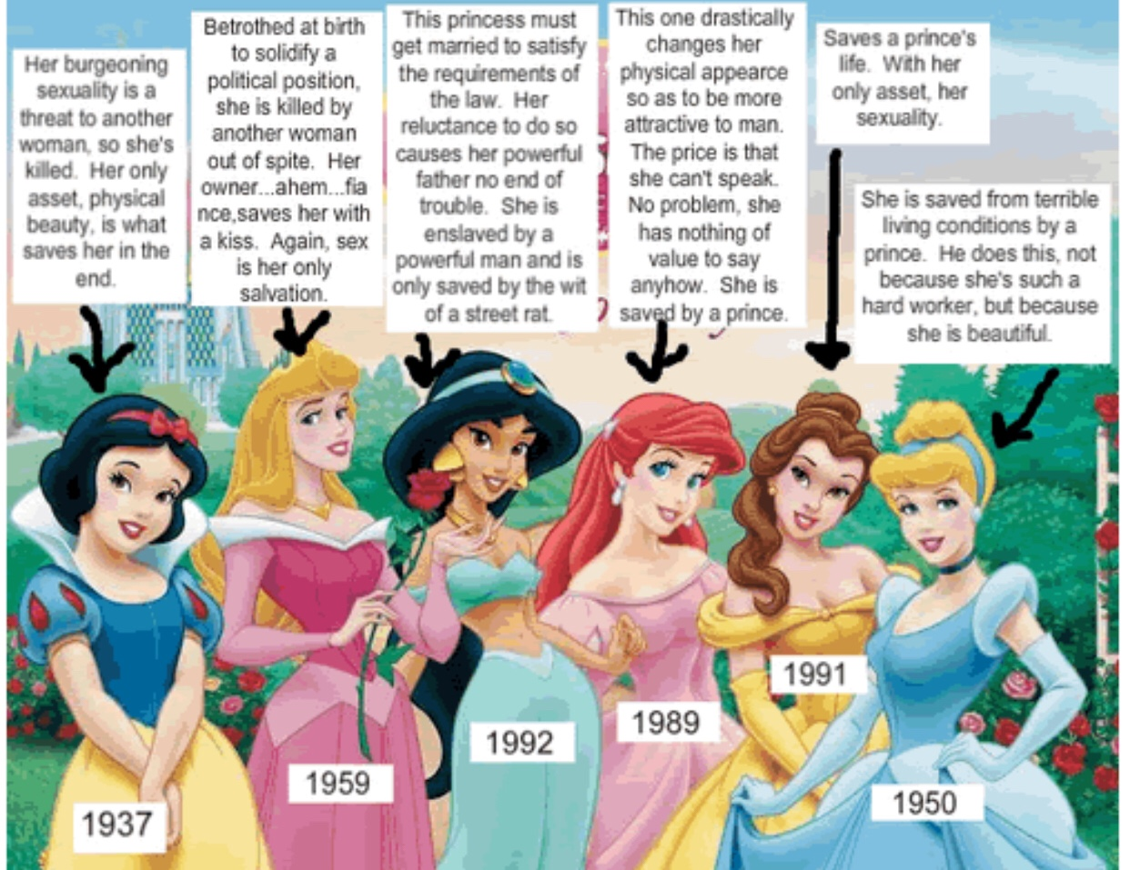
As well as being exposed to media featuring women with a lack of power, young females are also exposed to media with an extreme vanity appeal. Popular magazines, television, movies, and even factual programs often depict women “not as people, but as objects, largely empty of thought or of feelings” . In early adolescence, “girls learn how important appearance is in defining social acceptability” . Females learn at an early age that their purpose is to physically appeal to a man. Teen girl magazines are built on this principle. As a marketing ploy for cosmetics and dieting, teen girl magazines depict women as unnaturally beautiful objects usually attached to an equally handsome boyfriend. This presentation of women creates a wild, unreachable fantasy for young teenage girls

Slide 3
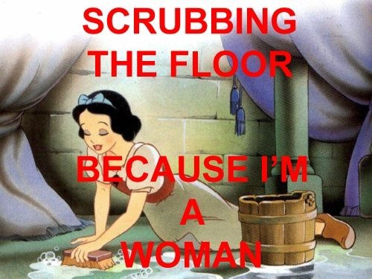
Men, on the other hand, are shown as “fearless, tough, decisive, a man of action” . Men are often portrayed as commanding and authoritative. They have no fear, and never show any weakness. The most extreme example of this stereotype are Saturday morning cartoon superheroes such as Superman, Batman, and Spiderman; super-powered men fighting for justice and the safety of a helpless community. The media leads viewers to believe that this masculine stereotype is “natural, normal, and universal” . Men also tend to have more important speaking roles, while women are “rarely heard” . In these speaking roles, males’ voices generally “carry more authority” . Men are the decision makers and leaders. Their word is final. Women, on the other hand, are rarely seen as an authoritative figure. Men, on the other hand, are shown as “fearless, tough, decisive, a man of action” . Men are often portrayed as commanding and authoritative. They have no fear, and never show any weakness. The most extreme example of this stereotype are Saturday morning cartoon superheroes such as Superman, Batman, and Spiderman; super-powered men fighting for justice and the safety of a helpless community. The media leads viewers to believe that this masculine stereotype is “natural, normal, and universal” . Men also tend to have more important speaking roles, while women are “rarely heard” . In these speaking roles, males’ voices generally “carry more authority” . Men are the decision makers and leaders. Their word is final. Women, on the other hand, are rarely seen as an authoritative figure.

Slide 4
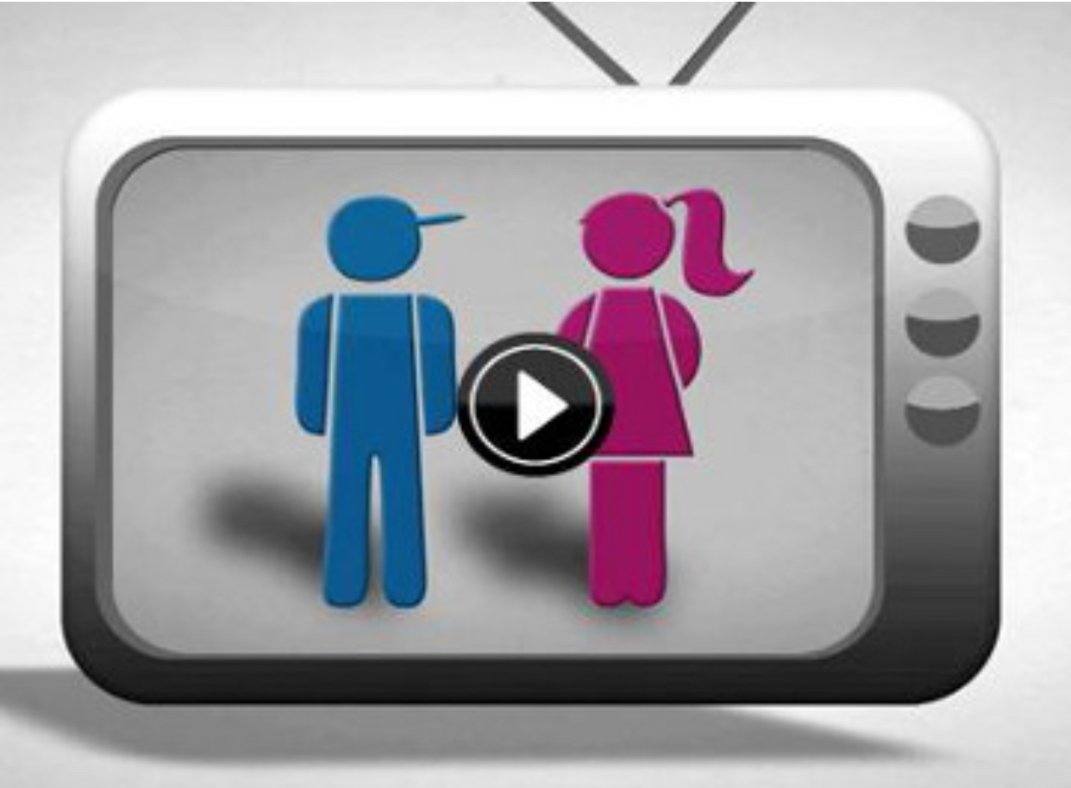
Despite either theory, it is undeniable that there is an over-saturation of gender stereotypes in the media. What accounts for this misrepresentation of gender roles? Perhaps it could in part be a result of entertainment being “mostly made by men” . Because the media is primarily controlled by men, “the picture they show of women is often the woman of their dreams” . This woman is either obedient and never asks for too much attention, or is unnaturally beautiful. Both are unrealistic products of an imaginative male mind. Recognizing this begs the question: why hasn’t the media changed? Since men are controlling the media, they fail to see an imbalance of gender representation, as the current setup favors them.

Slide 5
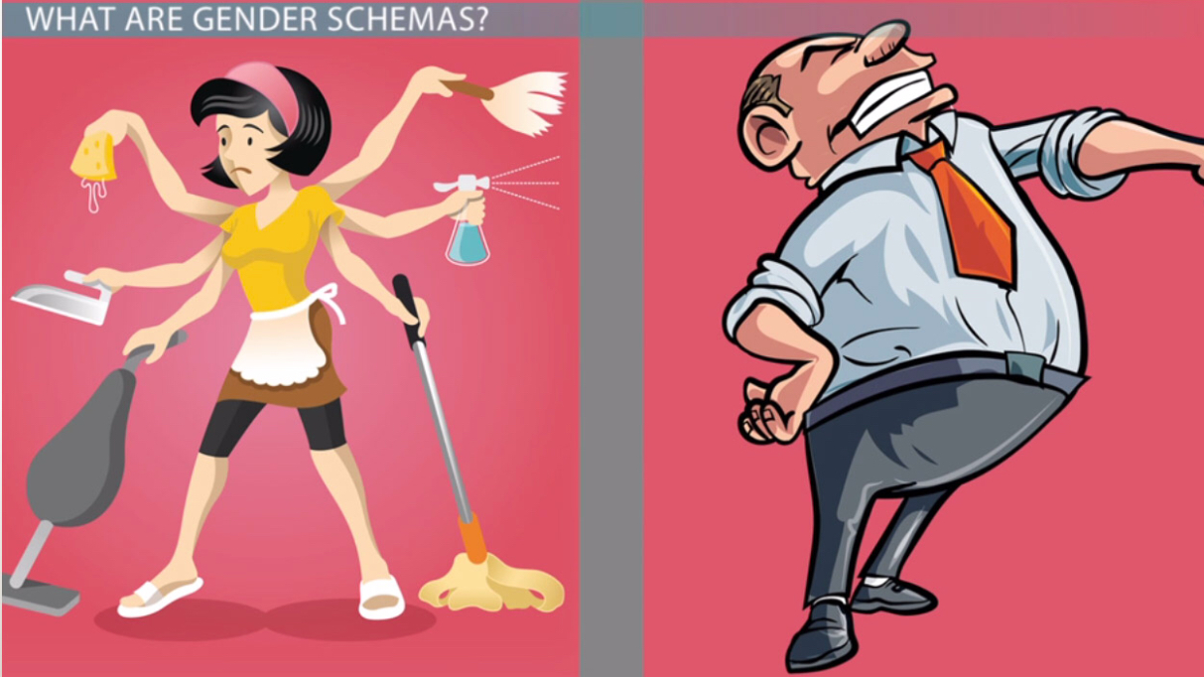
The male presence in the media’s decision making is apparent in the vast majority of television programs, movies, books, and video games. However, the industry is slowly improving the way females and males are represented. From the 1990’s on, it was found that “gender roles on television became increasingly equal and non-stereotyped” . Now it is possible to watch television shows in which “men and women are seen working side by side, as equals, in the hospitals, schools, and police stations” . However, both of these characters have one thing in common: they are glamorously, even unrealistically beautiful. While the use of strong female characters is a welcome relief, this portrayal of their appearance acts much like a teen girl magazine in that it creates a picture of women that is simply impossible to reach.

Slide 6
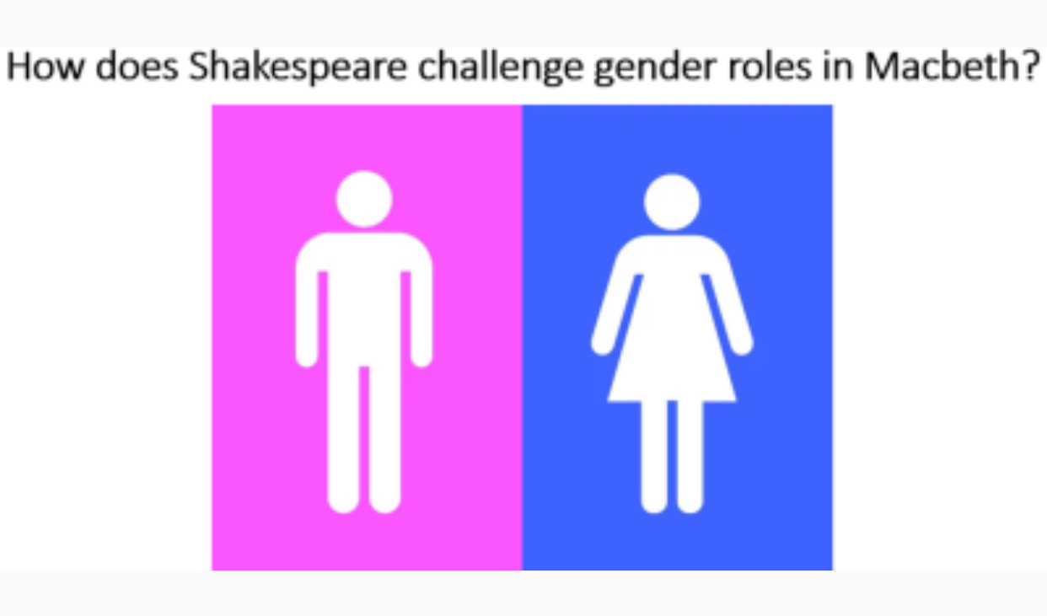
The media has improved greatly in the past few years. Women are slowly gaining leading roles, and it is not uncommon to see men and women depicted as equals, working along side each other in equally challenging settings. However, this is not yet a standard in the entertainment industry. Women and men are still misrepresented as stereotypes in the majority of the media. This stereotype becomes embedded in the human mind, and is passed on from generation to generation as an acceptable view of male and female gender roles.

