Slide 1
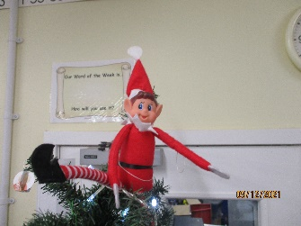
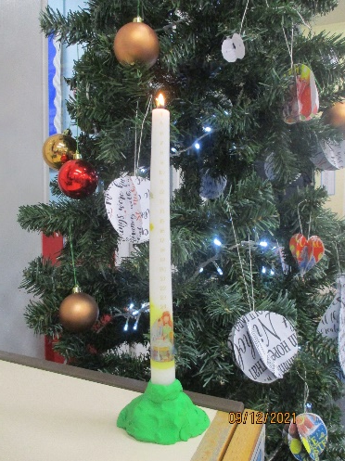
Christmas Traditions
By Willow Class, Year 6

Slide 2
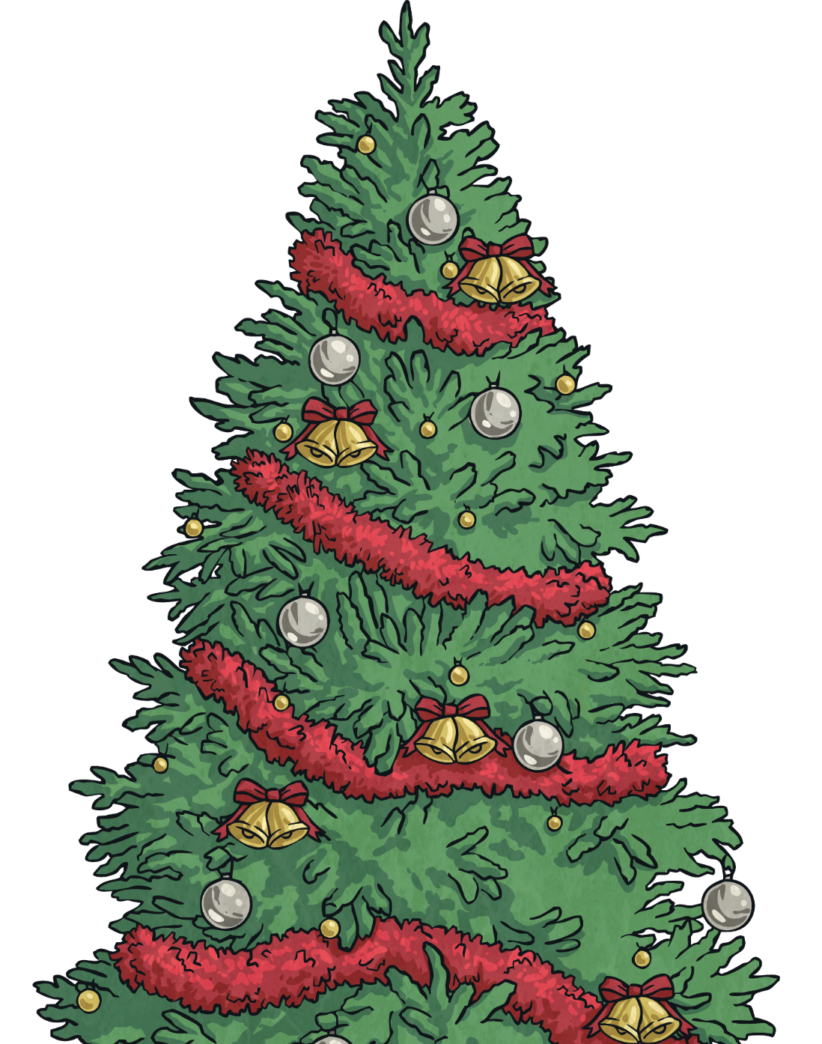
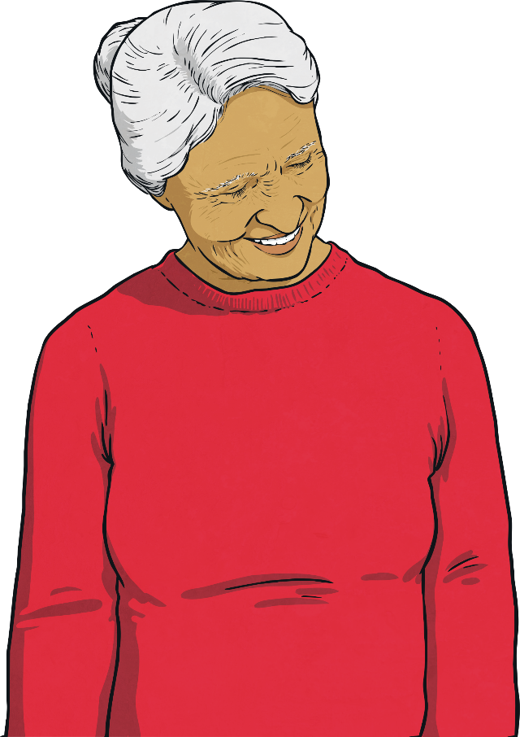
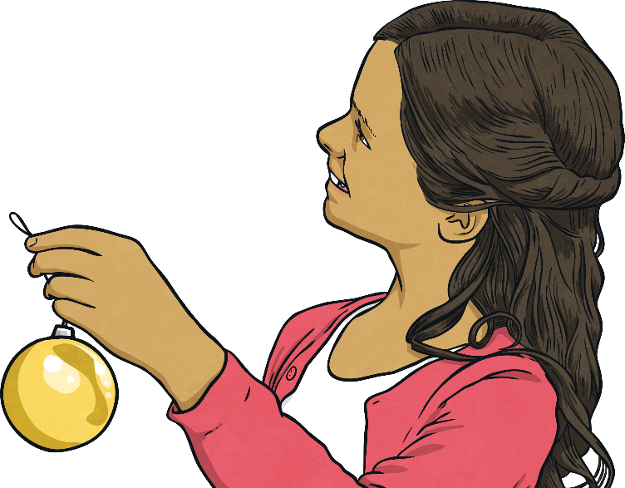
Christmas
Christmas is an important and popular festival in England. It is a Christian festival to celebrate the birth of Jesus Christ on 25th December. Christmas Day is a national holiday in England.

Slide 3
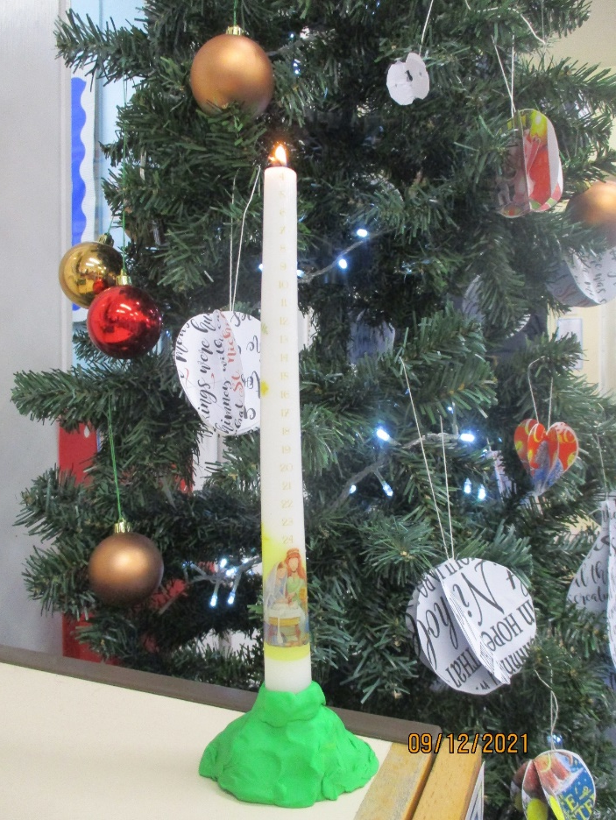
Advent calendars By Emily and Lucas
This is our class Advent calendar.
Advent calendars are used to count down the days until Christmas day – 25th December.
You can also use Advent candles and burn a day each day until Christmas day.
This is our class Advent candle.

Slide 4
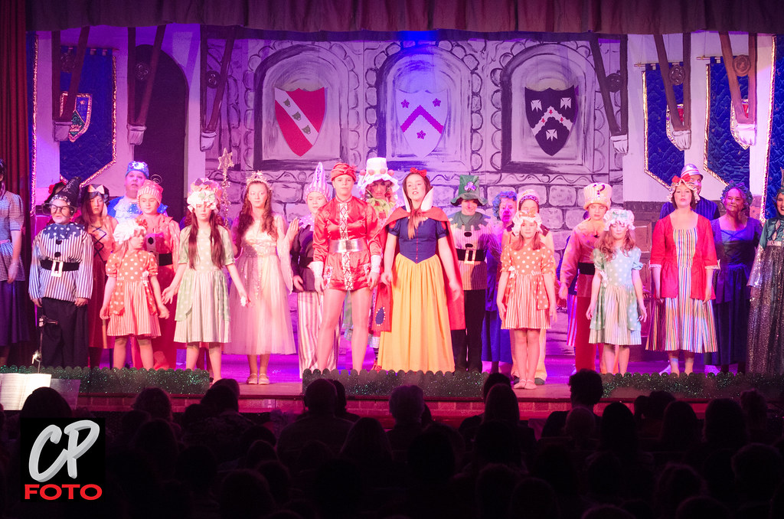
The Pantomime
This tradition is celebrated by most of the population in the UK. A pantomime is where actors put on a funny show from a well-known story.
Some examples are: Snow White, Beauty and the Beast and Sleeping Beauty.
This year, our school, Little Hadham Primary, will be going
to the theatre to see Rapunzel.
By Arthur and Teddy

Slide 5
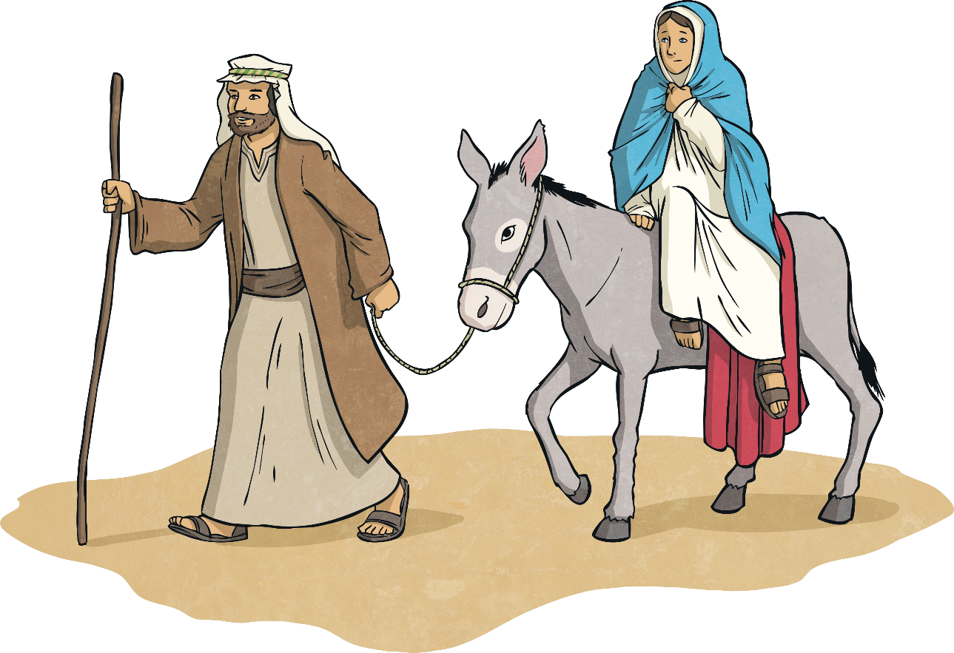
The Nativity
The Nativity is the traditional Christian story of Jesus Christ’s birth. The Nativity story explains that Mary gave birth to baby Jesus in Bethlehem in a stable, alongside her husband, Joseph.

Slide 6
Christmas Cards!
Between friends and family, Christmas cards are shared out near Christmas! Each card contains a special letter or note to the selected person!
We hope you have enjoyed receiving our Christmas cards.
By Charis and Ilana

Slide 7
Decorations and Lights!
Lights and decorations are used at Christmas to show festivity at houses and decorated towns!
Nearly everyone puts these lights and decorations up at Christmas time. Wreaths and other decorations are also hung up on doors, inside and outside.
Our school has many decorations up at the moment ☺

Slide 8
Christmas Decorations
At Christmas, we put up a tree and decorate it with baubles.
At our school we made all of our own decorations and we also put an elf on the top of the tree, instead of a star.
You can put anything on the tree, anything you want.
By Ashton and Alfred

Slide 9
Christmas tree & treats for Santa
Queen Charlotte decorated the first Christmas tree, in the late 18th Century.
Traditionally, we decorate them with baubles and bright lights with a star or an angel on top.
If you are a good child you get presents under the tree from Father Christmas.
On Christmas Eve, we give Santa (Father Christmas) mince pies and milk and carrots for his reindeers.
By Harry and Gracie

Slide 10
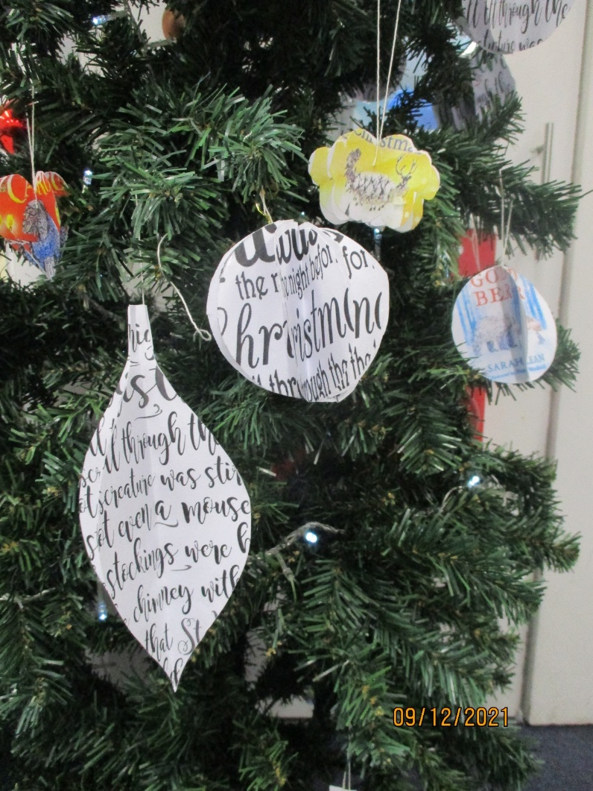
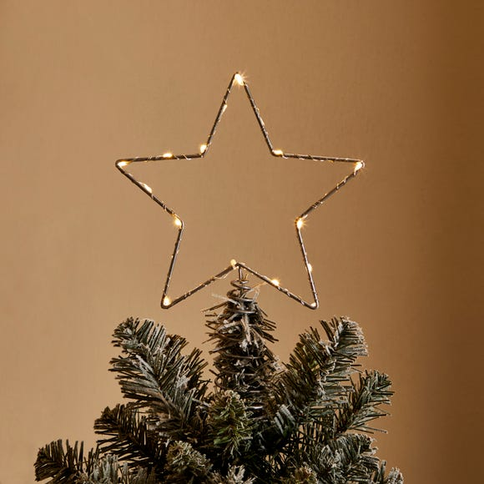
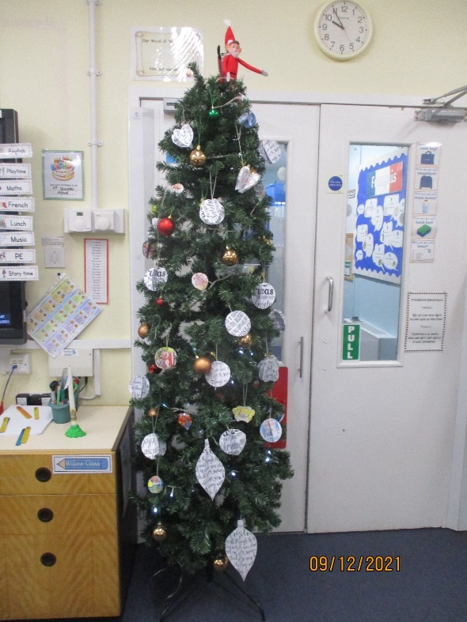
Decorating the Christmas tree Emily and Lucas
Most people at Christmas decorate the tree with lights, tinsel, ornaments and usually a star, an angel or anything you want on the top of the tree.
This is our Christmas tree!
We made baubles to go on our tree.

